Slide 1
Whey Recovery in Dairy Plants
Prepared by: Supervisor: Dr. Abdelrahim Abusafa
Nada Abdulhadi
Noor Samaneh
Wassan Sawalha

Slide 2
Agenda
Introduction
Definition of Whey
Falling Film Evaporator - Single Stage Evaporator Mod. UMEC/EV
Mathematical Modeling of Single-Effect Evaporator
Spray Dryer - SD-06
Mathematical Modeling of Spray Dryer
Methodology
Experimental Work
Conclusion
References

Slide 3
Introduction
As known, the industrial sector is one of the biggest consumers of the energy. It`s important to mention that the industrial sector represents 12% of the total local economy, according to the statistics of 2013.
Food industry has played an important role; it has contributed more than 24% of the local production value. The food industry takes its importance in its energy consumption. Producing a large number of wastes, mainly that from the dairy factories.

Slide 4
Introduction
The objectives of this study is to investigate the food industry in Palestine in terms of energy consumption and waste, explore the dairy process, energy and waste, the whey recovery methods, carry out experimental studies on whey recovery and a feasibility study regarding the whey recovery possibilities through the using of the falling film evaporator and spray dryer based on the lowest energy consumed and minimum-operating cost. Al –Safa diary factory was selected as the case study.

Slide 5
Definition of Whey
One of the most wasted byproduct in food industries is whey ‘the liquid residue of cheese, casein and yoghurt production’; that is derived mainly from the dairy products.
This type of waste can be used to convert it into protein through a range of processes that consume high energy.
So basically, our main concern, in this study, is obtaining such a useful product by converting the raw whey into protein powder through evaporation- spray drying techniques, which are the most reliable and useable methods in the field of dairy and food industries.
Portion Powder mainly used as supplements; Protein assists human’s body with fat loss and muscle building, repair, and maintenance.

Slide 6
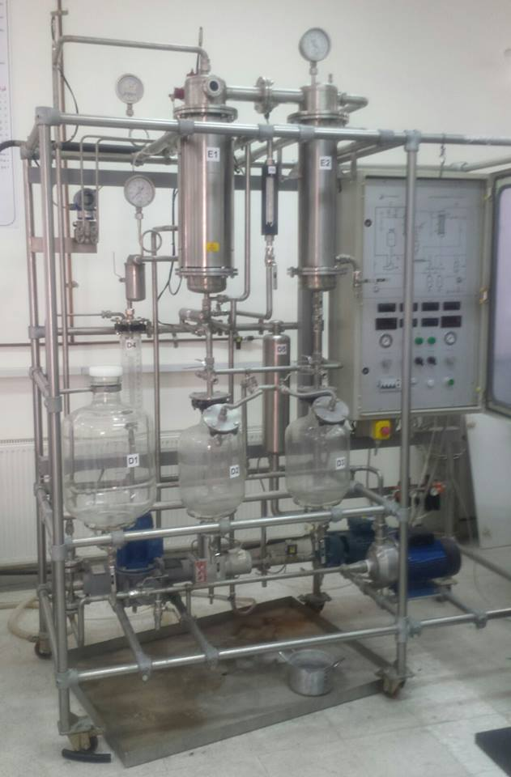
Falling Film Evaporator-Single Stage Evaporator Mod. UMEC/EV

Slide 7
Mathematical Modeling of Single-Effect Evaporator
To calculate the thermal load of the selected Evaporator and Condenser Energy Balances
Qe = (Vf * d) × Cp × (Tb - Tf) + Vb λv = Vd ×λst
Whereas :
𝑄𝑒: Thermal load of the evaporator (𝑘J)
V𝑓: Volume of feed whey (L)
Cp: Specific heat of feed whey (kJ/kg .ºC)
𝑇b: Boiling temperature (ºC)
𝑇𝑓: Temperature of the feed whey (ºC)
Vb: Volume of concentrated whey (L)
𝜆𝑣@41.9℃: Latent heat of the evaporated whey (𝑘𝐽/𝑘𝑔)
Vd: Volume of distilled water (L)
𝜆st @61.5℃: Latent heat of the steam (𝑘𝐽/𝑘𝑔)
d: Density of concentrated whey

Slide 8
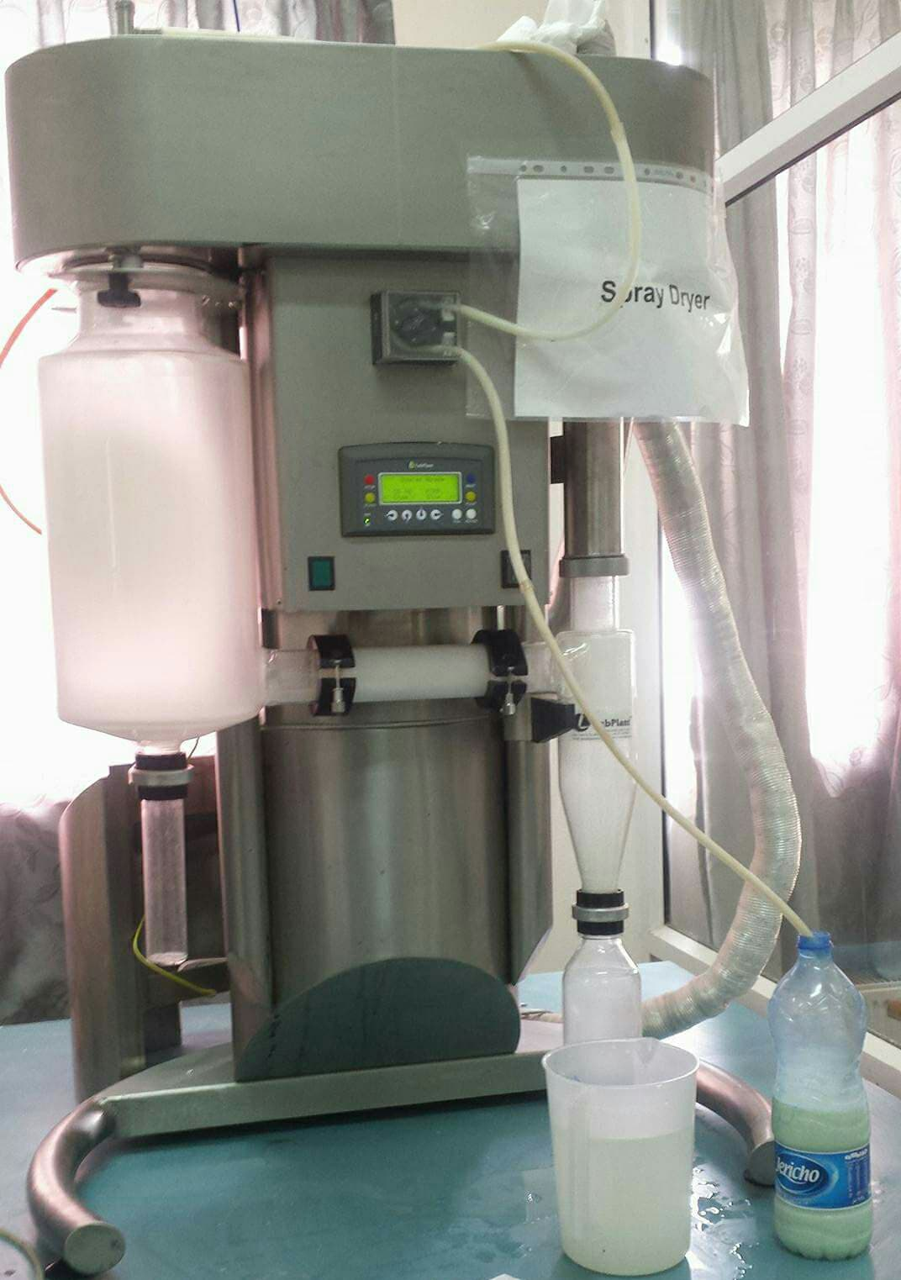
Spray Dryer – SD-06
SD-06 Spry Dryer is used in this study all its major components are housed within a stainless steel cabinet and the unit can be used on a bench top or with an optional stainless steel stand, as shown .
Designed primarily for
Simplicity
Ease of use,
Rapid assembly and disassembly for
- cleaning,
- minimal maintenance,
- efficiency of operation

Slide 9
Mathematical Modeling of Spray Dryer
To obtain the energy consumed from spray dryer for drying a specific amount of whey,
Qs = V × d × Cp air × (Tin - Tout)
V = V` × t
V` = A × S
A = π/4 × D^2
Whereas
Qs = Thermal load of the spray dryer (kJ)
Cp = Specific heat of the air (kJ/kg .oC)
V = Volume of air (L)
V' = Volumetric flow rate of air (L/s)
d = Density of air (kg/L)
∆T: Temperature difference between the inlet and the outlet
t = Time of process consumed (s)
S = Air speed at exhaust (m/s)
A = Exhaust airflow's Area (m2)
D = exhaust airflow's diameter hose (mm)

Slide 10
Methodology
The liquid whey byproduct has market value only if it is concentrated or powdered. For the purpose of concentrating whey, the cheese industry uses falling-film type evaporation systems due to the temperature sensitivity of the product. To fully dry the whey to a powder, condensed whey then is fed to a spray dryer. Both of these processes are highly energy intensive due to the heating required

Slide 11
Operating data for falling film Evaporator process
Operating Points
7.5 4.5 6.35 3.5 8.0 61.5 | Whey Feed Rate to Evap. (Liter) Prod. of Whey Concentrate (Liter) Feed Concentration (Total Solids) % Total Condensate Production (Liter) Product Concentration (Total Solids)% Boiling Temperature (°C)

Slide 12
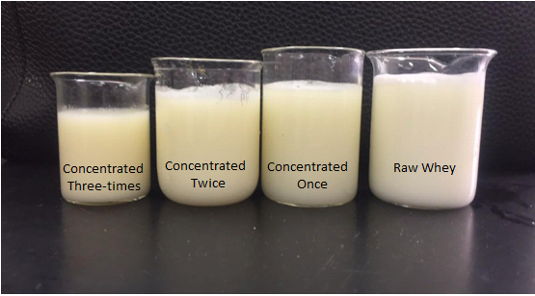
Experimental Work
Samples of whey are collected from Al-Safa factory, which produces about 67200 L/year whey.
Finally , The concentrated samples from pass one, two and three were taken and entered into the spray dryer which converts the concentrated whey to powder; the process was achieved under specific parameters (sample feed rate, fan speed, air temperature) within three trials, in each trial one of the parameters was changed several times to obtain the optimum performance of the spray dryer.

Slide 13
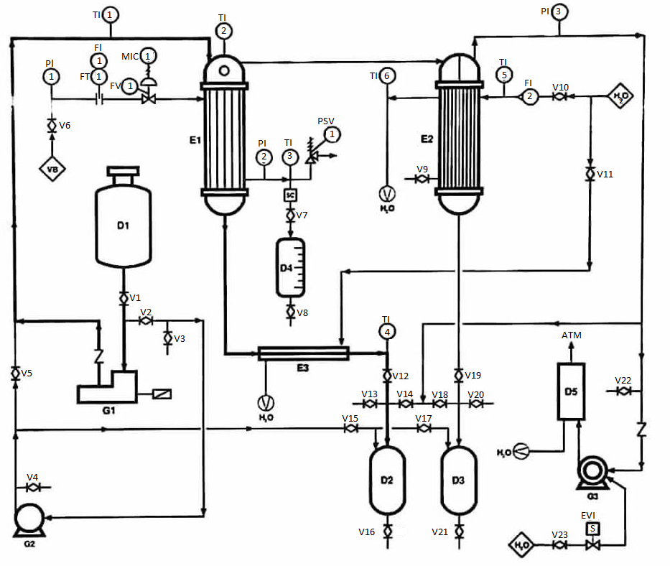
Description of single Effect Evaporator

Slide 14
Evaporation process was delivered to the raw-whey sample obtaining a concentrated whey, by repeating the process a couple of times, it is clearly noticed that the concentrated percent goes up while the water content decline from feed whey
Concentration Ratio | Concentrated whey volume | Feed whey Volume | # of Sample Passes
1.67 | 4.5 L | 7.5 L | Pass 1
1.67 | 2.7 L | 4.5 L | Pass 2
1.43 | 1.4 L | 2 L | Pass 3

Slide 15
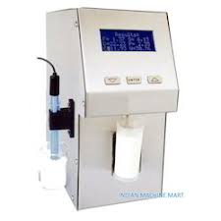
  Whey Physical Analysis
  The evaporation process has been taken into account in whey treatment to increase its solid content from 6.35 % - 14.1 %
Measured Solids% | Lactose % | Freezing Point ºC | Water % | Protein% | Density kg/L | Solid% (not Fat) | Fat % | Concentrated Sample
0.51 | 3.47 | -0.384 | 26.1 | 2.36 | 1016 | 6.35 | 1.52 | Origin
0.65 | 4.37 | -0.487 | 6.34 | 2.97 | 1027 | 8.0 | 0.61 | Pass One
0.88 | 5.95 | -0.687 | - | 4.05 | 1036 | 10.89 | 0.94 | Pass Two
1.14 | 7.70 | - | - | 5.24 | 1047 | 14.10 | 1.31 | Pass Three

Slide 16
  Energy Analysis for Falling Film Evaporator
Energy analysis for Pass - One
Single stage evaporator (Solid Content from 𝟔.35% to 8.0%)
Qe = (Vf * d) × Cp × (Tb - Tf) + Vb λv
Main results obtained from pass 1 :
7.5 L | Vf
4.5 L | Vb
3.0 L | Vd
1444.1 kJ | Qe
2.32 | Ue
0.27 m2 | Ae

Slide 17
  Energy Analysis for Falling Film Evaporator
Energy analysis for Pass - Two
Single stage evaporator (Solid Content from 8.0% to 10.89%)
Main results obtained from pass 2 :
4.5 L | Vf
2.7 L | Vb
1.8 L | Vd
867.9 kJ | Qe pass
2312 kJ | Qe total

Slide 18
  Energy Analysis for Falling Film Evaporator
Energy analysis for Pass - Three
Single stage evaporator (Solid Content from 10.89% to 14.1%)
Main results obtained from pass 3 :
2.7 L | Vf
1.4 L | Vb
1.3 L | Vd
464.6 kJ | Qe pass
2776.6 kJ | Qe total

Slide 19
Energy Analysis for Spray Dryer
The concentrated sample from pass three was taken and entered to the spray dryer which converts the concentrated whey to powder; the process was taken under specific parameters within two trials.
First trial:
The variable parameter was the concentrated flow rate. Whereas, the first flow rate was at 321 mL/h, then, the next flow rate at 444 mL/h, and the final flow rate at 362 mL/h. According to these parameters, the optimum performance was achieved at flow rate 321mL/h.
Second trial:
, the variable parameter was the air temperature. Whereas the first temperature at 160 C and the next air temperature at 220 C, and the final air temperature at 250 C. According to these parameters, the optimum performance was achieved at air temperature of 160 C.

Slide 20
Energy Analysis for Spray Dryer
The thermal load consumed by spray dryer under the optimal operation conditions at a volume of 50 mL whey within 4.25min
Note that, the energy consumed in spray dryer which equals to 4288.6 kJ/L whey is differed by the solid contents of whey obtained from each single – pass evaporator.
1.96 × 10⁻³ m² | A
8.44×10⁻³ L/s | V`
43.04 L_{air} | V
4288.6 kJ/L_{whey} | Qs

Slide 21
Energy Analysis for Spray Dryer
The differentiate thermal load of the spray dryer according to the changing in % solid for each pass. Kilograms of solid in each sample are calculated by
Solid (kg) = %Solid × Volumetric Flow Rate of Whey (L/min) × Density of Concentrated Whey (kg/L) × time (min)
Thermal Load for Spray Dryer (Qs) | Solid Content (g) | Concentrated Sample
65770 kJ/kg | 65.2g/L | Origin
52170 kJ/kg | 82.2g/L | Pass One
38360 kJ/kg | 111.8g/L | Pass Two
30410 kJ/kg | 144.8g/L | Pass Three

Slide 22
Energy Analysis
The energy obtained for each kilogram solid in the falling film evaporator :
Energy Consumed kJ/kg | Solid Content (g) | Concentrated Sample
- | 65.2g/L | Origin
17568.1kJ/kg | 82.2g/L | Pass One
20679.7 kJ/kg | 111.8g/L | Pass Two
19175 kJ/kg | 144.8g/L | Pass Three

Slide 23
The Total Energy Required and Cost Analysis
The total energy required for each kilogram solid in the overall processes (Spray Dryer + Falling Film Evaporator)
Total Energy Consumed kJ/kg | Solid Content (g) | Concentrated Sample
65770 kJ/kg | 65.2g/L | Origin
69738.1kJ/kg | 82.2g/L | Pass One
59039.7 kJ/kg | 111.8g/L | Pass Two
49585 kJ/kg | 144.8g/L | Pass Three

Slide 24
The Total Energy Required and Cost Analysis
The cost consumption for each pass, evaporator and spray dryer, with a specific thermal load kJ/kg solid is determine by
Qt/ɳ (Boiler) = [Kilograms of Diesel × C.F] (Diesel)
Liters of Diesel = Kilograms of Diesel (kg) / Density of diesel (kg/L)
Cost = Liters of Diesel (L) × Cost of Liter of Diesel (Nis/L)
Cost _{solid} _{whey} | Liter _{of Diesel} | Total Thermal Load (Qt) | Concentrated Sample
12.06 Nis/kg | 2.04 L | 65770 kJ/kg | Origin
12.83 Nis/kg | 2.17 L | 69738.1kJ/kg | Pass One
10.88 Nis/kg | 1.84 L | 59039.7 kJ/kg | Pass Two
9.12 Nis/kg | 1.55 L | 49585 kJ/kg | Pass Three

Slide 25
Conclusion
This project focused on the identification of actions related to falling- film evaporator and spray dryer analysis for the production of solid proteins from waste whey.
It was observed that the whey concentrated three times from evaporation process was more effective and cost-efficient than the first and second passes because it has the lowest moisture content.
In spray dryer it was observed that when increasing the concentrated whey, powder production increased and energy consumed decreased. However, the energy consumed from spray dray was much higher than the falling film evaporator.
The total energy consumed for overall process was 49585 kJ/kg solid.

Slide 26
References
Tetra Pak, 1995. Dairy Processing Handbook, Whey Processing, Concentration, Sweden. [Accessed 15 October 2017].
ZEHR, S., 1997. Process Energy Efficiency Improvement In Wisconsin Cheese Plants, Master Thesis. Madison: University Of Wisconsin.
GEA Company, 2016. Falling-Film-Evaporator, German
[Online] Available at:https://www.gea.com/en/products/falling-film-evaporator.jsp. [Accessed 18 November 2017].
Elettronicaveneta SPA, 1963. Falling-Film-Evaporator, Italy
[Online] Available at:http://www.elettronicaveneta.com. [Accessed 21 November 2017].
Keison Products, 2003. Spray Dryer, England, UK.
[online] Avaliable at: http://www.keison.co.uk/products/labplant/SD06AManual.pdf [Accessed 22 March 2018].

