Slide 1
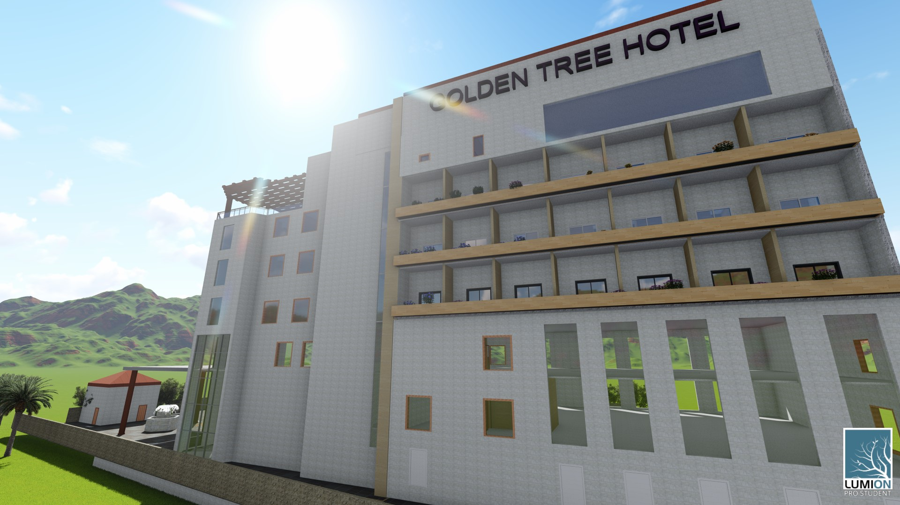
Redesign Golden Tree hotel
Prepared by:
Raghad Nazzal
Sewar Abbadi
Jannat Yamak
Supervisor :
Eng. Fadi fatayer

Slide 2
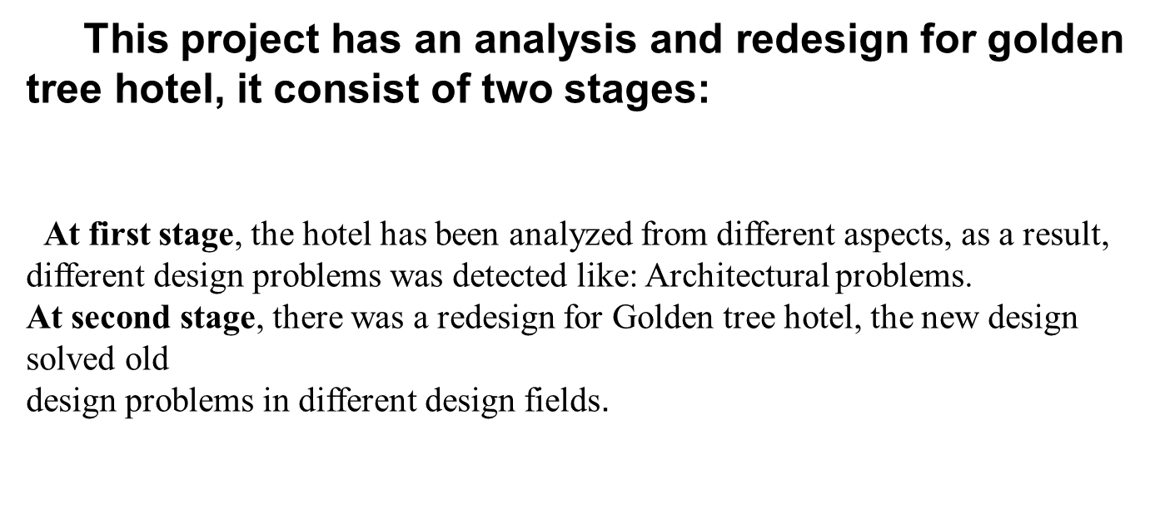
Introduction :

Slide 3
Outline:
Introduction
Site plan
Architectural Redesign
Environmental Redesign
Structural Redesign
Electro – Mechanical Redesign
Safety Redesign
Integration
Conclusion
Quantity surveying and cost estimation

Slide 4
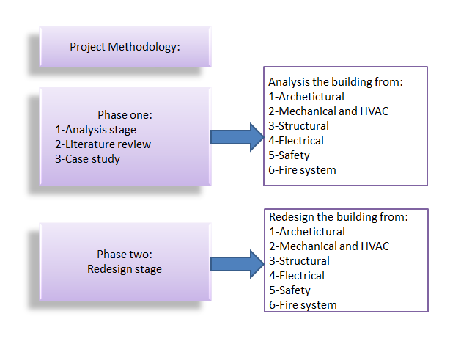
Methodology
Consist of two Phases:
Fig: Methodology

Slide 5
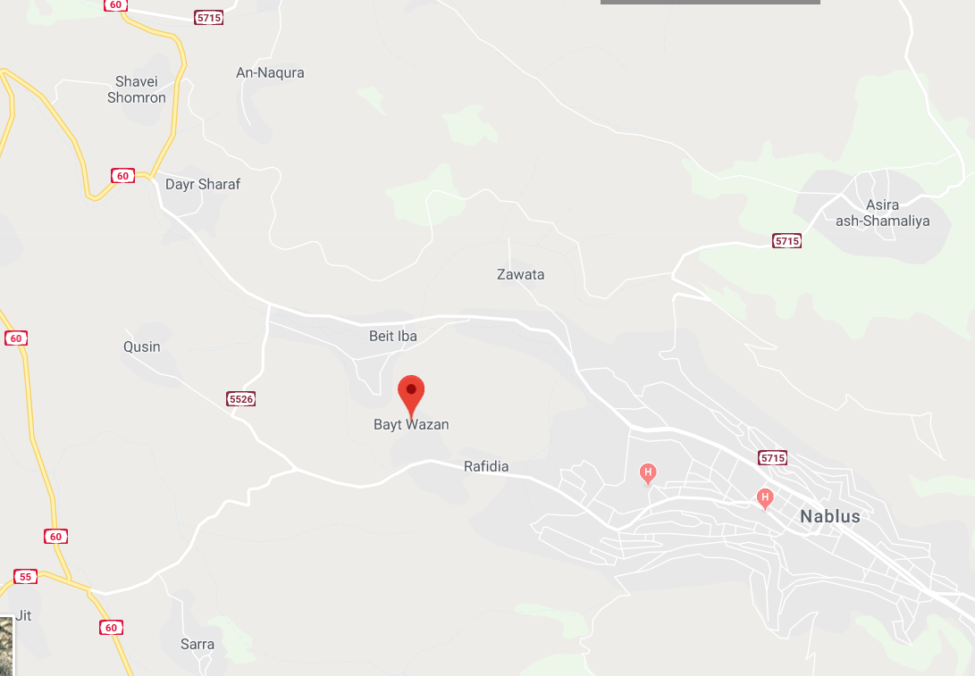
    Site analysis
This hotel located at Bayt-Wazan Nablus city.
Fig: Location of the hotel

Slide 6
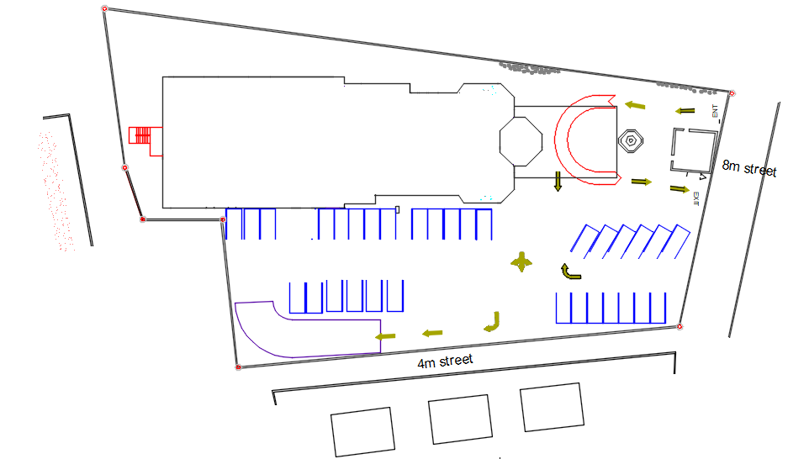
      Location of project and site plan
Fig: Hotel site

Slide 7
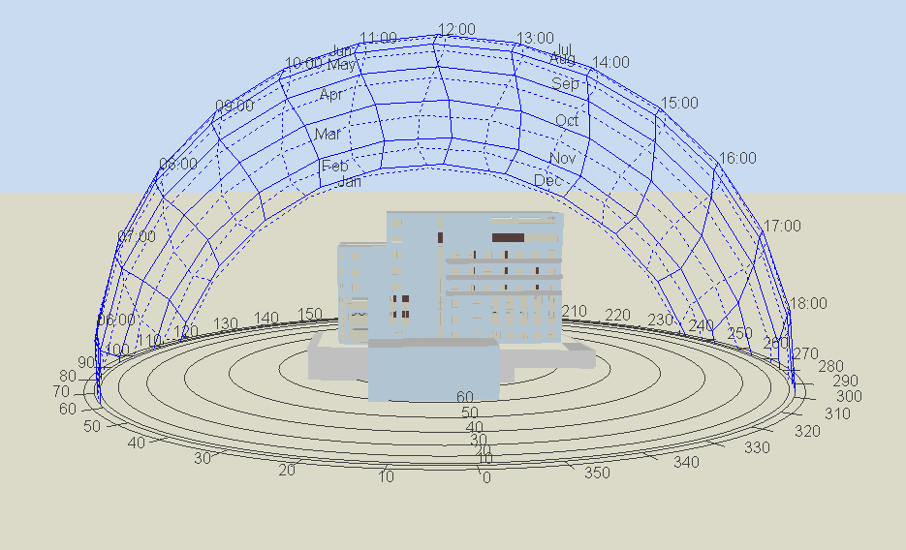
Fig: Sun path

Slide 8
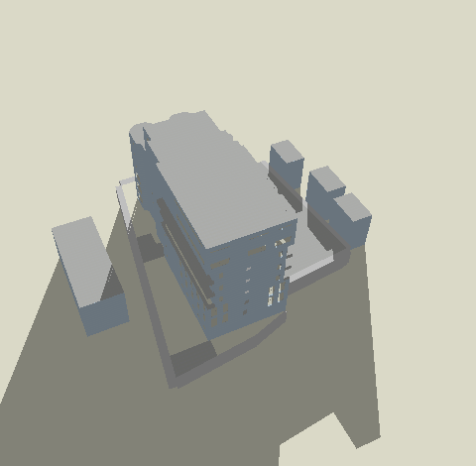
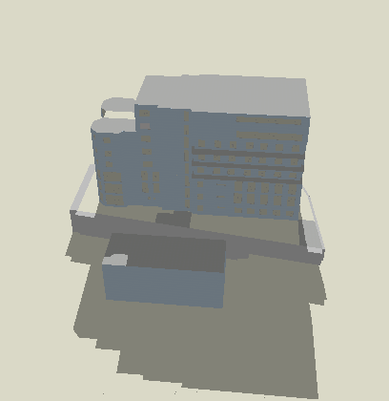
Building shadow
At 21- January
Fig: Shading at 21- January at 8am
Fig: Shading at 21- January at 12pm

Slide 9
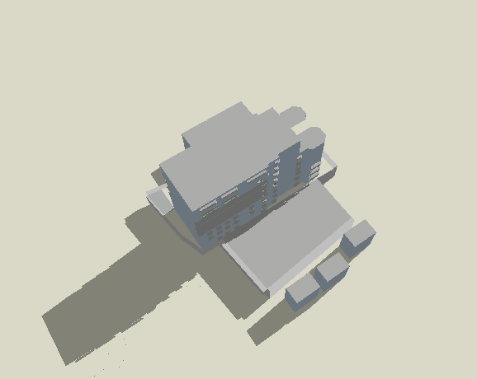
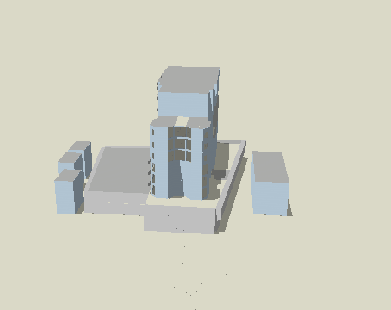
At 21- July
Fig: Shading at 21- July at 8am
Fig: Shading at 21- July at 12pm

Slide 10
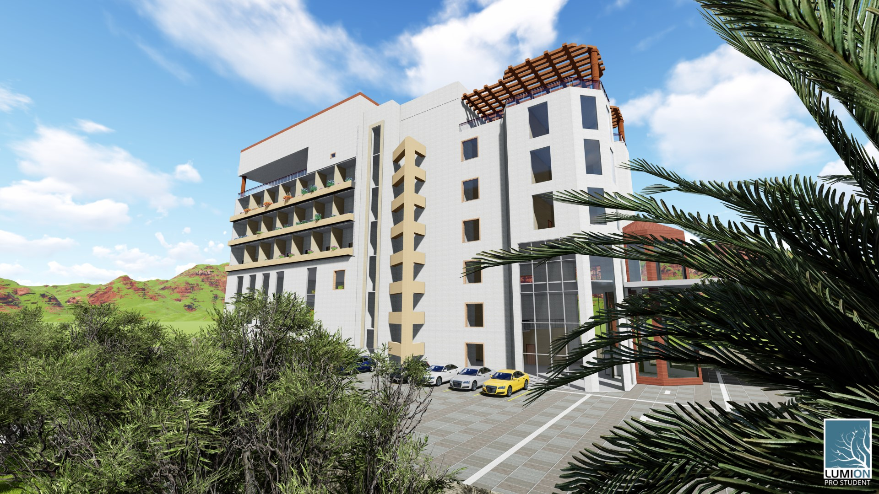
3D views for new design
Fig: Hotel 3D view

Slide 11
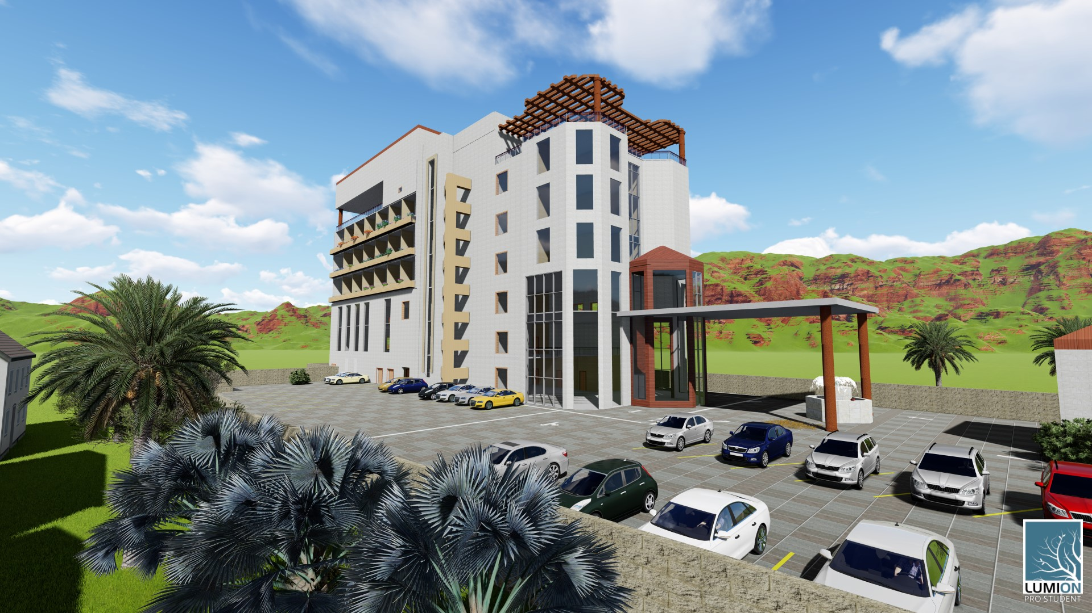
Fig: Hotel 3D view

Slide 12
Fig: Hotel 3D view

Slide 13
Architectural Redesign

Slide 14
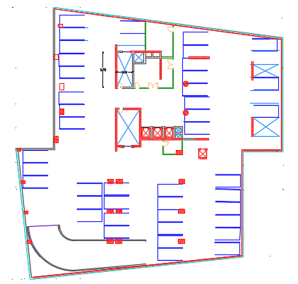
Architectural plans
The new design has 9 floors: 2basements, Ground, 1st …. 6th floors.
Fig: Basement 2 floor plane
Notes:
The ground floor contains the reception and cashier, coat room, kitchen, dining area, mechanical and electrical rooms and storage

Slide 15
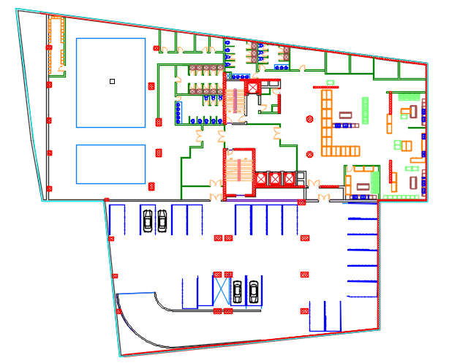
Fig: Basement 1 floor plane

Slide 16
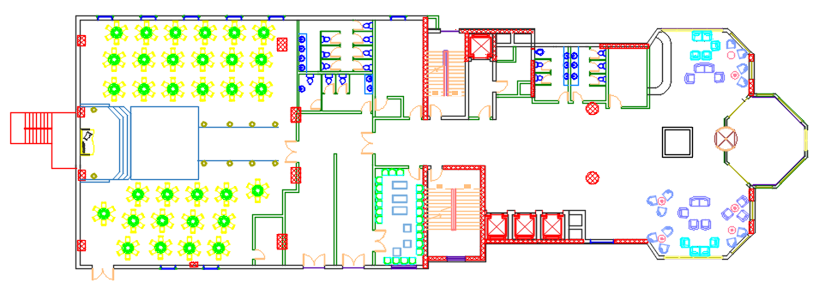
Fig: Ground floor plane

Slide 17
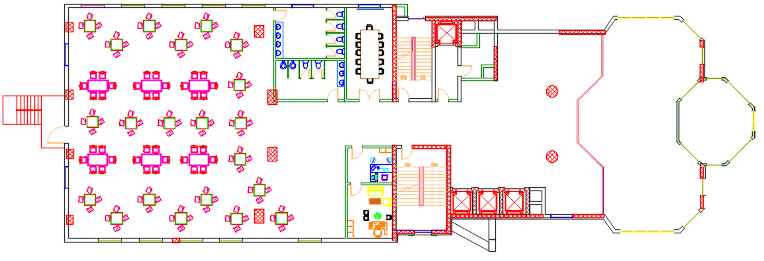
Fig: First Floor plane

Slide 18
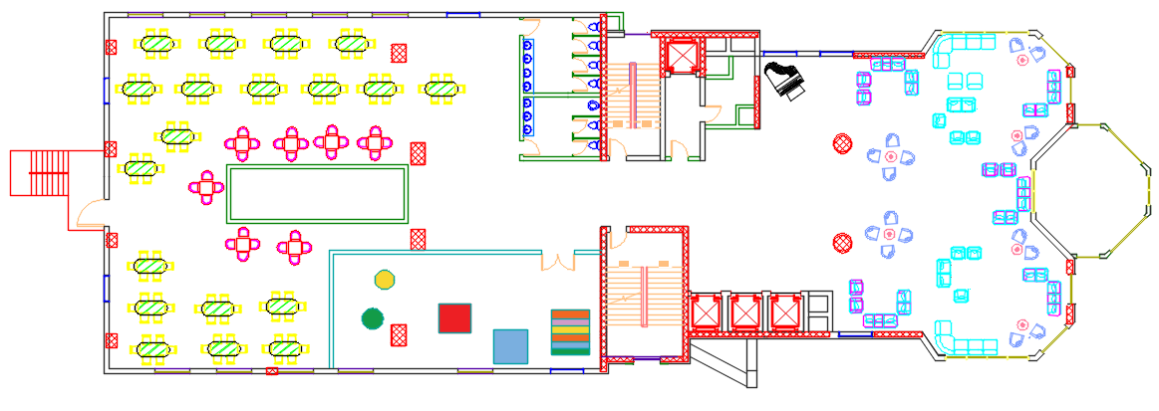
Fig: Second floor plane

Slide 19
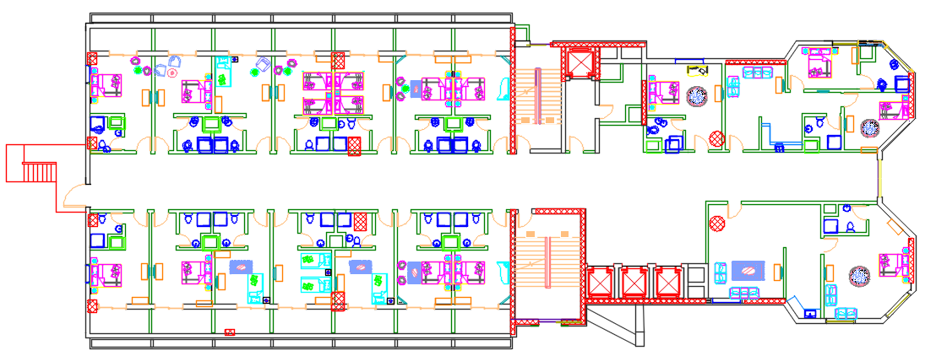
Fig: 3rd, 4th and 5th floors plane

Slide 20
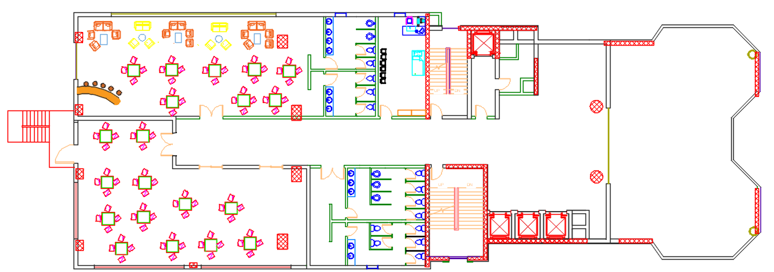
Fig: 6th floor plane

Slide 21
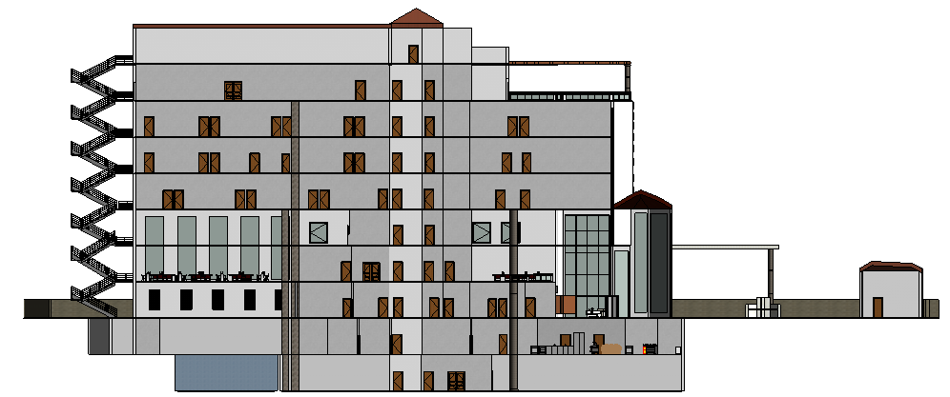
Sections
Fig: Section 3-3

Slide 22
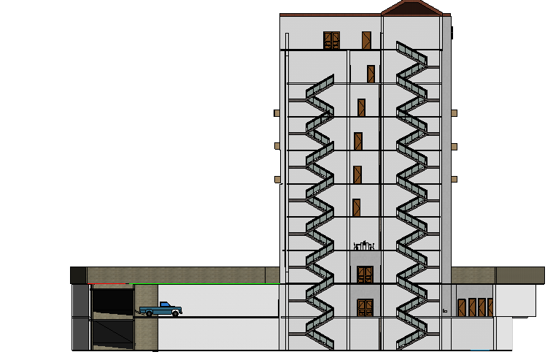
Fig: Section 4-4

Slide 23
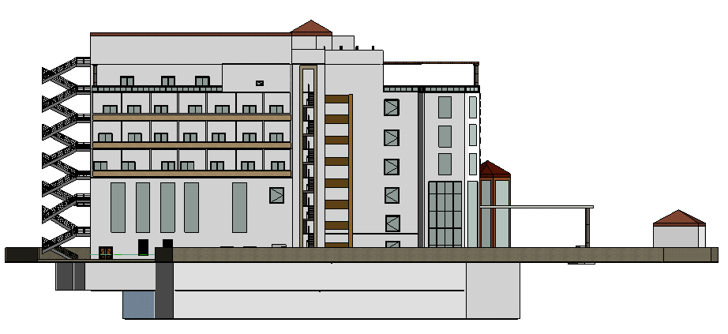
Elevations
Fig: South Elevation

Slide 24
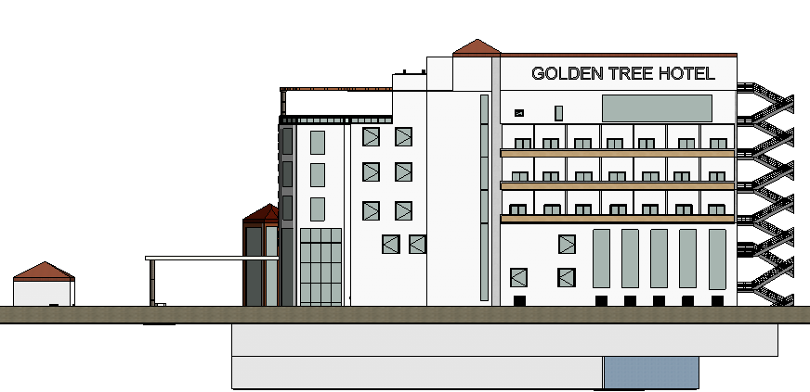
Fig: North Elevation

Slide 25
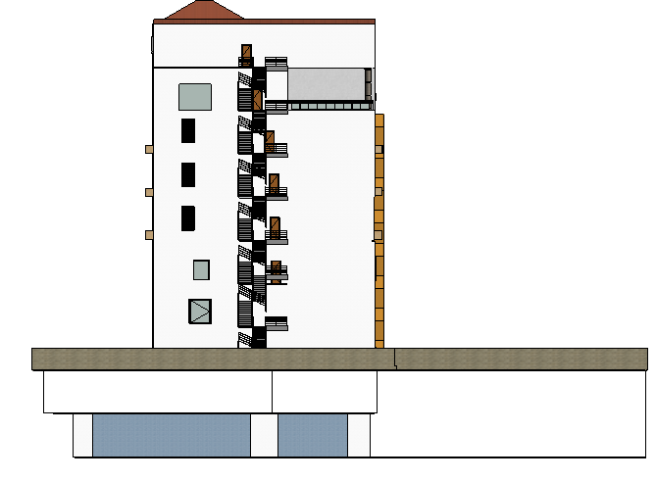
Fig: West Elevation

Slide 26
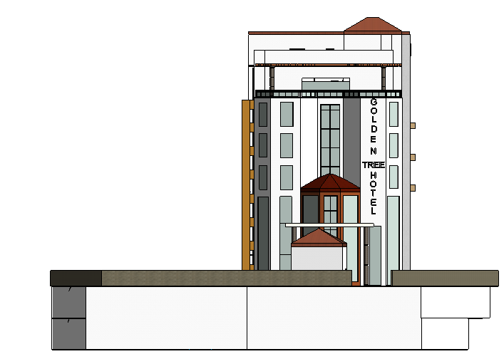
Fig: East Elevation

Slide 27
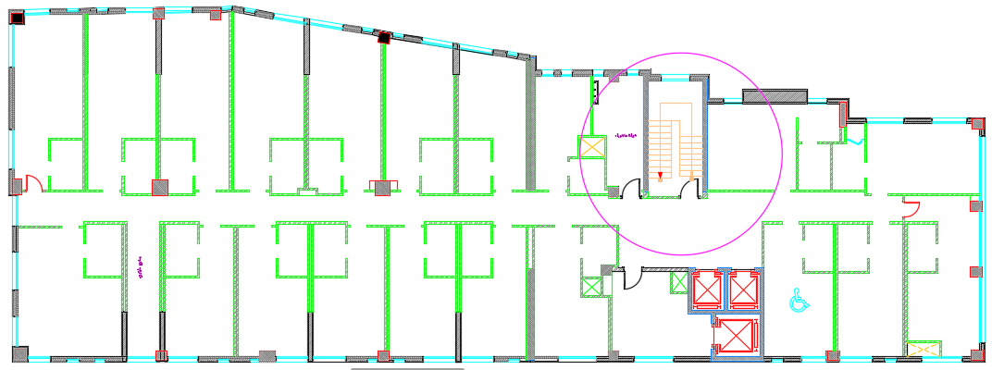
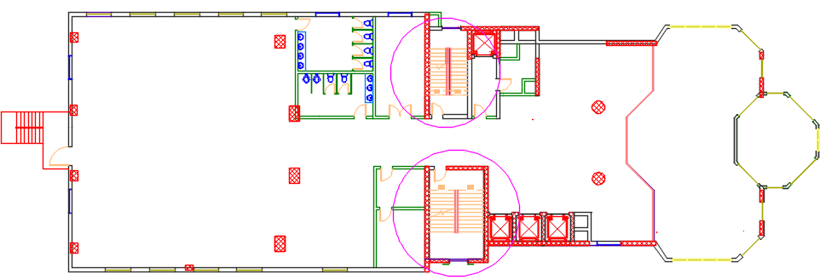
Strength points at new design:
1_circulation
Fig: Circulation stairs in plan before .
Fig :Circulation stairs in plan after .

Slide 28
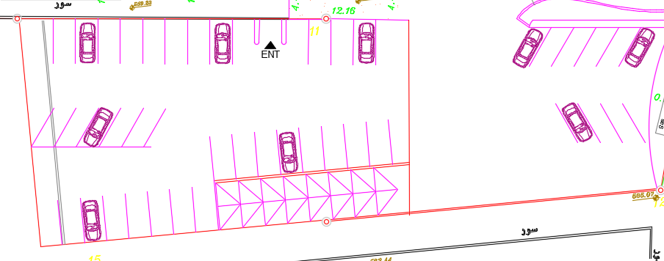
2_ Garages
Fig: Old design garages

Slide 29
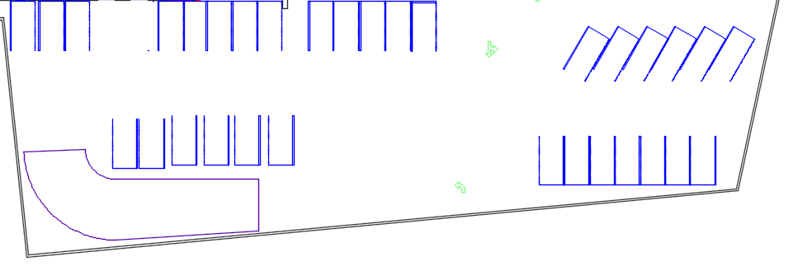
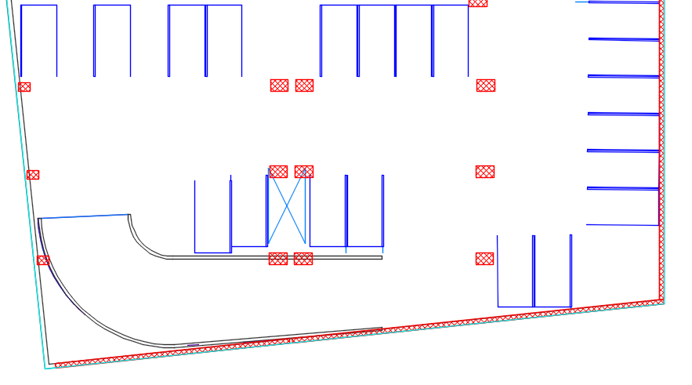
Fig: Gf garages
Fig:B1 garages

Slide 30
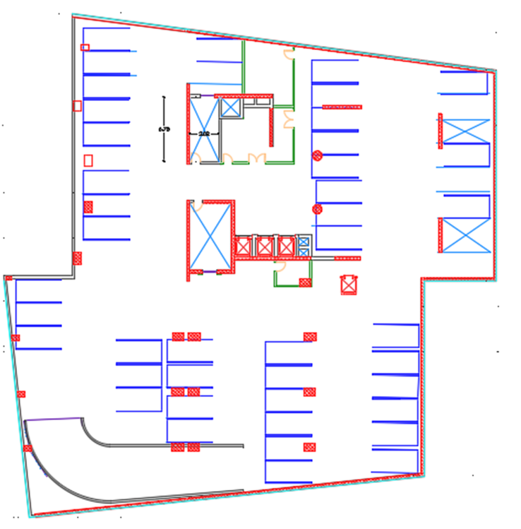
Fig: B2 garages

Slide 31
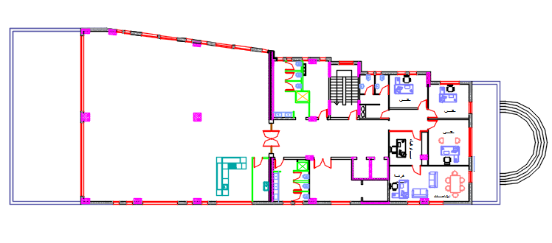
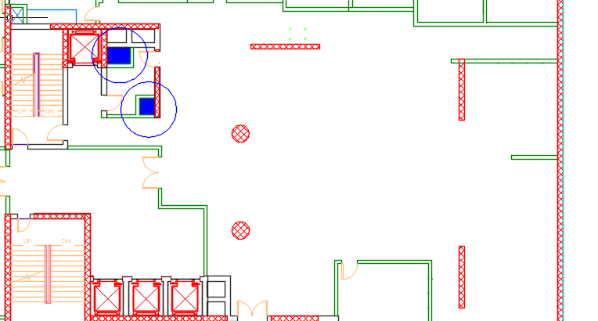
3_ Rubbish and Linen shuts
Fig :Show no Rubbish and linen shut before
Fig :Show Rubbish and linen shut after

Slide 32
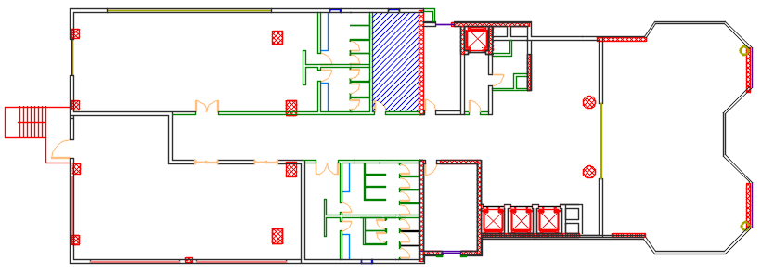
4_ No clinic
Fig :show no clinic in plans before .
Fig :show clinic in plans after .

Slide 33
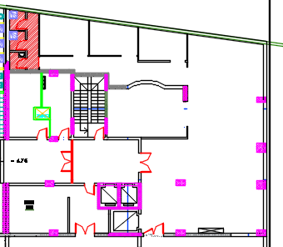
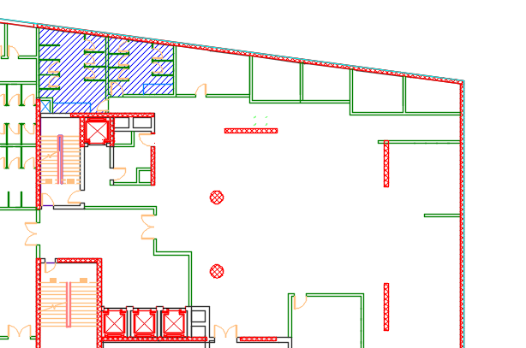
5_ Service shower and W.Cs
Fig :W.C and shower service in plan before .
Fig :W.C and shower service in plan after .

Slide 34
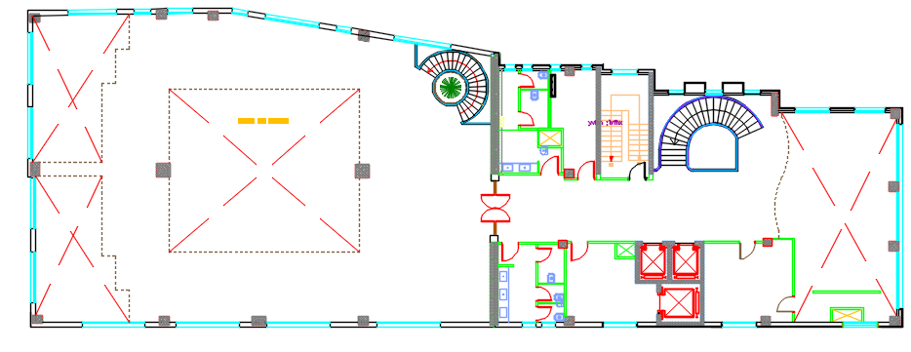
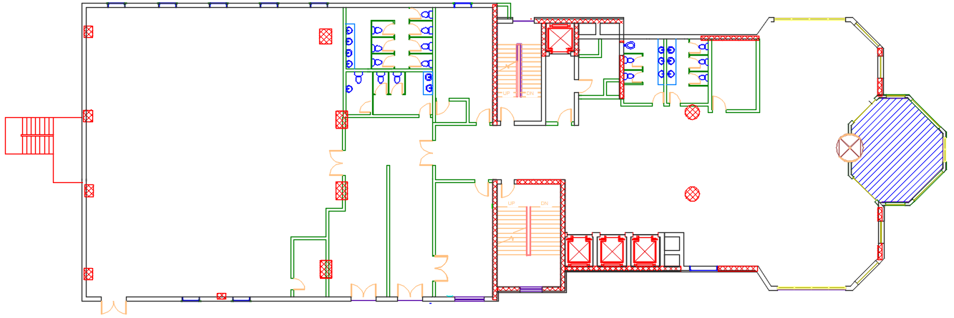
6_ Intermediate lobby
Fig : No Intermediate lobby in plans before.
Fig :Intermediate lobby in plans after.

Slide 35
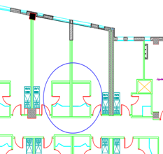
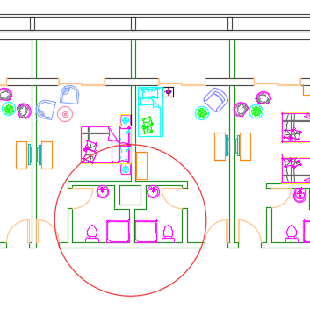
7_ Bedrooms shafts.
Fig: Shafts not found at old design
Fig: New design shafts

Slide 36
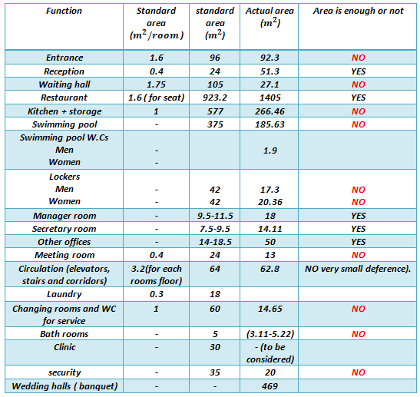
Table: Old design spaces area compared with standards

Slide 37
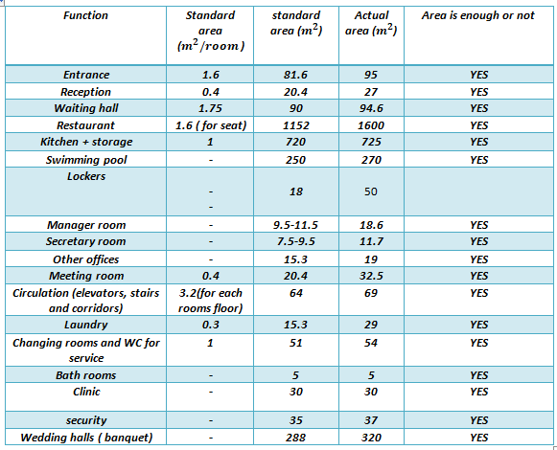
Table: New design spaces area compared with standards

Slide 38
Environmental Redesign

Slide 39
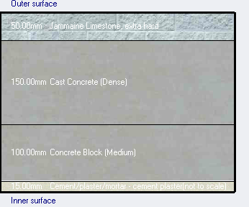
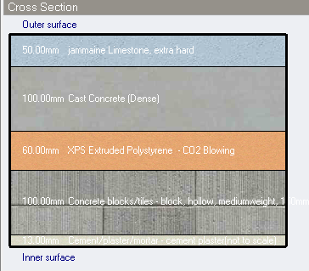
Design builder analysis
Envelope layers
Fig : Section on external wall before
Fig : Section on external wall after

Slide 40
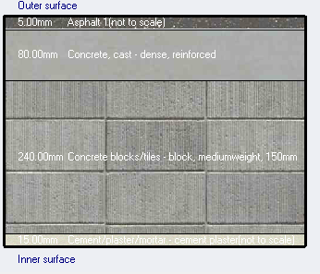
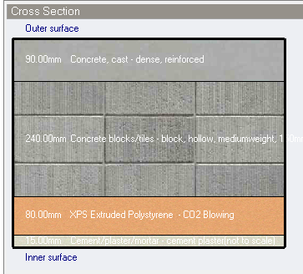
Fig :Section in roof before
Fig :Section in roof after

Slide 41
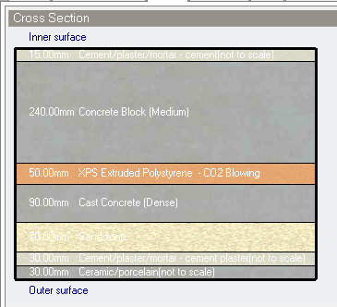
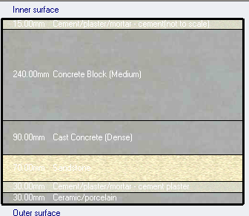
Fig :Section in internal floor before
Fig :Section in internal floor after

Slide 42
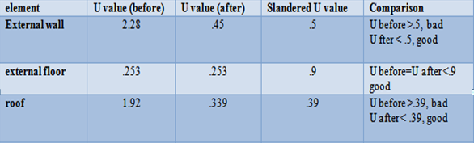
Simulation:
U values for envelope:
Table: Comparison in U value between old and new design

Slide 43
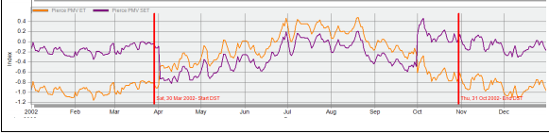

Comfort analysis:
Fig : Comfort simulation before .
Fig :Comfort simulation after.

Slide 44


Table: comparison in comfort value
Total site energy
Table: Total site energy before.

Slide 45


Table : Total site energy after
Table : Total energy comparing

Slide 46

Cooling load and heating load analysis:
Table: Heating load before

Slide 47


Table : Heating load after
Table : Heating and cooling load comparison.

Slide 48


Acoustical Redesign
Reverberation time (RT60)
Used materials for the wedding hall
False celling
Fig: Absorption coefficient for the
Celling (old)
Fig: Absorption coefficient for the
Celling (new)

Slide 49


Walls materials
Fig: Absorption coefficient for walls
surfaces (old)
Fig: Absorption coefficient for walls
surfaces (new)

Slide 50


Floor and windows
Fig: Absorption coefficient for the
floor (old and new)
Fig: Absorption coefficient for
windows (old and new)

Slide 51

Redesign wedding hall Eccotict results
Table: Redesign wedding hall RT60

Slide 52
Table: Old and new design wedding hall RT60 values compared with standards

Slide 53



Sound Transmission Class (STC)
Fig: External wall
Fig: Internal wall
Table: Old and new STC values for partition walls compared with standards

Slide 54




Impact Insulation Class (IIC)
It’s a measure to find sound transition through slab (floor) between critical zones.
Fig: Floor layers
66 > 62 its good
Fig: 6th floor restaurant Floor CII

Slide 55

Fig: Speakers distribution and coverage for 6th floor
Speakers distribution

Slide 56
Structural Redesign

Slide 57
Design Codes:
ACI-318-08 for reinforced concrete design .
UBC-97 for earthquake load computations .
ASCE for load computations

Slide 58
Characteristics of materials:
Compressive strength of Concrete f′c = 28MPa.
Concrete weight per unit volume= 25kN/m3
Concrete modules of elasticity E=24870MPa.
Yielding strength of steel FY = 420MPa.

Slide 59

Loads:

Slide 60


Project description:

Slide 61

Etabs Model for block A

Slide 62

Seismic design:
Using UBC1997 design code:
1. Importance factor: I =1
2. Seismic Zone factor = 0.2
3.Soil profiles in the project (Sd).
4. acceleration-dependent seismic coefficient (Ca) = 0.28
5. velocity-dependent seismic coefficient (CV) = 0.4
6.Response modification factor (R)=5.5

Slide 63


Model verification checks:
1. Compatibility check:
2.Deflection check:
U from Etabs = 41.5mm < U max= 54.41mm
Notes:
compatibility had achieved as shown in the figure

Slide 64
2. Equilibrium check:
Load | Manual | Etabs | Error
Dead load | 54207.05 KN | 54440.551KN | 0.5%
Live load | 18951.01 KN | 18876.15 KN | 0.25%
SID | 29419.26 KN | 29472.99KN | 0.18%
3. Internal Forces Check:
Load |  | Manual | Etabs | Error
For Dead load | Slab | 36.2 | 35 | 3.3 %
Load |  | Manual | Etabs | Error
For Dead load | Beam | 1224.3 | 1171.3 | 4.3%
Load |  | Manual | Etabs | Error
For Dead load | Column | 1182.57 | 1885.92 | 0.28%

Slide 65
Seismic checks:
Period check:
Base shear check:
Drift check:
∆ S = 18 mm from ETABS
Then
∆M =0.7*5.5*18 < 0.025 (5) *10³ → Ok
∆M The Maximum Inelastic Response Displacement
∆ S the Maximum Elastic Response Displacement (from ETABS)
Period manually | Period from Etabs | Error | Satisfy
0.77 | 1.1 | 2.8% | Yes
Shear manually | shear from Etabs | Satisfy
9691.9 KN | 9692 | Yes

Slide 66

Slab design: one way ribbed slab
1- one way ribbed slab (33 cm thickness )
Slab plan

Slide 67

Section in slab:
Section in one way ribbed slab
Slab section

Slide 68

Design of beams
Beams layout for B1 floor

Slide 69


Group D section
Group D detailing

Slide 70



Group C detailing
Group C beam sections

Slide 71

Remaining beams detailing

Slide 72

Design of columns:
column layout for B1 floor

Slide 73


Section in column C2

Slide 74

Reinforcement for remaining columns

Slide 75


Design of footings:
Footing Layout

Slide 76



Detailing of single footing group B

Slide 77


Detailing of combined footing F10B

Slide 78


Section in matt foundation
Reinforcement for remain footing

Slide 79

Shear Wall Design:
Shear wall detailing

Slide 80


Detailing for remain shear walls

Slide 81
Electro-Mechanical Redesign

Slide 82
Lighting Redesign
Old design problems
There were problems in hotel spaces lighting like: bad illuminace, uniformity and glare.

Slide 83
New design solutions
The new design solved old design problems by using this strategy:
1_Luminaire with low illuminace and good distribution.
2_ Different lighting system is used in the same. 3_Dimming system was used.
4_Philips led light.

Slide 84

Dialux evo analysis
Fig: 6th floor created using dialux evo

Slide 85

Dining area analysis
Fig: 3D view for restaurant using dialux evo

Slide 86

Lighting Units
Table: Luminaries used in the restaurant and number of used units

Slide 87

Analysis results
Fig: False colour for the dining area

Slide 88

Table: Old, new and standard values for IL luminance, glare and uniformity in
the dining area

Slide 89

Table: Old, new and standard values for IL luminance, glare and uniformity
at analysed spaces

Slide 90

Day light factor

Slide 91

Electrical connections
Fig: Electrical connection for 6th floor

Slide 92

Power distribution
Fig: Power distribution for 6th floor

Slide 93


Old design problems and solutions
1_
Fig: New corridor socket distribution
Fig: Old corridor socket distribution

Slide 94


2_
3_
Fig: Old design office
Fig: Old design bedroom

Slide 95

Mechanical Redesign
Water system Redesign
New plans :
Fig : Water plan for basement 1 floor

Slide 96


Fig : Water plan for ground floor
Fig: Water plan for first floor

Slide 97

Fig: Water plan for second floor98*

Slide 98


Fig:Water plan for third ,fourth and fifth floors
Fig: Water connection in bathroom

Slide 99

Fig: Water plan for sixth floor

Slide 100
Diameter used according to calculation:
Table : Diameter used for fresh water.
Pipe | Branch | Horizontal | Vertical
Diameter | 2" | 3" | 4"
Losses | 14 | 23.5 | 1
Table : Diameters used for grey water .
Pipe | Branch | Horizontal | Vertical
Diameter | 2" | 3 " | 4"
Losses | 14 | 23.5 | 1

Slide 101
Problems solved in redesign:
Separate black and grey water ,which means more efficiently in using water.
Using fresh water tanks for 3 days , and added grey water tanks

Slide 102

Drainage system Redesign
New plans:
Fig : Drainage plan for basement 1 floor

Slide 103


Fig : Drainage plan for ground floor
Fig: Drainage connection in W.C

Slide 104


Fig: Drainage plan for first floor
Fig: Drainage plan for second floors

Slide 105


Fig : Drainage plan for third, fourth and fifth floor
Fig: Drainage plan for sixth floor

Slide 106


Problem solved in redesign:
1-Connect W.C to trap
Fig:conection before
Fig: conection after

Slide 107


2-No shafts which make connection untidy
Fig: Shows no shaft Before
Fig: Shows shaft in new plans after

Slide 108


3- Connect W.C to each other.
Fig: W.Cs connection before
Fig: Wcs connection after

Slide 109
HVAC System
VRF system is used as the main Hvac system in the hotel, because it has different functions and zones with different loads and this system allows zones individual control, also the system is energy efficient with Quit operation and less down time.
Notes:
Irrigate grass

Slide 110

Old design problems
The old design had different problems like: Insufficient supply, bad diffusers distribution, no ventilation, bad air quality and no fresh air.
Fig: Old design mezzanine HVAC system

Slide 111


Sample calculation:
Fig: Restaurant supply system
Table: Ducts sizing for restaurant

Slide 112

Fig: Total air conditioning system at 6th floor restaurant with duct sizing
and diffusers load:

Slide 113

Fig: Total air conditioning system at 6th floor with duct sizing and
diffusers load

Slide 114
Safety Redesign

Slide 115

Fire System
Fig: 3rd, 4th and 5th floors Floor plans

Slide 116


Fig: Sprinkler system at 1st floor
Table: Old and new distances between sprinklers

Slide 117



Fig: Sprinkler coverage at 1st floor restaurant
Fig: Smoke detector
Fig: Indications signs

Slide 118
Quantity surveying and cost estimation
Cost equals 1713 NIS/MS

Slide 119


Integration:
Fig: Restaurant false celling

Slide 120

Fig: Restaurant celling

Slide 121


