Slide 1

Graduation Project 2
Design of a “HPLC” Device
An-Najah National University
Faculty of Engineering and Information Technology
Mechanical Engineering Department

Slide 2
Contents
Introduction
Design steps
Device characteristics
Obstacles
Future works
Conclusion

Slide 3
Introduction

Slide 4
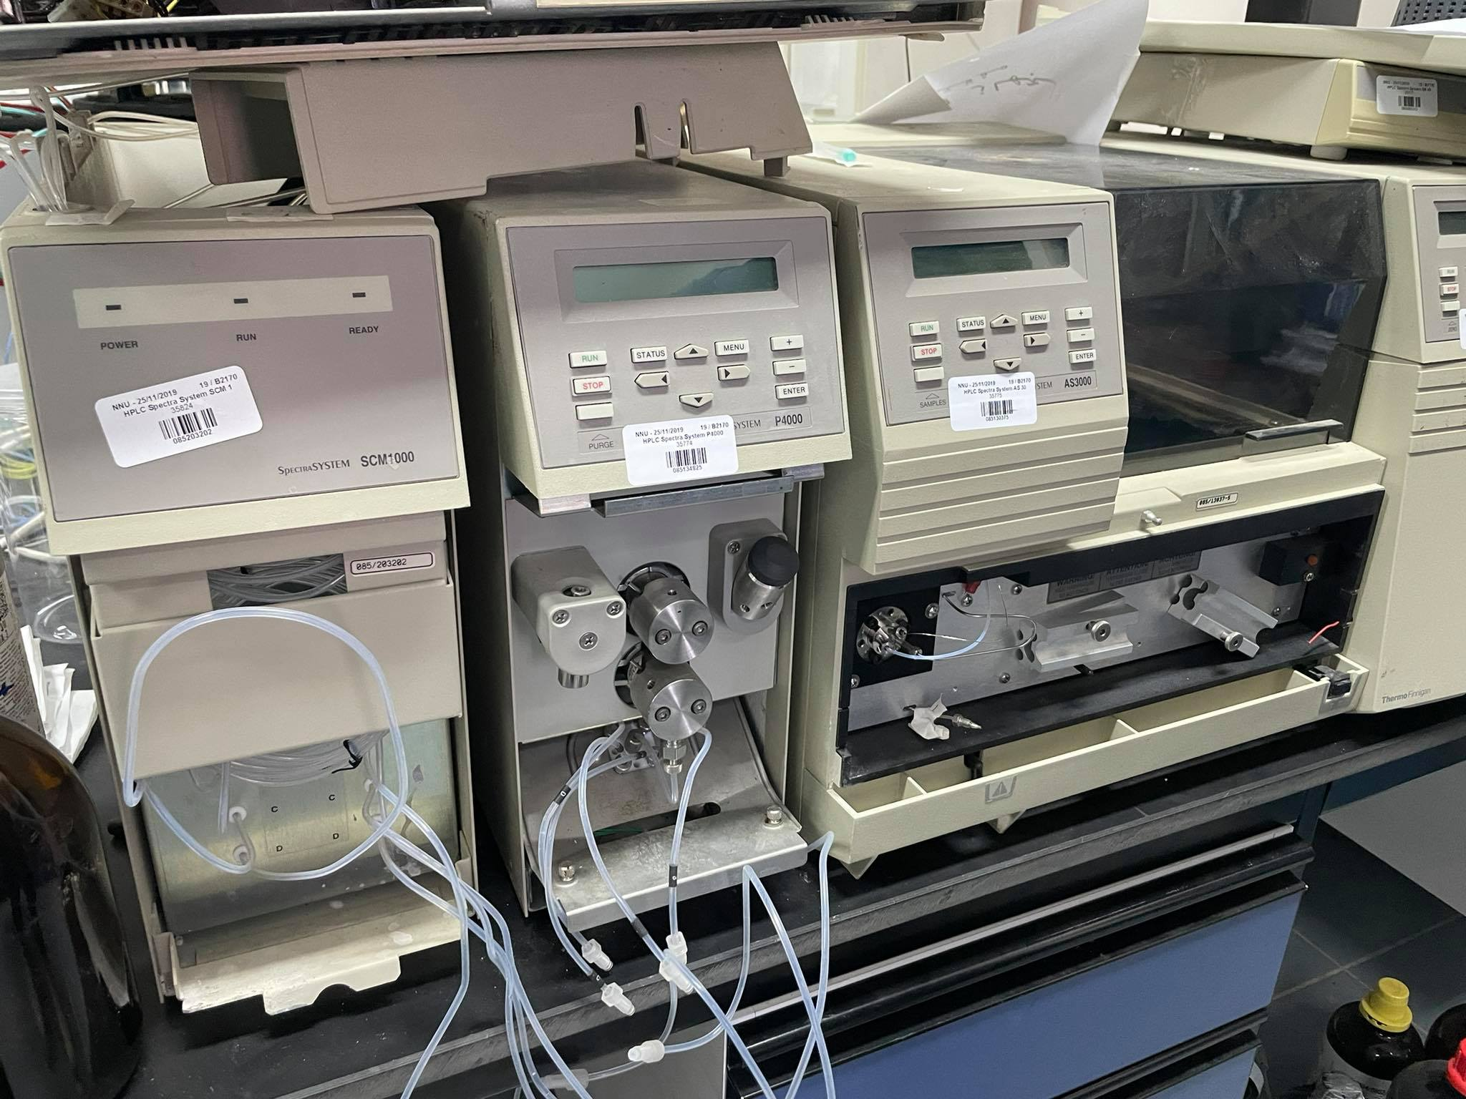


Slide 5
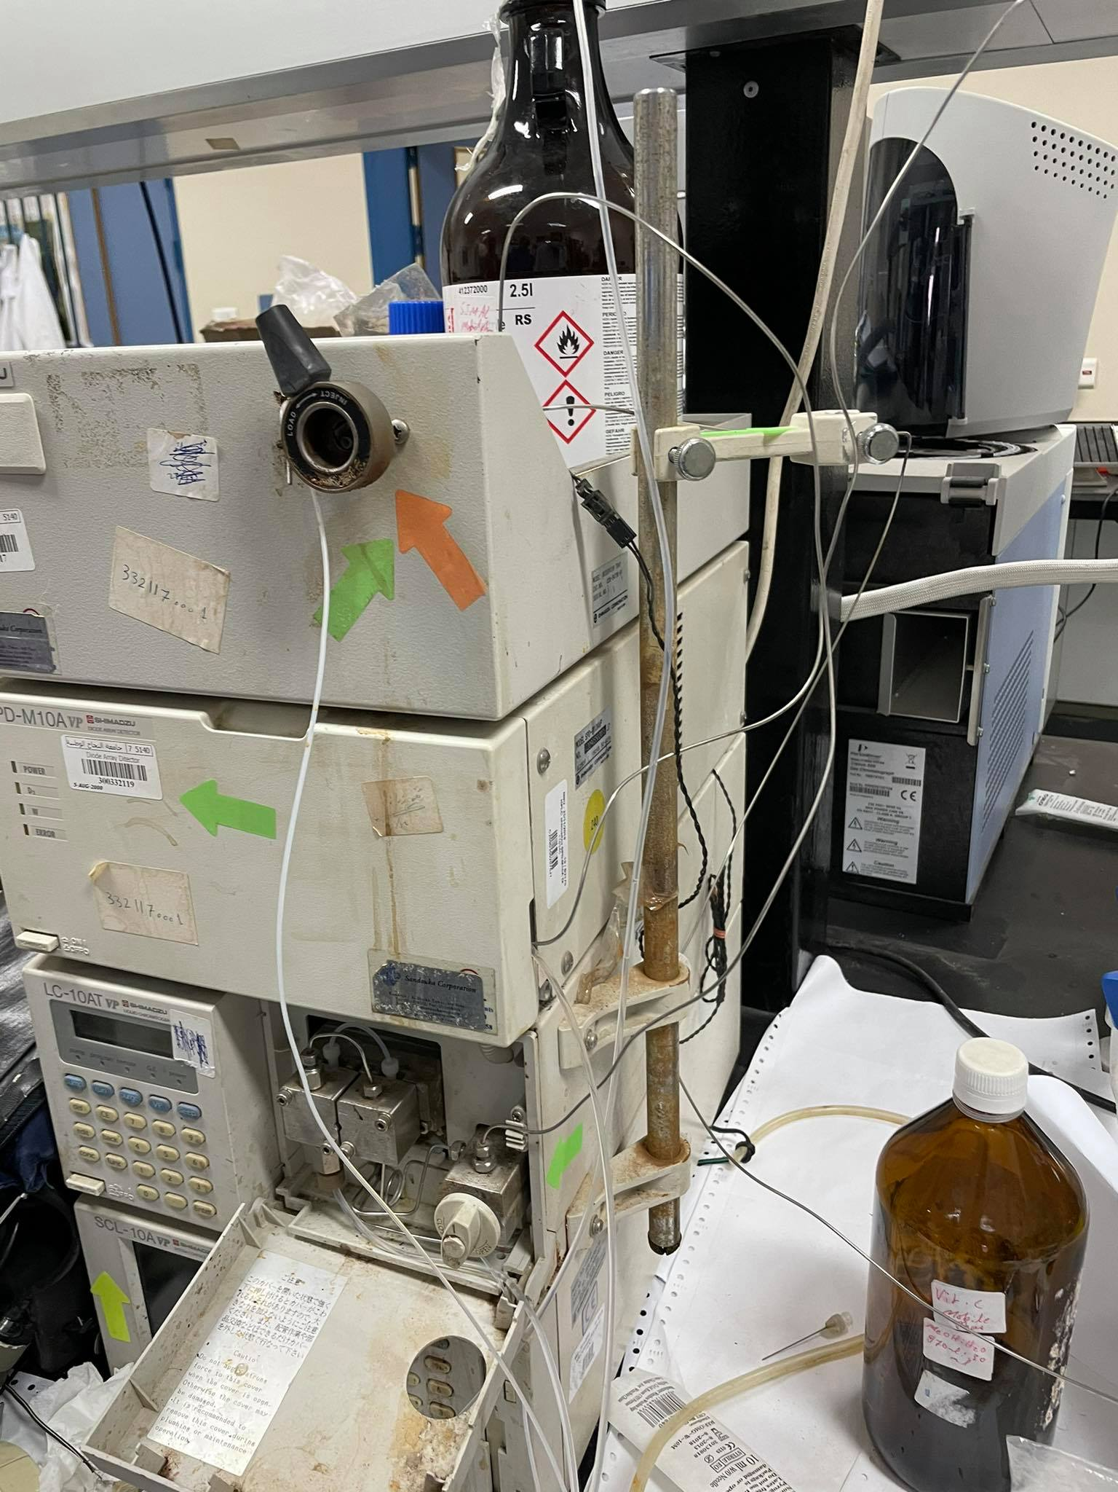


Slide 6
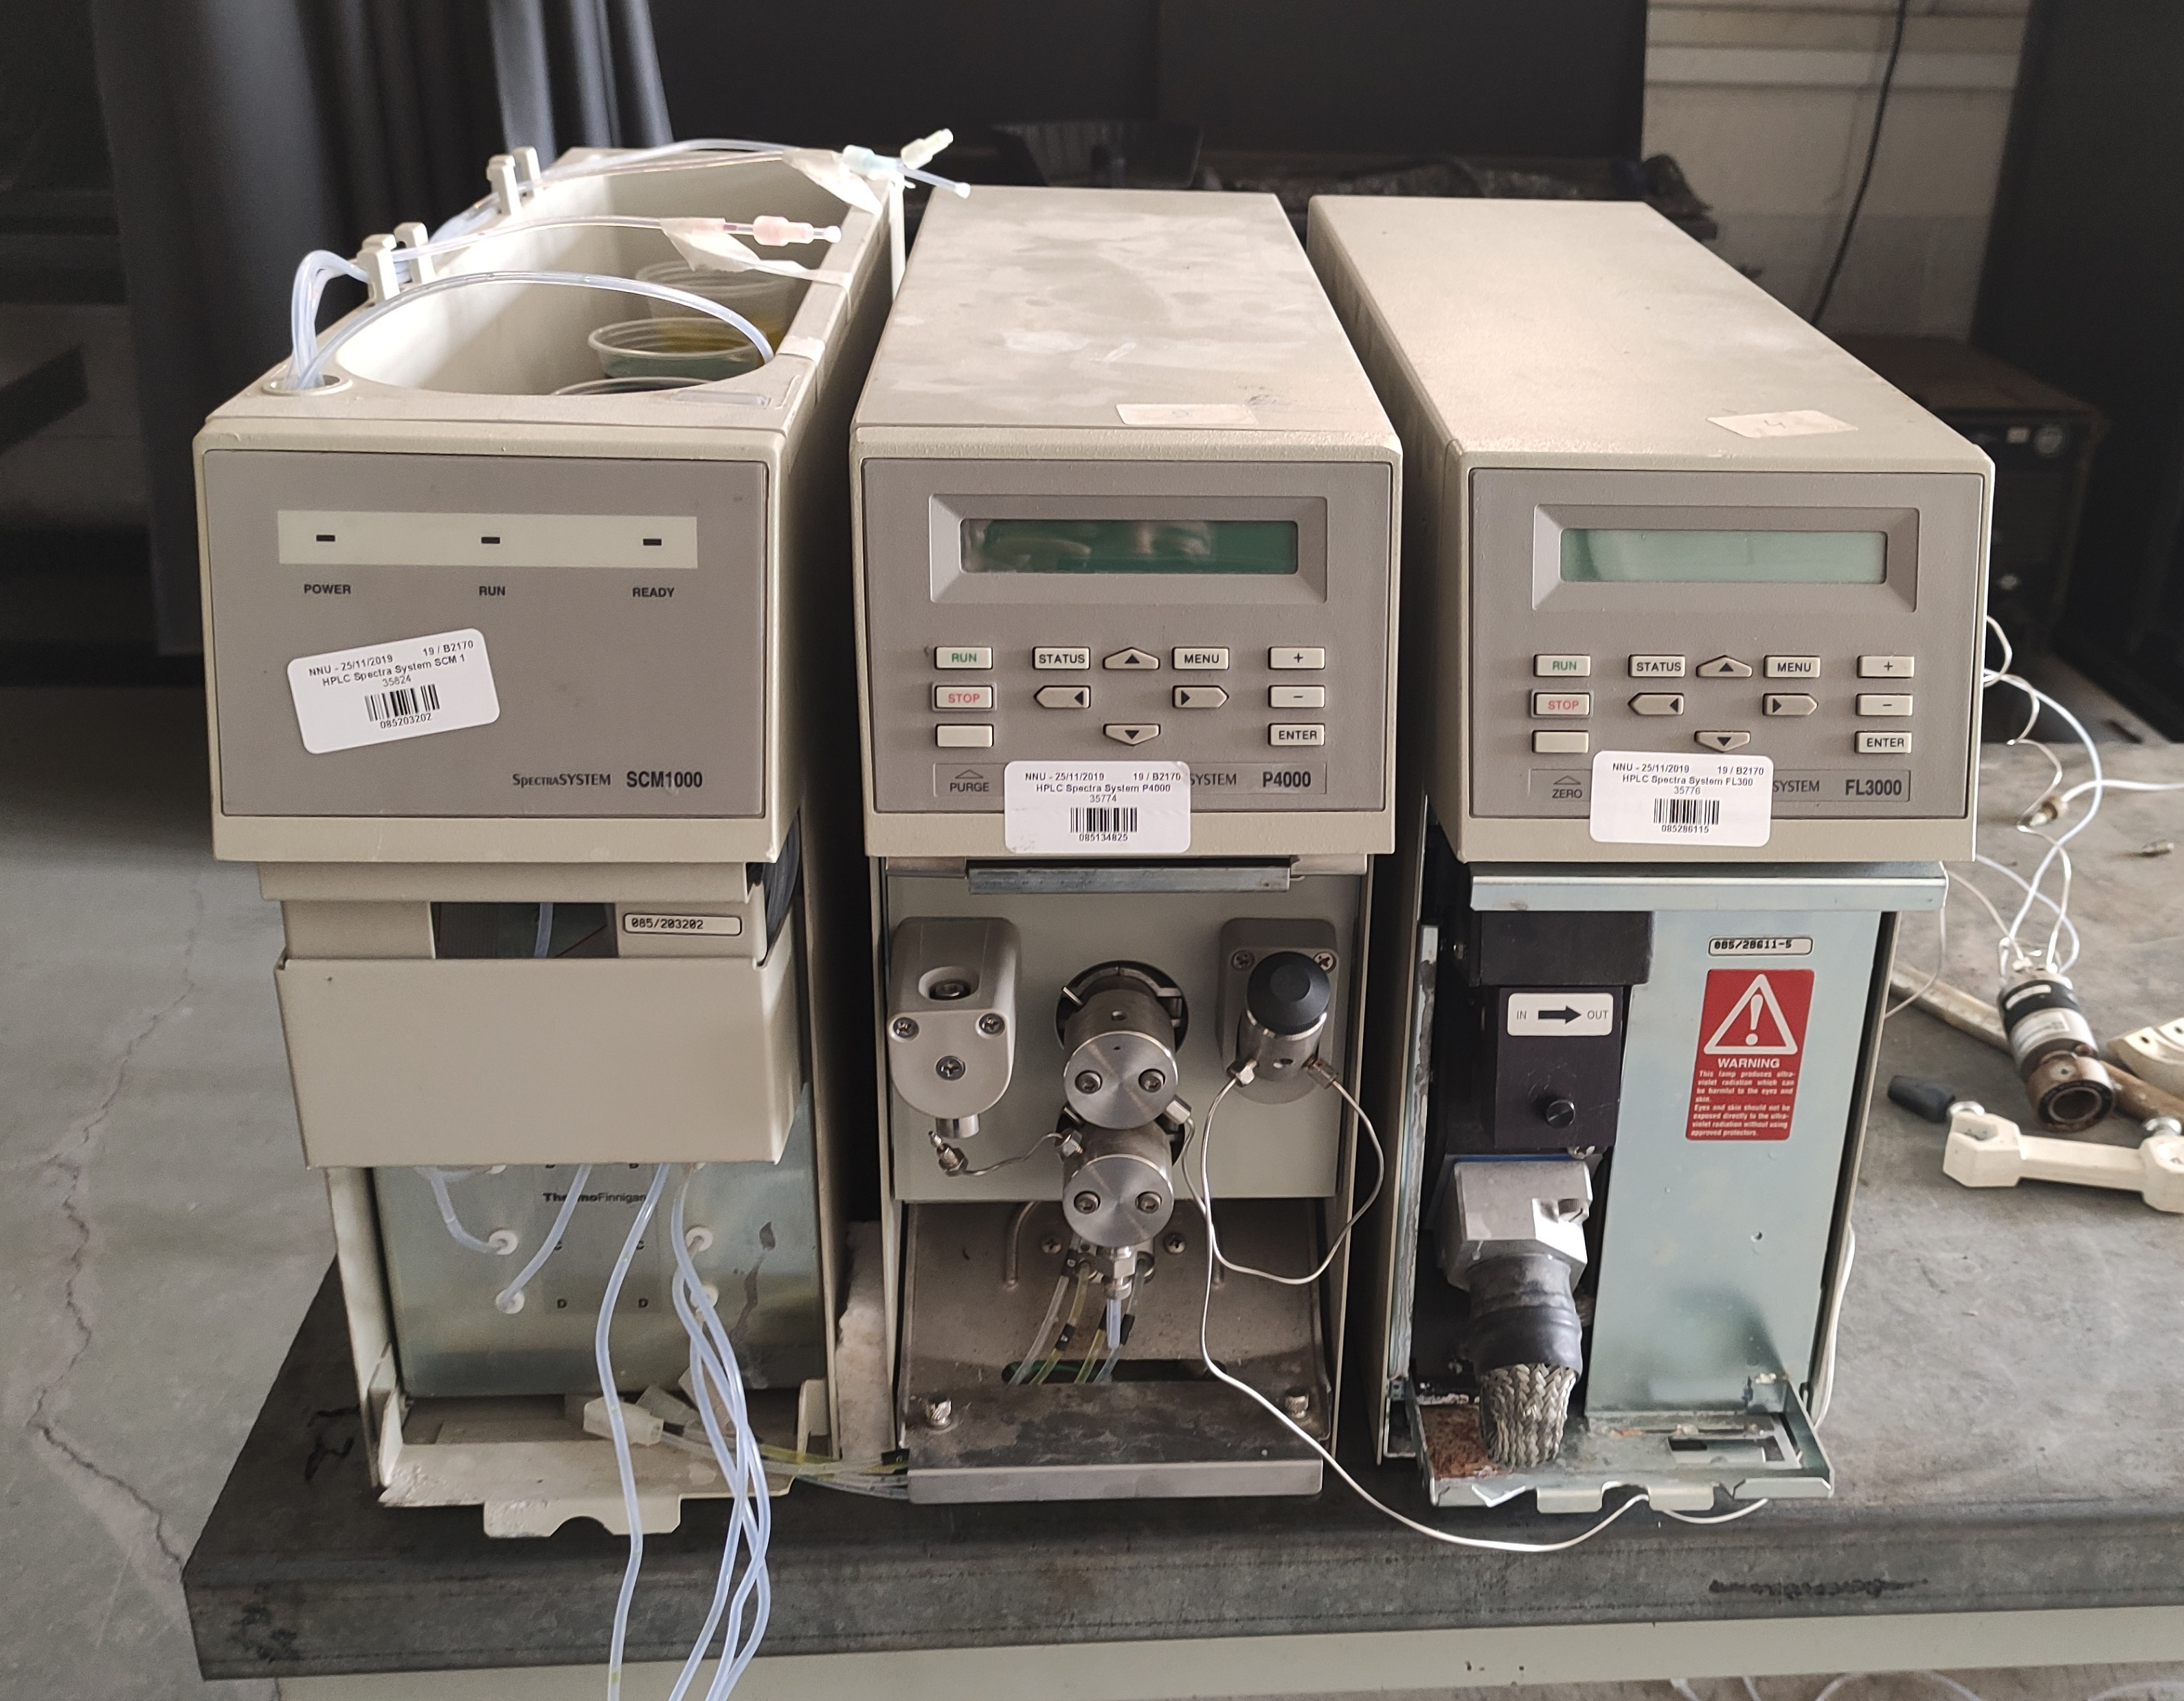
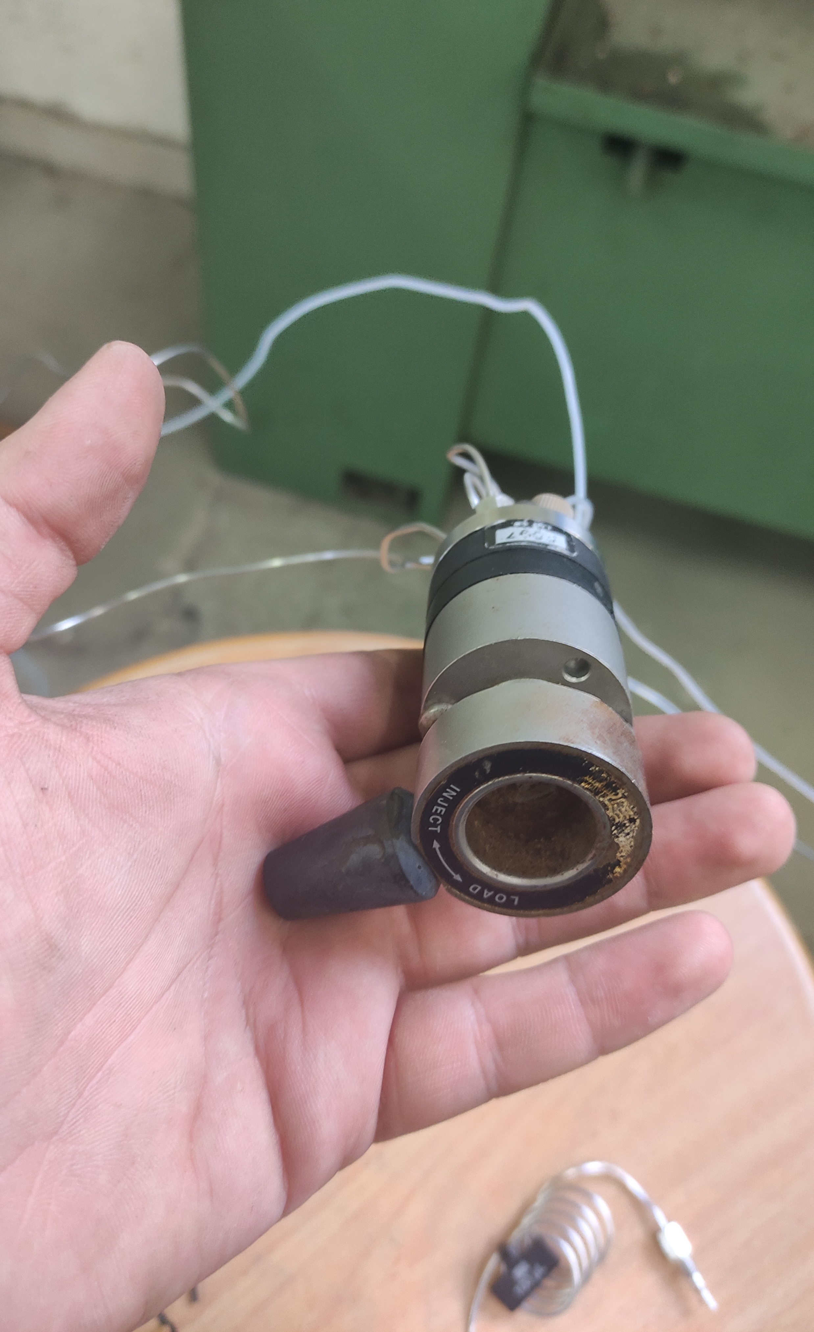

Slide 7
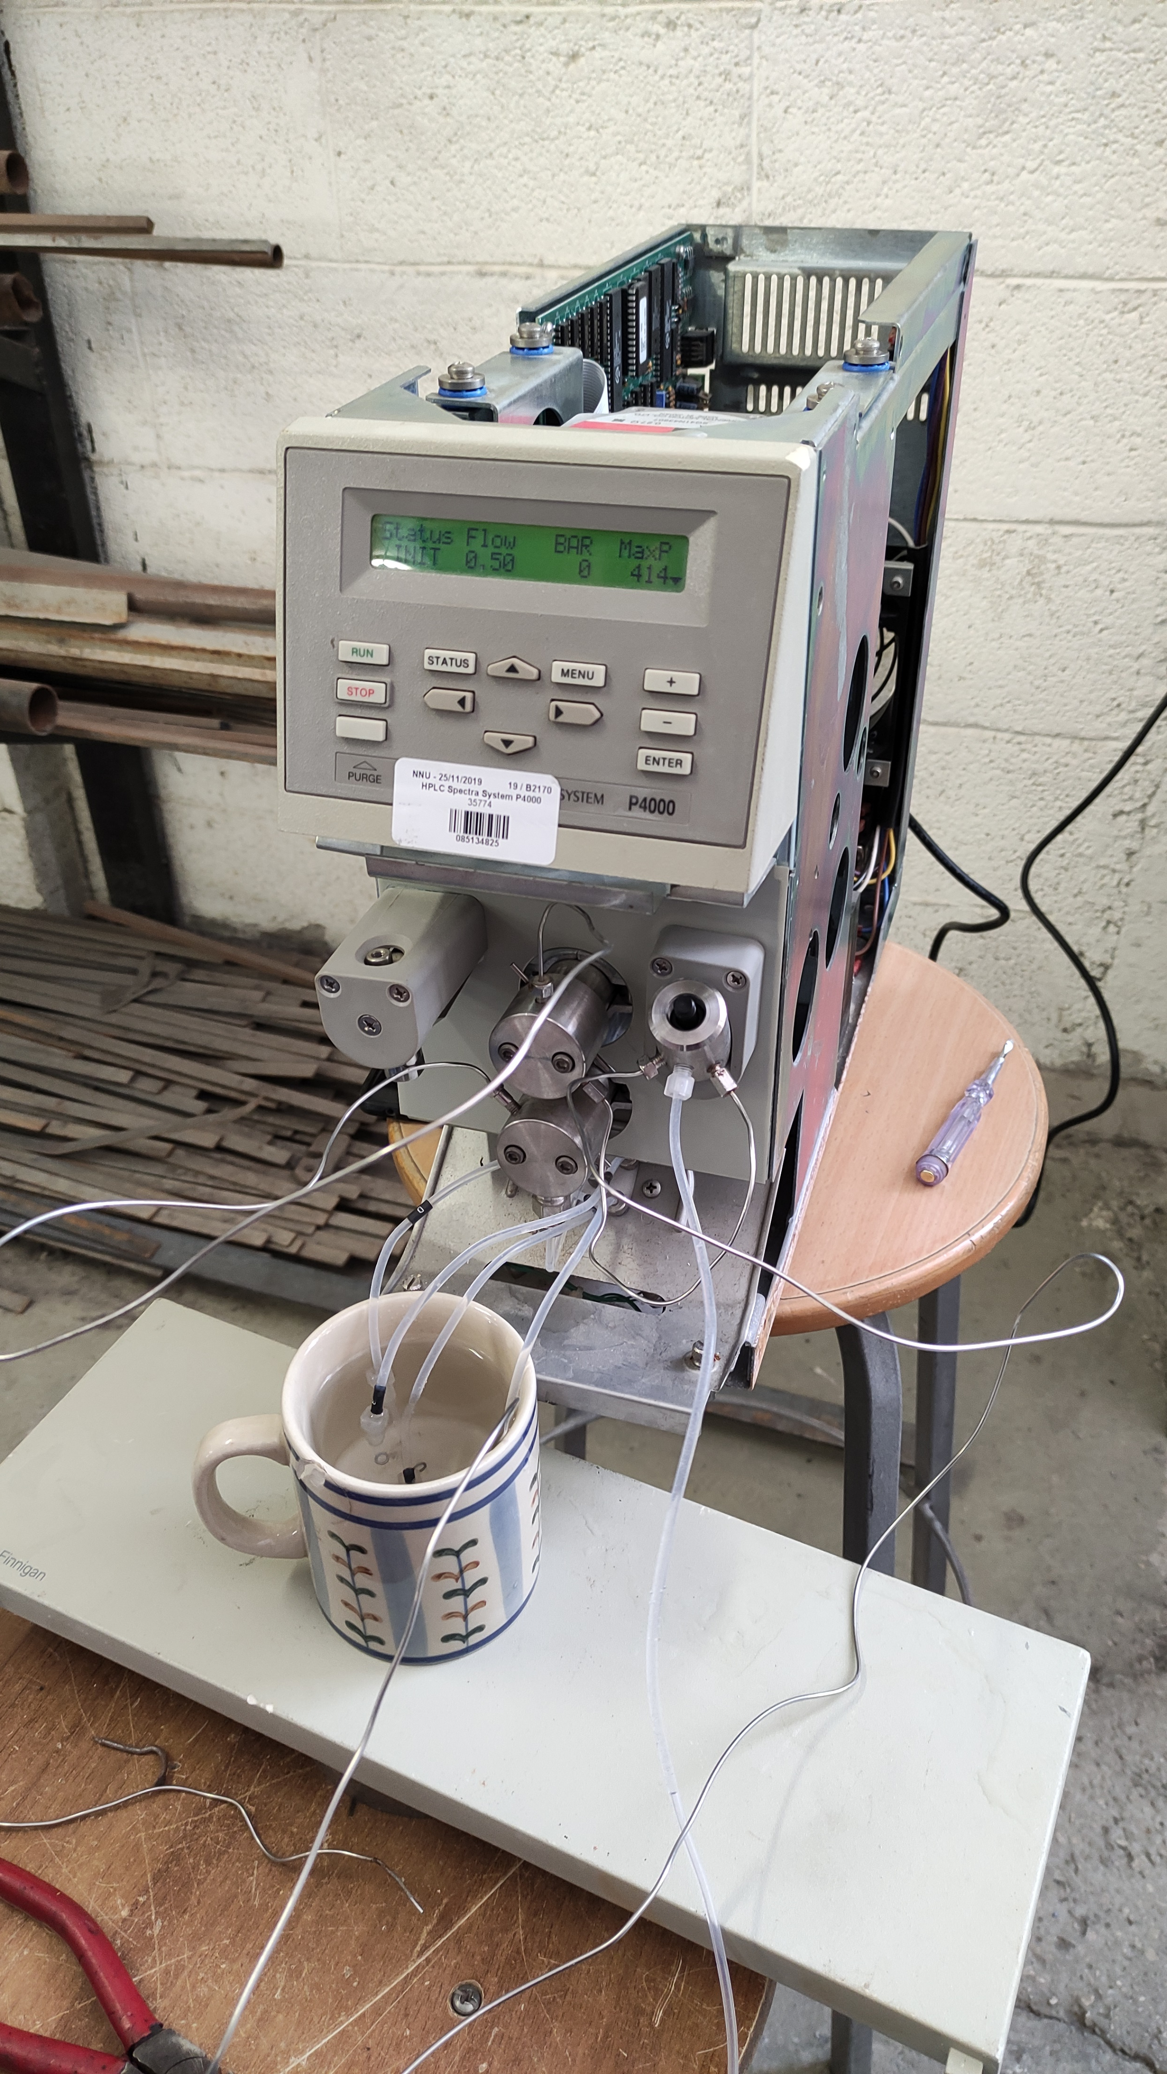

Design steps

Slide 8
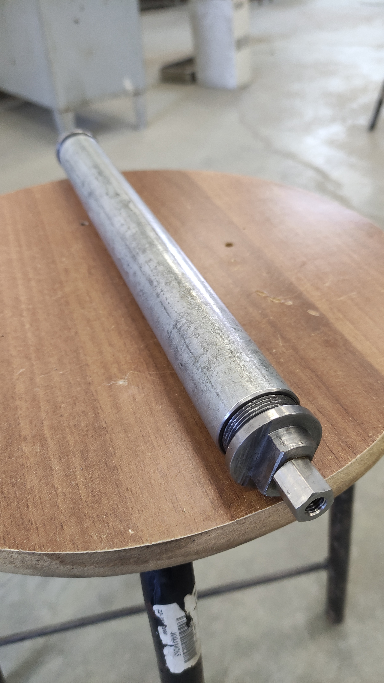
Design steps

Slide 9
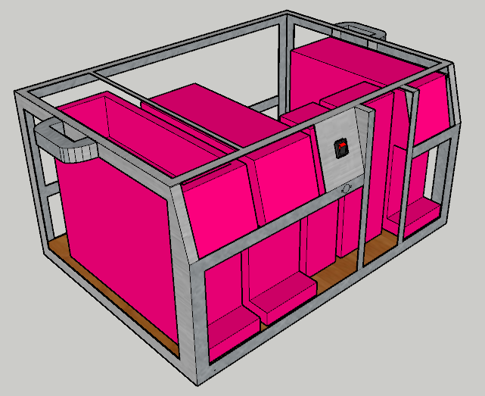
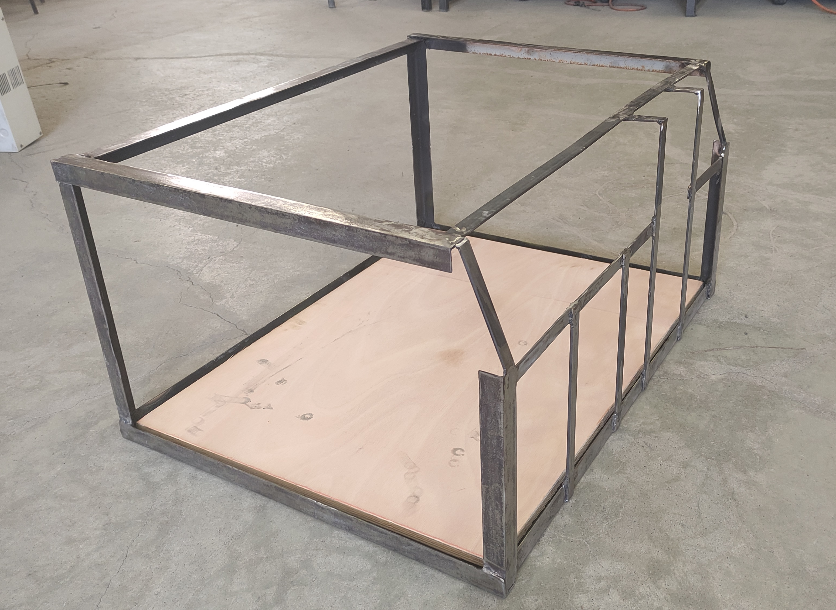
Design steps

Slide 10
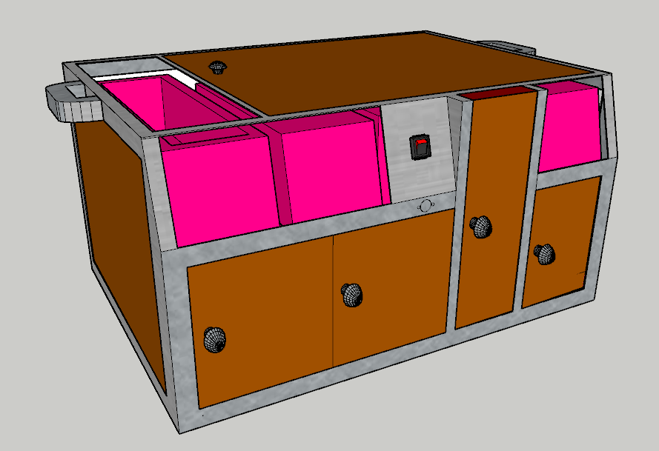
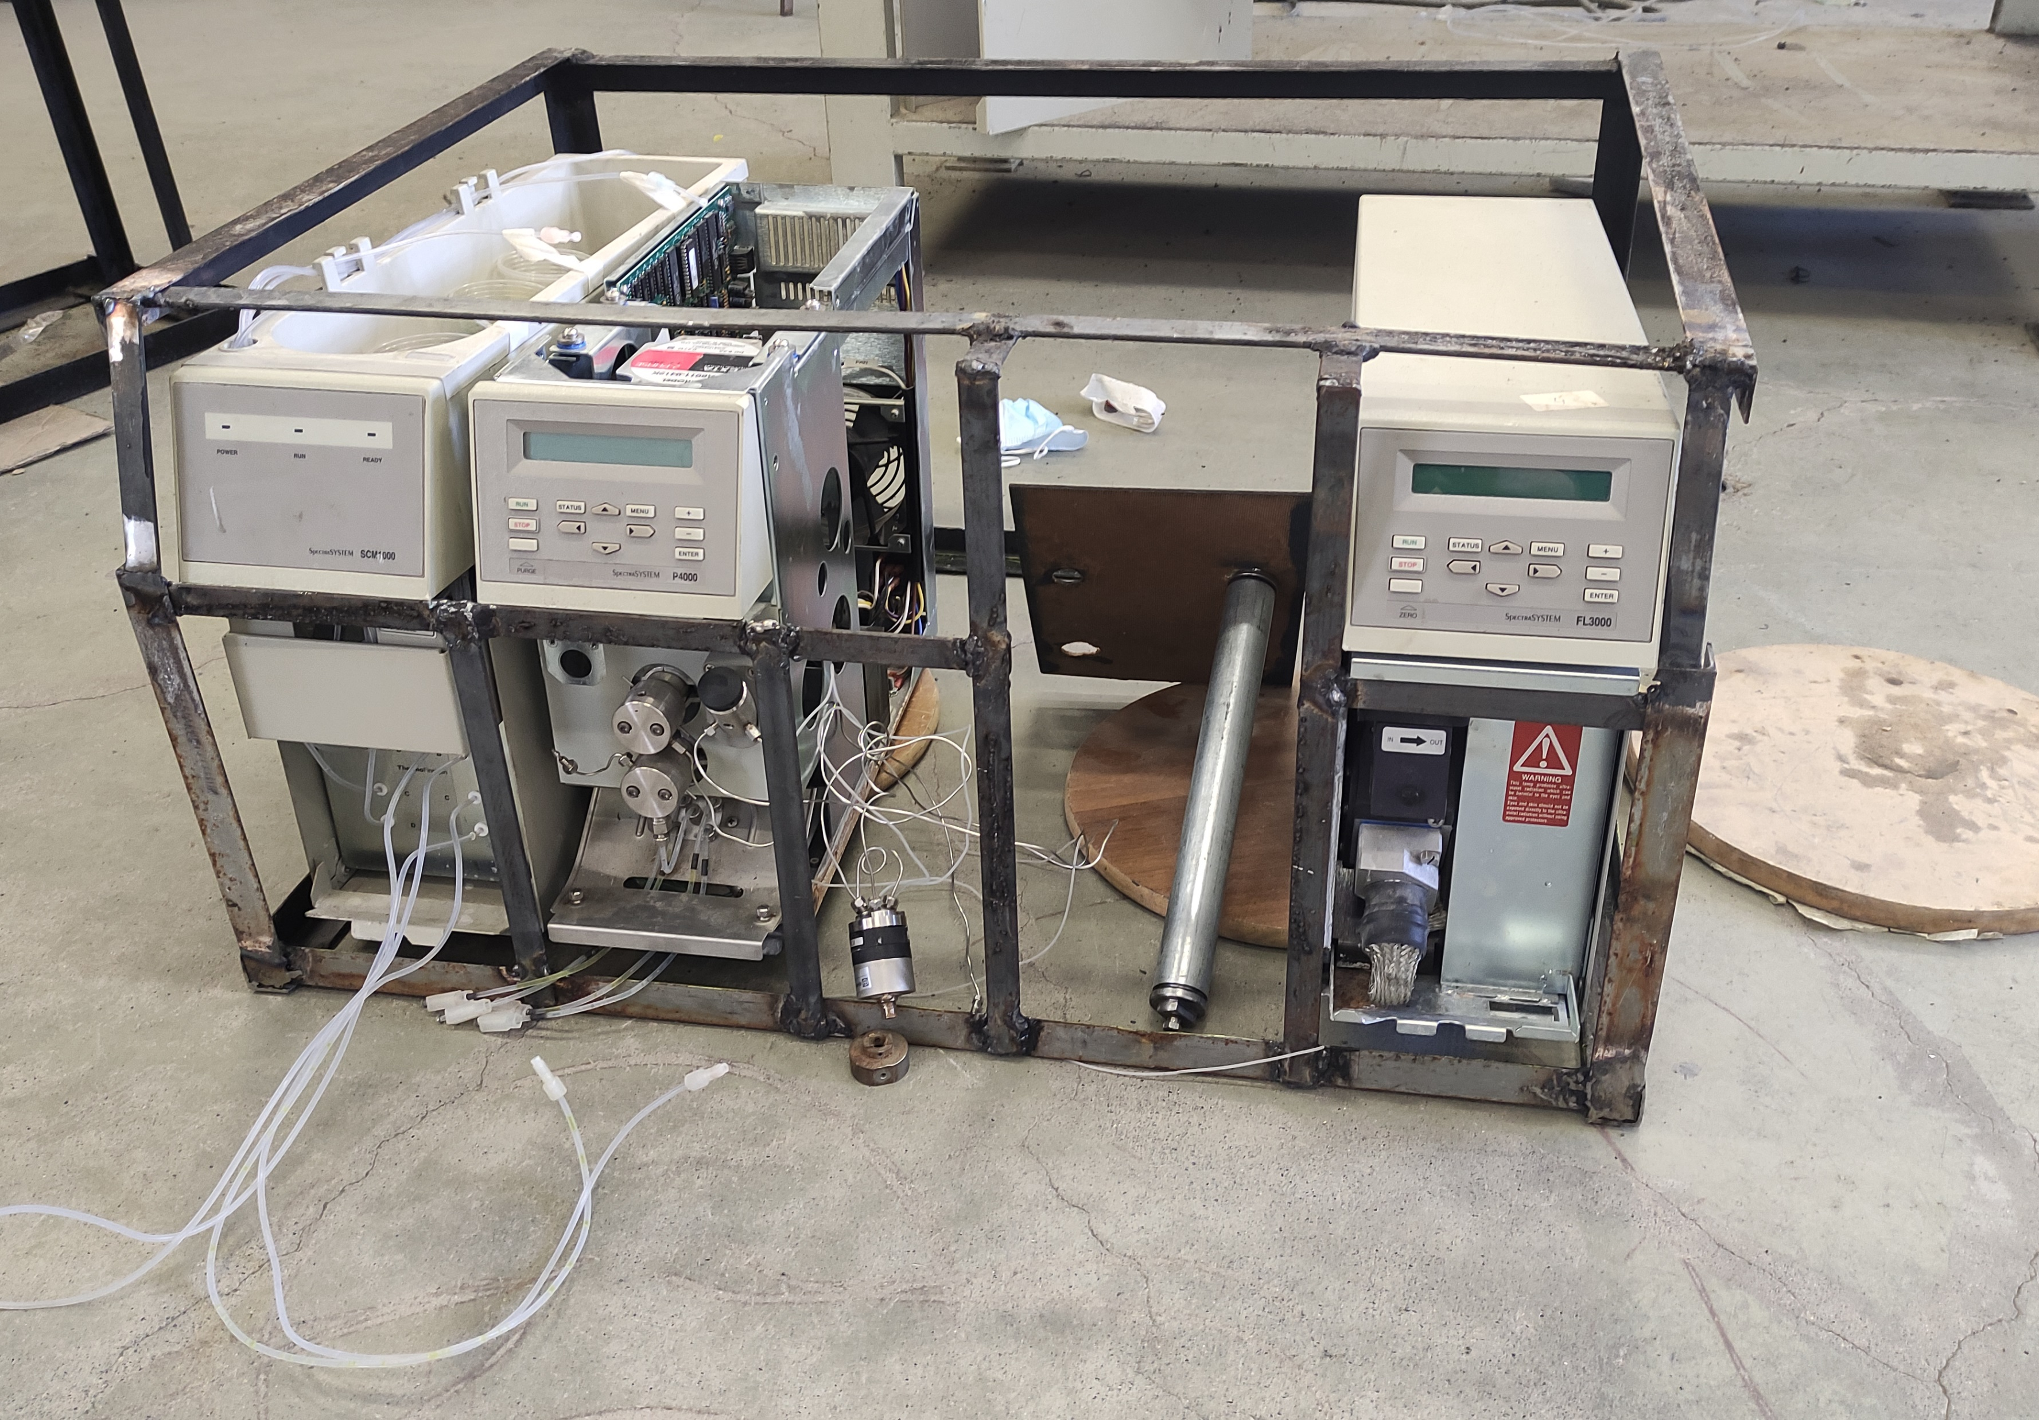
Design steps

Slide 11
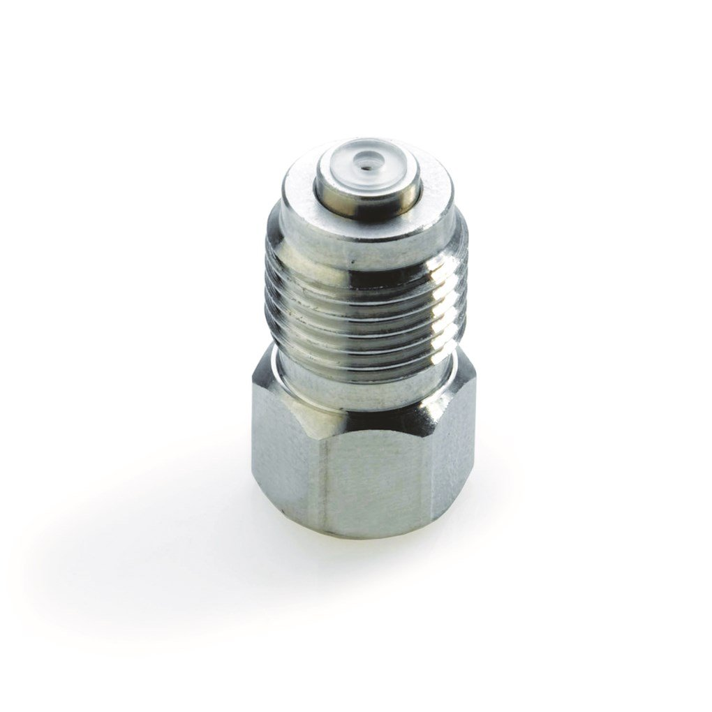
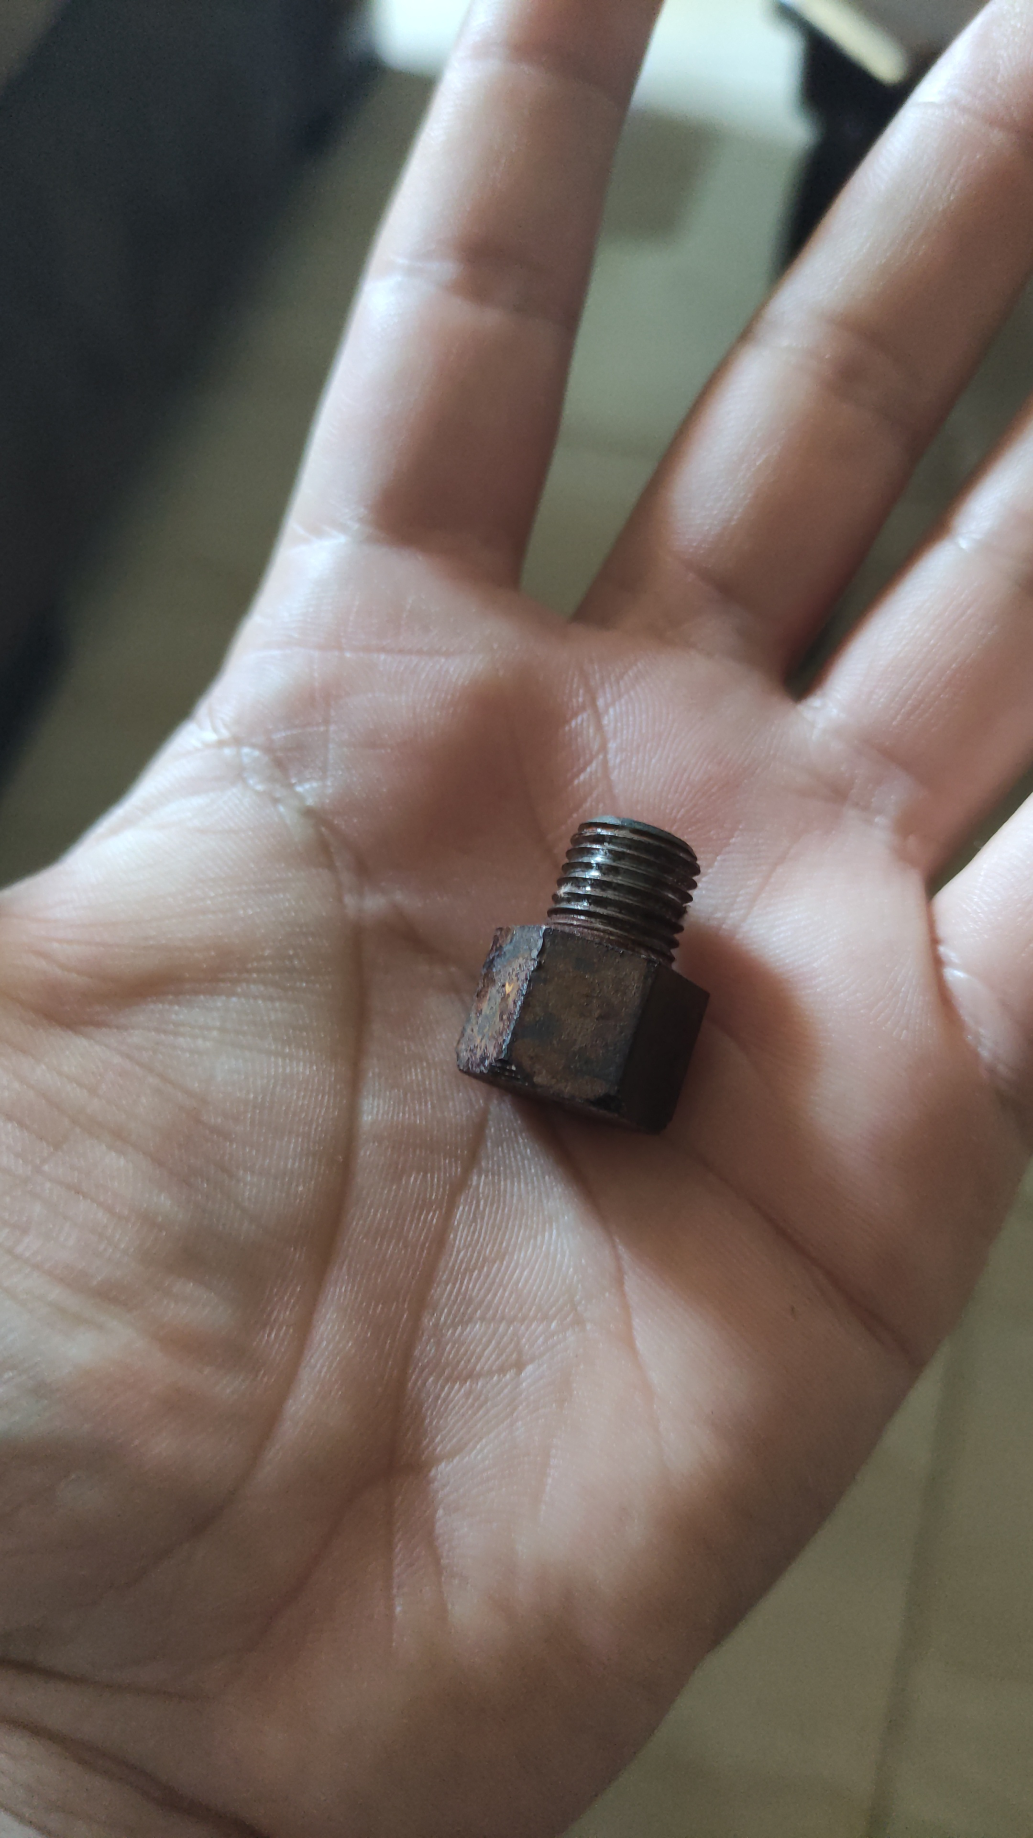
Design steps

Slide 12
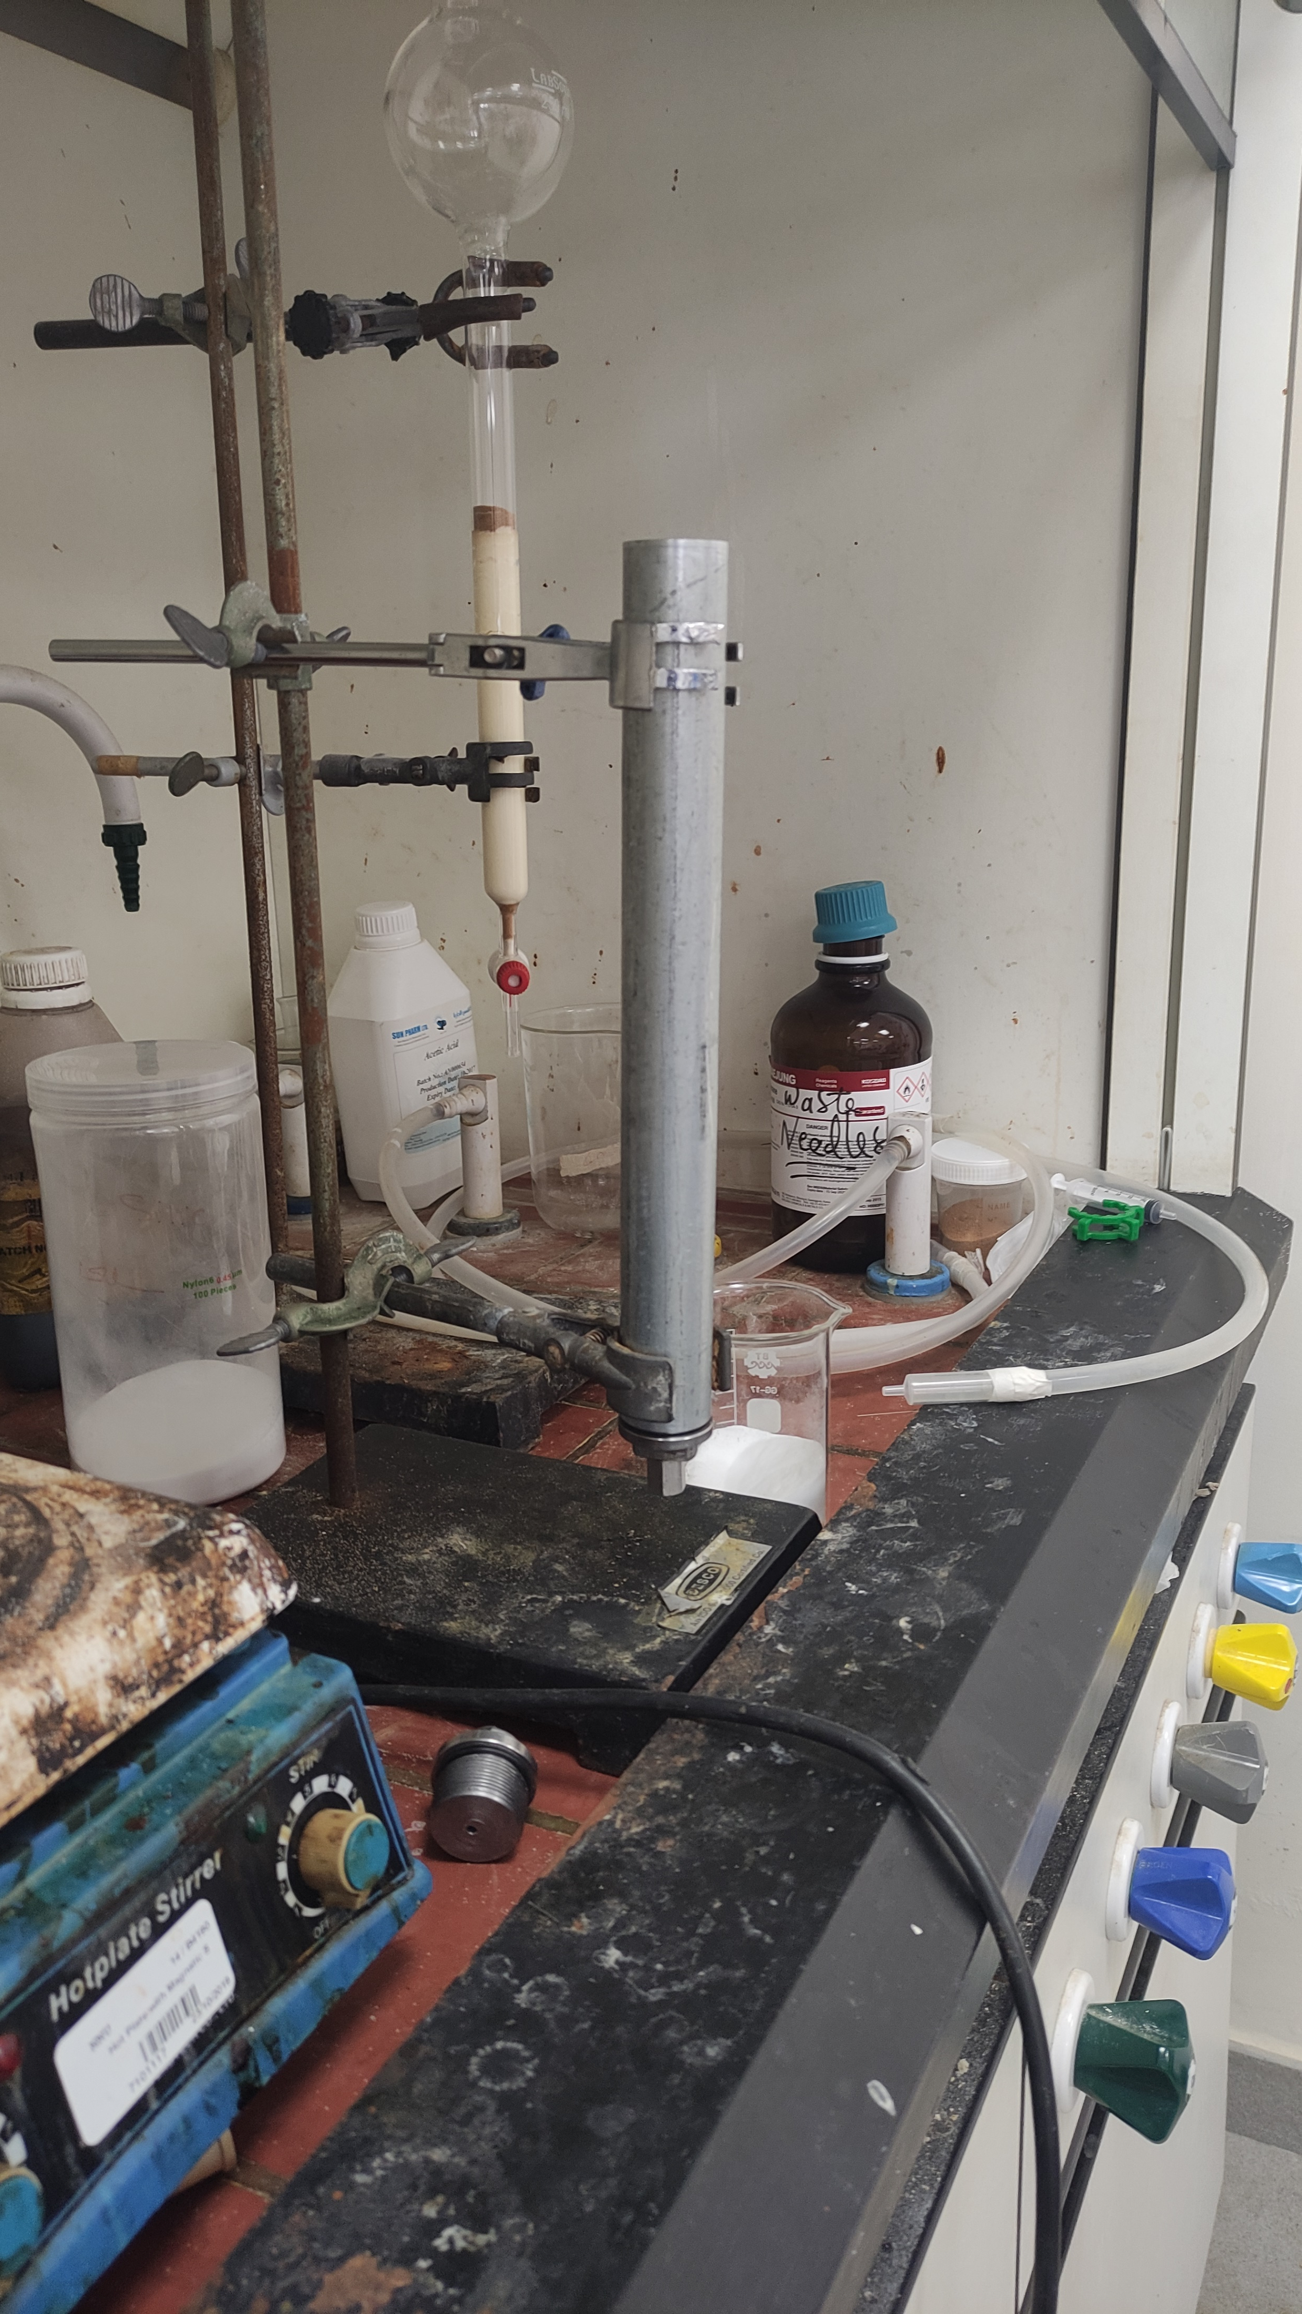
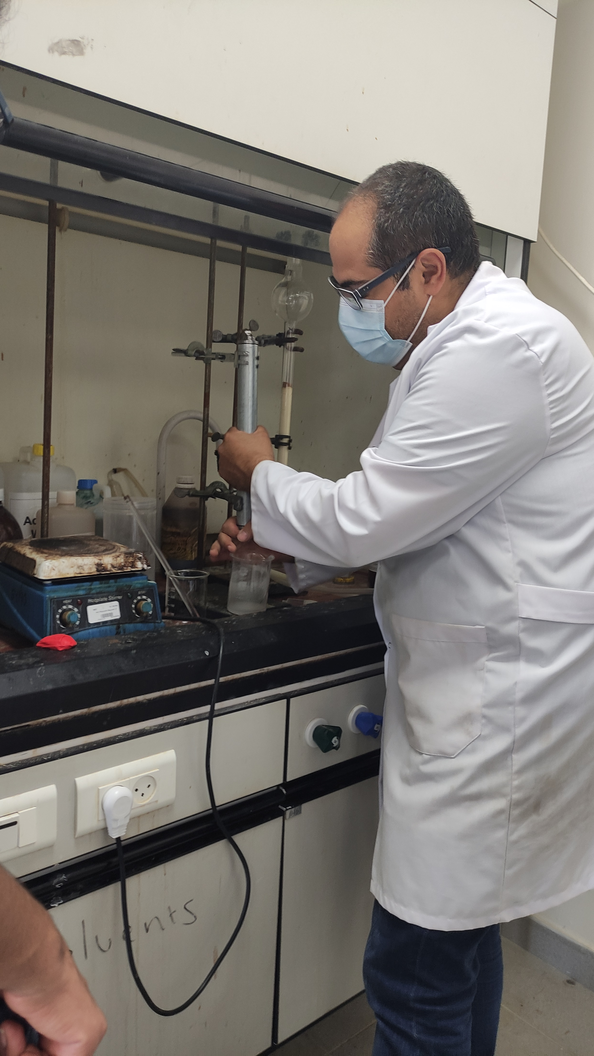
Design steps

Slide 13

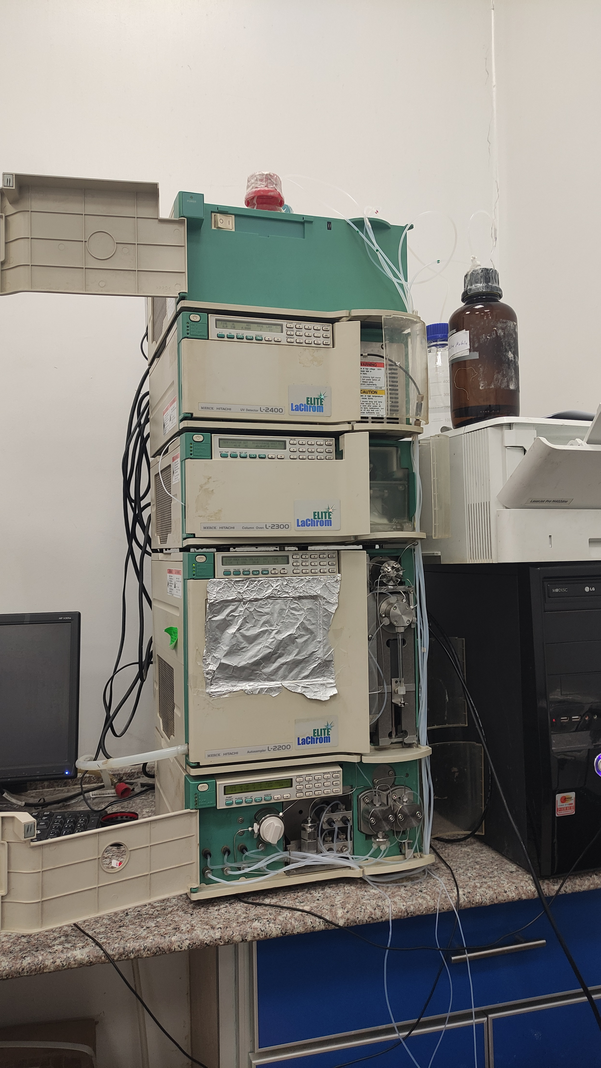

Design steps

Slide 14
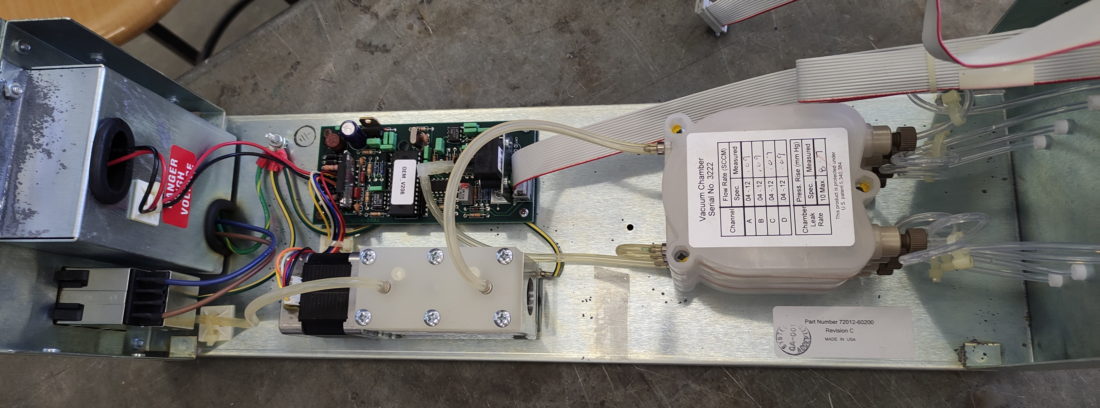
Device characteristics
Vacuum degasser

Slide 15
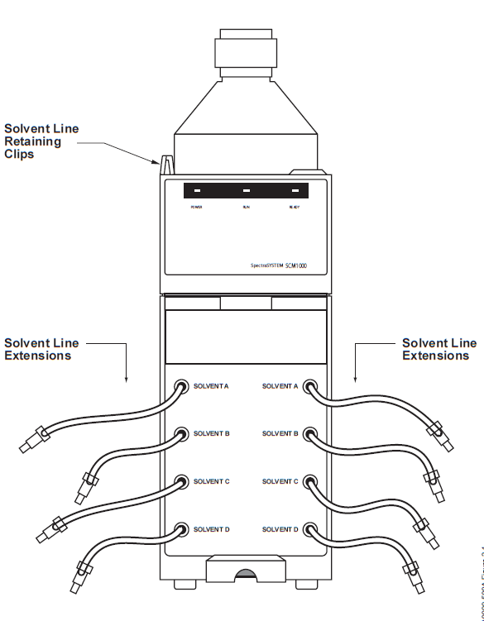
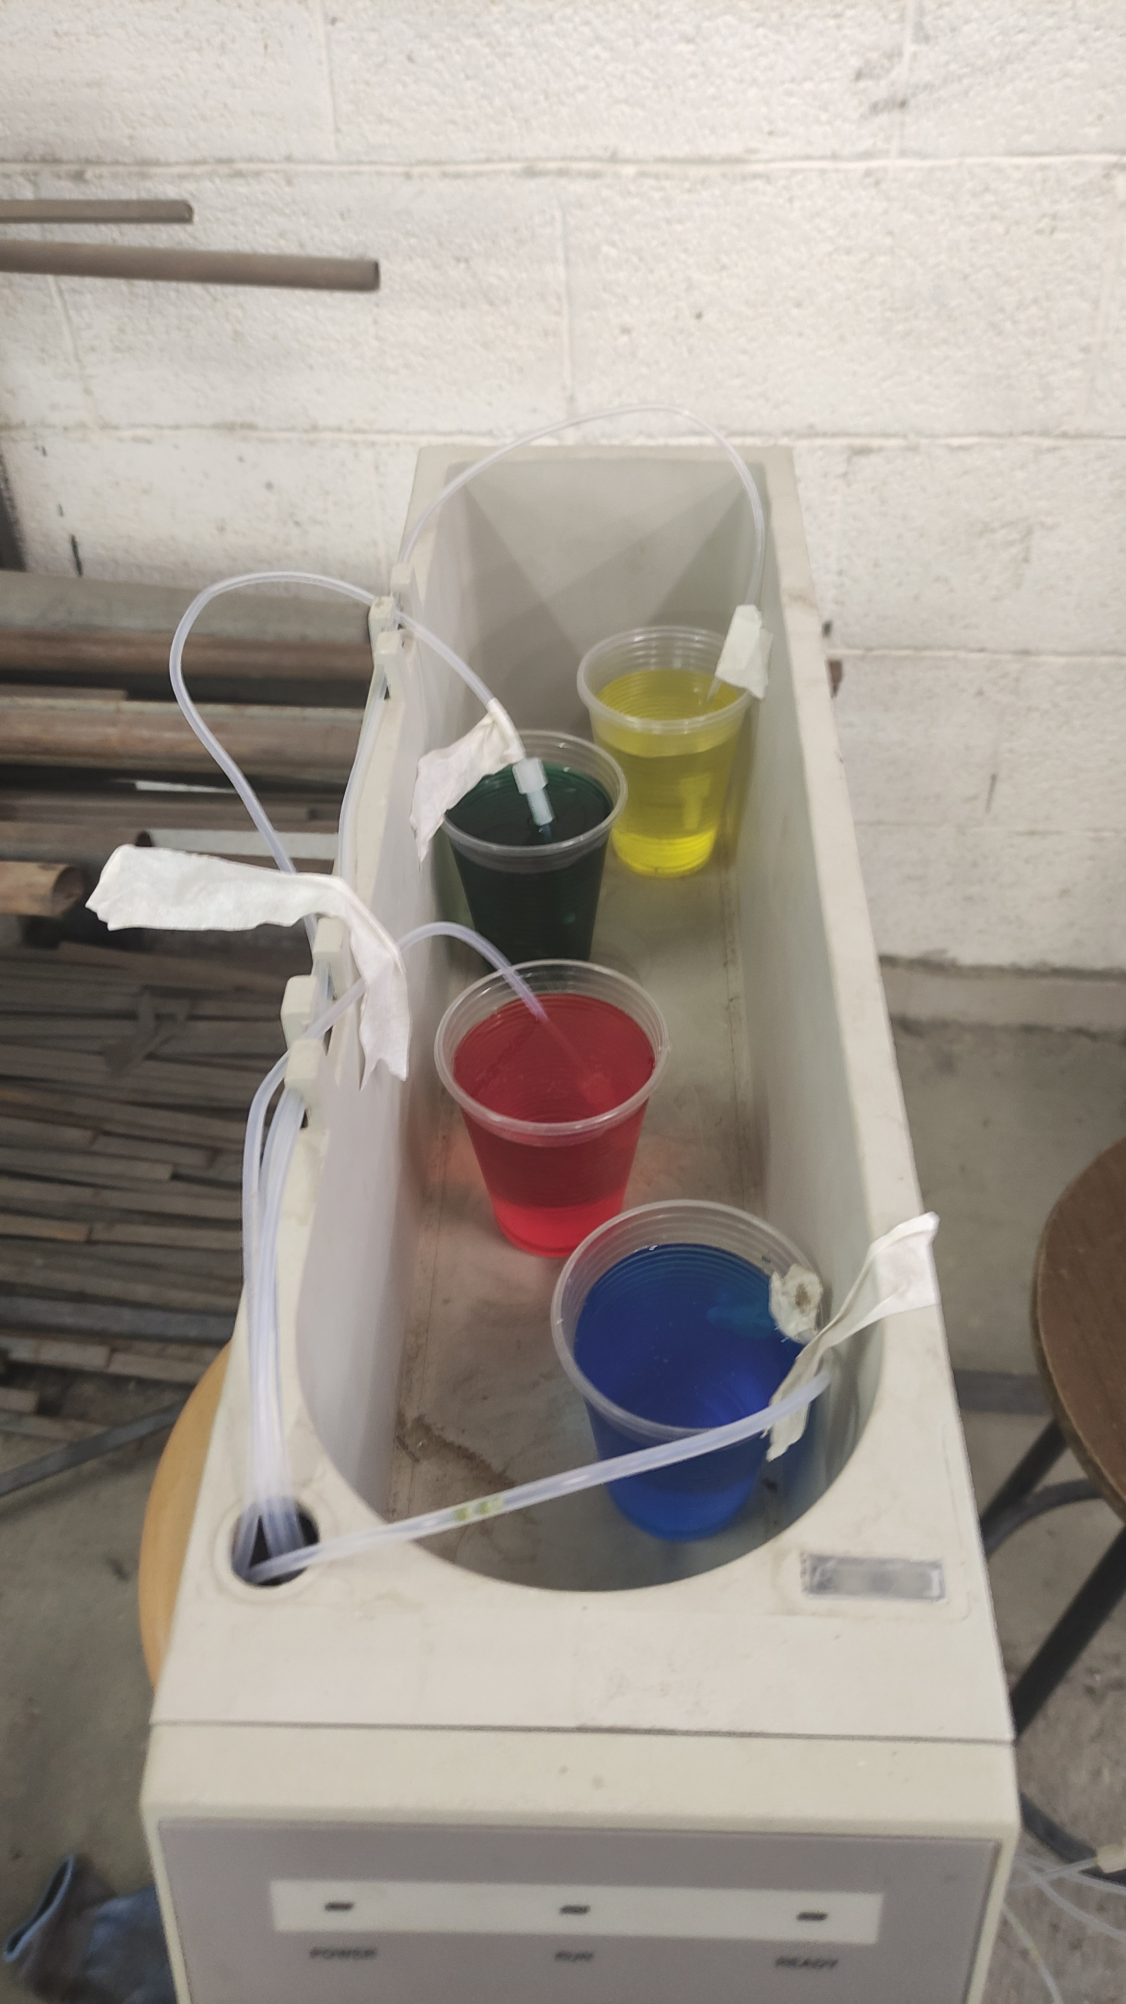


Slide 16
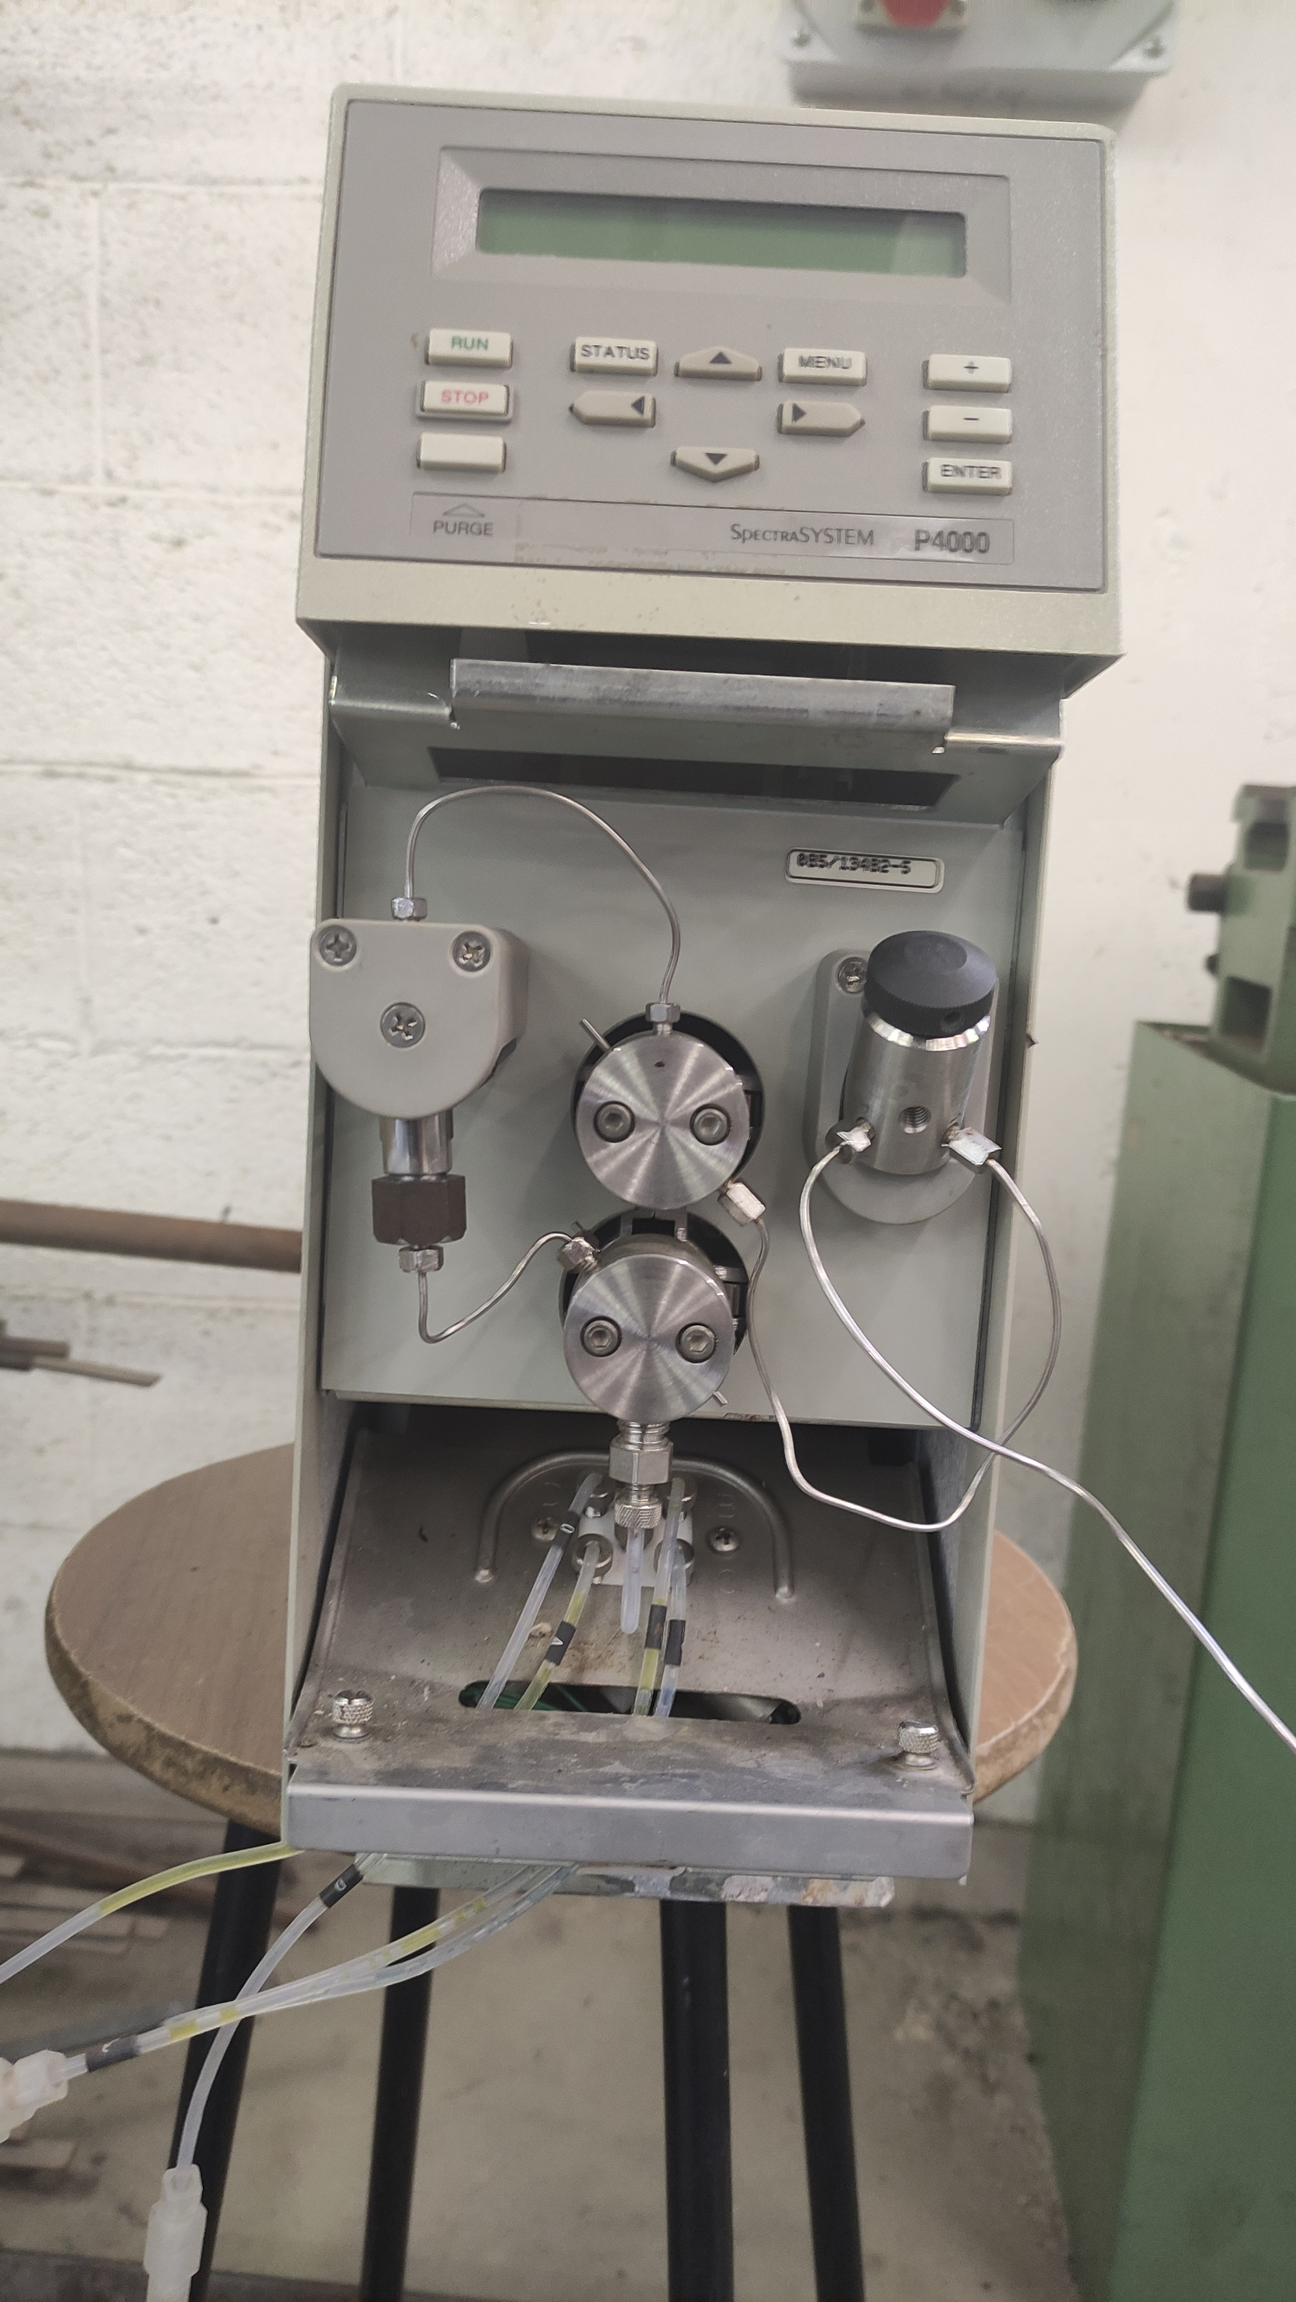
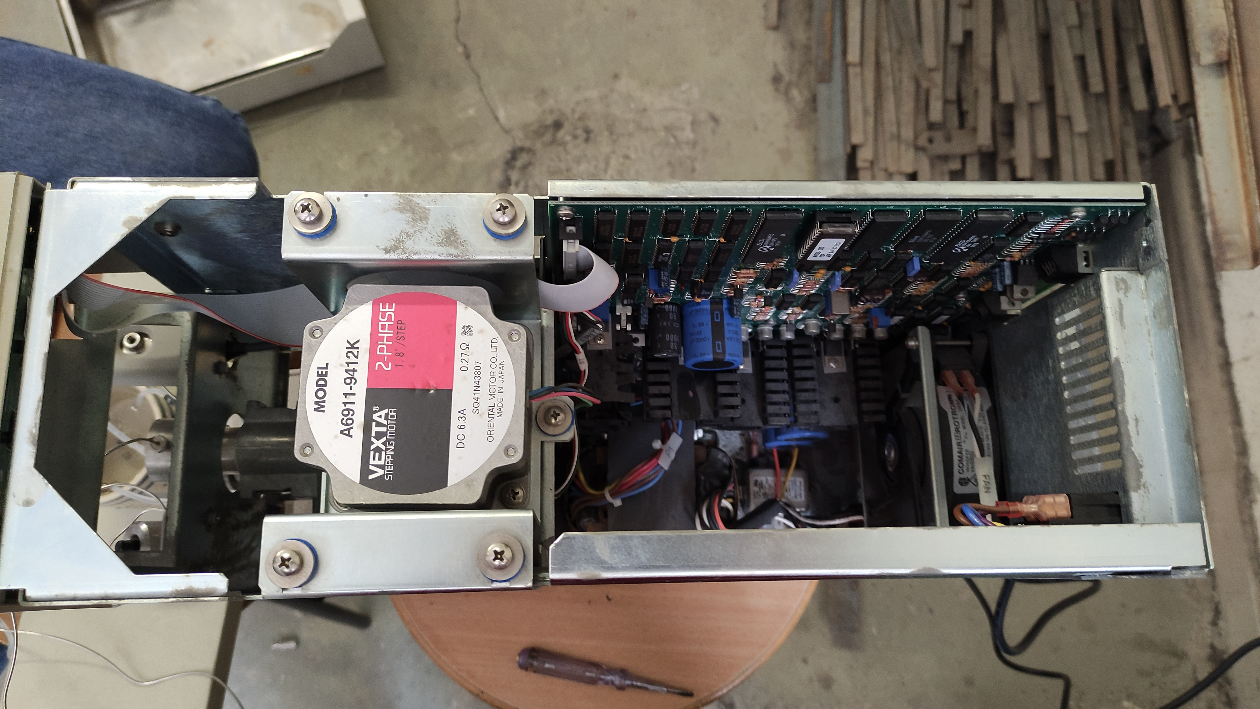
Device characteristics
Pump

Slide 17
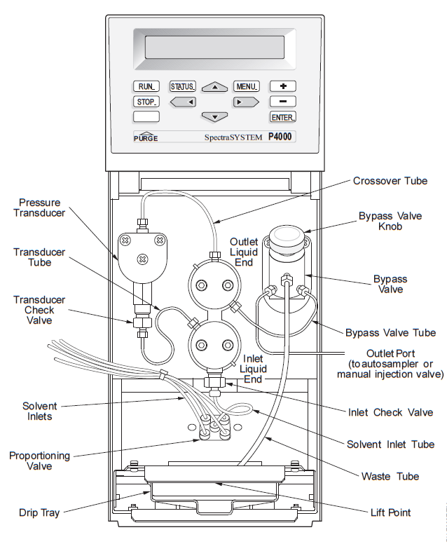

Slide 18
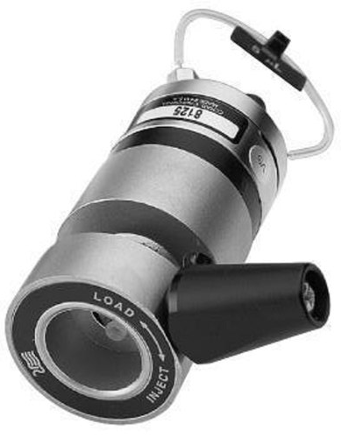
Device characteristics
Injector

Slide 19

Device characteristics
HPLC column

Slide 20

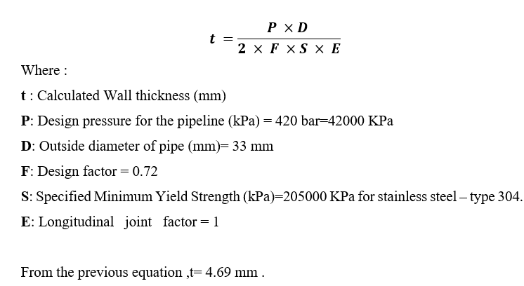
American Society of Mechanical Engineers (ASME)

Slide 21

Obstacles

Slide 22

Future works
Inlet check valve
Detector
HPLC software

Slide 23

Conclusions

Slide 24


