Slide 1
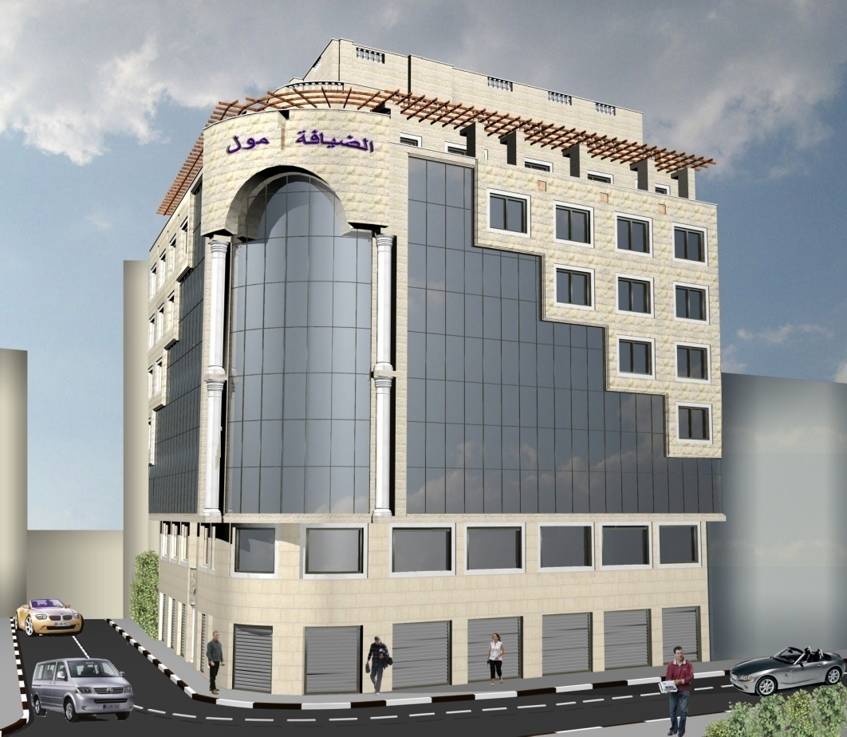
Structural Design for Host Mall

Slide 2
Outline
location & Description.
Material properties.
Slab system & load transfer.
Preliminary design & Load calculations.
3D sap model.
Static design.
Dynamic analysis.
Final design.

Slide 3
location & Description
The structure is a commercial building, It is located at Ramallah city.
with 12 stories.
The building has many functions:-
  parking lots
  shopping centers
  business offices.
Architectural plan.

Slide 4
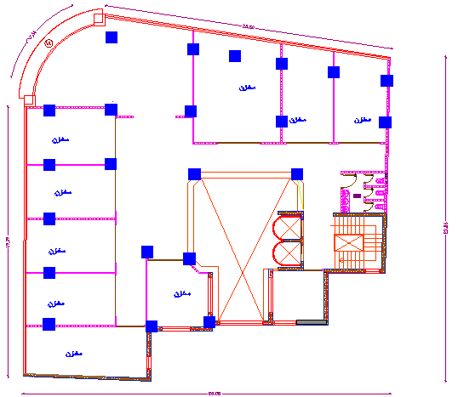

Slide 5
Material properties.
MATERIAL | TYPE | PROPERTIES
Reinforced con (beam &slab) | Structural | fc’ = 28MPa
Reinforced con (column) | Structural | fc’ = 35MPa
Reinforcement steel | Structural | fy = 420MPa
MATERIAL | TYPE | PROPERTIES
Sand | Non-structural | γ = 20
Plain concrete | Non-structural | γ = 24
Block | Non-structural | γ = 12
Stone | Non-structural | γ = 26
Tile | Non-structural | γ = 28
Mortar | Non-structural | γ = 23

Slide 6
Structural System
To design the building we choose
  Two way solid slab.
to achieve best condition in load transfer.

Slide 7
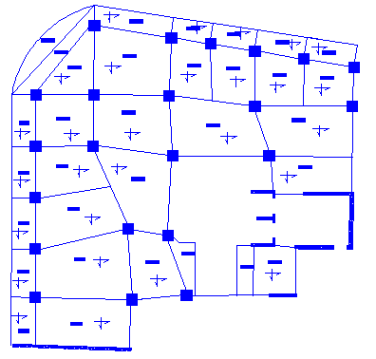
Load transfers

Slide 8
Preliminary design & Load calculations
min thickness for beam :
 | SS | OEC | TEC | CANT.
OWSS | L/20 | L/24 | L/28 | L/10
Beam Or OWRS | L/16 | L/18.5 | L/21 | L/8
We use beam 60 X 40 cm

Slide 9

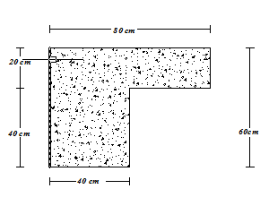
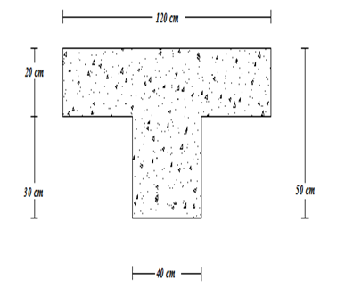
Slab thickness
h min
= 0.15m
we take h_{min}= 0.2 m

Slide 10
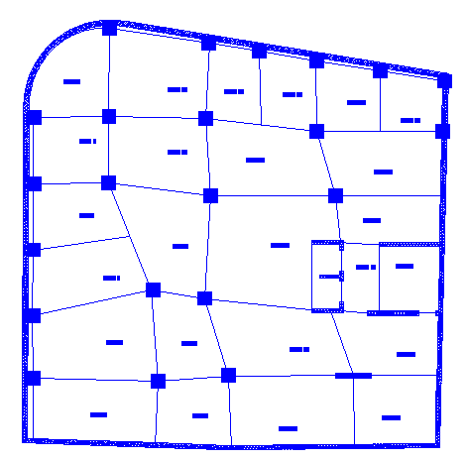

Slide 11


To check if the thickness is sufficient or not
→ ∑αf_{m}
αf_{m} = =
= 3.61
check it for shear :
Maximum ultimate shear on slab
V_{u}=W (Ln/2 – d)
Vu =60 KN
Shear capacity for slab:
ɸVc= 1/6 x ɸ x x bw x d /1000
ɸVc =105.8 KN
So→ the thickness of slab is ok.

Slide 12
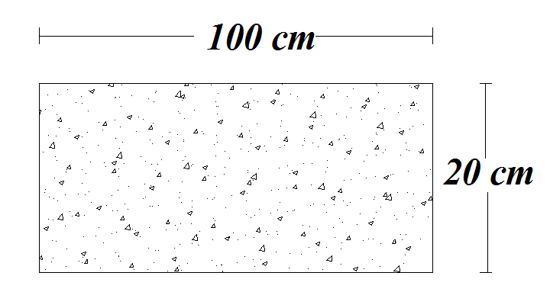
Load calculations
Superimposed dead load = 0.025 x28 + 0.025 x23 +0.1 x20 = 3.3KN/m²
The own weight of slab = 25x0.2x1 = 5 KN/m²

Slide 13
Partitions own weight = 1 KN/m²
Masonry wall own weight = 3.5 (0.1 x12 + 0.11 x24 +0.07x 26 +0.02 x23)
= 21KN/m run
Fall sealing = 0.2KN/m²
Live load = 4.79KN/m²

Slide 14
Load combination
  For ultimate load we use :-
U = 1.4 D
U = 1.2 D + 1.6 L
U = 1.2 D + 1.0 E + 1.0 L
U = 0.9 D + 1.0 E

Slide 15
SAP MODEL VERIFICATIONS :-
Compatibility
Compatibility is ok as the model move as a one unit.
Equilibrium
  TOTAL Building own weight by hand = 4637.92 KN
  TOTAL Building own weight from sap = 4674.492 KN KN
Error = (4637.92 – 4674.49)/4637.92 =0.788 %....ACCEPTED

Slide 16


Stress-Strain relationship
Distributed load on the beam = 10.951KN/m
M= WL²/ 8 =11.3x6.25²/8 =53.473KN.m
The moment from SAP
Maximum Negative Moment From SAP
Maximum Positive Moment From SAP

Slide 17

The moment from SAP = (44.3958/2)+29.0053
=51.203KN.m
Error calculation
Error =
= 4.24% < 5% OK

Slide 18

Dynamic analysis
Structure period
We use two method to estimate the period :-
  T=
  = 1.20602 sec
  T=
  = 1.658741 sec
  T_{sap} = 1.31016 sec

Slide 19
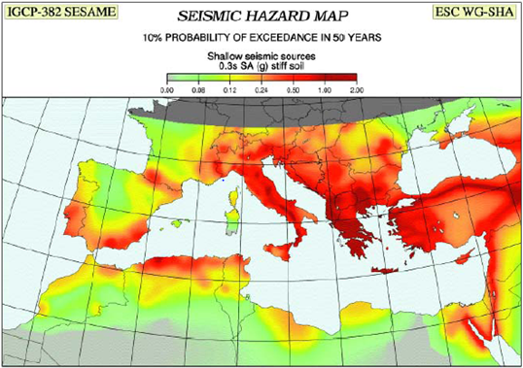
Seismic Hazard Map to Find Ss.

Slide 20
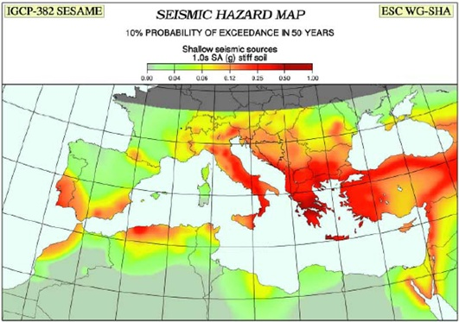
Seismic Hazard Map to Find S1

Slide 21
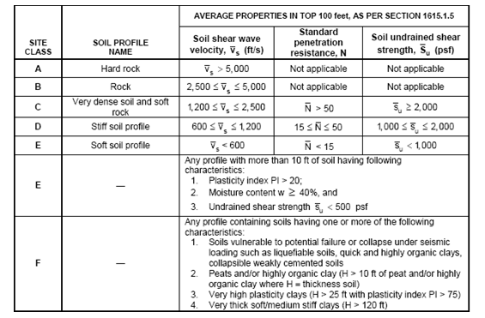
Site Soil type

Slide 22
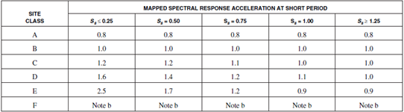
Value of Site coefficient F_{a}

Slide 23
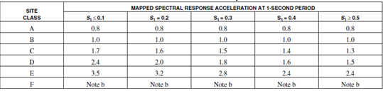
Value of Site coefficient Fv

Slide 24
The Factors Used in the Analysis:
R=5.5
I = 1.00
Ss= 0.24
S1= 0.18
Site classification: B (Rock).
Fv= 1
Fa= 1
S_{Ms}= F_{a}×S_{s}= 0.24
S_{M1} = F_{v}×S₁ = 0.18
SDs= 2/3(S_{MS)}= 0.16
SD1= 2/3(S_{M1)}= 0.12
S_{Ds}/2.5= 0.064

Slide 25
Where:
Ss: The mapped spectral accelerations for short periods
S1: The mapped spectral accelerations for 1-second periods
Fa: Site coefficient for Ss
Fv: Site coefficient S1
SMS and SM1: Maximum spectral response acceleration
SDS and SD1: Design spectral response acceleration
R : Response modification factor
I : occupancy importance factor
CT and x: factors for calculating the fundamental period
Ta: Approximate the fundamental period
Cs: Seismic response coefficient

Slide 26
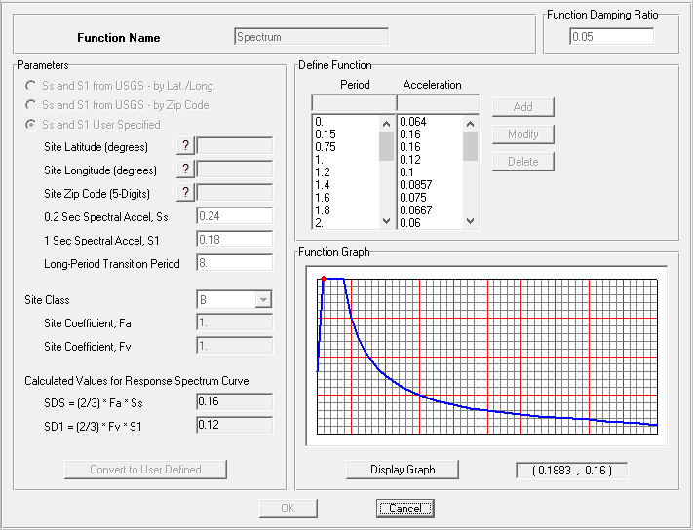

Slide 27
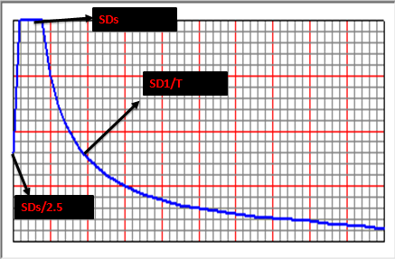
Spectral Response acceleration curve.

Slide 28
For X-direction:
  The scale factor for U₁= = 1.78.
  The scale factor for U₂= X 30%= 0.535.
  The result base shear in X direction=1419.973KN.
For Y-direction:
  The scale factor for U₂= = 1.78.
  The scale factor for U₁= X 30%= 0.535.

Slide 29

Total Reactions for Response Spectral from SAP 2000

Slide 30
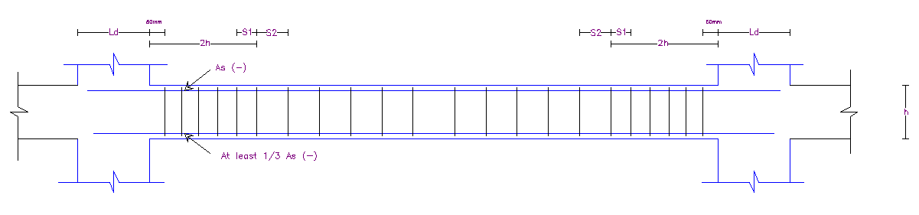

Slide 31
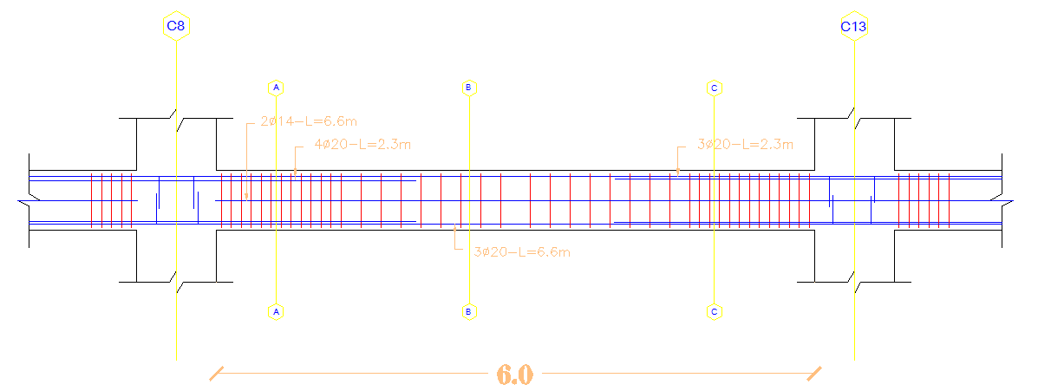
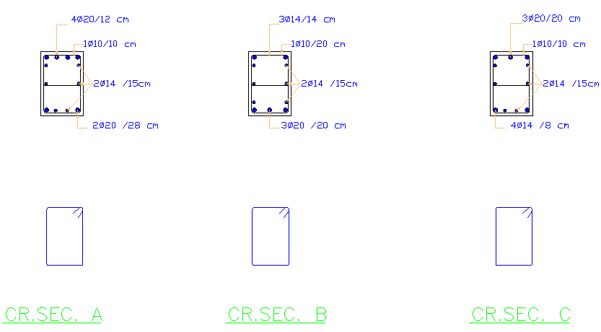

Slide 32
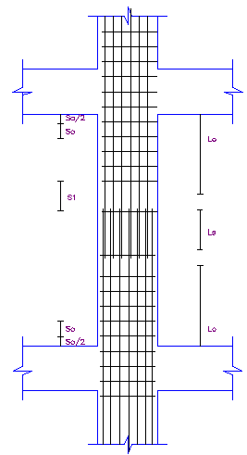

Slide 33
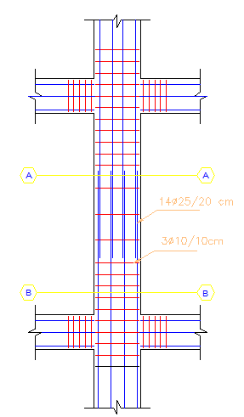
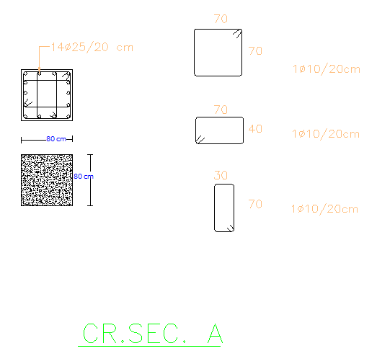

Slide 34
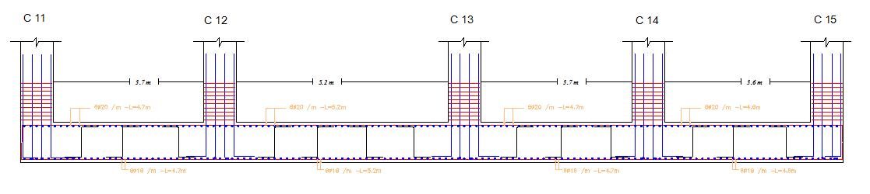
Strip Section in MAT Foundation Y dir

Slide 35
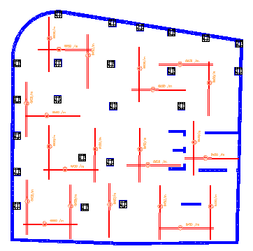

Slide 36
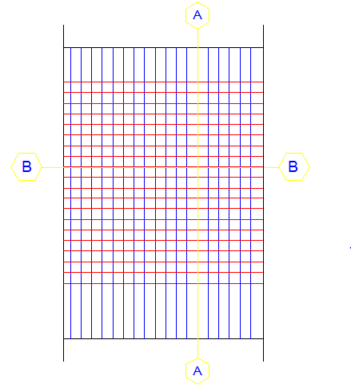
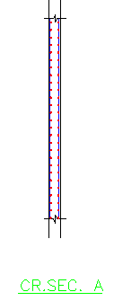
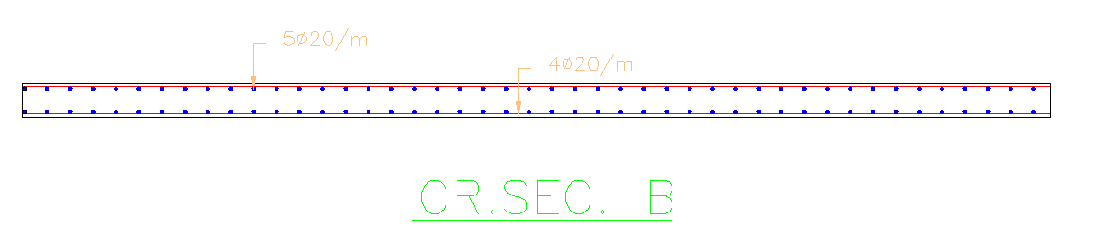

Slide 37
