Slide 1
Home Robot Vacuum Cleaner
Prepared by:
Laith Abukhader
Sudqi Jawabreh

Slide 2
Outline
-Motivation
-Technical choices
-Implementation
-Constraints
-Demo
-Future work

Slide 3
Motivation
-The tedious process of cleaning
-For elderlies and disabled.

Slide 4
Hardware options
-Controllers -Hbridge
-Sensor -Motors
-Air Blower -Batteries
-Step-Down

Slide 5
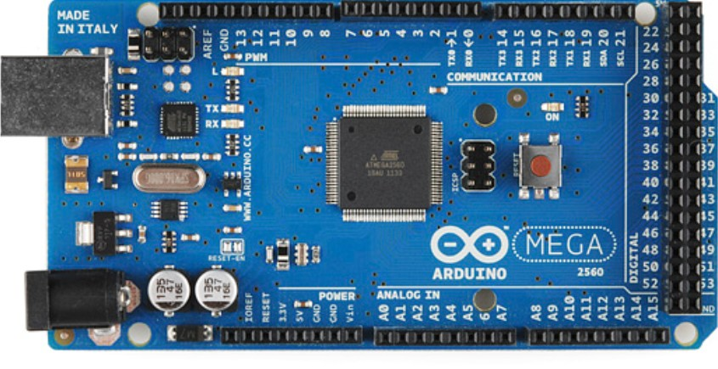
Controllers
-Arduino MEGA

Slide 6
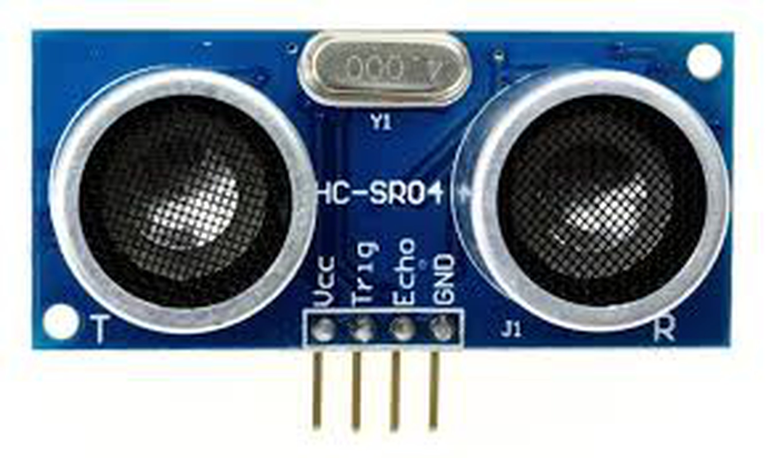
Sensors
-Ultrasonic Sensors
-range 2-200 cm
- angle 20 degree

Slide 7
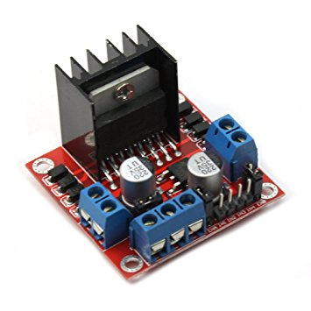
H-bridge
Motor Drive Controller Board Module
L298N Dual H Bridge

Slide 8
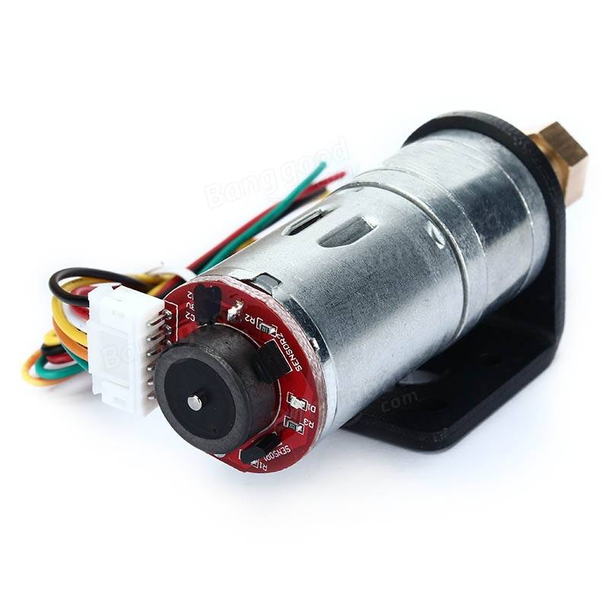
Motors
-DC motor with Gearbox
- 6v 210rpm
-quadrature hall effect encoder
-(34:1 Ratio)

Slide 9
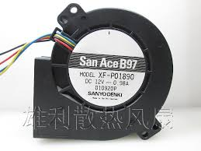
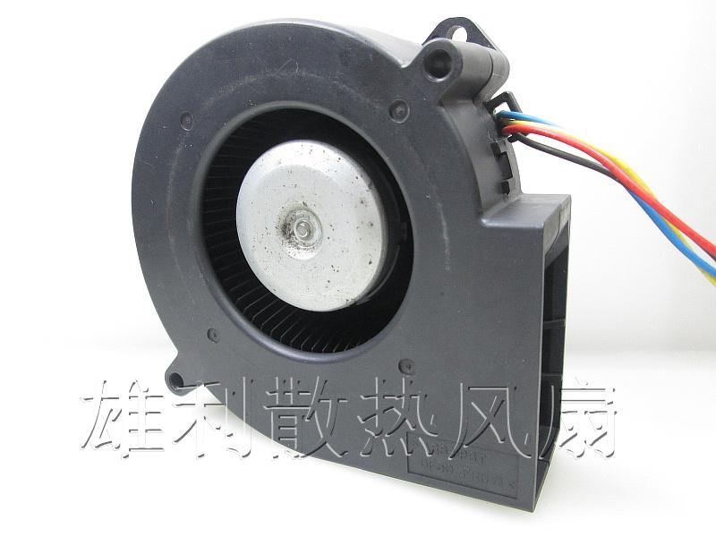
Air Blower
-SanAceB97
-High speed Air Blower (12V DC-- 3.4A)/1.4 cmh

Slide 10
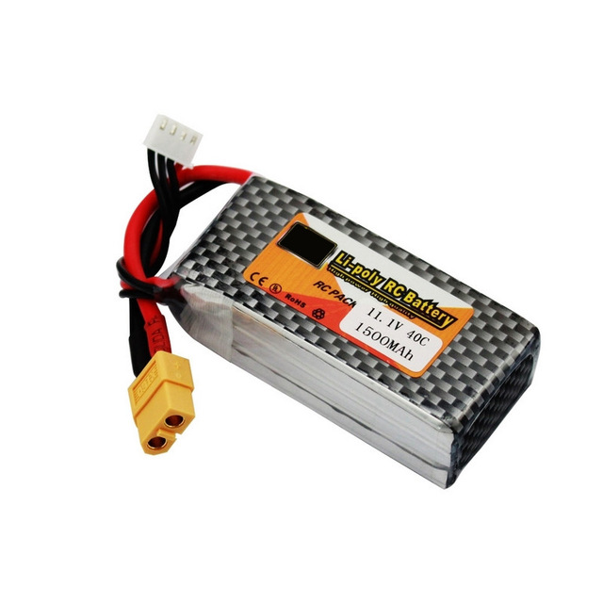
Batteries
-3 Cell LiPo Battery
-1500mAh
-11.1V

Slide 11
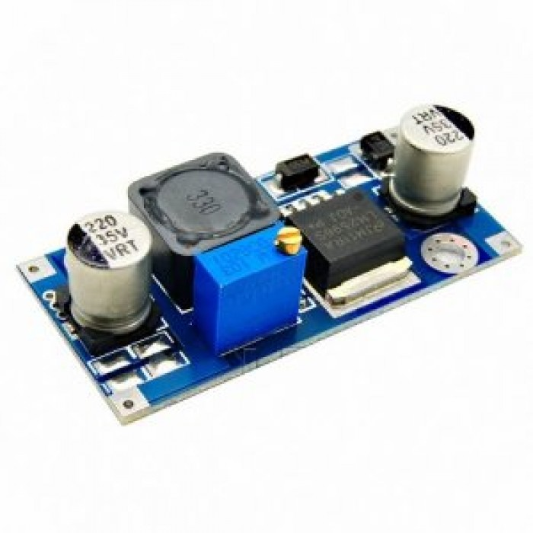
Step-Down
LM2596 2A Adjustable Step-Down
-2 A

Slide 12
Air Flow and 3D model

Slide 13
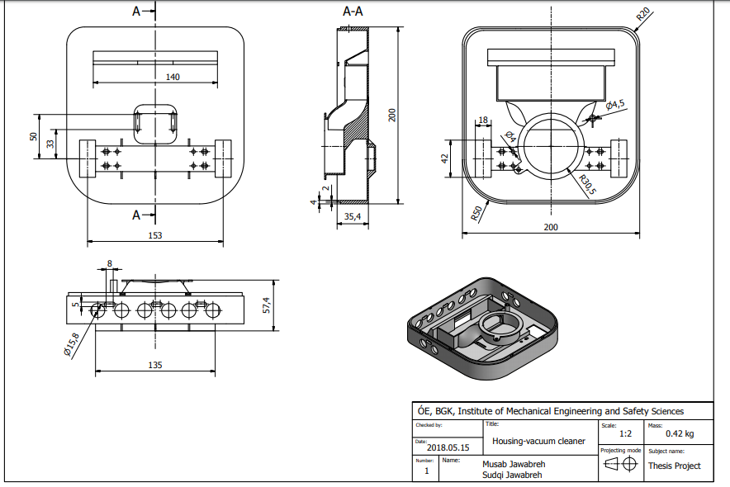

Slide 14
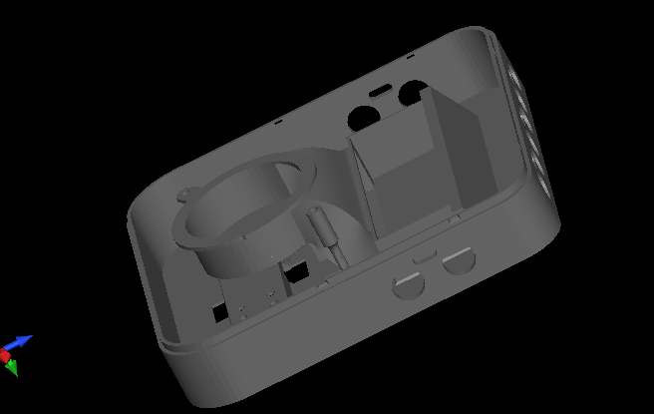

Slide 15
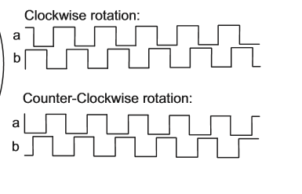
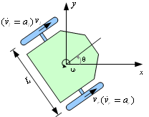
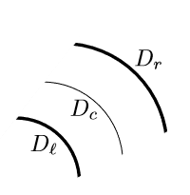
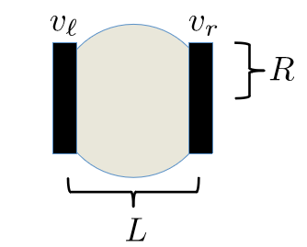
Motion
-Algorithms
-ZigZag

Slide 16
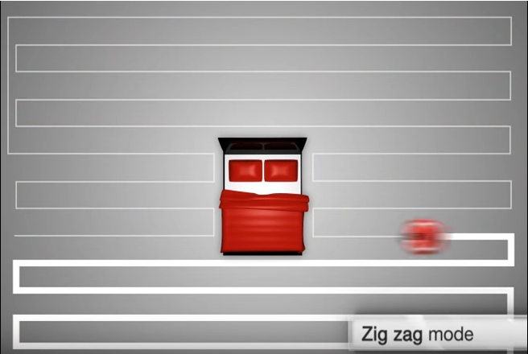

Slide 17
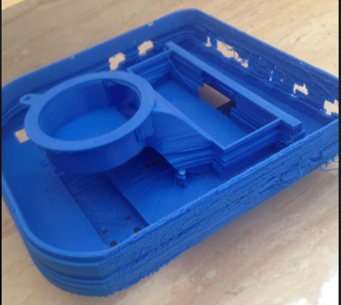
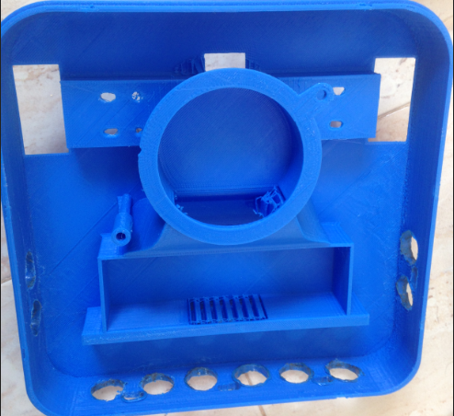
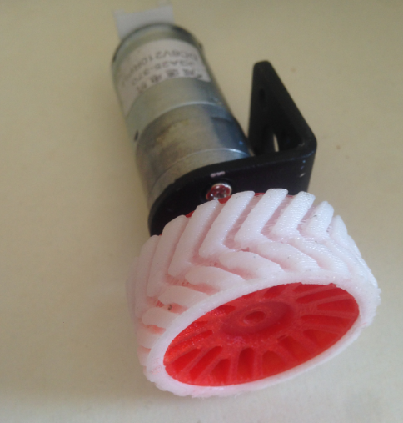
Constrains
Noisy sensors.
Accumulated error in state.
Model Spacing.
Drifting.
Unavailable parts so we 3D-printed them.
The cost of the printing process.

Slide 18
Demo

Slide 19
Future work
Support for different surfaces
Self-charging
Mapping and Localization

Slide 20
THANKS!

