Slide 1

Design For The English School
An-Najah National University
Faculty of Engineering
Building Engineering Department
Prepared By:
Ahmad Daraghmeh.
Mohammad Shurrab.
1
Supervisor: Dr. Ahmad Alhaj Saleh

Slide 2
Contents
Introduction.
Site Analysis.
Architectural Design.
Environmental Design.
Structural Design.
Electrical Design.
PV-System Design.
Mechanical Design.
Quantity Survey and Cost.
2

Slide 3
Site Analysis

Slide 4
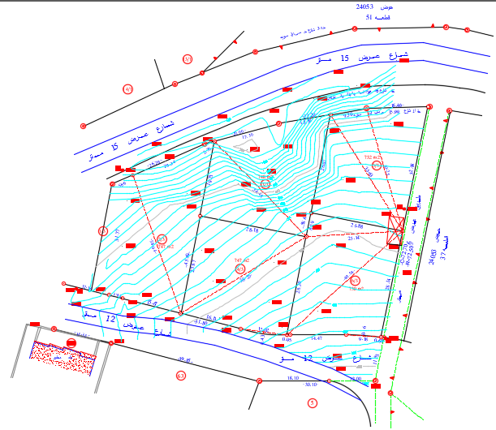
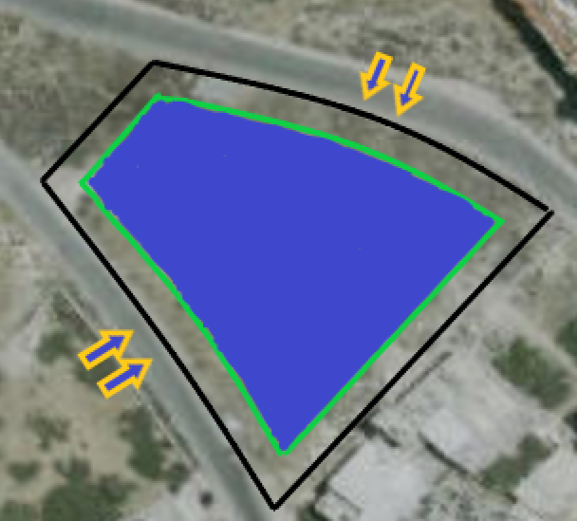
Site analysis
The Site is located in Al-Ma’jeen in Nablus City, its rise about 486 m above sea level, The total area of site is 3704 m²

Slide 5
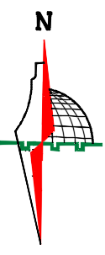

Slide 6
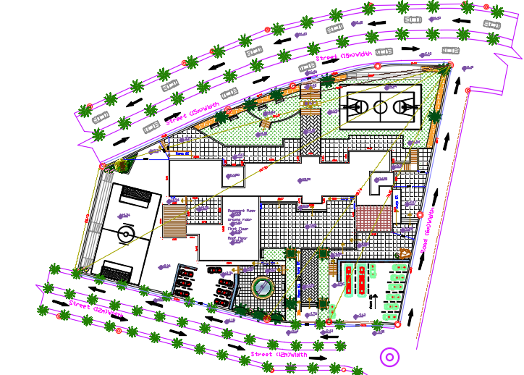
Building Area = 2430 m²
Number | Floor name | Floor area (m²)
1 | Basement floor | 956
2 | Ground floor | 950
3 | First floor | 524

Slide 7
Architectural Design

Slide 8
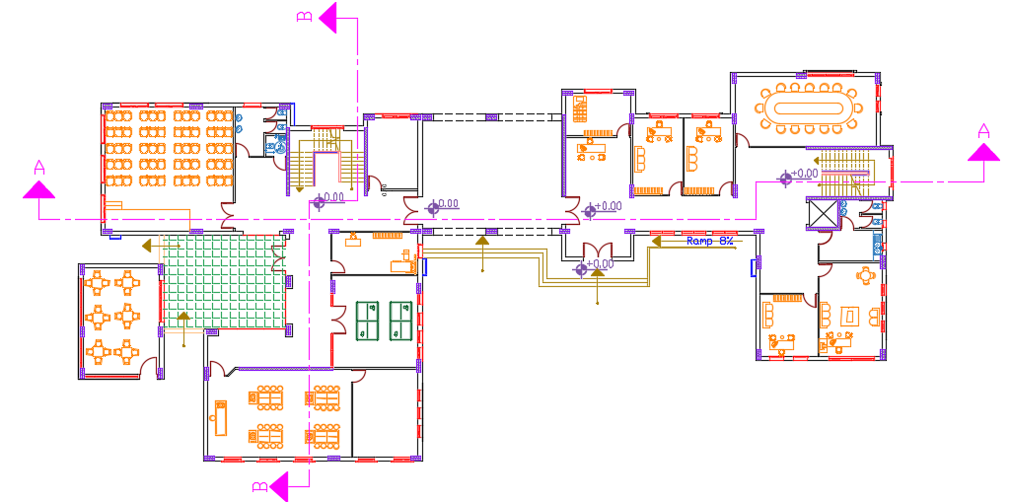
Basement Floor

Slide 9
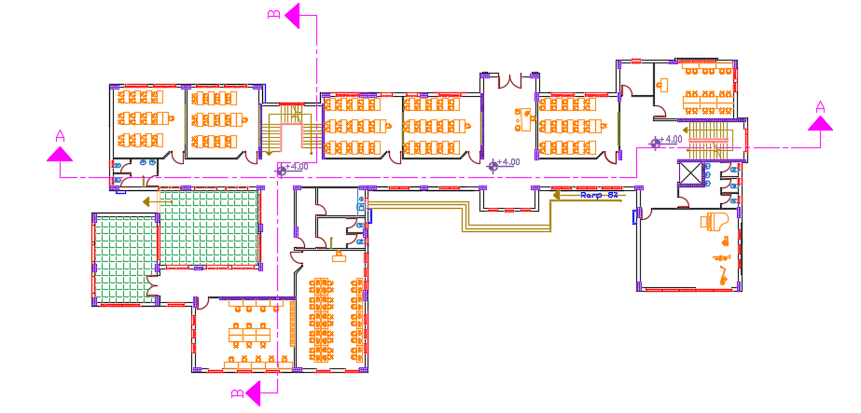
Ground Floor

Slide 10
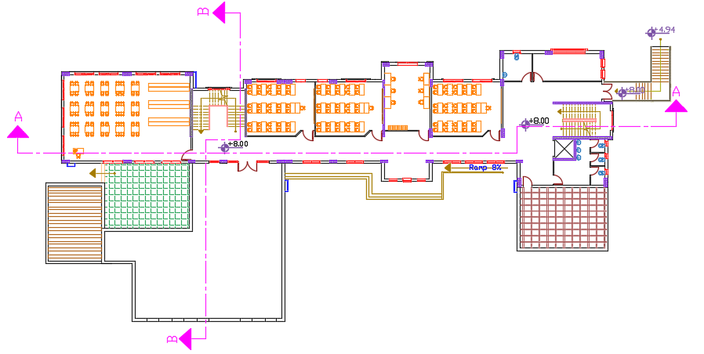
First Floor

Slide 11
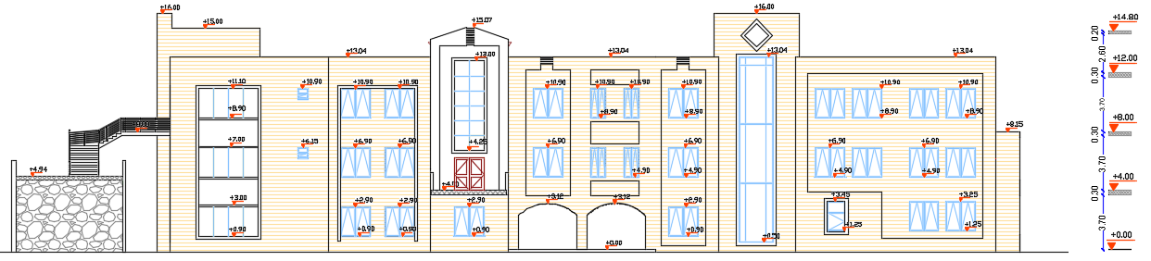
North Elevation

Slide 12
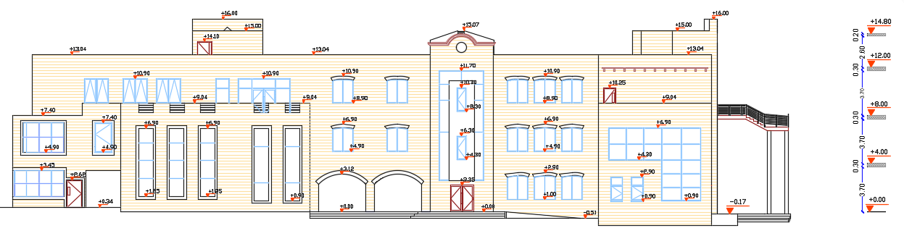
South Elevation

Slide 13
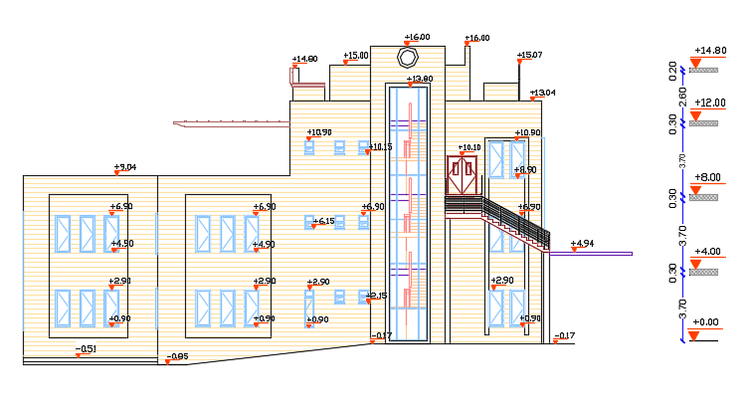
East Elevation

Slide 14
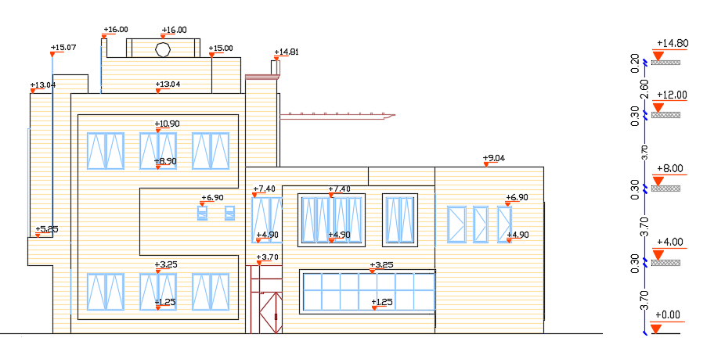
West Elevation

Slide 15
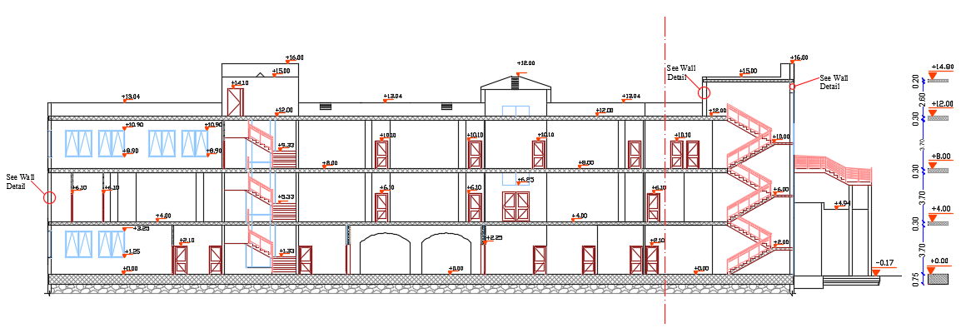
Section A-A

Slide 16
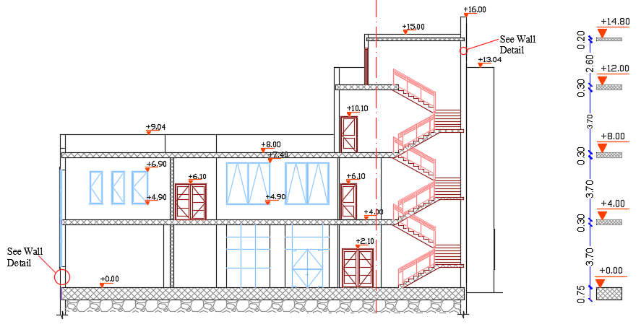
Section B-B

Slide 17
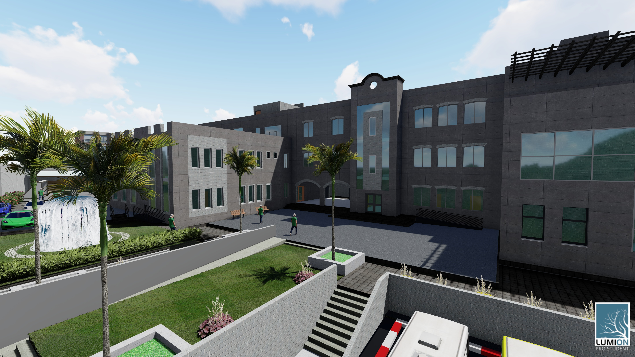
3D Model

Slide 18
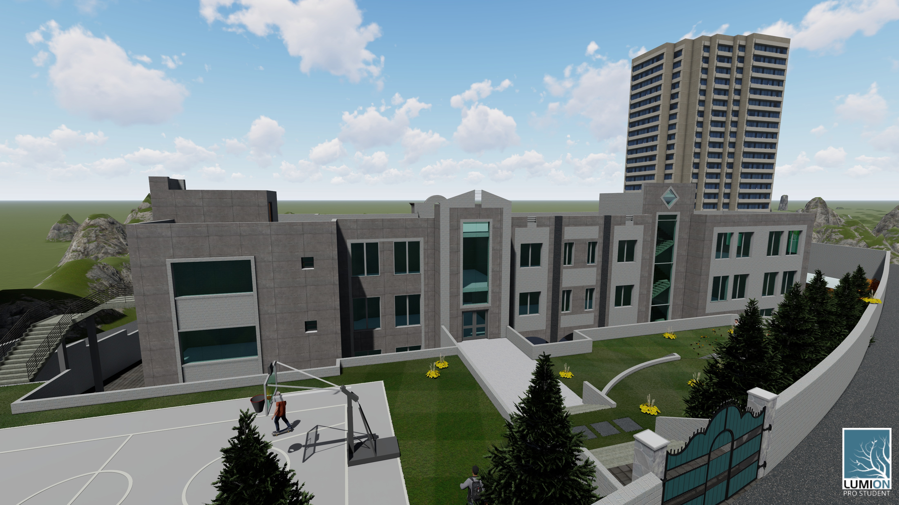
3D Model

Slide 19
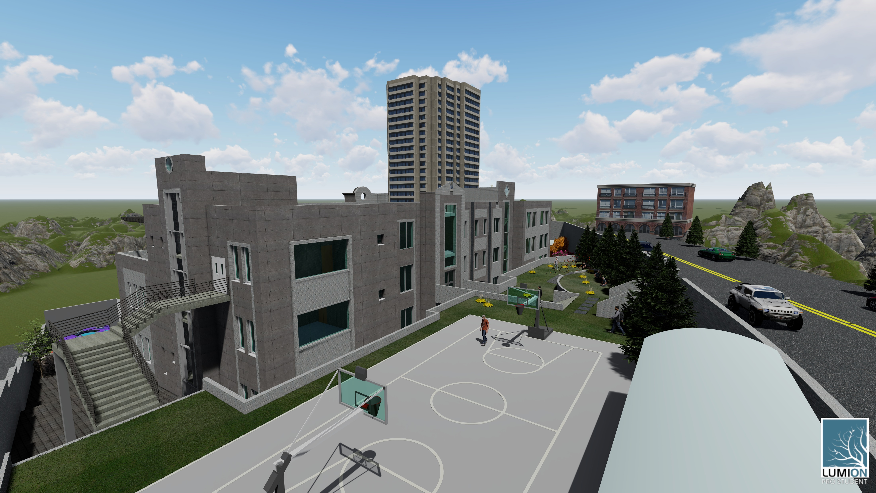
3D Model

Slide 20
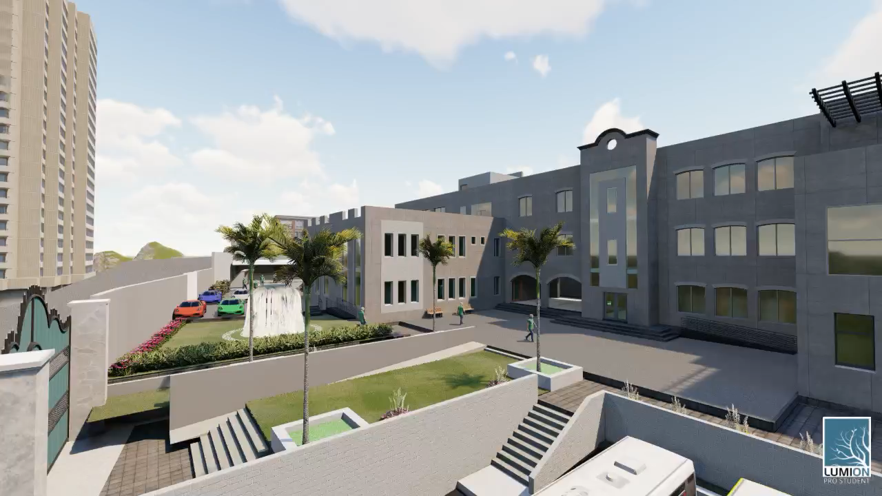
3D Model

Slide 21
Environmental Design.

Slide 22
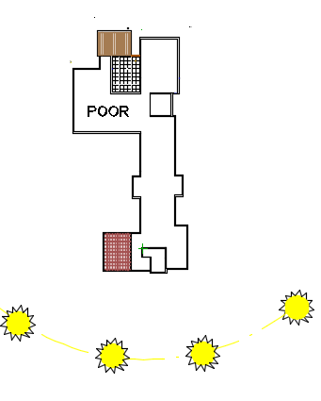
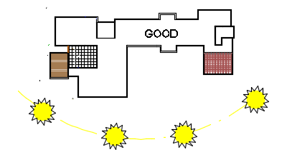
ENVIRONMENTAL DESIGN.
ORIENTATION.

Slide 23
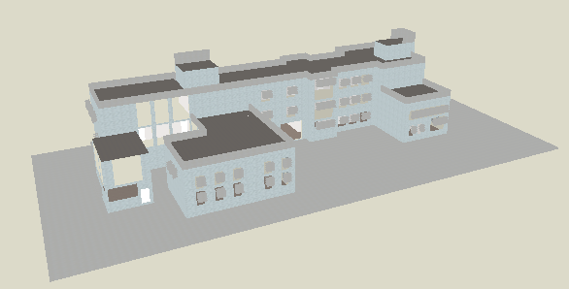
ENVIRONMENTAL DESIGN.
Thermal Design.
3D Model in Design Builder.

Slide 24
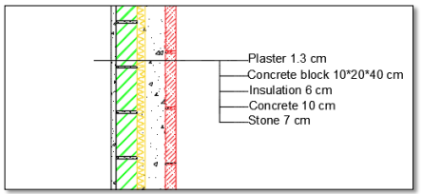
ENVIRONMENTAL DESIGN.
Material used and properties:
External Walls
U value = 0.36 w/m².k.

Slide 25
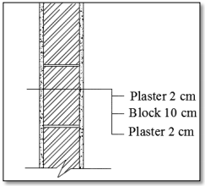
ENVIRONMENTAL DESIGN.
Material used and properties:
Internal partition
U value = 1.13 w/m².k.

Slide 26
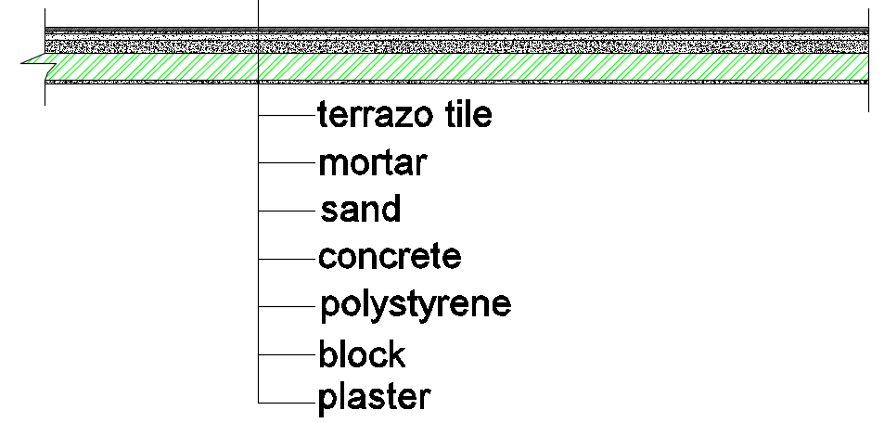
ENVIRONMENTAL DESIGN.
Material used and properties:
Internal floor
U value = .366 w/m².k.

Slide 27
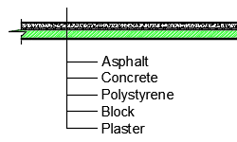
ENVIRONMENTAL DESIGN.
Material used and properties:
Roof
U value = 0.389 w/m².k.

Slide 28
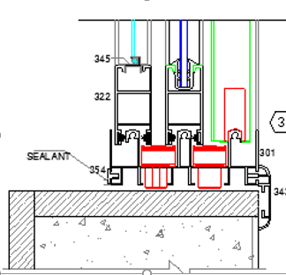
ENVIRONMENTAL DESIGN.
Material used and properties:
Windows
6mm Double glass
with 13mm air gab
U value = 1.77w/m².k.

Slide 29
ENVIRONMENTAL DESIGN.
Thermal Design.
Shading
Louvers System For south Elevation
Cantilever System For Other Elevation.
According to calculation we need cantilever with a length 0.7 m.

Slide 30
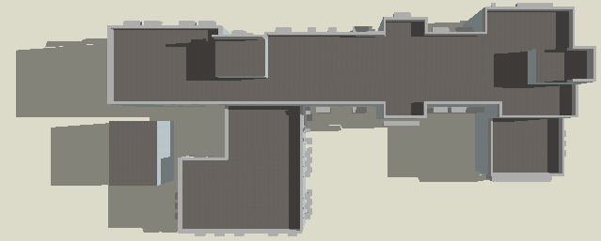
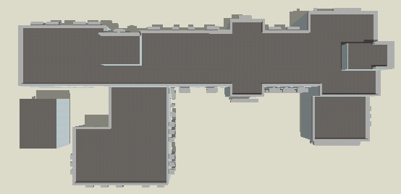
ENVIRONMENTAL DESIGN.
Thermal Design.
Shading
In Winter Day
21 July at 8 AM
21 July at 12 PM

Slide 31
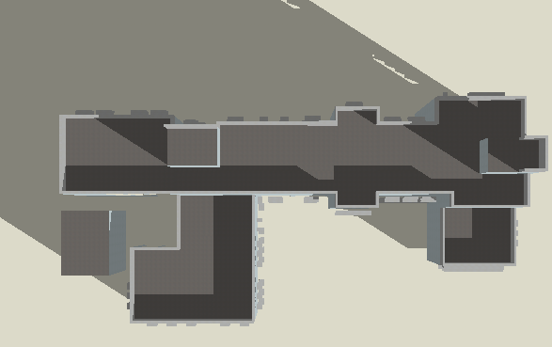
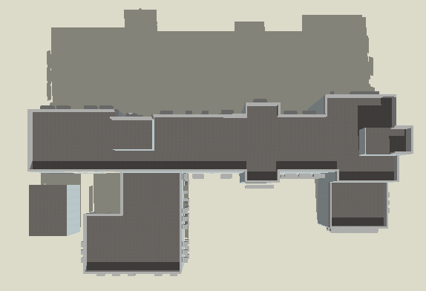
ENVIRONMENTAL DESIGN.
Thermal Design.
Shading
In Winter Day
21 January at 8 AM
21 January at 12 PM

Slide 32
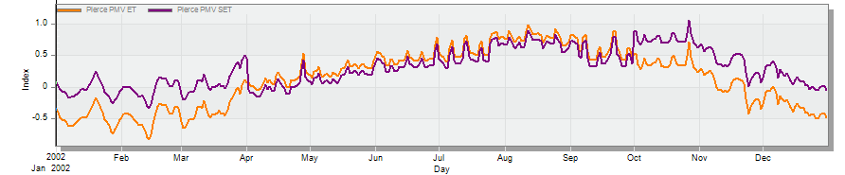
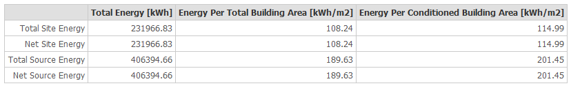
ENVIRONMENTAL DESIGN.
Thermal Design.
Comfort PMV-Set.

Slide 33
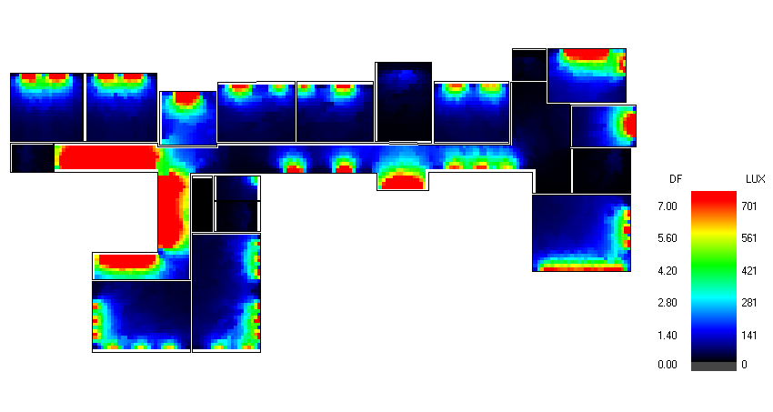
ENVIRONMENTAL DESIGN.
Day lighting performance.
Ground floor result:
for classroom
%DF =5%
Recommendation Rang = 2%-6%

Slide 34
ENVIRONMENTAL DESIGN.
Acoustical DESIGN.

Slide 35
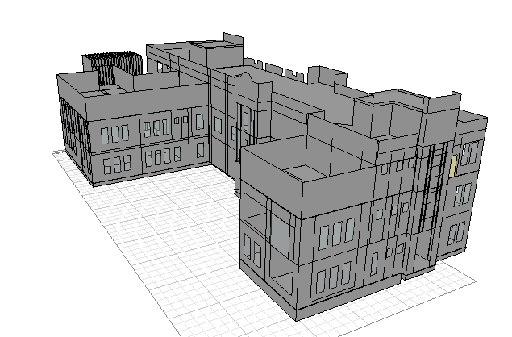
Acoustical Design.
3D Model in Ecotect.

Slide 36
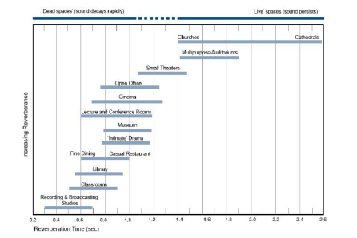
Acoustical Design.
Recommended values of RT60.

Slide 37
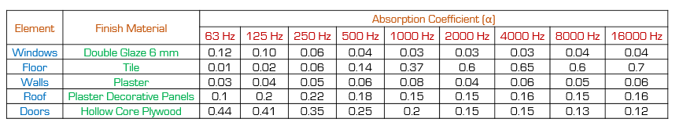
Acoustical Design.
Absorption Coefficient.

Slide 38
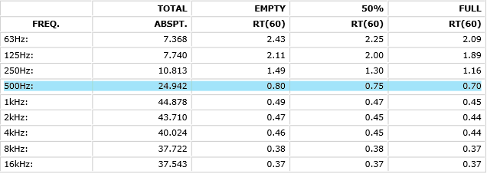
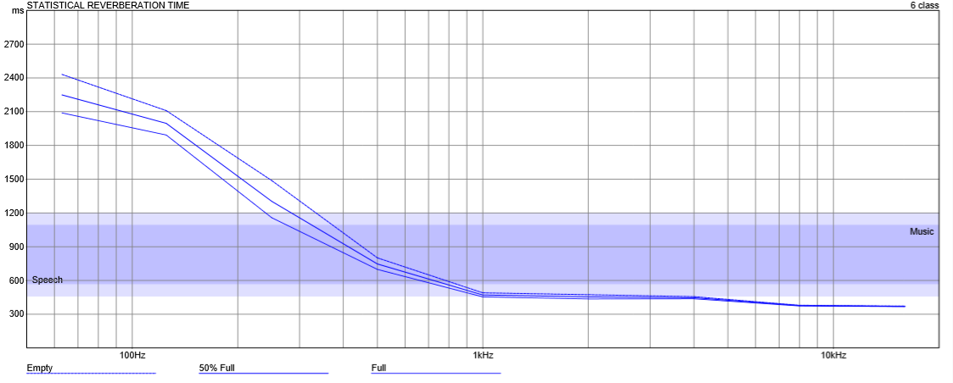
Acoustical Design.
Reverberation time (RT60).
Recommended Value(0.5-0.9).

Slide 39
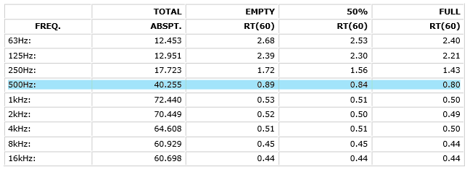
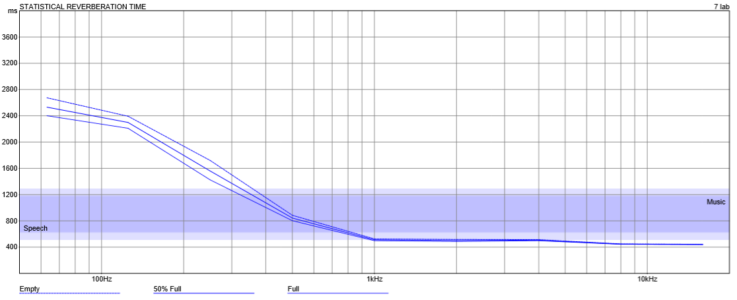
Acoustical Design.
Reverberation time (RT60).
Recommended Value(0.6-1.15).

Slide 40

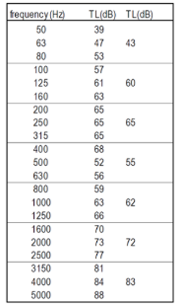
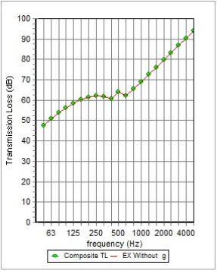
Acoustical Design.
STC for external wall.
The Recommended Range (50 – 60) dB

Slide 41
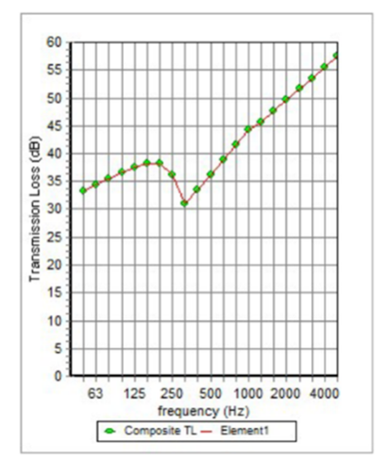
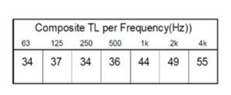
Acoustical Design.
STC for internal wall between classrooms.
The Recommended Value = 45 dB

Slide 42
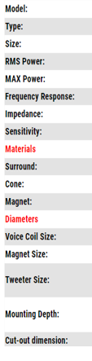
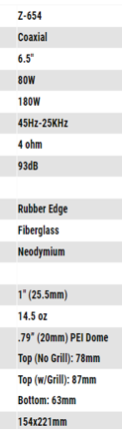
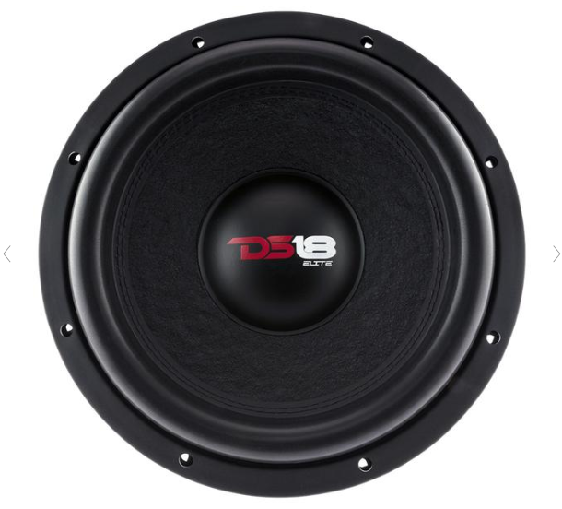
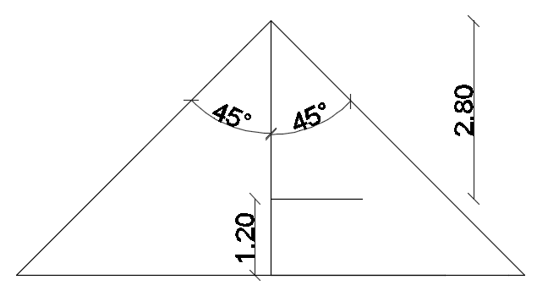
Acoustical Design.
Speakers Design.
Number of speaker for lab = $\frac{total area}{coveriance area }$ = $\frac{45}{24.6}$ = 1.94 = 2 speakers.

Slide 43
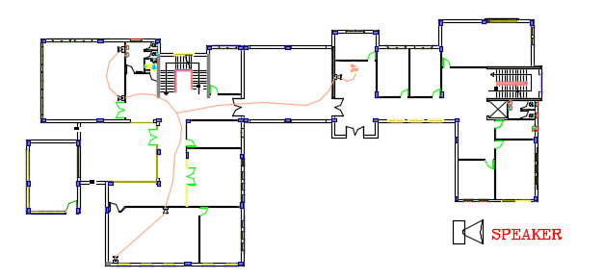
Acoustical Design.
Speakers Design.

Slide 44
Structural Design

Slide 45
Codes & Parameters
Codes
IBC – 2010.
ACI 318-14 for RC structure design.
Design Parameters:
Super imposed dead load = 4 KN/m².
Live load = 5 KN/m².
External Wall Weight = 25 KN/m.
R = 6 (Building Frame System – Shear walls).
Ss = 0.7 , S1 = 0.18 in Nablus.
Qall = 250 KN/m²
Cd = 5

Slide 46
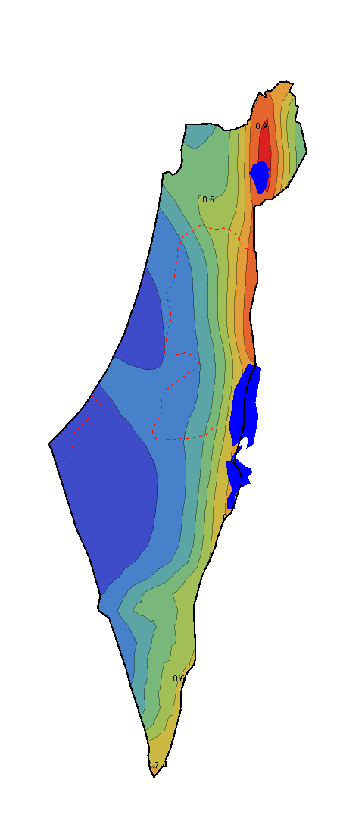
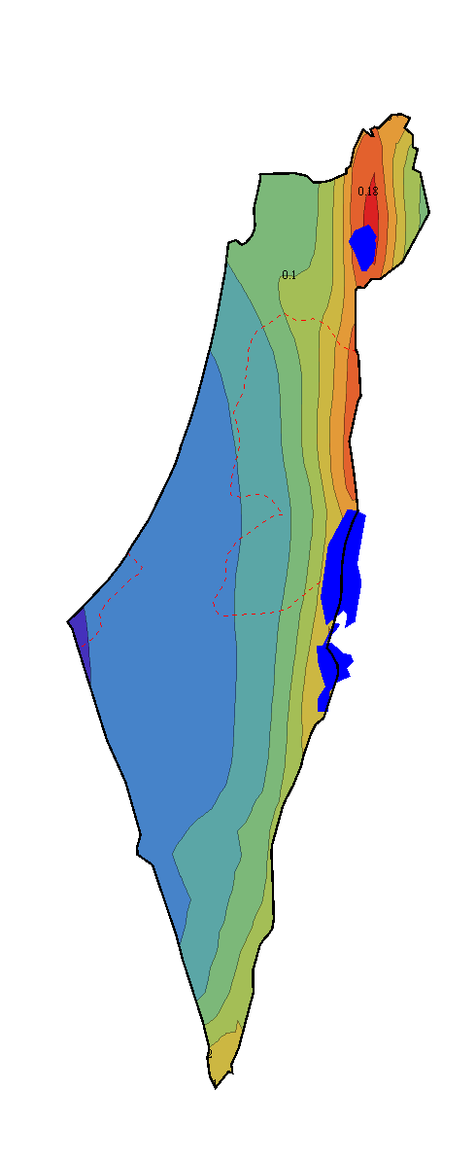



Codes & Parameters
Seismic Hazard Maps

Slide 47
Structural System
Structural System
One way and Two way Ribbed Slab with Drop Beams.
Materials
Concrete fc = 24 Mpa for slabs and beams.
Concrete fc = 28 Mpa for Columns and Footings.
Design Sections
Slabs Thickness 30 and 32 cm.
Column Dimensions ( 30 × 70 cm , 30 × 90 cm )
Shear Wall thickness = 20 cm.

Slide 48


3-D Models for Building
Model of Block 1
Model of Block 2

Slide 49


Model Checks
Compatibility Check

Slide 50
Model Checks
Equilibrium Check
Load cases/comp | ETABS | Hand Calculations | Error
Dead | 8519 | 8509 | 0.12%
Live | 5338 | 5339 | 0.0013%
SID | 14464 | 14439 | 0.17 %
Values for Block 2
The values are within error less than 5%
Internal Forces Check
The values are within difference less than 10% and done for slab, beam and column.

Slide 51
Model Checks
Deflection Check
For Block 1, the maximum deflection value was 34.5 mm.
Allowable deflection = L/240 = 9/240 = 37.5 mm > 34.5mm.
So the deflection is OK.
For Block 2, the maximum deflection value was 29 mm.
Allowable deflection = L/240 = 9/240 = 37.5 mm > 29 mm.
So the deflection is OK.

Slide 52


Model Checks
Drift Check
Maximum inelastic displacement (∆D) = $\frac{Cd×Drift }{I}$
Since the maximum inelastic displacement is less than Allowable Drift, check is OK.

Slide 53



Model Checks
P-Delta Check
θ = $\frac{P}{K ×h}$
θ: Stability coefficient
P: Axial force
K: Stiffness
h: Story height
θ max = $\frac{0.5}{βCd}$ $≤0.25$
θ must be less than θ max or 0.1 so, check is OK

Slide 54


Detailing
Slab Reinforcement
First Slab for Block 2

Slide 55

Detailing
Slab Reinforcement
Cross section in slab for block 2

Slide 56



Detailing
Beams Reinforcement
Longitudinal Section of Beam
Section A-A
Section B-B

Slide 57


Detailing
Columns Reinforcement
C1

Slide 58

Detailing
Shear Wall Reinforcement

Slide 59

Detailing
Stairs Reinforcement

Slide 60

Detailing
Footing Reinforcement

Slide 61

Detailing
Footing Reinforcement

Slide 62
Electrical Design.

Slide 63


Electrical Design.
Luminaires Layout.

Slide 64
Electrical Design.
Recommended Lux.
uniformity | glare | Illuminance (Lux) | Classrooms assessment
0.6 | 19 | 300 | Standards
0.6 | 13.8 | 318 | Result
uniformity | glare | Illuminance (Lux) | multi-purpose assessment
0.6 | 19 | 500 | Standards
0.61 | 15.2 | 506 | Result

Slide 65

Electrical Design.
3D – rendering view (classrooms).

Slide 66

Electrical Design.
3D – rendering view (Lab).

Slide 67

Electrical Design.
3D – rendering view (office).

Slide 68

Electrical Design.
3D – rendering view (Tennis Table).

Slide 69

Electrical Design.
3D – rendering view (Library).

Slide 70

Electrical Design.
Artificial Lighting.
Basement Floor.

Slide 71

Basement Floor.
Artificial Lighting.
Ground Floor.

Slide 72

Electrical Design.
Artificial Lighting.
First Floor.

Slide 73

Electrical Design.
Socket.
Basement Floor.

Slide 74

Electrical Design.
Socket.
Ground Floor.

Slide 75

Electrical Design.
Socket.
First Floor.

Slide 76

Electrical Design.
Solar PV system.

Slide 77

Electrical Design.
Solar PV system.
Depends on calculation we need 80 cells from type 400 watt to achieve zero net energy building. but we will use 117 cells, and all KWH Will be sold to the municipality of Nablus for .6 NIS per KWH.

Slide 78

Electrical Design.
Solar PV system.

Slide 79

Electrical Design.
Solar PV system.
Summary:
Initial cost of the system = 46.8*1700 = 79560 $
Operation Cost = 1200 $/year.
Electricity Production = 93295KWh/yr.
Annual Saving = 15860 $/yr.
Payback Period =80760/15860= 5.09 years.

Slide 80
Mechanical Design.
Water supply system
Water consumption.
Domestic hot water.
Drainage system
HVAC system
Firefighting system
Elevator system

Slide 81

Mechanical Design.
Water supply system.
diameter | Pipe
2" | Vertical feeder
1.5" | Horizontal pipe
1" | Branch pipe

Slide 82
Mechanical Design.
Water consumption.
Water consumption by people 5-8 litter for cold water.
Water consumption by people 5 litter for hot water for the purpose of ablutions.
Total number of people 228 person /day.
Total amount of cold fresh water 1.4 cm /day.
Total amount of hot water 1.2 cm /day.

Slide 83


Mechanical Design.
Domestic hot water.

Slide 84

Mechanical Design.
Domestic hot water.
Q= 17.58 Kwh.
Number of panels that has be needed = 17.85/2.77= 6.44 (7 panels).
These cells will be covered in the summer months to protect them from height temperature.

Slide 85

Mechanical Design.
Water drainage system.
Diameter | Pipe
4" | Vertical pipe
2" | Horizontal pipes (lavatory)
2" | Horizontal pipes (kitchen sink)
4" | Horizontal pipes (W.C)
8" | Pipes between manhole

Slide 86


Mechanical Design.
Water drainage system.

Slide 87

Mechanical Design.
Rainwater drainage system.

Slide 88



Mechanical Design.
HVAC system.

Slide 89
Mechanical Design.
Design of Radiator.
dimension | Q radiator from catalog | number of section | number of radiator | Q section | Q radiator (Q total*1.15) | Q total | function
628*600 | 1037*1 | 13 | 1 | 80 | 908.5 | 790 | classrooms
904*600 | 1516*3 | 19 | 3 | 80 | 4830 | 4200 | labs
1180*600 | 1995*3 | 25 | 3 | 80 | 5658 | 4920 | library
1180*600 | 1995*3 | 25 | 3 | 80 | 6062.8 | 5272 | multipurpose
Assume the velocity of water = 0.9 m/s.
our selection shall be (250 SE pump).
Volume of tank that be needed from Boiler = 5 tank.
the chimney diameter = 126 mm.

Slide 90


Mechanical Design.
Radiator System.

Slide 91

Mechanical Design.
Radiator System.

Slide 92

Mechanical Design.
Radiator System.

Slide 93
Firefighting system.

Slide 94




Mechanical Design.
Firefighting system.
Fire Extinguishers.
Hose Stations.
Warning Signs.
smoke detector.

Slide 95

Mechanical Design.
Emergency Fire Protection System.

Slide 96

Mechanical Design.
Emergency Fire Protection System.

Slide 97

Mechanical Design.
Emergency Fire Protection System.

Slide 98





Mechanical Design.
Sprinklers System.
High | Moderate | Low
8 | 12 | 20 | area (m²)
3.5 | 3.5 | 4.5 | Distance (m)
N = $\frac{66.68}{8}=8 Sprinkler$
$\frac{ 10.3}{4} =2.57$= distribution of sprinkler in y axis
$\frac{ 6.35}{2} =3.17$= distribution of sprinkler in x axis

Slide 99

Mechanical Design.
Emergency Exist and Evacuation System.

Slide 100

Mechanical Design.
Emergency Exist and Evacuation System.

Slide 101

Mechanical Design.
Emergency Exist and Evacuation System.

Slide 102

Mechanical Design.
Elevators System.
we will use one elevator for services
675 Kg | Capacity
1.5 m/s | Speed
9 person | Number of passengers allowed

Slide 103
Quantity Survey.
Cost | Stage
1737557NIS | Structural work
166056NIS | Mechanical work
163066NIS | Electrical work
1404992NIS | Finishing
3471672NIS | Total project cost
1428NIS/m2 | Unit cost

Slide 104
Done!
Thanks a Lot

