Slide 1
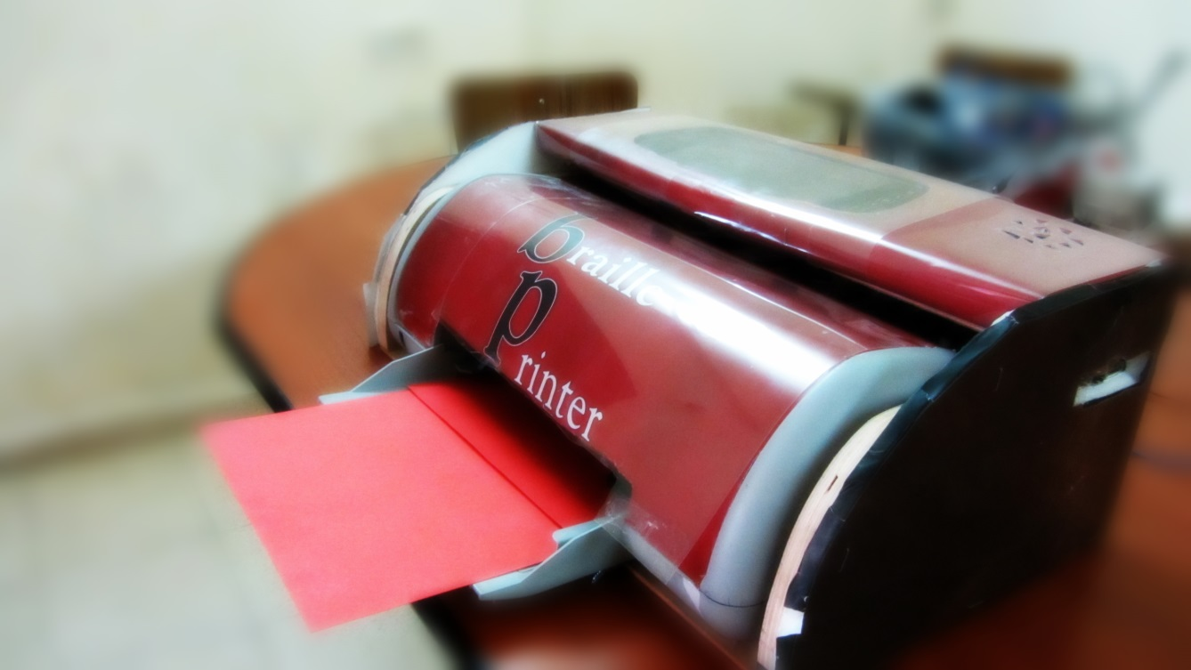

BRAILLE PRINTER
SUPERVISOR
Dr.
Nidal Farahat

Slide 2
Outline…
Introduction
Objectives
Mechanical & Electrical components
Control system
Protection
Methodology
Cost
Future work
Conclusion

Slide 3
Introduction
In our project we look at the reality of life and search for the most marginalized groups which need serious attitudes to help them .
We found that the more groups that deserve assistance are a class of blindness

Slide 4
So we worked hard to develop a printer which prints braille alphabets with High-tech and low cost than those in the world market.

Slide 5







Overview of Braille language
Each character is presents by six points, three on the right and three on the left

Slide 6





OBJECTIVES
Help blind people to learn by offering enough amounts of Braille books.
Reduce time and cost for blind people to get a book written in Braille language.
Increase the efficiency of performance in blind’s schools.
Make printing very effective process using computer and flash memory.

Slide 7
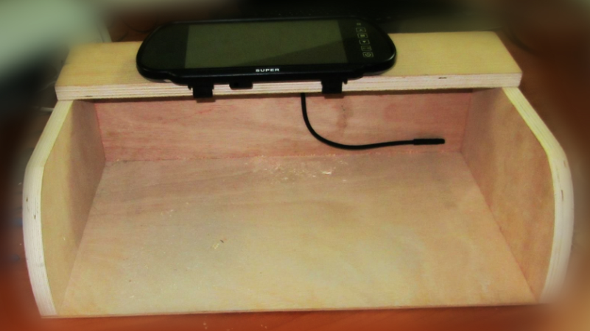
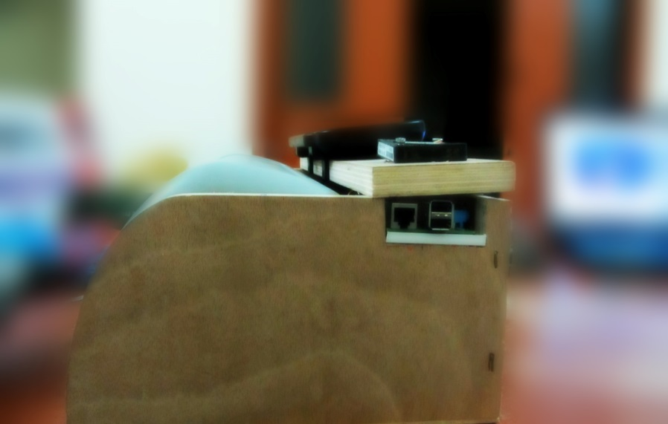
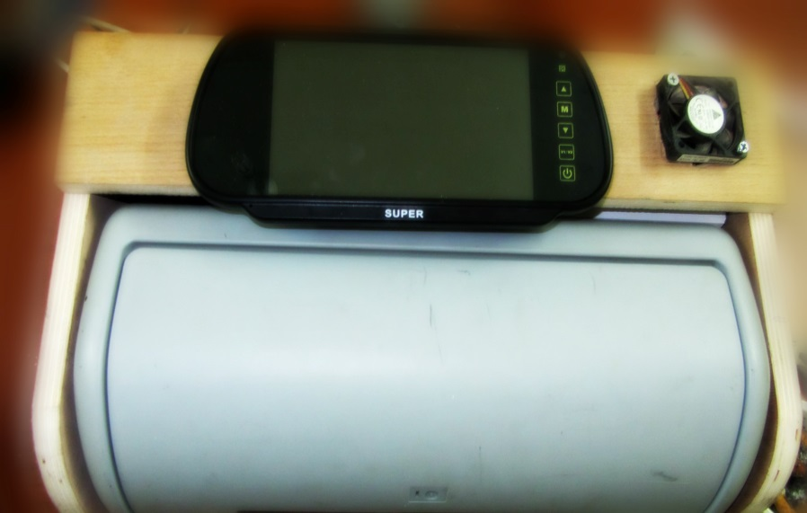
MECHANICAL & ELECTRICAL
COMPONENTS
Housing and paper feeder
The cover of our project is
designed to like the modern
printer.
Housing contains USB ports
,screen, paper feeder

Slide 8
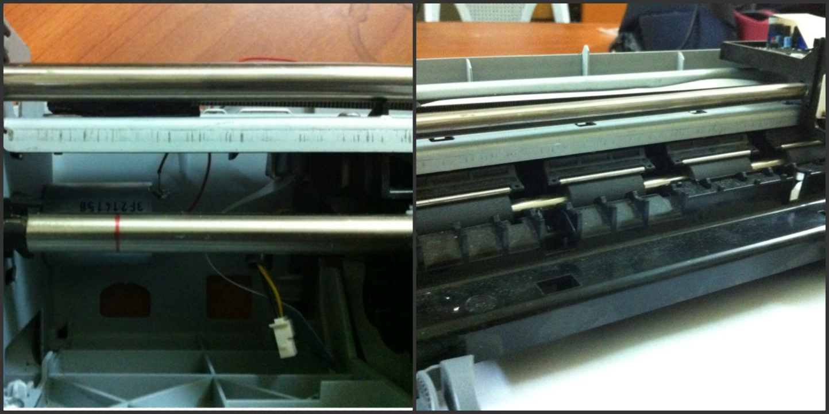
RODS
Four rods are used two to support the solenoid, and the other to connected with rollers to allow passing paper through printing.

Slide 9
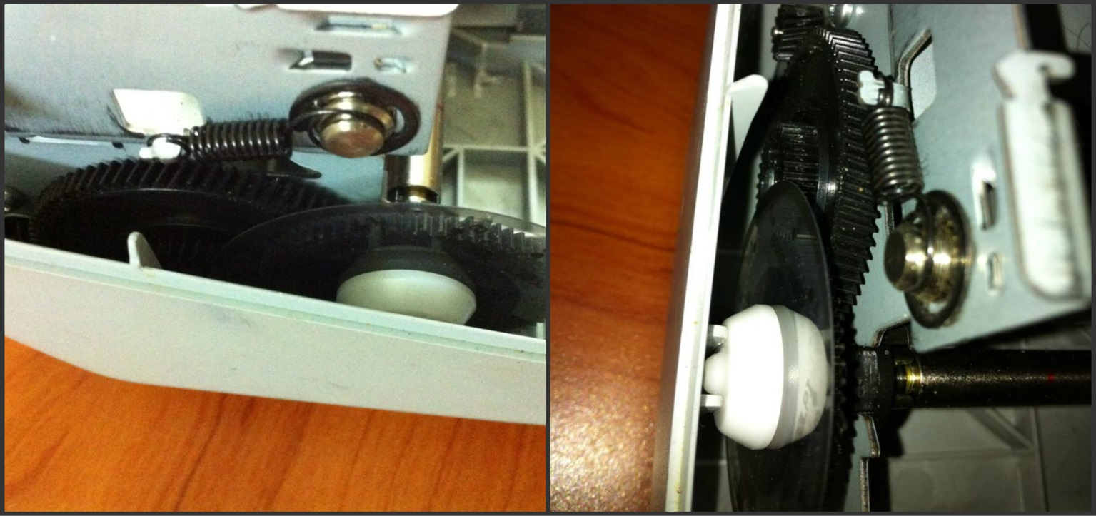
GEARS
Five spur gears are used to transfer the motion of DC motor to rod that used for pull the paper.

Slide 10
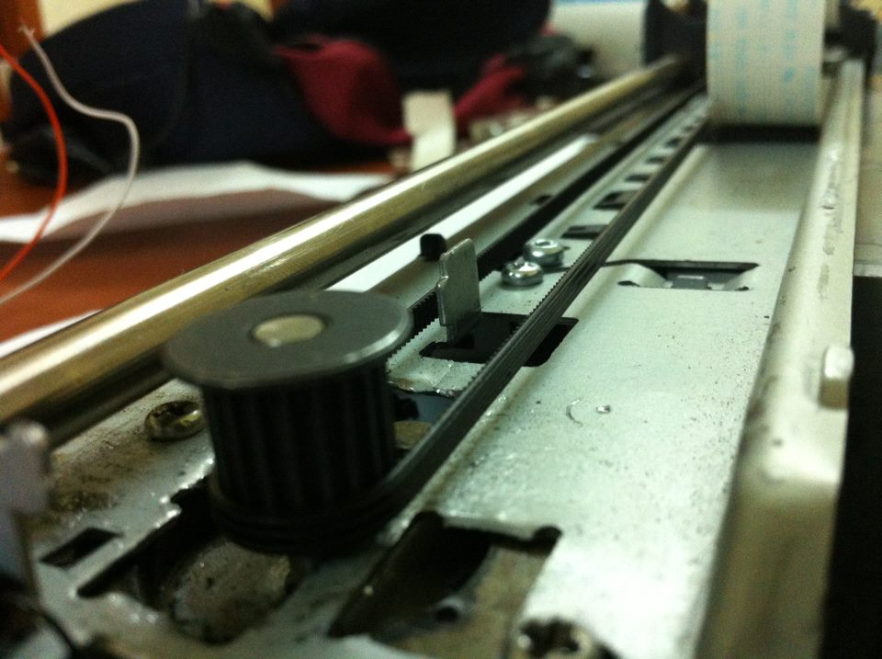
BELTS
One toothed belt is used to move the solenoid left and right (in the horizontal direction) when receives data from stepper motor.

Slide 11
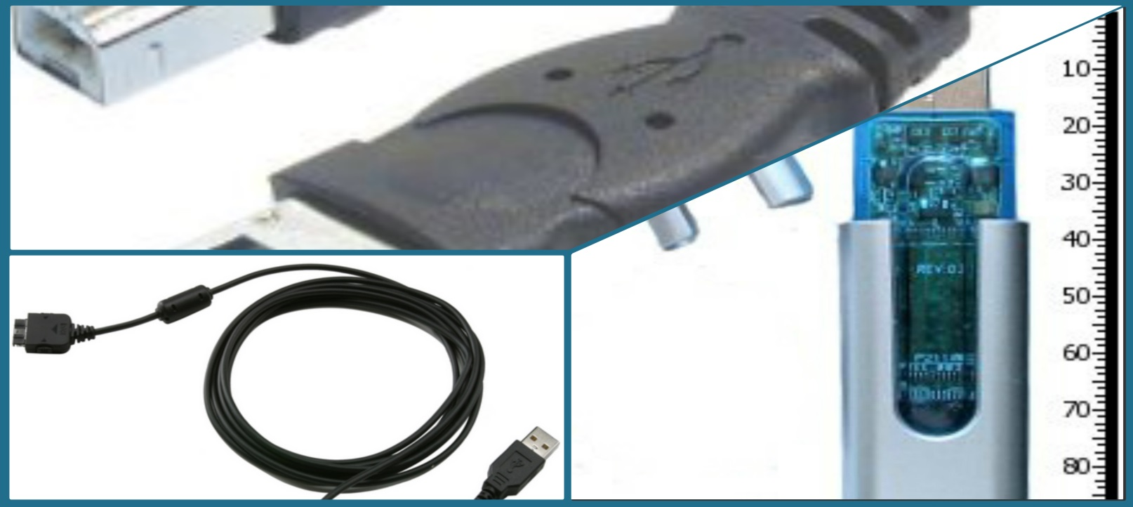
Universal Serial Bus (USB)
In this project any USB can be used, because Raspberry Pi contains a USB hub which make it easy to recognize the files inserted by user.

Slide 12
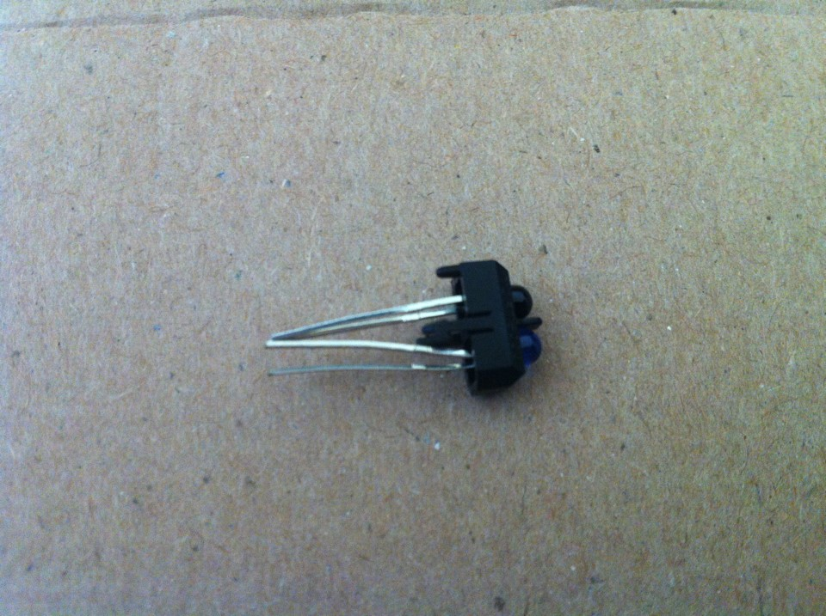
SENSORS
We used the sender and receiver sensor (TCRT 5000) that will give an output when there is no paper in the feeder.

Slide 13
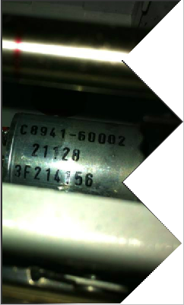
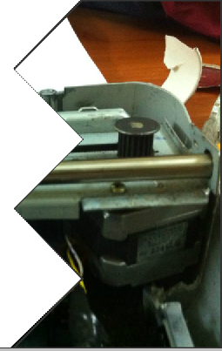
One stepper motor of type (Bipolar) is used to move the solenoid horizontally while printing, and one DC motor is used to passing the paper.
STEPPER AND DC MOTORS
DC MOTOR
STEPPER MOTOR

Slide 14
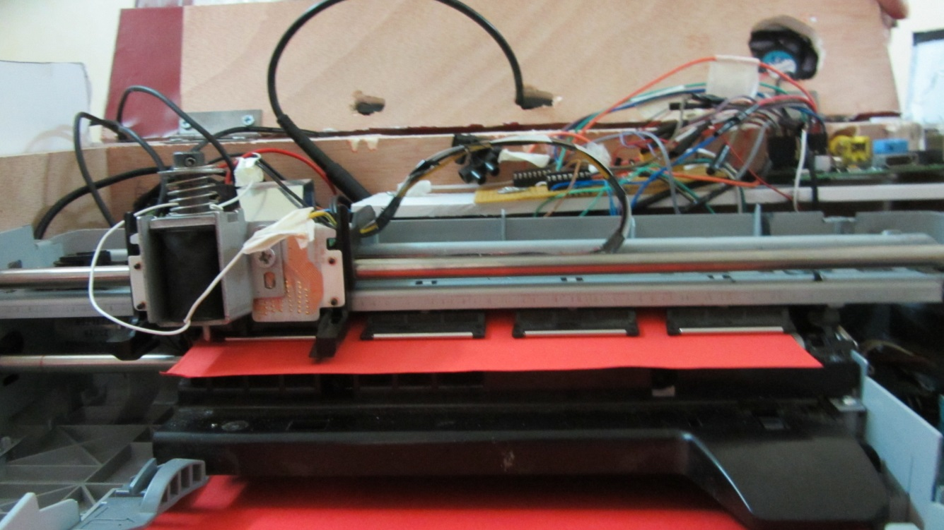
SOLENOID
In our project we used a Solenoid with relay carried by a stainless steel rods.
We choose the electrical Solenoid with the needle that make the required hole in the paper

Slide 15
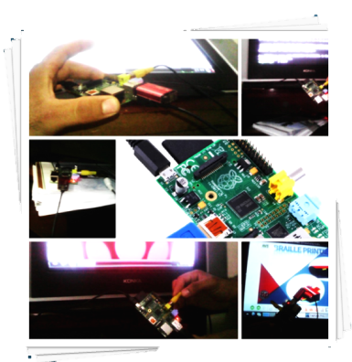

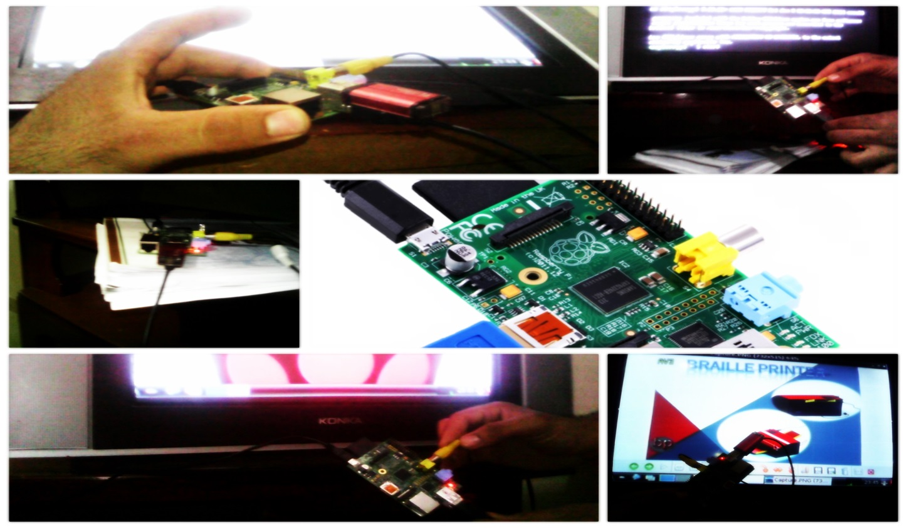
CONTROL SYSTEM

Slide 16
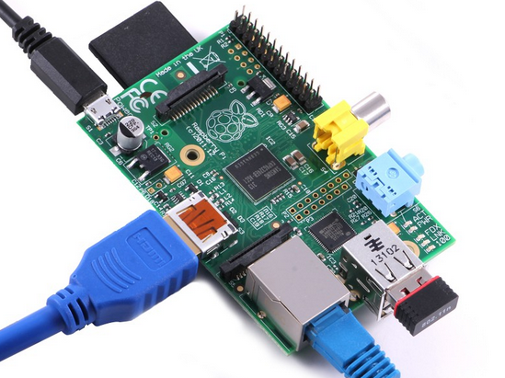
CONTROLLING DEVICE
In project1 we discussed to use Arduino Due in controlling the printer but after constructing the printer we decided to use Raspberry pi.

Slide 17
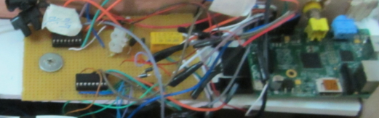
Raspberry Pi is the main part in our project that connects all the electrical and mechanical components with each other.
operates in the same way as a standard PC, requiring a keyboard for command entry, a display unit and a power supply.

Slide 18
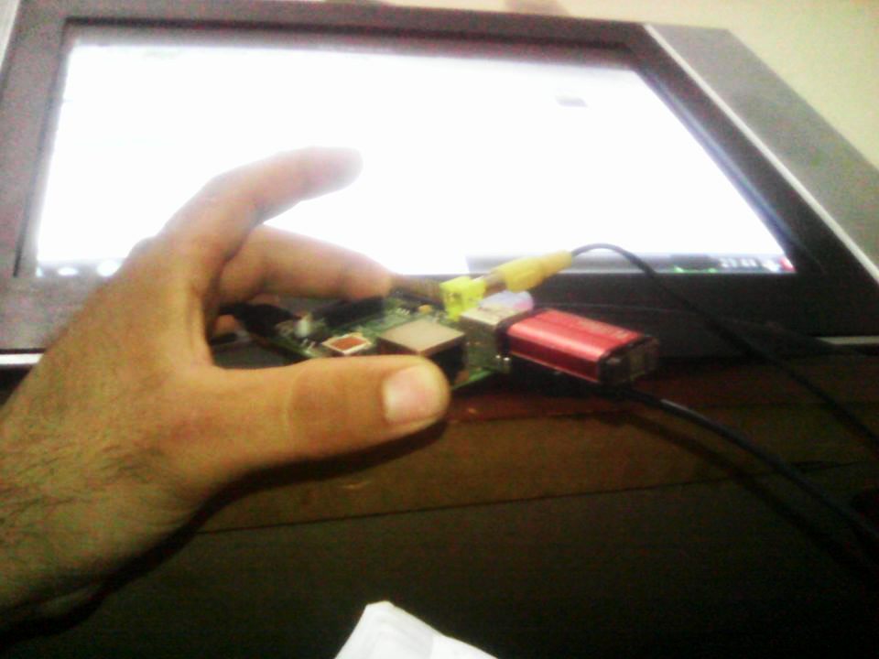
FLASH MEMORY & SD CARD
Importing data and files from flash memory or SD cards will be the main source from printing.
The user can print any document (PDF, txt, word)

Slide 19
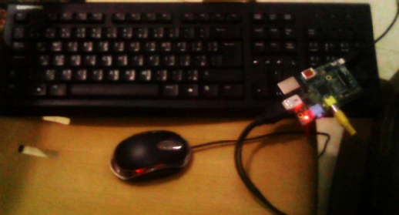
SERIAL CONNECTIONS
The other source of data that the printer will receive is the computer.
Serial connections includes any interfacing device such as mouse, keyboard, … etc

Slide 20
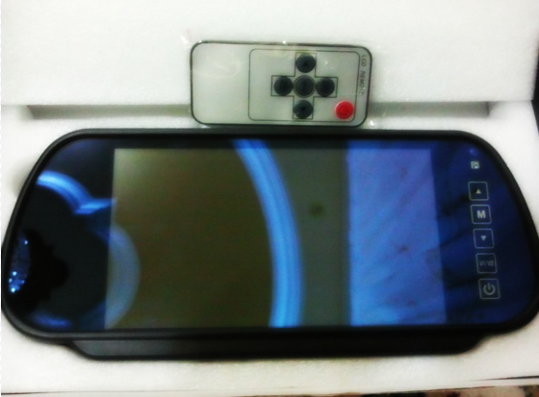
SCREEN
The screen is used in our project that will act as an output and Input device, it is display the data coming from flash memory and computer in icons, and controlled by a remote.

Slide 21
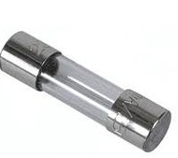
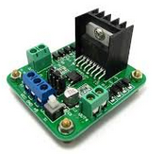
protection
In designing Braille printer we considered the protection sources, these are:
Fuses: we use fuses to overall protection
H-Bridge: Used to protect DC motor

Slide 22
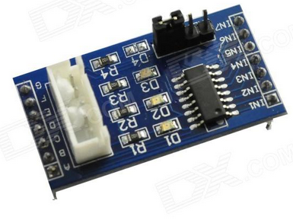
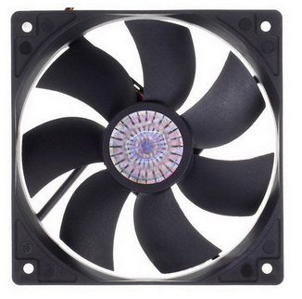
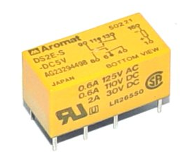
ULN2003: it is stepper motor driver module used to protect and controlling the movement of the stepper motor
Raspberry Pi Cooler: required to remove the waste heat produced by printer components, to keep them within permissible operating temperature limits
Relay: is used to protect the solenoid and passes power

Slide 23
methodology
START
Insert Flash Memory
Read The File
Read The Matrix
Convert To Matrix (0,1)
IF
(1)
YES
The Solenoid Will Strike
NO
IF
YES
end Line
DC Will Pull The Paper
NO
IF
Sensor ON
End Paper
Print ”NO PAPER”
NO
YES
NO
YES
END
Pull The Next Paper

Slide 24
Video….

Slide 25

cost
In project1 we put a plan explained the cost to about 600 JD, but actually it costs 2000 JD, Due to the prices of the components available in the market.

Slide 26

Future work
In the future, we will work to make different sizes of braille printer to enable printing on the various paper sizes (A3,A5,..)
We can also make the printing process more fast that will print a whole document such as the ordinary printer prints.

Slide 27

conclusion
In this project we made a plan of Braille printer that does not need any extra program that will be installed in computer and receive data from flash memories and computers .
The printer enable receiving files (Pdf ,text, and document) and convert it to Braille language by convert each letter or character to a specific movement of stepper motor that hold needle carried by solenoid the printing will be effective and fast depending on the speed of solenoid and stepper motors.

Slide 28
THANK YOU
FOR LISTENEING

