Slide 1

Security online transaction system
Developed by
Nagham Fahim Hamad
Razan Nael Jabir

Slide 2
Introduction
Computer networks have grown in both size and importance in a very short time.
If the security of the network is compromised, there could be serious consequences, such as loss of privacy, theft of information, and even legal liability.
The types of potential threads to network security are always evolving which make the situation more challenging for network administrator,

Slide 3
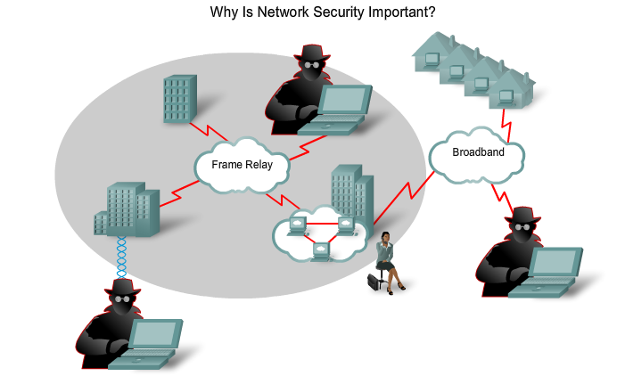
Why Is Network Security Important?

Slide 4
Network Security Importance
As e-business and Internet applications continue to grow, finding the balance between being isolated and open is critical.
In addition, the rise of mobile commerce and wireless networks, demands on the security solutions become seamlessly integrated, more transparent, and more flexible.
Every PC, notebook, Smartphone, … etc is now connected to the internet.

Slide 5

In the last few years internet applications has been developed in a very fast way, so that banking, Forex, and exchange becomes online.
All these applications need to be secured.
Our project aims to provide secure connection using symmetric authentication.

Slide 6
The Increasing Threat to Security
Over the years, network attack tools and methods have evolved. in 1985 an attacker had to have sophisticated computer, programming, and networking knowledge to make use of rudimentary tools and basic attacks. As time went on, and attackers' methods and tools improved, attackers no longer required the same level of sophisticated knowledge.People who previously would not have participated in computer crime are now able to do so.

Slide 7
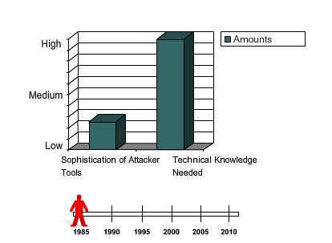
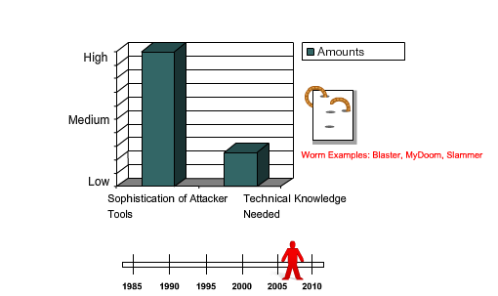

Slide 8

Think Like an Attacker
The attacker's goal is to compromise a network target or an application running within a network.
A company webpage can lead to information, such as the IP addresses of servers. From there, an attacker can build a picture of the security profile or "footprint" of the company.

Slide 9


An attacker can expand on the footprint by monitoring network traffic with a packet sniffer such as Wireshark, finding information such as version numbers of FTP servers and mail servers. A cross-reference with vulnerability databases exposes the applications of the company to potential exploits.

Slide 10
attackers try to increase their network privileges.
Gather additional passwords and secrets. With improved access privileges, attackers use their talents to gain access to well-guarded, sensitive information.
Install backdoors. Backdoors provide the attacker with a way to enter the system without being detected.

Slide 11

motivation
Access and Security Balance
Access
Security

Slide 12

The overall security challenge is balancing two important needs:
keeping networks open to support evolving business requirements.
protecting private, personal, and strategic business information. by developing a fast and relatively cheap secure authentication process.

Slide 13

OUR Project

Slide 14
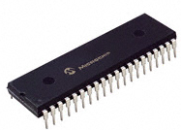
components
Our project consists of two parts:
  Hard Ware:
  Microcontroller PIC18F4620
  CNY70 - Reflective Optical Sensor that includes an infrared emitter and Phototransistor in a leaded pack- age which blocks visible light.

Slide 15
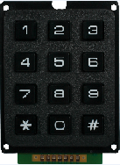
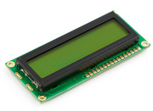

Keypad .
LCD.
Power Supply.

Slide 16
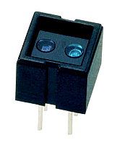
The CNY70 Sensor
Reflective Optical Sensor
with Transistor Output.
The CNY70 has a compact construction where the emitting light source and the detector are arranged in the same direction to sense the presence of an object by using the reflective IR beam from the object.

Slide 17
The operating wavelength is 950 nm.
The detector consists of a phototransistor.
We used the CNY70 Sensor to detect the flashing of Black and White colors.
We wrote a decoding protocol that mimic morse code to transmit textual information as a series of “on-off” lights.
Each number is represented by a unique sequence of black and white.

Slide 18
Number1
Number2
Number3
Number4
Number5
Number6
Number7
Number8
Number9

Slide 19
Every decoded number must start with a static sequence called “Start signal” of black and white flashing, which is represented by
when the PIC detects “Start signal” it starts to read the following flashing which is the encrypted number.
after detect the number there is a stop signal.
the following step is to take a secret number from the user using keypad, which will be used as an input for a encryption function.

Slide 20
Software
Language
We used C to program software for our project
to program the microcontroller, and PHP & JavaScript to program the website.
by using PicC program.
Compiler
PicC Complier.

Slide 21
The transferring of the encrypted data
data signal
stop signal
Start signal
Start signal and after that data signal then stop signal

Slide 22
Code:
We used Symmetric Encryption method.
Symmetric Encryption is to use a secret key between tow parties.
The client take a secret key from the screen depending on the flashing sequence,
and then the client enter his Secret number on the keypad.
This way of authentication give high level of security because for each time the same user take different random number.

Slide 23
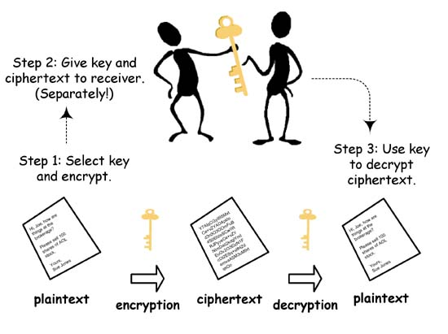
Symmetric Encryption

Slide 24
After that we made hashing function depending on MD5 protocol to generate number that depends on the flashing number and on the secret number of the user.
User enter that number in text field to use his account.
computer compare between the entered number and the flashing which is hashed using secret number of the user if it is true then user can login to his account.

Slide 25
Communication protocol
Database for users with username and password
Sending encrypt data using flashing bars
computer
PIC
Write the data from PIC to PC
Computer calculate secret key and flashing data using hash function
Then comparing with data from PIC
If it is match then the authentication ok
Enter secret key using keypad
The PIC decrypt the data from flashing
Then using the secret key and data to calculate
A new Data using hash function

Slide 26
obstacles
We first try to use RGB Color-Sensor, which is a sensor that defines the R-G-B values for colored elements. But this sensor worked well on papers and not on the screen so we used CNY70.
We made collaborations for this sensor by using algorithm to determine the sensitivity of the sensor for a certain color by writing values inside integration and capacitor registers.

Slide 27
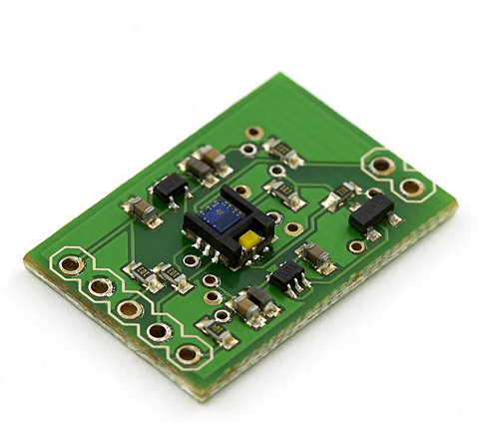
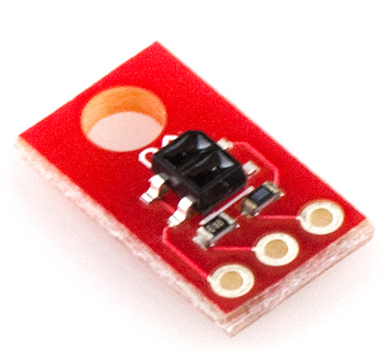
Color Sensor
QRE1113 Line Sensor Breakout - Analog

Slide 28
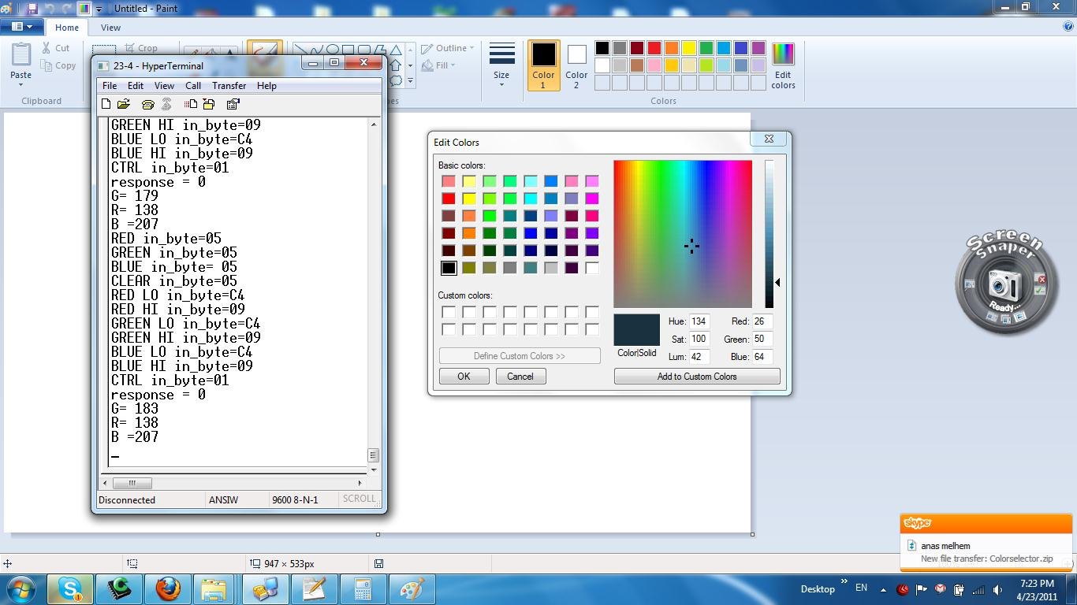
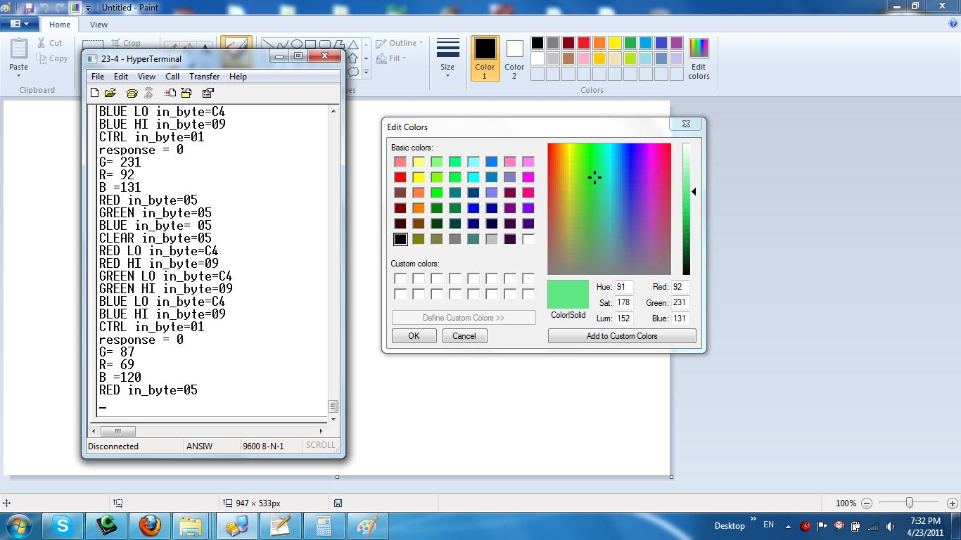


Slide 30
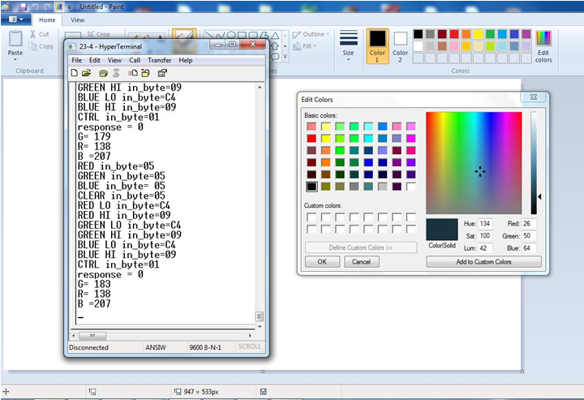

Slide 31
Thank You

