Slide 1

An-Najah National University
Civil-Engineering Department
Graduation Project 2
High Strength Concrete
Supervision of Eng. Hussein Abu-Zant
By:
Abdullah Shehadi
Ahmad Yousef
Mohammed Hamshari
Tarneem Kabha
2022/2023
11/6/2023 Sunday

Slide 2
INTRODUCTION
The main objective is to prepare concrete mixture 600 kg/cm2 with the minimalcost.
Concrete is the backbone of construction
It is a cornerstone material for modern construction projects.
The concrete mixes prepared comply with the Palestinian Specifications

Slide 3
Methodology
Performing required tests on aggregates and cement
Adopting of a previous concrete mix
Chemical additives
Preparing concrete mixing
Conducting compressive strength tests
Adopting the required strength, which is 600 kg/cm2
Preparing several mixes to achieve the lowest possible cost
Estimating the direct and indirect costs of the required mix

Slide 4
General Tests
Aggregates:
Lost Angeles Test, Abrasion Ratio = 27.8% < 50% then OK.
Cement:
Crushing strength of Silo Cement = 53.7 MPa > 52.5 then OK.
Crushing strength of Portland Cement = 42 MPa very close to 42.5 then OK.
Sand Equivalent Test:
Sand Equivalent Value = 84% > 60% then OK.

Slide 5
Mix Design Proportions
MIX TRIAL | W/C RATIO % | SUPER-PLASTICIZER kg | WATER CONTENT kg | CEMENT CONTENT kg | مغسول 2mm kg | مدراج kg | فولية 12.5mm kg | عدسية 10mm kg | رمل kg
1 | 32 | 0.012 | 2.04 | 6.36 | 2.76 | 5.76 | 5.76 | 3.36 | 3.6
2 | 40 | -- | 2.25 | 5.625 | 2.875 | 6 | 6 | 3.5 | 3.75
3 | 30 | 0.104 | 1.209 | 4.03 | 2.99 | 7.54 | 6.24 | 3.64 | 3.9
4 | 35 | 0.153 | 1.9 | 5.44 | 3.91 | -- | 8.16 | 4.76 | 5.1
5 | 40 | 0.055 | 2.54 | 6.36 | 2.76 | 5.76 | 5.76 | 3.36 | 3.6
6 | 40.0 | 0.12 | 4 | 10 | 4.6 | 9.6 | 9.6 | 5.6 | 6
7 | 39.6 | 0.14 | 3.8 | 9.6 | 4.6 | 9.6 | 9.6 | 5.6 | 6
8 | 41.7 | 0.12 | 3.84 | 9.2 | 4.6 | 9.6 | 9.6 | 5.6 | 6
9 | 41.7 | 0.14 | 4.34 | 10.39 | 10.85 | 10.85 | 10.85 | 6.33 | 6.78

Slide 6
Mix Trials Results At 28 Days
SAMPLE NUMBER | AVERAGE 28-DAY STRENGTH kg/cm² | SLUMP mm
1 | 586 | 20
2 | 491 | 35
3 | 625 | 0
4 | 332 | 25
5 | 630 | 38
6 | 656.5 | 50
7 | 650.7 | 50
8 | 646.7 | 70
9 | 654.8 | 60

Slide 7
Quantity Adjustments
5th Mix Adjusted Quantities
Aggregate Type | Original Quantity kg | Modified Quantity kg | Modified Volume m³
عدسية | 280 | 253.60 | 0.099
فولية | 480 | 434.75 | 0.169
مدراج | 480 | 434.75 | 0.175
مغسول | 230 | 208.32 | 0.084
رمل | 300 | 271.72 | 0.105
Water | 212 | 192.01 | 0.192
Cement | 530 | 480.04 | 0.152
Superplasticizer | 4.6 | 4.17 | 0.004
TOTAL VOLUME |  |  | 0.98
8th Mix Adjusted Quantities
Aggregate Type | Original Quantity kg | Modified Quantity kg | Modified Volume m³
عدسية | 280 | 263.59 | 0.103
فولية | 480 | 451.87 | 0.176
مدراج | 480 | 451.87 | 0.181
مغسول | 230 | 216.52 | 0.087
رمل | 300 | 282.42 | 0.109
Water | 192 | 180.75 | 0.181
Cement | 460 | 433.05 | 0.137
Superplasticizer | 6 | 5.65 | 0.005
TOTAL VOLUME |  |  | 0.98

Slide 8
Direct Costs For Every Component
Concrete Component | Price Per Ton NIS | Unit Price Per kg NIS
عدسية | 28 | 0.028
فولية | 28 | 0.028
مدراج | 37 | 0.037
مغسول | 39 | 0.039
رمل | 70 | 0.07
Water | 7 (NIS/1 m³) | 0.007 (NIS/Liter)
Cement | 600 | 0.6
Superplasticizer | 10 (NIS/Liter) | 10(NIS/Liter)

Slide 9
Overhead Costs Per 1 m³
Indirect Cost Category Per m³ | Factory 1 NIS | Factory 2 NIS | Factory 3 NIS | Average Cost NIS
Maintenance | 20 | 18.5 | 22 | 20.2
Fuel | 20 | 22 | 27 | 23
Labor | 25 | 28 | 23 | 25.3
Electricity | 0.89 | 0.6 | 1.67 | 1.05
Water | 2.22 | 1.42 | 2 | 1.9
Advertisement | 1 | 1 | 1 | 1
Income Tax | 1.6 | 1.43 | 1.5 | 1.5
Value Added Tax VAT | 2.8 | 2.3 | 2.5 | 2.5
Insurances | 11 | 9.2 | 7 | 9.1
TOTAL INDIRECT COST NIS |  |  |  | 85.5

Slide 10
Cost Analysis
5th Mix Direct Cost
Aggregate Type | Modified Quantity kg | Quantity Direct Cost NIS
عدسية | 253.60 | 7.10
فولية | 434.75 | 12.17
مدراج | 434.75 | 16.09
مغسول | 208.32 | 8.12
رمل | 271.72 | 19.02
Water | 192.01 | 1.34
Cement | 480.04 | 288.02
Superplasticizer | 4.17 | 41.00
TOTAL DIRECT COST |  | 393
9th Mix Direct Cost
Aggregate Type | Modified Quantity kg | Quantity Direct Cost NIS
عدسية | 263.59 | 7.38
فولية | 451.87 | 12.65
مدراج | 451.87 | 16.72
مغسول | 216.52 | 8.44
رمل | 282.42 | 19.77
Water | 180.75 | 1.27
Cement | 433.05 | 259.83
Superplasticizer | 5.65 | 56.50
TOTAL DIRECT COST |  | 383

Slide 11
Net Costs Per 1 m³
The total cost for a one-meter cube of the 5th mix = direct + indirect costs = 393 + 85.5 = 478.5 NIS.
The price including the reasonable profit (which is almost 10%) = 478.5*1.1 = 526 NIS.
The total cost for a one-meter cube of the 9th mix = direct + indirect costs = 383 + 85.5 = 468.5 NIS.
The price including the reasonable profit (which is almost 10%) = 468.5*1.1 = 515 NIS.

Slide 12
Conclusions
For the 9th mix trial, the average strength reached 654.8 kg/cm2 after 28 days
This mix has a slump = (60mm).
The lowest priceof cement = 515 NIS

Slide 13
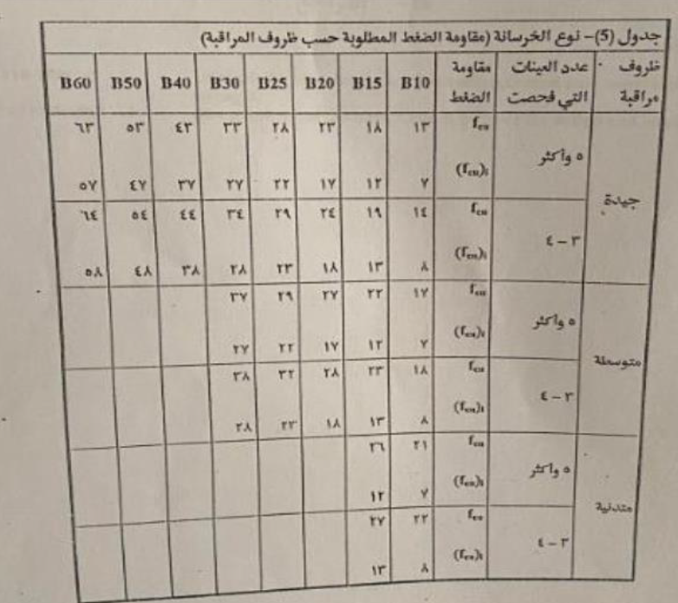
Conclusions
According to the Palestinian Specifications, the 9th mix reached the desired strength (654.8 kg/cm2) for B60 concrete, with 5 samples prepared of this mix.

Slide 14
Recommendations
More mix trials must be done
To reduce the cost 1 m3 of concrete
Accepted slump values
The crushing strength complies with the Palestinian Standards

