Slide 1
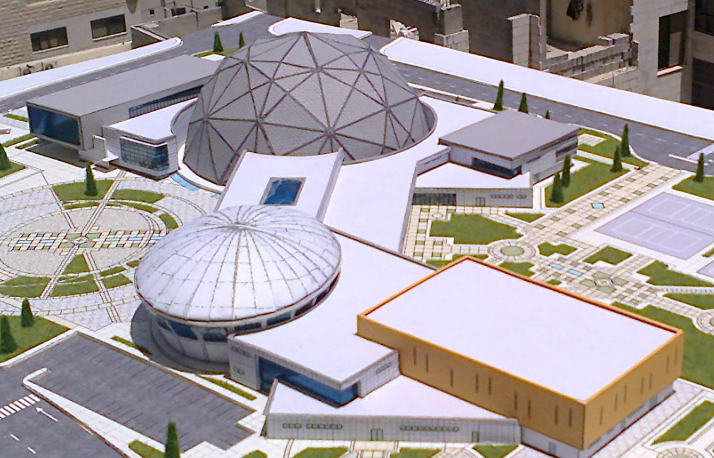
The sport hall

Slide 3
Out line :
Introduction
Site of the Project
Architectural design
Structural design
Environmental design
Mechanical design
Electrical design

Slide 4
Introduction:

Slide 5
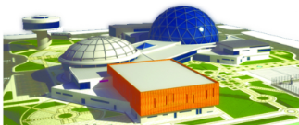
Building:
Area : 6800 m2 for each floor
sport hall
Area : 2800 m2

Slide 6
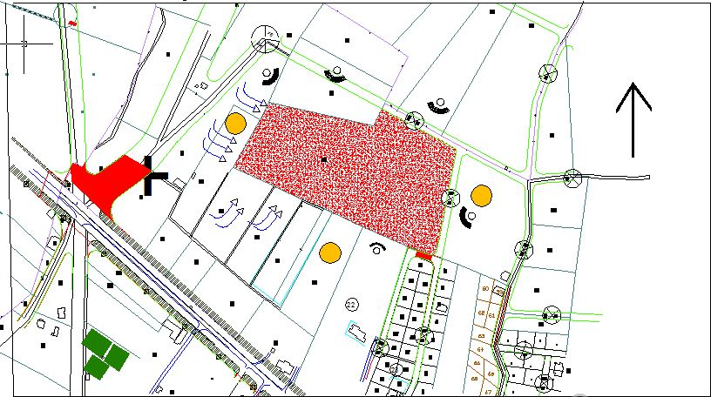
Site of the project
The site of the project is located Jenin behind Haifa street and extend to marj Ben Amer lands with total area of 50000m2

Slide 7

Text
Architectural design

Slide 8
Site Plan:

Slide 9
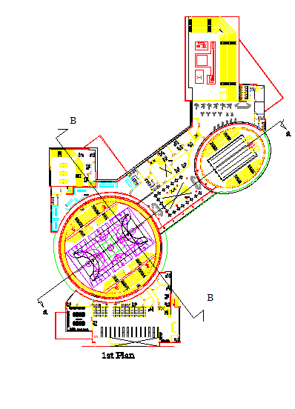
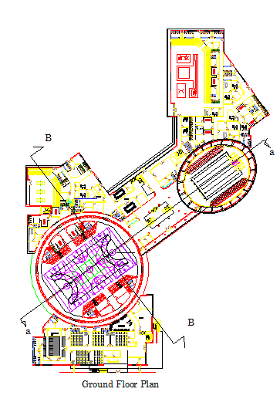
Old plans:

Slide 10
Parking :

Slide 11
Hall plans
Basement plane:

Slide 12
Hall plans
ground plane:

Slide 13
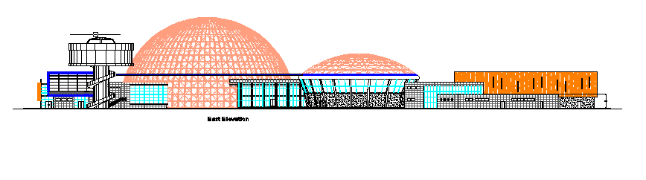
Elevation
EAST ELEVATION

Slide 14
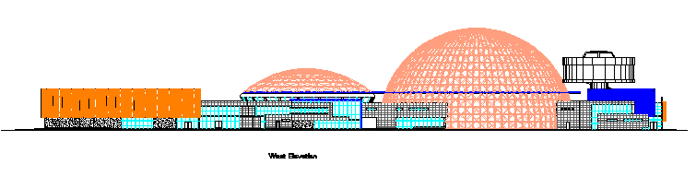
Elevation
WEST ELEVATION

Slide 15
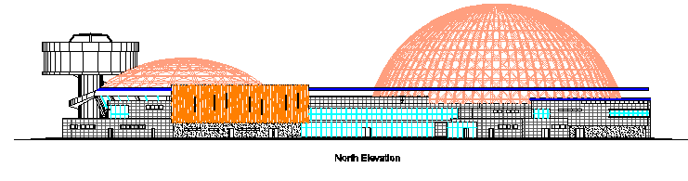
Elevation
NORTH ELEVATION

Slide 16
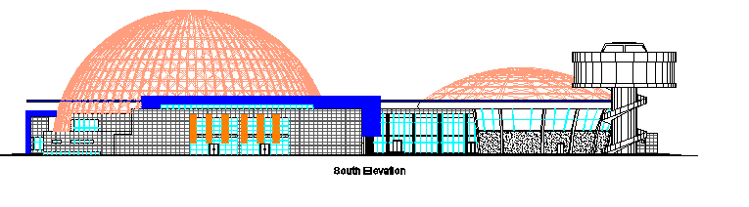
Elevation
SOUTH ELEVATION

Slide 17
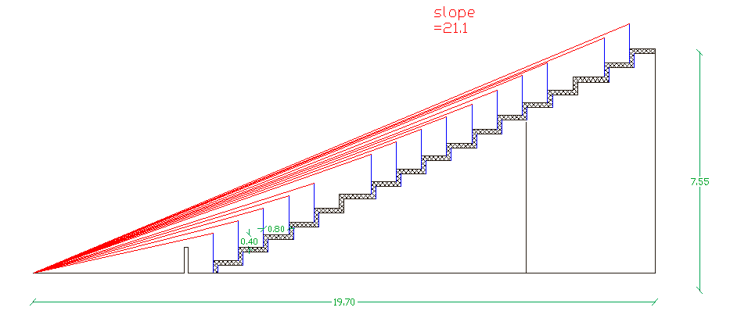
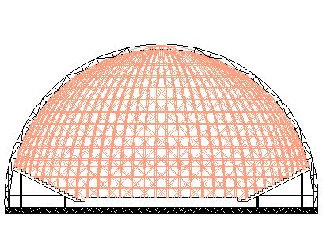
Section

Slide 18

Environmental design

Slide 20
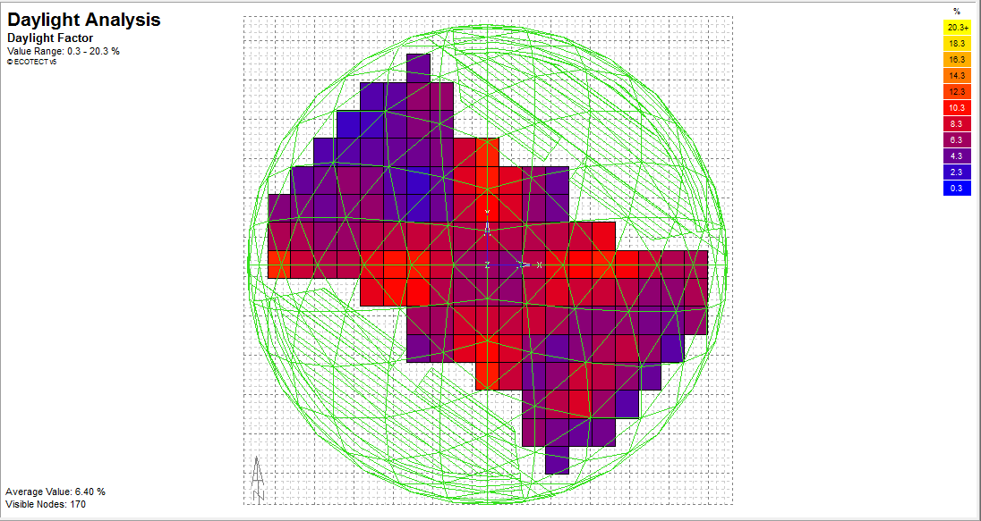

Daylight analysis
Ecotect analysis:
The required value=4%-7%
Ecotect value=6.4% is accepted

Slide 21
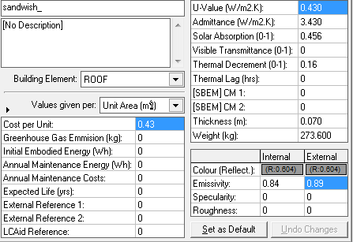
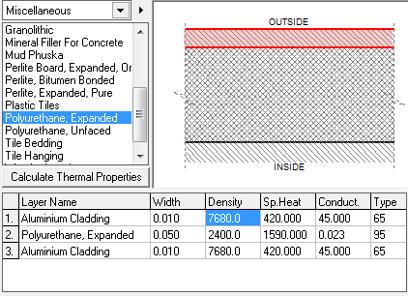
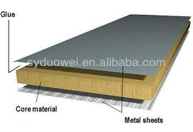
Sandwich panel
The cover of dome panels

Slide 22
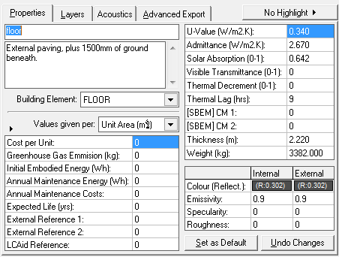
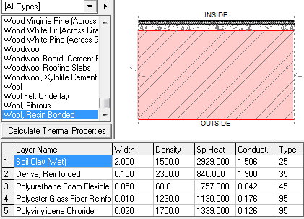
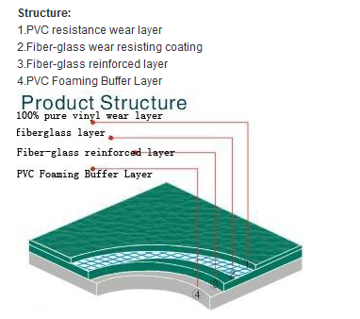
Layers of floor:

Slide 23
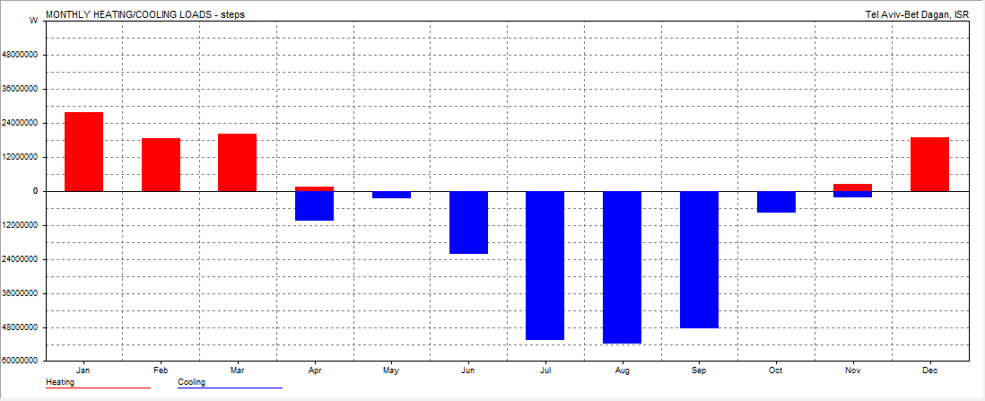
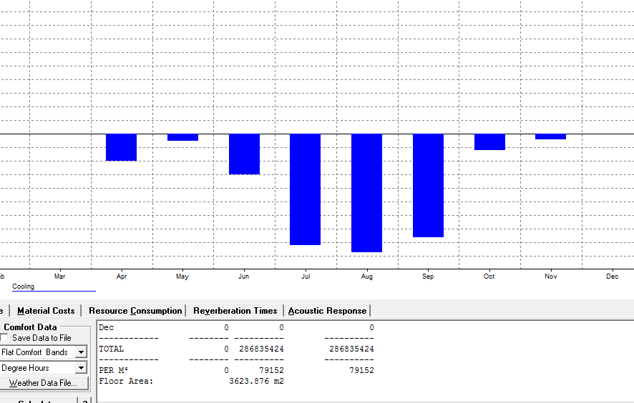
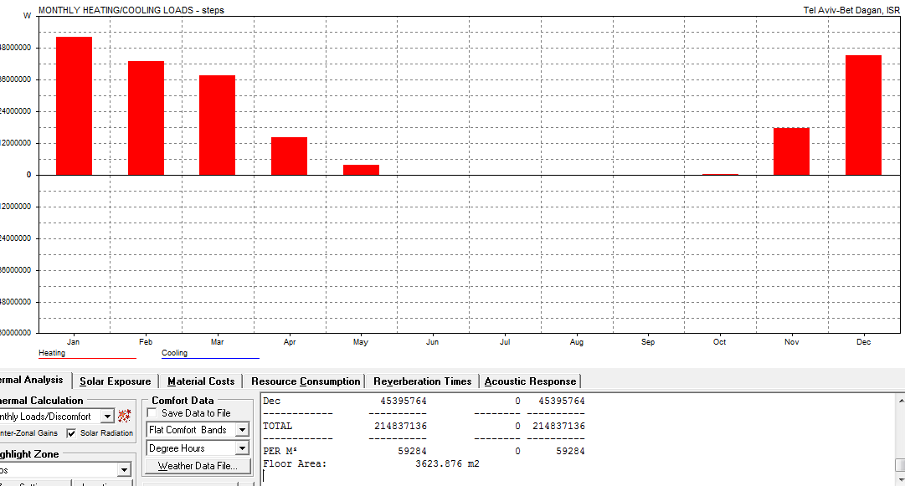
Thermal analysis
Heating and cooling
Cooling load=80kw/m2
Heating load=60kw/m2

Slide 24
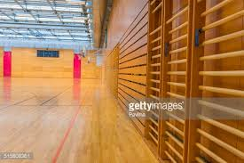
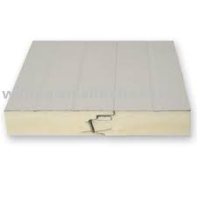
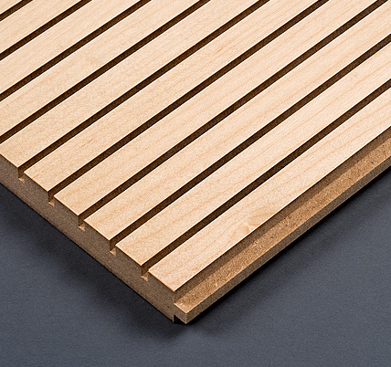
Acoustical analysis
1)Wood provide a solution to the high reverberant noise levels found in sports halls.
2)Roof is sandwich panel It is a good sound absorbent
Likely to reach sound absorption(α) to 1
New RT60 =

Slide 25
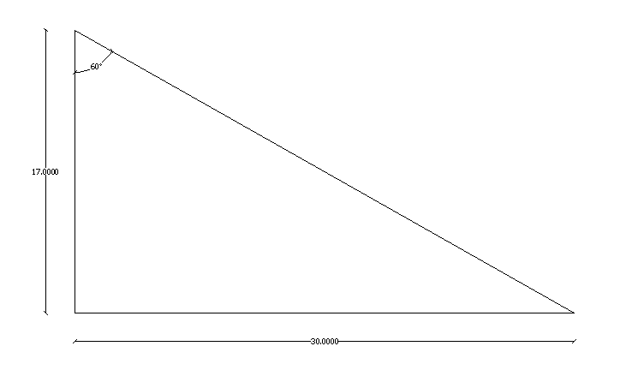
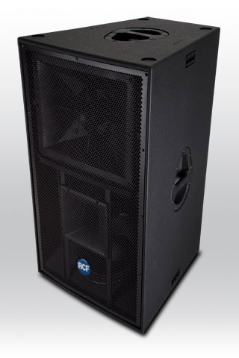
The vertical range
The speakers :

Slide 26
Electrical Design

Slide 27
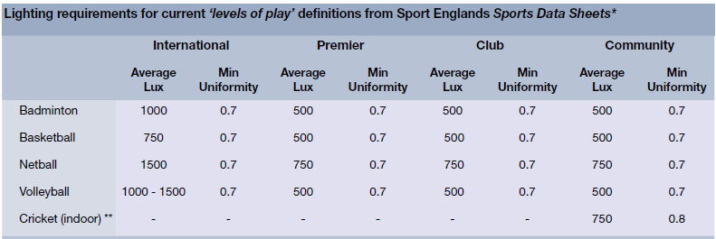

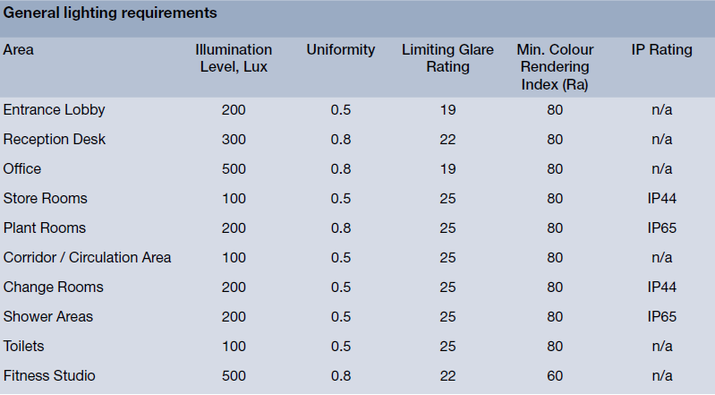
Artificial lighting:
using “Dialux” for sport hall
For The courts
For other room

Slide 28
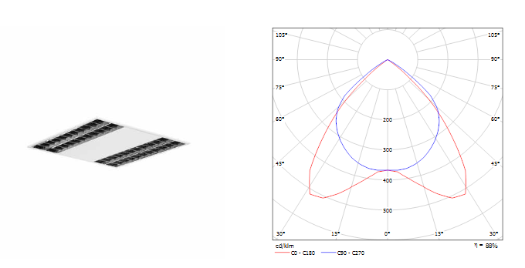
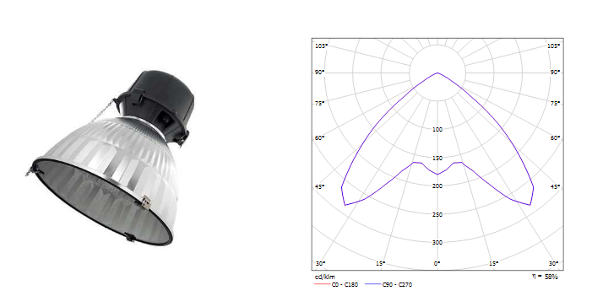
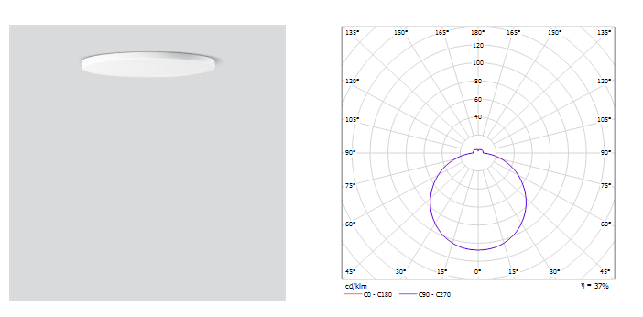
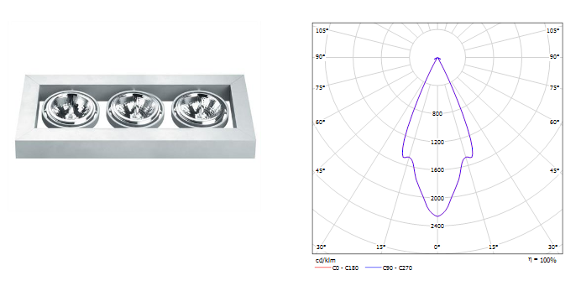
The lamps we used
rooms
The hall
wc

Slide 29
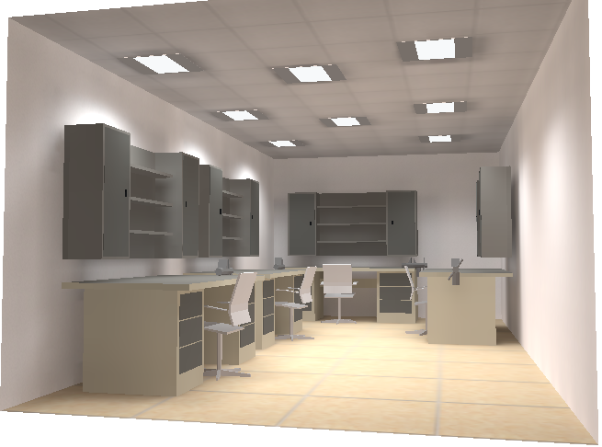
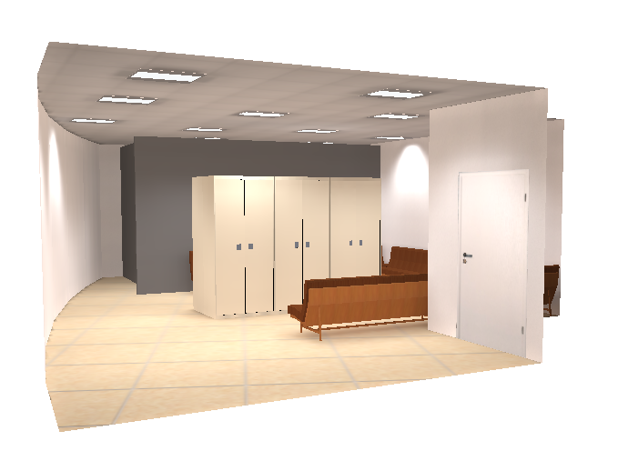
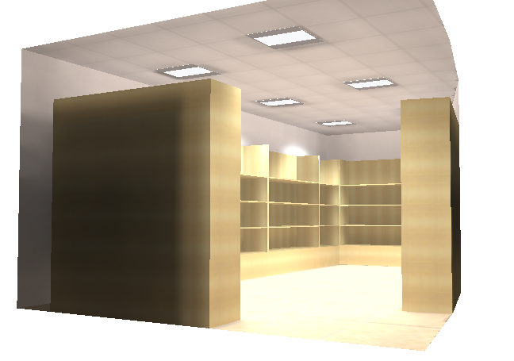

Slide 30
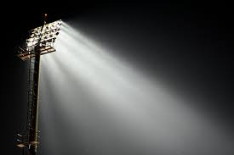
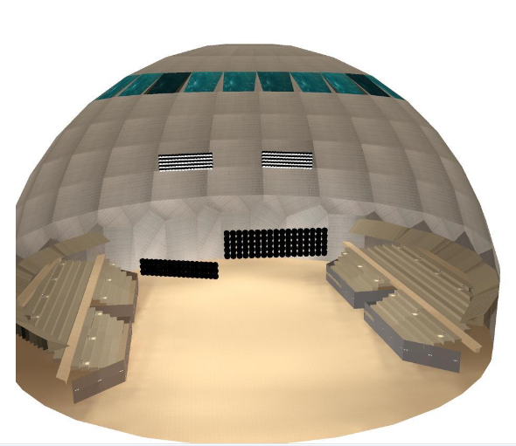
The lighting system in the hall

Slide 31
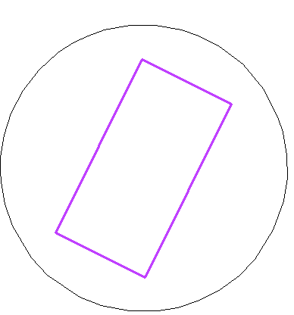
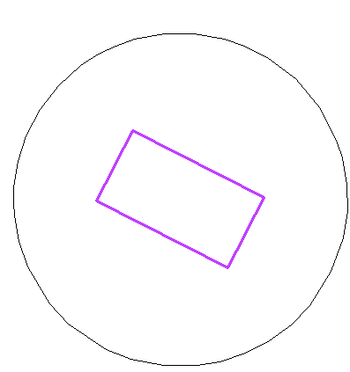


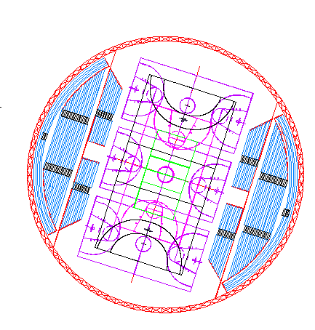
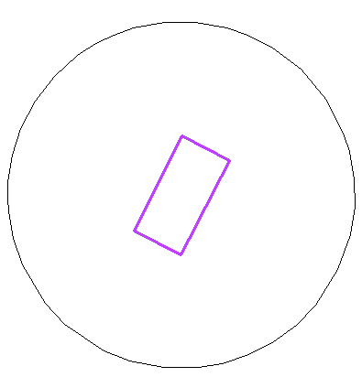


Slide 32
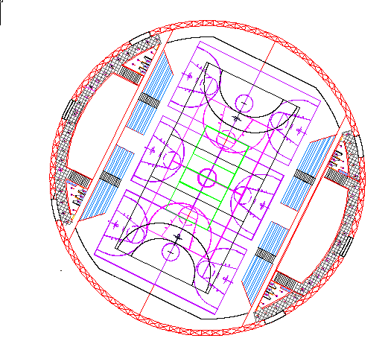
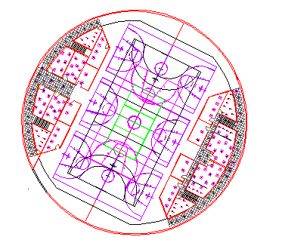
Distribution of lighting:

Slide 33
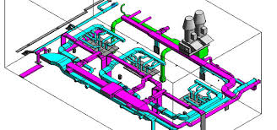
Mechanical Design

Slide 34
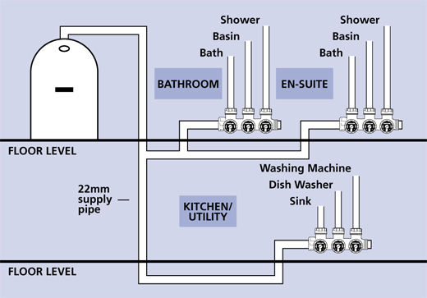
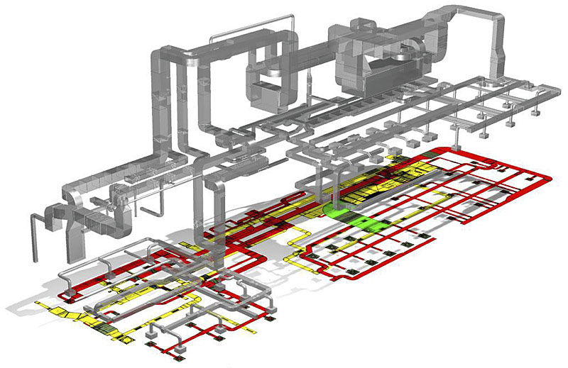
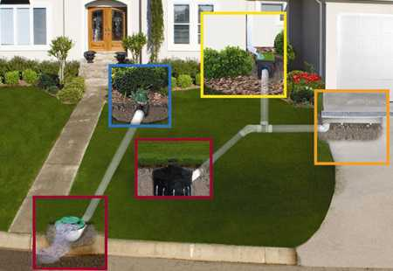
Including :
1- water supply design
2- drainage design
3- HVAC design

Slide 35
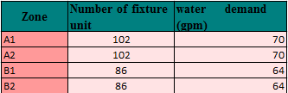
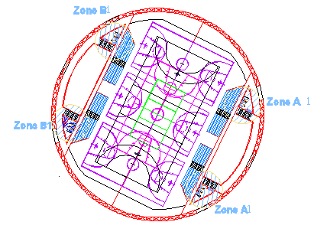
Water supply design :
We've divided the building into four zones and we compute the diameter of the pipes for main vertical feeder, main horizontal feeder and branches for each zone.

Slide 36
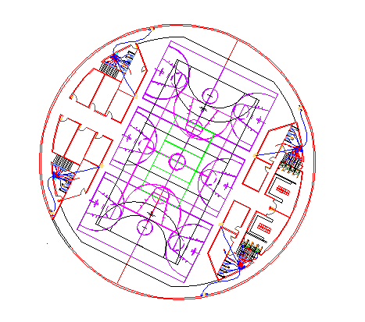

The space for water tanks
Choosing out side water tanks
The capacity of water tanks = 150 m3

Slide 37



Zone A water supply
Collector

Slide 38



Calculations results :
Vertical (steel)
Horizontal and branch(pvc)

Slide 39


Drainage design
pipe | diameter
Vertical(stack) | 4”
horizontal | 4”1%slope
The main drain pipes (underground pipes | 4”2% slope
Zones

Slide 40



Use 2septic tank(To dispose of waste water in the hall)
Specific room
With pumps

Slide 41


we find the dimensions of the septic tank then we draw it in the plan .
Length=14ft=4m
Width=8ft=3m
Height=6ft=2m

Slide 42


HVAC system:
For solving the problem of height of building, (wall diffuser) was selected for this objective.

Slide 43
Structural design

Slide 44
Design codes :
The American Concrete Institute code (ACI 318-08).
American Institute Of Steel Construction code (AISC 360-05)
The seismic design according to UBC-97.
The analysis and design were done using SAP2000.

Slide 45
Design data :
1. Concrete compressive strength
f’c =24 MPa for slabs and beams.
f’c =28MPa for shear walls, and footings.
2.Yielding strength of steel
The yield strength of steel Fy= 420MPa
3. Bearing capacity of soil
the bearing capacity of soil = 240 KN/m2

Slide 46
Structural systems
Two way solid slab with drop beams "stairs”
Truss system “hall Building”
Thickness :
Two way solid slab = 30cm
Truss system span = 2m

Slide 47
Structural elements
1. Truss members sections
2. Stadium (( 18 steps .slope 25))
4.Shear wall
3. Beams
5.Retining wall(30cm*350cm)
6.Footing:

Slide 48

Structural elements
Type | Dimensions(mm)
Hollow rec. section (Top) | 168X240X10
Hollow rec. section (Bottom) | 260X182X10
Hollow rec. section (Braces) | 140X140X7
1. Truss members sections :
Type | Dimensions (cm)
Landing | 80
Run | 40

Slide 49

Beams
Stairs details
Type | Dimensions(mm)
Main beams | 750X400
Secondary beams | 400X300

Slide 50


Retuning wall details

Slide 51


Matt foundation details :

Slide 52


3D view
2D view

Slide 53


Truss system: (designed sections)
For top bars: (TUBO 200*100*5.9)
For bottom bars: (TUBO 200*100*5.4)

Slide 54

For bars connected to retaining wall: (TUBO 340X170X10):

Slide 55

bars connected to retaining wall:

Slide 56



Slide 58
Fire protection design:
  1)Exit.
  2)First aid
  3)Fire extinguisher
  4) Fire hose system
  5) fire sprinkler

Slide 59


  In case of emergency
  The best way to escape

Slide 60
Cost estimation

Slide 61

  This table shows the a rough cost estimate

