Slide 1
Redesign of Residential and
Commercial building
Graduation Project 2
Prepared By:
Ali Mahamdeh
Amr Sama’neh
Anas Suheil
Mohammad Kharouf
Building Engineering Department
Supervised by: Eng. Fadi Fatayer

Slide 2
Outline:
Introduction
Structural Design
Quantity Surveying and Cost Estimation
Environmental Design
Mechanical Design
Electrical Design
Architectural Redesign
Safety Design

Slide 3
Introduction:
Multi-functional building in general ( commercial and residential) is an example of the integrated design that use different functions to achieve the economic benefits in its own region as well as to exploit the street categories in the right case as mentioned by the local municipality .
However, multi-functional buildings are considered to be one of the vast and vital projects that spread worldwide in globe in general and in Palestine in particular since human beings need that type to express their needs and to provide a safe place where inhabitants can exercise their socio-cultural activities.

Slide 4
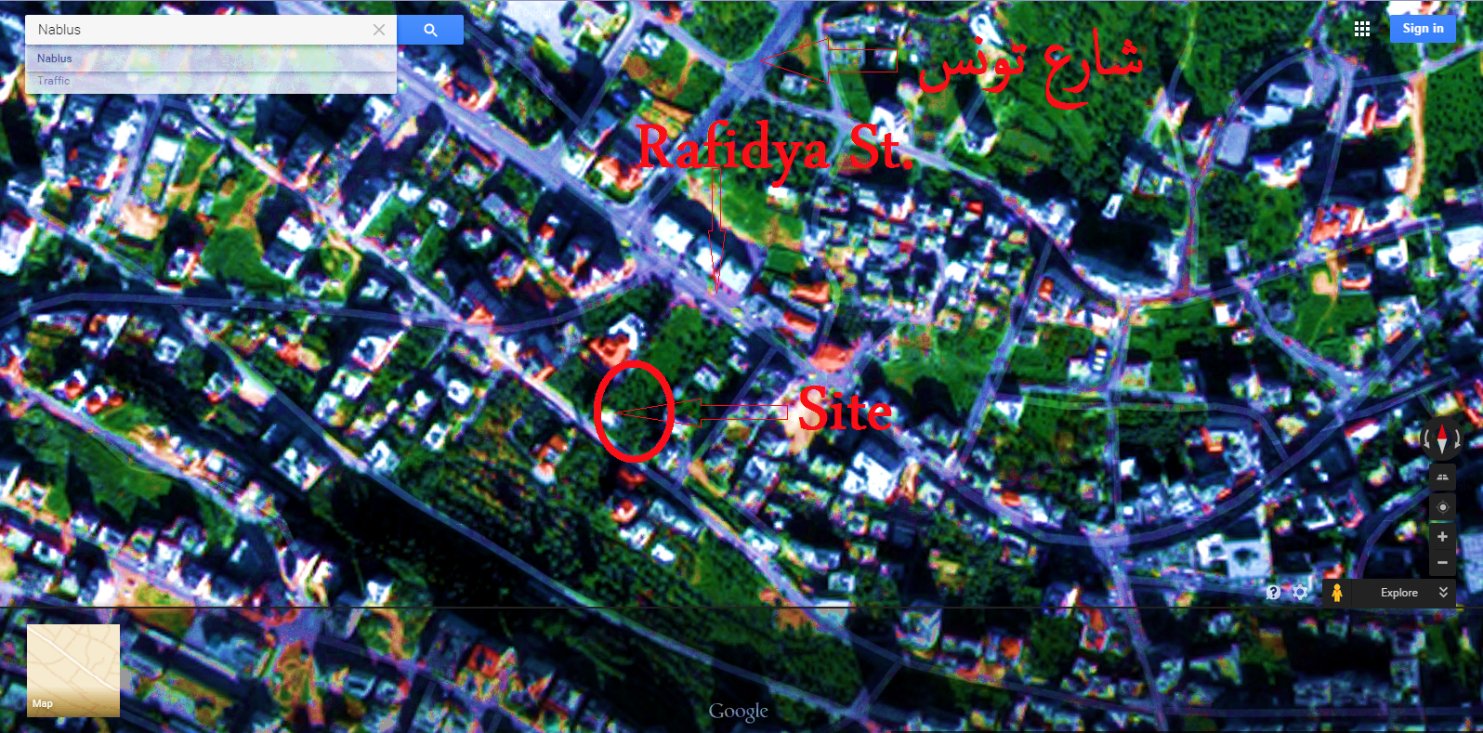
Site location:
Location: Nablus City, Rafidya street behind of Amaken Restaurant

Slide 5
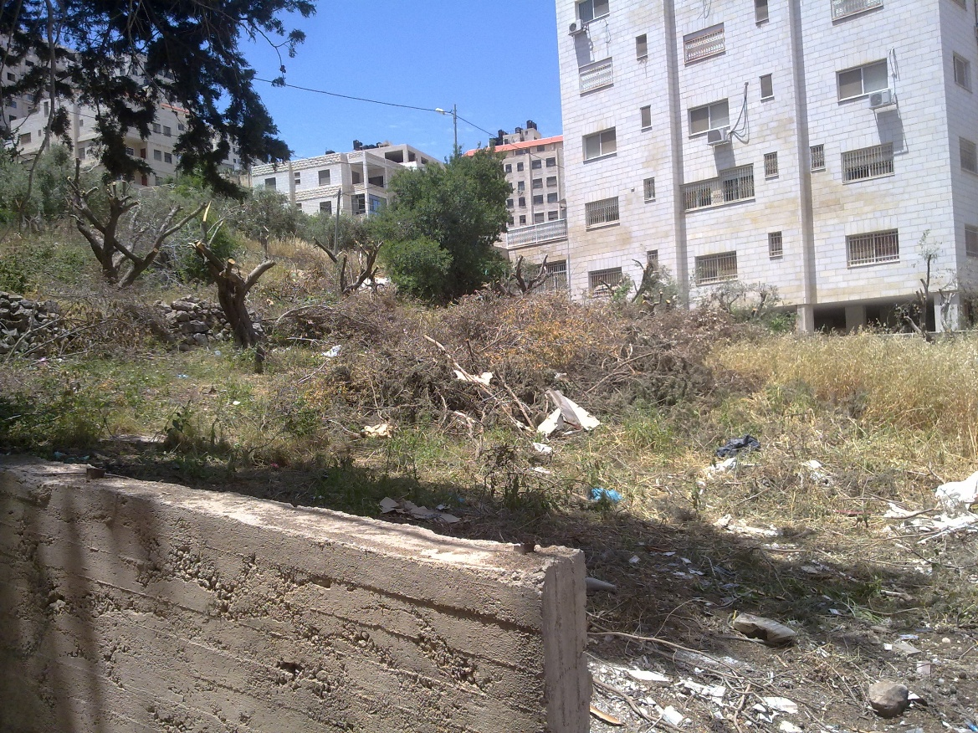
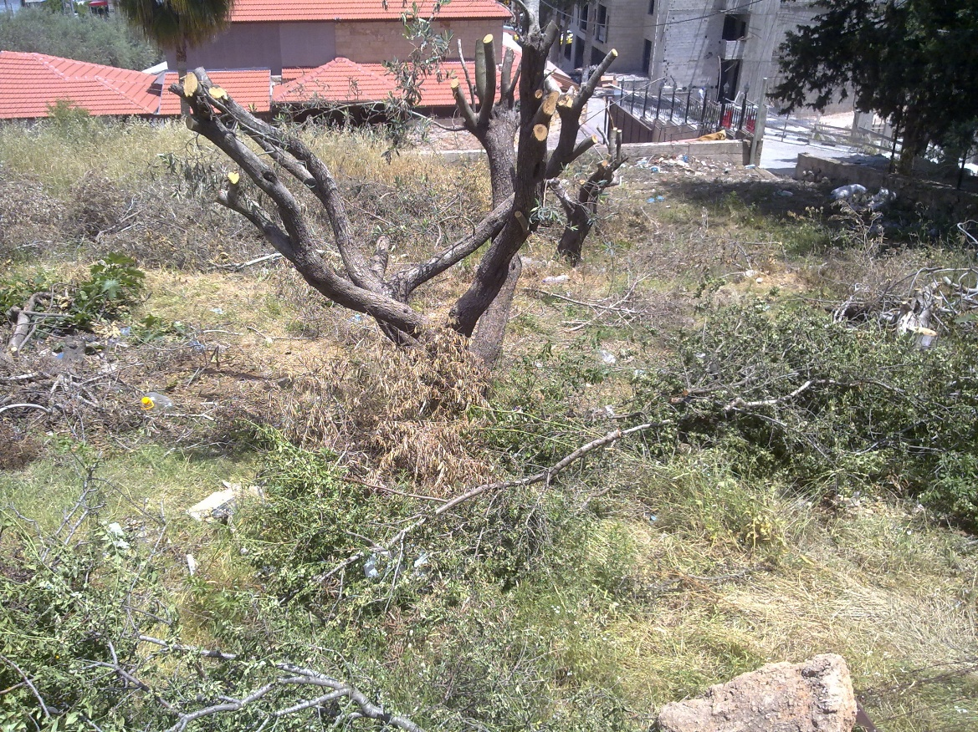
Site location:
Site Advantages :
The slope of land can be handled.
Has a quiet surrounding environment.

Slide 6
Architectural Re-Design

Slide 7
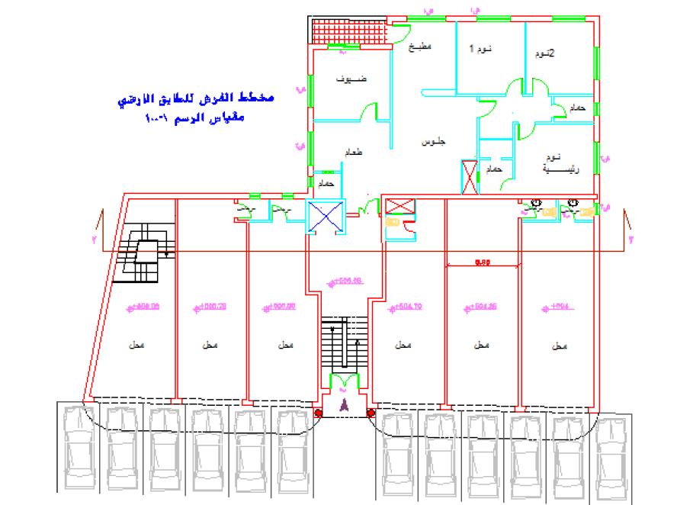
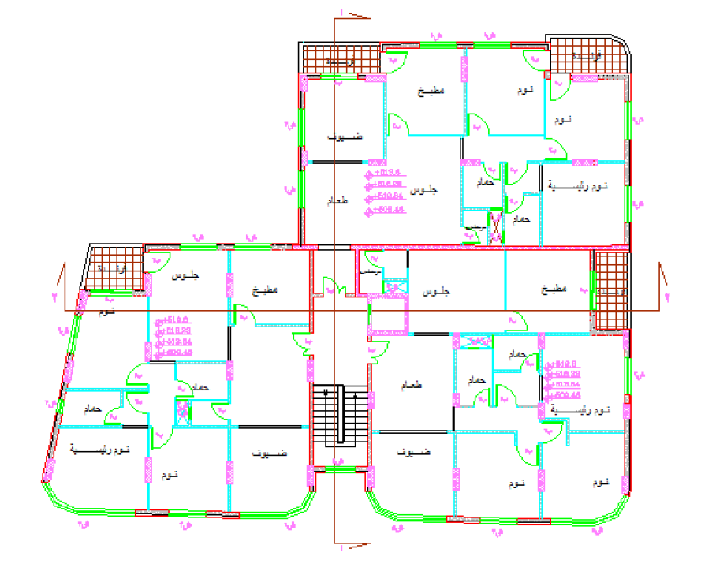
Architectural Redesign:
Old design layout:

Slide 8
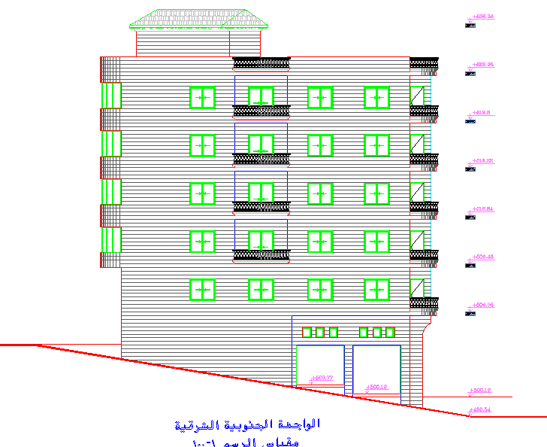
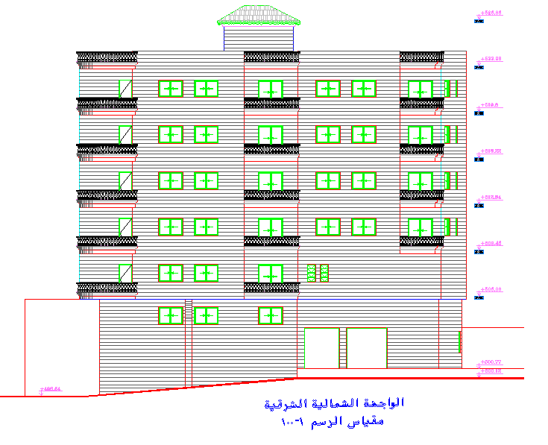
Architectural Redesign:
Old design elevation:

Slide 9
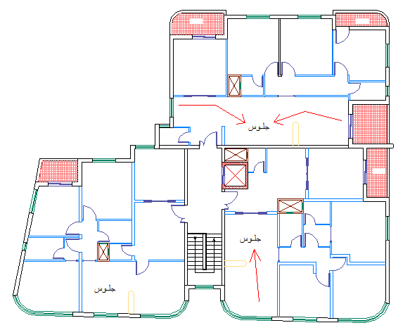
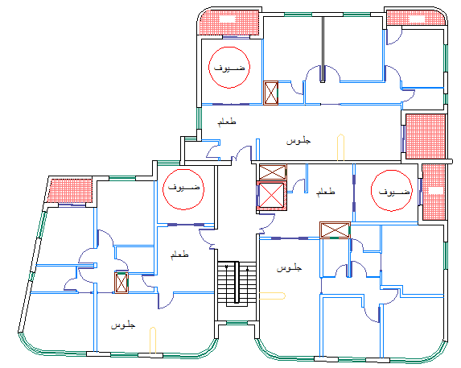
Architectural Redesign:
Modifications:
Rearranging the locations of kitchens, living room, dinning, and guest rooms in compatible of ventilation, lighting, and the ease of access.
Making architectural changes in the shape of building to obtain the privacy between the three apartments.

Slide 10
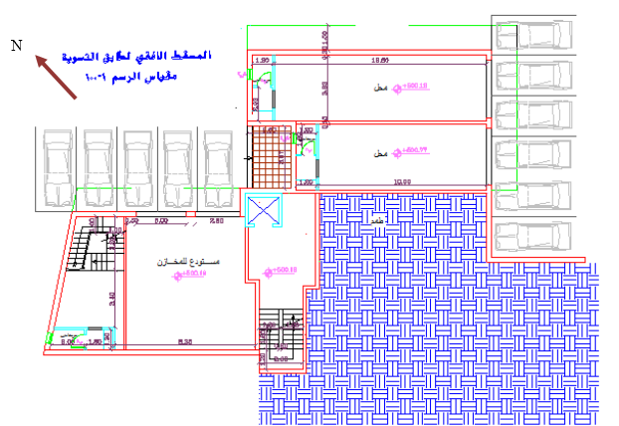
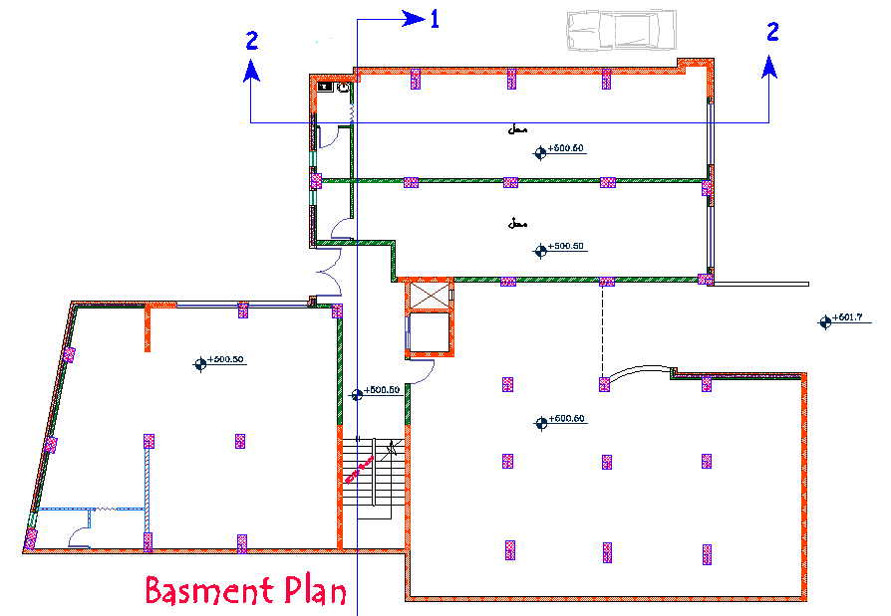
Architectural Redesign:
Modifications:
Changing the locations of bathrooms in order to decrease the amount of ventilation-voids
Removing the backfill soil, thus allowing for more space for cars.
Enlarge sizes for certain stores

Slide 11
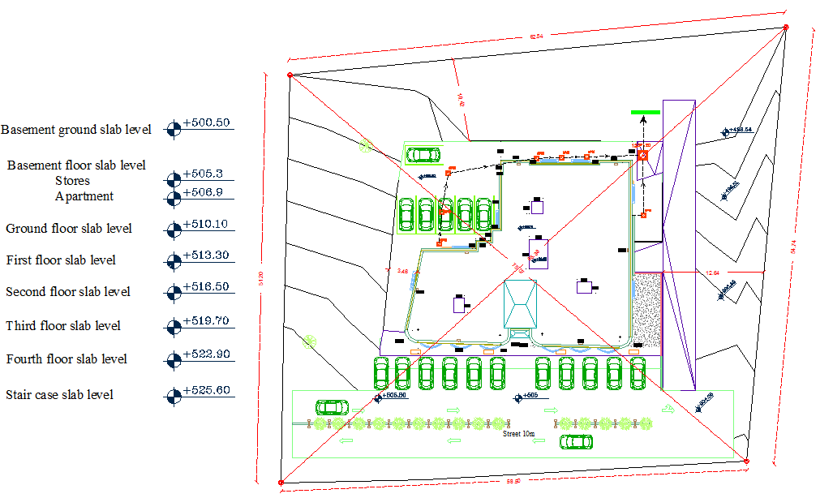
Architectural Redesign:
Site plan:

Slide 12
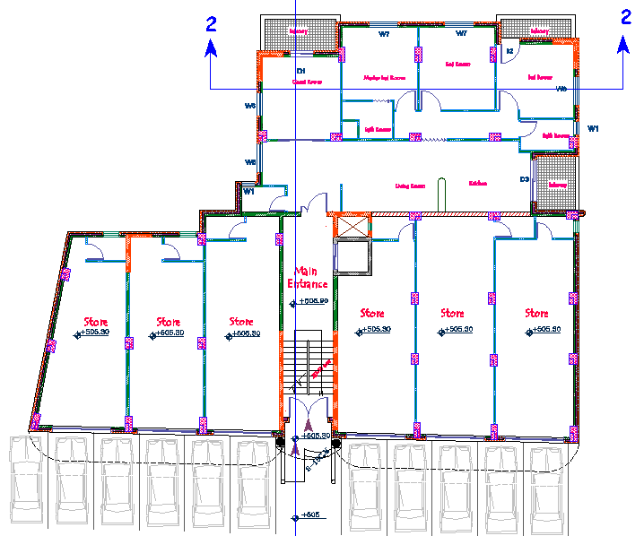
Architectural Redesign:
Ground Floor Area = 480 m².

Slide 13
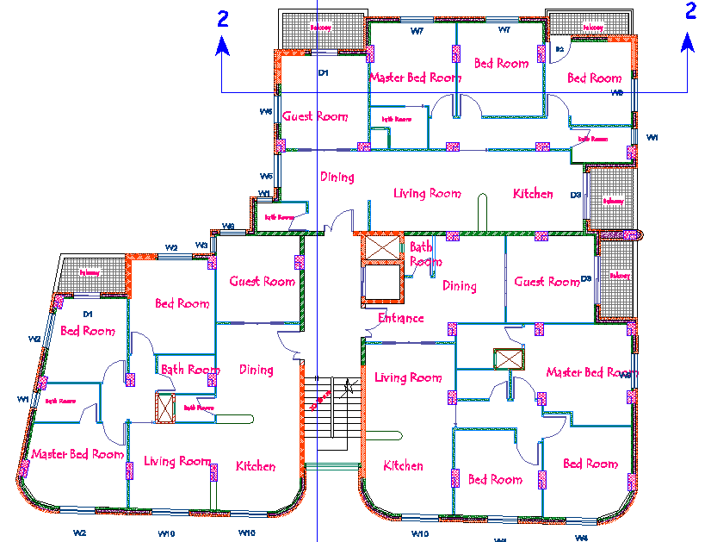
Architectural Redesign:
First Floor Area = 520 m².

Slide 14
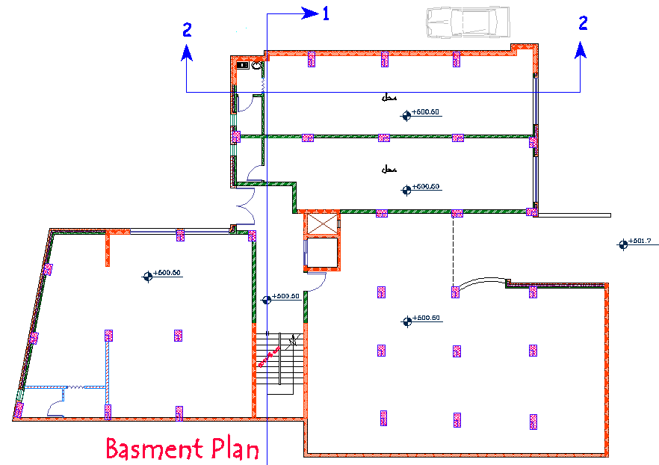
Architectural Redesign:
Basement Floor Area = 500 m².

Slide 15
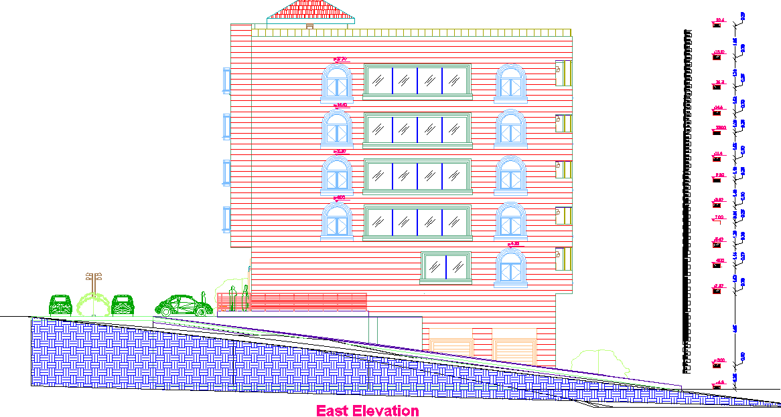
Architectural Redesign:
Elevation:

Slide 16
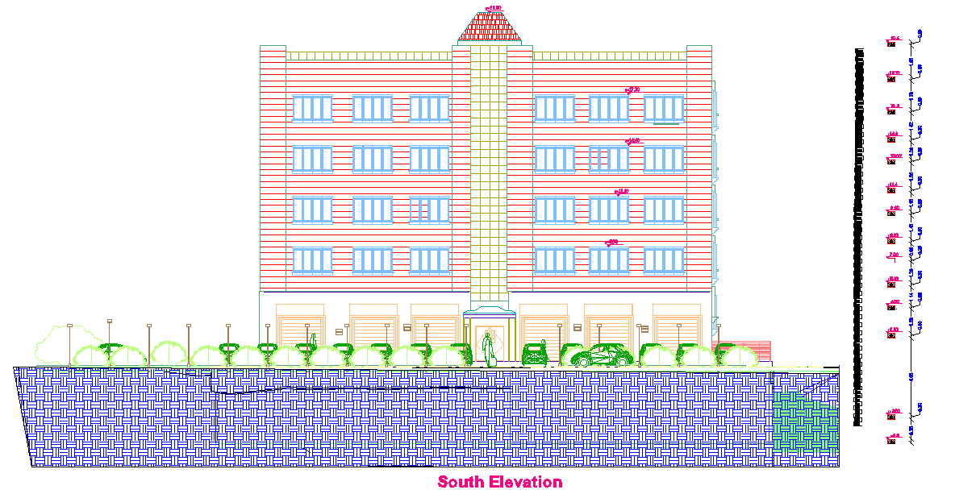
Architectural Redesign:
Elevation:

Slide 17
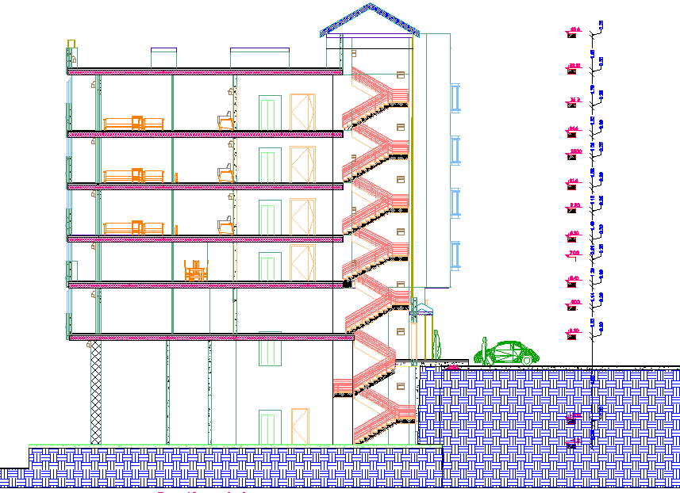
Architectural Redesign:
Section:

Slide 18
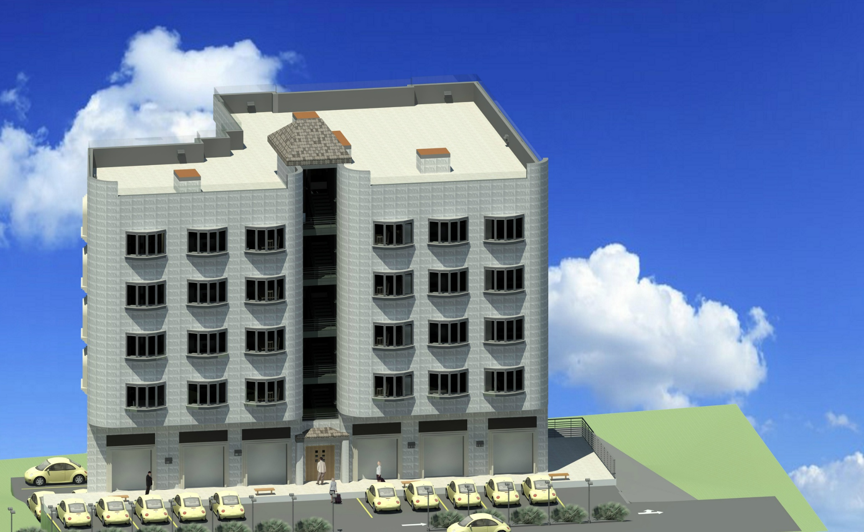
Architectural Redesign:
Final design photos:

Slide 19
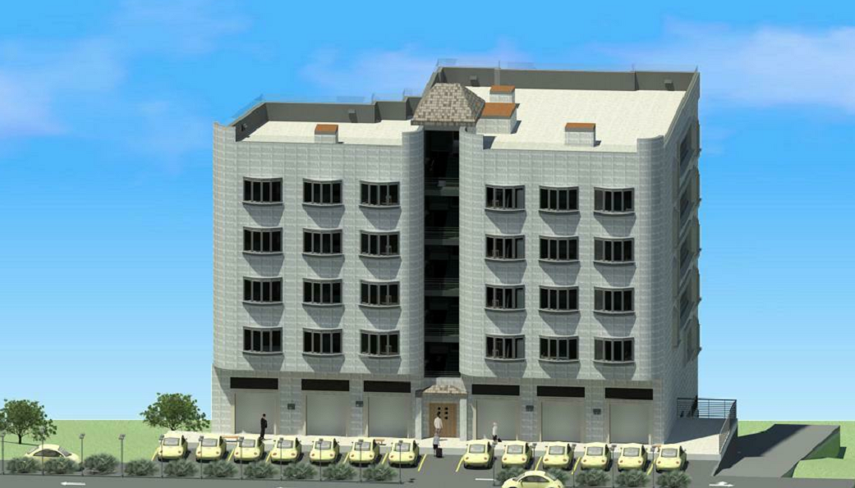
Architectural Redesign:
Final design photos:

Slide 20
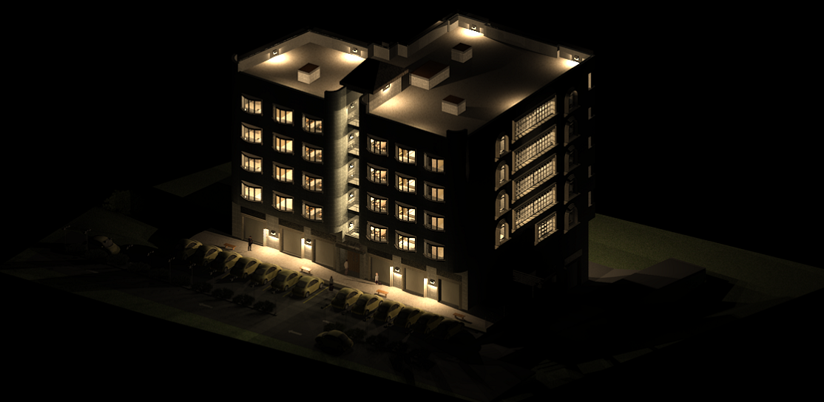
Architectural Redesign:
Final design photos:

Slide 21
Architectural Redesign:
Video

Slide 22
Architectural Redesign:
Video:

Slide 23
Structural Design

Slide 24
Structural Design:
Design Codes:
ACI -318-08 (American Concrete Institution) for reinforced concrete structural design.
UBC-97 (Uniform Building Code) for earthquake load computations.
ASCE (American Society Of Civil Engineers) for design loads.

Slide 25
Structural Design:
Materials:
Material | Density KN/m³
Reinforced concrete | 25
Concrete Hollow Block | 12
Masonry stones | 27
Polystyrene | 0.3
Mortar | 26
Glass | 2.3

Slide 26
Structural Design:
Types of loads:
Type of load | Load KN/m²
Live load For Apartments Live load For Storages | 3 KN/m² 5 KN/m²
Super imposed dead load | 4 KN/m²
Exterior walls | 21 KN/m
Combined Glazed walls with stone | 7 KN/m

Slide 27
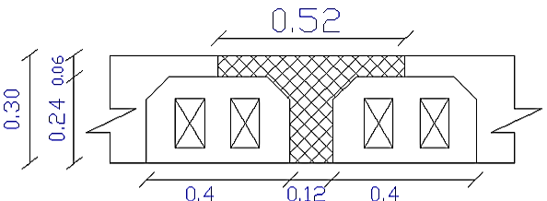
Structural Design:
Structural System:
Ribbed slab system.
The system of the slab is one way ribbed slab(30 cm thickness) with Hidden beams.

Slide 28
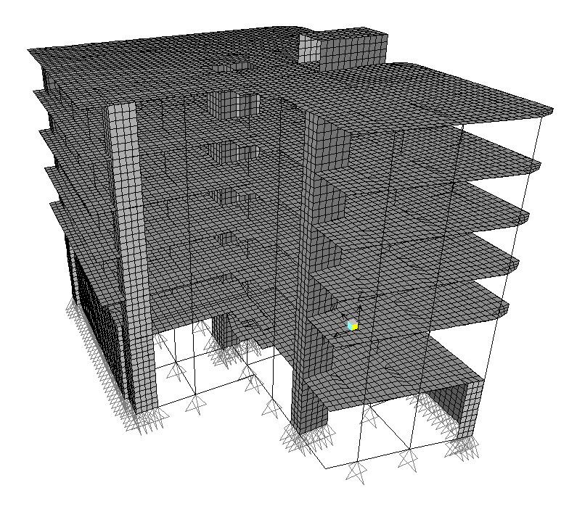
Structural Design:
Sap model:

Slide 29
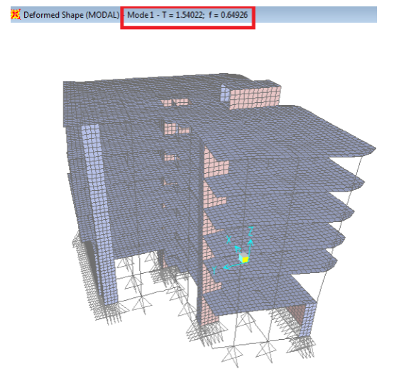
Structural Design:
Model validation:
Compatibility check

Slide 30
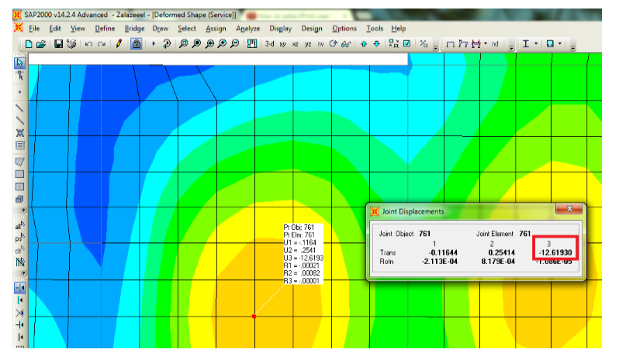
Structural Design:
Deflection check:

Slide 31
Structural Design:
Equilibrium check:
Load | Manual | Sap | Error
Dead load | 25238.8 KN | 25613 KN | 1.46 %
Live load | 3710 KN | 3820.2 KN | 2.88 %
Internal forces check
Element | Manual | Sap | Error
Slab | 35.4 KN.m/m | 36.65 KN.m/m | 3.41 %
Beam | 157.16 KN.m | 163.10 KN.m | 3.64 %
Column 7 | 2058 KN | 2176.959 KN | 5.00 %

Slide 32
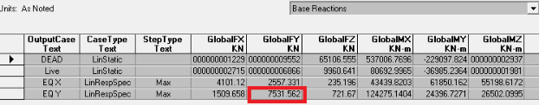
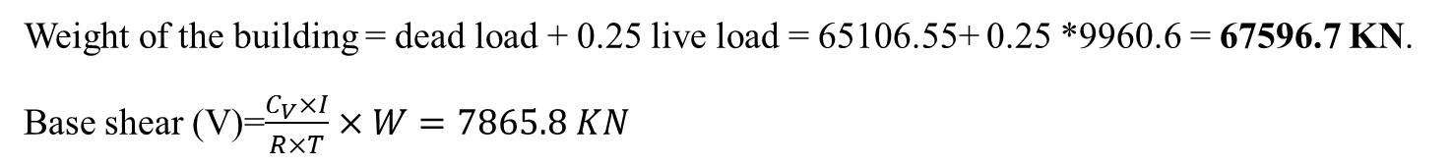
Structural Design:
Dynamic Analysis
Weight of the building = dead load + 0.25 live load = 65106.55+ 0.25 *9960.6 = 67596.7 KN.
Base shear (V)=$\frac{C_{V}×I}{R×T}×W=7865.8 KN$

Slide 33
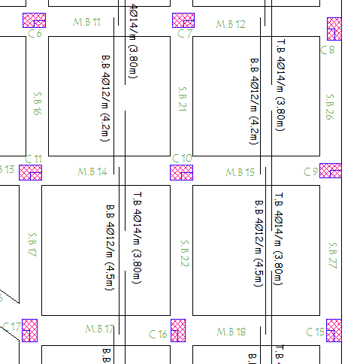
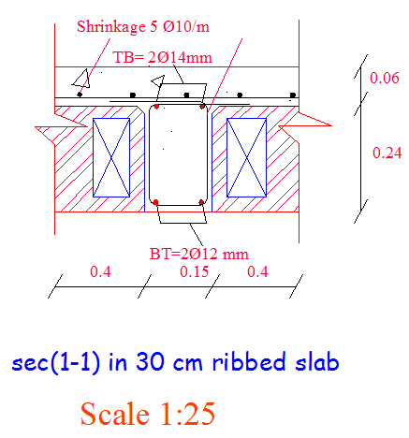
Structural Design:
Slab Reinforcement

Slide 34
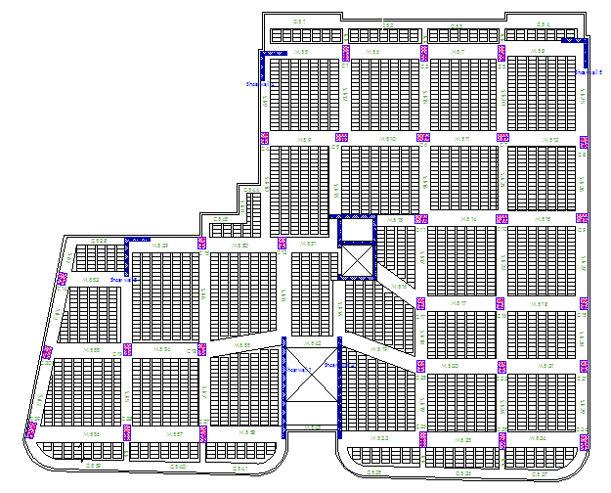
Structural Design:
Beam Layout

Slide 35
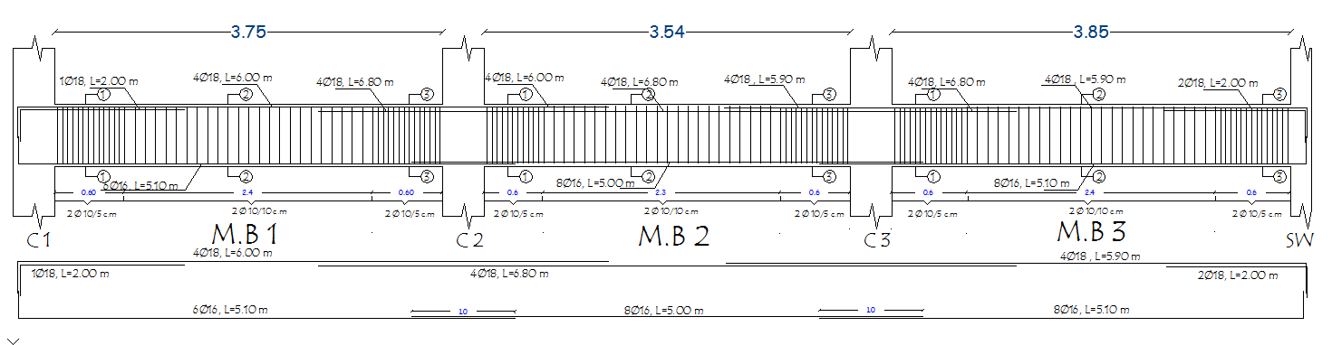
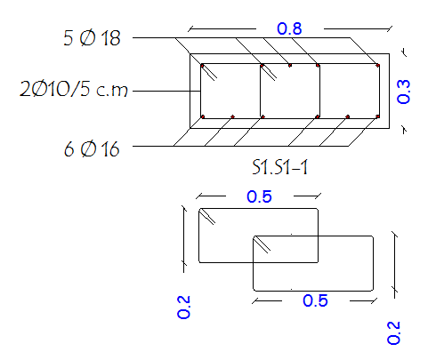
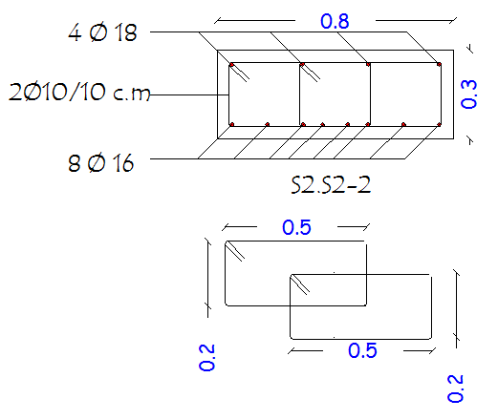
Structural Design:
Beam Reinforcement

Slide 36
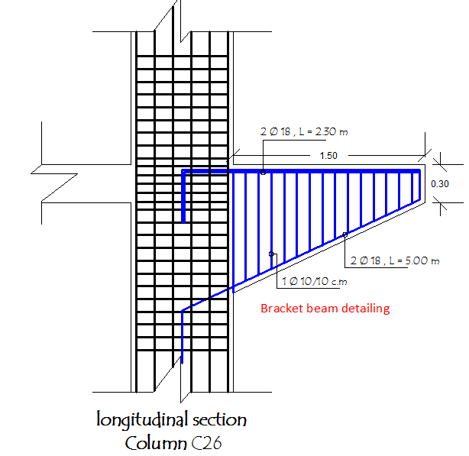
Structural Design:
Bracket Beam Reinforcement

Slide 37
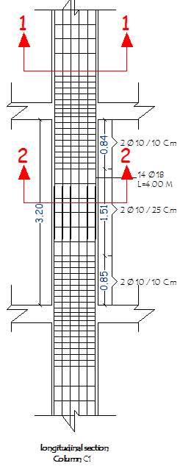
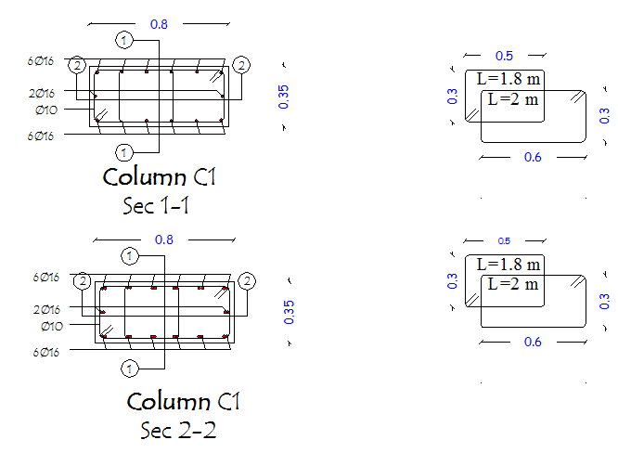
Structural Design:
Column Reinforcement

Slide 38
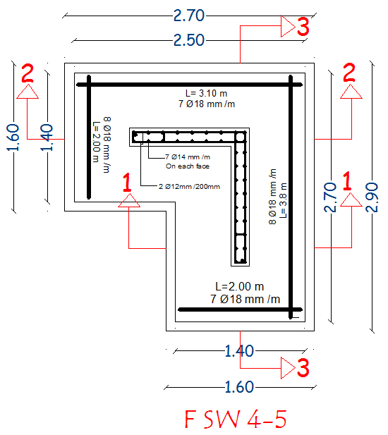
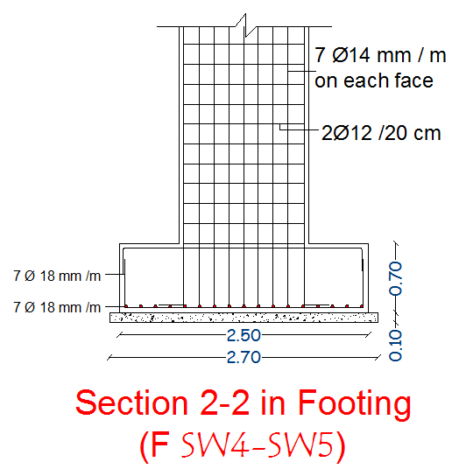
Structural Design:
Shear wall Reinforcement

Slide 39
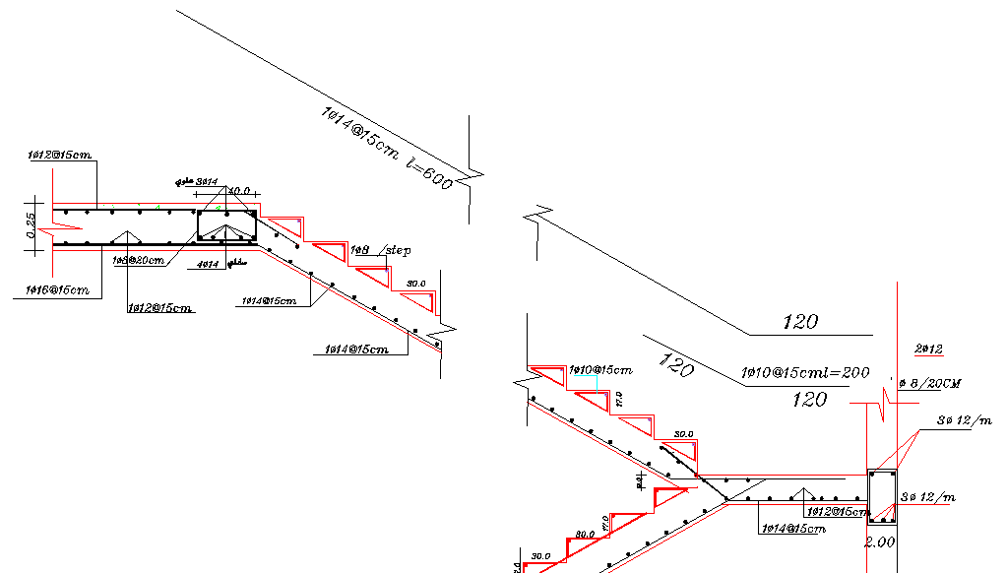
Structural Design:
Stairs Reinforcement

Slide 40
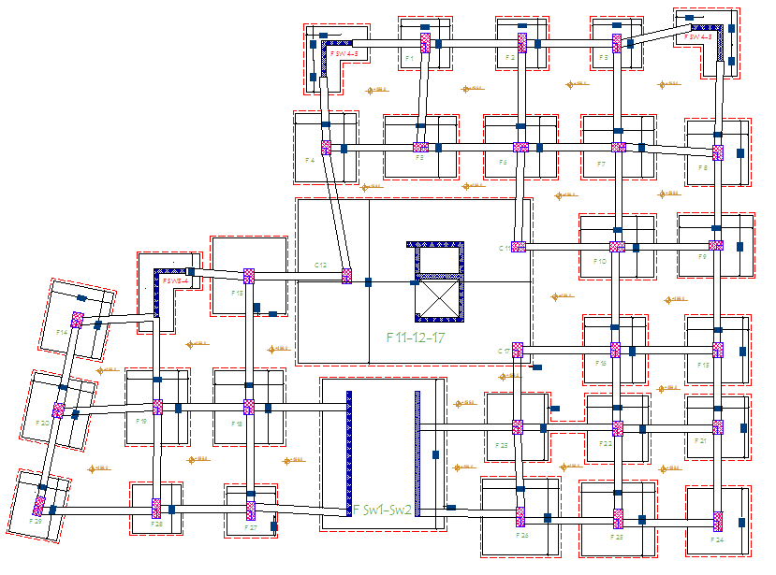
Structural Design:
Footing layout

Slide 41
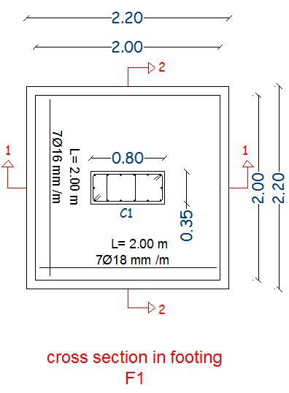
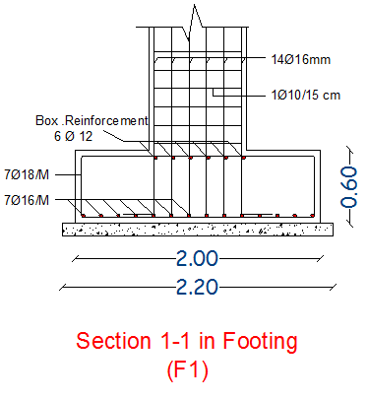
Structural Design:
Footing Reinforcement

Slide 42
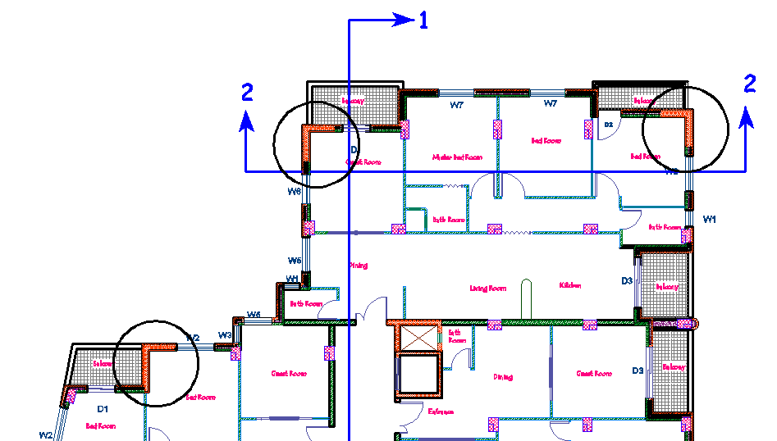
Structural Design:
Earthquake Requirements
Angel Shear wall at the corner of building.
Bracket beam at cantilever to reduce potential risk for cantilever

Slide 43
Structural Design:
Bracket Beam Reinforcement

Slide 44
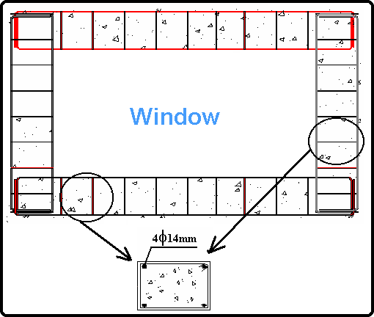
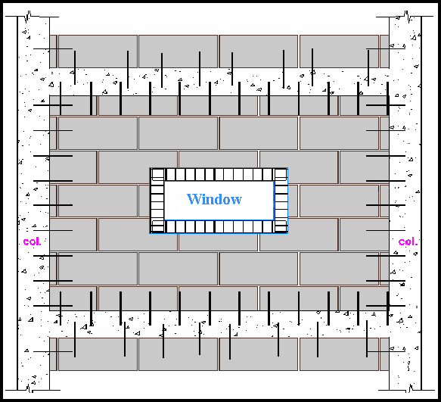
Structural Design:
Reinforcement around window

Slide 45
Environmental Design

Slide 46
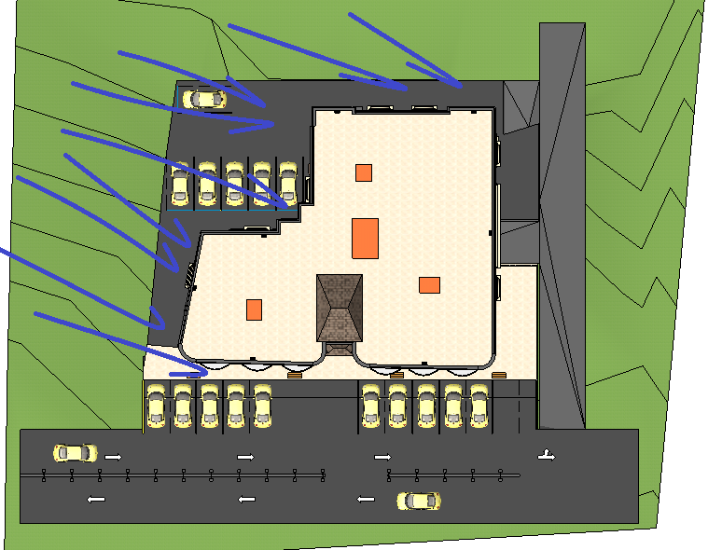
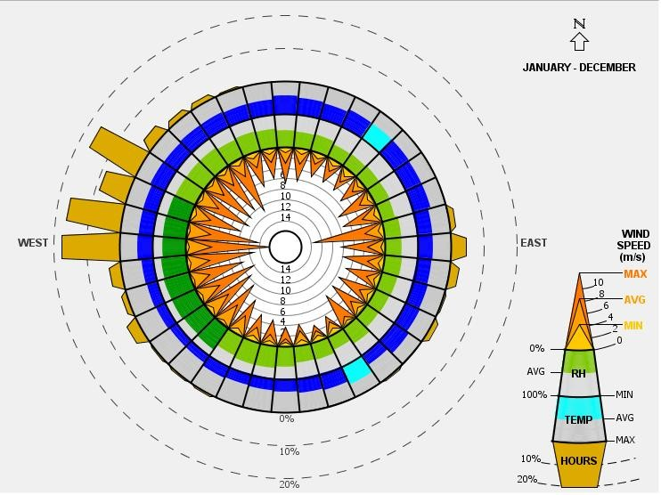
Environmental Design:
Wind analysis:

Slide 47
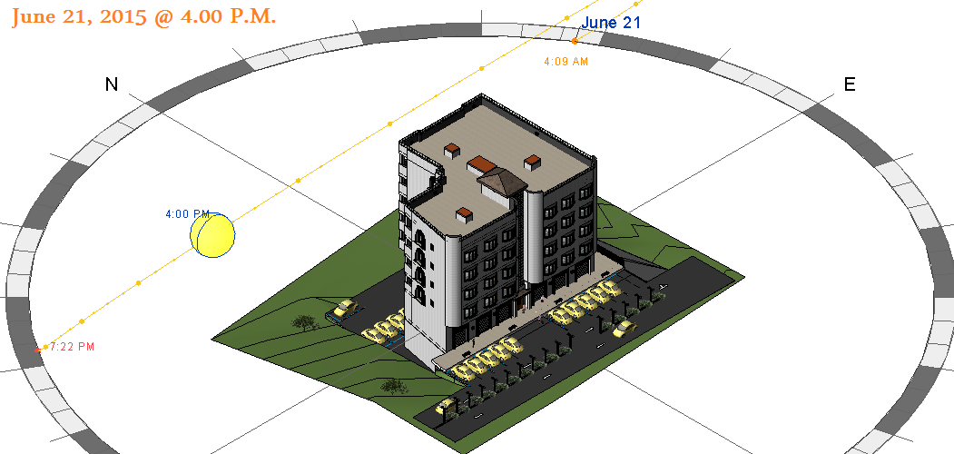
Environmental Design:
Solar analysis:
Summer day

Slide 48
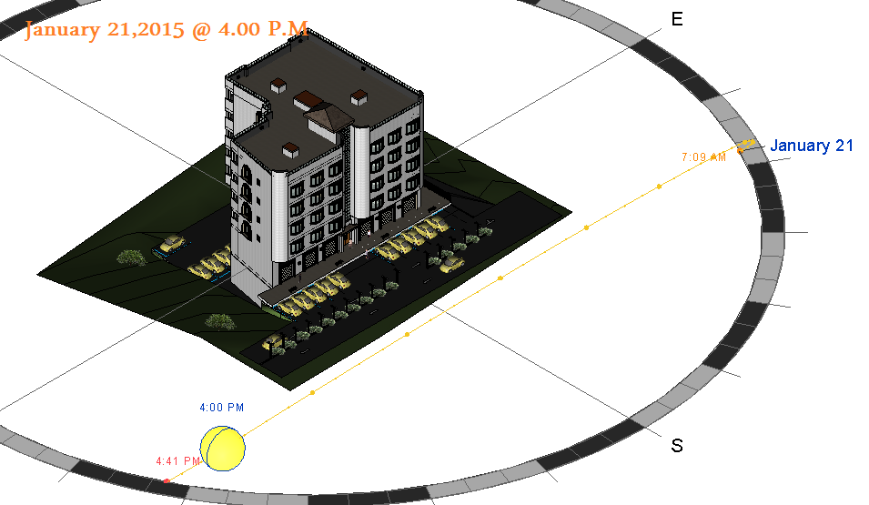
Environmental Design:
Solar analysis:
Winter day

Slide 49
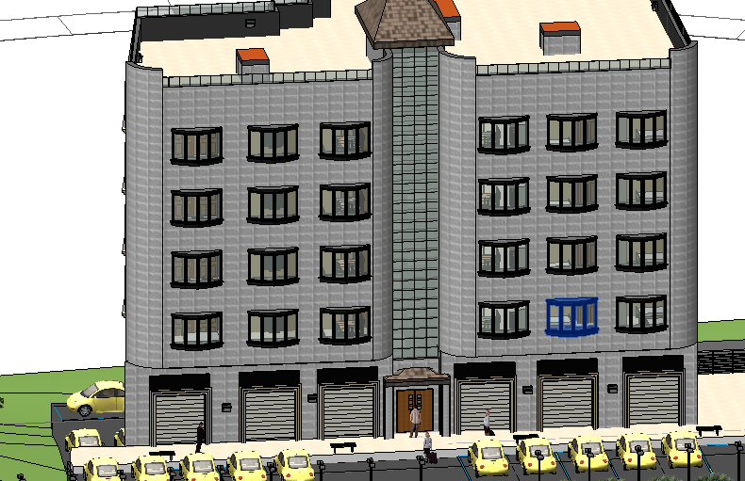
Environmental Design:
Solar Shading:
The southern elevation was considered to be the most critical one because it is fully exposed to solar with large glassing windows which affected the results of solar gaining along the whole .

Slide 50

Environmental Design:
Solar Shading:
As shown in the last figure, the sun is concentrated on the southern elevation at the afternoon hours where is the highest peak for sun at summer. So the heating gain is huge.
Solution:
Using vertical louvers with depth 1m to block sun exposure, in order to reduce heat gain and side fines with depth 1m
Used material:
Windows are double glassing with 20% e and 6mm argon gas
Glassing doors with 70% visibility

Slide 51


Environmental Design:
Solar Shading:

Slide 52
Environmental Design:
Thermal Insulation:
The goal: The achieved thermal coefficient U for all new and air-conditioned buildings should be not more than the U-value of the specified code
 | Highest Value for U | Outer structural elements of the building |  | Number
 | 0.5 | The External wall |  | I-1
 | 0.39 | Exposed horizontal roof |  | I-2
 | 0.39 | Exposed leaning roof |  | I-3

Slide 53


Environmental Design:
Thermal Insulation:
Exterior wall
 |  | R | K | Thickness (m) | Material Name
 |  | 0.31 |  |  | Inside
 |  | 0.019 | 2.6 | 0.05 | Stone
 |  | 0.054 | 1.85 | 0.1 | concrete
 |  | 2.27 | 0.022 | 0.05 | insulation
 |  | 0.24 | --- | 0.1 | Block
 |  | 0.014 | 1.4 | 0.02 | Plaster
 |  | 0.05 |  |  | External
 |  | 2.957 | Total
U = $\frac{1}{R}$ = 0.338 (W/(m.$K^{0}$))< 0.50

Slide 54



Environmental Design:
Thermal Insulation:
Ceiling
U = $\frac{1}{R}$ = 0.32 (W/(m.$K^{0}$))< 0.390

Slide 55

Environmental Design:
Acoustical Design:
One goal of acoustical engineering can be the reduction of unwanted noise, which is referred to as noise control. Unwanted noise cane have significant impacts on human health and well-being
According to specifications of residential apartments the required RT60 is ( 0.6 – 0.8 ) sec
The calculation was taken for the bed room:
RT60=0.61 sec

Slide 56

Environmental Design:
Acoustical Design:
STC Calculations:
For inner wall ( between the kitchen and bedroom ):
Previous design: 100mm lightweight hollow block + plaster on both sides = 36+4 = 40dB
Current design: 150mm dense hollow block + plaster resilient on both sides = 43+15 = 58dB
Required STC 55
Final STC after modification 58

Slide 57


Environmental Design:
The results of total zone heating and total cooling loads for the five- story building were 65KW/m2 which is between 30-80KW/m2 as shown below.
Heating and cooling:

Slide 58

Environmental Design:
Daylight factor:
For example the average daylight for the living room and kitchen was 2.59% with uniformity 0.6 and 233 Lux

Slide 59
Mechanical Design

Slide 60

Mechanical Design:
HVAC system
VRF : variable refrigerator flow
Design capacity Cooling (KW) | Design capacity Heating (KW) | Floor
25.91 | 15.28 | 1

Slide 61


Mechanical Design:
HVAC system
Duct sizing

Slide 62

Mechanical Design:
Water supply

Slide 63


Mechanical Design:
Water drainage

Slide 64

Mechanical Design:
Basement Floor drainage system

Slide 65

Mechanical Design:
Tank installation with Solar Panel

Slide 66

Mechanical Design:
Roof Slope:

Slide 67
Electrical Design

Slide 68


Electrical Design:
Artificial lighting for bedroom
Lamp used: PHILIPS 332TSW 2*TL-5 24W
Power: 2*24 watt
Luminous flux: 3045 lm
Correction factor: 0.58
Lighting level: 300 lux
Suspension Height: 0 m

Slide 69


Electrical Design:
Artificial lighting for bedroom
Fixtures distribution & results:
Number of units: 2
Center distance: 1.9 m
Side Distance: 0.86 m

Slide 70

Electrical Design:
Artificial lighting for bedroom

Slide 71

Electrical Design:
Artificial lighting for kitchen and living room
Fixtures distribution & results:
Number of units: 4
Center distance: 1.5 m
Side Distance: 1.46 m

Slide 72

Electrical Design:
Artificial lighting for Guest room
Fixtures distribution & results:
Number of units: 2
Center distance: 1.5 m
Side Distance: 1.2 m

Slide 73
Safety Design

Slide 74


Safety Design:
Fire system
Hose station Fire system

Slide 75


Safety Design:
Flame detector
Flame detector in the Kitchen

Slide 76

Safety Design:
Fire System at parking

Slide 77

Quantity surveying and cost estimation:
The total cost of Project is about 3851046 NIS .
The total cost per meter square of project is about 270 JD / m²

Slide 78


