Slide 1
Graduation Project #2
Grid connected PV System with Energy Storage
Designed by: Mohammad Shehadeh
Supervisor: Dr. Aysar Yasin
10-Jun-2020

Slide 2
Outline
Problem statement.
Main objectives.
Energy flow from PV.
Adapted scenarios.
Result and analysis.
Recommendation and conclusion.

Slide 3
Problem statement
  In Palestine, the grid connected PV system is the most common and used system, and at this days energy consumption increases in certain months of the year, especially at peak times, and in some governorates of the country peak loads are at night, so we need another power source to supply the load, the suggestion was to add the battery power storage system (BES) to the grid's photoelectric system. The reason for choosing this system is the industrial revolution of batteries and the low purchasing cost in these days.

Slide 4
Main objective
The first one is study the effects of adding an energy storage system to the grid connected PV system.
The second objective is to increase the performance and stability of the system.
The third objective is to increase annual savings.

Slide 5
Energy flow from PV
Option (1)
Option (2)
Energy from PV
Energy storage system
(Batteries)
To grid
Load
Energy from PV
Load
To grid
Energy storage system
(Batteries)

Slide 6
Adapted scenarios
Scenario 1
Scenario 3
Item | PV | Storage energy
size | 1 MW | 500 Kw (3000 kWh)
Energy flow mechanism | PV Energy feed battery before load and then to grid
Time of used | During day | At night
Item | PV | Storage energy
size | 2 MW | 500 Kw (5000 kWh)
Energy flow mechanism | PV Energy feed battery before load and then to grid
Time of used | During day | At night
Scenario 2
Item | PV | Storage energy
size | 1 MW | 500 Kw (3000 kWh)
Energy flow mechanism | PV Energy feed battery before load and then to grid PV Energy feed battery before load and then to grid
Time of used | During day | In mid-day At night
Notes:
May require more than one slide

Slide 7
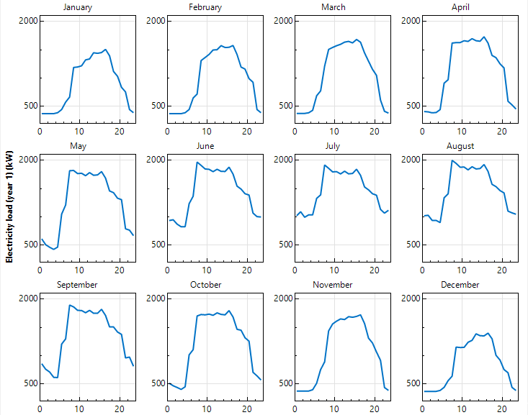
Result and analysis
Note: The load profile is fixed for all scenarios.

Slide 8
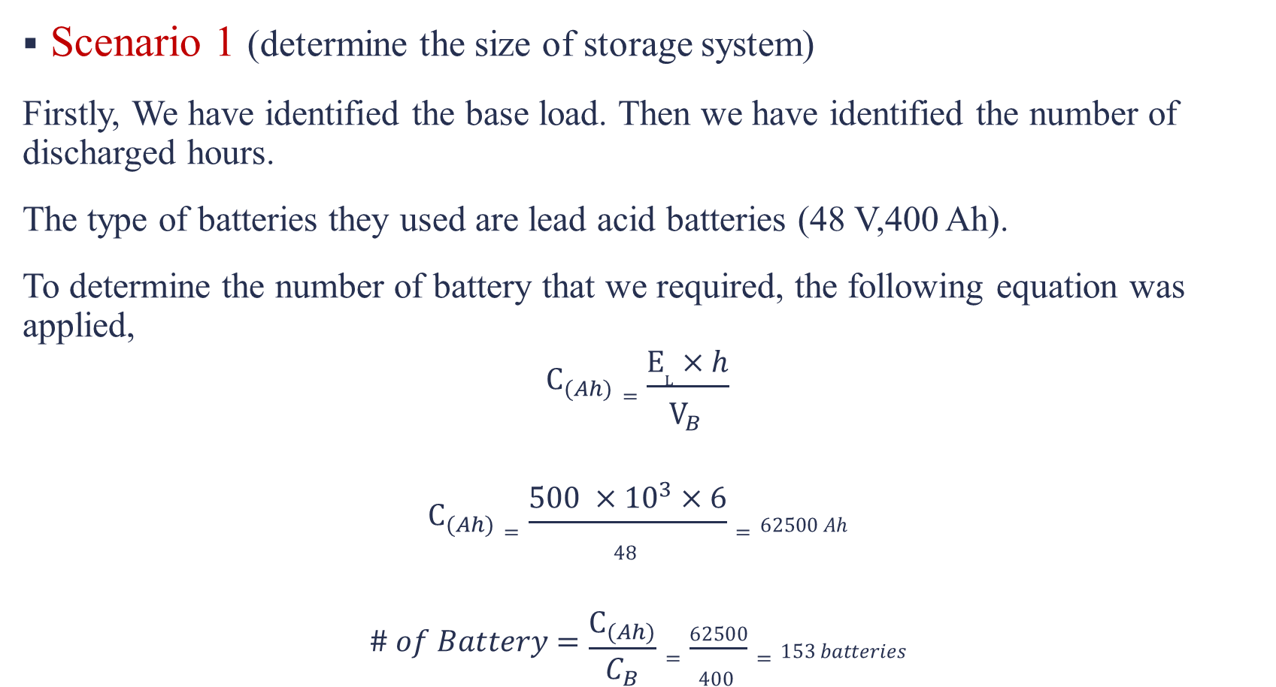
Result and analysis
Scenario 1 (determine the size of storage system)
Firstly, We have identified the base load. Then we have identified the number of discharged hours.
The type of batteries they used are lead acid batteries (48 V,400 Ah).
To determine the number of battery that we required, the following equation was applied,
$$C_{(Ah)}=\frac{E_{L}×h}{V_{B} }$$
$$C_{(Ah)}=\frac{500 ×{10}^{3}×6}{48 }=62500 Ah$$
$$\# of Battery=\frac{C_{(Ah)}}{C_{B}}=\frac{62500}{400 }=153 batteries$$

Slide 9
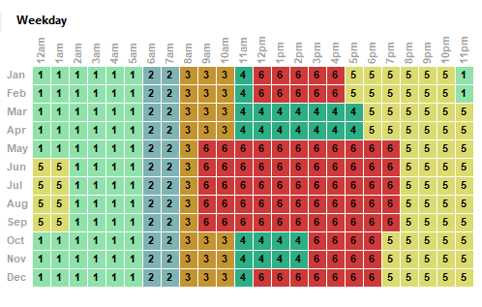
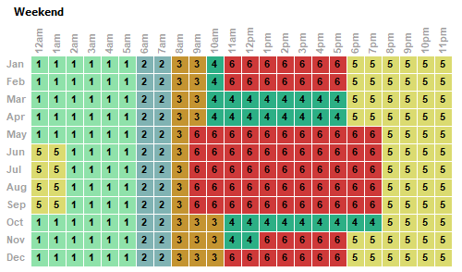
selling price of electricity
Period | Peak (kWh) | Charge ($/kWh) | Charge(NIS/kWh)
1 | 1000 | 0 | 0
2 | 1000 | 0.13 | 0.46
3 | 1000 | 0.143 | 0.51
4 | 1000 | 0.1514 | 0.54
5 | 1000 | 0.16 | 0.58
6 | 1000 | 0.157 | 0.56

Slide 10
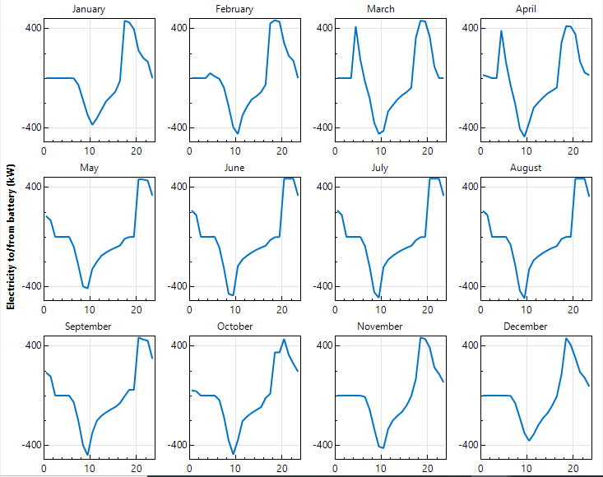
Charging and discharging storage system

Slide 11
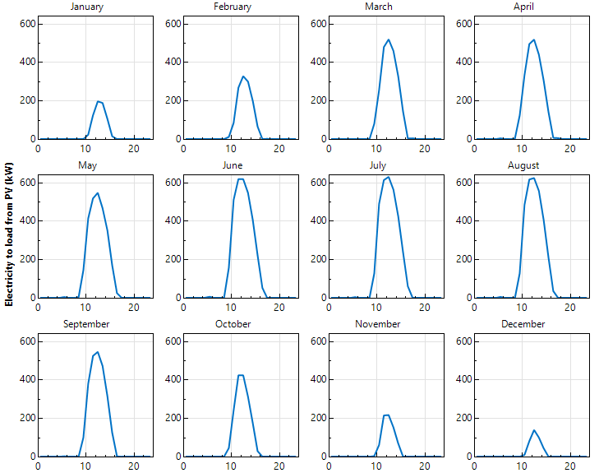
Energy flow from PV to load

Slide 12
month | Energy to load from PV (MWh) | Energy to load from battery (MWh) | Energy to load from grid (MWh)
Jan | 3.30% | 8.54% | 88.10%
Feb | 5.80% | 8.61% | 85.60%
Mar | 9.75% | 8.87% | 81.40%
Apr | 10.12% | 8.38% | 81.44%
May | 9.42% | 6.70% | 83.87%
Jun | 9.95% | 6.19% | 83.53%
Jul | 10.08% | 6.11% | 84.00%
Aug | 9.46% | 5.96% | 84.60%
Sep | 8.66% | 6.46% | 84.89%
Oct | 6.73% | 7.00% | 86.20%
Nov | 3.72% | 7.80% | 88.52%
Dec | 2.50% | 8.88% | 88.65%
Notes:
May require more than one slide

Slide 13
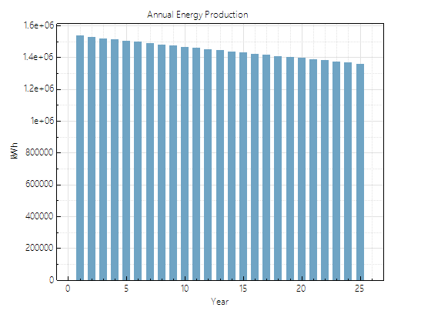
Annual energy production from the system
The efficiency of PV modules decreased 0.5% per year.
Annual energy production in 1st year = 1,535 MWh
Annual energy production in year 10 = 1,470 MWh
Annual energy production in year 25 = 1,360 MWh

Slide 14
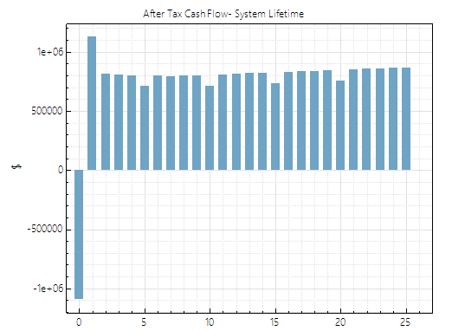
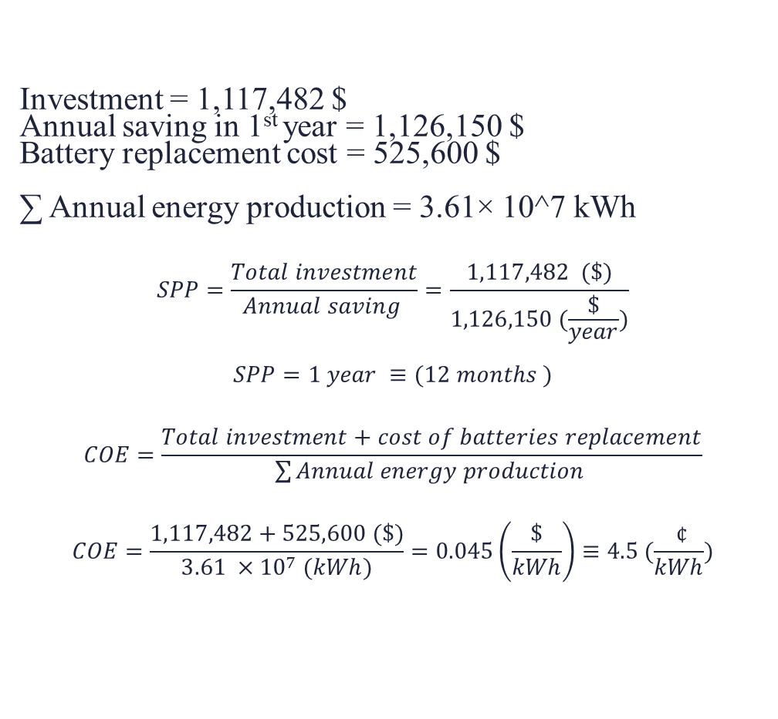
Cash flow diagram & Economic analysis
Investment = 1,117,482 $
Annual saving in 1st year = 1,126,150 $
Battery replacement cost = 525,600 $
∑ Annual energy production = 3.61× 10^7 kWh
$$SPP=\frac{Total investment}{Annual saving }=\frac{1,117,482 (\$)}{1,126,150 (\frac{\$}{year})}$$
$$SPP=1 year ≡(12 months )$$
$$COE=\frac{Total investment+cost of batteries replacement}{\sum{Annual energy production }}$$
$$COE=\frac{1,117,482+525,600 (\$)}{3.61 ×{10}^{7} (kWh)}=0.045\left(\frac{\$}{kWh}\right)≡4.5 (\frac{ ¢}{kWh})$$

Slide 15
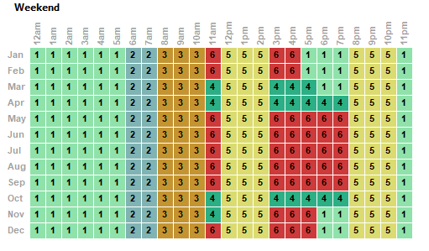
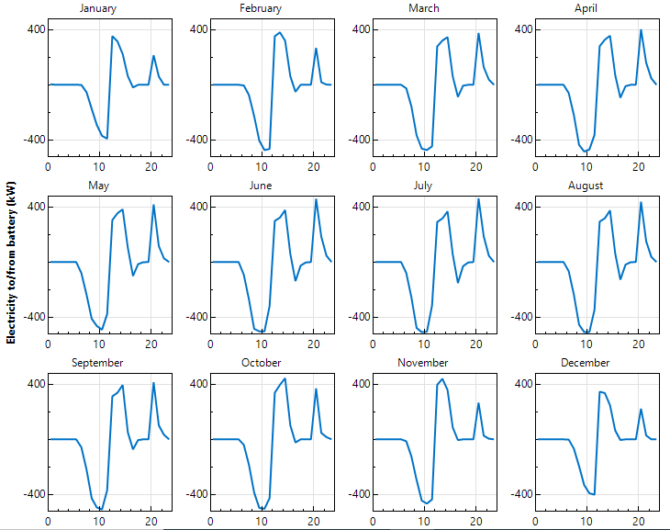
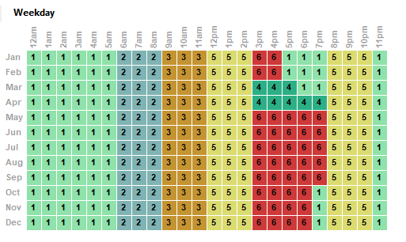
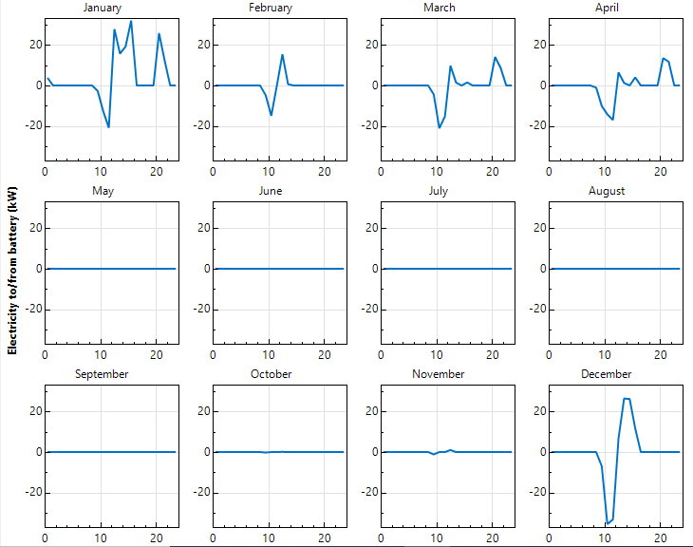
Scenario 2
PV energy meeting battery before load
PV energy meeting load before battery

Slide 16
The difference in annual energy production is clearly between two options. For example the difference in 1st year equal 200 (MWh).

Slide 17
Scenario 2 summarized
Item | Option 1 (PV energy meeting battery before load) | Option 2 (PV energy meeting load before battery)
Total investment ($) | 1,117,482 | 1,117,482
Battery replacement cost ($) | 525,600 | 262,800
Annual saving ($) | 1,014,500 | 1,114,460
∑ Annual energy production from system (MWh) | 3.04 × 10^7 | 3.58 × 10^7
SPP (month) | 13 | 12
COE (¢/kWh) | 5.4 | 3.8
Note: COE in option 2 less than option 1 because the replacement battery cost in option 2 less than option 1.

Slide 18
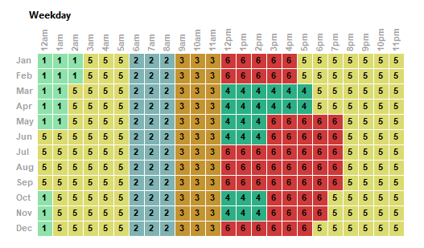
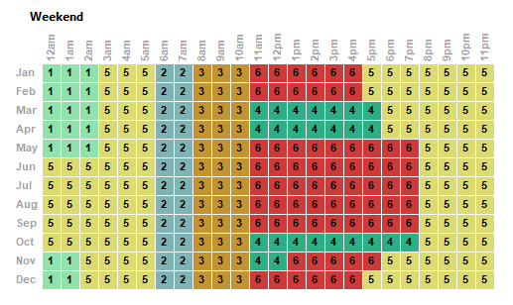
Scenario 3
Size of PV = 2MW
Size of energy storage =5000kWh
Batteries type are lithium ion.(48 Volt,100Ah)

Slide 19
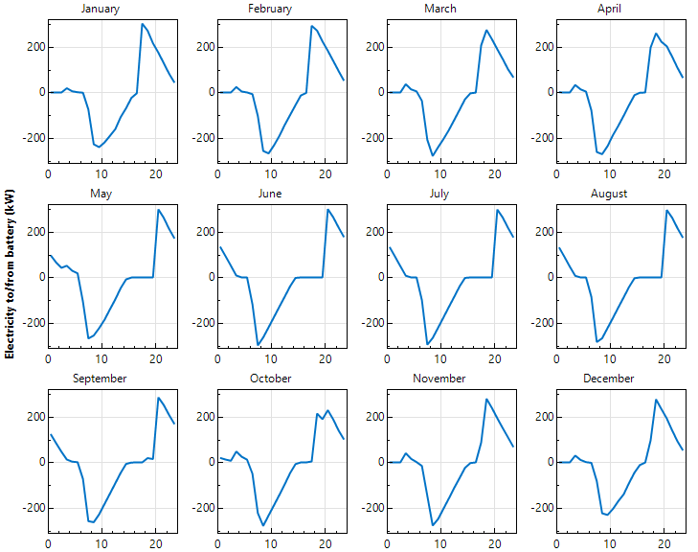
Energy flow from/to batteries
The amount of energy that stored in batteries is 40-50% from storage system size . As a result, increase the capacity of storage system not effective.

Slide 20
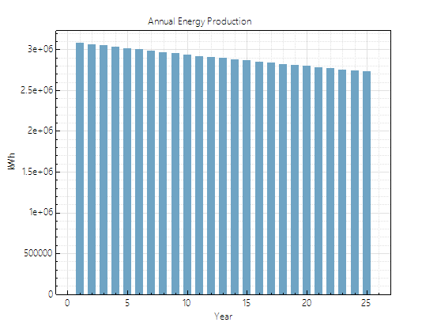
It normal that annual energy production, revenue are
increased. But in this scenario we did not benefit from
storage system very well.
 | Scenario 1 | Scenario 2
Annual saving($) | 1,126,150 | 1,848,956
SPP (month) | 12 | 14
COE (¢/kWh) | 4.5 | 3.5

Slide 21
Recommendation and conclusion
Electrical loads should be determined during the day.
multiple software programs should be used to reach the exact result to find out the size.
In scenario 1. if we used lithium ion batteries instead of lead acid batteries the COE will be reduce from 4.5 to 3.9 (¢/kWh).
Awareness campaign regarding the crises of energy situation and why we should look for alternatives energy sources.

Slide 22
Thank you

