Slide 1

An-Najah National University
Faculty Of Engineering
Civil Engineering Department
Graduation Project II
Analysis and Redesigned of Water Distribution Network and Design of Wastewater Network for 'Illar Town
Prepared By :
Ameed Tayeh
Ahmad Kmail
Obada Zaid
Supervision of Dr. Anan Jayyousi

Slide 2
Outline:
Objectives of the project.
Study area.
Questionnaire analysis.
Analyzing the water distribution network.
Redesign of water distribution network.
Design of wastewater collection network.
Summary.

Slide 3
Objectives
Analyze the existing water network.
Redesign the water network in the town.
Design the Wastewater network in the town.

Slide 4
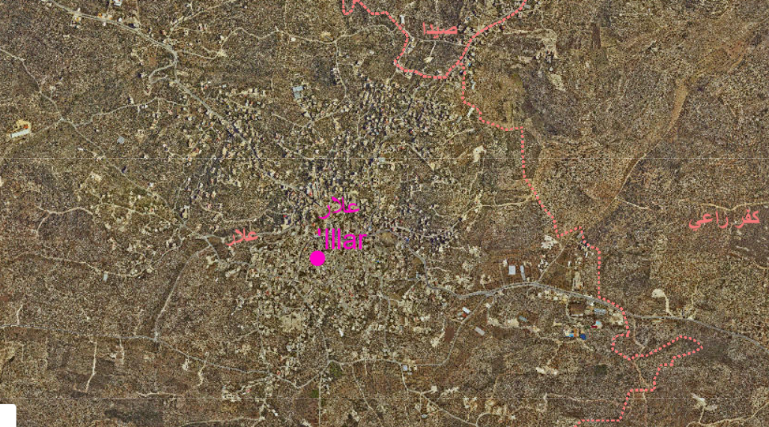
Study area

Slide 5
Study area
Location :
'Illar town is located 10 kilometers northeast of Tulkarm.
Climate :
The annual average maximum temperature is 21.5Cº and the annual average minimum is 14.4Cº

Slide 6
Study area
Population :
The total population of the town was 7456 capita in 2017.
Water resources :
'Illar town have three main water resources and it sells water to the near villages .

Slide 7
Kufr Ra'I village
Well 1
Receiving tank
Main tank
Well 2
Seda village
Zeeta village
town's houses

Slide 8
Questionnaire analysis

Slide 9
Questionnaire analysis
Per Capita Water Consumption Rate

Slide 10
Questionnaire analysis
Sources of Water

Slide 11
Questionnaire analysis
Effect of Existing of Yard on Water Consumption

Slide 12
Questionnaire analysis

Slide 13
Questionnaire analysis

Slide 14
Questionnaire analysis
Effect of Income on Water Consumption

Slide 15
Analyzing the Network

Slide 16
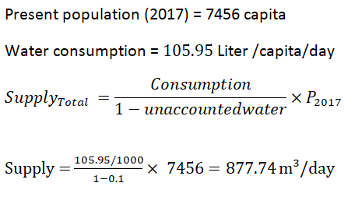
Modeling of WDN

Slide 17
Number of Elements | Elements
1 | Reservoirs
218 | Nodes
243 | Pipes
2 | Valves (FCV)

Slide 18
WDN
Design constraints:
Pressure at junction between (20-100) m.H₂O.
Velocity in pipe (0.3-3.0) m/s.

Slide 19
Result of analysis of WDN
Pressure at minimum demand (4:00 am).

Slide 20
Pressure at maximum demand (2:00 pm).

Slide 21
Result of analysis of WDN
Velocities at minimum demand (4:00 am).

Slide 22
Velocities at maximum demand (2:00 pm).

Slide 23
Redesign of WDN

Slide 24
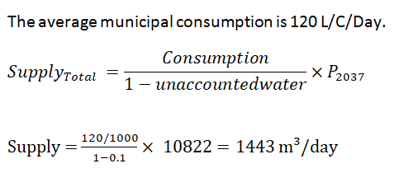
Data of future population
Future population in 2037 = 10822

Slide 25
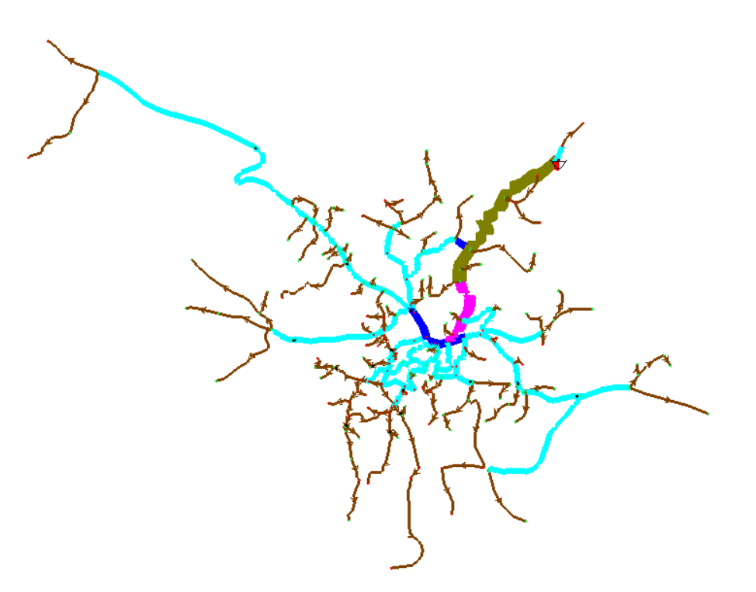
Model of WDN

Slide 26
WDN
Number of Elements | Elements
1 | Reservoirs
206 | Nodes
231 | Pipes
14 | Valves (PRV)

Slide 27
Design Criteria
Pressure criteria from 20 to 100 mH2O.
Velocity criteria from 0.3 to 3 m/sec.

Slide 28
Results of WDN for Design
Pressure at minimum demand (4:00 am).

Slide 29
Results of WDN for Design
Pressure at maximum demand (2:00 pm).

Slide 30
Results of WDN for Design
Velocity at maximum demand (2:00 Pm).

Slide 31
Results of WDN for Design
Velocity at minimum demand (4:00 am).

Slide 32
Cost estimation
Diameter (in) | Length (m) | Unit Price /m |  | Total Price
1 | 14593 | 95 |  | 1386335
2 | 7732 | 115 |  | 889180
3 | 428 | 130 |  | 55640
4 | 314 | 211 |  | 66254
6 | 752 | 274 |  | 206048
8 | 21 | 330 |  | 6930
 |  |  | Total | 2610387
VULVE | NO. | COST/1VULVE | Total cost
PRV | 14 | 5000 | 70000
TOTAL COST | 2680387 NIS
TOTAL COST | 725000 $

Slide 33
Design of Wastewater network

Slide 34
WWCN
Conduites
Manholes
Outfalls
Length <=30
Diameter>=8in
Material (PVC)
n
Diameter
Drop Manhole
Material
Loads
Elevation
Location
Elevation
Slope

Slide 35
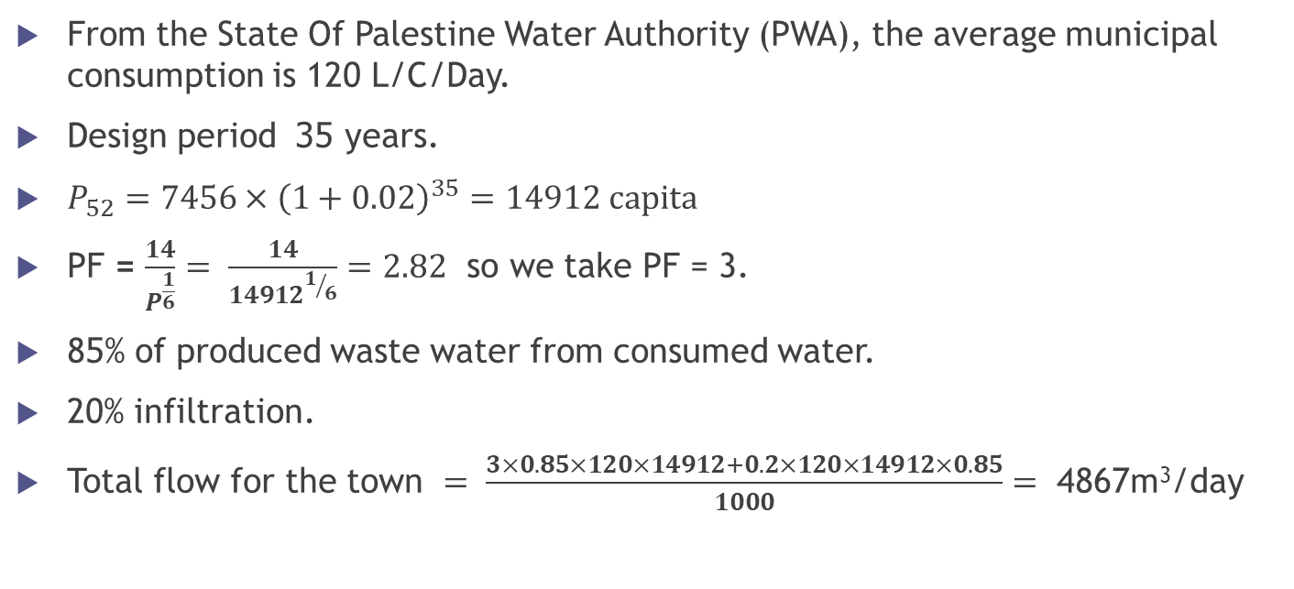
Wastewater Generation
From the State Of Palestine Water Authority (PWA), the average municipal consumption is 120 L/C/Day.
Design period 35 years.
$P_{52}=7456×{\left(1+0.02\right)}^{35}=14912 capita$
PF = $\frac{14}{P^{\frac{1}{6}}}= \frac{14}{{14912}^{1/6}}=2.82$ so we take PF = 3.
85% of produced waste water from consumed water.
20% infiltration.
Total flow for the town $= \frac{3×0.85×120×14912+0.2×120×14912×0.85}{1000}=$ 4867m³/day

Slide 36
Design Criteria
The velocity : (0.6 – 3 m/sec)
The cover : (1-5m)
The slope : (1-12%)
The distance between manholes are less than 30 m.

Slide 37
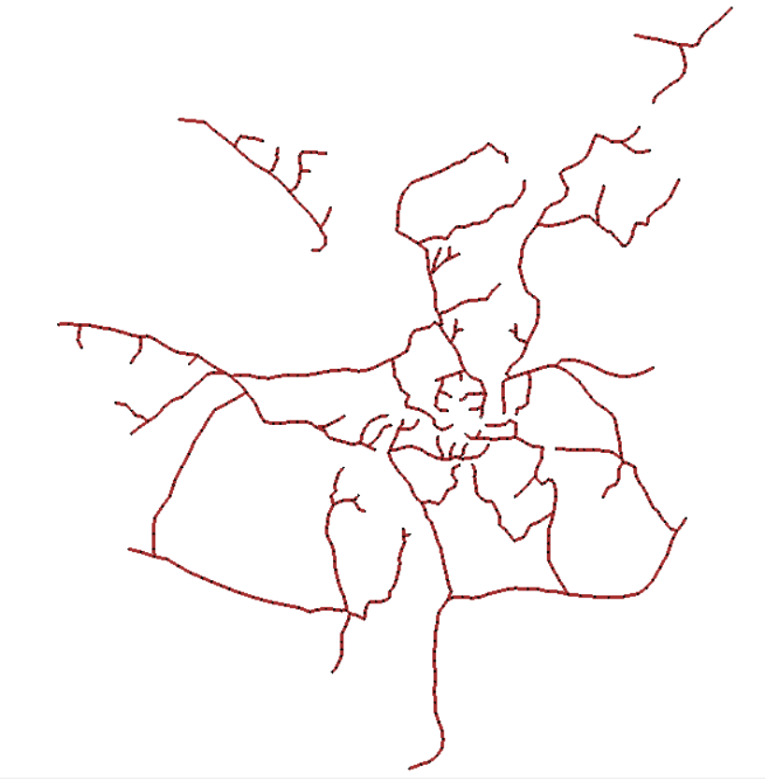
Model of the wastewater network

Slide 38
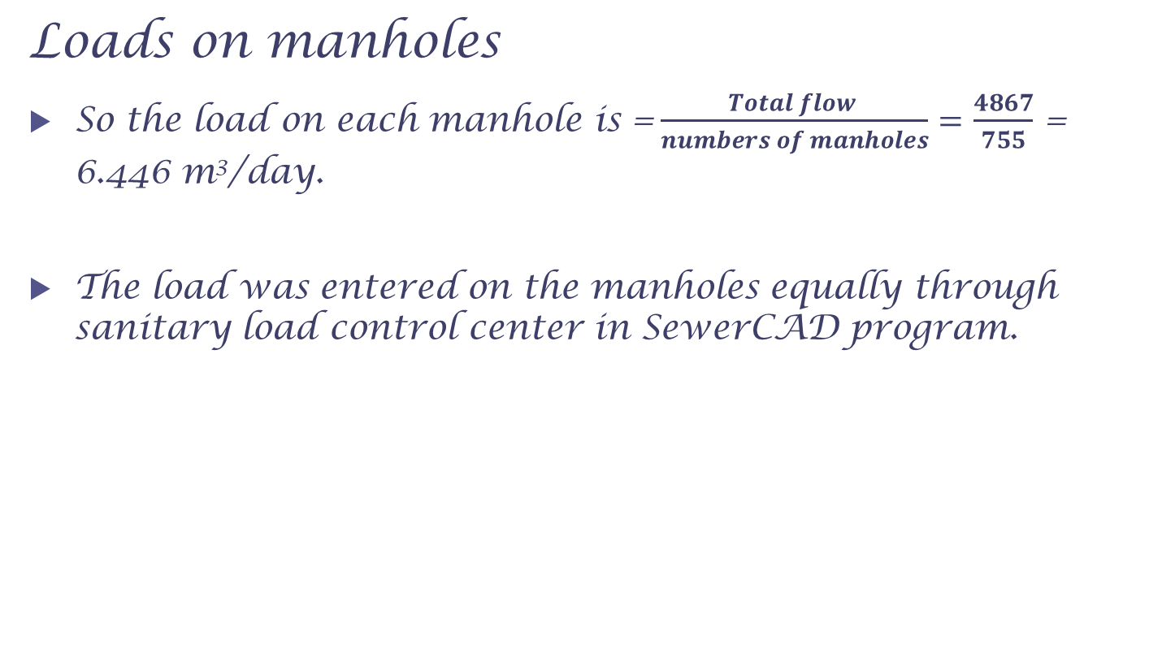
Loads on manholes
So the load on each manhole is =$\frac{Total flow }{numbers of manholes}=$ $\frac{4867}{755}$ = 6.446 m³/day.
The load was entered on the manholes equally through sanitary load control center in SewerCAD program.

Slide 39
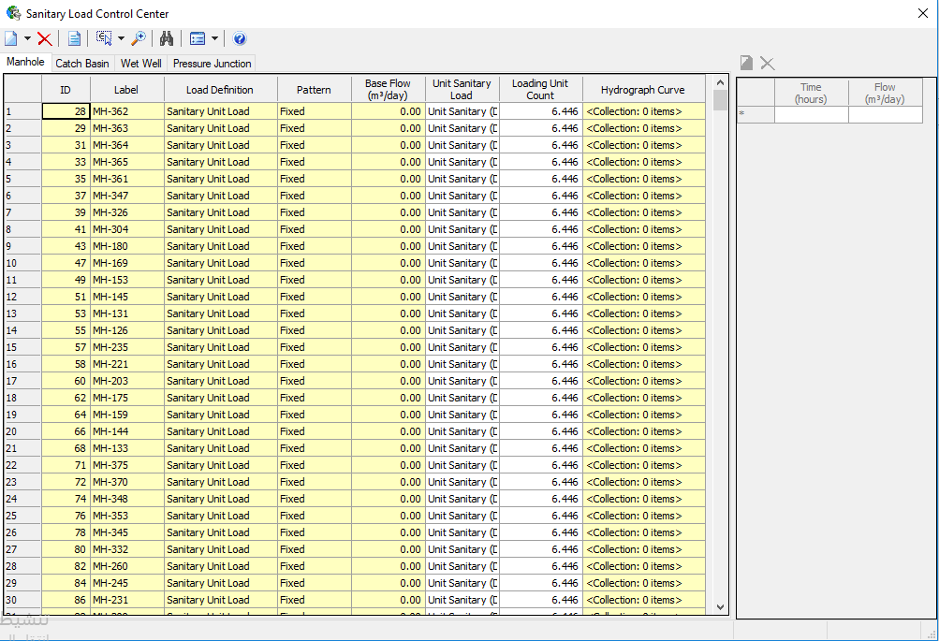

Slide 40
The Outfalls

Slide 41
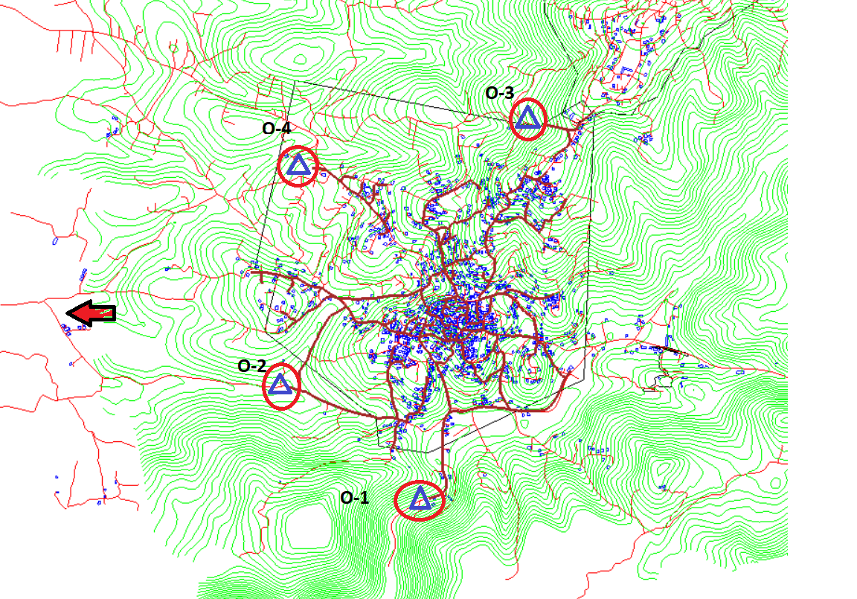

Slide 42
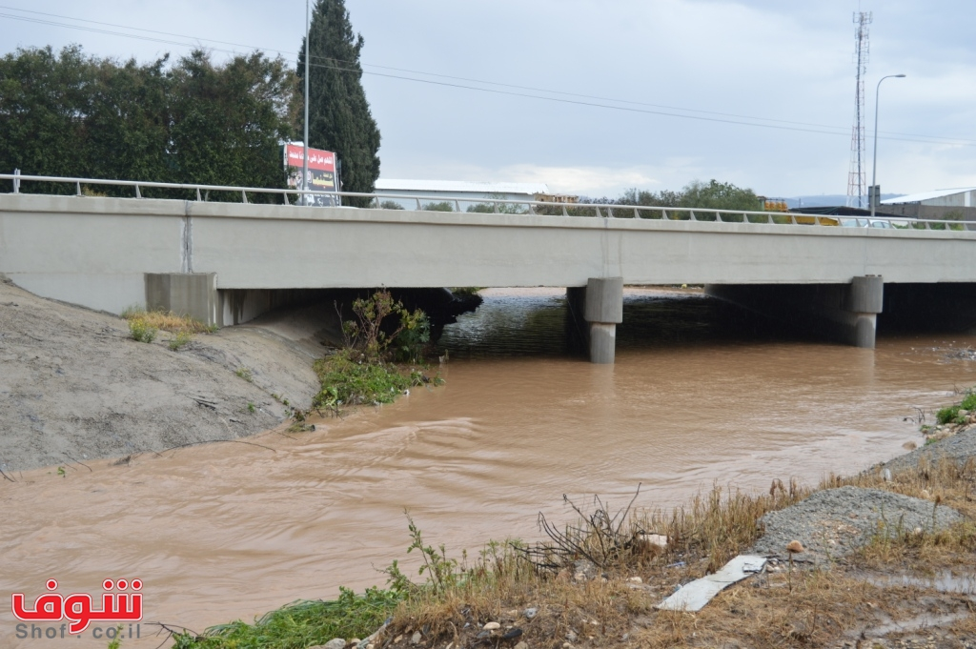
Abu Al-Nar Wadi

Slide 43
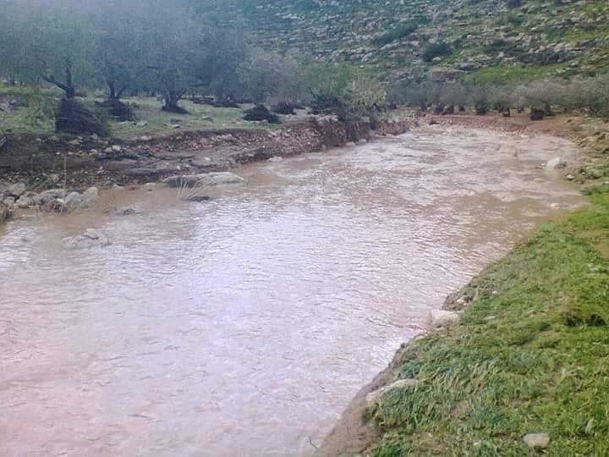
Massin Wadi

Slide 44
Results

Slide 45
Slope Result

Slide 46
Velocity Result

Slide 47
Cover Result

Slide 48
Cover Result

Slide 49
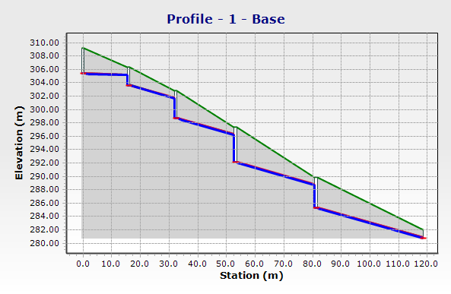
Profile

Slide 50

Cost estimation

Slide 51
Cost estimation
 | Unit | Quantity | Unit price ($) | Total price ($)
conduits cost | m | 15,455 | 40 | 618200
excavation and filling and paving cost | m | 15,455 | 30 | 463650
manholes cost | number | 755 | 650 | 490750
 |  |  | total cost | 1572600

Slide 52
Summary

Slide 53
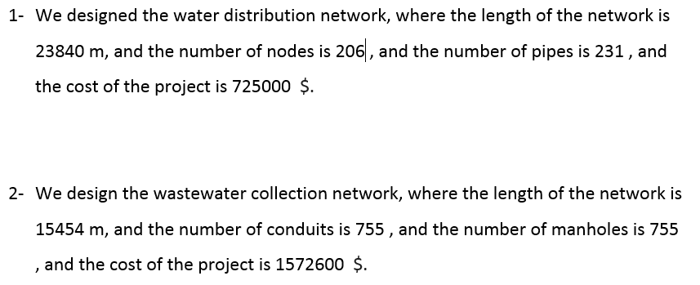
Summary

Slide 54
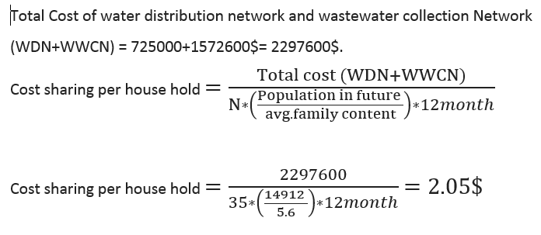


Cost sharing per house hold

Slide 55


