Slide 1
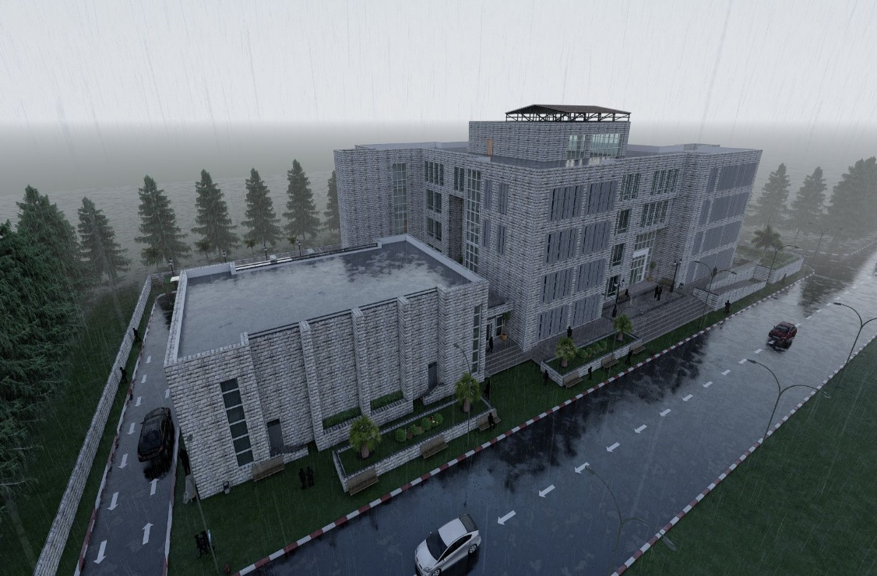

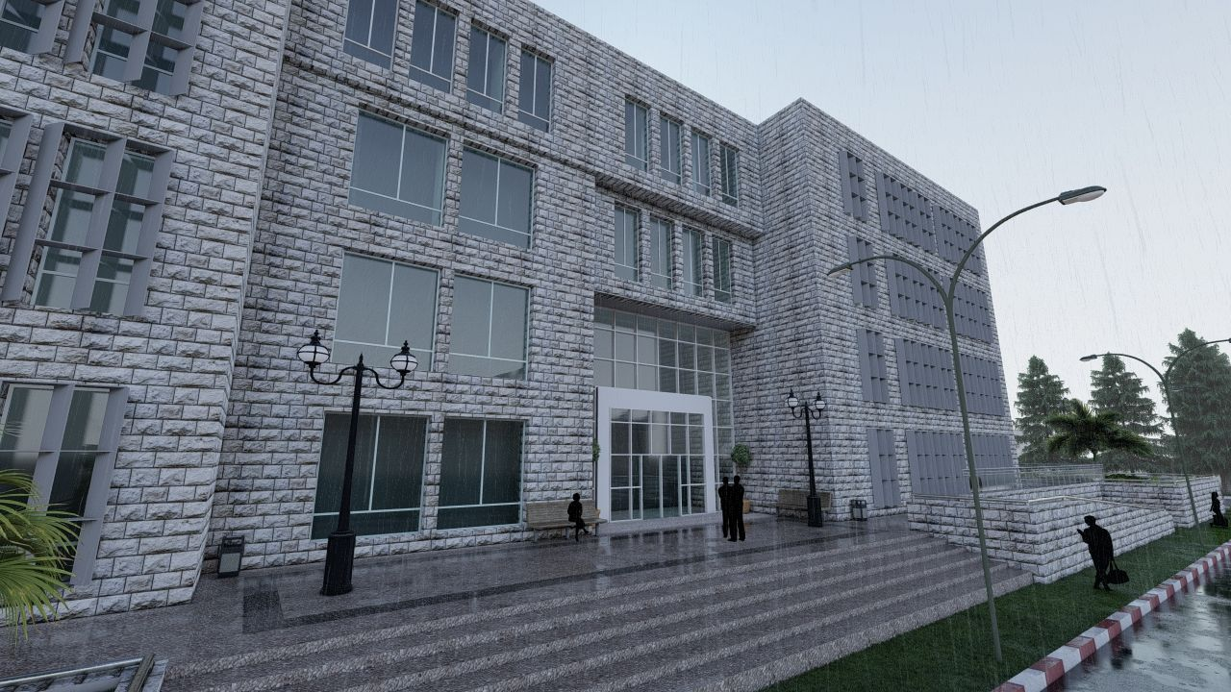
Integrated Re-design of the Faculty of Economics at Palestine Technical University
An-Najah National university
Faculty Of Engineering
Building Engineering Department
Supervisor :
Dr. Monther Dwaikat
Prepared by :
Nirmeen Mhanna
Nour Salahat
Seema Bolas

Slide 2

OUTLINES
Introduction
Site description
Architectural design
Environmental design
Structural design
Mechanical design
Electrical design
Cost estimation

Slide 3
Introduction
Integrated Re-design of the Faculty of Economics at Palestine Technical University.
Statistics at Palestine Technical University indicate that the number of students enrolled in the Faculty of Economics has been increasing in recent years.
Total number of students is 1800 ( 2019/2020).
Total number of employees is 70 .

Slide 4
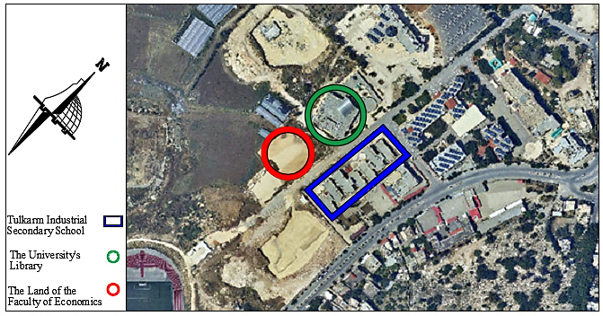
Site Description
Located to the west of Tulkarm.
Total area of the site is 5606 m².
It is surrounded by the university’s library and Tulkarm Industrial Secondary School .
The faculty is reached by two roads each has an entrance leading inside, the first road has a width of 12 m, and the second has a width of 9m.

Slide 5
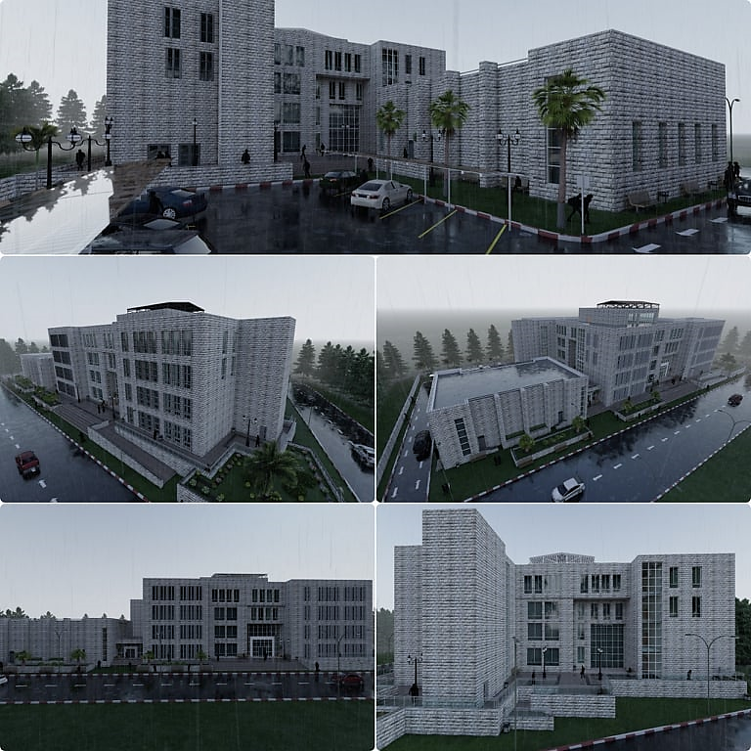
Architectural Design
The 3rd model for the existed architectural plan.

Slide 6
Project Description
Five stories with total area of 10130 m² .
First floor
area
1621.5 m²
second floor area
1775.6 m²
Third floor area
1775.6 m²
Ground floor area
2405.3 m²
Basement
2411.7 m²

Slide 7
Project Description
Spaces area
Area (m²) | Spaces
57.6 | Classroom
20.2 | Office has three employees
11.6 | Office has two employees
61.5 | Computer lab
58.8 | Meeting room
452.4 | Auditorium
120.8 | Cafeteria

Slide 8
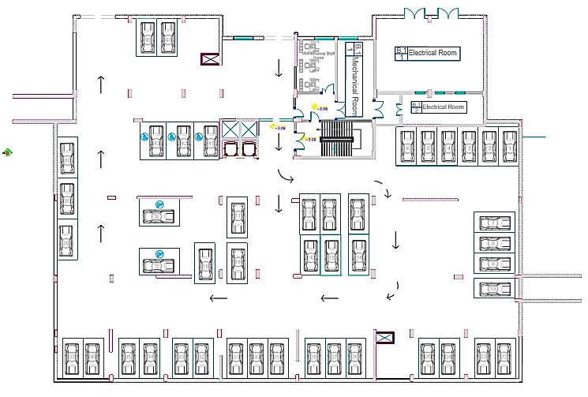
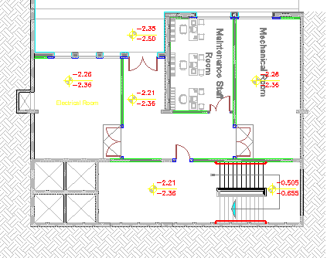
Architectural Modifications
Basement floor
Before
After

Slide 9
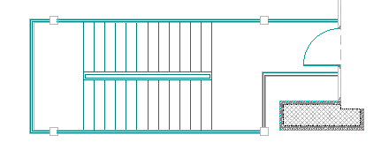
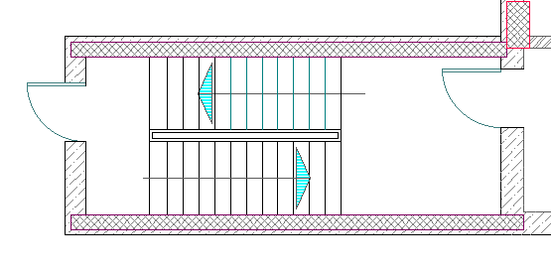
Architectural Modifications
Emergency stairs
Before
After

Slide 10
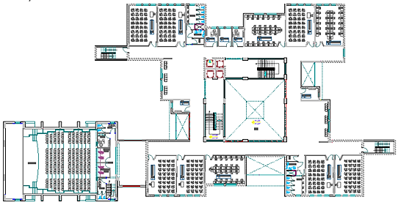
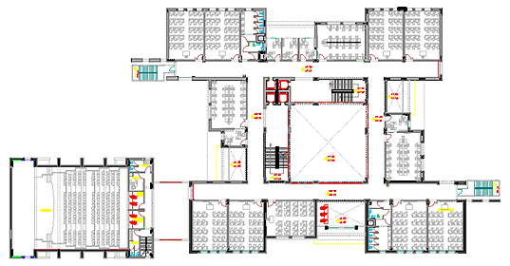
Architectural Modifications
Covering area for students
Before
After

Slide 11
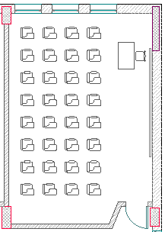
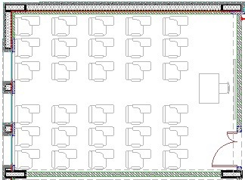
Architectural Modifications
Doors orientation and furniture layout
Before
After

Slide 12
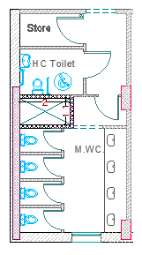
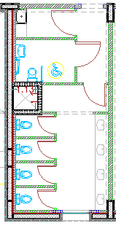
Architectural Modifications
Shaft dimension
Before
After

Slide 13
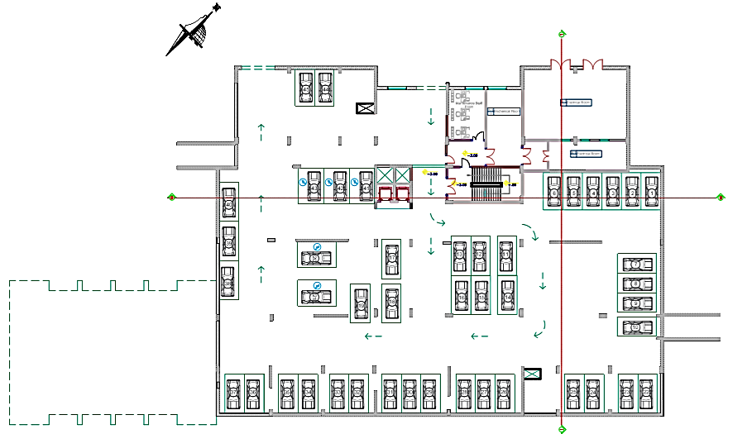
Architectural Plans
Basement floor plan

Slide 14
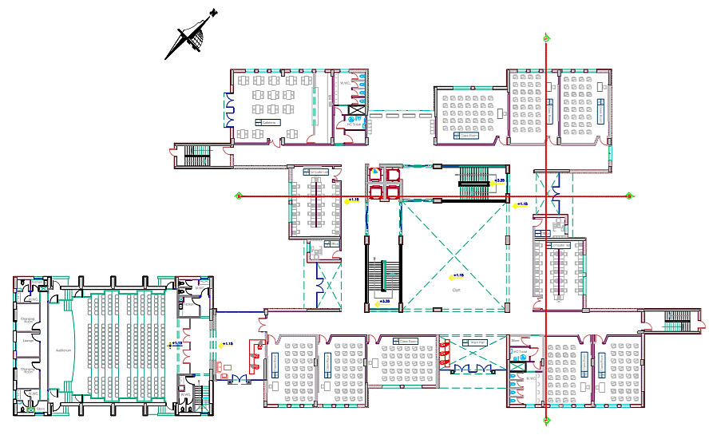
Ground floor plan

Slide 15
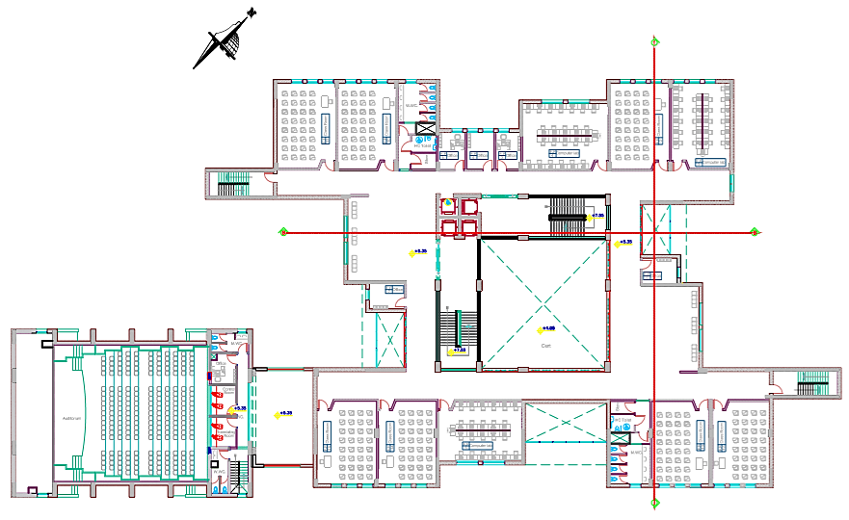
First floor plan

Slide 16
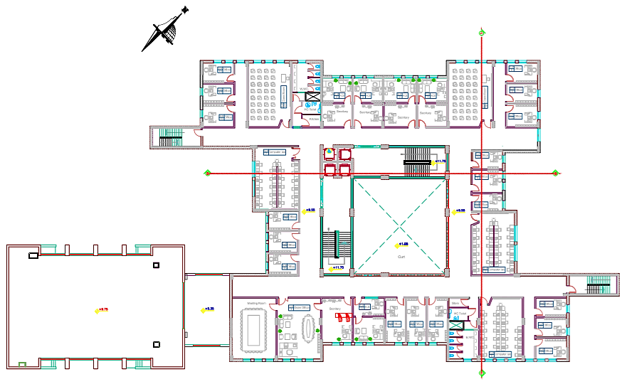
Second floor

Slide 17
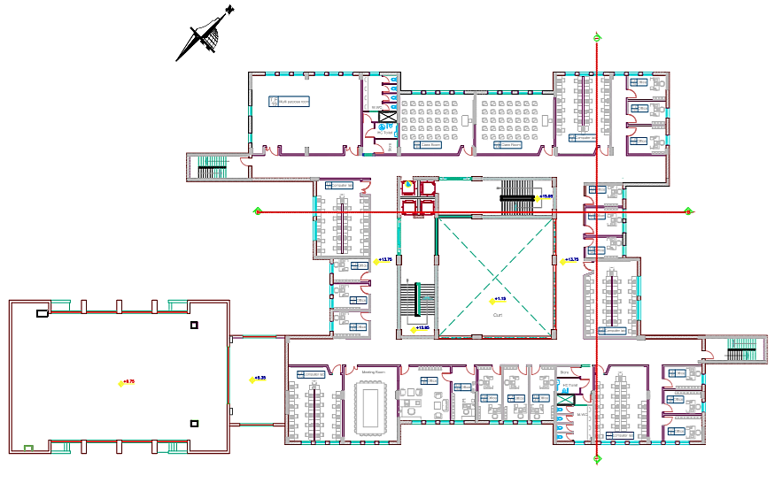
Third floor

Slide 18
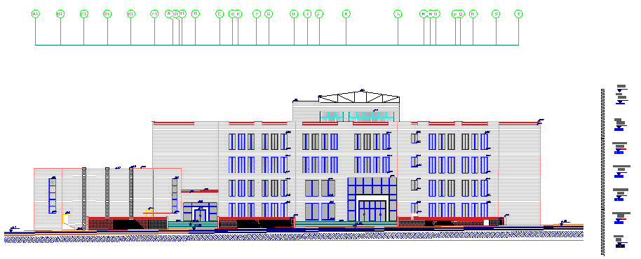
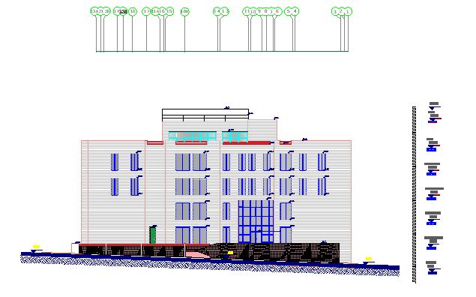
Elevations
South-east
North-east

Slide 19
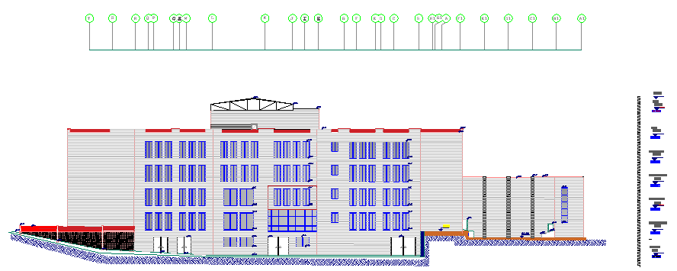
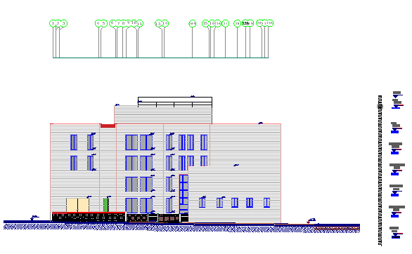
Elevations
North-west
South-west

Slide 20
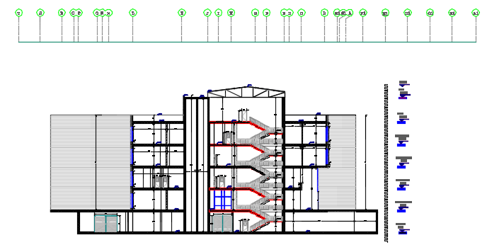
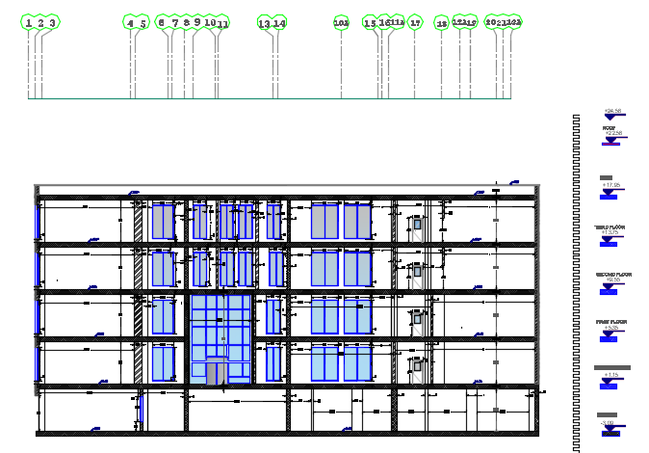
Sections
Section B-B
Section 1-1

Slide 21
Environmental design
Material properties
Thermal behavior
Ventilation
Daylighting
shading

Slide 22
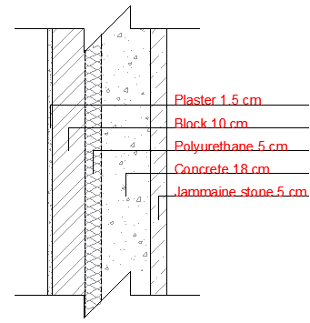
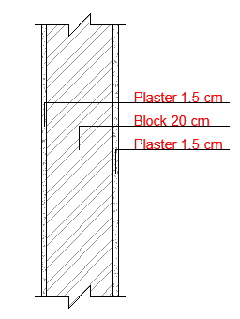
Material properties
U – value for glass equals 1.8 w/m².k
External wall
Internal wall
U – value
0.438 w/m².k
U – value
1.61 w/m².k

Slide 23
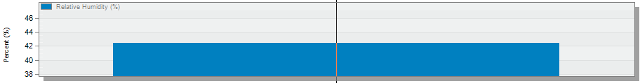
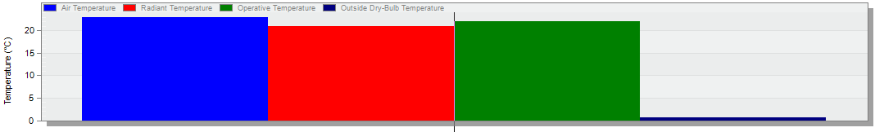
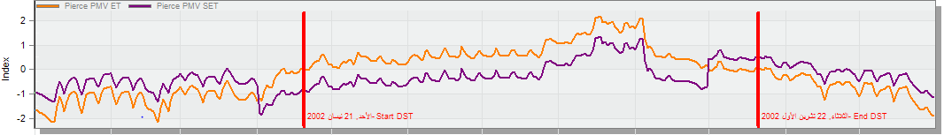
Thermal comfort Analysis
Relative humidity
42 %
Temperature
23 C
Pierce PMV
(-3 to +3)

Slide 24
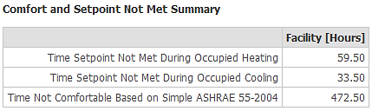
Thermal Analysis
Total design heating capacity = 186 kW
Total design cooling capacity = 205 kW
Number of uncomfortable hour = 472.5 hour/year .

Slide 25
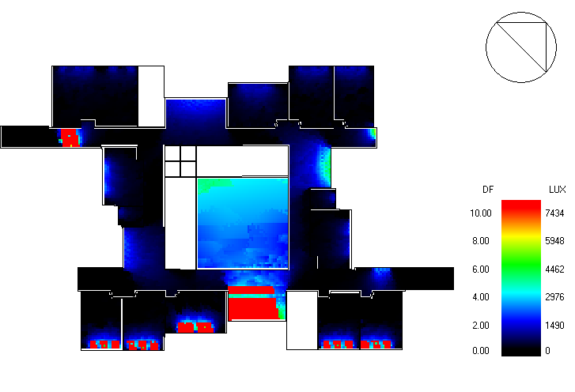
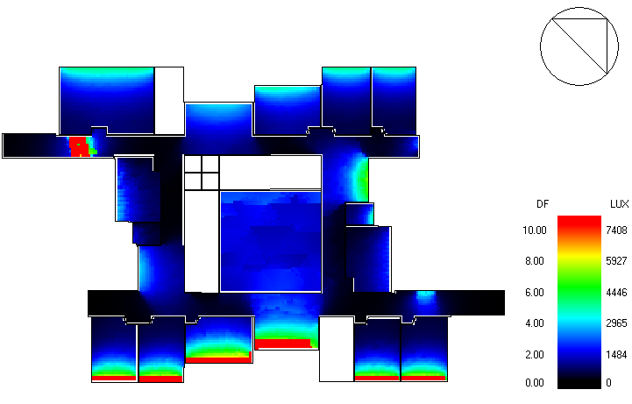
Daylight analysis for the model for the ground floor before and after modification
Before
After

Slide 26
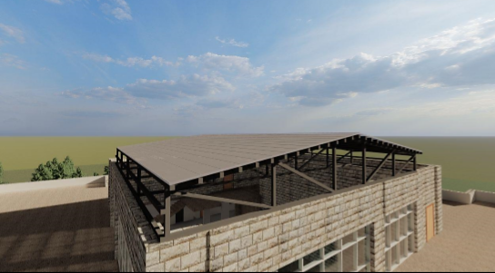
Ventilation
Natural ventilation is obtained through court yard truss system.

Slide 27
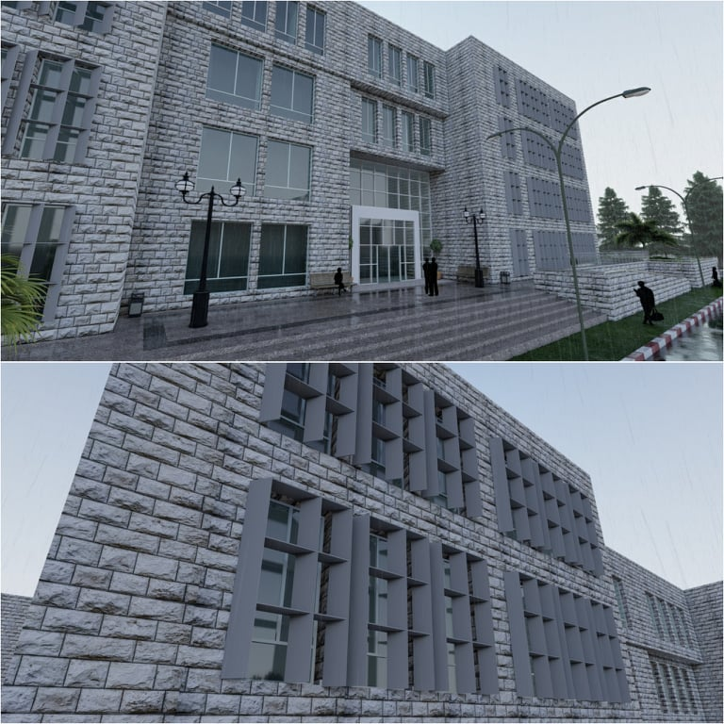
Shading
Horizontal and vertical louvers were added to windows and curtains of the southeastern and southwestern facades for the decreasing process of solar gain through glass.

Slide 28
Structural Design
Material properties
Verification checks
Seismic checks
Design and detailing
Codes

Slide 29
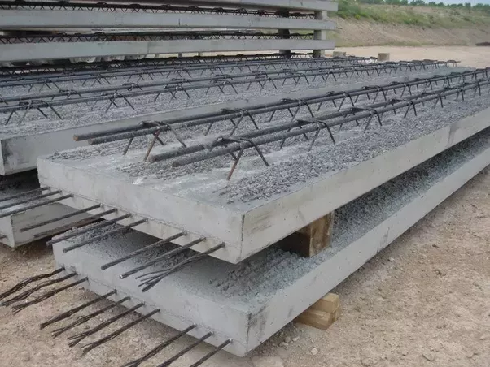
Structural Design
Codes
IBC 2014
ACI 318M-14
AISC-16
Material Properties
Reinforced Concrete
Property | Value
Compressive strength fʹc | 24 MPa
Modulus of elasticity E | 23025
Poisson’s ratio U | 0.2

Slide 30
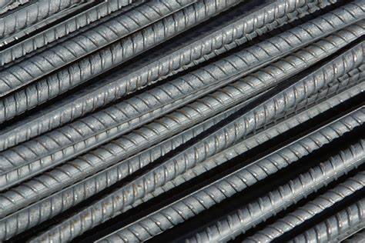
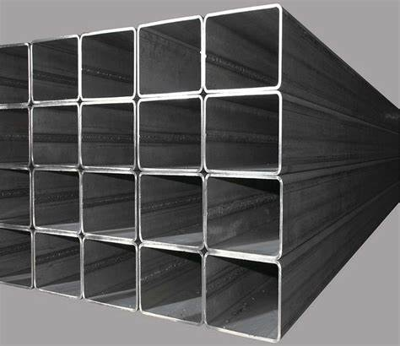
Reinforcing Steel
Structural Steel
Property | Value
Grade | Grade 60
Modulus of elasticity | 200 GPa
Yielding strength | 420 MPa
Ultimate strength | 620 MPa
Property | Value
Grade | Grade 50
Modulus of elasticity | 200 GPa
Yielding strength | 340 MPa
Ultimate strength | 450 MPa
Load | Value
Live load 1 | 5 kN/m²
Live load 2 | 3 kN/m²
Live load 3 | 1 kN/m²
Super imposed dead load 1,2 | 5 kN/m²
Super imposed dead load 3 | 0.1 kN/m²
Snow load | 0.15 kN/m²
Wind load | 1 kN/m²
Designed Loads

Slide 31
Earth quick load
Short period spectral acceleration ( Ss) = 0.45
one second period spectral acceleration ( S1) = 0.09
Soli profile: Stiff soil with site classification D
Site coefficient Fa = 1.44
Site coefficient Fv = 2.4
Structural system block 1 : Special reinforced concrete shear walls (R = 6)
Structural system block 2 : Special reinforced concrete moment frames (R = 8)

Slide 32
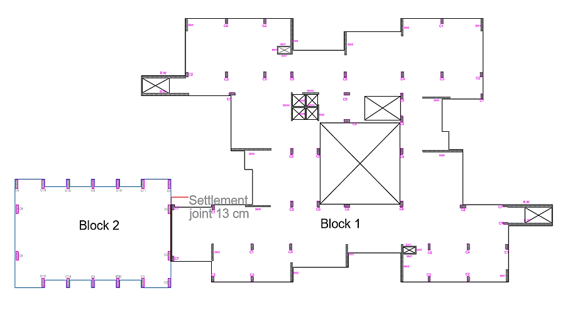
Structural blocks

Slide 33
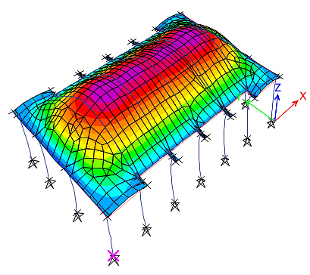
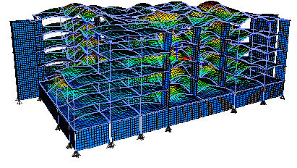
Verifications checks
Compatibility check
Equilibrium check
Internal Forces check
Deflection check
Block 2
Block 1

Slide 34
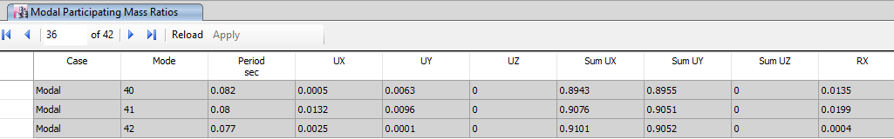
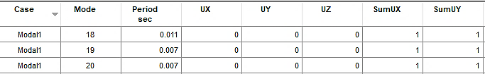
Seismic load checks
Mass participation ratio for modal analysis check
Base shear for response spectrum analysis check
Load case | EQ res1 | EQ eq 1 | EQ eq /EQ res | New scale factor | EQ res2 | EQ eq 2 | Difference
Vx | 7509.9773 | 8087.1576 | 1.077 | 2736.58 | 7917.4 | 7178.5079 | 0.02
Vy | 8039.4138 | 7908.6191 | 0.984 | 2500.27512 | 8081.8527 | 7178.5096 | 2.00E-07
Load case | EQ res1 | EQ eq 1 | EQ eq /EQ res | New scale factor | EQ res2 | EQ eq 2 | Difference
Vx | 132.9473 | 445.307 | 3.35 | 5134.91 | 445.307 | 445.373 | 0.2
Vy | 563.4189 | 553.795 | 0.983 | 1506.742 | 553.795 | 553.654 | 2.00E-01

Slide 35
Seismic load checks
Drift check
Story | Direction | Design elastic story drifts | Design inelastic story drifts | Allowable story drift | Check
Story6 | X | 0.000154 | 0.000616 | 0.015 | Ok
Story6 | Y | 0.000818 | 0.003272 | 0.015 | Ok
Story5 | X | 0.000621 | 0.002484 | 0.015 | Ok
Story5 | Y | 0.002541 | 0.010164 | 0.015 | Ok
Story4 | X | 0.000806 | 0.003224 | 0.015 | Ok
Story4 | Y | 0.001842 | 0.007368 | 0.015 | Ok
Story3 | X | 0.00092 | 0.00368 | 0.015 | Ok
Story3 | Y | 0.001481 | 0.005924 | 0.015 | Ok
Story2 | X | 0.00102 | 0.00408 | 0.015 | Ok
Story2 | Y | 0.001506 | 0.006024 | 0.015 | Ok
Story1 | X | 0.0011974 | 0.0047896 | 0.015 | Ok
Story1 | Y | 0.0012445 | 0.004978 | 0.015 | Ok
Story6 | Y | 0.003573 | 0.014292 | 0.015 | Ok
Story5 | X | 0.00057 | 0.00228 | 0.015 | Ok
Story5 | Y | 0.001243 | 0.004972 | 0.015 | Ok
Story4 | X | 0.000746 | 0.002984 | 0.015 | Ok
Story4 | Y | 0.001675 | 0.0067 | 0.015 | Ok
Story3 | X | 0.000847 | 0.003388 | 0.015 | Ok
Story3 | Y | 0.002014 | 0.008056 | 0.015 | Ok
Story2 | X | 0.000863 | 0.003452 | 0.015 | Ok
Story2 | Y | 0.001904 | 0.007616 | 0.015 | Ok
Story1 | X | 0.0012366 | 0.0049464 | 0.015 | Ok
Story1 | Y | 0.0011192 | 0.0044768 | 0.015 | Ok
Story | Direction | Elastic story drifts | Inelastic story drifts | Allowable story drift | Check
Story1 | X | 0.00318 | 0.014 | 0.015 | Ok
Story1 | Y | 0.00034 | 0.0015 | 0.015 | Ok

Slide 36

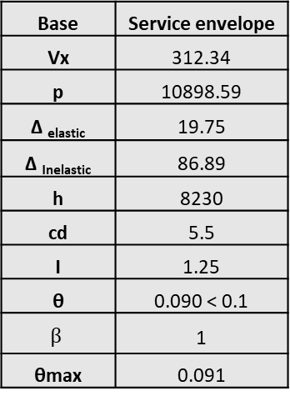
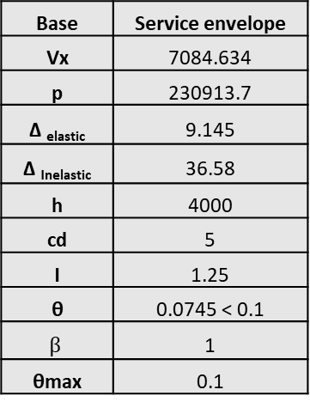
Seismic load checks
P- Delta check
Block 1
Block 2
Base | Service envelope
Vx | 7084.634
p | 230913.7
Δ _{elastic} | 9.145
Δ _{Inelastic} | 36.58
h | 4000
cd | 5
I | 1.25
θ | 0.0745 < 0.1
$β$ | 1
θmax | 0.1
Base | Service envelope
Vx | 312.34
p | 10898.59
Δ _{elastic} | 19.75
Δ _{Inelastic} | 86.89
h | 8230
cd | 5.5
I | 1.25
θ | 0.090 < 0.1
$$β$$ | 1
θmax | 0.091
Story | Direction | Delta-Max | Delta-Min | Max/Avg
1 | x | 0.836 | 0.795 | 1.025
2 | x | 3.089 | 3.08 | 1.001
3 | x | 6.09 | 6.06 | 1.002
4 | x | 9.571 | 9.491 | 1.004
5 | x | 13.105 | 13.041 | 1.002
6 | x | 10.779 | 10.646 | 1.006
1 | y | 0.904 | 0.647 | 1.166
2 | y | 4.831 | 3.489 | 1.161
3 | y | 10.105 | 7.343 | 1.158
4 | y | 15.985 | 11.492 | 1.164
5 | y | 21.773 | 16.245 | 1.145
6 | y | 33.427 | 19.34 | 1.267

Slide 37
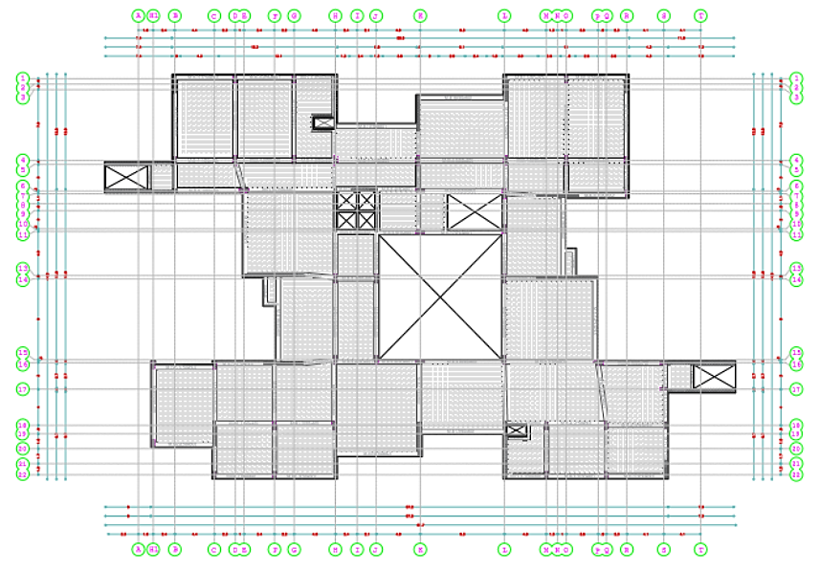
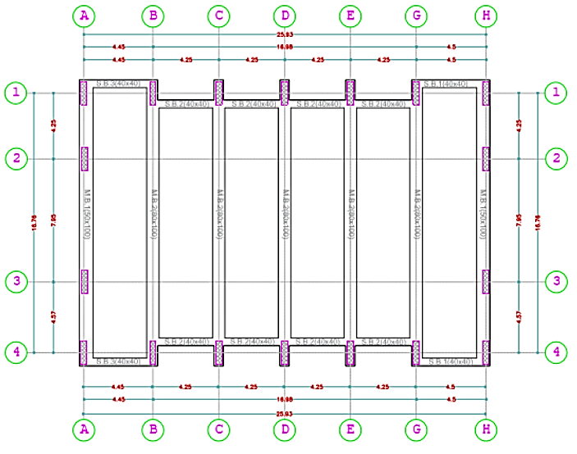
Slabs systems
Block 2 – Solid slab 20 cm – Drop beams
Block 1 – Two-way ribbed slab 40 cm – Drop beams

Slide 38
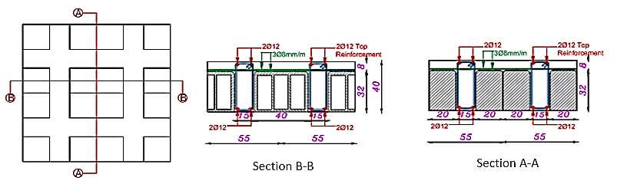
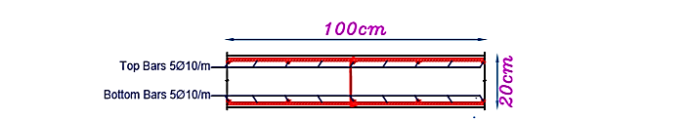
Two-way ribbed slab section
Solid slab section

Slide 39

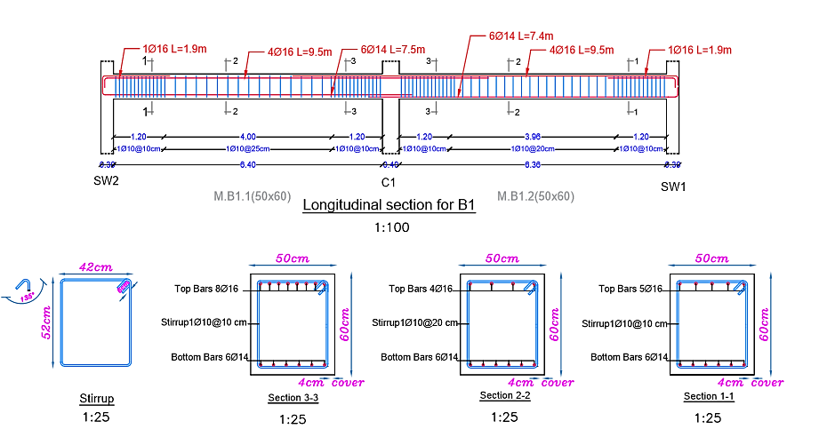



Beams Design

Slide 40




Columns Design
Longitudinal reinforcement steel design
Column | Rebar % | Width | Depth | As used | Middle | Corner | S1 | S2
 |  | mm | mm | mm² | bars | bars | cm | cm
C1 | 1.66% | 400 | 800 | 5316 | 18Ø18 | 4Ø18 | 9 | 7
C2 | 1.00% | 400 | 800 | 3200 | 18Ø14 | 4Ø14 | 14 | 10
C3 | 3.85% | 400 | 1000 | 15412 | 18Ø32 | 4Ø25 | 12 | 6
C4 | 2.25% | 400 | 1000 | 9017 | 22Ø20 | 4Ø32 | 8 | 10
C5 | 1.00% | 400 | 1000 | 4000 | 22Ø14 | 4Ø14 | 9 | 7
C6 | 2.15% | 400 | 800 | 6892 | 18Ø20 | 4Ø20 | 8 | 7
C7 | 1.75% | 300 | 800 | 4196 | 18Ø16 | 4Ø16 | 19 | 5
C8 | 2.62% | 500 | 1000 | 13117 | 24Ø25 | 4Ø25 | 8 | 7
Column | Rebar % | Width | Depth | As used | Middle | Corner | S1 | S2
 |  | mm | mm | mm² | bars | bars | cm | cm
C9 | 1.00% | 400 | 1500 | 6000 | 26Ø16 | 4Ø16 | 9 | 9
C10 | 1.26% | 400 | 1500 | 6367 | 24Ø18 | 4Ø18 | 14 | 9
C11 | 1.06% | 400 | 1500 | 7554 | 28Ø18 | 4Ø18 | 14 | 9

Slide 41



Columns Design
Transverse reinforcement steel design
Column | Width | Depth | bc1 | bc2 | Ash1 | Ø used | No. | Ash2 | Ø used | No. | So | S1 | Lo
 | mm | mm | mm | mm | mm² | mm | bars | mm² | mm | bars | mm | mm | mm
C1 | 400 | 800 | 320 | 720 | 213.3 | 12 | 2 | 480 | 12 | 5 | 100 | 100 | 800
C2 | 400 | 800 | 320 | 720 | 213.3 | 12 | 2 | 480 | 12 | 5 | 100 | 100 | 800
C3 | 400 | 1000 | 320 | 920 | 196.8 | 12 | 2 | 565.7 | 12 | 6 | 100 | 150 | 1000
C4 | 400 | 1000 | 320 | 920 | 196.8 | 12 | 2 | 565.7 | 12 | 6 | 100 | 120 | 1000
C5 | 400 | 1000 | 320 | 920 | 196.8 | 12 | 2 | 565.7 | 12 | 6 | 100 | 100 | 1000
C6 | 400 | 800 | 320 | 720 | 213.3 | 12 | 2 | 480 | 12 | 5 | 100 | 120 | 800
C7 | 300 | 800 | 220 | 720 | 194.3 | 12 | 2 | 635.8 | 12 | 6 | 100 | 100 | 800
C8 | 500 | 1000 | 420 | 920 | 216 | 12 | 2 | 473.1 | 12 | 5 | 100 | 150 | 1000
Column | Width | Depth | bc1 | bc2 | Ash1 | Ø used | No. | Ash2 | Ø used | No. | So | S1 | Lo
 | mm | mm | mm | mm | mm² | mm | bars | mm² | mm | bars | mm | mm | mm
C9 | 400 | 1500 | 320 | 1420 | 175.8 | 12 | 2 | 780 | 12 | 7 | 100 | 100 | 1500
C10 | 400 | 1500 | 320 | 1420 | 175.8 | 12 | 2 | 780 | 12 | 7 | 100 | 100 | 1500
C11 | 400 | 1500 | 320 | 1420 | 176 | 12 | 2 | 780 | 12 | 7 | 100 | 100 | 1500

Slide 42

Shear wall Design
Transverse reinforcement
Boundary Element T. reinforcement
Longitudinal reinforcement
S.W | Length mm | Thickness mm | Reinforcement | S mm
SW1 | 2000 | 300 | 2Ø10/200mm | 200
SW2 | 2900 | 300 | 2Ø10/200mm | 200
SW3 | 3500 | 300 | 2Ø10/200mm | 200
SW4 | 5900 | 300 | 2Ø10/200mm | 200
SW5 | 2880 | 300 | 2Ø10/200mm | 200
SW6 | 4820 | 310 | 2Ø10/200mm | 200
SW7 | 1280 | 150 | 2Ø10/400mm | 400
SW8 | 4300 | 300 | 2Ø10/200mm | 200
SW9 | 6900 | 300 | 2Ø10/200mm | 200
SW10 | 2850 | 300 | 2Ø10/200mm | 200
SW11 | 4250 | 300 | 2Ø10/200mm | 200
S.W | Length mm | Thickness mm | Ø used mm | No.bars each side | S mm
SW1 | 2000 | 300 | 14 | 11 | 180
SW2 | 2900 | 300 | 16 | 15 | 190
SW3 | 3500 | 300 | 12 | 20 | 150
SW4 | 5900 | 300 | 14 | 30 | 190
SW5 | 2880 | 300 | 14 | 15 | 190
SW6 | 4820 | 310 | 14 | 25 | 190
SW7 | 1280 | 150 | 12 | 11 | 190
SW8 | 4300 | 300 | 14 | 18 | 200
SW9 | 6900 | 300 | 14 | 30 | 200
SW10 | 2850 | 300 | 14 | 16 | 200
SW11 | 4250 | 300 | 10 | 21 | 200
B.E | Width mm | Depth mm | Ash1 | Ash2
BE1 | 300 | 280 | 3Ø12 | 2Ø12
BE2 | 300 | 460 | 2Ø12 | 3Ø12
BE3 | 300 | 390 | 2Ø12 | 3Ø12
BE4 | 300 | 760 | 2Ø12 | 4Ø12
BE5 | 300 | 382 | 2Ø12 | 3Ø12
BE6 | 310 | 618 | 2Ø12 | 4Ø12
BE7 | 150 | 292 | 2Ø12 | 4Ø12
BE8 | 300 | 470 | 2Ø12 | 3Ø12
BE9 | 300 | 790 | 2Ø12 | 4Ø12
BE10 | 300 | 395 | 2Ø12 | 3Ø12
BE11 | 250 | 390 | 2Ø12 | 3Ø12

Slide 43




Footing Design
50 cm matt foundation
100 cm matt foundation

Slide 44


Steel Design
Group | Section (mm)
Top cord | TUBO 80×80×8
Bottom cord | TUBO 80×80×8
Vertical | TUBO 80×80×8
Diagonal | TUBO 80×80×8
Lateral | TUBO 80×80×8
Bracing | UPN-80
Purlin | UPN-80

Slide 45


Connection Design

Slide 46




Connection Design
Connection 5 detailing
Top chord – Bracing Connection

Slide 47


Connection Design
Splice connection

Slide 48


Connection Design
Connection between Bracings

Slide 49

Retaining wall Design
Vertical reinforcement for basement retaining wall
Side | Moment | Rebar | As | 0.5 As min | As used | Ø | No. bars
 | kN.m | percentage | mm²/m | mm²/m | mm²/m | mm
Vertical left | 58 | 0.000958 | 393 | 375 | 393 | 12 | 4
Vertical right | 60.4 | 0.001 | 410 | 375 | 410 | 12 | 4
Retaining wall’s base steel reinforcement for top and bottom
Side | Moment | Rebar | As | As min | As used | Ø | No. bars
 | kN.m | percentage | mm²/m | mm²/m | mm²/m | mm
Top | 69.73 | 0.001956 | 606.3 | 720 | 720 | 14 | 5
Bottom | 40.3 | 0.00113 | 350.41 | 375 | 720 | 14 | 5

Slide 50


Stairs Design
External stair detailing

Slide 51




Mechanical design
Water system
Drainage system
HVAC system
Fire Fighting

Slide 52


Water system
Roof water tank capacity =170 m³.
Diameter Of Pipes
Vertical | Horizontal | Branch
2.5 '' | 2'' | 0.75''

Slide 53


Drainage system

Slide 54

Drainage system
Rain water drainage

Slide 55



HVAC system ( VRF )
Total cooling load = 205.72 kW
Three out door units with a capacity of 72.8 kW for each unit
Indoor unit – wall mounted with air flow of 473 CFM
Indoor unit – cassette unit with air flow of 390 CFM
Daikin FIXN_K (E) VJU - Wall mounted split unit
Out door unit
Samsung VRF DVM S
Daikin FCQ PVJU - Cassette unit

Slide 56

Distribution of exhaust ducts for the ground floor

Slide 57

Distribution of exhaust ducts for the first floor

Slide 58

Distribution of indoor supply and piping system for the first floor

Slide 59




Fire Fighting

Slide 60


Emergency Exits

Slide 61



Electrical design
Socket distribution
Artificial lighting
Load speakers

Slide 62




Electrical design
Socket distribution

Slide 63


Electrical design
Artificial lighting
Class room
Computer lap
Lux | Required Lux | UGR | Required UGR | Uniformity | Required uniformity
508 | 500 | 17.9 | 19 | 0.61 | 0.6
Lux | Required Lux | UGR | Required UGR | Uniformity | Required uniformity
508 | 500 | 16.8 | 19 | 0.62 | 0.6

Slide 64


Light and switch distribution

Slide 65


Main distribution board

Slide 66

Acoustical Design
Designed spaces:
Auditorium
Cafeteria
Classroom
Corridor
Massing, shape and arrangement of seating
Assumptions

Slide 67



Design standards
RT 60 (s) | SPL (dB) | STI | Alcons | NC (dB) | STC (dB) | C50
1.4-1.8 | > 85 | >= 0.6 | < 10% | 35-40 | 42-45 | >-5
Reinforcement system
H 1315 WP
RT -60 Results

Slide 68





Distribution of values for direct SPL
Distribution of values for articulation loss
Distribution of values for STI
Distribution of values for C50
Total STC

Slide 69

Reflected ceiling for ground floor

Slide 70
Quantity surveying and cost estimation
1. Total project cost is ILS 18,294,150
2. Unit cost for project ILS 1810 per m²
3. Unit cost for structural work ILS 1660 per m²
4. Unit cost for mechanical work ILS 77 per m²
5. Unit cost for electrical work ILS 72 per m²

Slide 72


