Slide 1

An-Najah National University
جامعة النجاح الوطنية
Faculty of Engineering
كلية الهندسة
Civil Engineering Department
Graduation Project
Analysis and Design of Al-Assi Mall
Supervisor: Dr. Shaker Bitar.
Prepared by: Hala Bouzia
Mohammed Bayyari
Muzna Masri

Slide 2
Outline
Introduction.
Preliminary design.
Three Dimensional structural analysis.
ETABS model checks.

Slide 3
Introduction
Project description :
A commercial building located in Nablus , Palestine.
consist of ten floors with total area of 11313.82 m² .
The building will be assessed as a parking facility at the heart of the commercial center in Nablus.

Slide 4
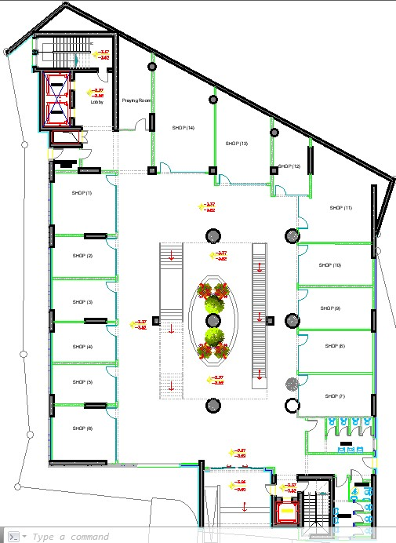
Architectural plan for Base Floor

Slide 5
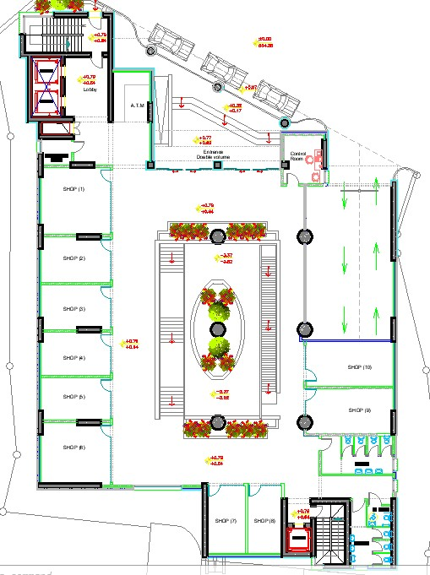
Architectural plan for Ground Floor

Slide 6
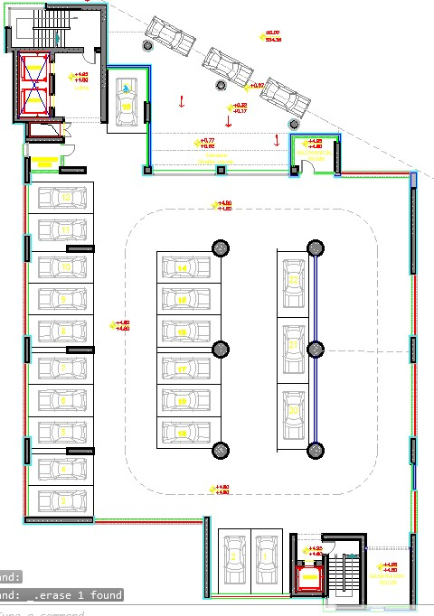
Architectural plan for First Floor

Slide 7
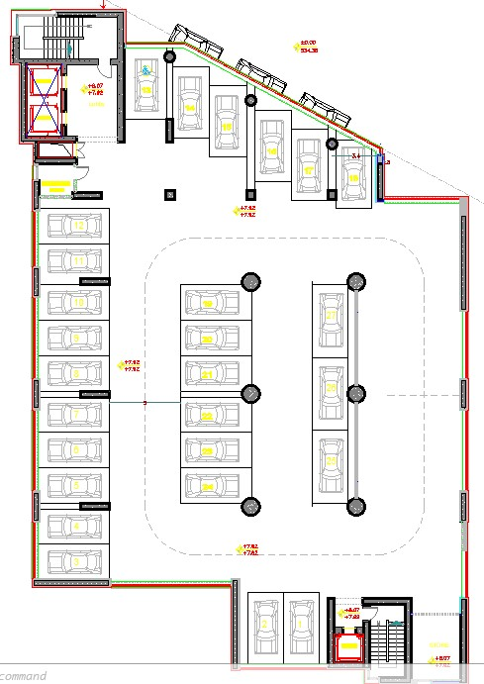
Architectural plan for Second to Seventh Floor

Slide 8
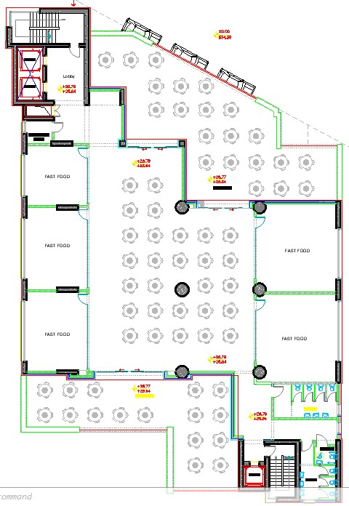
Architectural plan for Eighth Floor

Slide 9
Codes and Standards:
      ACI 318-14 (American concrete institute )
      ASCE 7-16 (American Society Of Civil Engineers )
      AASHTO (American Association of State Highway and Transportation )
Materials :
  Structural :
        Reinforcement steel
        Concrete
  Non Structural
Material | Density KN/m³
Fill | 16
Mortar | 23
Plaster | 23
Tile | 25

Slide 10
Gravity loads :
      Live Load :
Parking (2.0 kN/m2) Shopping and restaurants (5.0 kN/m2) Stair(5.0 kN/m2)
      Super Impose Dead Load:
Parking(1.0 kN/m2) Shopping , restaurants & Stair (2.5 kN/m2)
      Slab Own Weight (8.75 kN/m2)

Slide 11
Geometry design of Parking Garage
In our project we found that the parking doesn’t satisfy AASHTO specifications of :
1) Ramp slope 2) Ramp width 3) Turning circles
Some of criteria we used:
Ramp width
ramp width = 7.0m
Ramp slope
In AASHTO the maximum
allowable slope is about 16%
Ramp | Slope%
From ground | 15.9 & 10
From first (& all other ramps the same) | 15

Slide 12
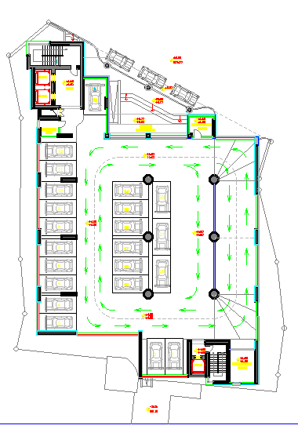
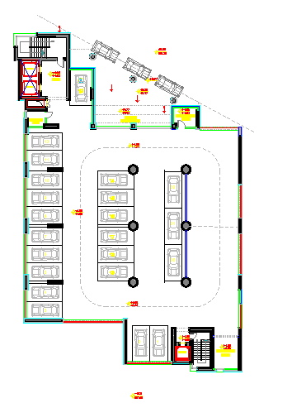
Plan before modification Plan after modification

Slide 13
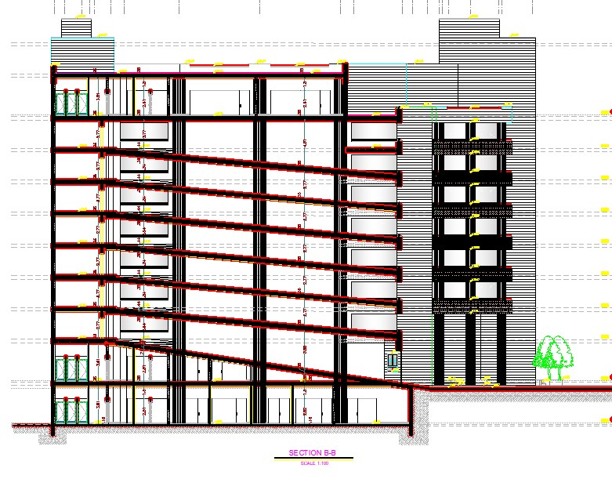
section for building before modification

Slide 14
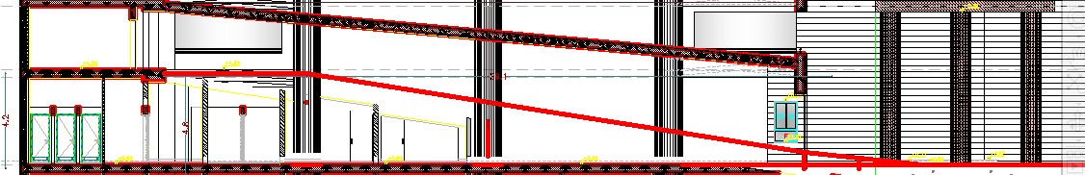
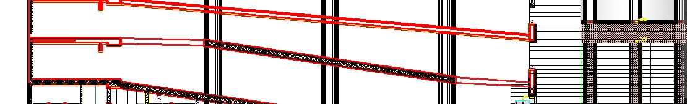
First ramp after modified
second ramp after modification
Computer programs:
ETAPS 2016 is used to analyze and design the structural elements (3D).
spSlab is used to analysis and design the slabs on the project.

Slide 15
Equivalent frame method
The slab is divided into series of two-dimensional frames in each direction, positive and negative moments are computed by an elastic frame analysis. Then, these moments are divided between middle and column strips.

Slide 16
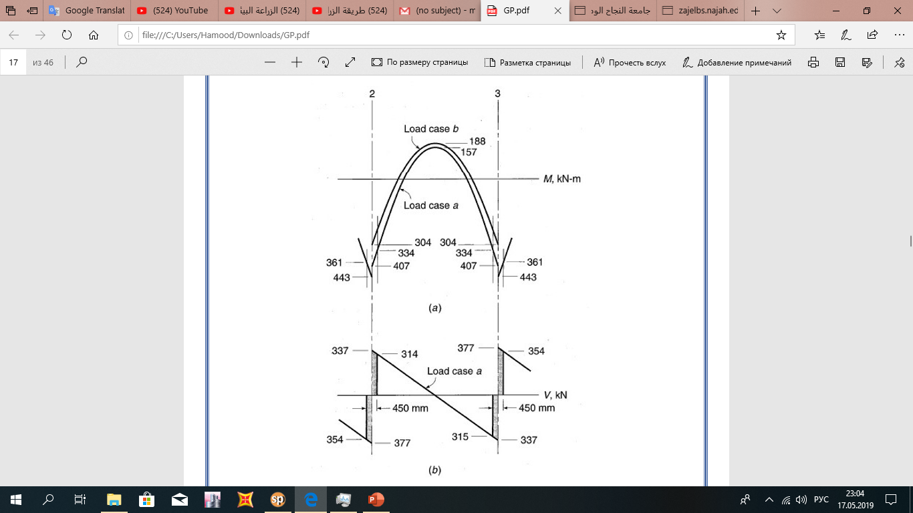
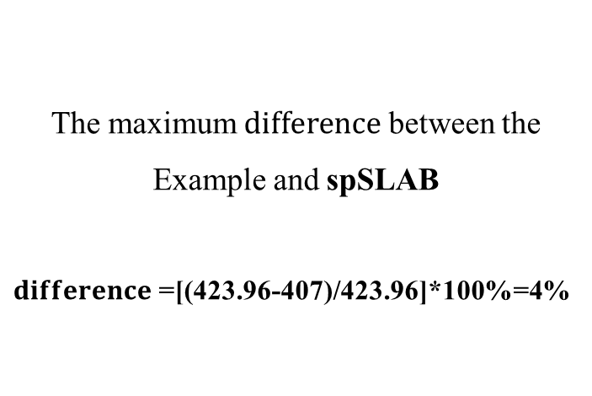
To ensure if spSLAB software analyzed correctly we applied example 13.3 (DESIGNE OF CONCRETE STRUCTURES 14th edition in SI UNITS)
The maximum $difference$ between the Example and spSLAB
$difference$=[(423.96-407)/423.96]*100%=4%

Slide 17
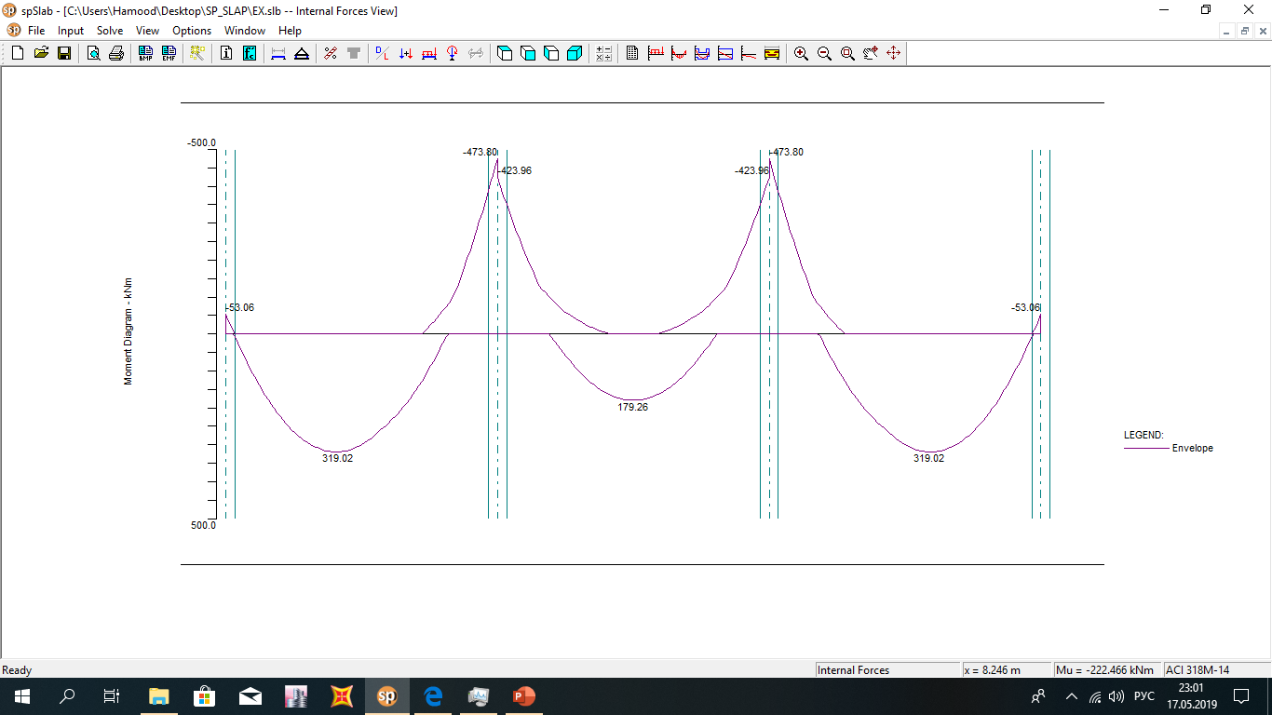
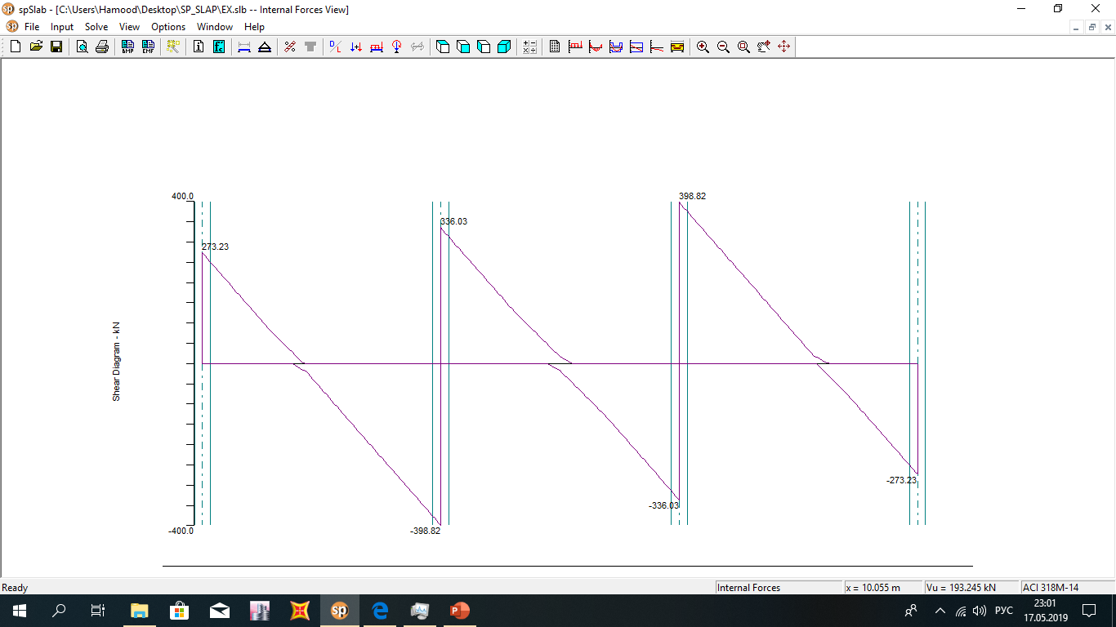

Slide 18
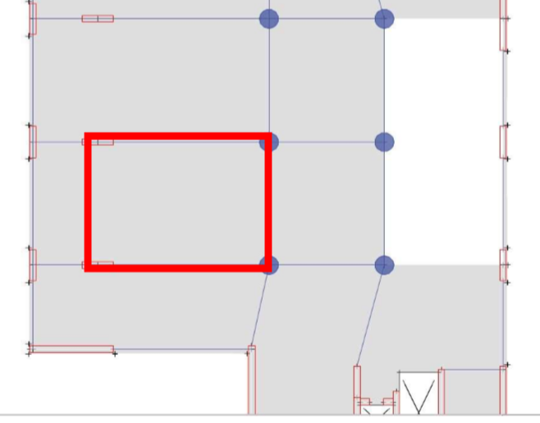
Preliminary design.
Slab System
Two-way solid slab and flat plate
The ratio of the long span to the short span (L/B) =1.39 which is less than 2 so it’s preferable to design the slab as two way solid slab
11m
7.9m

Slide 19
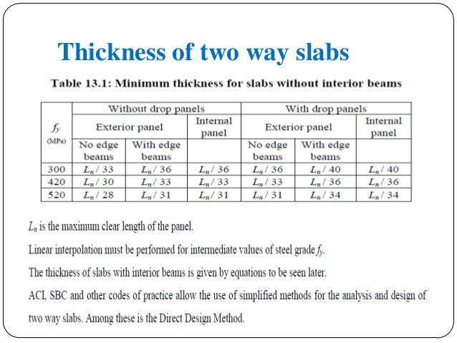
Slab thickness
Preliminary design.
In our structure the minimum thickness (t) equal to L/33
t=11/33=0.33m
So we used t=350mm

Slide 20
Check slab for Punching
Preliminary design.
Slab thickness t=350mm , d=310mm
𝐼 𝑐𝑖𝑟𝑐𝑢𝑙𝑎𝑟 = 𝐼 𝑠𝑞𝑢𝑎𝑟𝑒
Л(𝐷^4)/64=1/12∗ 𝑏 ∗ ℎ
b =h= 1.051 mm
Tributary area=(7.4/2)+(11/2)∗ 7.9 = 72.68𝑚
𝑊𝑢 = (0.35 ∗ 25 + 1) ∗ 1.2 + (2 ∗ 1.6) = 14.9KN/m^2
𝑃𝑢 = (72.68∗14.9)-14.9(1.05+0.31)^2= 1055.3𝐾𝑁
𝑃𝑛 =1055.3/0.75=1407.06𝐾𝑁
𝑏0 = (1051 + 310)∗4=5444𝑚𝑚, 𝑑=310𝑚𝑚, 𝛼=40, 𝐵=1
𝑣𝑐𝑝1=[0.17(1+1/2)∗(28^0.5)∗5444∗310]/1000=2277.18𝐾𝑁
𝑣𝑐𝑝2=[0.083∗({40∗310/5444}+2)∗(28^0.5)∗5444∗310]/1000=3170.66𝐾𝑁
𝑣𝑐𝑝3=[0.33∗(28^0.5)∗5444∗310]/1000=2976.71𝐾𝑁
Minimum 𝑣𝑐𝑝=2277.18𝐾𝑁 > 𝑃𝑛 =1407.06𝐾𝑁 …… OK

Slide 21
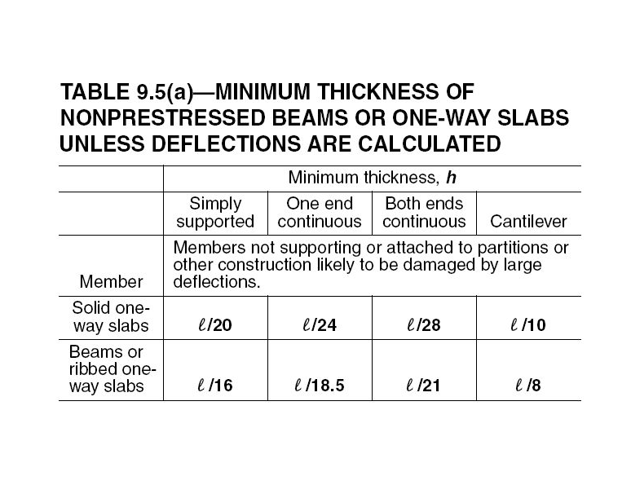
Beam dimensions
Preliminary design.
Beam thickness (h):
We chose the critical beam span length which is 11m
h=11/21=0.52m
We used h=550mm
Beam width:
Minimum allowable width=200mm …. Try 300mm

Slide 22
Columns
Preliminary design.
The slenderness for columns is calculated as shown below:
Assume Sway …….. KL/R <22
K=1, L= 5.1, r = 0.25D, D=1.2m
KL/R=17 < 22 ……so we have short column
Columns dimensions:
12666.104*10^3=0.75*0.85[0.85*28(Ag-0.02Ag)+420*0.02Ag]
Ag=6262814.05mm…..so Dmin=892.9 mm
So we take in this part of project diameter as it come from architectural drawing=1200 mm

Slide 23
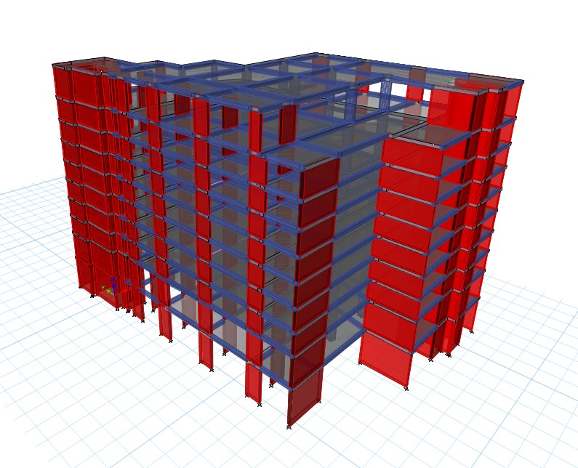
Three Dimensional structural analysis

Slide 24
Input data of the Models.
  Material:
f′𝑐= 28MPa for columns & shear walls.
f′𝑐= 24MPa for beams & reinforced slabs.
  The modifiers of Columns, Beams, Slab and Shear wall are shown in table:
  But, Torsion modifiers are too small 𝑴𝟏𝟐 = 𝟎. 𝟎𝟎𝟏 No need for torsional reinforcement.
Section | Modifiers
Column | 0.7
Beam | 0.35
Slab | 0.35
Shear wall | 0.7

Slide 25
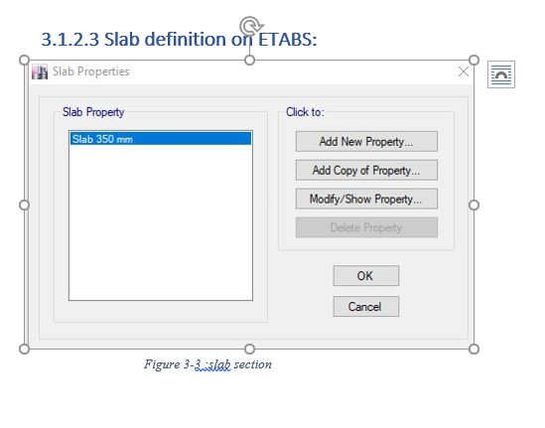
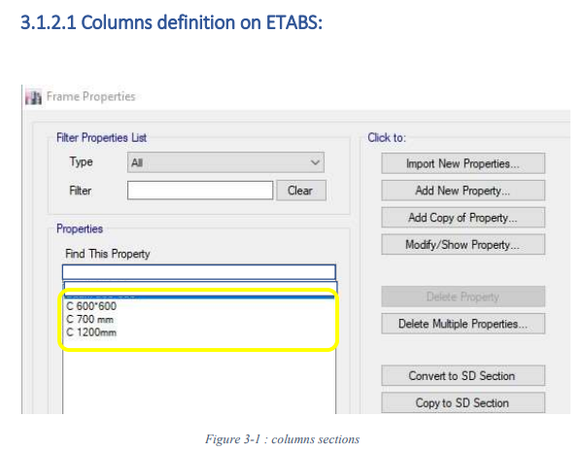
Sections on ETABS:

Slide 26
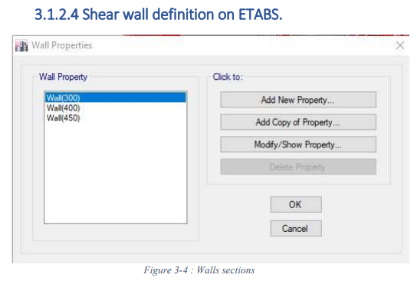
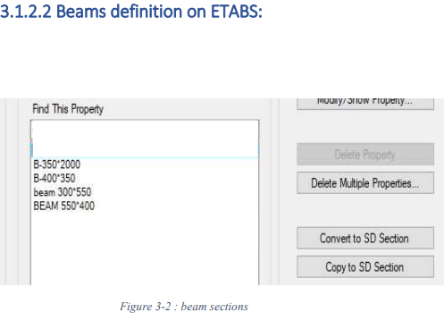

Slide 27
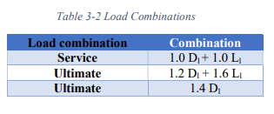
Loads on ETABS:
Load Cases:
Live load:
-Parking ………… (2.0 kN/m2)
- Shopping and restaurants ………… (5.0 kN/m2)
- Stair………… (5.0 kN/m2)

Slide 28
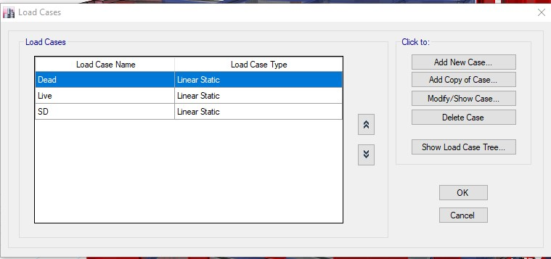
Superimposed dead load:
-Parking ………… (1.0 kN/m2)
- Shopping and restaurants ………… (2.5 kN/m2)
- Stair………… (2.5 kN/m2)

Slide 29
ETABS model checks
Drawing structural model
Compatibility
External equilibrium
Stress Strain Check
Slab deflection

Slide 30

Drawing structural model

Slide 31
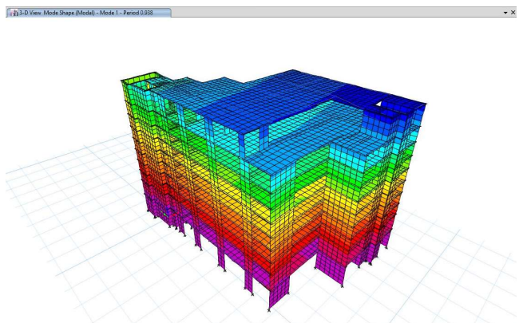
Compatibility
As shown in period = 0.938 which is Acceptable

Slide 32
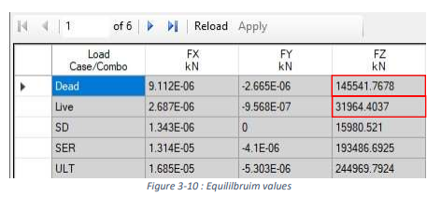
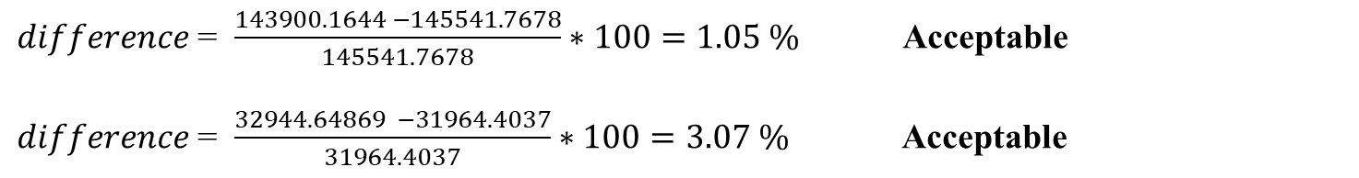
External equilibrium
Hand calculation
Dead loads = 143900.1644 kN
Live loads = 32944.64869 Kn
2. Etabs values:
$difference$= $\frac{143900.1644 −145541.7678}{145541.7678}∗100=1.05 \%$ Acceptable
$difference$= $\frac{32944.64869 −31964.4037}{31964.4037}∗100=3.07 \%$ Acceptable

Slide 33
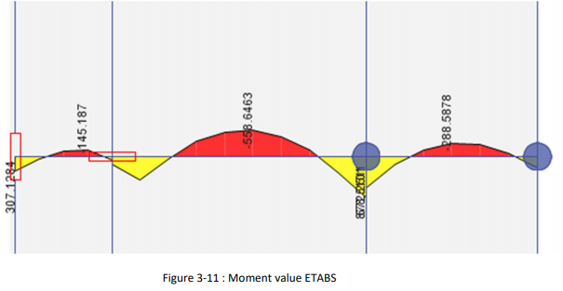
Stress Strain Check.
For interior span in EF frame in X-direction:
E
F

Slide 34
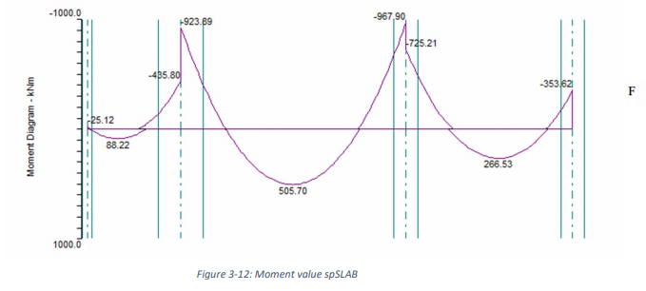
For moment values from spSLAB :
$difference=\frac{558.6−505.7}{505.7}∗100=10\%$

Slide 35
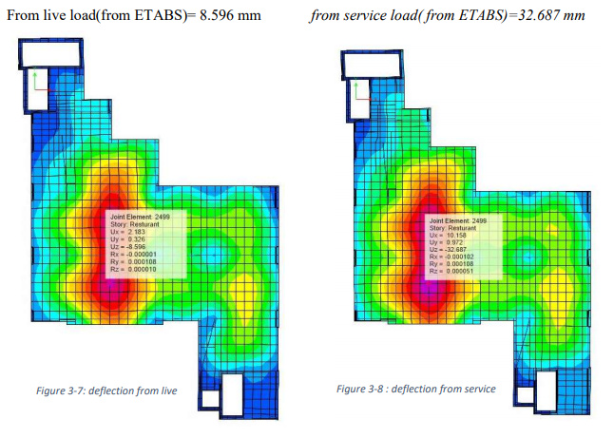
Slab deflection

Slide 36
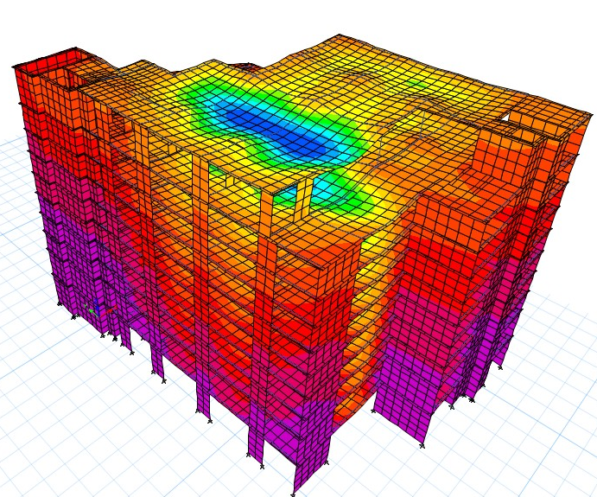
max 𝑑𝑒𝑓𝑙𝑒𝑐𝑡𝑖𝑜𝑛 = 7.9 ∗ 1000 /240 = 32.917mm
32.687 < 32.917mm
8.596 < 32.917mm

Slide 37
CONCLUSION
As a result of this stage of project:
1.we modified this building and make a proper design for its parking garage.
2. make preliminary design for building.
3. prepare this building for second stage.
In the stage #2 of this project we will:
1. Design this building to gravity and seismic loads.
2. design the most suitable footing for this building.

Slide 38
Thank You All
for your attention

