Slide 1


IMPLEMENTING ISO 9001:2015 AT AL-HIJJAWI PRINTING PRESS
PREPARED BY:
Wesal Abuissa
Aroob Hindya
Ward Batyeh
Tasneem Darwish
Supervisor: Dr. Suleiman Daif

Slide 2

OVERVIEW
01
02
03
Introduction
Problem Statement
Objectives
04
05
06
Theoretical Background
Methodology
Gap Analysis Results
07
08
09
10
Challenges
Expected Benefits
Future Work
Conclusion

Slide 3


INTRODUCTION
About Al-Hijjawi Printing Press:
Established in 1935 in Nablus, it is a leader in the printing and packaging industry.
Known for producing high-quality packaging materials, labels, and paper products.
Importance of ISO 9001:2015:
A globally recognized standard for quality management.
Helps ensure consistent quality and enhances customer satisfaction.
Why This Project?
To identify gaps and align Al-Hijjawi Printing Press’s operations with ISO 9001:2015 requirements.

Slide 4





PROBLEM STATEMENT
01
What is the Problem?
    Lack of a formal quality management system in Al-Hijjawi Printing Press.
    Frequent errors, delays, and customer complaints.
    Inefficiencies and lack of clarity in processes.
Why is it Important?
    Impacts customer satisfaction and trust.
    Weakens the company’s market competitiveness.
02

Slide 5
OBJECTIVES
Main Goals:
    Align Al-Hijjawi’s processes with ISO 9001:2015 standards.
    Improve operational efficiency and reduce errors.
    Enhance customer satisfaction and organizational reputation.
Specific Objectives:
    Establish structured and efficient processes.
    Promote continuous improvement and employee engagement.
    Build a culture of quality and compliance.

Slide 6

ABOUT ISO 9001:2015
ISO 9001:2015 IS AN INTERNATIONALLY
RECOGNIZED STANDARD FOR QUALITY MANAGEMENT SYSTEMS (QMS), DEVELOPED BY THE INTERNATIONAL ORGANIZATION FOR STANDARDIZATION (ISO).
IT PROVIDES A STRUCTURED FRAMEWORK THAT ORGANIZATIONS CAN USE TO ENSURE THEY CONSISTENTLY DELIVER PRODUCTS AND SERVICES THAT MEET CUSTOMER AND REGULATORY REQUIREMENTS WHILE ENHANCING OVERALL EFFICIENCY AND CUSTOMER SATISFACTION.

Slide 7
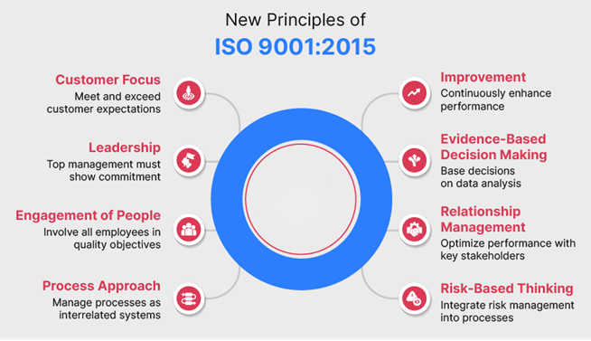
PRINCIPLES OF ISO 9001 :2015

Slide 8
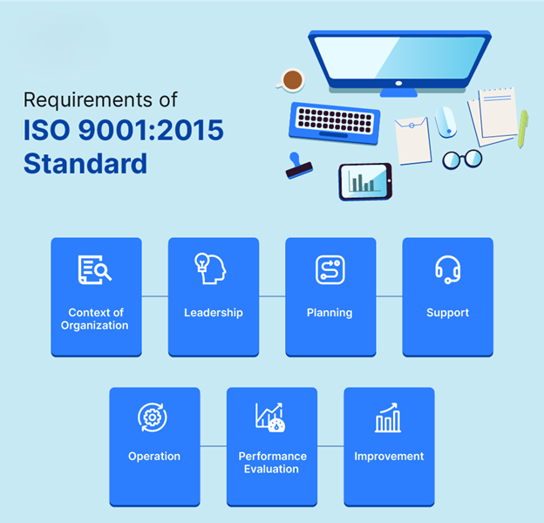
Requirements
ISO 9001:2015
Standard :

Slide 9
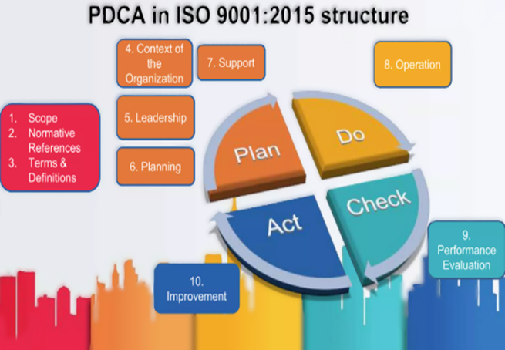
PDCA
CYCLE:
PLAN
  DO
CHECK
ACT

Slide 10

Methodology
Reviewing existing processes and practices.
    Analyzing Current Operations
Comparing current processes with ISO 9001:2015 requirements.
Conducting Gap Analysis
Identifying areas of compliance and non-compliance.
Developing a Checklist
Gathering expert feedback and recommendations.
Collaborating with External Auditors
Formulating Recommendations
Proposing actionable steps for alignment with ISO standards.

Slide 11




GAP ANALYSIS RESULTS
Key Findings:
Clause 4: Context of the Organization:
Internal and external factors not well-documented.
Recommendation: Conduct SWOT and PESTLE analysis.
Clause 5: Leadership:
Quality policy exists but is not effectively communicated.
Recommendation: Document and communicate the policy organization-wide.
Clause 6: Planning:
No formal risk management or quality objectives.
Recommendation: Develop a risk management plan and set measurable quality objectives.

Slide 12
GAP ANALYSIS RESULTS
Clause 7: Support:
Inadequate documentation and employee training.
Recommendation: Enhance training programs and implement a documentation control system.
Clause 8: Operations:
Lack of defined KPIs and monitoring mechanisms.
Recommendation: Establish KPIs and ensure regular monitoring.
Clause 9: Performance Evaluation:
Internal audits are irregular and lack structure.
Recommendation: Create and follow a structured audit schedule.
Clause 10: Improvement:
No formal process for identifying and addressing areas of improvement.
Recommendation: Implement a continuous improvement framework using data-driven decision-making.

Slide 13

CHALLENGES
KEY OBSTACLES FACED:
Lack of structured documentation
Resource and time constraints.
Employee resistance to new processes.
Limited awareness of ISO standards.

Slide 14


EXPECTED BENEFITS
For Al-Hijjawi Printing Press:
Improved internal processes and operational efficiency.
Increased customer satisfaction and trust.
Enhanced reputation in local and international markets.
Better alignment with global quality standards.

Slide 15


Future Work
IMPLEMENTATION PHASE:
    APPLY THE RECOMMENDATIONS FROM THE GAP ANALYSIS.
    Train employees on ISO 9001:2015 requirements.
    Develop and maintain documentation for processes.
MONITORING AND CONTINUOUS IMPROVEMENT:
    CONDUCT REGULAR INTERNAL AUDITS.
    Use performance metrics to track progress and improvements.
CERTIFICATION GOAL:
    ACHIEVE ISO 9001:2015 CERTIFICATION TO STRENGTHEN THE COMPANY’S COMPETITIVE EDGE.

Slide 16

Conclusion
Summary:
    The project identifies gaps and proposes actionable steps for ISO 9001:2015 compliance.
    It enhances Al-Hijjawi Printing Press’s quality standards and market positioning.
Future Outlook:
    Implement recommendations and achieve ISO certification.

Slide 17



THANK YOU!

