Slide 1
Evaluation and Analysis of Nablus Entrances

Slide 2
Objectives
Analyze and evaluate the traffic conditions for Nablus entrances, in order to increase their efficiency at these entrances by checking traffic conditions at the mentioned entrances.
Estimation of future conditions for the entrances .

Slide 3
Significance of work
The significance of the work is to study the entrances of nablus city. Since it has an importance to facilitate traveling from nablus to other cities and villages, and vice versa.
The volume at these intersections is relatively high, and expected to increase significantly in future, due to the population growth and nablus economical position. This growth will make the movement more complicated.

Slide 4
Help the municipality of nablus to improve the accessibility and mobility to the city therefore that will lead to improvement the touristic and economic situation for the city.

Slide 5
Methodology
Counting traffic volume at each intersection.
Data analysis to obtain LOS for current and future conditions.
Check the intersections for warrants.
Signal timing for the warranted intersections.
LOS’s assuming warranted intersections are signalized.

Slide 6
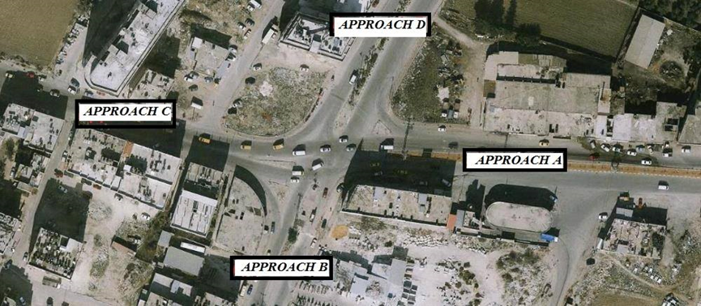
Site Description
Al-Ghawi intersection

Slide 7
Al-Ghawi intersection
The intersection carries traffic from the eastern part of Nablus to the center of the city with four approaches,
Al-Hesba street (Approach A),
Balata street (Approach B),
Amman Street (Approach C)
Askar street (Approach D).

Slide 8
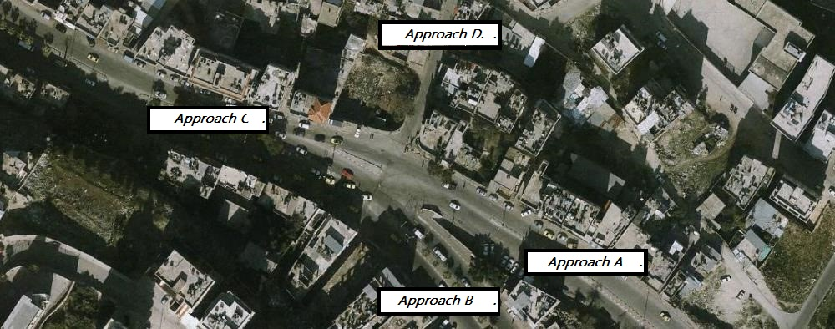
Al-Quds intersection

Slide 9
Al-Quds intersection
Have two major streets
Al-Quds street (Approach B) that carries traffic from ramallah and many villages around nablus like howara village, etc... ,
Minor road which is carrying traffic from balata refugees’ camp and many villages located in east of nablus like beit-fourik, salem, etc...(Approach D)

Slide 10
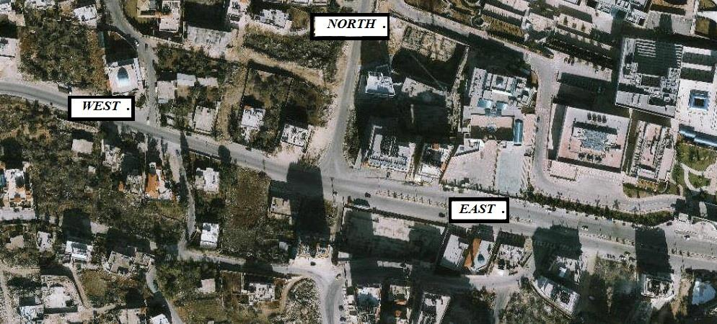
Beit –Wazan intersection

Slide 11
Beit –Wazan intersection
T intersection that carries the traffic from Qalqilya city and a part of Tulkarm traffic in addition to small traffic volumes from Ramallah and the western villages of Nablus, Qouseen, etc.. .
The other approach connects to the major entrance street that comes from Deir-Sharaf intersection.

Slide 12
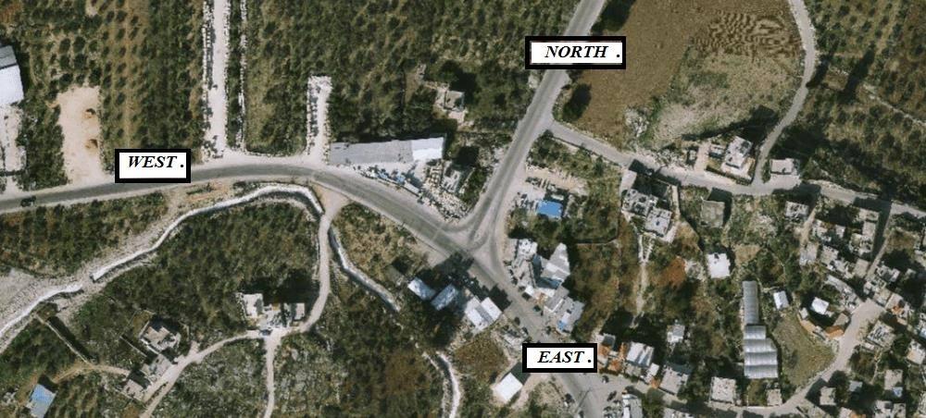
Deir-Sharaf intersection

Slide 13
Deir-Sharaf intersection
T intersection carries traffic volume from Jenin, Nablus, and Tulkarm cities. As shown in the photo, the western approach comes from Tulkarm and continues to Nablus, while the Eastern-North comes from Jenin.

Slide 14
Traffic volume
Count the traffic volume for the four intersections
Al-Ghawi intersection
Al-Quds intersection
Beit –Wazan intersection
Deir-Sharaf intersection

Slide 15
 | AL-Ghawi | Beit-Wazan | Deir-Sharaf | AL-Quds
PH | 7:45 – 8:45 | 7:15 - 8:15 | 7:15 - 8:15 | 7:15 - 8:15
PHV | 2119 | 1385 | 896 | 2937

Slide 16
Accidents (Crashes)
Safety is an important issue when planning to improve existing facility.
The number of crashes per year is the major indication of the safety on The intersection

Slide 17
The numbers of crashes occur exactly at Al-Ghawi Intersection at the last 12 months are 19 crashes , regardless of their severity, and for Al-Quds Intersection are 9 crashes.
The average was estimated to be within 15-20 crash per year at Al-Ghawi intersection and about 10 at Al-Quds intersection, in the day and night time, which is considered to be a high value.

Slide 18
Month / Year | No. of accidents Al-Ghawi Intersection | No. of accidents Al-Quds Intersection
Jan-14 | 3 | 0
Feb-14 | 2 | 4
Mar-14 | 1 | 0
Apr-14 | 2 | 2
May-14 | 2 | 1
Jun-14 | 0 | 1
Jul-14 | 0 | 1
Aug-14 | 3 | 0
Sep-14 | 0 | 1
Oct-14 | 0 | 0
Nov-14 | 1 | 0
Dec-14 | 2 | 0
Jan-15 | 1 | 1
Feb-15 | 1 | 1
Mar-15 | 2 | 0
Apr-15 | 4 | 0
May-15 | 2 | 1
Jun-15 | 0 | 1
Jul-15 | 3 | 2
Aug-15 | 1 | 1
Sep-15 | 1 | 1
Oct-15 | 1 | 0

Slide 19
Data analysis

Slide 20
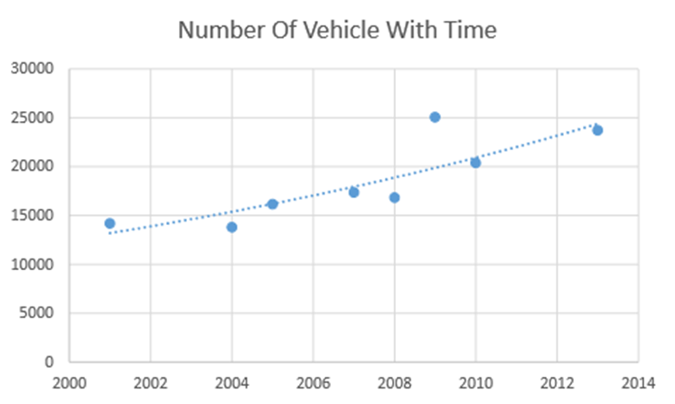
Future Analysis
To calculate the future traffic volume, there is a need to determine the traffic growth rate ( i )
Based on the Palestinian Central Bureau of Statistics related to number of vehicles in Nablus form 2001 to 2014.
i=4 % .

Slide 21
Level of service (LOS) is a measure used by traffic engineers to determine the effectiveness of elements of transportation infrastructures it is most commonly used to analyze highways, but the concept has also been applied to intersections, transit, and pedestrian facilities. The transportation LOS system uses the letters A through F, with A being the best and F being the worst.

Slide 22
Level of service
SIDRA , HCS Softwares were used to estimate the level of service’s at the intersection’s while hand caculations according to HCM were also used to determine LOS’s for the links and Deir Sharaf intersection .

Slide 23
Data Analysis for Intersections (level of service) current
Current LOS for the intersections
Intersection | AL-Ghawi | Beit-Wazan | Deir-Sharaf | AL-Quds
Current LOS | F | B | A | F

Slide 24
Data Analysis for Intersections (level of service) expected
Future LOS for the intersections
Intersection | AL-Ghawi | Beit-Wazan | Deir-Sharaf | AL-Quds
Future LOS | F | F | B | F

Slide 25
Data Analysis for links (Two Lane Rural Highway) current
Where:
1: West approach in Beit-Wazan intersection
2: North approach in Beit-Wazan intersection
3: north approach in Deir-Sharaf intersection.
4: West approach in Deir-Sharaf intersection.
5: Approach C in AL-Ghawi intersection
Current LOS’s for two lane highway links.
Link # | 1 | 2 | 3 | 4 | 5
LOS | D | A | B | B | C

Slide 26
Data Analysis for links (Two Lane Highway)
Expected
Where:
1: West approach in Beit-Wazan intersection
2: North approach in Beit-Wazan intersection
3: north approach in Deir-Sharaf intersection.
4: West approach in Deir-Sharaf intersection.
5: Approach C in AL-Ghawi intersection.
Future LOS’s for two lane highway links.
Link # | 1 | 2 | 3 | 4 | 5
LOS | E | B | C | C | E

Slide 27
Data Analysis for links (MultiLane Rural Highway) current
Where:
1: East approach in Beit-Wazan intersection.
2: East approach in Deir-Sharaf intersection.
3: Approach A in AL-Quds intersection.
4: Approach B in AL-Quds intersection.
5: Approach C in AL-Quds intersection.
6: Approach D in AL-Ghawi intersection.
7: Approach A in AL-Ghawi intersection.
8: Approach B in AL-Ghawi intersection.
LOS’s for the current multilane highway links.
LINK # | 1 | 2 | 3 | 4 | 5 | 6 | 7 | 8
LOS | B | A | B | B | C | A | A | B

Slide 28
Data Analysis for links (MultiLane Rural Highway) current
Where:
1: East approach in Beit-Wazan intersection.
2: East approach in Deir-Sharaf intersection.
3: Approach A in AL-Quds intersection.
4: Approach B in AL-Quds intersection.
5: Approach C in AL-Quds intersection.
6: Approach D in AL-Ghawi intersection.
7: Approach A in AL-Ghawi intersection.
8: Approach B in AL-Ghawi intersection.
LOS’s for the current multilane highway links.
LINK # | 1 | 2 | 3 | 4 | 5 | 6 | 7 | 8
LOS | B | A | B | B | C | A | A | B

Slide 29
TRAFFIC SIGNAL WARRANT
A warrant is a set of criteria which can be used to define the relative need for a particular traffic control device (traffic signal, etc.).
In order to achieve the purpose to check the four intersections for
TRAFFIC SIGNAL WARRANT , PC WARRANT SOFTWARE was used .

Slide 30
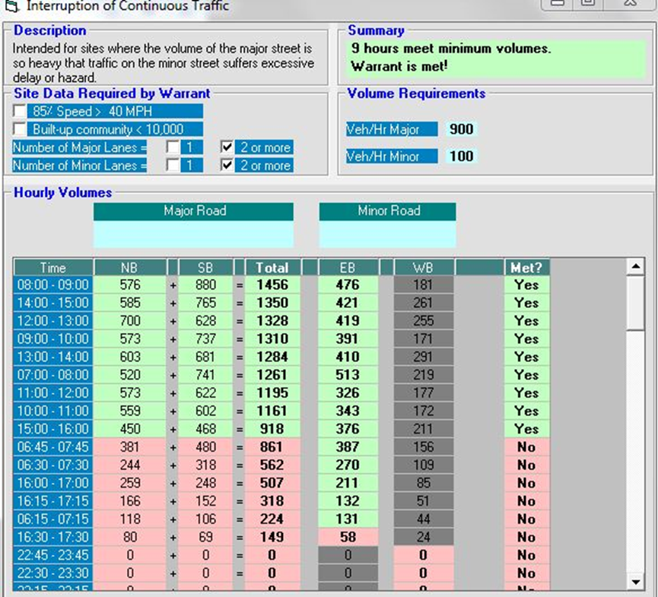
Warrant 1, Eight-Hour Vehicular Volume condition A,
check for Al-Ghawi intersection.obtained using PC WARRANT .

Slide 31
Deir Sharaf | Beit Wazan | AlQuds | AlGhawi
Not | Not | Met | Met | Warrant 1, Eight-Hour Vehicular Volume
Not | Not | Met | Met | Warrant 2, Four-Hour Vehicular Volume
Not | Not | Met | Not | Warrant 3, Peak Hour

Slide 32
DESIGN OF TRAFFIC SIGNALS

Slide 33
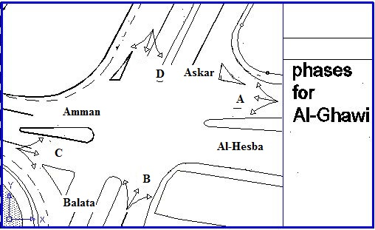
Al Ghawi Intersection

Slide 34
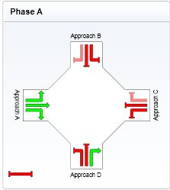
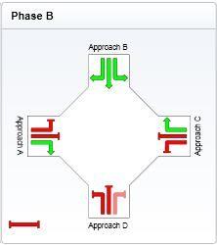
Phases for Al-Ghawi

Slide 35
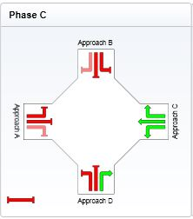
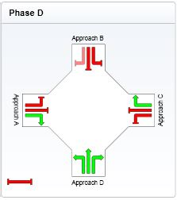
Phases for Al-Ghawi

Slide 36
Sample Calculations
This table summarizes the volume, flow, saturation flow and Y_{i} for every approach
Sum (Yi) = 0.53
volume | approach A | approach B | approach C | approach D
 | 517 | 209 | 808 | 141
qi | 575 | 233 | 898 | 157
S | 3700 | 3700 | 3700 | 3700
Yi | 0.1554 | 0.076 | 0.2427 | 0.0554

Slide 37
calculations
E) Determine the optimum cycle length
Co = (1.5L+5)/(1-sumYi)
Where L is the total lost time in all phases (assume L=3.5sec/approach)
L = 4*3.5=14 sec
Co = (1.5*14+5)/ (1-0.567) = 55.35 sec
Then the optimum cycle length equal (60sec)

Slide 38
calculations
F) Find yellow interval
Yellow interval = δ + (W+L/Uo) + (Uo/ (2(a+Gg))
Yellow interval =6 sec and take all red 1sec
So,
Total effective green time = Co-{L + R}
= 60-{14+4} = 42sec

Slide 39
calculations
G) Actual green time for each phase
Actual green time for phase (A) = ((0.164/0.53)*42) + 3.5 -6 = 11 sec
Actual green time for phase (B) = ((0.098/0.53)*42) + 3.5 -6 = 5.6 sec take 6 sec
Actual green time for phase (C) = ((0.237/0.53)*42) + 3.5 -6 = 14 sec
Actual green time for phase (D) = ((0.068/0.53)*42) + 3.5 -6 = 3.1 sec take 6 sec as minimum actual green time equals to yellow time

Slide 40
calculations
H) Calculations for pedestrian green time:
G_{p}=3.2+ (L/S_{p}) + {2.7*(N_{ped}/W_{E})}…… for W_{E} ≥ 10 ft
L = (4*3.6) +.5 =15m = 49 ft
W_{E} = take 4 m = 13.12 ft
N_{ped} = considered as min. (25)
G_{p} = 3.2+ (49/4) + {2.7*(25/13.12)}
G_{p} = 20 sec
So, consider 20 sec all-red interval for pedestrian.

Slide 41
Results
Hand calculations results
Phase | A | B | C | D
Green Time (sec) | 11 | 6 | 17 | 6
Yellow Time (sec) | 6 | 6 | 6 | 6
All-Red Time (sec) | 1 | 1 | 1 | 1
Phase Time (sec) | 18 | 13 | 24 | 13

Slide 42
SIDRA Results
The signal timing was designed by SIDRA program and the results were as follow:
Phase | A | B | C | D
Green Time (sec) | 12 | 6 | 18 | 6
Yellow Time (sec) | 6 | 6 | 6 | 6
All-Red Time (sec) | 1 | 1 | 1 | 1
Phase Time (sec) | 19 | 13 | 25 | 13

Slide 43
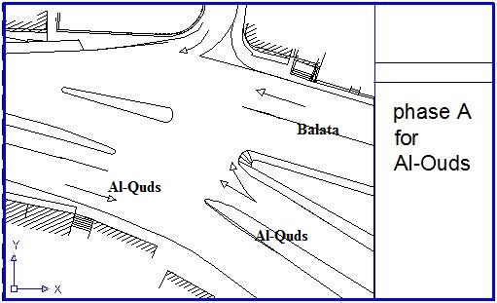
Al Quds Intersection
Phase A

Slide 44
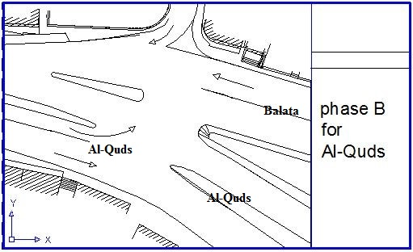
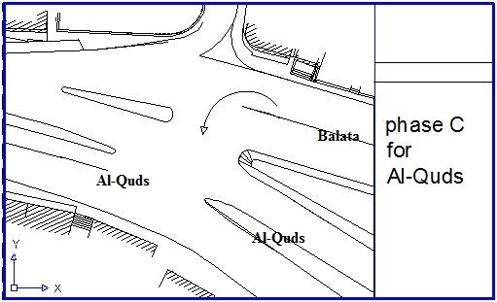
Phases for Al Quds Intersection

Slide 45
Results
Hand calculations results by applying the same previous equations
Phase | A | B | C
Green Time (sec) | 22 | 21 | 6
Yellow Time (sec) | 6 | 6 | 6
All-Red Time (sec) | 1 | 1 | 1
Phase Time (sec) | 29 | 28 | 13

Slide 46
SIDRA Results
Phase | A | B | C
Green Time (sec) | 23 | 20 | 6
Yellow Time (sec) | 6 | 6 | 6
All-Red Time (sec) | 1 | 1 | 1
Phase Time (sec) | 30 | 27 | 13

Slide 47
LOS for Al-Ghawi as signalized intersection.
Al-Ghawi
Approach D | Approach C | Approach B | Approach A
C | C | C | C | App. LOS
C |  |  |  | Intersection LOS

Slide 48
LOS for Al-Quds intersection as signalized intersection.
Al-Quds
Approach D | Approach C | Approach B | Approach A
A | C | C | C | App. LOS
C |  |  |  | Intersection LOS

Slide 49
CONCLUSIONS AND RECOMMENDATIONS

Slide 50
The outcomes of this research could be as the followings.
1-Intersection at Deir-Sharaf: The LOS at this intersection is A, which means the high comfort for the users and the free flow speed is applied. This result could be justified since left turns were not exists. Besides, roundabout will eliminate the crossing conflict points.

Slide 51
2-Intersectionat Al-Ghawi: The LOS at this intersection is B, which means slight decline in the freedom to maneuver with in the traffic stream, this could be justified since the intersection right turns were existed, besides adequate lane widths for all approaches. In addition; this will make crossing points to be eliminated

Slide 52
3-Intersection at Beit-Wazan. The LOS at this interception B this is justified due to the low traffic volume from the north approach.
4-Al-Quds Intersection. The LOS F. This is due to a high volumes at all approaches. Queues were formed at all approaches. In addition the intersection angle is high. This make the vehicles from east approach to minimize their speed to turn right that decline the performance at that approach.

Slide 53
Recommendations
A more detailed travel demand study is recommended, taking into account the future demand generation in the study area. The number of crashes mentioned in this study was collected from the surrounding inhabitance since no database for the next generations, in order to save time instead of review a written documents in the police department.

Slide 54
The interaction between the transportation and environmental is not discussed
Traffic signal management (TSM) actions and measures may be locked for.

Slide 55
For instance, remedial actions for Beit wazan intersection to enhance the LOS with available ROW and within standard may solve the problem or short-term solution may be considered.
Public involvement for searching a solution is recommended for such projects.

Slide 56
Thank You

