Slide 1

AN-Najah National University
Faculty of Engineering & Information Technology
Mechatronics Engineering Department
Graduation Project 1
Forklift Mobile Robot
Students: | Supervisor:
Fahd Hamdallah | Dr. Bashir M. Y. Nouri
Diab Esam Motaz Shehab

Slide 2






Forklift Mobile Robot
Notes:
https://unsplash.com/photos/AXu2aZ3YgP8

Slide 3
Overview

Slide 4
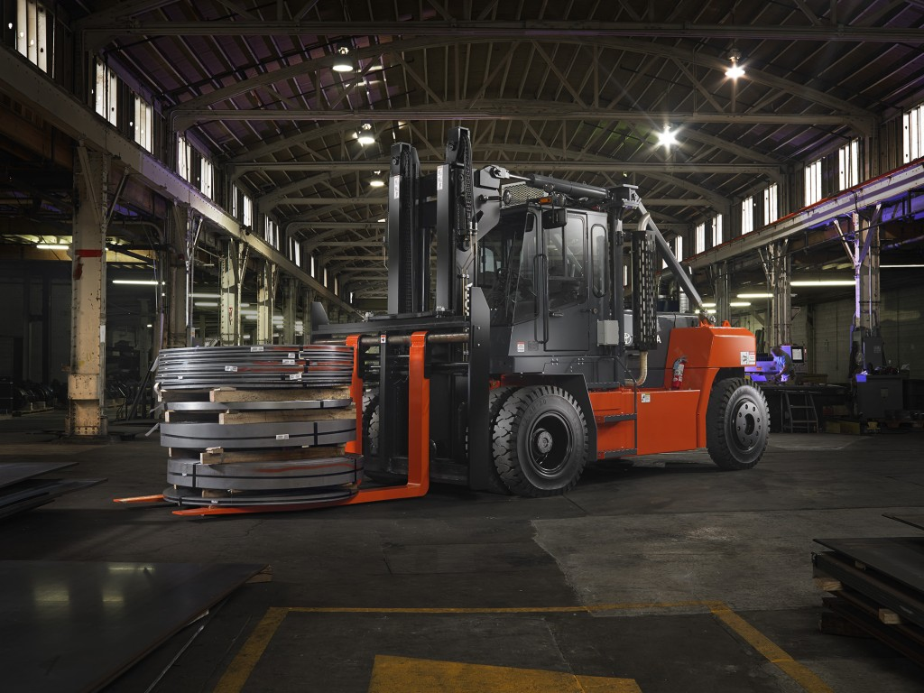
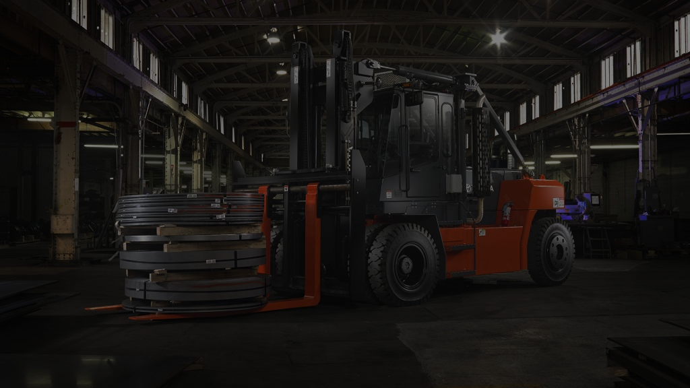
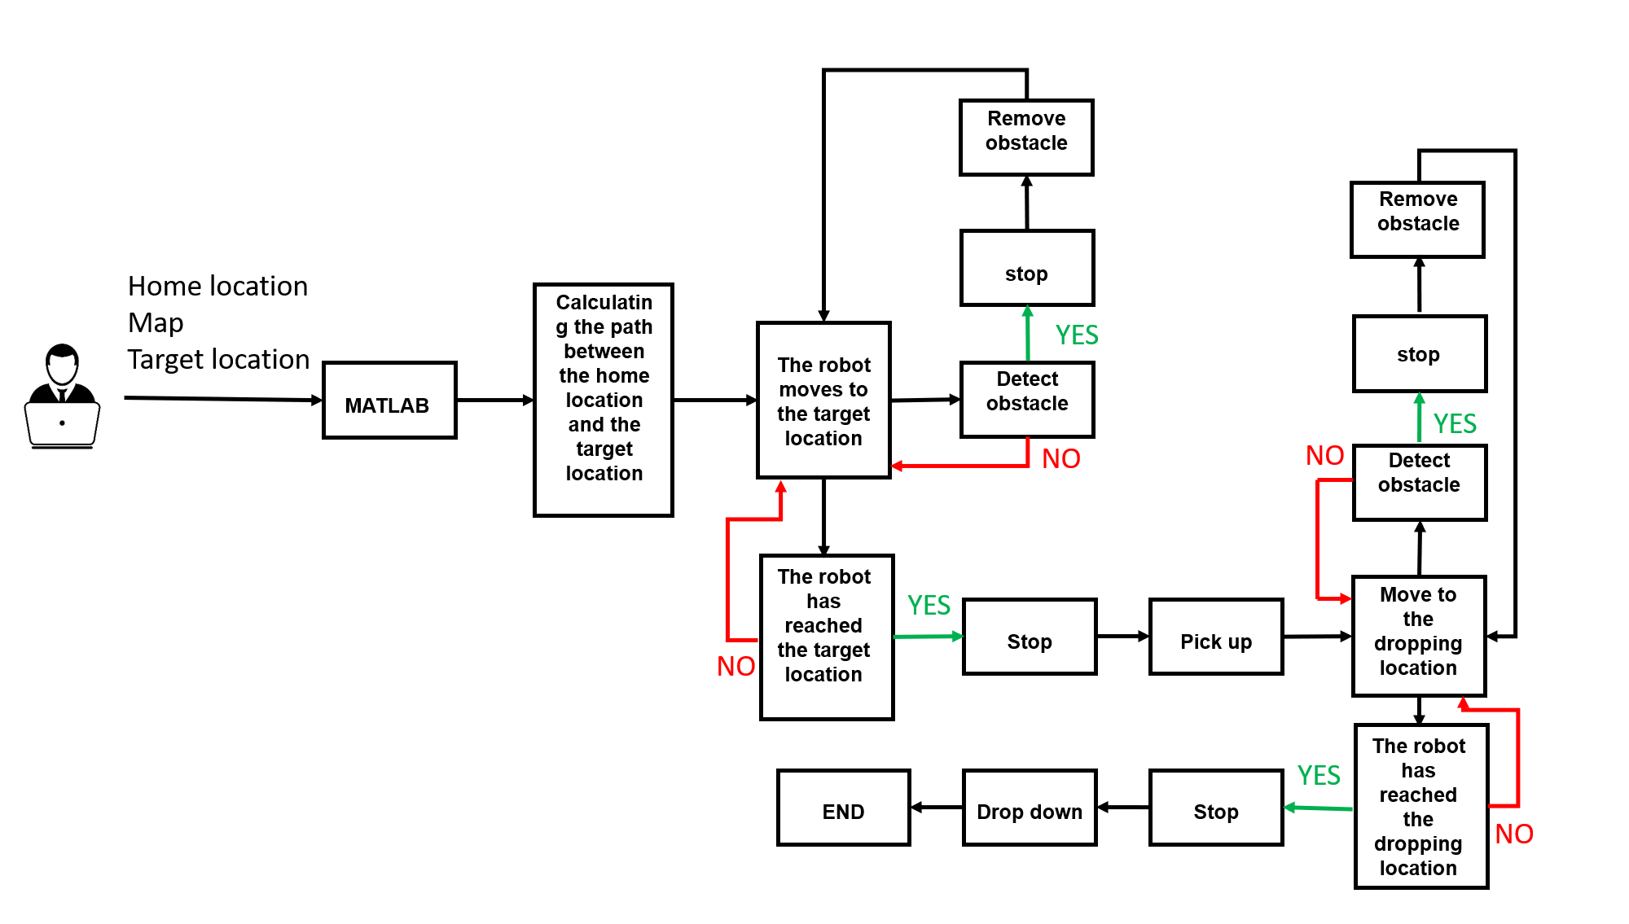
Overview
Notes:
https://unsplash.com/photos/48nerZQCHgo

Slide 5
Mechanical Design

Slide 6
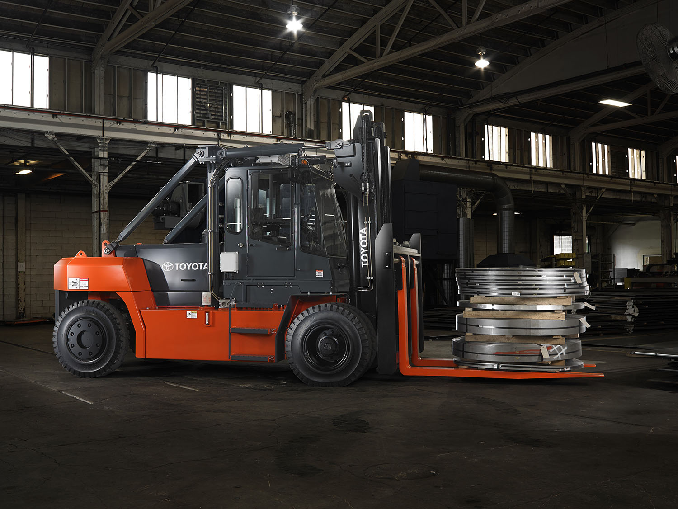
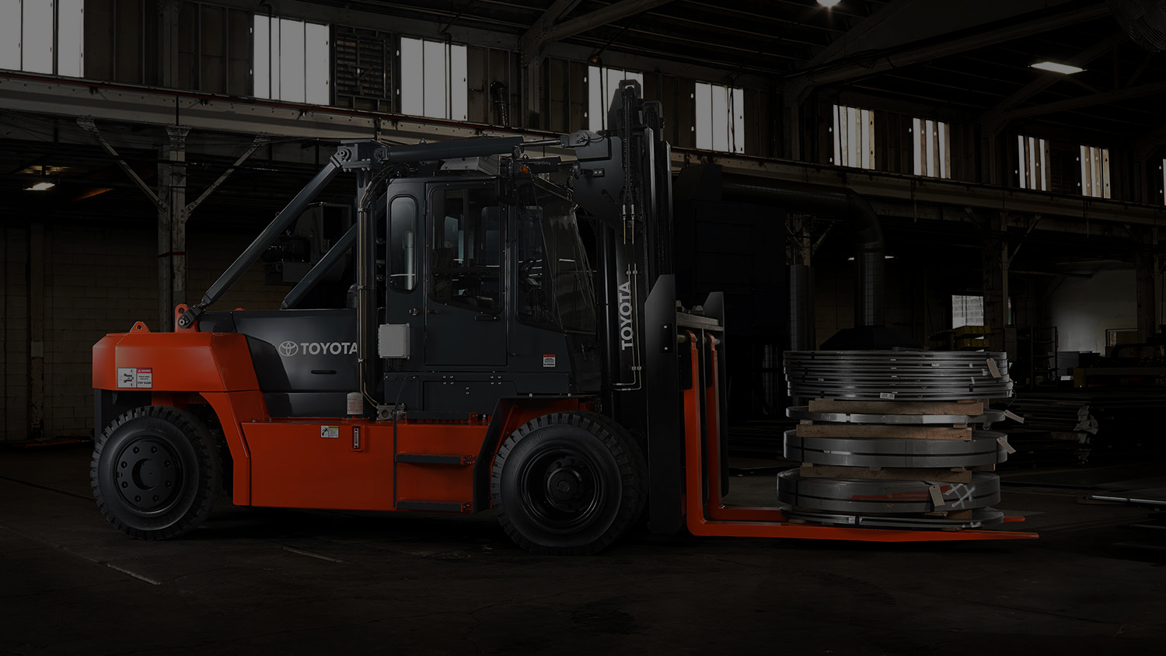
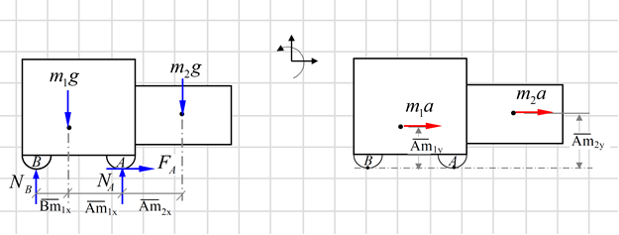

Structure design
Mechanical Design
Equations of motion:
$\sum{F_{x}=ma_{x} → F_{A}=m_{1}a+ m_{2}a}$
$\sum{F_{y}=ma_{y} → 2N_{A}+N_{B}−m_{1}g+ m_{2}g}=0$
$\sum{M_{A}=\sum{{{(M}_{K})}_{A}} }$
$$→m_{1}\left( \overline{{Am}_{1x}} \right)−N_{B}\left( \overline{{Bm}_{1x}}+\overline{{Am}_{1x}} \right)−m_{2}\left( \overline{{Am}_{2x}} \right)=−m_{1}a\left( \overline{{Am}_{1y}} \right)−m_{2}a(\overline{{Am}_{2y}} )$$
no tipping condition; $N_{B}≅0$
$$→ m_{1}\left( \overline{{Am}_{1x}} \right) −m_{2}\left( \overline{{Am}_{2x}} \right)=−m_{1}a\left( \overline{{Am}_{1y}} \right)−m_{2}a(\overline{{Am}_{2y}} )$$
Notes:
https://unsplash.com/photos/TvN54bnuQg8

Slide 7
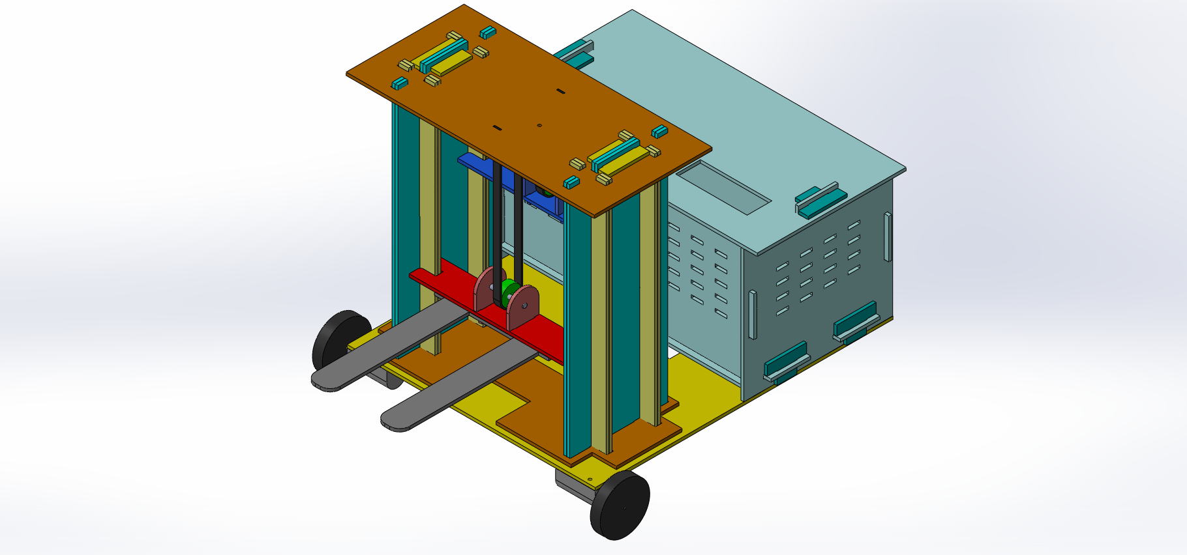
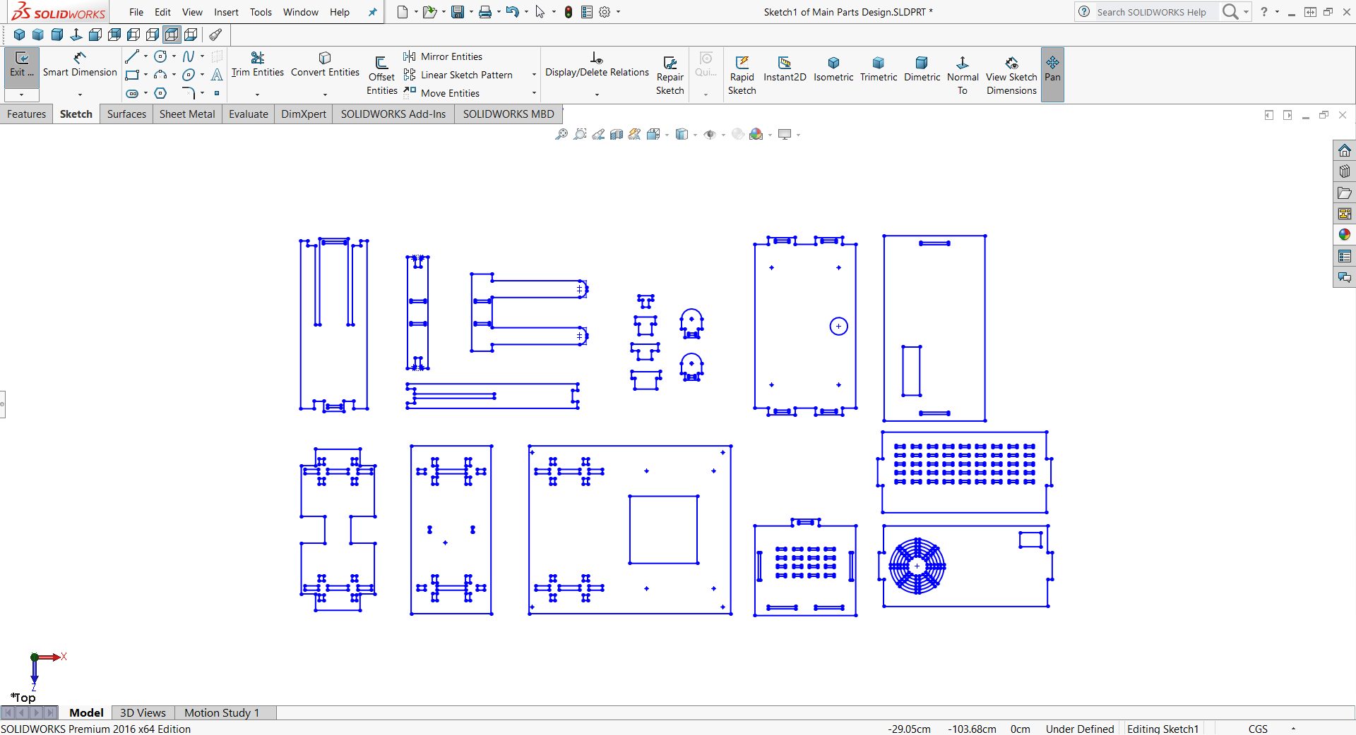
Mechanical Design
Notes:
https://unsplash.com/photos/TvN54bnuQg8

Slide 8
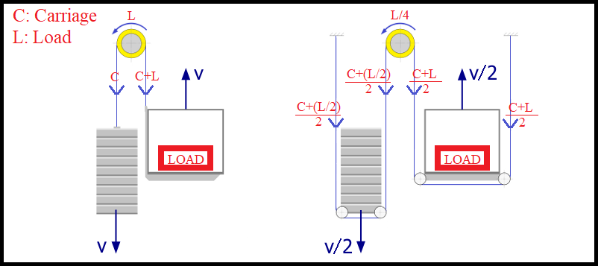
Lifting Mechanisim
Mechanical Design
Notes:
https://unsplash.com/photos/TvN54bnuQg8

Slide 9
Control System

Slide 10
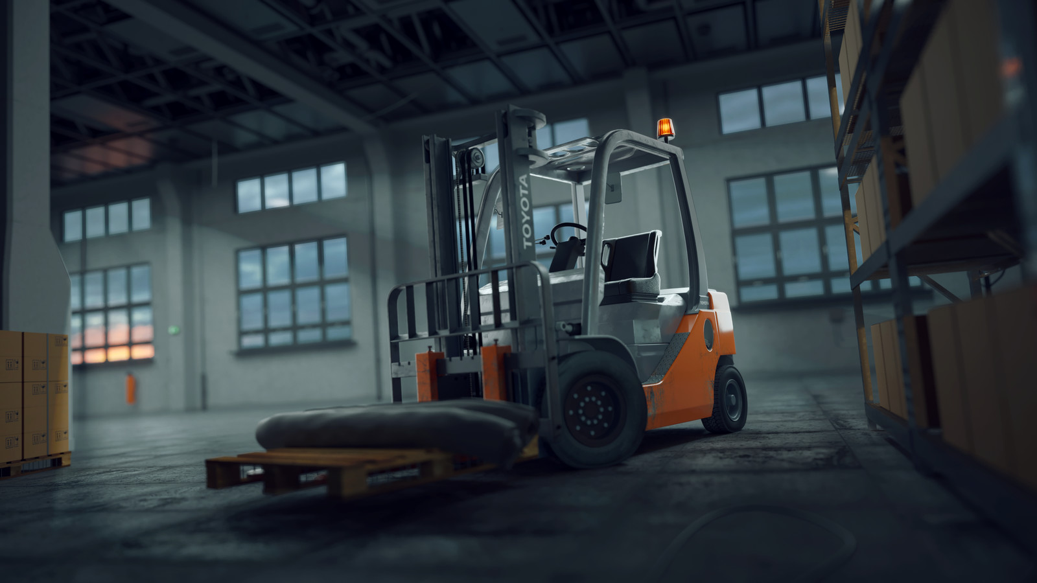
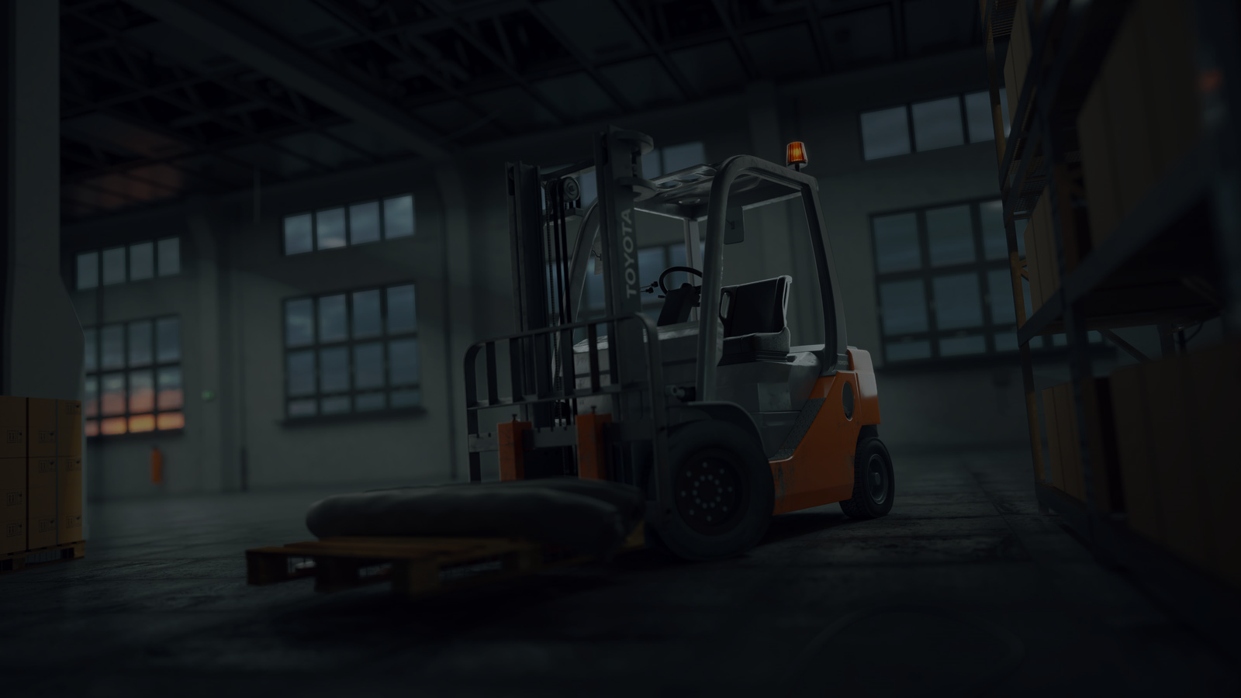
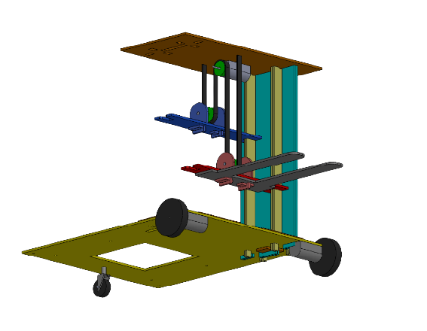
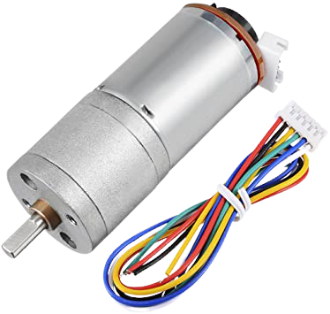
Control System
Motor 1
Motor 2
Motor 3
Notes:
https://unsplash.com/photos/GKLIsLZxhj0

Slide 11
Control System
DC Motor Control
Obstacle detection
Notes:
https://unsplash.com/photos/GKLIsLZxhj0

Slide 12
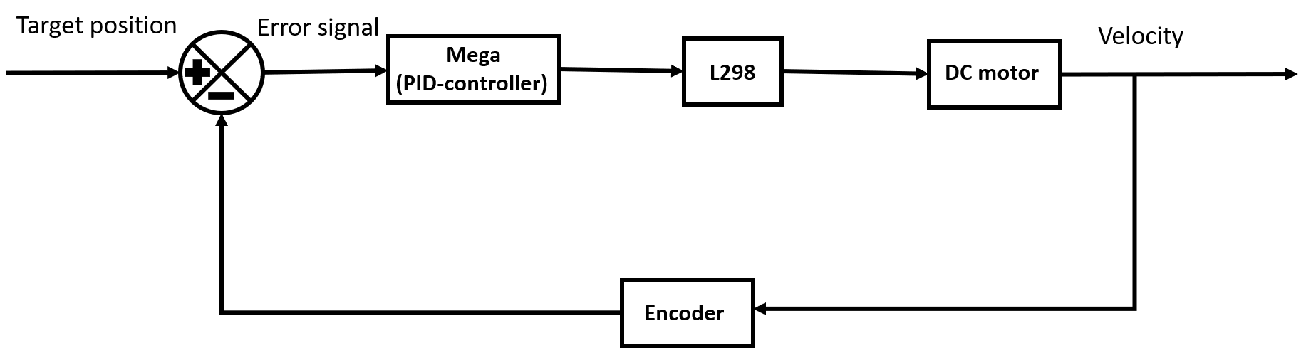
DC Motor Control
Notes:
https://unsplash.com/photos/GKLIsLZxhj0

Slide 13
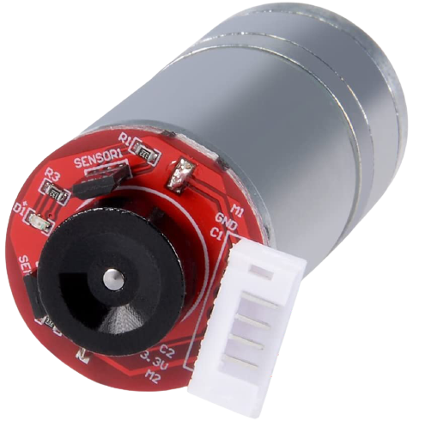
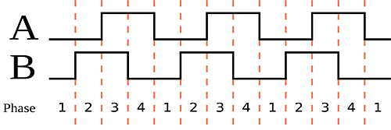

DC Motor Control
Sensor A
$$y=\left(\frac{D}{C_{1}}\right)C_{2}$$
Sensor B
Notes:
https://unsplash.com/photos/GKLIsLZxhj0

Slide 14
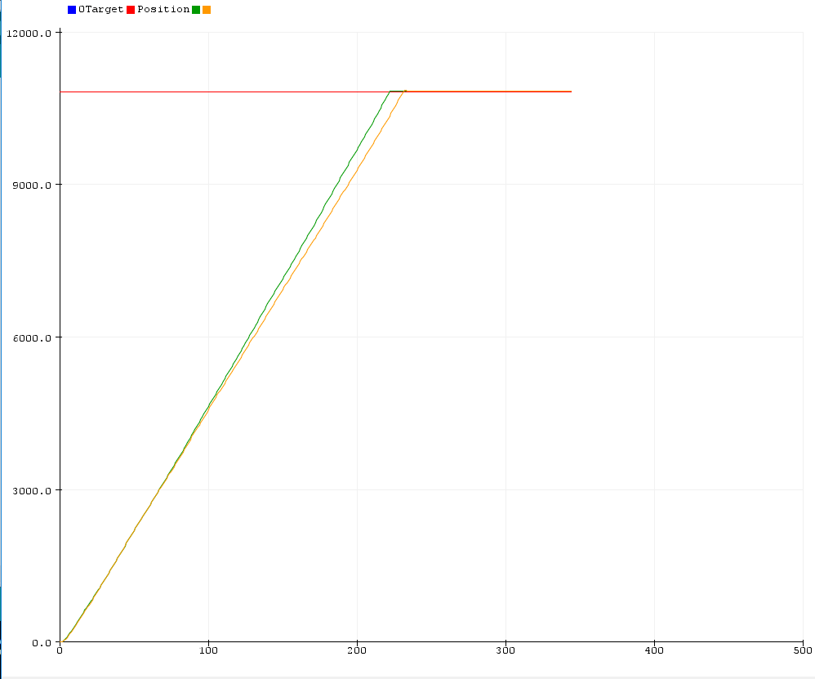
DC Motor Control
KP = 5, KI =0 and KD =0.025.
Notes:
https://unsplash.com/photos/GKLIsLZxhj0

Slide 15
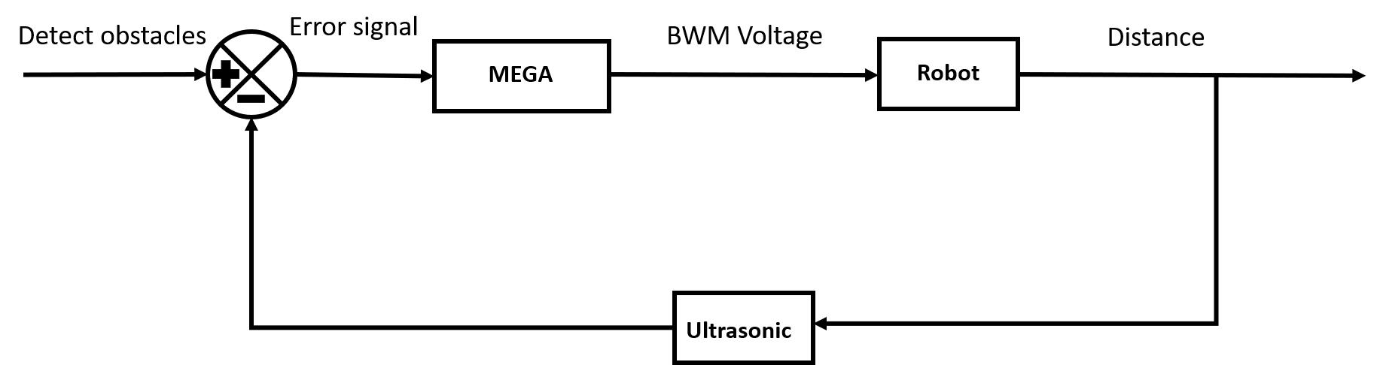
Obstacle detection
Notes:
https://unsplash.com/photos/GKLIsLZxhj0

Slide 16
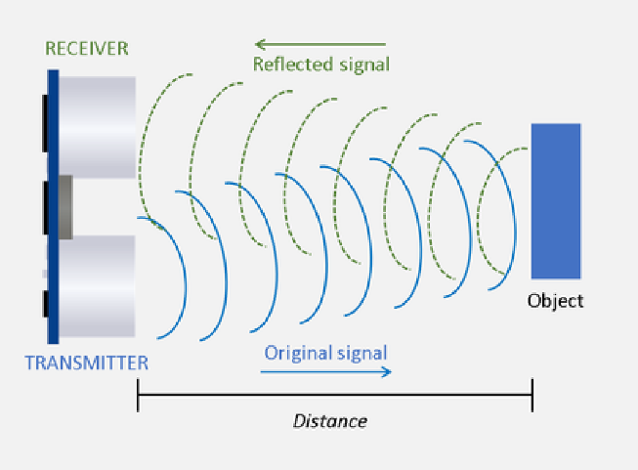
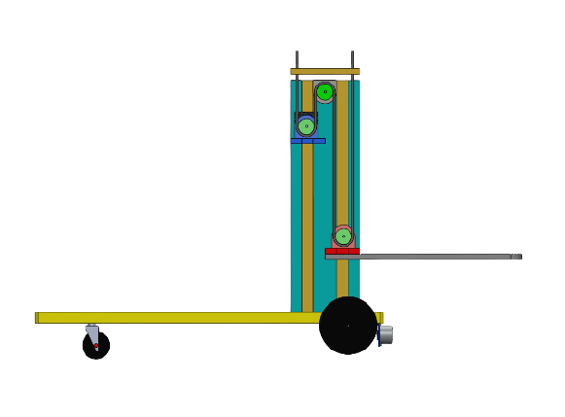
Obstacle detection
20 cm
Obstacle
Ultrasonic
Notes:
https://unsplash.com/photos/GKLIsLZxhj0

Slide 17
Navigation

Slide 18
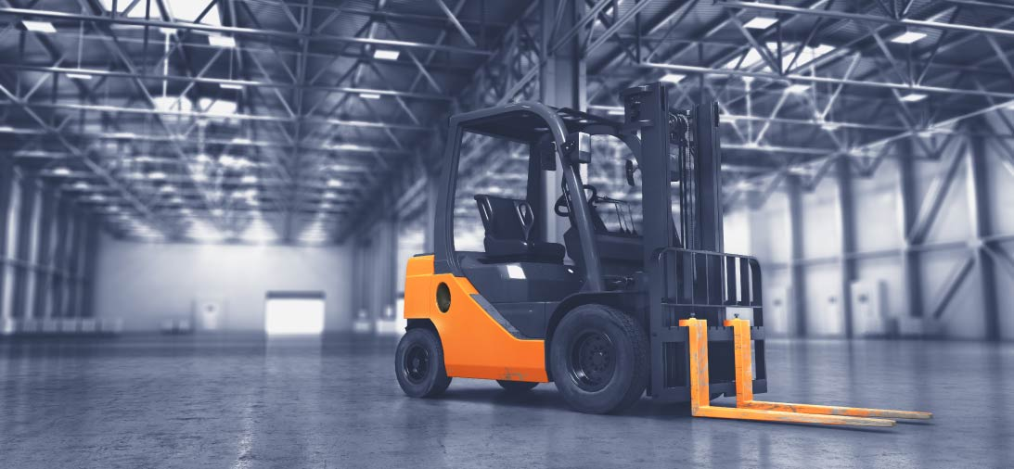
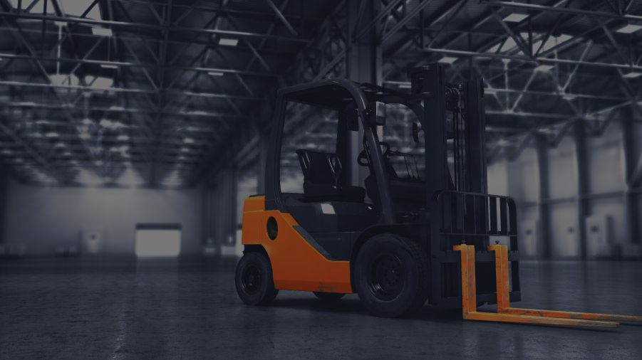
Navigation
Differential Drive Robot

Slide 19
Navigation
Environment Modeling

Slide 20
Navigation
Localization

Slide 21
Navigation
Path Planning

Slide 22
Navigation
Path Tracking

Slide 23
Future Vision

Slide 24
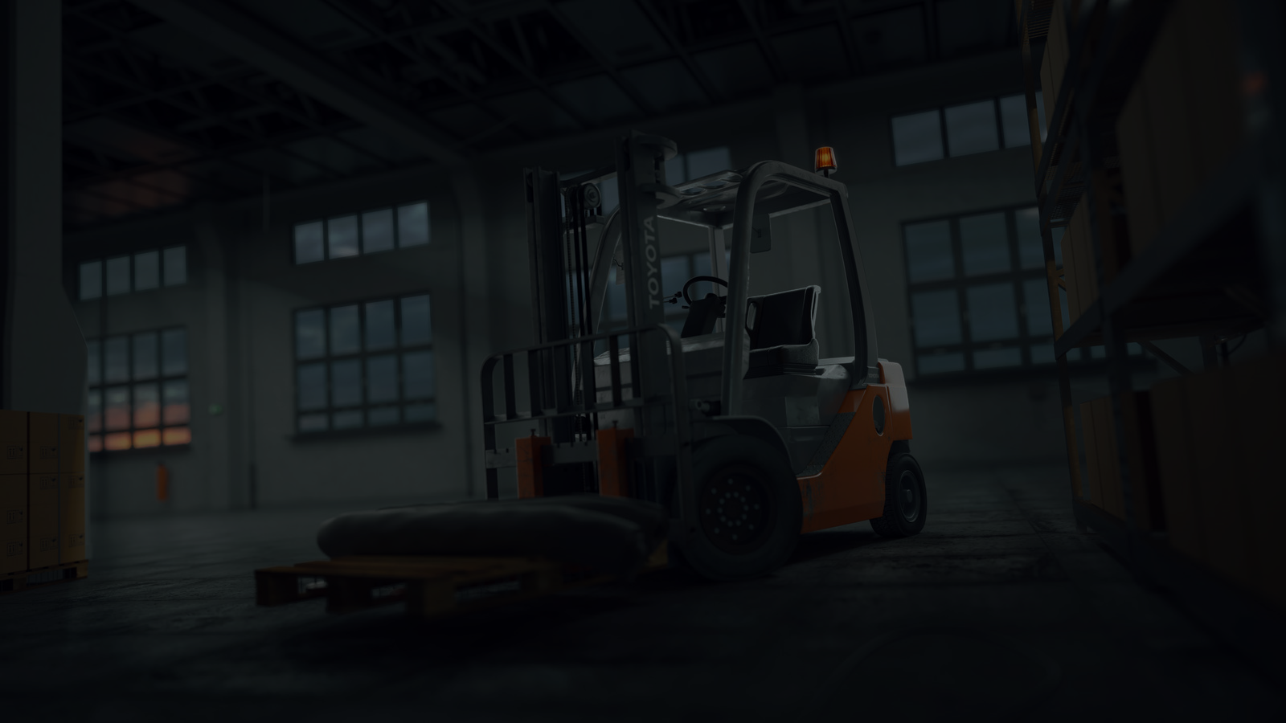
Future Vision
We can use the LIDAR sensor to get better distances between the robot and surrounding obstacles, as well as the dimensions of the environment in which the robot operates.
A camera can be added to display a live image of the robot's work environment.
The robot can be connected to a phone that displays all the necessary information from location, speed and others to increase safety.
Some other improvements can be added such as the material used, the speed and the weight that the robot can carry.

