Slide 1
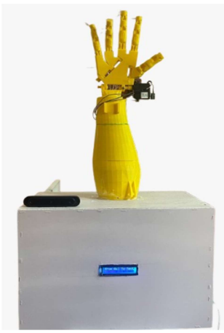
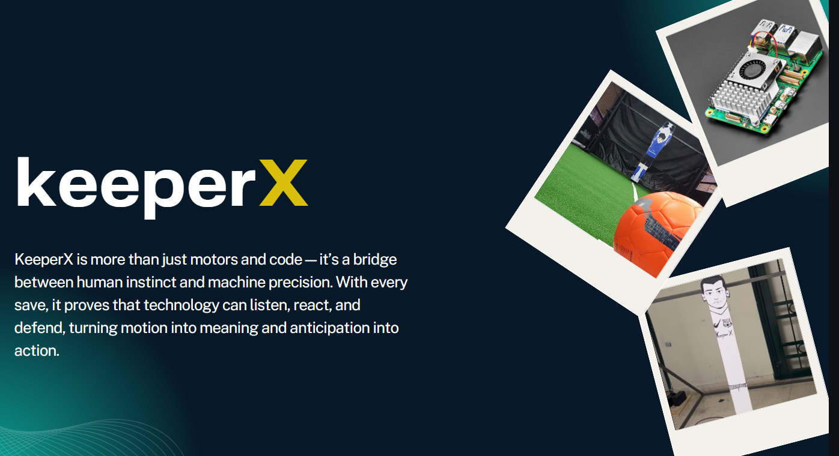
SignTalk
is an assistive system designed to enhance communication between
the deaf and hearing community using sign language technology. The system
includes three main features, each addressing a unique interaction challenge and
helping to break down communication barriers in public and private settings, such
as hospitals, airports, and schools.

Slide 2


Slide 3
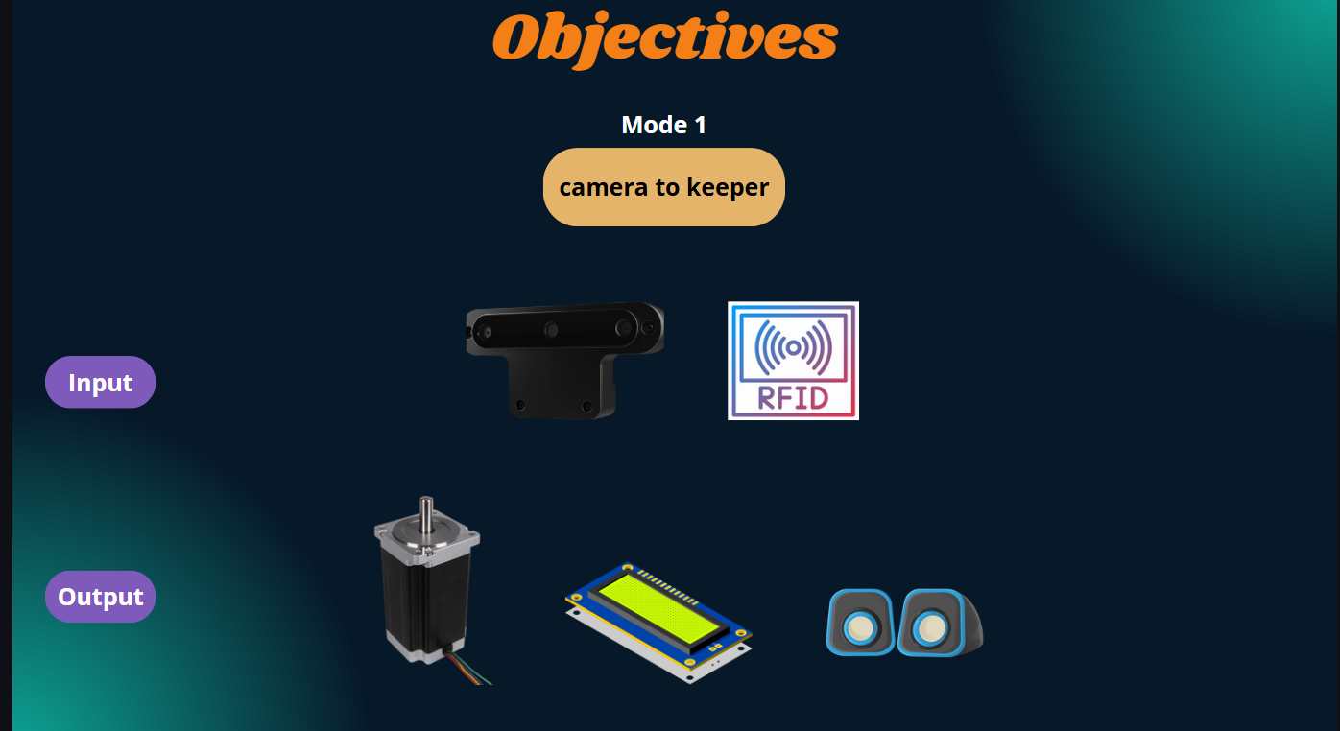

Slide 4
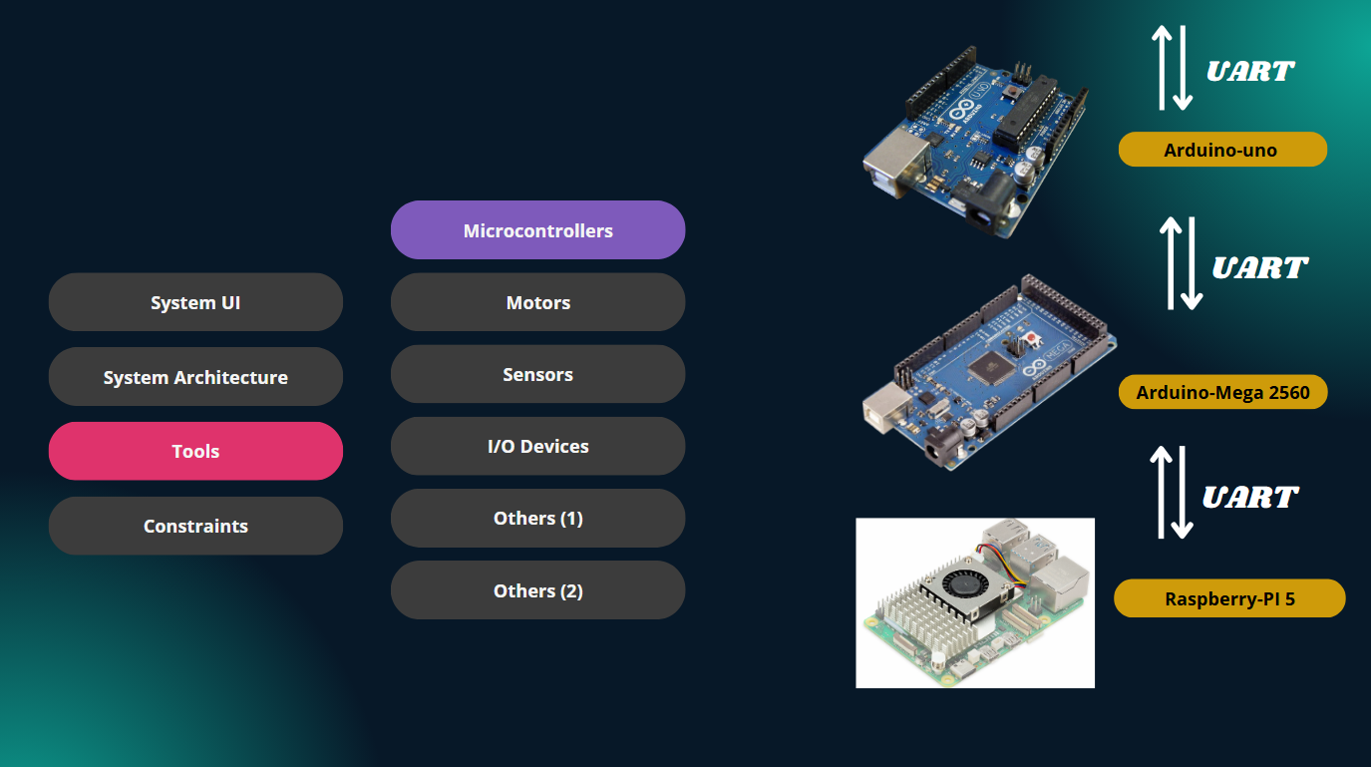
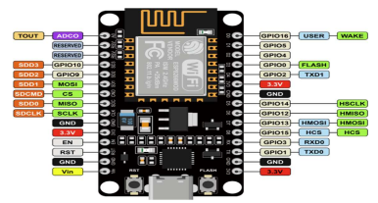
esp32

Slide 5
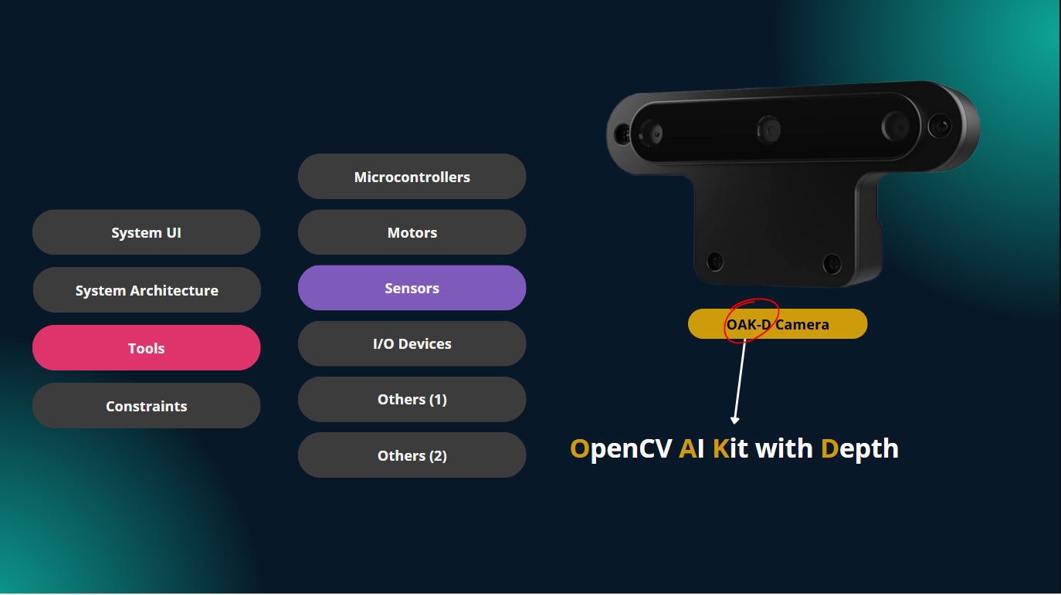

Slide 6
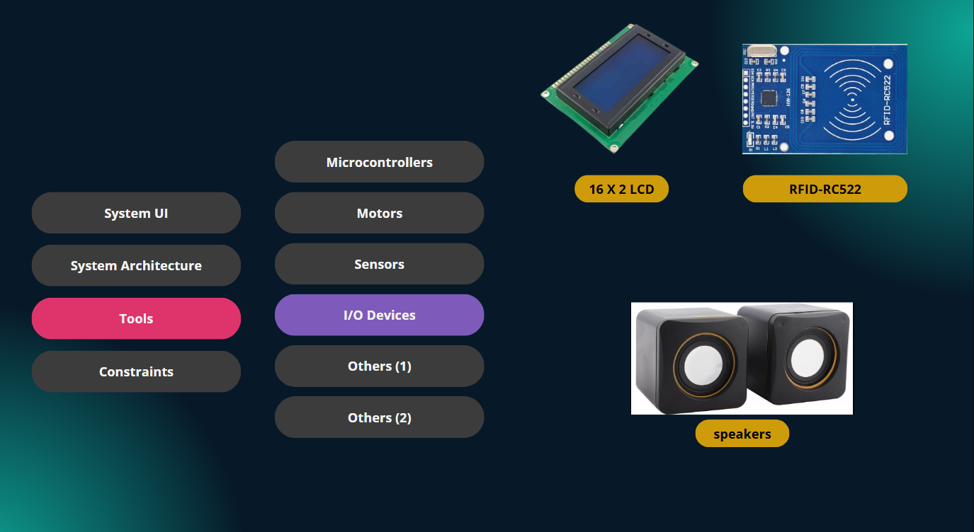

Slide 7
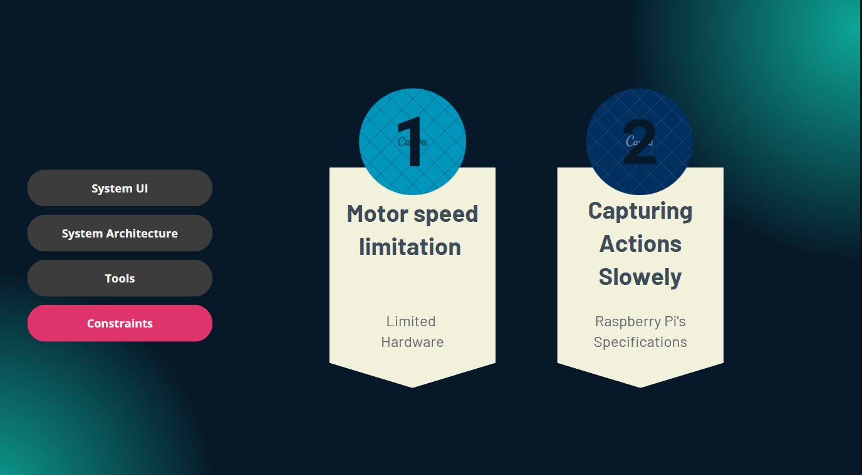

Slide 8


Slide 9
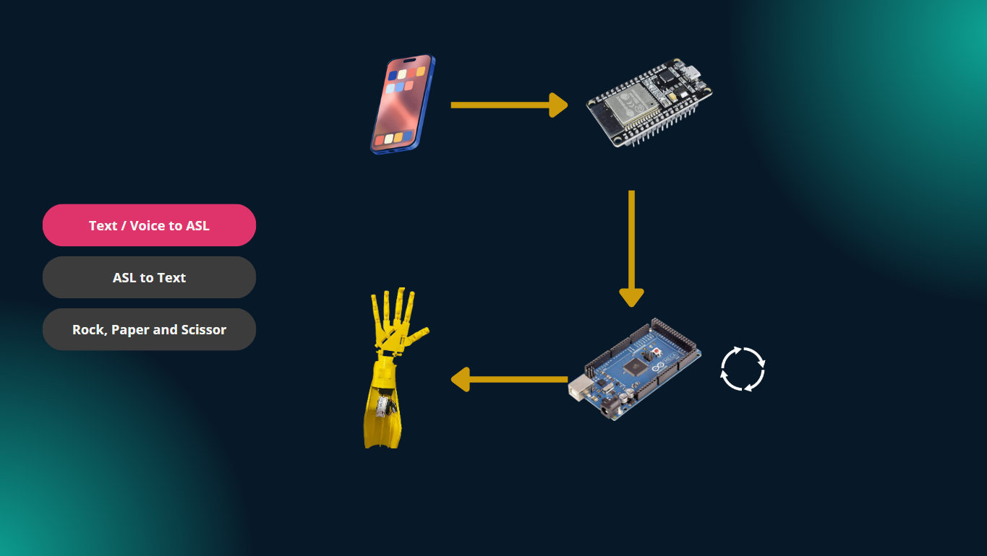

Slide 10
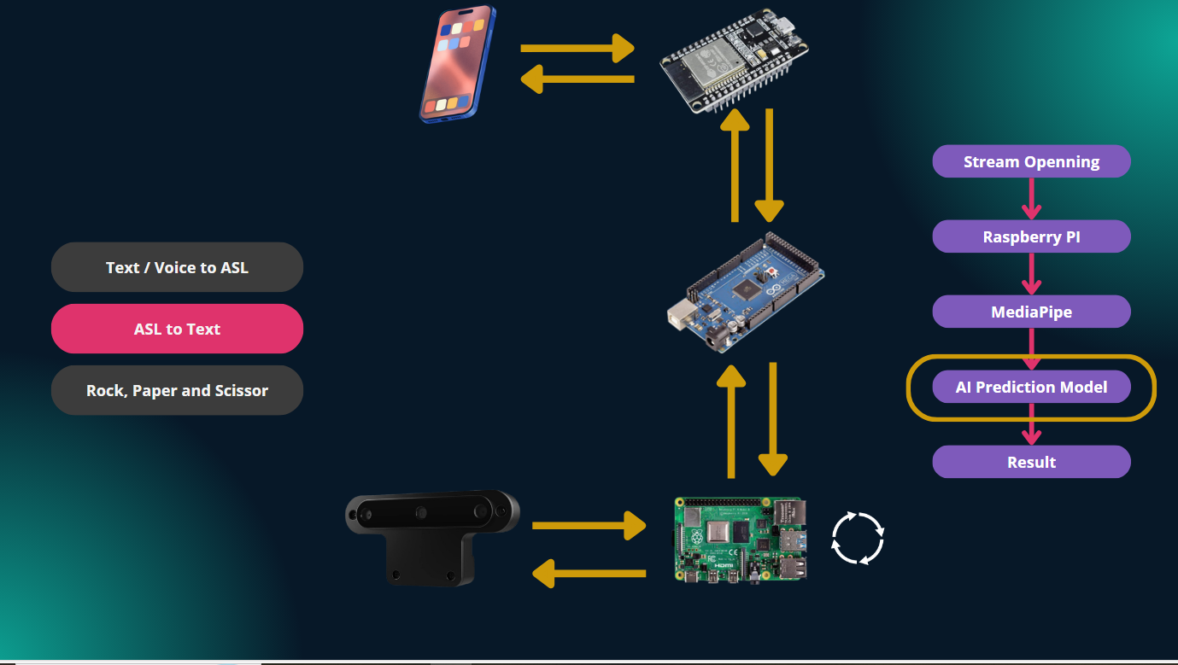

Slide 11


Slide 12
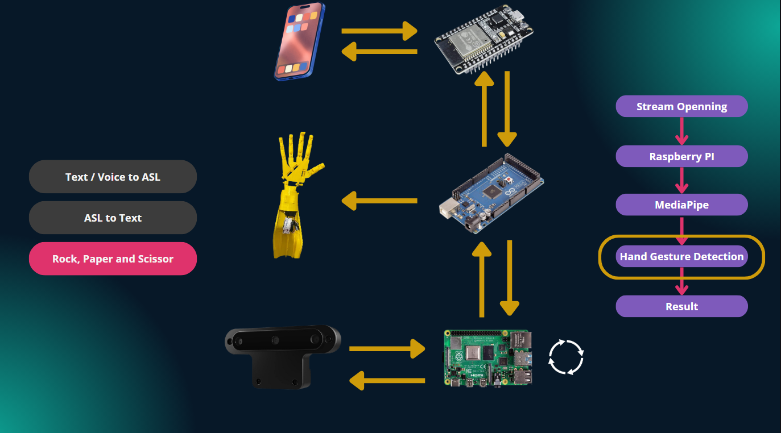

Slide 13

