Slide 1
Villa
An-Najah National university
Faculty of engineering
Building engineering departmenet
Graduation project ||
Prepared By :
Lotfe juaidi
Zakaria sabaaneh
Mahdi samara
Nabel saadi
Supervisor :
Dr. Mutasem baba

Slide 2
Outline
Introduction.
Site analysis.
Architectural design.
Structural design.
Environmental design.
Mechanical design.
Electrical design.
Safety and fire system.
Quantity survey

Slide 3
Introduction
Project definition
Objective.
Green villa
Palestinian requirements
Integrated design
Comfortable
Affordable
Energy efficient

Slide 4
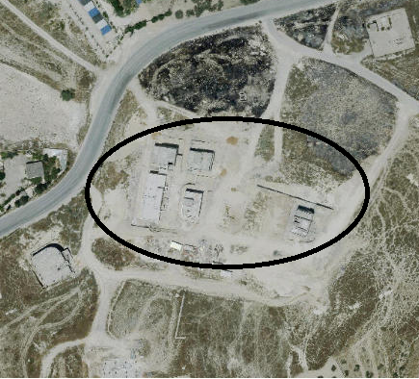
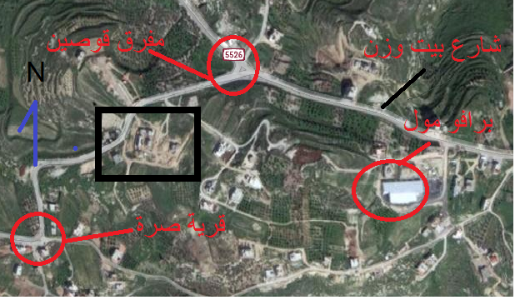
Site Analysis
Al-Badia ,
Nablus- Palestine
Total area of 3868.23 m²

Slide 5
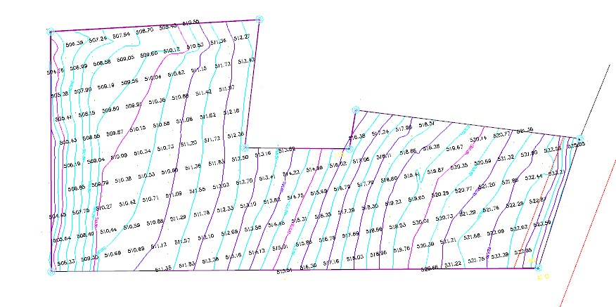

Slide 6
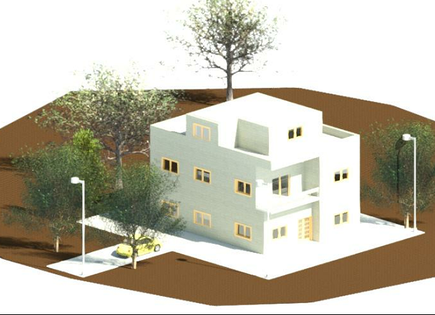
Architectural Design

Slide 7
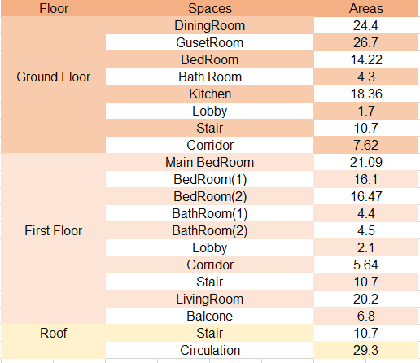
Architectural Design
The total area of a villa equal 265 m² divided into two floors plus roof, the distributions and area of spaces in each floor are shown in the following table.

Slide 8
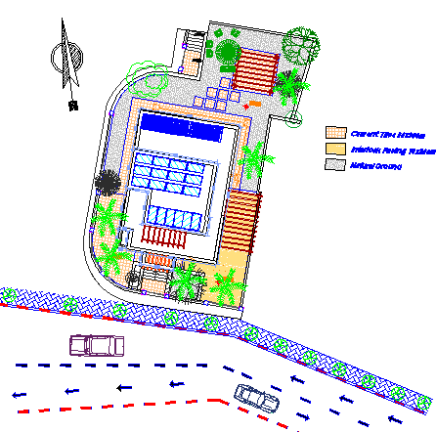
Architectural Design
Site plan

Slide 9
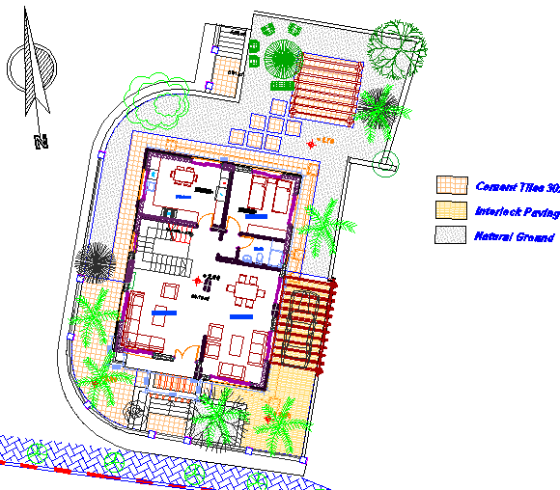
Architectural Design
Master plan

Slide 10
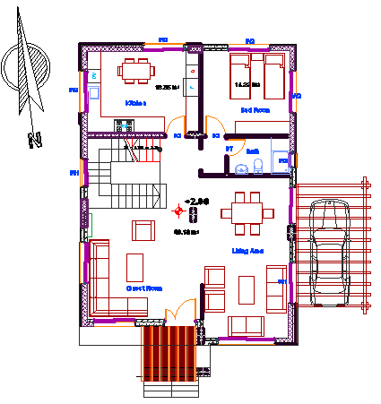
Architectural Design
Ground floor

Slide 11
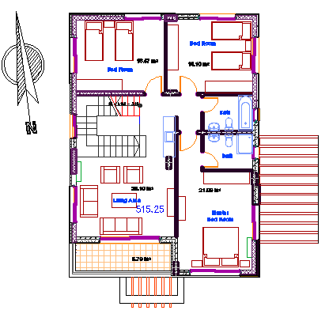
Architectural Design
First floor

Slide 12
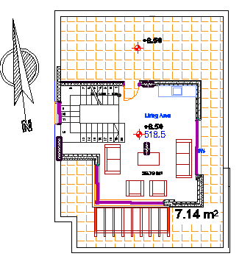
Architectural Design
Roof floor

Slide 13
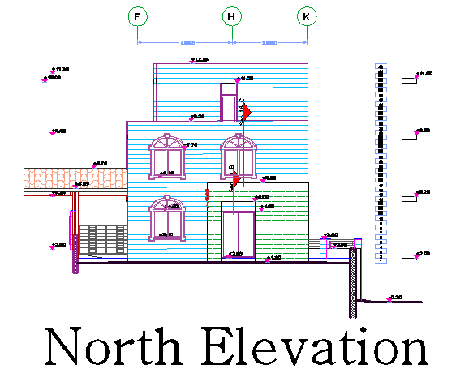
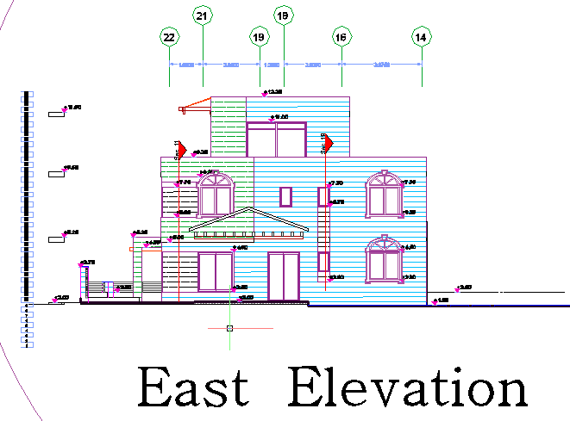
Architectural Design
North and East elevations

Slide 14
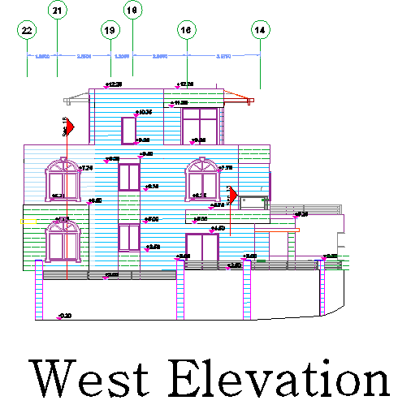
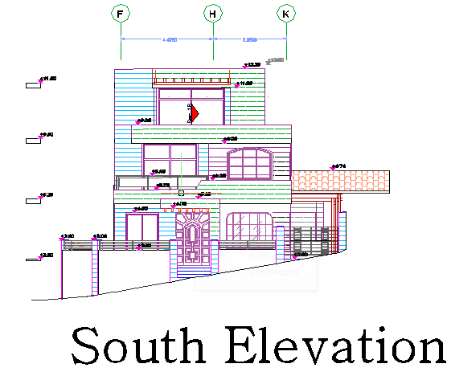
Architectural Design
South and West elevations

Slide 15
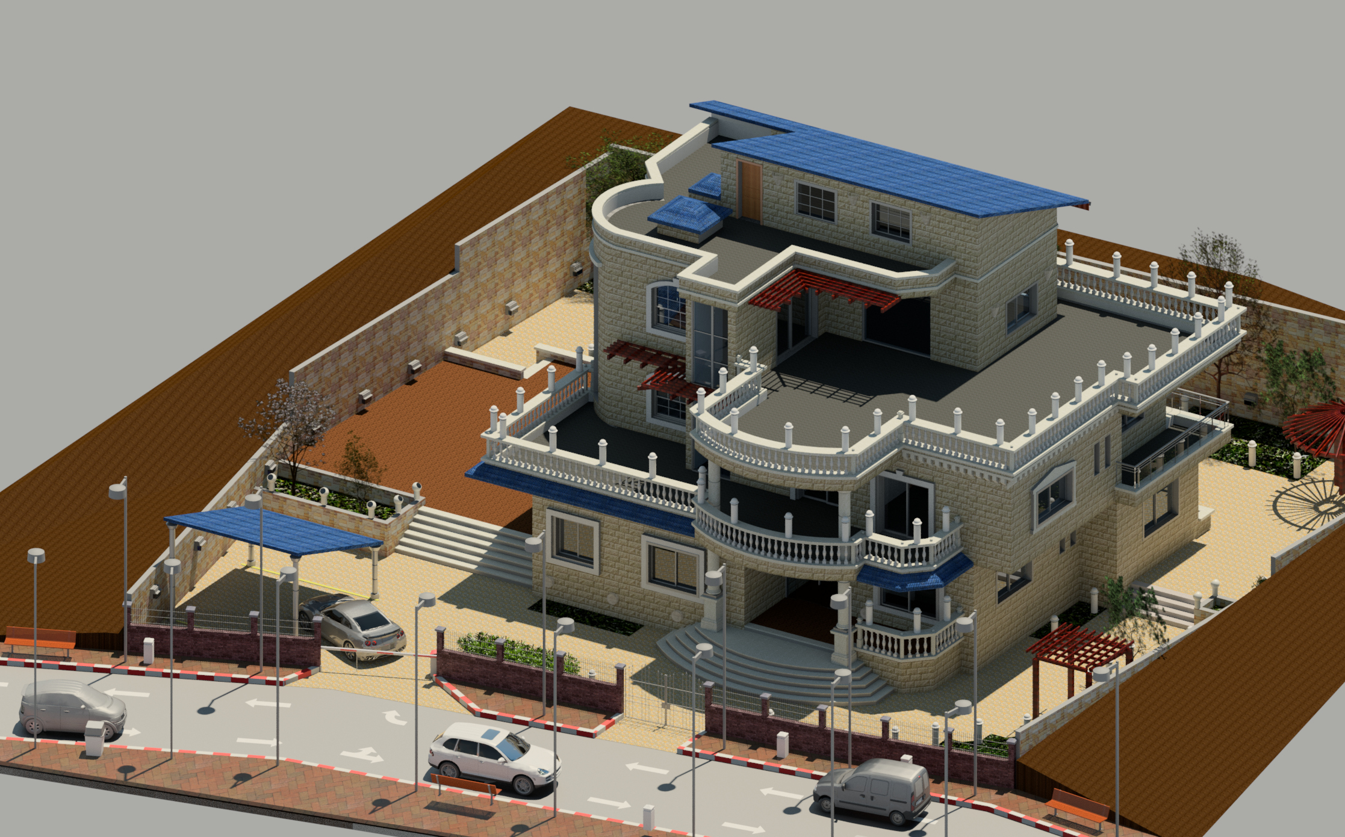
3DView

Slide 16
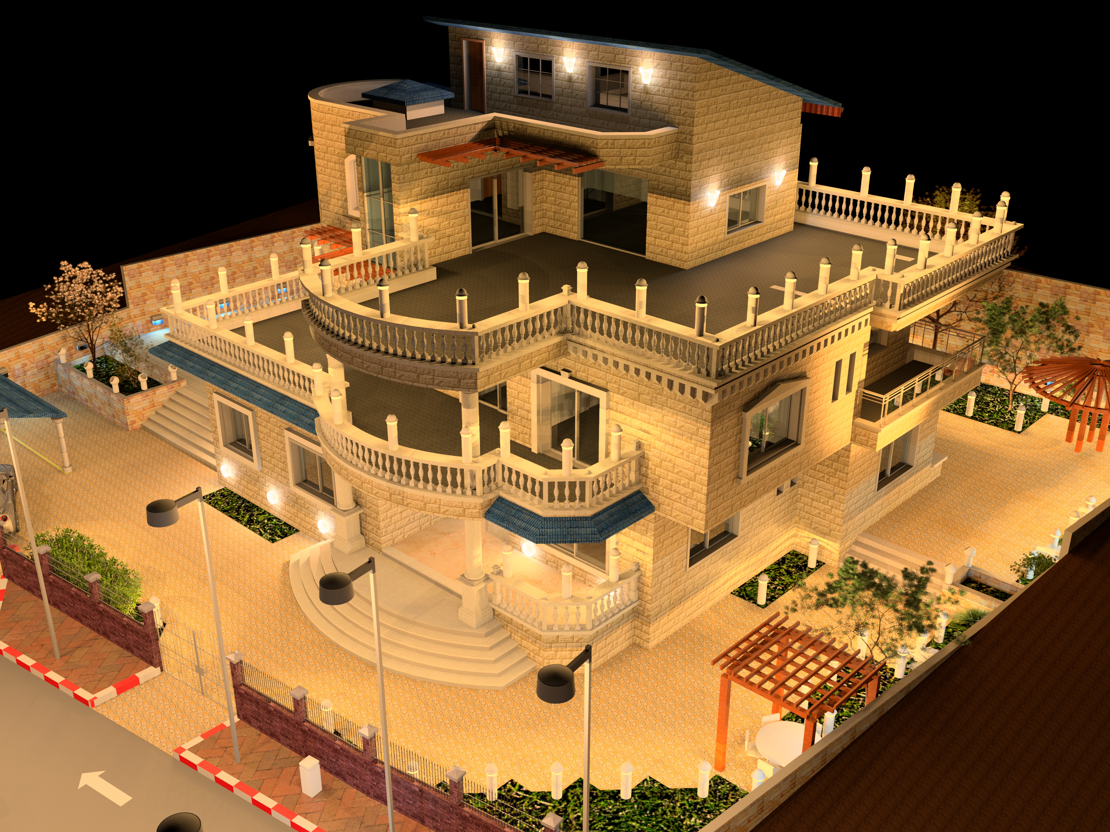
N.W View

Slide 17
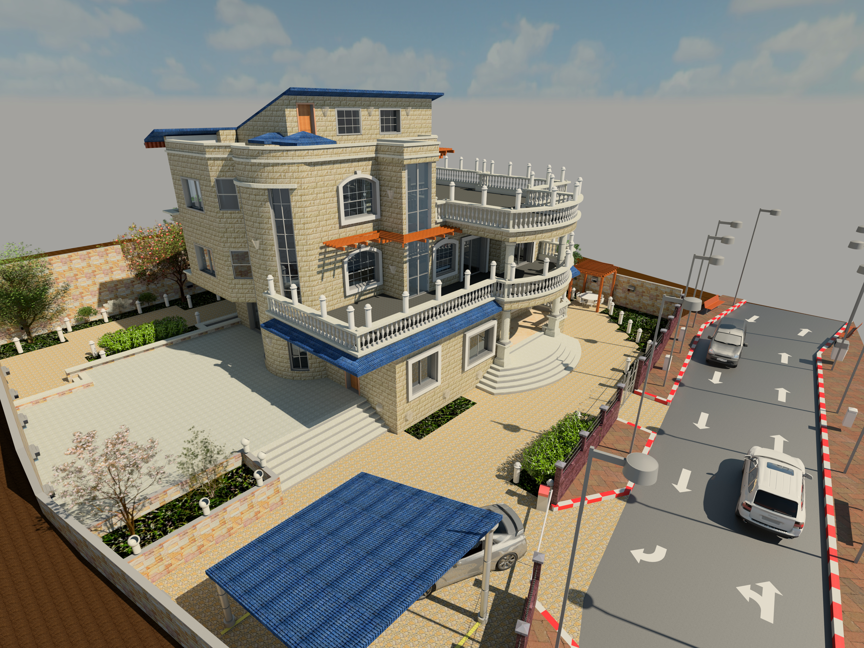
N.E View

Slide 18
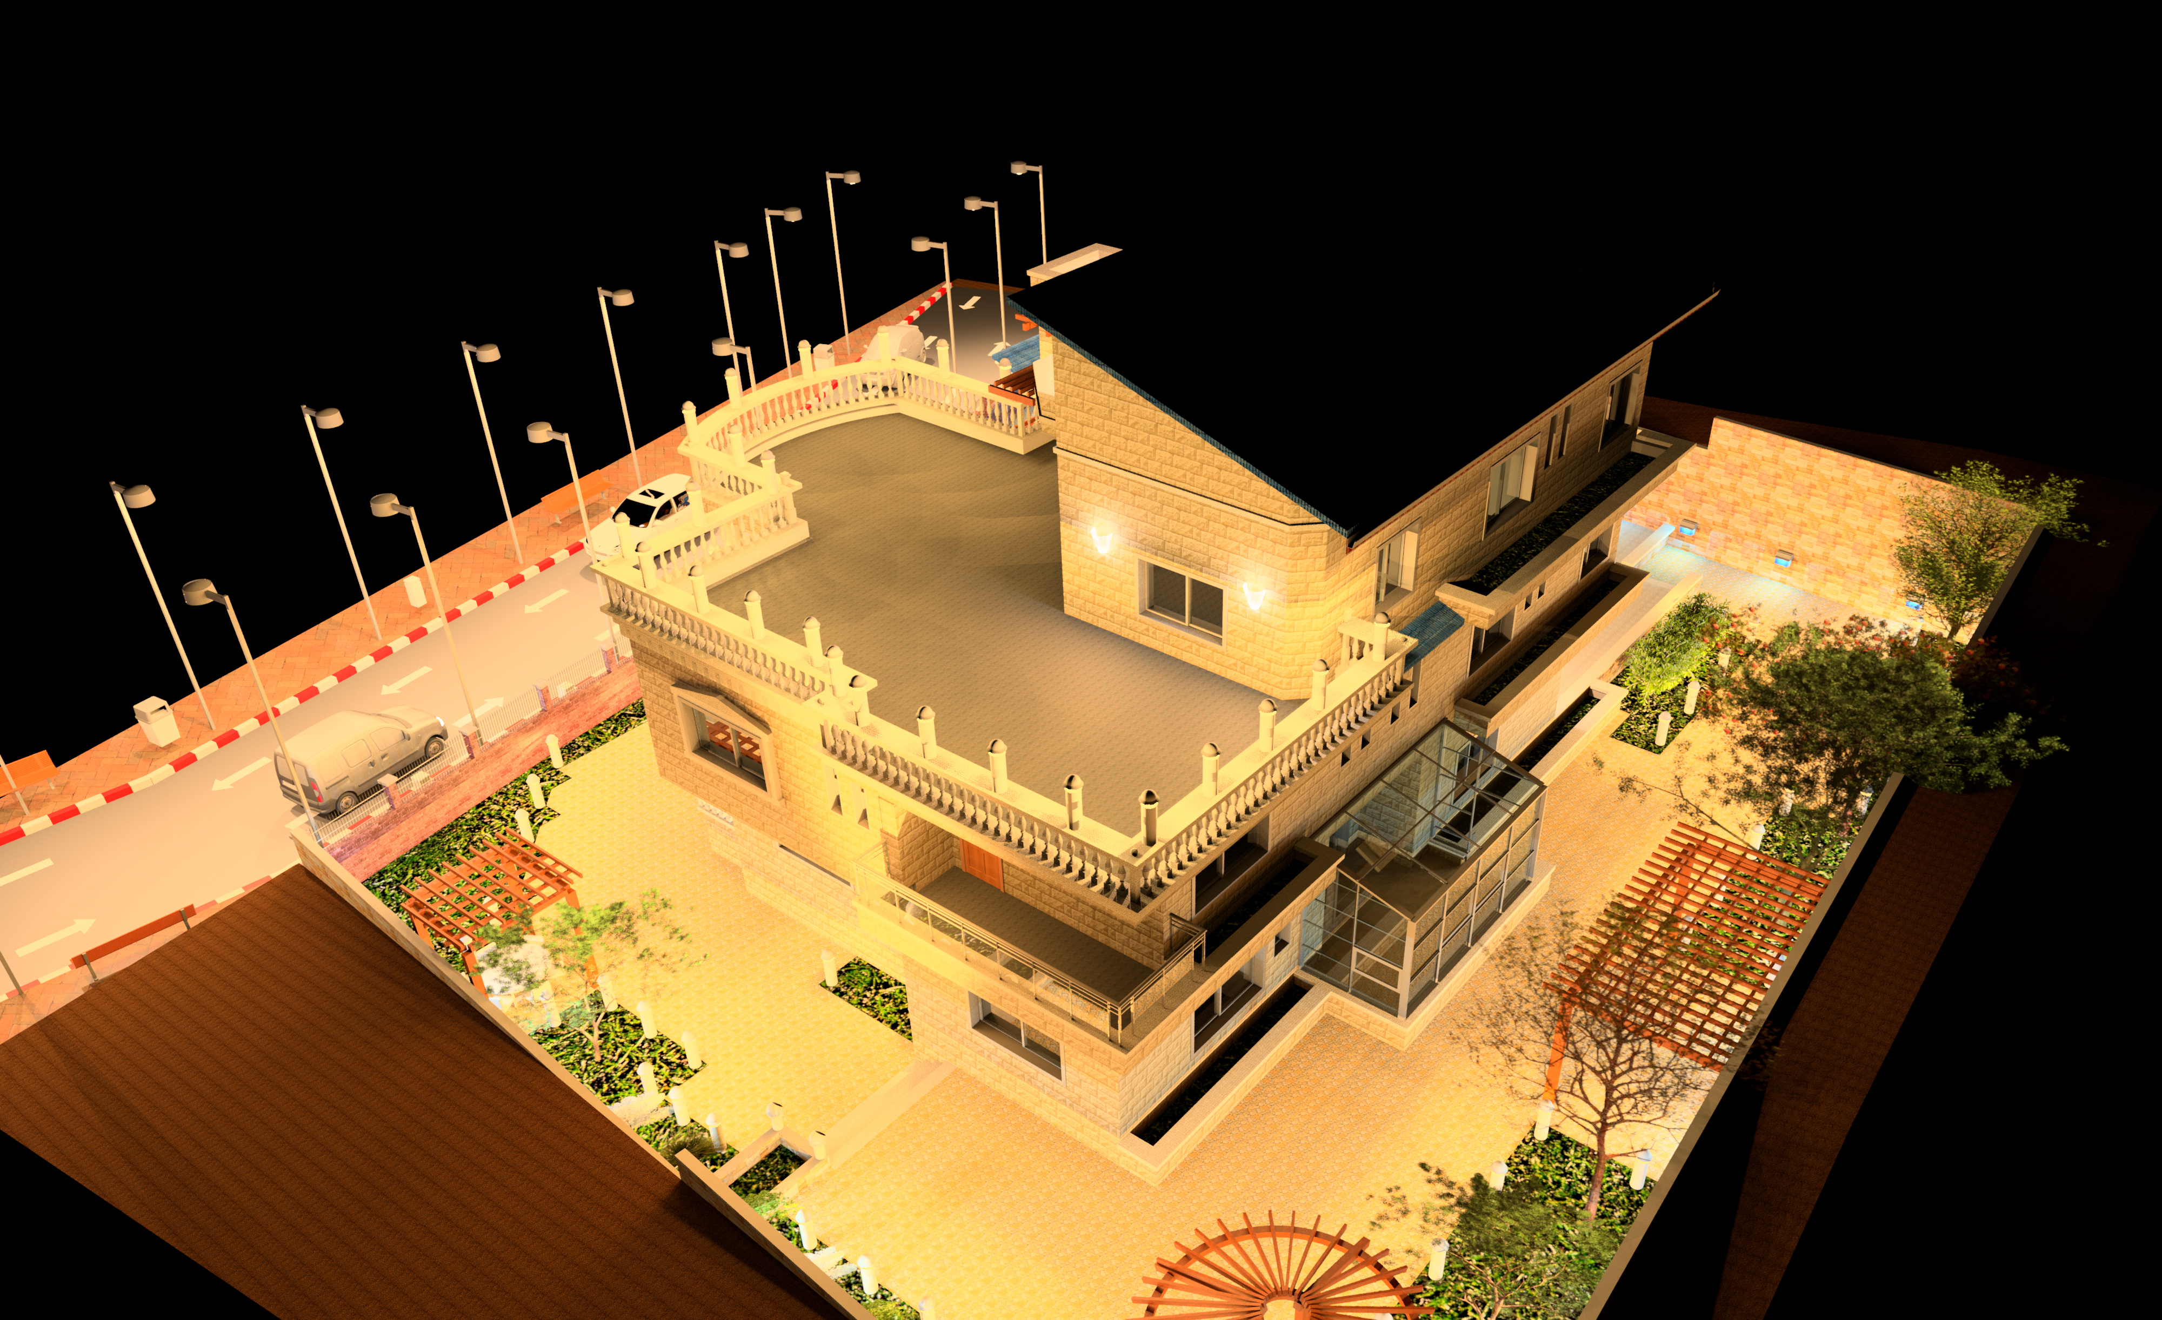
S.W View

Slide 19
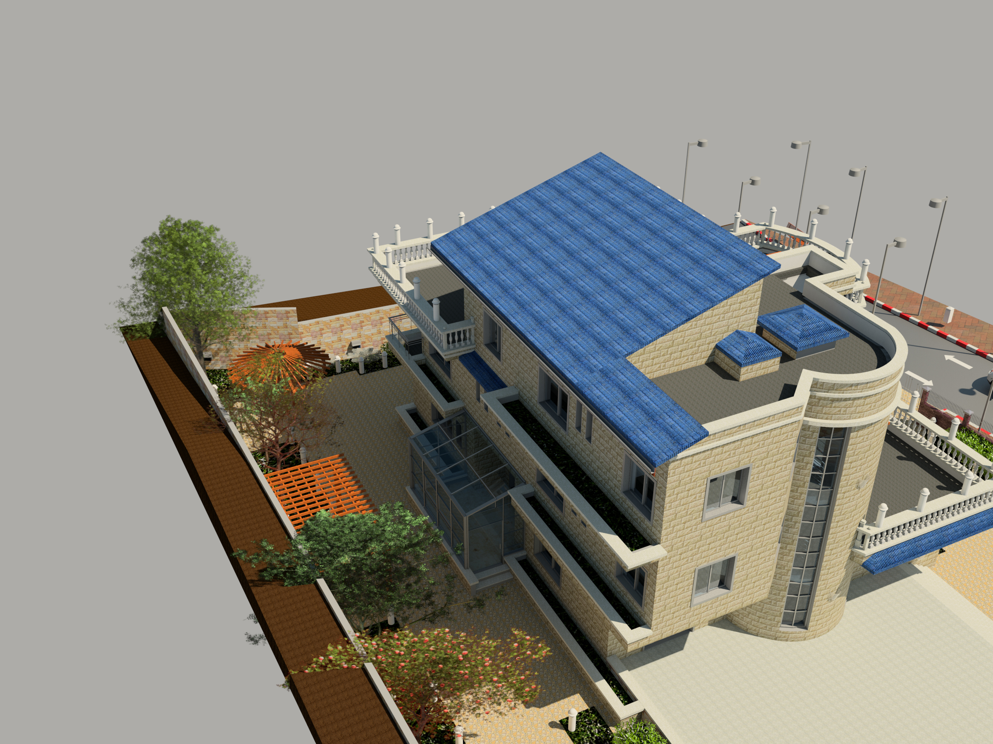
S.E View

Slide 20
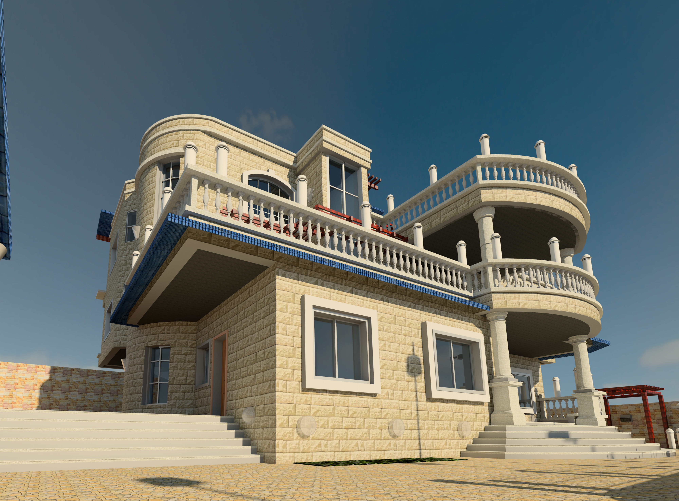
Structural Design

Slide 21
Structural Design
Codes and Standards:
ACI -318-11 for reinforced concrete structural design.
UBC -97 for earthquake design.
ASCE 7 2010 for load combinations

Slide 22
Structural Design
Design data:
Concrete strength for slabs and beams, f’_{c}=28 mpa.
Concrete strength for columns and shear walls ,f’_{c}=28 mpa.
Steel yield strength f_{y}=420 mpa.
Bearing capacity for soil = 250 kN/m²

Slide 23
Structural Design
Loads:
Load Type | Ribbed slab
Live | 1.98 (kN/m²)
S.I.D | 3.6 (kN/m²)

Slide 24
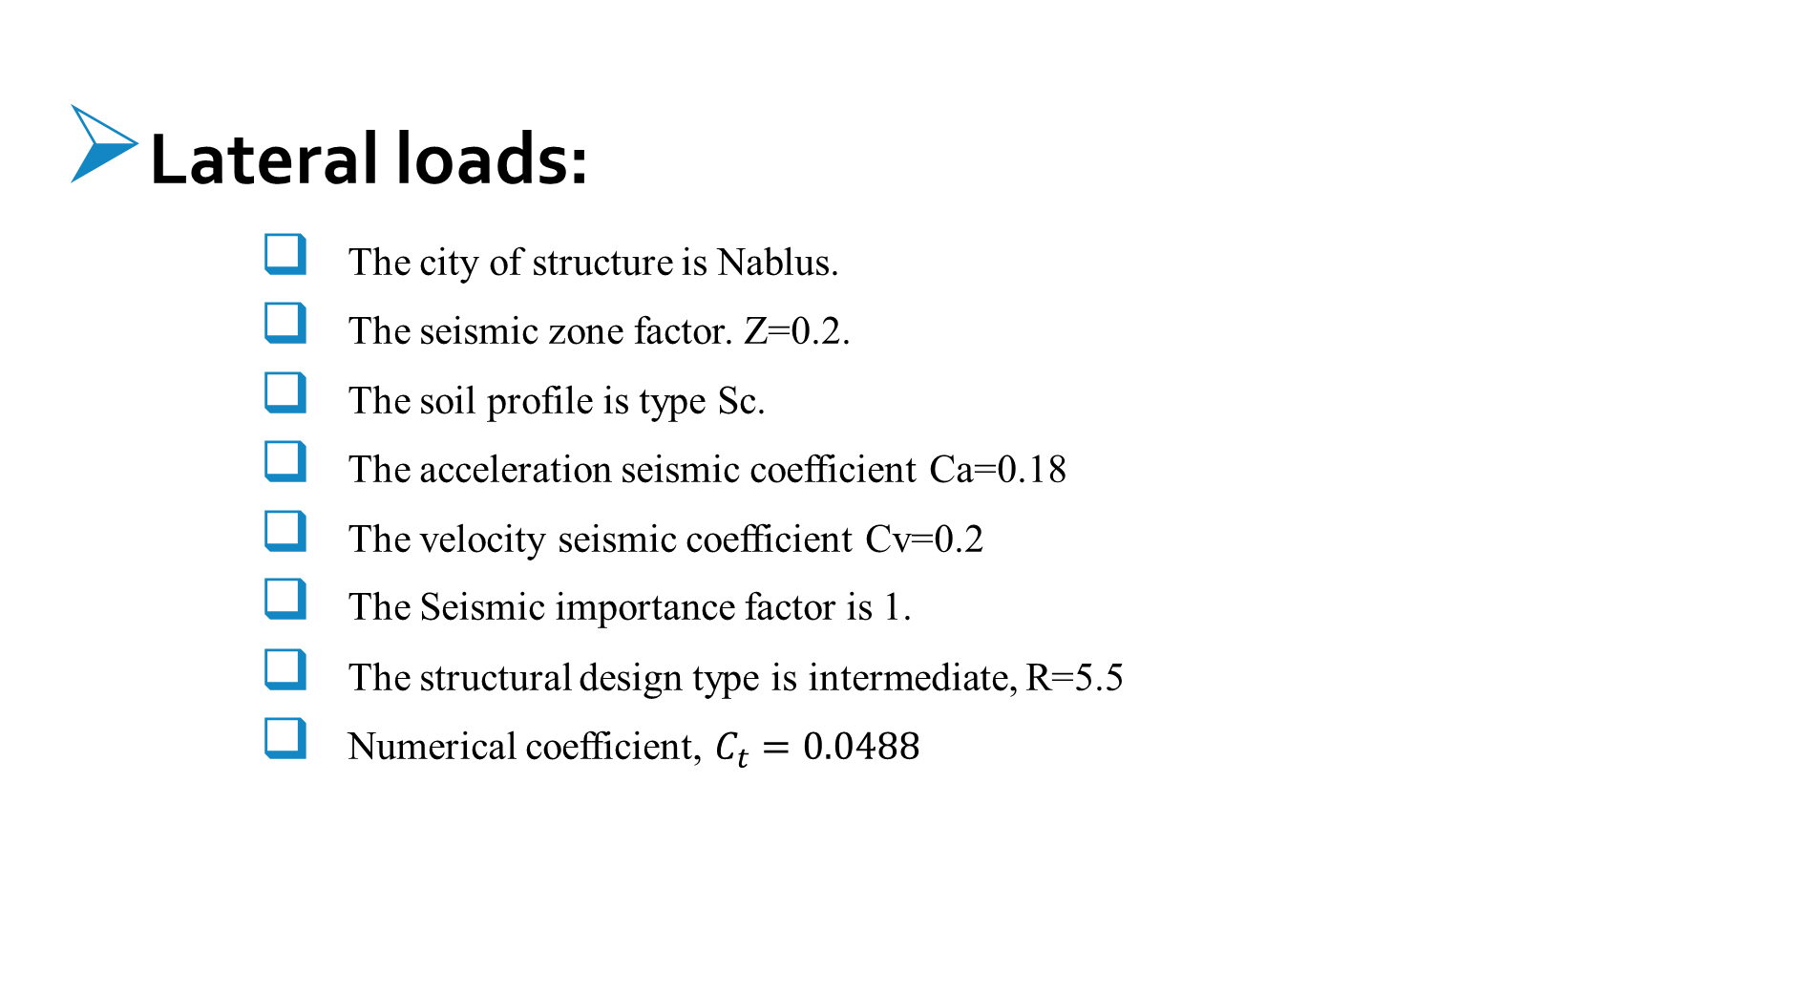
Structural Design
Lateral loads:
The city of structure is Nablus.
The seismic zone factor. Z=0.2.
The soil profile is type Sc.
The acceleration seismic coefficient Ca=0.18
The velocity seismic coefficient Cv=0.2
The Seismic importance factor is 1.
The structural design type is intermediate, R=5.5
Numerical coefficient, $C_{t}=0.0488$

Slide 25
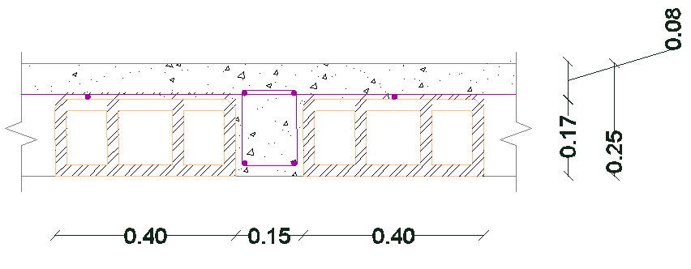
Slabs
ribbed slab with 25 cm thickness.

Slide 26
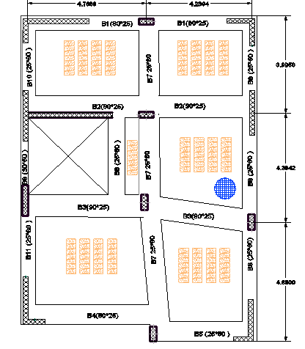
Beams

Slide 27
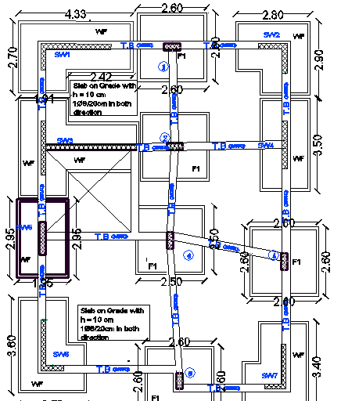
Columns and footings

Slide 28
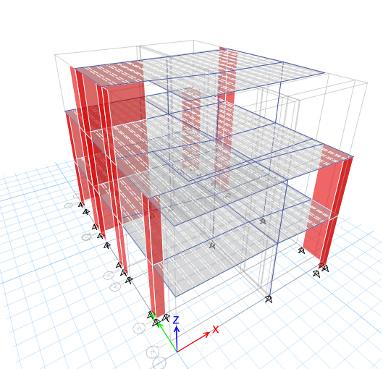
Modeling

Slide 29
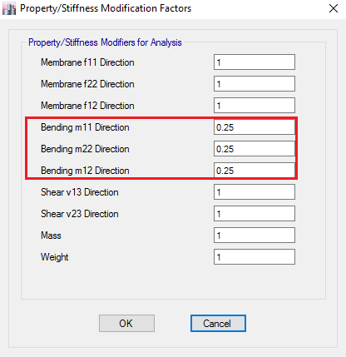
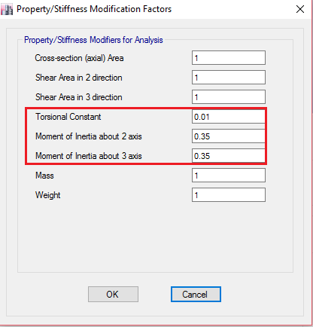
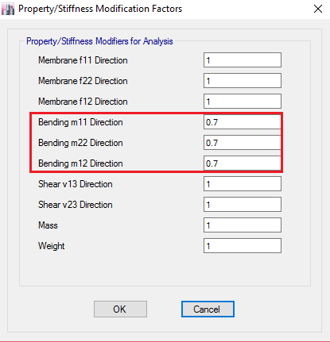

Slide 30
Verification of model
Compatibility check
Equilibrium check
Internal force check
Deflection check
Drift check
Period check

Slide 31
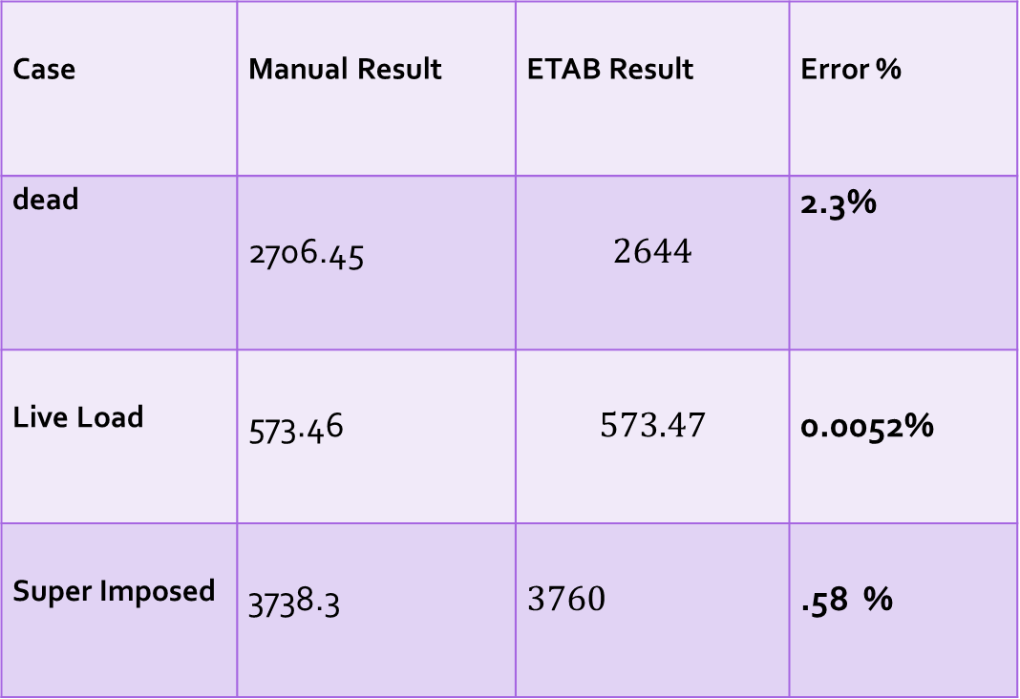
Case | Manual Result | ETAB Result | Error %
dead | 2706.45 | $$2644$$ | 2.3%
Live Load | 573.46 | $$573.47$$ | 0.0052%
Super Imposed | 3738.3 | $$3760$$ | .58 %

Slide 32
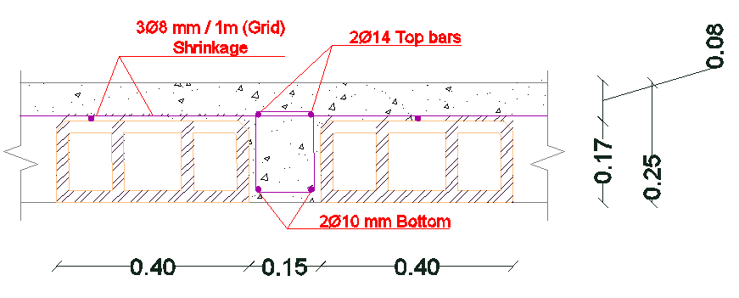
Slab Reinforcement

Slide 33
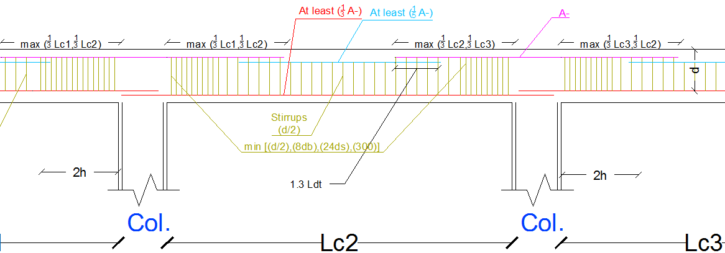
Beam Reinforcement

Slide 34
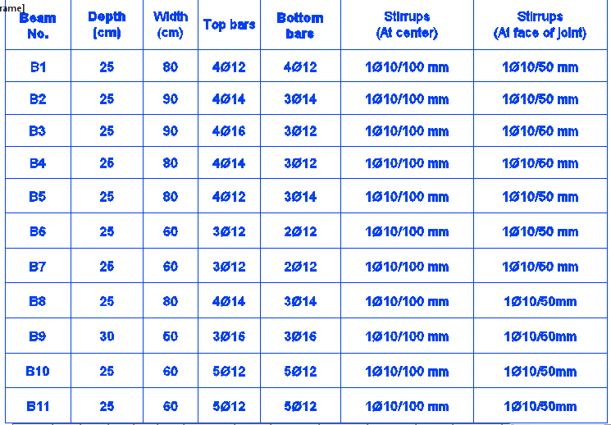
G.F Beam Reinforcement

Slide 35
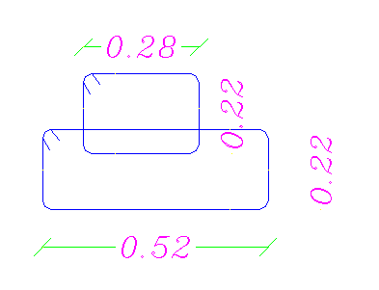
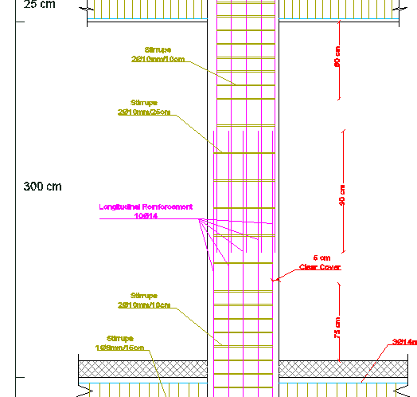
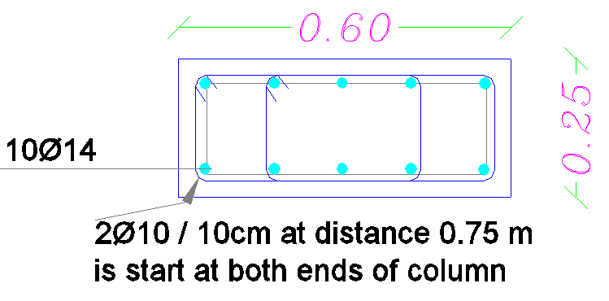
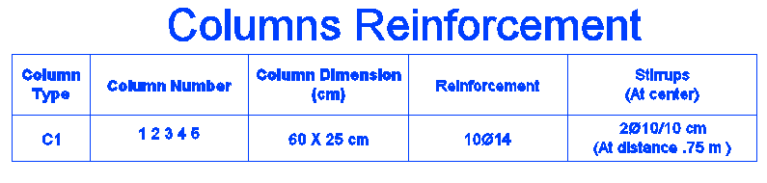
Columns Reinforcement

Slide 36
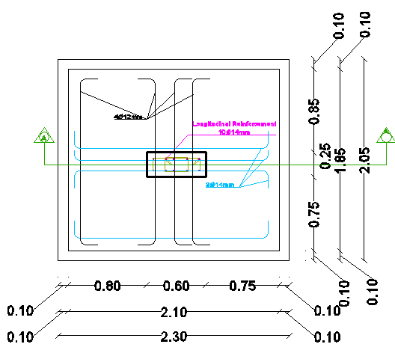
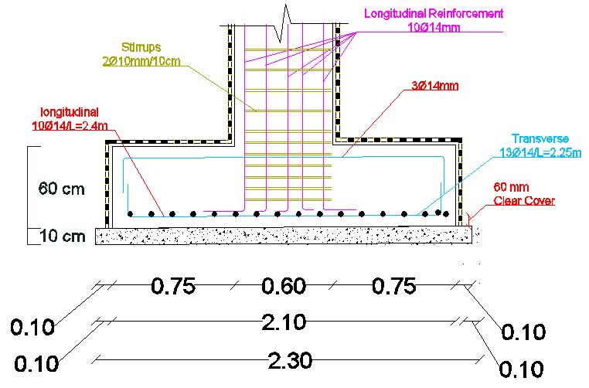
Footing Reinforcement

Slide 37
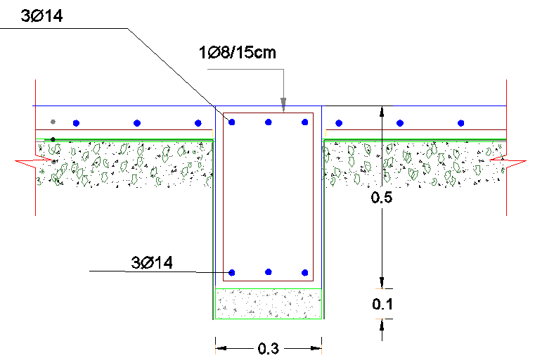
Ground beam Reinforcement

Slide 38
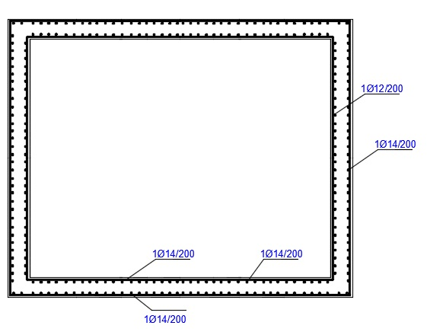
Water tanks Reinforcement

Slide 39

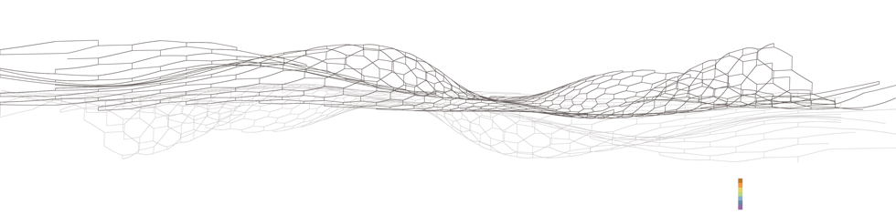
Environmental Design

Slide 40
Environmental Design
Palestinian requirements for green building
Number | The outer structural elements | Maximum U-Value w/m².k
1 | Outer wall | 0.5 w/m².k
2 | Outer Slab | 0.39 w/m².k
3 | Ground slab | 0.46 w/m².k
4 | Windows | 2.1 w/m².k
5 | Doors | 6 w/m².k

Slide 41
Environmental Design
Palestinian requirements for green building
 | Maximum U-Value w/m².k | Shading coefficient | Transmitting coefficient
The ratio of glass to wall less than 40% | 2.1 w/m².k | 0.4 max | 25% min
The ratio of glass to wall between (40-60) % | 1.9 w/m².k | 0.32 max | 10% min
The ratio of glass to wall greater than 60% | 1.9 w/m².k | 0.25 max | 10% min

Slide 42
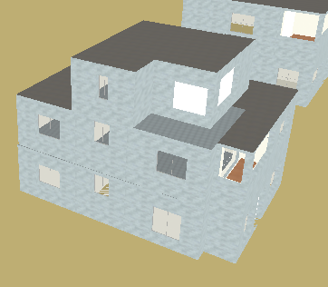
Modeling

Slide 43
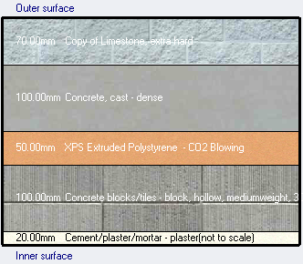
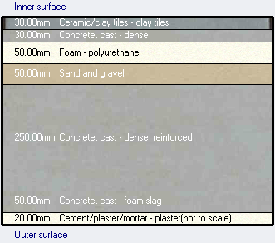
Thermal Analysis
External wall for Mall
U value = .462 W/m²k
Internal Floor
U value = .396W/m²k

Slide 44
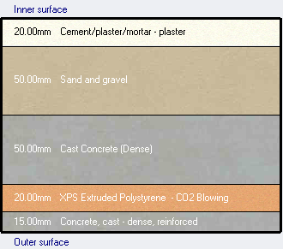
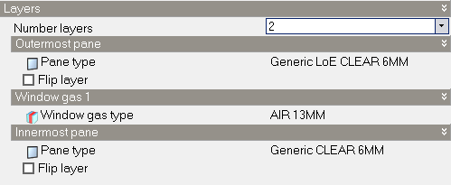
Thermal Analysis
Ground Slab
U value = .435 W/m²k
Window
U value = 1.761 W/m²k

Slide 45
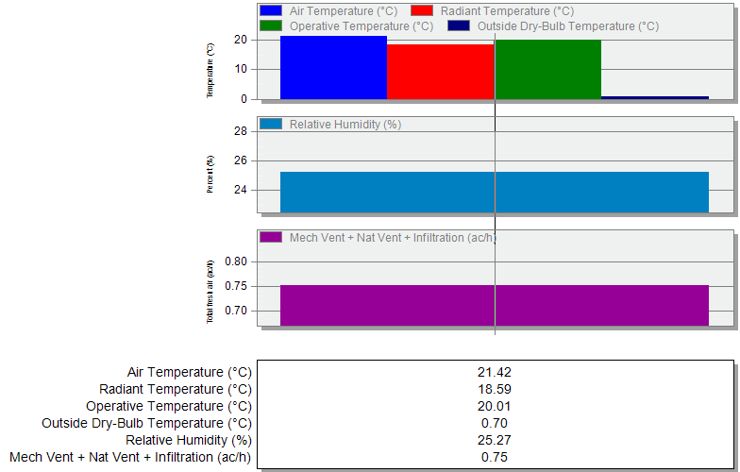
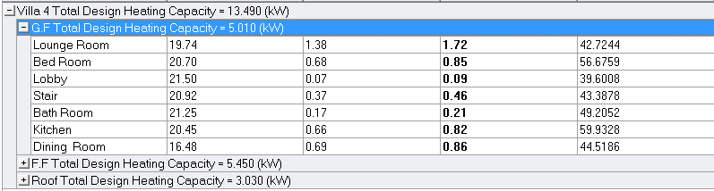
Energy Simulation
Heating Load Design
Total Heating Load = 13.490 kW

Slide 46
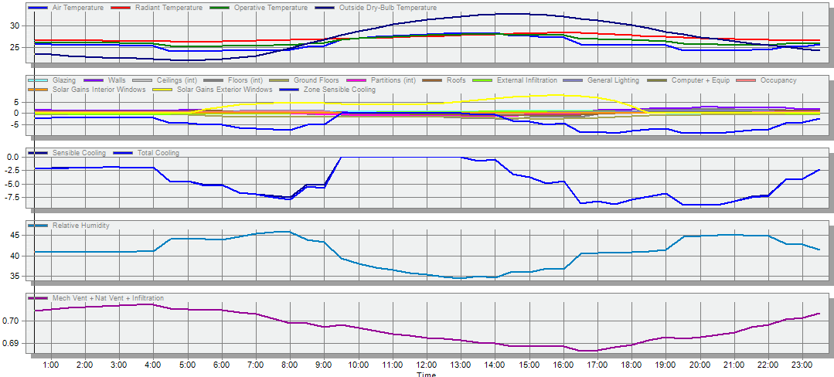
Energy Simulation
Cooling Load Design and Simulation
Total Cooling Load= 15.06 kW

Slide 47
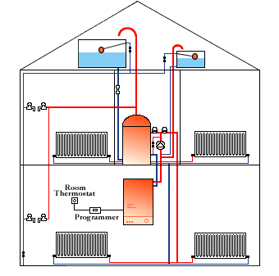

Techniques
Heating
Cooling

Slide 48
Environmental Design
Materials
Palestinian Requirements |  | GREEN Villa
Element | Value | Value | Fit/Not
External walls | 0.5 w/m².k | 0.462 | Fit
External roof | 0.39 w/m².k | 0.367 | Fit
Ground slab | 0.46 w/m².k | 0.435 | Fit
Glass | 2.1 w/m².k | 1.701 | Fit
transmitting | 25% min | 42 | Fit

Slide 49
Thermal Analysis
Story | Zone | Design Capacity (KW) | Area (m²)
Ground Floor | Kitchen Bed room Dining Room Lounge Room Stair Bath Room | 0.82 0.85 0.86 1.72 0.46 0.21 | 18.0 15.0 27.5 25.5 13.0 4.10
First Floor | Bath Room Bath Room Bed Room1 Bed Room2 Bed Room3 Circulation Lobby1 Lobby2 Stair | 0.34 0.26 0.92 0.83 1.00 0.86 0.07 0.14 0.42 | 5.0 5.0 16.0 16.5 18.6 6.0 2.2 3.0 13.0
Roof | Circulation Stair | 2.28 0.75 | 7.15 13.0
Heating load of the villa

Slide 50
Thermal Analysis
` | Zone | Design Capacity (KW) | Area (m²)
Ground floor | Kitchen Bed room Dining Room Lounge Room Stair Bath Room | 0.87 0.42 1.20 0.72 0.14 0.10 | 18.0 15.0 27.5 25.5 13.0 4.10
First Floor | Bath Room Bath Room Bed Room1 Bed Room2 Bed Room3 Circulation Lobby1 Lobby2 Stair | 0.28 1.12 1.12 0.77 0.91 1.01 0.11 0.10 0.30 | 5.0 5.0 16.0 16.5 18.6 6.0 2.2 3.0 13.0
Roof | Circulation Stair | 1.98 0.46 | 7.15 13.0
Cooling load of the villa

Slide 51

Daylight Factor

Slide 52

Mechanical Design

Slide 53


Drainage system

Slide 54


System of distribution of water
Recycled water | Fresh water
12 | 28 | Total FUs
1.5" | 2" | Vertical pipe diameter
1.25" | 1.25" | Horizontal pipe diameter
3/4" | 3/4" | branch pipe diameter

Slide 55

Layout of water tank

Slide 56


System of distribution of water

Slide 57


Slide 58

Heating system

Slide 59


HVAC System
VRF - multi split unit
Indoor Split unit
Outdoor Unit

Slide 60

VRF System

Slide 61
Acoustical Design
STC
Layers | STC
8-in(20 cm) Dense hollow block | 48
Add plaster to both sides | 4
Total | 52 db

Slide 62

Photovoltaic System

Slide 63

Photovoltaic System
8323 kWh total consumption energy
75% can be covered

Slide 64

Electrical Design

Slide 65

Artificial Lighting

Slide 66


Living Room

Slide 67

Living Room

Slide 68

Artificial Lighting

Slide 69

Sockets

Slide 70
Sockets
Floor | Number of socket 2 Amp | Number of socket 10 Amp | Number of branches (3Ø2.5 mm²)
G.F | 14 | 2 | 6
F.1 | 21 | 1 | 9
Roof | 4 | 0 | 2

Slide 71

Branches

Slide 72




Fire and Alarm System

Slide 73

Fire and Alarm System

Slide 74

Quantity Survey

Slide 75
THANK
YOU

