Slide 1



Slide 2

Introduction
Problem
Solution
Future work

Slide 3
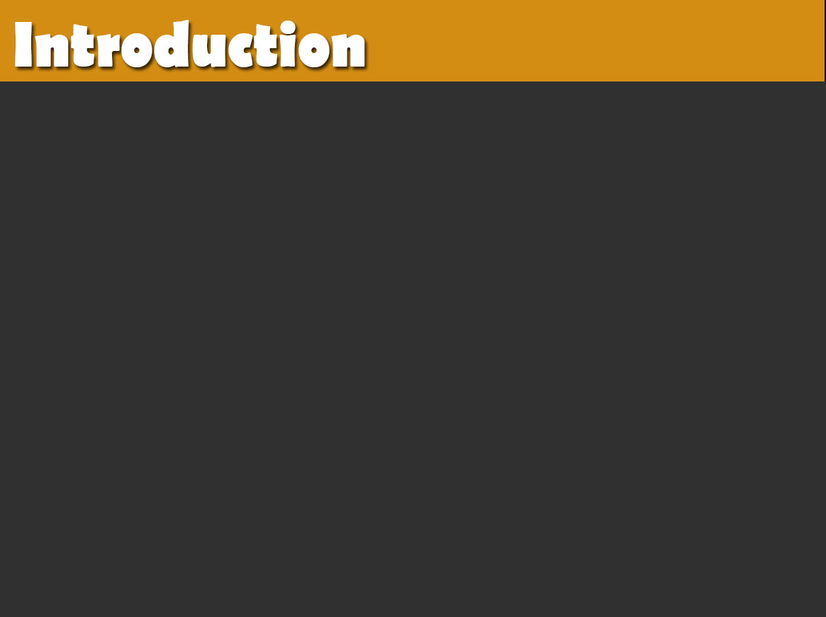

What is Interactive Devices Project ?
Smart Devices System

Slide 4


Oh my God, should me do this at all time.
How can I turn
Lighting before reaching home ?

Slide 5
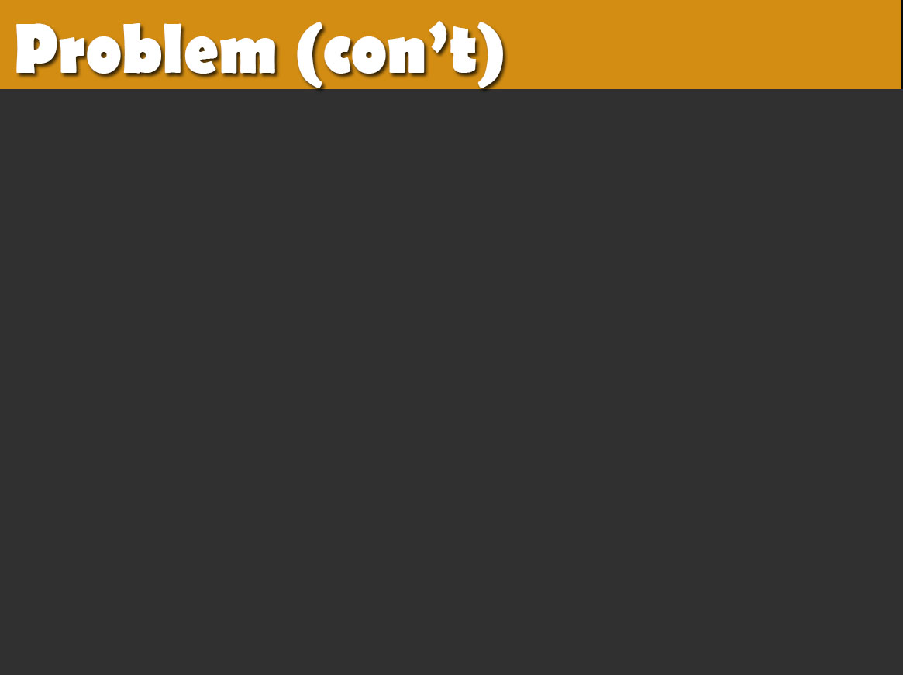
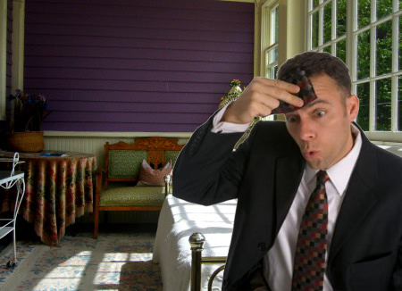
How can I keep a proper temperature in the room ?

Slide 6

How can I know the status of the doors and windows ?

Slide 7


Please find me a solution

Slide 8
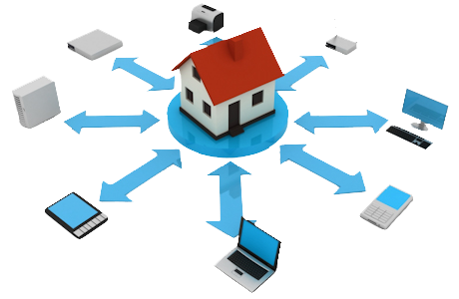

Slide 9
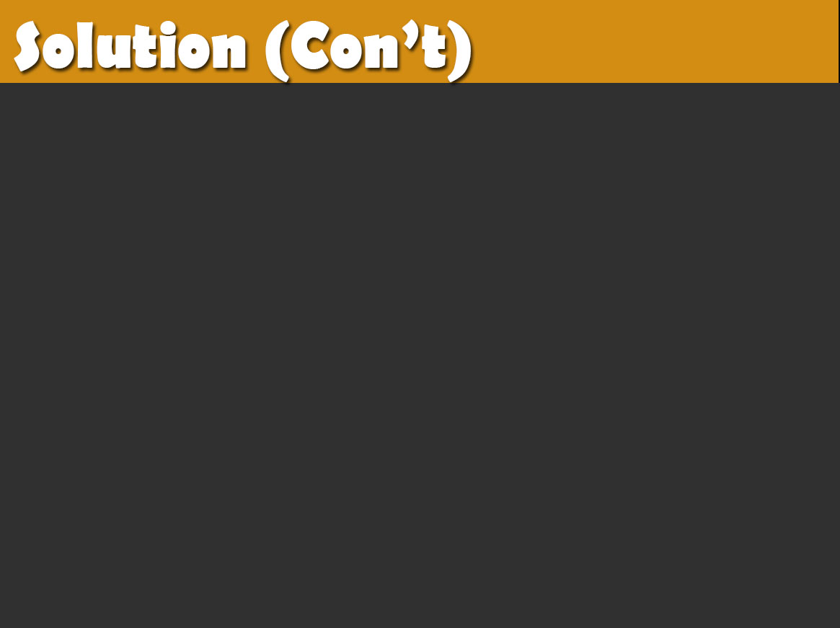
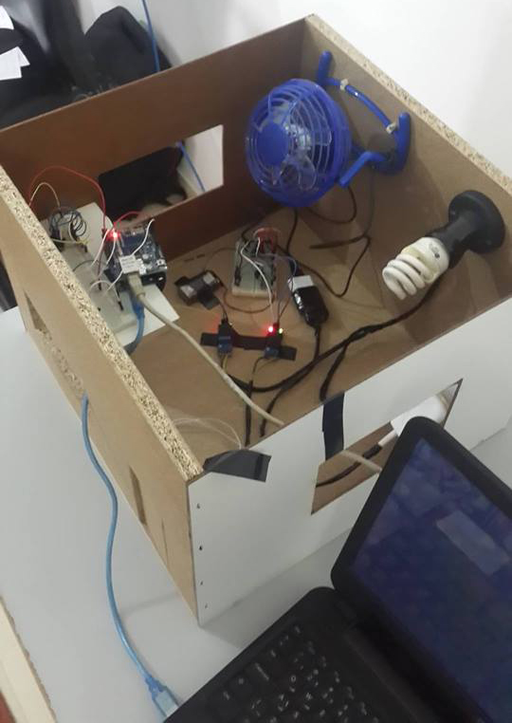
Smart devices project
will help you !!

Slide 10
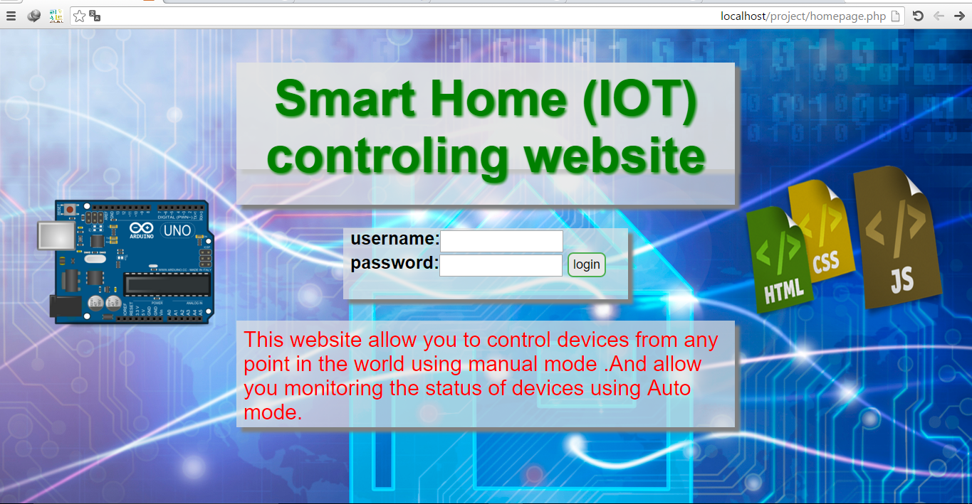
Fast and easy way to get the status of devices and control them.

Slide 11
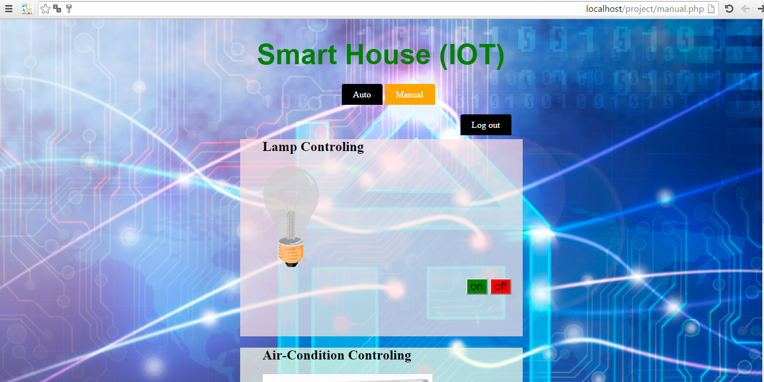
No matter where you are, you will know.

Slide 12
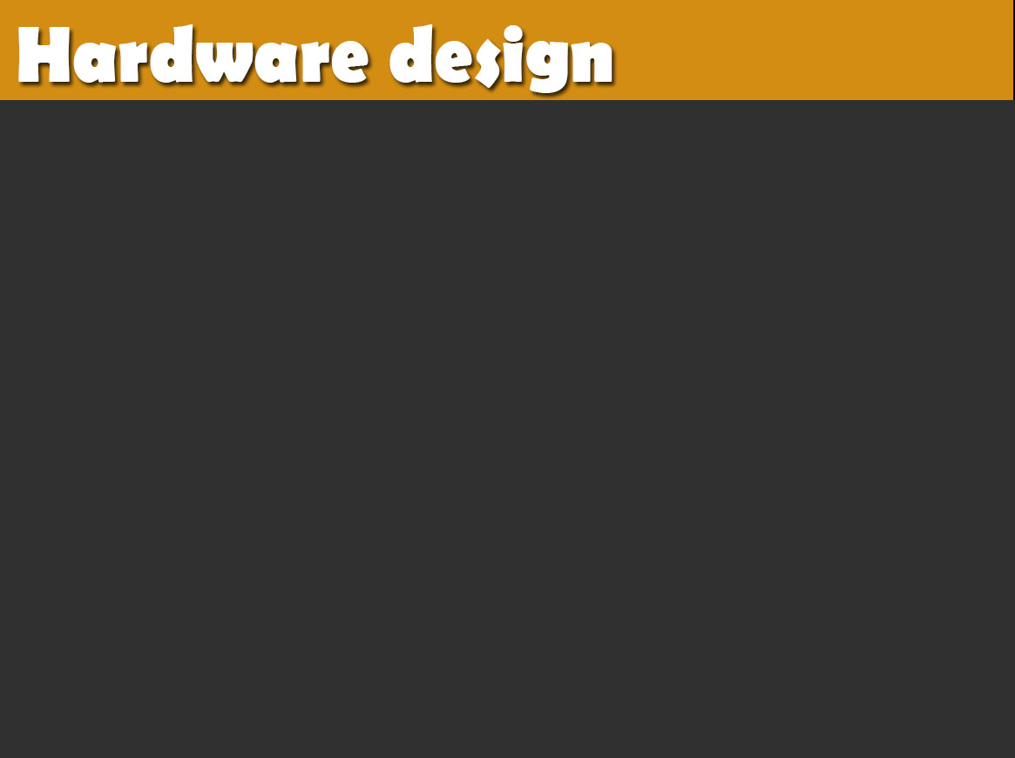
Arduino Uno.
Ethernet shield.
RF transmitter/receiver module.
Lamp and Fan.
Temperature and photoresistor sensors.
Reed switch sensor.
Relay.

Slide 13
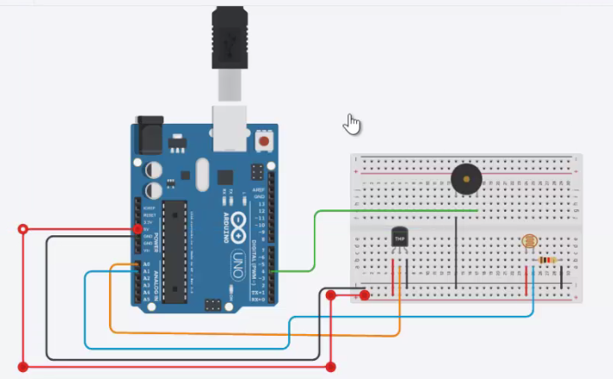
we connect arduino with the temperature and photoresistor sensors to implement auto mode.

Slide 14
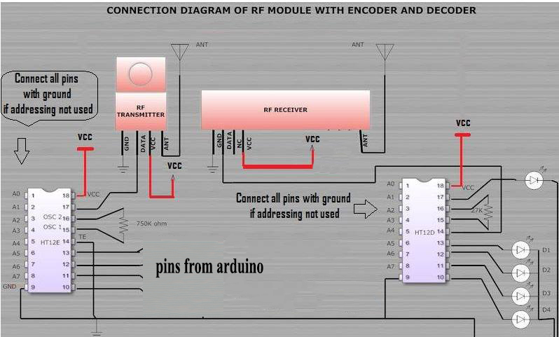
We connect the RF Tx and Rx as shown .
It’s the connection
way between the
controller and the
devices

Slide 15
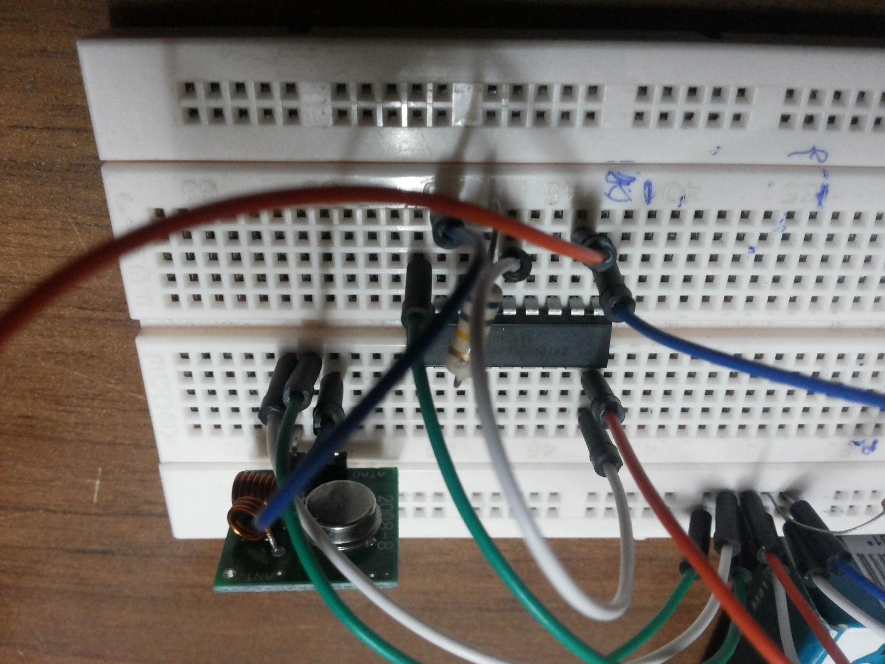
RF Tx
We send via it the on/off commands.

Slide 16
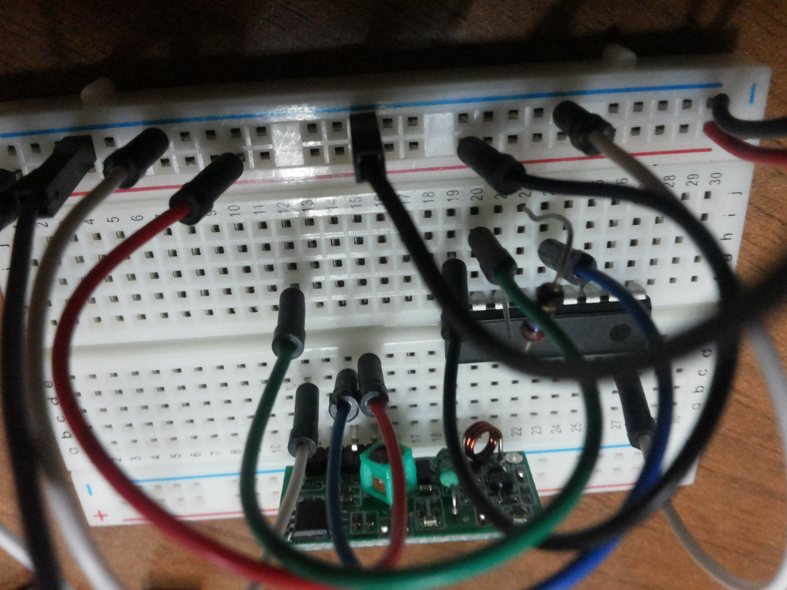
RF Rx
We connect the output pins of it to the devices.

Slide 17
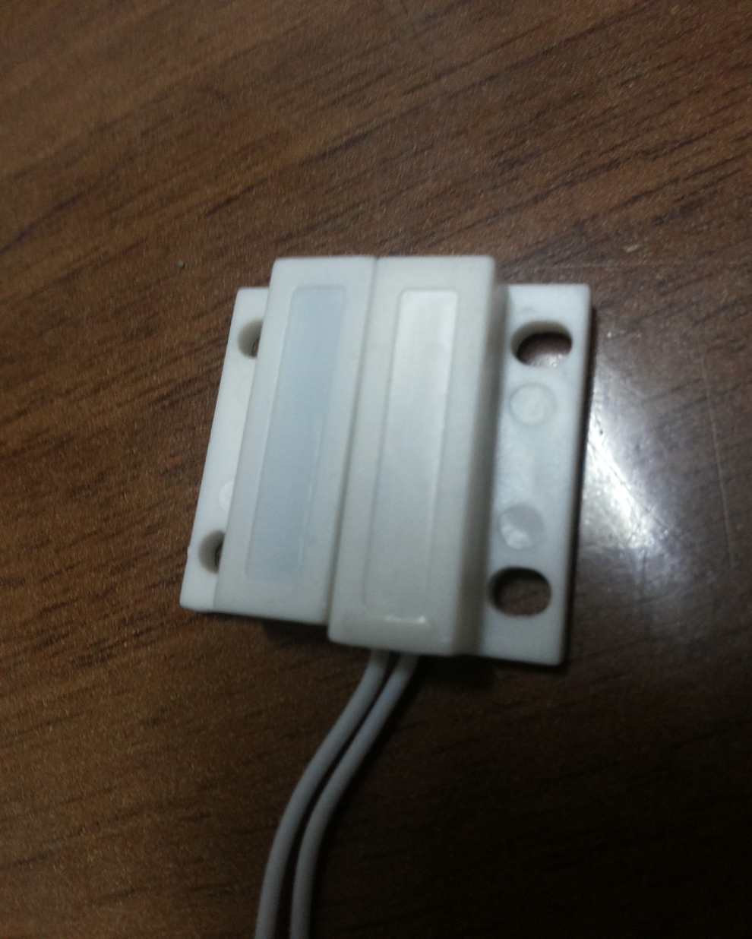
Magnetic Sensor
We use Reed switch sensor
to know the status of the door or window (open/close)

Slide 18
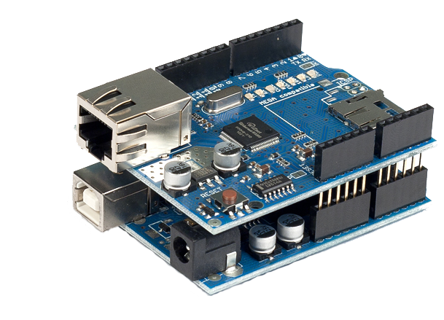
Ethernet shield
Connects the
Arduino to the
server

Slide 19


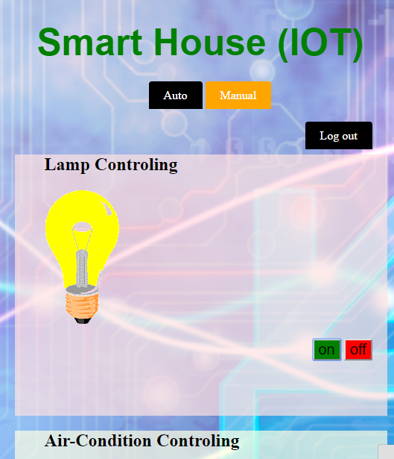
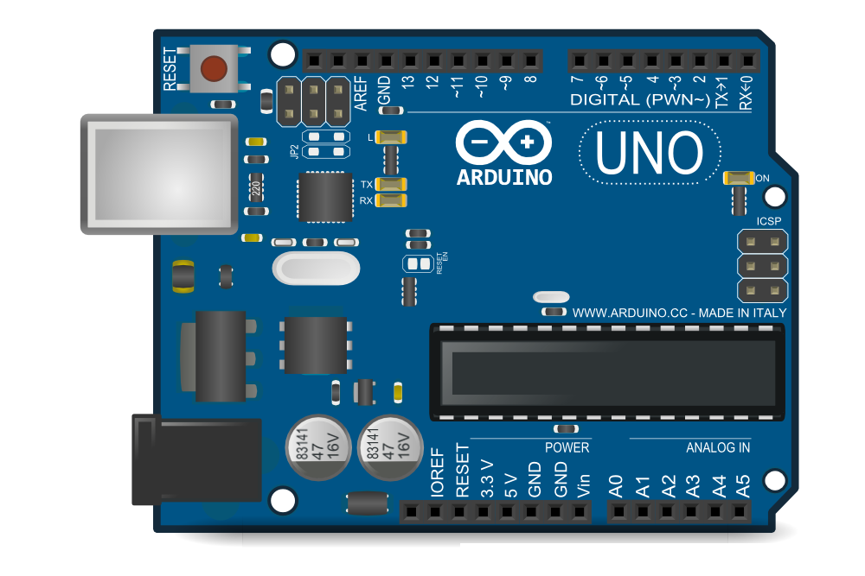

Slide 20
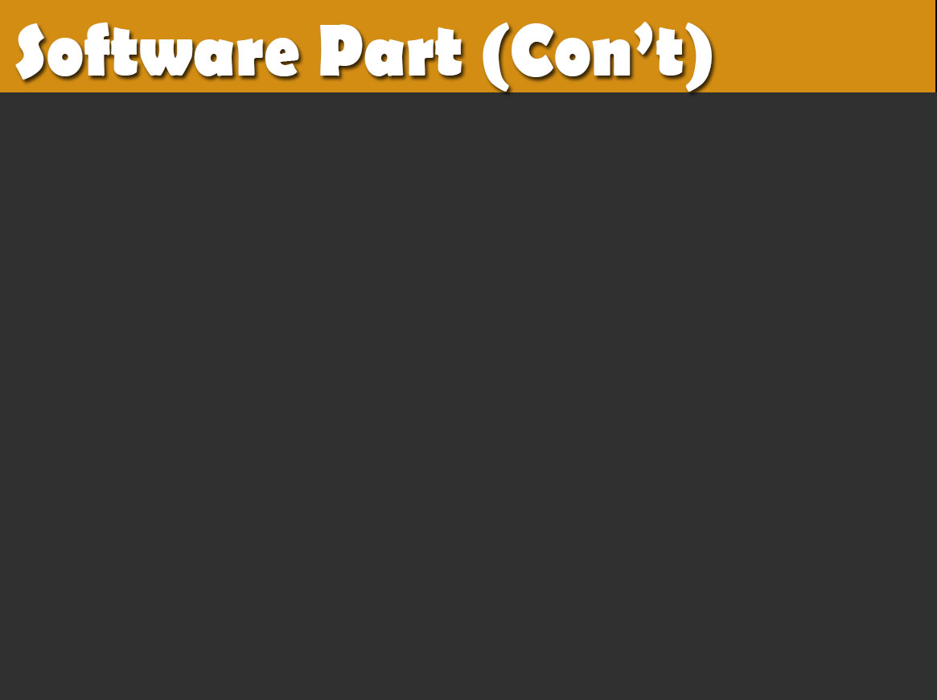
Turn on

Slide 21
Turn on
Response

Slide 22
Sensing
Turn on
Response

Slide 23
Sensing
Turn on
Response
Response

Slide 24
Verification
Sensing
Turn on
Response
Response

Slide 25
Response
( turn the device on )

Slide 26
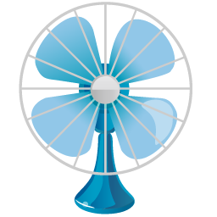
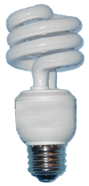
How can the system detect what device will deal with it ?

Slide 27
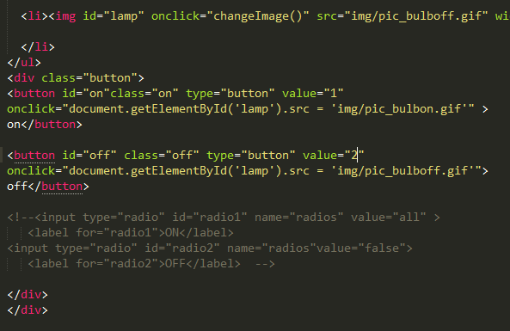
Each device have
an id and value.

Slide 28
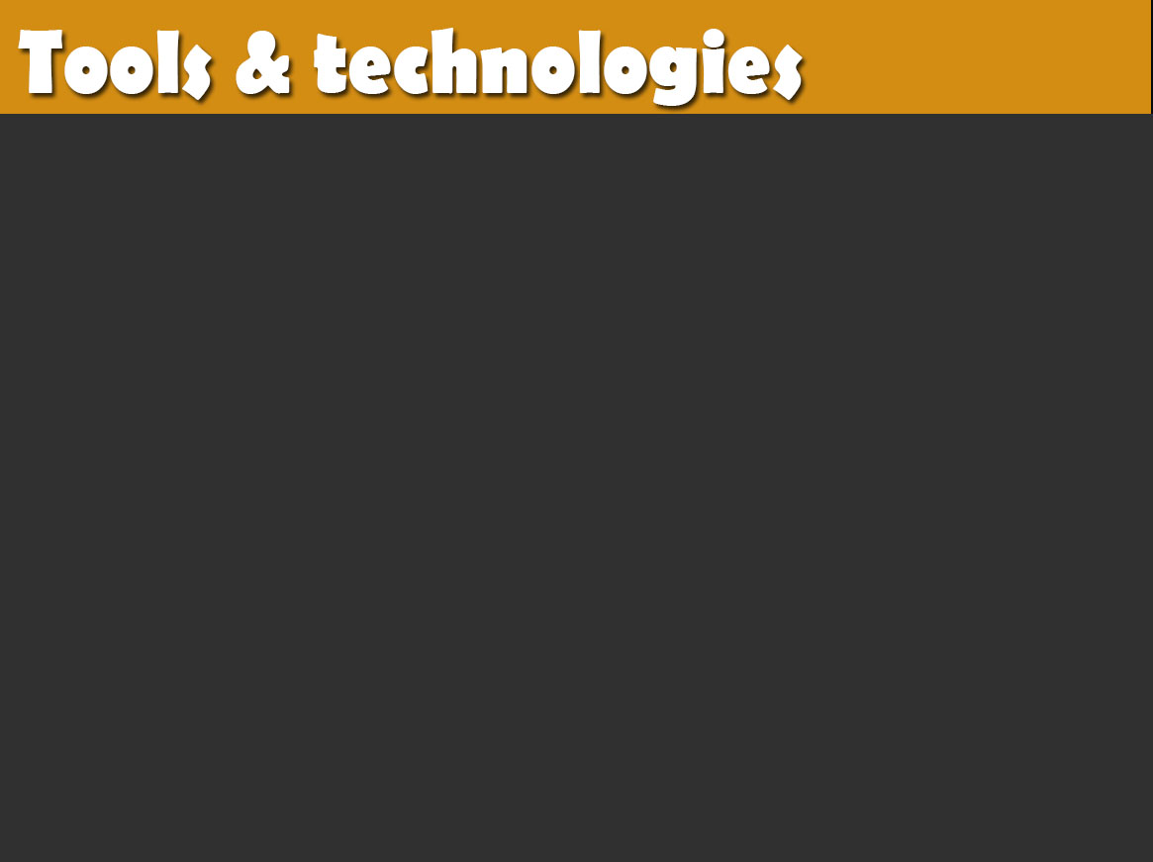




Arduino
Website
html, css, java script , php
ASP.NET – web services

Slide 29

Android application.
More attractive website.
Database for users registration.

Slide 30


