Slide 1
Stay
Healthy
Alaa Nahla 11610928
Osaid najjar 11610879

Slide 2
Introduction
What Is Stay Healthy ?
It is an Android system that provides health benefits to all segments of society...
What services does " stay healthy " provide ?
  Calorie Counter
  Weight Tracker
  Medicine Alert
  Emergency
  Child Vaccinations

Slide 3
calorie Counter
What is the function of the calorie counter ?
- The calorie counter estimates the daily calories amount that a person need in order to maintain, lose or gain weight
What can the user do ?
  Add a meal to calculate the amount of calories that consumed
  Add exercise to calculate the burned calories
  Can review the total burned and consumed calories and daily goal of calories
What the system do ?
  calculate the amount of calories that consumed or burned
  calculate the amount of remaining calories to stay in the range of daily goal
  Show information about each meal or exercise that added by user

Slide 4
calorie Counter
What BMR And AMR ?
  BMR : Basal Metabolic Rate
  AMR : Active Metabolic Rate
To compute BMR we will use The Revised Harris-Benedict Equation :
Men BMR = 88.362 + (13.397 * weight in kg) + (4.799 * height in cm) - (5.677 * age in years)
Women BMR = 447.593 + (9.247* weight in kg) + (3.098 * height in cm) - (4.330 * age in years)

Slide 5
calorie Counter
To compute AMR multiply the BMR result by the current level of activity :
  Sedentary (little or no exercise): AMR = BMR * 1.2
  Light active (exercise 1-3 days/week): AMR = BMR * 1.375
  Moderate active (exercise 3-5 days/week): AMR = BMR * 1.55
  Active (exercise 6-7 days/week): AMR = BMR * 1.725
  Very active (hard exercise 6-7 days/week): AMR = BMR * 1.9
  - 1 KG of weight = 7.700 kcal
  - 1 pound of weight = 3.500 kcal

Slide 6
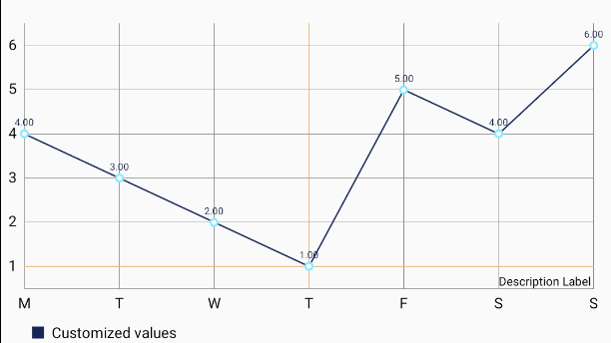
  Weight Tracker
This modules used to show a line chart diagram that describe how the user’s weight is changing during weeks .
How this module work ?
  User will enter his current weight and current time
  System describe the change of user weight by line chart
  user enter weight and height to compute BMI by system
What is BMI ?
BMI is a measurement used to detect if that person has overweight, underweight, or normal weight based on his weight and height measures

Slide 7
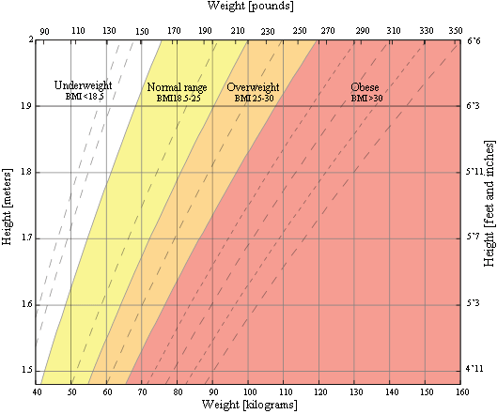
BMI (Body Mass Index)
BMI calculation formulas for adults (18-65 years ):
BMI = weight (kg) / [height (m)] ^ 2 ----- For Men
BMI = 703 * weight (lbs) / [height (in)] ^ 2 ----- For Women
Result Range :
Underweight = < 18.5
Normal weight = 18.5 – 24.9
Overweight = 25 – 29.9
Obesity = 30 or greater

Slide 8
  medicine alert
What is the function of Medicine Alert ?
It is used to remind the user when to take their medication
What information is required to create an alarm?
  Medicine name
  Medicine type " Capsule , Syrup , Injection , Drops “ and Dosage amount
  Repeating Days
  Times for alarm
What the system do ?
Fire the alarm at the specific time and show alert information that contains medicine name , type and dosage

Slide 9
  Emergency - Child Vaccinations
EMERGENCY :
Used to get help for the user in an emergency situations
    user add up to three contact numbers for emergency situation
    system send a messages for all emergency number which added by user when user click on emergency button " SOS
Child Vaccinations :
    Helping parents know the vaccination times for their children
    user enter the child birthdate
    system indicates to the user the vaccinations that a child should receive in the first months of his life

Slide 10
Comparisons
 | MyPhitnessPal | Lose It! | Fatsecret | Stay Healthy
Medicine Alert | × | × | × | ✓
Recipes | ✓ | ✓ | ✓ | ×
Calculate BMI | × | × | × | ✓
Play Music | × | × | × | ✓
Emergency Call | × | × | × | ✓
Children Vaccinations | × | × | × | ✓
Articles | ✓ | × | × | ✓
Workouts | ✓ | × | × | ✓
Diary | ✓ | ✓ | ✓ | ✓

