Slide 1

Shopping Guide E-commerce Website
An-Najah National University
Management info. Systems Department
Abdullah Aladham
Msc. Maher abu-baker

Slide 2
Out line:-
Definition.
Motivation.
Objectives.
challenges
Future work
Implementation.
Conclusion.

Slide 3
Definition
What is Shopping Guide E-commerce Website ?
Is an Ecommerce site which gives right to its users putting their products to be sold safely and securely away from Scams and Spams.

Slide 4
Motivation
Why should we sign up for Shopping guide ?
1- because you are protected from spammers and scammers.
2- you are given a free sign up and put your products freely.

Slide 5
Objectives
Main goal :-
Make a market which products that shown is real not scam!
challenge:
Scammers
competitors
so what we do !!

Slide 6
Objectives
The solution is to do → Shopping Guide E-commerce Website
←
Seller → vendor
user→ customer
SGPS → Market
Make the customer arrive to the Market to buy real product.

Slide 7
Objectives
How it works ?
1- vendor.
2-customer.
Goals :-
Our goals represented in the following three points as follow :-

Slide 8
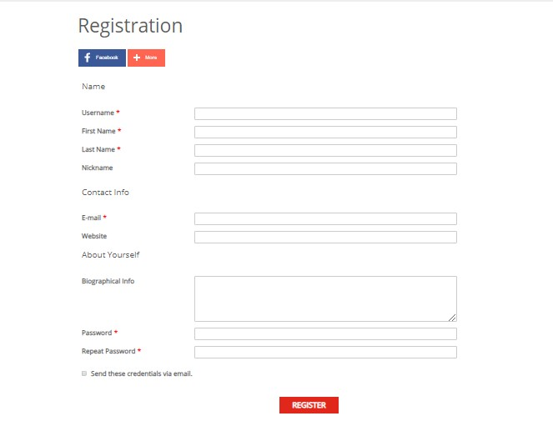
1.User registers to website as a user or subscriber

Slide 9
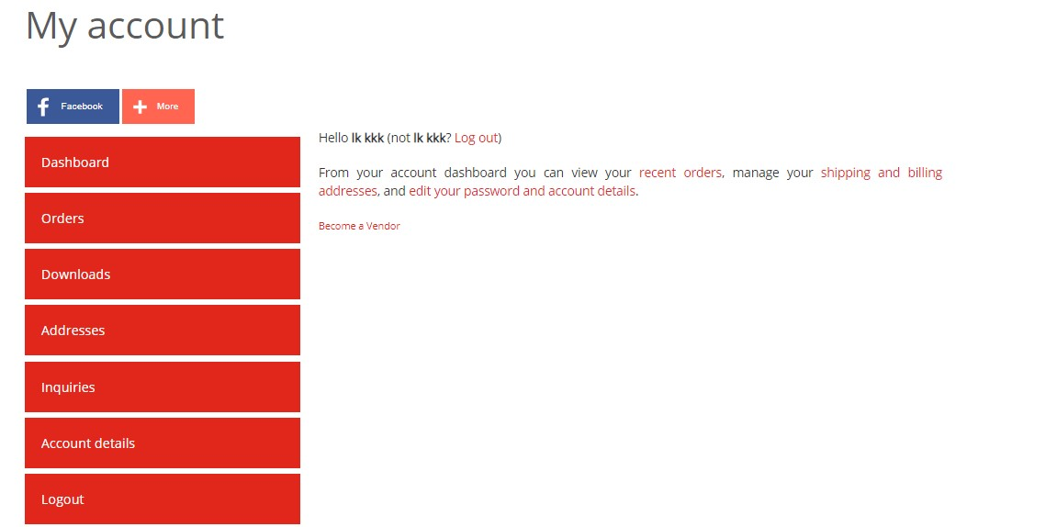
2. If user wants to become vendor just click on store manger and click on become a vendor

Slide 10
Challenges
Security breaches
having other local E-commerce Websites(competitors)
Facebook

Slide 11
Future work
through :-
buy / lease a storage unit(s)
Establishing Storage management System and ERPS
Building a great CRM

Slide 12
Implementation

Slide 13
Conclusion
Definition.
Motivation.
Objectives.
challenges
Future work
Implementation.
Conclusion

Slide 14
Thanks for Listening

