Slide 2
Introduction
several studies have been done on water purification plants: purification of water in ultraviolet light and through the rays of the sun and a station located in Palestine:1-the Ultra-Violet (UV)2-Solar water distillation3-The purification station in Nablus

Slide 3
Component
1-Waste water
2-Filter
3-Tank of waste
4-Tank of waste water
5-Separation6-Combination
7-Generator
8-Anaerobic Digestion

Slide 4
Separation
The water molecule consists of two elements: positive hydrogen ions and negative oxygen ion. When electricity is introduced into the water through two poles, the cathode (negative) and the anode (positive), these ions are attracted to the charged electrode. Therefore, positively charged hydrogen ions will be collected on the cathode and will collect negatively charged oxygen on the anode.

Slide 5
Calculation
1 m^3 of water need 3.67KW to separate Molar mass of water = 18# Mole = Mass/(Molar mass) = 1000/18 = 55.5 mol , 1 m^3 of water Contain 1000 kg water 8/9 * 1000 = 888.828 kg O2 , 1/9 * 1000 = 111.11 Kg H2 # mole of Hydrogen = 111.11/2 = 55.5 , Volume * pressure = # mole * R * Temperature Volume * 1 = 55.5 * 0.082 * 300 , Volume of Hydrogen = 1365. 3 Liter # mole of Oxygen = 888.88/32 = 27.7 , Volume * pressure = # mole * R * Temperature Volume * 1 = 27.7 * 0.082 * 300 , Volume of Oxygen = 683.3 Liter For 6000m^3 of water We can get 4,100,000 Liter Oxygen and 8,200,000 Liter Hydrogen

Slide 6
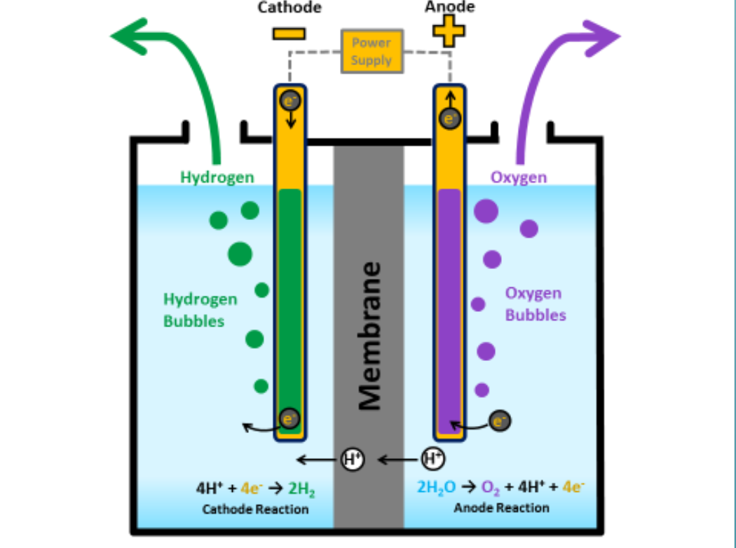
mechanism

Slide 7
Combination
At the anode a catalyst causes the fuel to undergo oxidation reactions that generate protons and electrons. The protons flow from the anode to the cathode through the electrolyte after the reaction. At the same time, electrons are drawn from the anode to the cathode through an external circuit. At the cathode, another catalyst causes hydrogen ions, electrons, and oxygen to react, forming water.

Slide 8
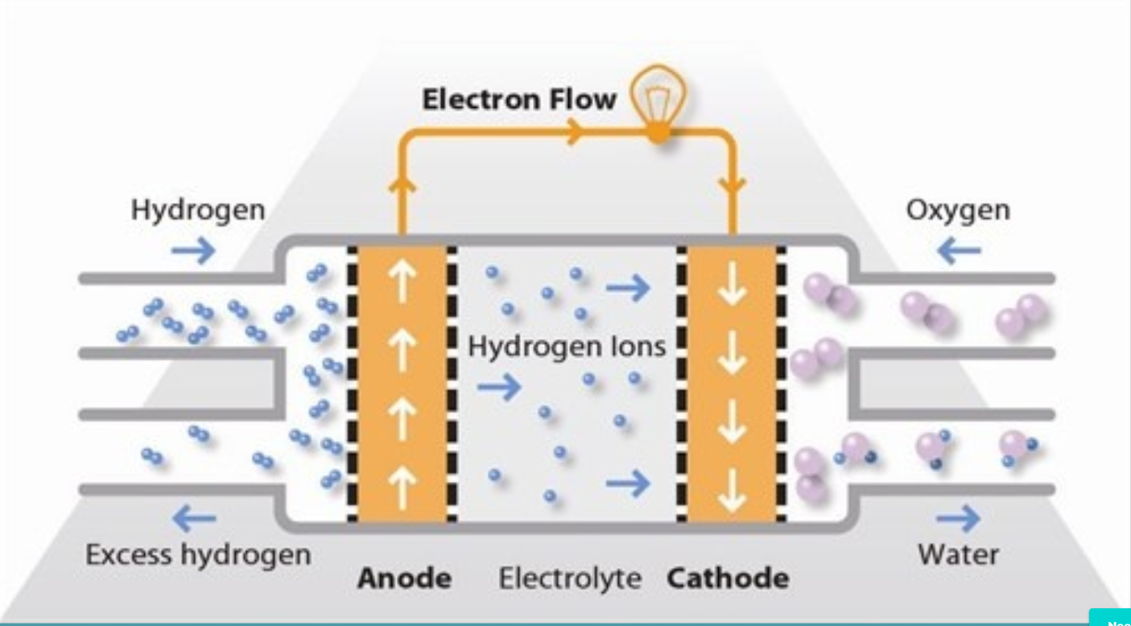
mechanism

Slide 9
Photovoltaic system
The photovoltaic system, as well as the photovoltaic system or solar system, is a power system designed to provide usable solar energy through solar modules. Consists of a range of components, including solar panels to absorb and convert sunlight into electricity, a solar reflector to change the voltage from DC to AC, as well as installation, cables, and other electrical accessories to create a working system.

Slide 10
Calculation
1 m^3 of water need 3.67KWH to separateThe total Electricity we need per day = 6000*3.67 = 22020KWHThe Electricity needed per houre = 917 KWThe cost of the Electricity per day = 22020 * 0.6 = 13212 NIS The cost of the Electricity per month =22020 * 30 = 396360 NIS We need 40% from total Electricity= 22020*0.4 =8000KWH (pv system)The total KWP = 8000KWH/6 H = 1333 KWP The number of moduels = 1333/0.35 =3500 modules Every 3 panels need 8 m^2 then 3500 panels need 9,330 m^2

Slide 11
Anaerobic digestion
Anaerobic digestion is a collection of processes by which microorganisms break down biodegradable material in the absence of oxygen. The digestion process begins with bacterial hydrolysis of the input materials. Insoluble organic polymers, such as carbohydrates, are broken down to soluble derivatives that become available for other bacteria. Acidogenic bacteria then convert the sugars and amino acids into carbon dioxide, hydrogen, ammonia, and organic acids. These bacteria convert these resulting organic acids into acetic acid, along with additional ammonia, hydrogen.. Finally, methanogens convert these products to methane.

Slide 12
Environmental Requirements
The methane-producing microbial process is affected by numerous interdependent environmental factors, such as temperature, retention time, loading rate, and agitation. An effective production system must control all these factors through provisions within its structural and equipment components.

Slide 13
Digester Size
A. Calculate weight and volume of manure to be handled:10000 m3 of waste water (solid +slug ) – 6000m3 (slug) = 4000m3 (solid waste)B. B. Calculate dry matter to be handled. Solids content of manure is expected to be about 15 percentDry matter: 4000ton x 0.15 = 600 tonC. C. Calculate weight and volume of slurry to be moved into the digester each day.Dry matter concentration of slurry: 13 percentTotal volume: excreted manure + added waterTotal weight of slurry: dry matter/0.13600 /0.13 = 4600 tonTotal volume of slurry: 4600m3D. Calculate volume of digester chamber for specific retention time.Assume retention time of 14 daysbChamber volume: daily slurry production x retention time4600 m3 x 14 = 64400 m3

Slide 14
Conclusion
In the separation method when electricity is introduced into the water through two poles, the cathode (negative) and anode (positive) are attracted These ions to the charged electrode. Then we calculate the total electricity that we need in the end Finally, we calculate the volume of production of oxygen and hydrogen, which was for 6000 waterTo reduce the total cost of the photoelectric system, the solar system was chosen to convert sunlight into electricity. The calculations and results illustrate the design of the PV system. Here, we need about 15 acres of panels to reduce 40% of the electricity equivalent to 8808 kilowatts per day.The fuel cell converts chemical energy from fuel to electricity and water, and electricity can be produced commonly as long as fuel and oxygen are supplied. composed of cathode, anode and electrolyte that press positively charged protons to move between the sides of the fuel cell. Energy efficiency of the fuel cell ranges from 40-60%; however, if the waste heat is captured in the cogeneration system, efficiencies of up to 85% can be obtained.

Slide 15
Any Question

