Slide 1
By the name of the god
Graduation project presentation

Slide 2
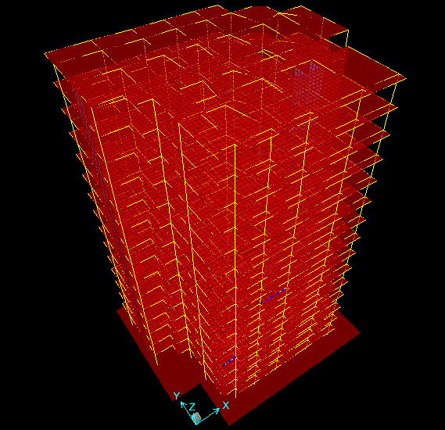
Our project was to design a15_stories irregular residential building for static and dynamic loading.

Slide 3
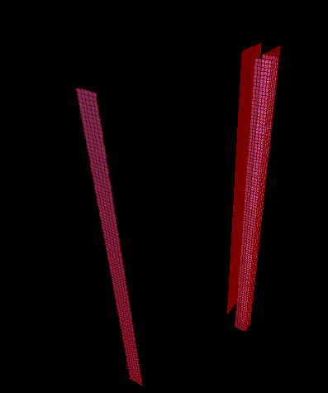
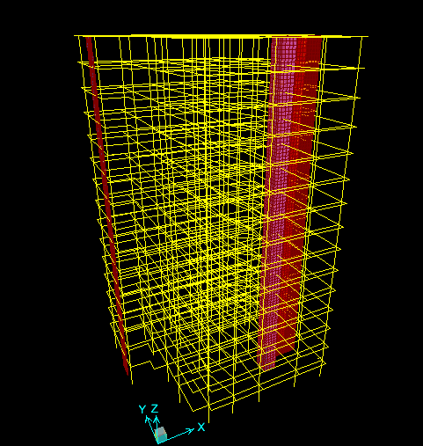
The type of structural method that we used is ordinary frame –shear wall interaction.

Slide 4
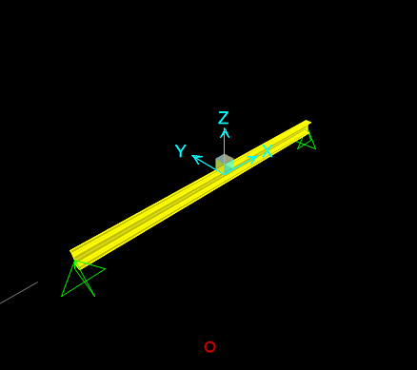
The first step in the project is to make a preliminary design for all elements as 1D element by using a1D sap model.

Slide 5

After finishing the preliminary design we start making a 3D model by using SAP 15 and make the necessarily checks (compatibility , stress strain relationship and equilibrium) .

Slide 6
Then we put all loads that affect the design of the building ,there were two main loads:
Static loads : dead ,live and superimposed dead loads.
Dynamic loads : earthquake and wind loads.

Slide 7
The live loads which was known from tables to be 2 KN/M2 and the dead loads is calculated by considering the composition of the slab and tiles.
In compute the earthquake loads we refer to the response spectrum method by using SAP , and we calculate the wind loads by using simple equations .

Slide 8
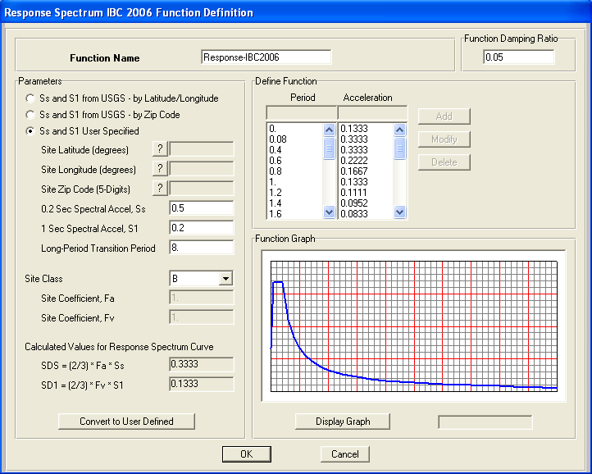
Response spectrum method :
It is a special case of time history method and it is the most precise one.
In this method the structure is subjected to many earthquakes and the max effect is considered. The following figure shows the response spectrum definition window

Slide 9
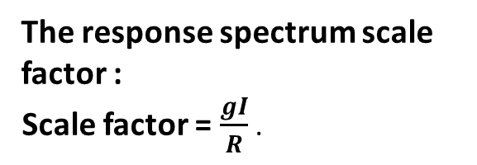
The following parameters are required to perform the dynamic analysis and design for the building using IBC2009 design code:
The soil class :
We decide the soil class based on soil characteristics, but we know only one information about the soil that it is rock, so use soil class “B”.
Importance factor: we have a residential building so it is given an importance factor I =1.
Peak Ground Acceleration (PGA): the value of PGA = 0.2g, since the building is located in Nablus city according to Palestine seismic map.
6.Spectral acceleration at short and long periods (Ss and S1) :
This building is located in Nablus so:
Ss = 0.5 ,S1=0.2.
And the site coefficients: Fa = 1
Fv = 1.
The values of Ss and S1 are measured from special spectral acceleration maps that are shown in the following figures:
Area mass: the superimposed load is the area mass = 4.2/9.81 =0.428 ton/m2.
The response spectrum scale factor :
Scale factor = $\frac{gI}{R}$ .

Slide 10
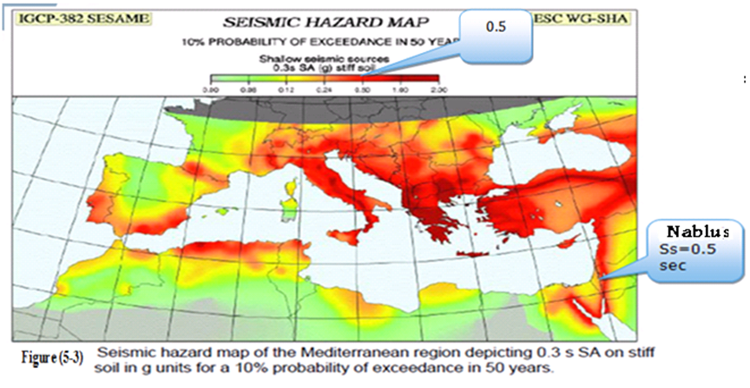

Slide 11
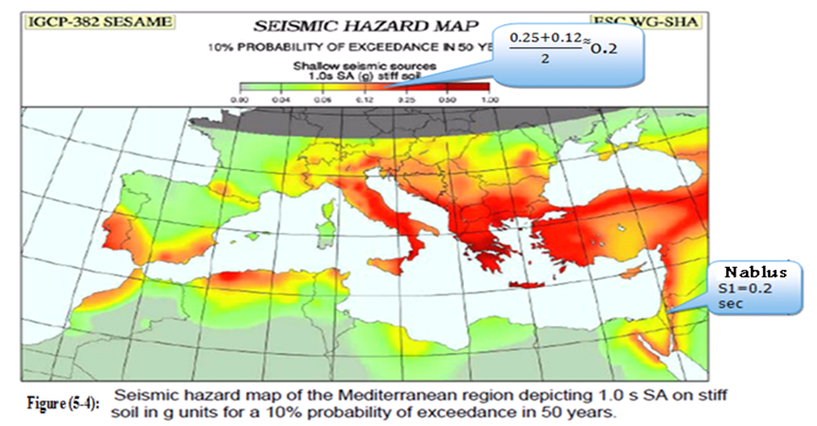

Slide 12
The structural system to be designed is "Ordinary Sway".
Response modification factor (R):
Since we have a shear wall oriented in y-direction and shear walls in x-direction the building classification will not differ in each direction .Thus:
- In x-direction :we have ordinary frame –shear wall interaction R = 4.5.
- In y-direction: we have ordinary frame –shear wall interaction R = 4.5.
Modal analysis:
Modal analysis involves analyzing the modes of the structure and studying the behavior of the structure under dynamic loads. Modal analysis includes studying all the potential modes and calculating the corresponding period and modal mass participation ratio(MMPR).

Slide 13
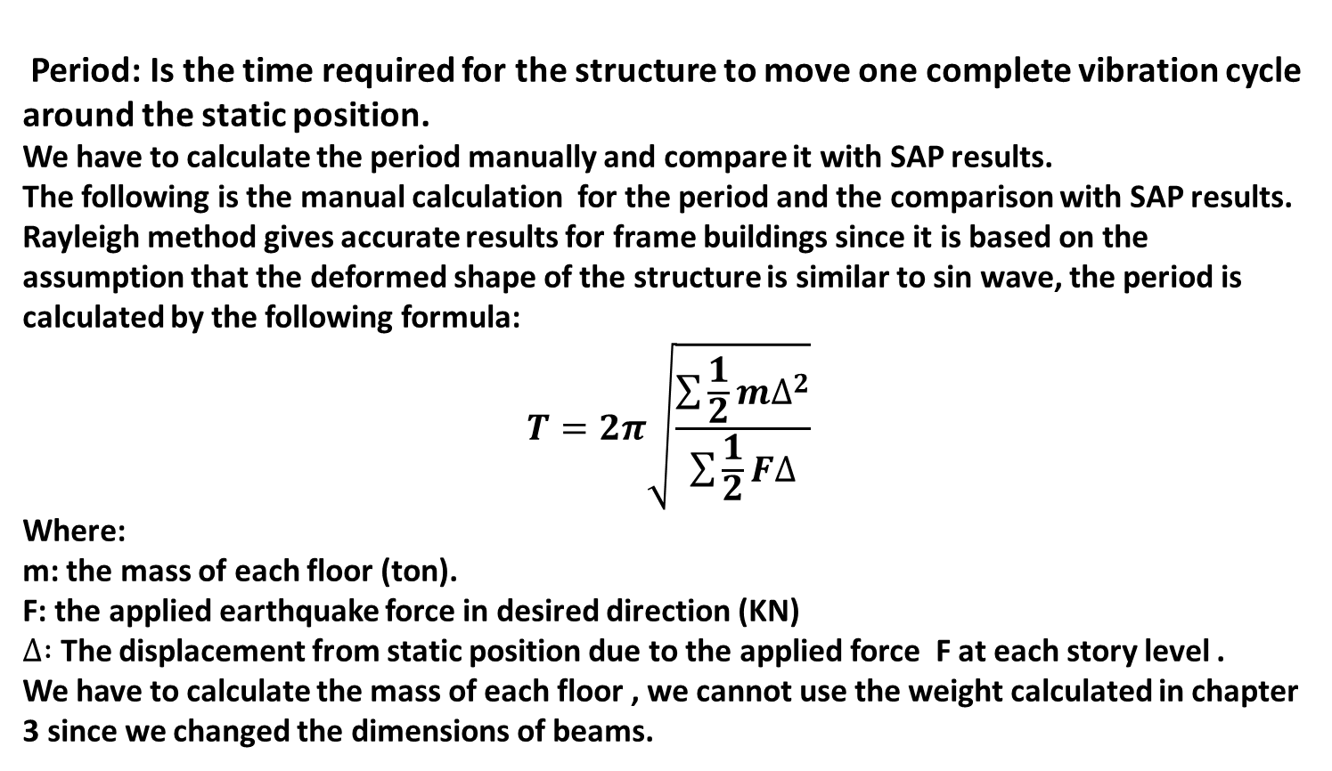
Period: Is the time required for the structure to move one complete vibration cycle around the static position.
We have to calculate the period manually and compare it with SAP results.
The following is the manual calculation for the period and the comparison with SAP results.
Rayleigh method gives accurate results for frame buildings since it is based on the assumption that the deformed shape of the structure is similar to sin wave, the period is calculated by the following formula:
$$T=2π\sqrt{\frac{\sum{\frac{1}{2}m∆^{2}}}{\sum{\frac{1}{2}F∆}}}$$
Where:
m: the mass of each floor (ton).
F: the applied earthquake force in desired direction (KN)
$∆ :$ The displacement from static position due to the applied force F at each story level .
We have to calculate the mass of each floor , we cannot use the weight calculated in chapter 3 since we changed the dimensions of beams.

Slide 14
The following table shows the mass of each story calculated based on the new dimensions of beams ;
Term | Weight (ton)
Slab Own weight | 0.455*538 = 244.79
SID | 0.42*538 = 225
Beams | 403.29
Columns | (0.7*0.7*3.12)*2.5*27 = 132.678
Shear walls | {(5.05*3.12*0.3*2)+(2.05*3.12*0.3*2)+ (2.5*3.12*0.3)+(1.9*3.12*0.3)}*2.5 = 43.524
Total | 1000 ton
To calculate the period by Rayleigh method we have to apply an earthquake force of 1 KN/m2 in both X and Y directions using the load patterns (cases) eqx and eqy. And then read the corresponding displacement at each story level in X and Y direction and substitute these values in Rayleigh equations as mentioned in the oroject documents.

Slide 15
The following table shows the modal analysis results taken from SAP for the fifteen stories building :
The following table shows the comparison between the manual results and SAP results for the period :
Mode No. | Direction | Period (sec.) | MMPR %
1 | y | 2.6 | 72%
2 | RZ(Torsion) | 2.13 | 24%
3 | x | 1.69 | 45%
Mode direction | SAP result(sec) | Manual result(sec) | Error %
x- direction | 1.69 | 1.8 | 6.5 %
y- direction | 2.6 | 2.8 | 7.6 %

Slide 16
The error between SAP and manual results is acceptable.
Notes :
- From modal analysis we note that the period is relatively has high value , this means that we have flexible structure.
- The torsion modes appears in the modal analysis comes from the eccentricity between the center of mass and the center of rigidity due to unsymmetrical distribution of vertical structural elements specially shear walls

Slide 17
Response spectrum analysis :
As mentioned previously there are many methods that can be used to perform the dynamic analysis for the structures such as equivalent static method , time history analysis method and response spectrum analyses method , we usually use the most suitable method based on several factors as : size and complicity of the structure , the importance and occupancy of the structure , and the level of seismic severity of the area(location of the building) since as we became closer to reality in modeling and analysis we will be able to improve the safety and economy of our structures.
The structure in this project is fifteen stories residential building which is located in Nablus- Palestine that is classified as moderate seismicity level we need to be accurate and close to reality in our design. So we will use the response spectrum analysis method to perform the dynamic analysis
We will define two response spectrum load cases for both X and Y directions since we don't know what is the direction of the earthquake .

Slide 18
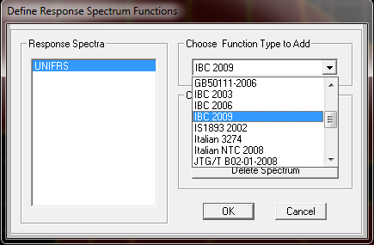
The following figures show the steps of defining the response spectrum function and load cases :
1. First choose the code ‘IBC2006” :

Slide 19
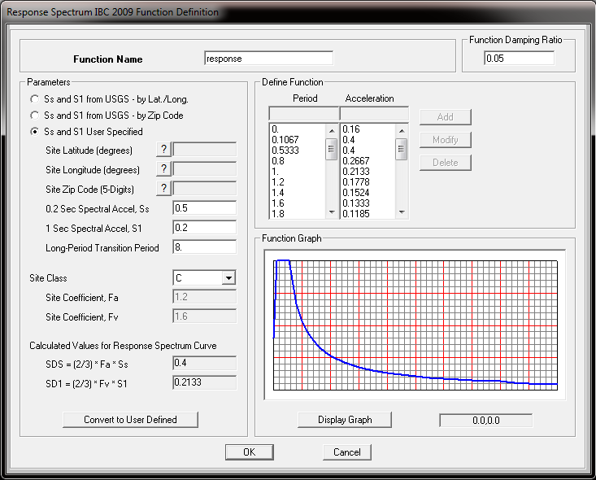
2. Enter the parameters for response spectrum definition :

Slide 20
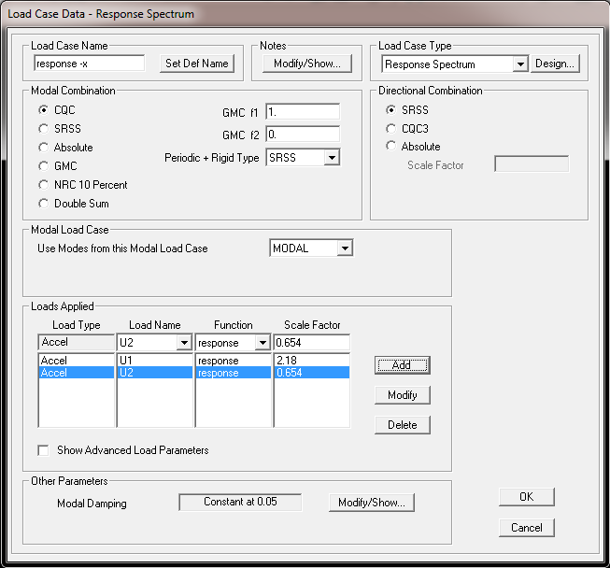
Define the load cases :
1. Response spectrum in x-direction :

Slide 21
Response spectrum in y-direction :

Slide 22
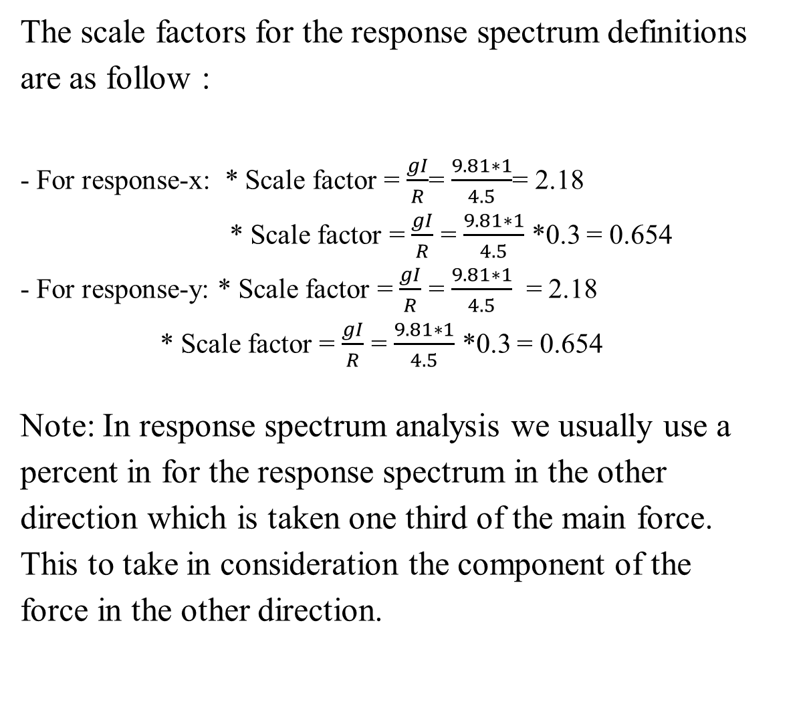
The scale factors for the response spectrum definitions are as follow :
- For response-x: * Scale factor = $\frac{gI}{R}$= $\frac{9.81∗1}{4.5}$= 2.18
* Scale factor = $\frac{gI}{R}$ = $\frac{9.81∗1}{4.5}$ *0.3 = 0.654
- For response-y: * Scale factor = $\frac{gI}{R}$ = $\frac{9.81∗1}{4.5}$ = 2.18 * Scale factor = $\frac{gI}{R}$ = $\frac{9.81∗1}{4.5}$ *0.3 = 0.654
Note: In response spectrum analysis we usually use a percent in for the response spectrum in the other direction which is taken one third of the main force. This to take in consideration the component of the force in the other direction.

Slide 23
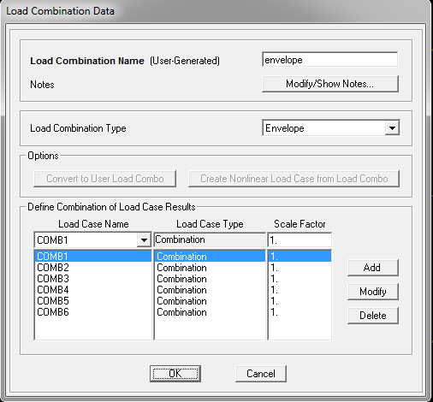
After finishing the input of loads on the 3D model we run the model and before reading any information we consider load combinations and envelope combination.

Slide 24
Load combinations
Load combinations are:
COMB1 = 1.2D.L + 1.6 LL.
COMB2 = 1.4 D.L.
COMB3 = 1.2D.L + L.L + response-x.
COMB4 = 1.2D.L + L.L + response-y.
COMB5 = 0.9D.L + response-x.
COMB6 = 0.9D.L + response-y
Now: check which load combination controls, to do so compare the results of forces and stresses for the structural elements due to both "gravity load combination " and "envelope combination".
.
We will consider response spectrum for the dynamic design of the structure, and to perform the dynamic design we have to check which load case is the most critical and then design the structure according to it. To do so we will define the envelope combination in SAP and use it in design.

Slide 25
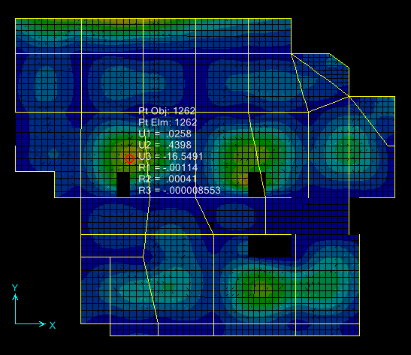
Before the design process we check the slap deflection .
So the allowable deflection = 19.9 mm > real deflection =17.35 OK.

Slide 26
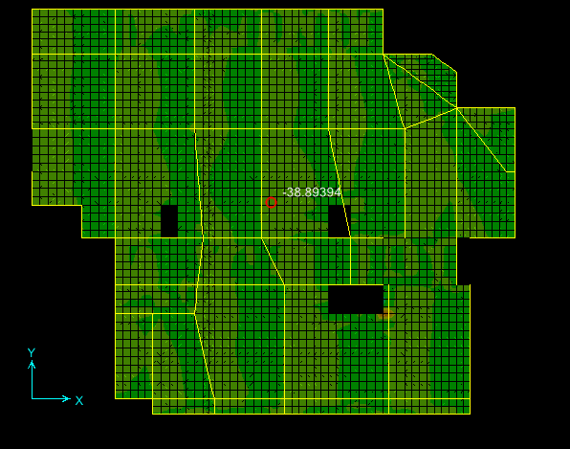
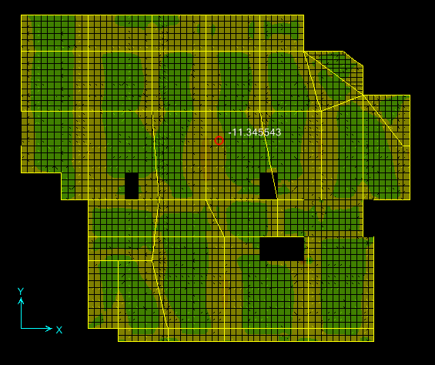
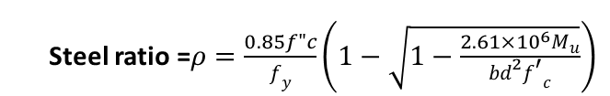
Design of slab
The design limit state for slabs is deflection, then the slab thickness is designed based on deflection criteria and we check it for shear and design for moment.
.
Shear = 38.22 KN/m * 0.52 = 19.87 KN/rib.
So
Vu = 19.87 <ΦVc = 20.1 KN/rib ……………oK
Steel ratio =$ρ=\frac{0.85f"c}{f_{y}}\left(1−\sqrt{1−\frac{2.61×{10}^{6}M_{u}}{bd^{2}{f^{′}}_{c}}}\right)$

Slide 27
Design of beams : flexure reinforcement(mm²)

Slide 28
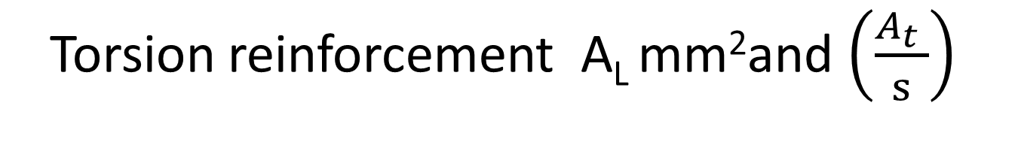
Torsion reinforcement A_{L} mm²and $\left(\frac{A_{t} }{s}\right)$

Slide 29

Shear reinforcement $\left(\frac{A_{v} }{s}\right)$

Slide 30
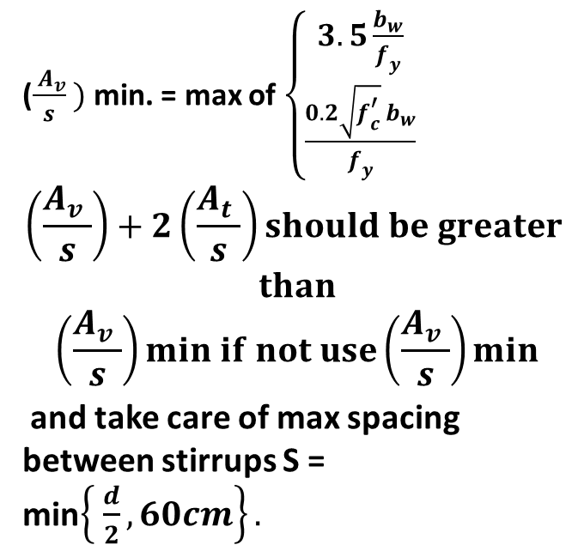
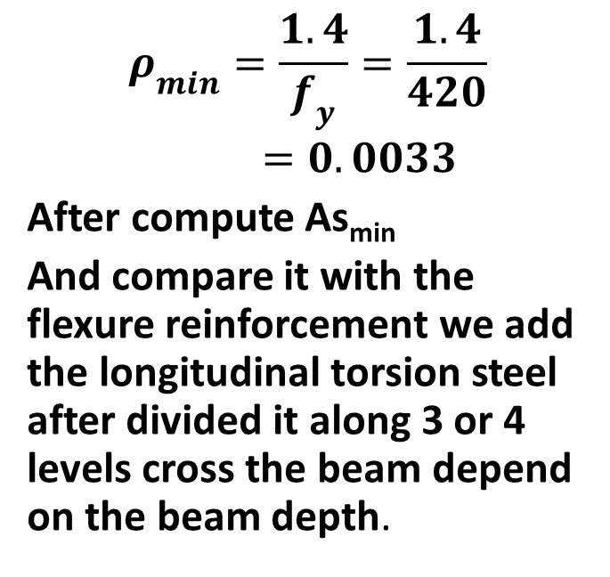
Then coordinate the steel reinforcement and compare with As_{min}
flexure :
Shear :
$$ρ_{min}=\frac{1.4}{f_{y}}=\frac{1.4}{420}=0.0033$$
After compute As_{min}
And compare it with the flexure reinforcement we add the longitudinal torsion steel after divided it along 3 or 4 levels cross the beam depend on the beam depth.
($\frac{ A_{v}}{s} )$ min. = max of $\left\{\begin{aligned}3.5\frac{b_{w}}{f_{y}} \\ \frac{0.2\sqrt{f_{c}^{′}} b_{w}}{f_{y}}\end{aligned}\right.$
$$\left(\frac{A_{v} }{s}\right)+2\left(\frac{A_{t} }{s}\right)should be greater$$
$$than$$
$$\left(\frac{A_{v} }{s}\right)min if not use\left(\frac{A_{v} }{s}\right)min$$
and take care of max spacing between stirrups S = min$\left\{ \frac{d}{2}, 60cm\right\}.$

Slide 31
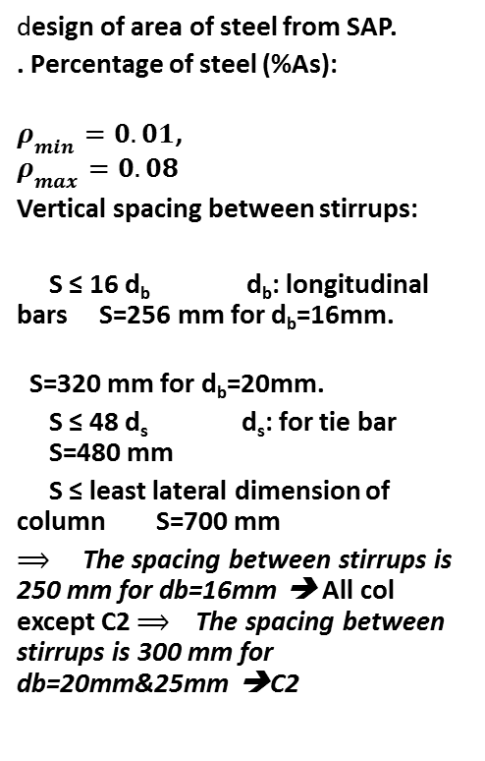
Design of columns :
design of area of steel from SAP.
. Percentage of steel (%As):
$ρ_{min}=0.01$, $ρ_{max}=0.08$
Vertical spacing between stirrups:
S ≤ 16 d_{b} d_{b}: longitudinal bars S=256 mm for d_{b}=16mm.
S=320 mm for d_{b}=20mm.
S ≤ 48 d_{s} d_{s}: for tie bar S=480 mm
S ≤ least lateral dimension of column S=700 mm
$⟹$ The spacing between stirrups is 250 mm for db=16mm ➔ All col except C2 $⟹$ The spacing between stirrups is 300 mm for db=20mm&25mm ➔C2

Slide 32
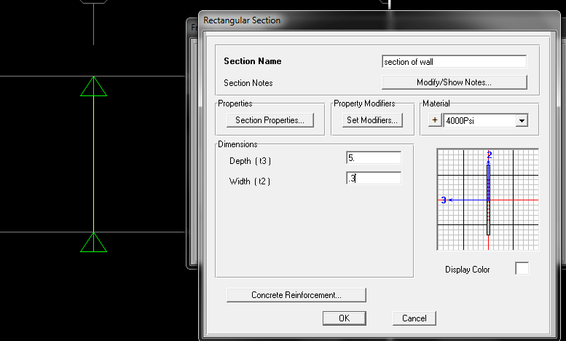
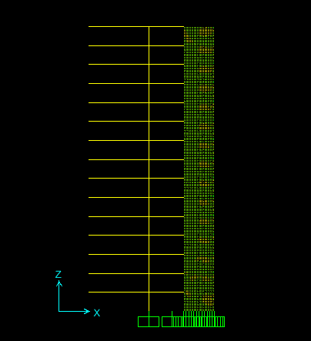
Design of shear walls:
by Simulation of shear wall as column

Slide 33
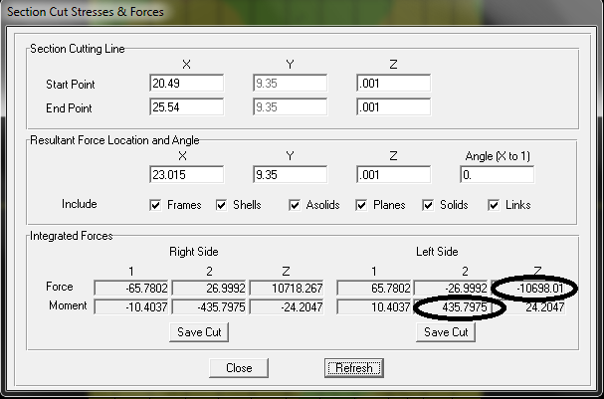
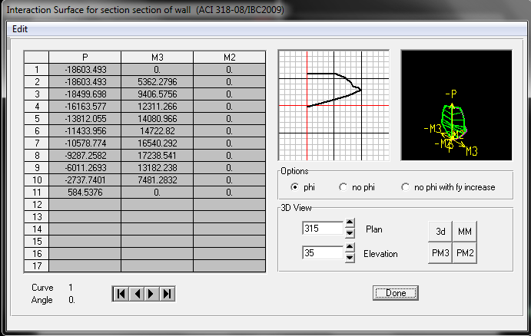
Then read the loads from every load combinations and fit the points on the moment-force interaction diagram for the shear wall.

Slide 34
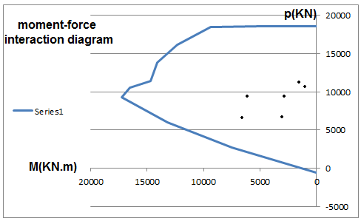
So, from the previous calculations we found that the concrete is sufficient to resist loads ,then, min reinforcement required

Slide 35
- The minimum reinforcement ratio required in horizontal direction = 0.002
As = 0.002*1000*300 =600 mm² (1Φ10@250 mm at each side).
- The minimum reinforcement ratio required in vertical direction =0.0018
As = 0.0018*1000*300 = 540 mm² (1Φ10@250mm at each side).

Slide 36
Design of footings :
column No. | service load(KN) | footing area(m²)
1 | 4919 | 19.676
2 | 6370 | 25.48
3 | 6664 | 26.656
4 | 4603 | 18.412
5 | 4033 | 16.132
6 | 4851 | 19.404
7 | 4747 | 18.988
8 | 5062 | 20.248
9 | 2672 | 10.688
10 | 3232 | 12.928
11 | 4983 | 19.932
12 | 4879 | 19.516
13 | 6183 | 24.732
14 | 4839 | 19.356
15 | 5380 | 21.52
16 | 4282 | 17.128
17 | 5271 | 21.084
18 | 4397 | 17.588
19 | 5714 | 22.856
20 | 6052 | 24.208
21 | 6316 | 25.264
22 | 6020 | 24.08
23 | 6864 | 27.456
24 | 6019 | 24.076
25 | 7523 | 30.092
26 | 5892 | 23.568
This building is fifteen stories building built on weak soil that have bearing capacity of 2.5 Kg/cm². So we have high column loads and weak soil.
The following table shows the axial forces in all columns in the building and the corresponding single footing area and then the total area of the single footings for all columns :

Slide 37
From the previous table we found that the total area required for columns footing is very high and more than the area of the building, the total area of footings in the previous table is 551 m².
So from the results shown on the previous table we note that the area of the single footings is very high in more than a half of the building area, so we need to Mat Foundation system.
There are many Types of mat foundation systems
And we decide to use flat plate system In this type we have uniform solid slab system without beams between columns, the main problem of this system is punching shear.

Slide 38
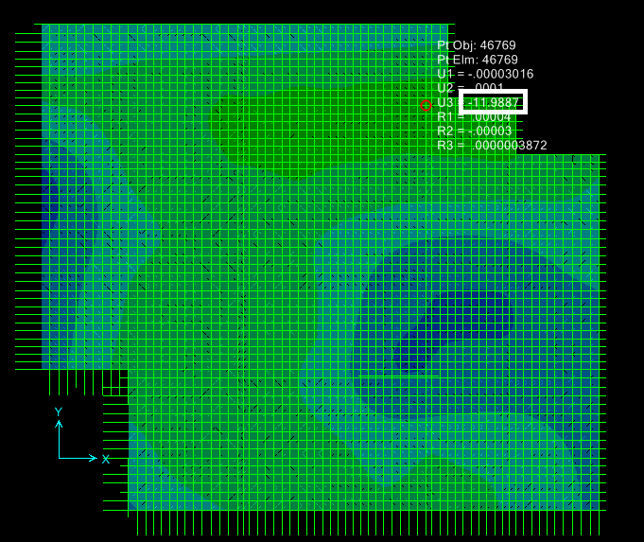
Design of mat foundation :
Deflection of the mat foundation.
We begin by assume the thickness of the mat to be 80cm and concrete B300 , after run the flat plate (tow way slap) the deflection exceed the allowable which was 10mm then, after several trials we decide to use B400and thickness of 1.3m .
Note that the area of mat equal to the service loads divided by the soil bearing capacity.

Slide 39
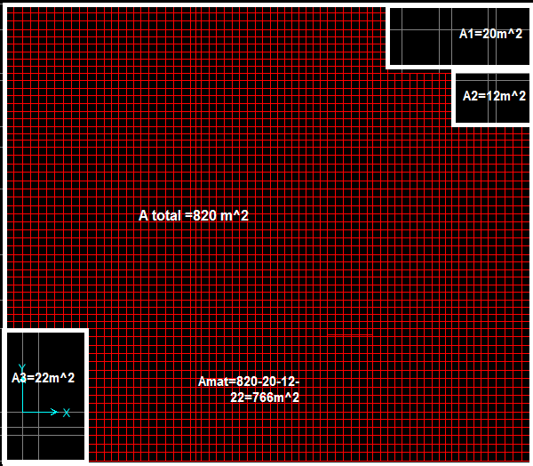

Design of mat foundation :
A_{min} = $\frac{190132.224}{250 }$ = 760.5 m² (the required area of the mat foundation to achieve acceptable stress under mat).

Slide 40
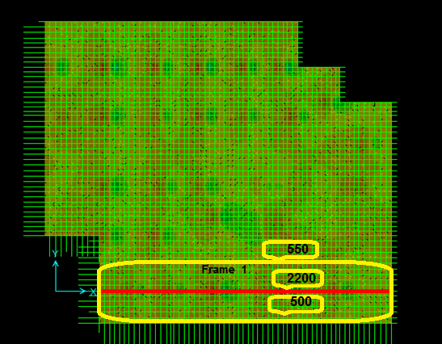
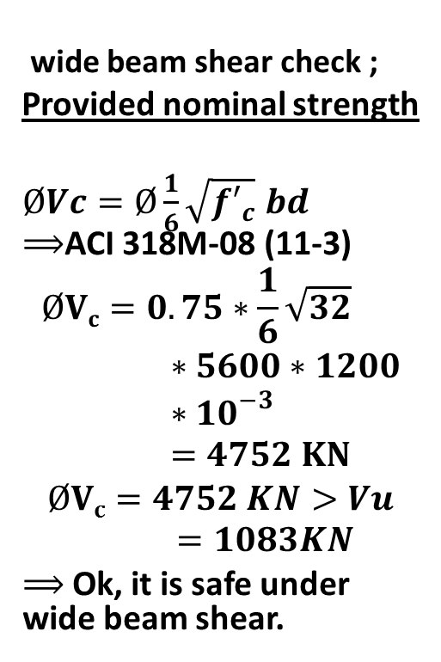
Design of mat foundation :
wide beam shear check ;
Provided nominal strength
$ØVc=Ø\frac{1}{6}\sqrt{{f′}_{c}} bd$ $⟹$ACI 318M-08 (11-3)
$$ØVc=0.75∗\frac{1}{6}\sqrt{32}∗5600∗1200∗{10}^{−3}=4752 KN$$
$$ØVc=4752 KN>Vu=1083KN$$
$⟹$Ok, it is safe under wide beam shear.

Slide 41
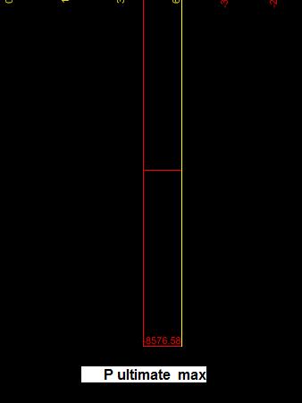
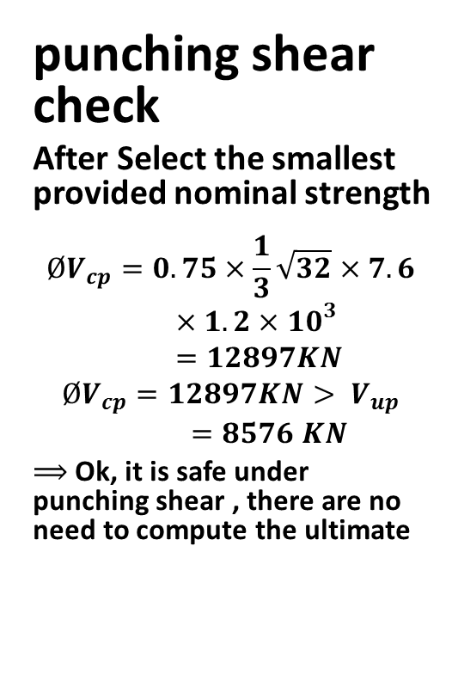
Design of mat foundation :
punching shear check
After Select the smallest provided nominal strength
$$ØV_{cp}=0.75×\frac{1}{3}\sqrt{32}×7.6×1.2×{10}^{3}=12897KN$$
$$ØV_{cp}=12897KN> V_{up}=8576 KN$$
$⟹$Ok, it is safe under punching shear , there are no need to compute the ultimate

Slide 42
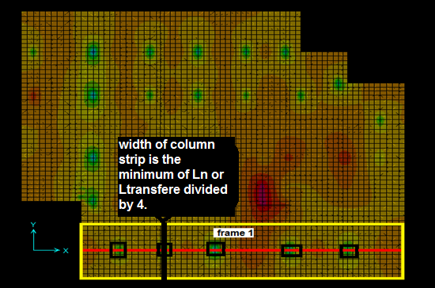
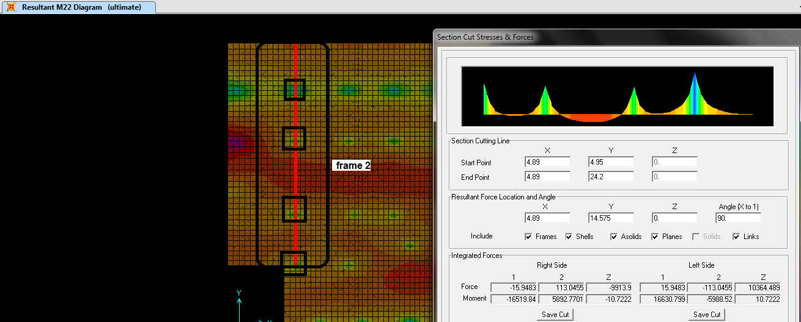
Design of mat foundation :
All moments was less than the corresponding minimum moment ,then the minimum shrinkage steel is enough(5φ25at top and bottom).

Slide 43
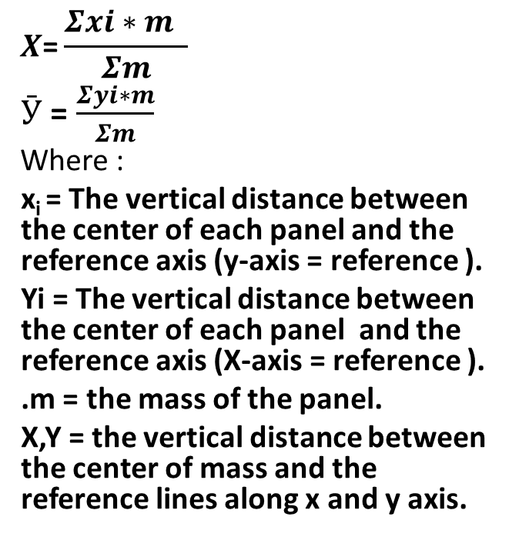
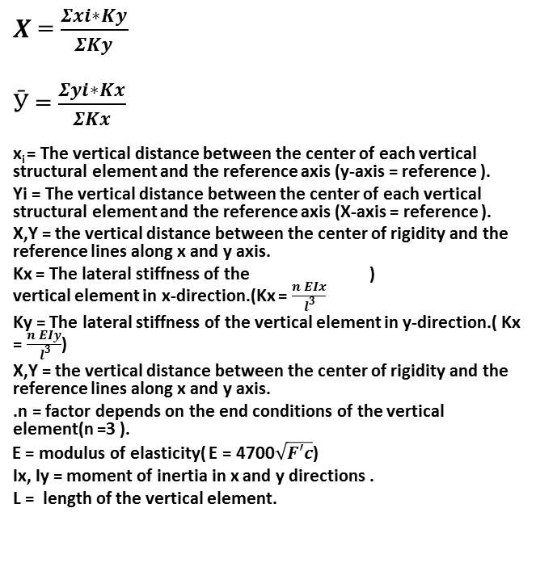
Reducing the torsion effect :
Center of rigidity :
Center of mass :
$X$ = $\frac{Σxi∗Ky}{ΣKy}$
$Ӯ$ = $\frac{Σyi∗Kx}{ΣKx}$
x_{i} = The vertical distance between the center of each vertical structural element and the reference axis (y-axis = reference ).
Yi = The vertical distance between the center of each vertical structural element and the reference axis (X-axis = reference ).
X,Y = the vertical distance between the center of rigidity and the reference lines along x and y axis.
) Kx = The lateral stiffness of the vertical element in x-direction.(Kx = $\frac{n EIx}{ l^{3}}$
Ky = The lateral stiffness of the vertical element in y-direction.( Kx = $\frac{n EIy}{ l^{3}}$)
X,Y = the vertical distance between the center of rigidity and the reference lines along x and y axis.
.n = factor depends on the end conditions of the vertical element(n =3 ).
E = modulus of elasticity( E = 4700$\sqrt{F′c}$)
Ix, Iy = moment of inertia in x and y directions .
L = length of the vertical element.
$$X\text{=}\frac{Σxi∗m }{Σm}$$
$Ӯ$ = $\frac{Σyi∗m}{Σm}$
Where :
x_{i} = The vertical distance between the center of each panel and the reference axis (y-axis = reference ).
Yi = The vertical distance between the center of each panel and the reference axis (X-axis = reference ).
.m = the mass of the panel.
X,Y = the vertical distance between the center of mass and the reference lines along x and y axis.

Slide 44
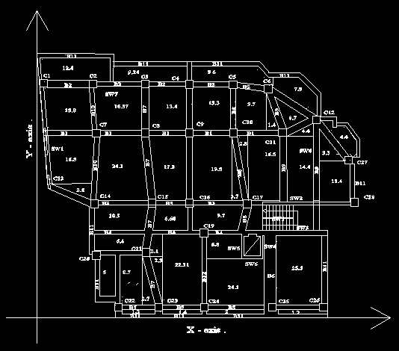
From the results we found that there is large eccentricity between centers of mass and center od rigidity , to solve this problem we add the shear walls SW7 and `W8 that are shown on the AutoCAD drawing, we control the distances and the length of these shear walls to match both centers to remove or at least reduce the torsion.

