Slide 1

An-Najah National University
Faculty of Engineering & Information Technology
Department of Building Engineering
Pharmaceutical factory
Suha Saleh
Abeer Ghannam
Lana Melhem
Rula Qaroot
← Prepared by →

Slide 2
Outline:
Architectural Design.
Environmental Design.
Structural Design.
Electrical design
Mechanical And Safety Design.
Quantity Survey And Cost Estimation.

Slide 3
Architectural Design

Slide 4
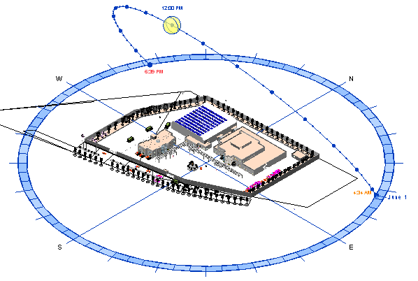
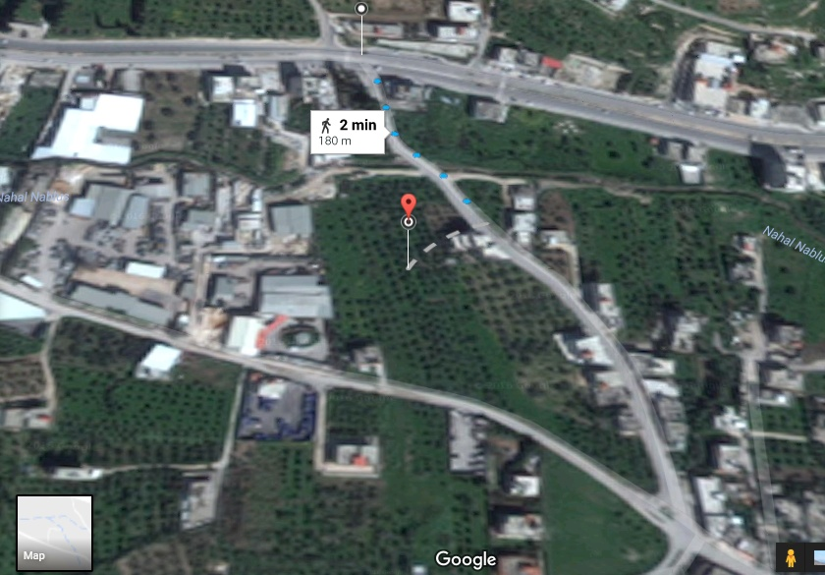
Site Analysis
Total area is 8200m2
The annual average humidity is 75%
wind speed is 5.4 km/hour

Slide 5
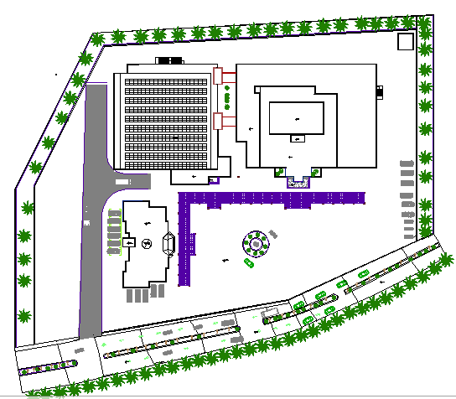
Site plan
N

Slide 6
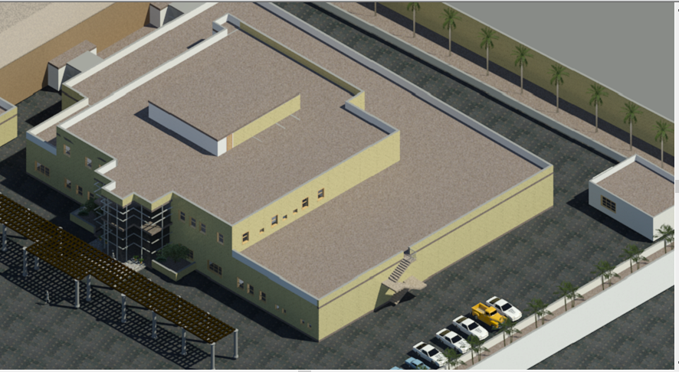
Factory Block

Slide 7
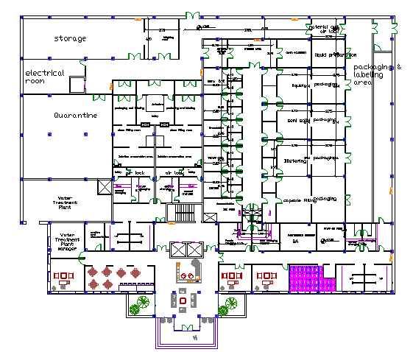
Production floor

Slide 8

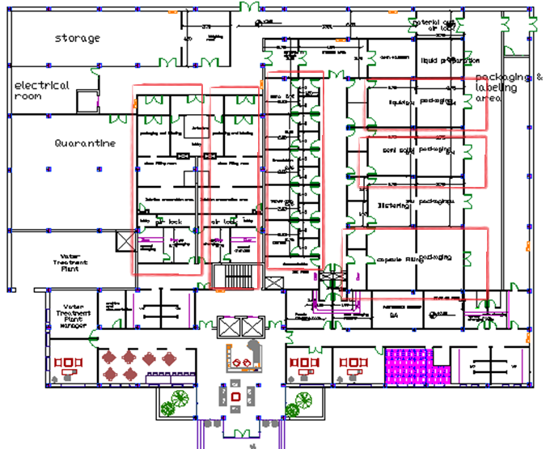





Tablet
Liquid
Injection
Semi solid
Drop
Capsule

Slide 9
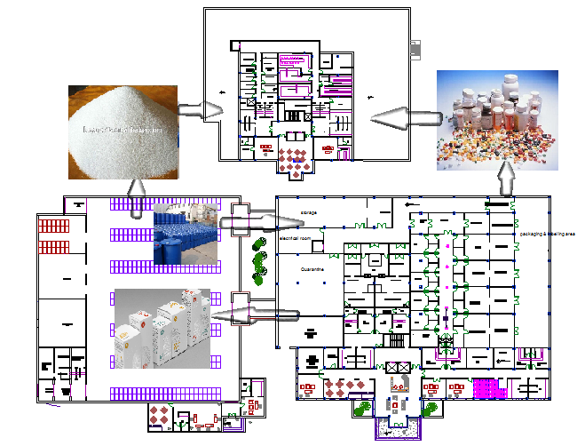
Material flow
1
2
3
4

Slide 10
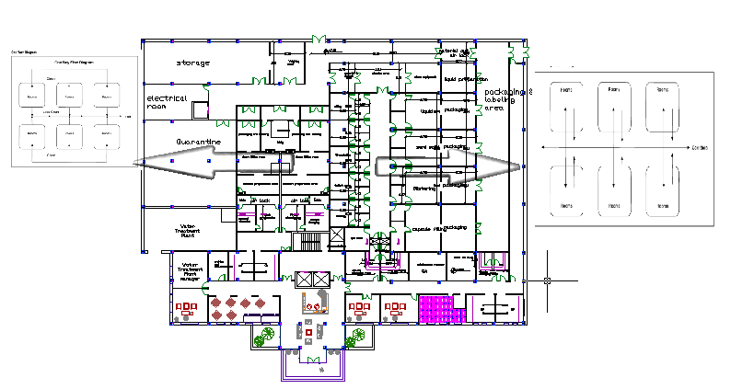
Personnel flow
One way flow
Two way flow

Slide 11
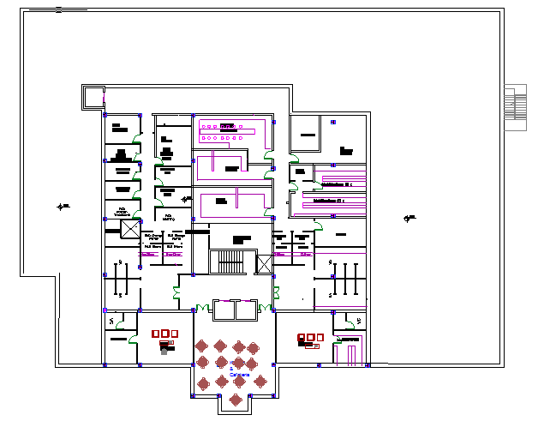
2. Laboratory floor

Slide 12
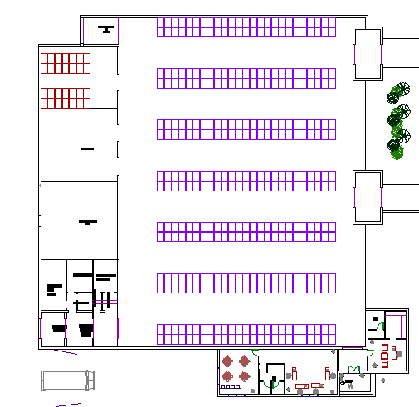
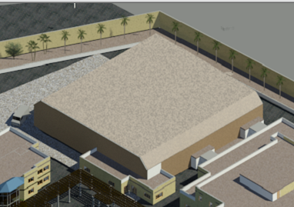
Warehouse

Slide 13
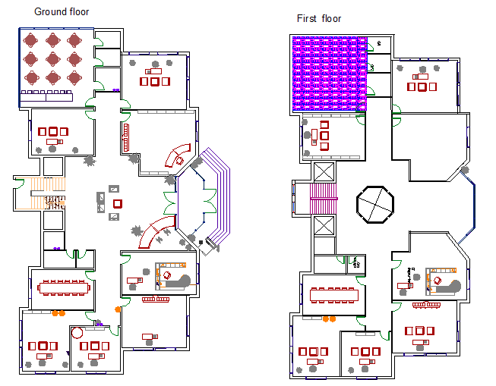
Administration

Slide 14
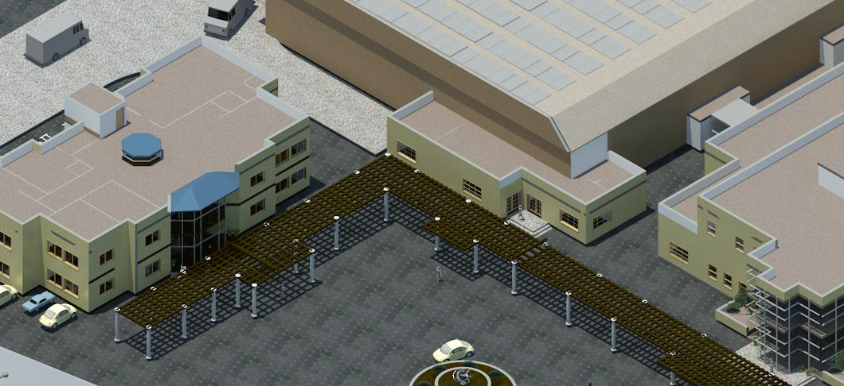
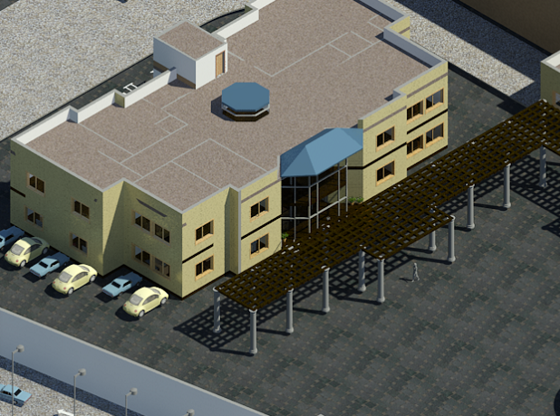
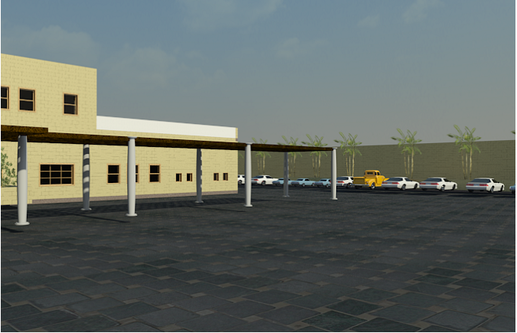
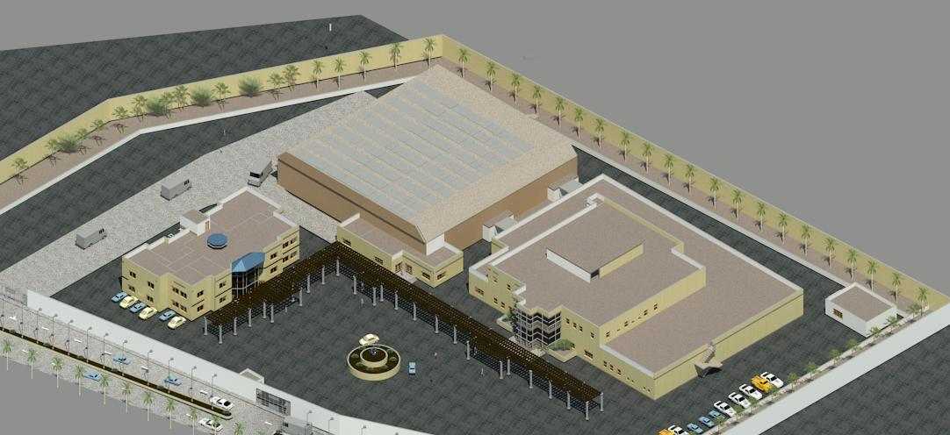

Slide 15
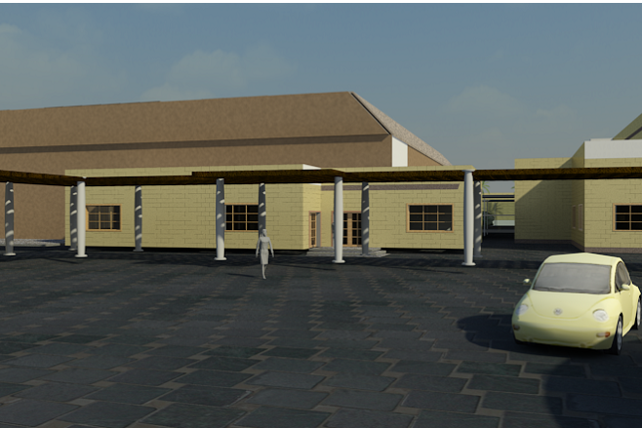
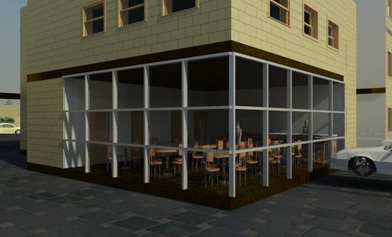
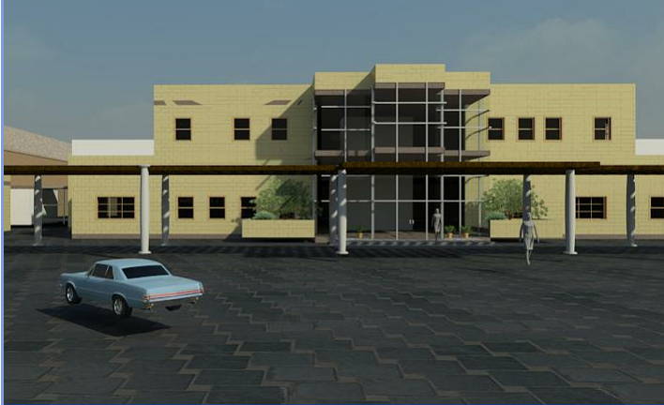
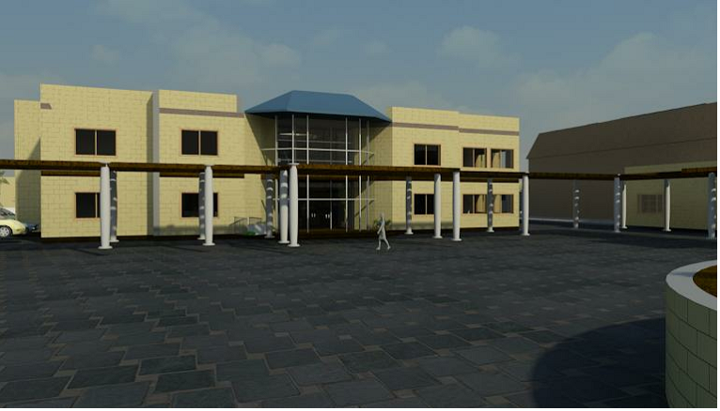

Slide 16
Environmental Design

Slide 17
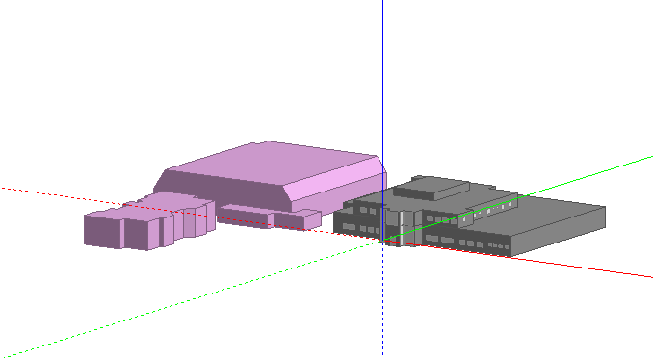
Environmental Design

Slide 18
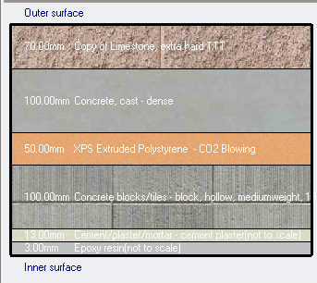
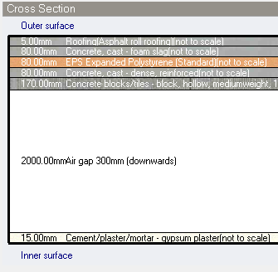
Thermal Analysis
External wall
Roof:
U-Value = 0.521 W/m2.k
U-Value = 0.307 W/m2.k

Slide 19
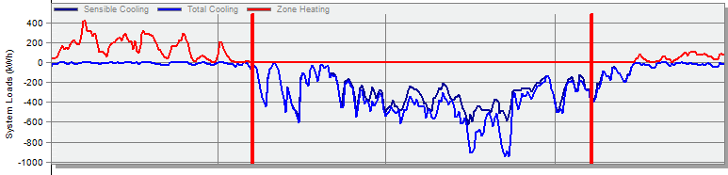
Energy simulation
Cooling Load = 103.4 kW
Heating Load = 98.24 kW

Slide 20
Structural Design

Slide 21
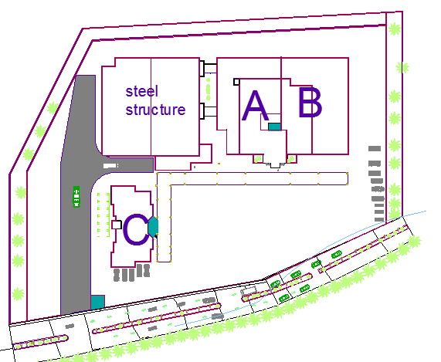
Structural blocks distribution

Slide 22
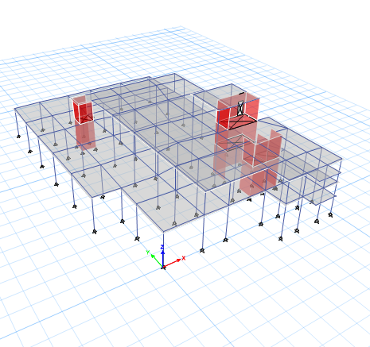
Concrete structure(A)
.One way ribbed slab
Concrete Fʹc= 28 MPa for all elements
Allowable Bearing Capacity of Soil = 180kN/m²
Loads:
Super imposed load = 4 kN/m²
Live load = 5 kN/m²
Model from ETABS

Slide 23
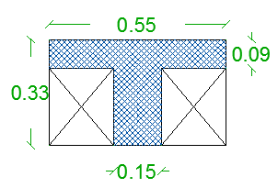
      Primary dimensions
One way ribbed slab with 33 cm slab thickness
Main beam 700*330 and 400*330 for secondary beam
400*400 column section

Slide 24
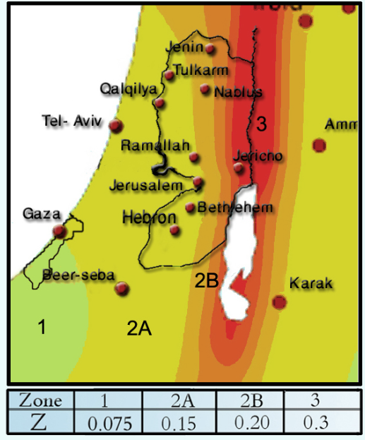
Seismic Design Data
Importance factor, I = 1.5
Soil Profile Type is SD
R = 5.5
Ca = 0.28
Cv= 0.4
Location → Nablus
Zone =2B → Z=0.20

Slide 25
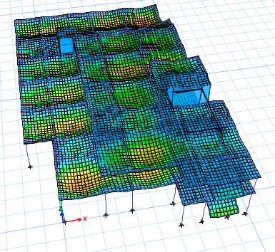
      Model Validation
Equilibrium check
Load type | Manual value (kN) | ETABS value (kN) | % error
Live load | 7297 | 7297 | 0
SID load | 13938 | 13893 | 0.3
Dead load | 14353 | 14530 | 1.2
Compatibility
Local equilibrium checks
column | Manual force(kN) | ETABS value(kN) | % difference
C3 | 440 | 444 | 0.9
Beam | Manual moment(kN.m) | ETABS value(kN.m) | % difference
B1 | 340 | 353 | 2
slab | Manual moment(kN.m)/m | ETABS value(kN.m)/m | % difference
1 | 50 | 52 | 3.8

Slide 26
      Seismic checks
Period check:
T calculated = 0.314 sec
From ETAB 0.3 sec
Period from ETAB < 1.4 T manual
Drift check:
∆M =0.7R∆S < 0.025(h story)
∆M =0.7*5.5*5 =19.25mm < 0.025 (5) *10³ = 125mm
Where elastic deformation from ETAB 5mm

Slide 27
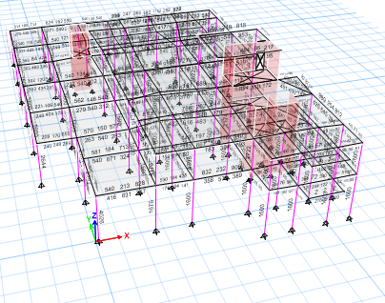
      Results:

Slide 28
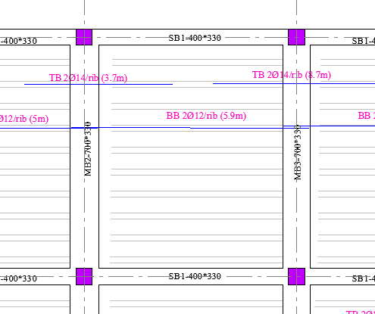
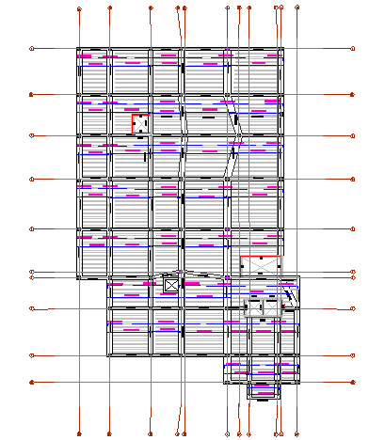
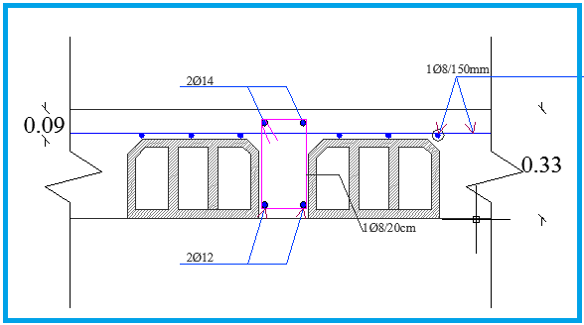
Slab section

Slide 29
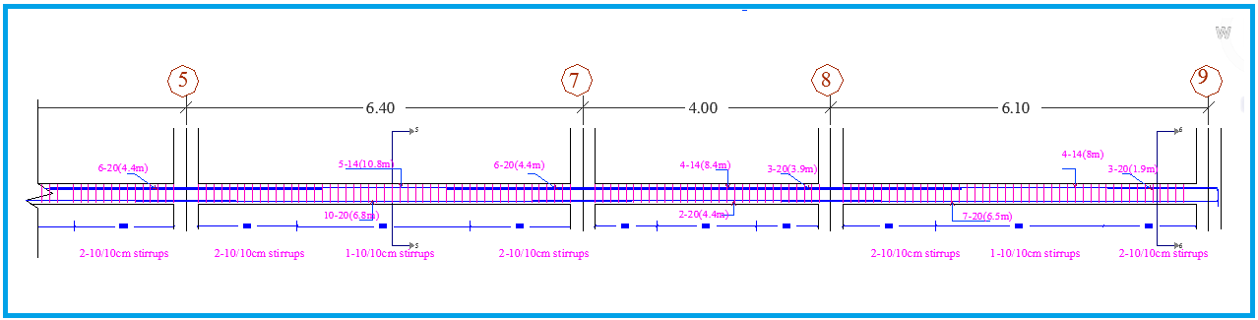
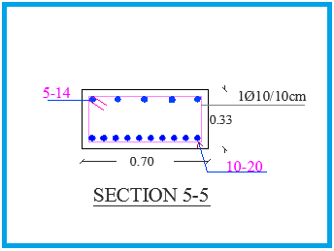
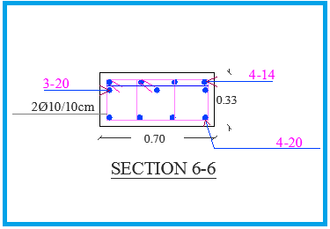
Beam details

Slide 30
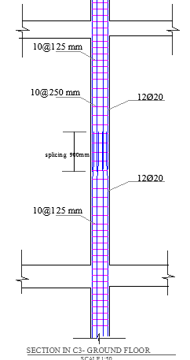
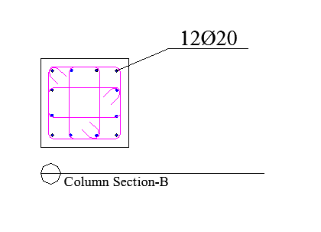
Column details

Slide 31
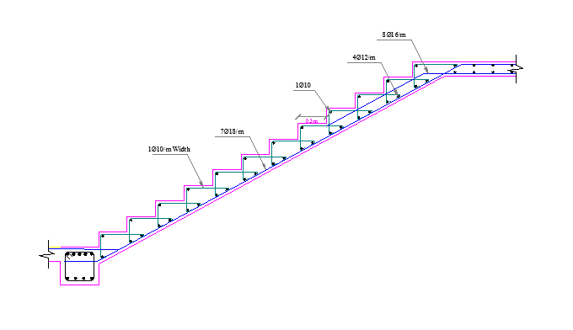
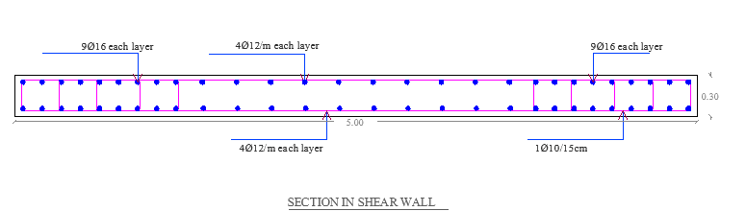
Stair details
Shear wall details

Slide 32
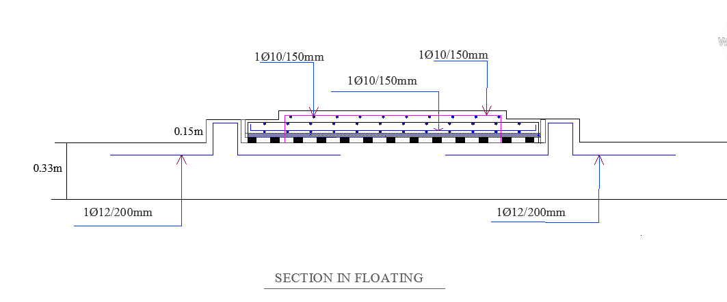
Floating slab details

Slide 33
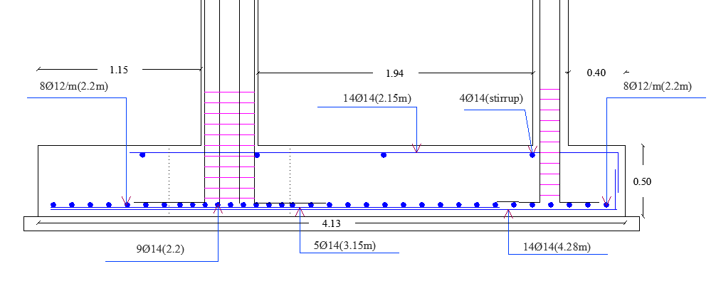
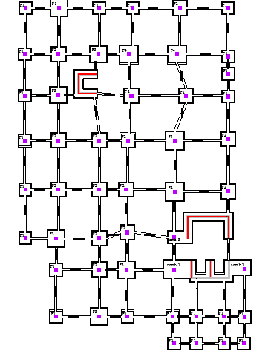
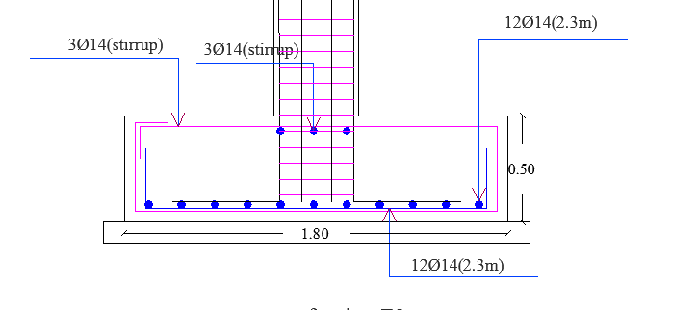
Footing details
Combined footing
Isolated footing

Slide 34
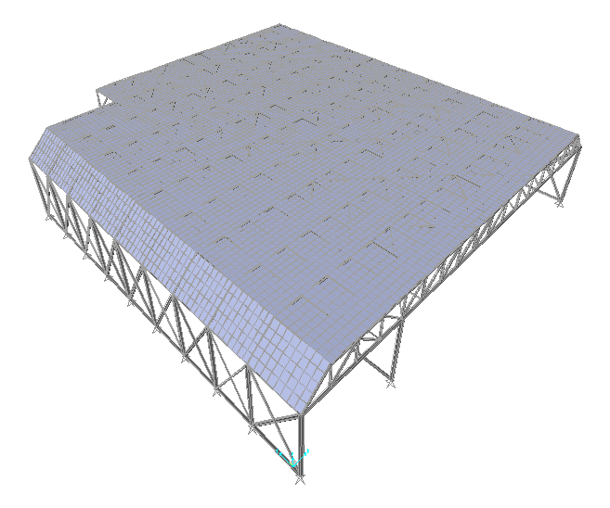
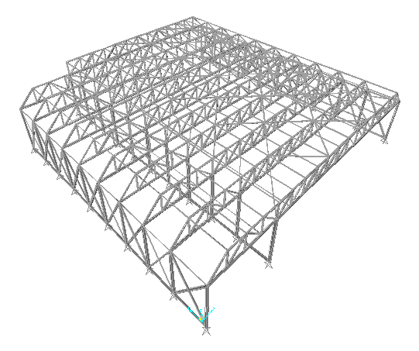
Structural Design of Store

Slide 35
Design Criteria
Structure is designed to carry the following loads:
  Own weight of structural members and covering material
  Solar panels that will be mounted above the roof (approximately 50 kg/m2)
  AC units and HVAC system (approximately 50 kg/m2)
  Snow load (50 cm) and an accidental live load (2 kN/m2)
  Wind load considering the design wind speed is 120 km/hr
Double galvanized steel with 5 cm insulation (sandwich panel) 32 kg/m2
Grade 36 steel (Fy=250 MPa) is used for all structural steel members

Slide 36
Modeling of store using SAP2000
Building is modelled using SAP2000
Preliminary analysis and design were performed using SAP2000
Five major groups of sections were selected
Model is checked manually for:
    Compatibility check (structure is compatible)
    Equilibrium check (Structure is under equilibrium)
    Joint Equilibrium (joints are under equilibrium)

Slide 37
Final sections and grouping
Group | Section | Applied load/design strength ratio
Interior strip of columns | Tubo260X260X16 | 0.95
Exterior strips of columns | Tubo200X200X16 | 0.5
Top and interior truss members | Tubo120X120X8 | 0.87
Bottom chord members | Tubo200X140X12.5 | 0.7
Bracing and purlins | Tubo60X42X4

Slide 38
Manual Design and checks
The following manual design steps were performed to account for all possible failure:
    Fracture limit state
    Local buckling for all sections
    Deflection of truss
    Lateral bracing for trusses and frames
    Connections detailing
    Design of base plate and footings

Slide 39
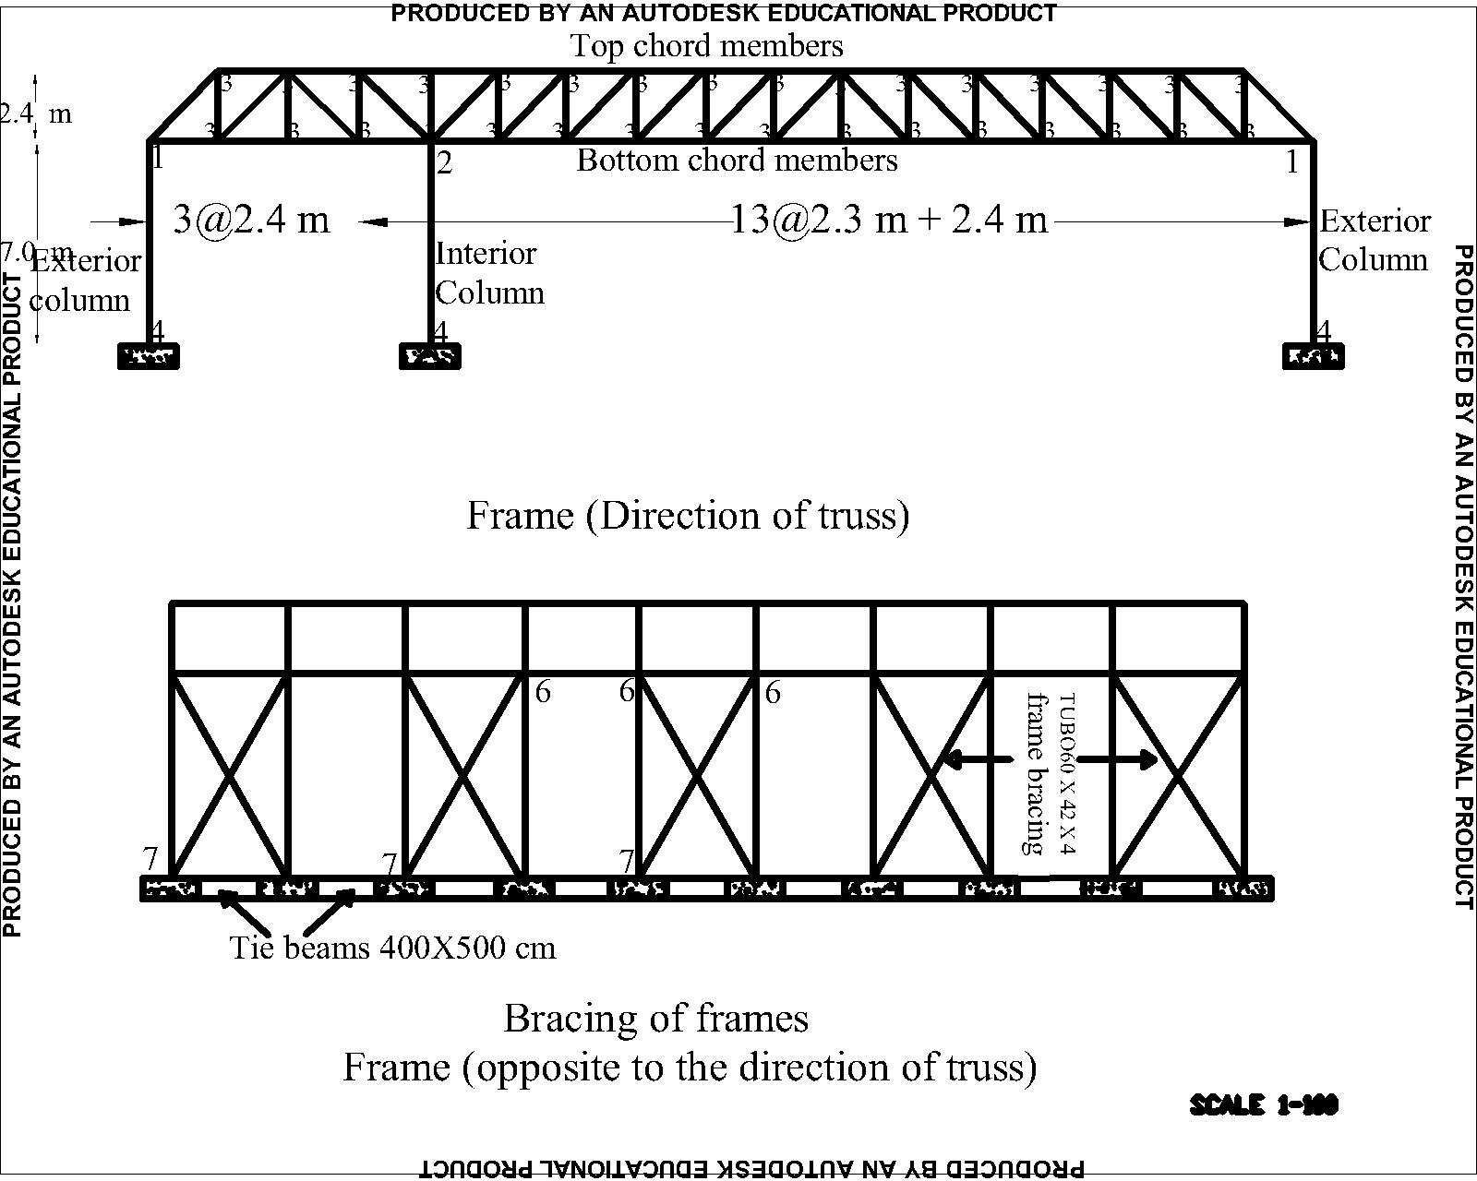
Truss and frame bracing

Slide 40
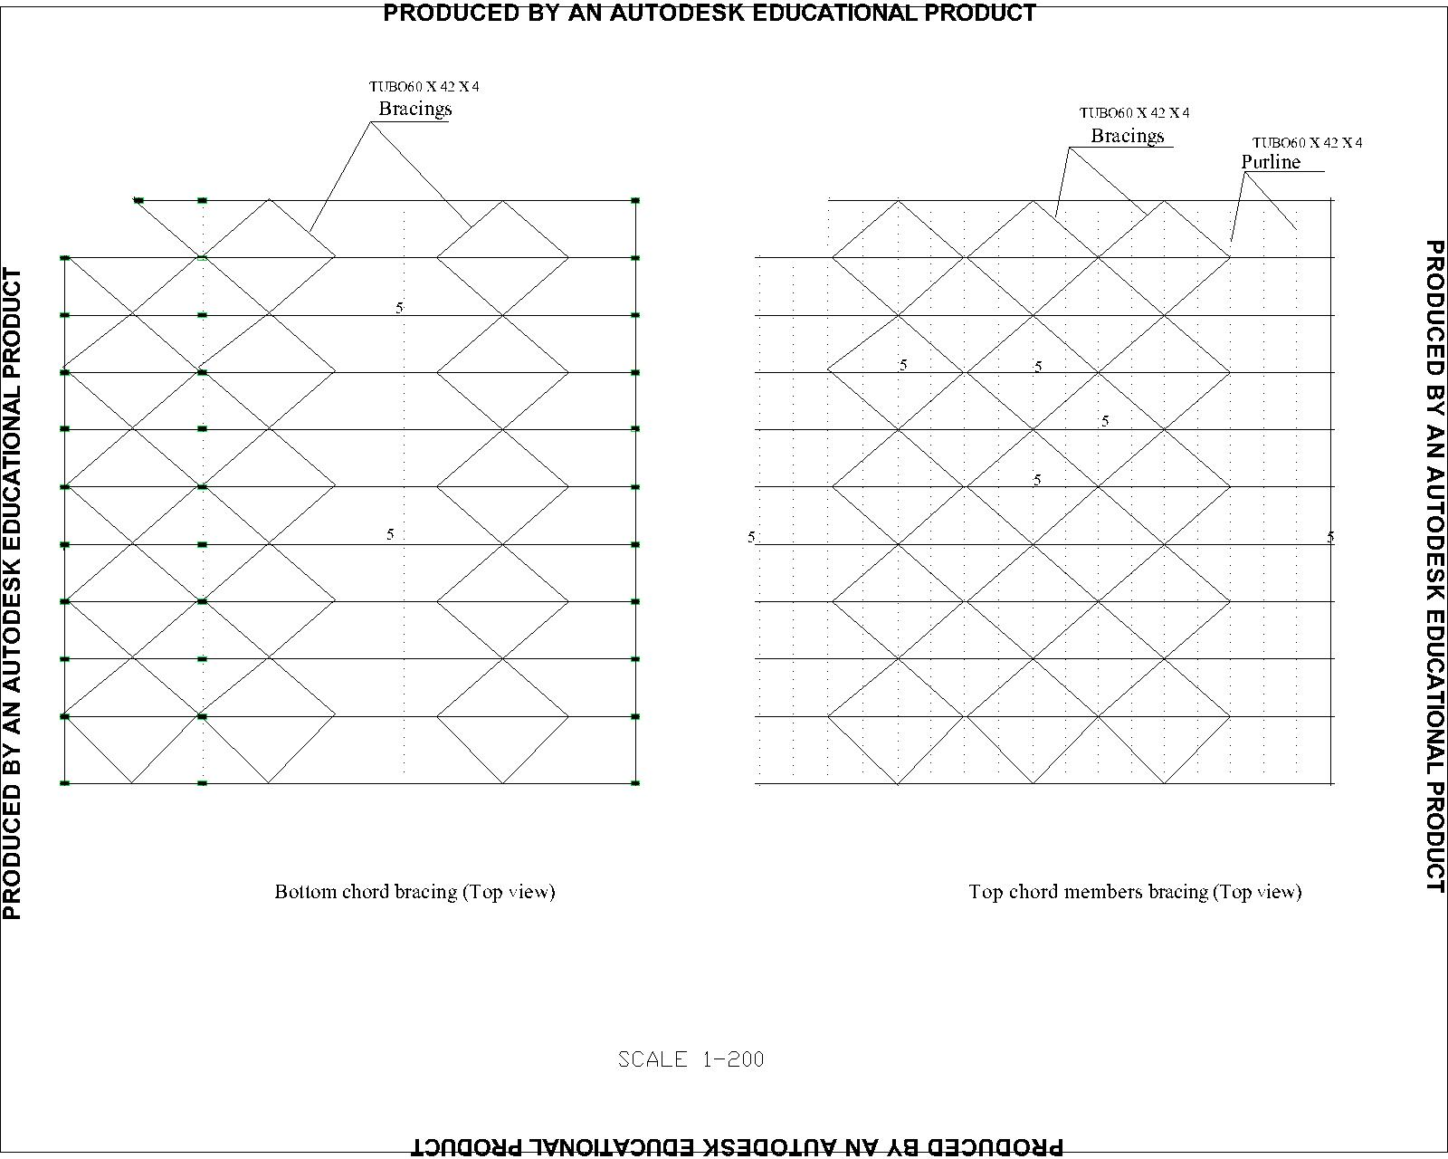
Trusses bracing

Slide 41
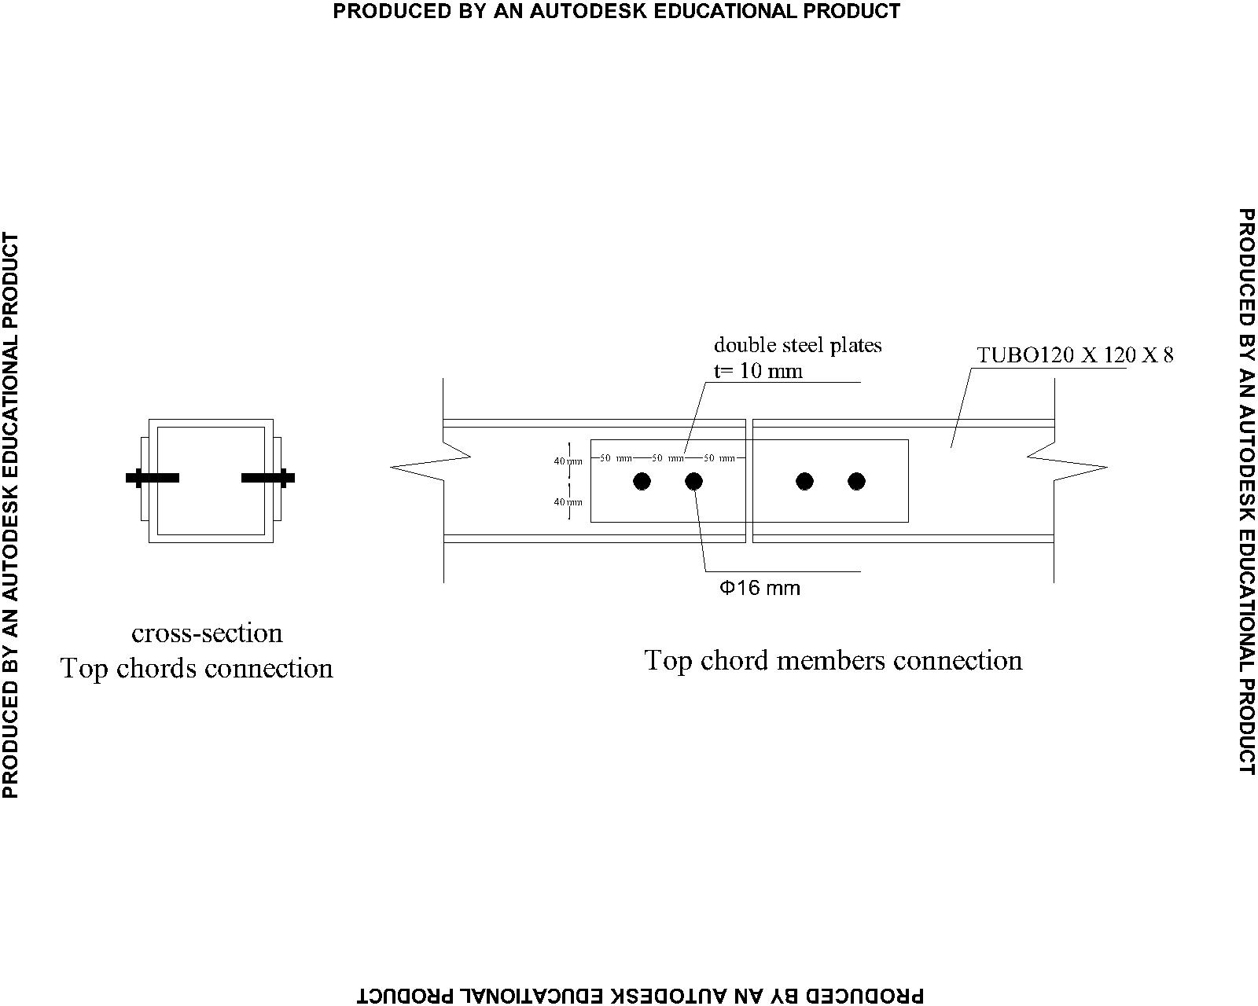
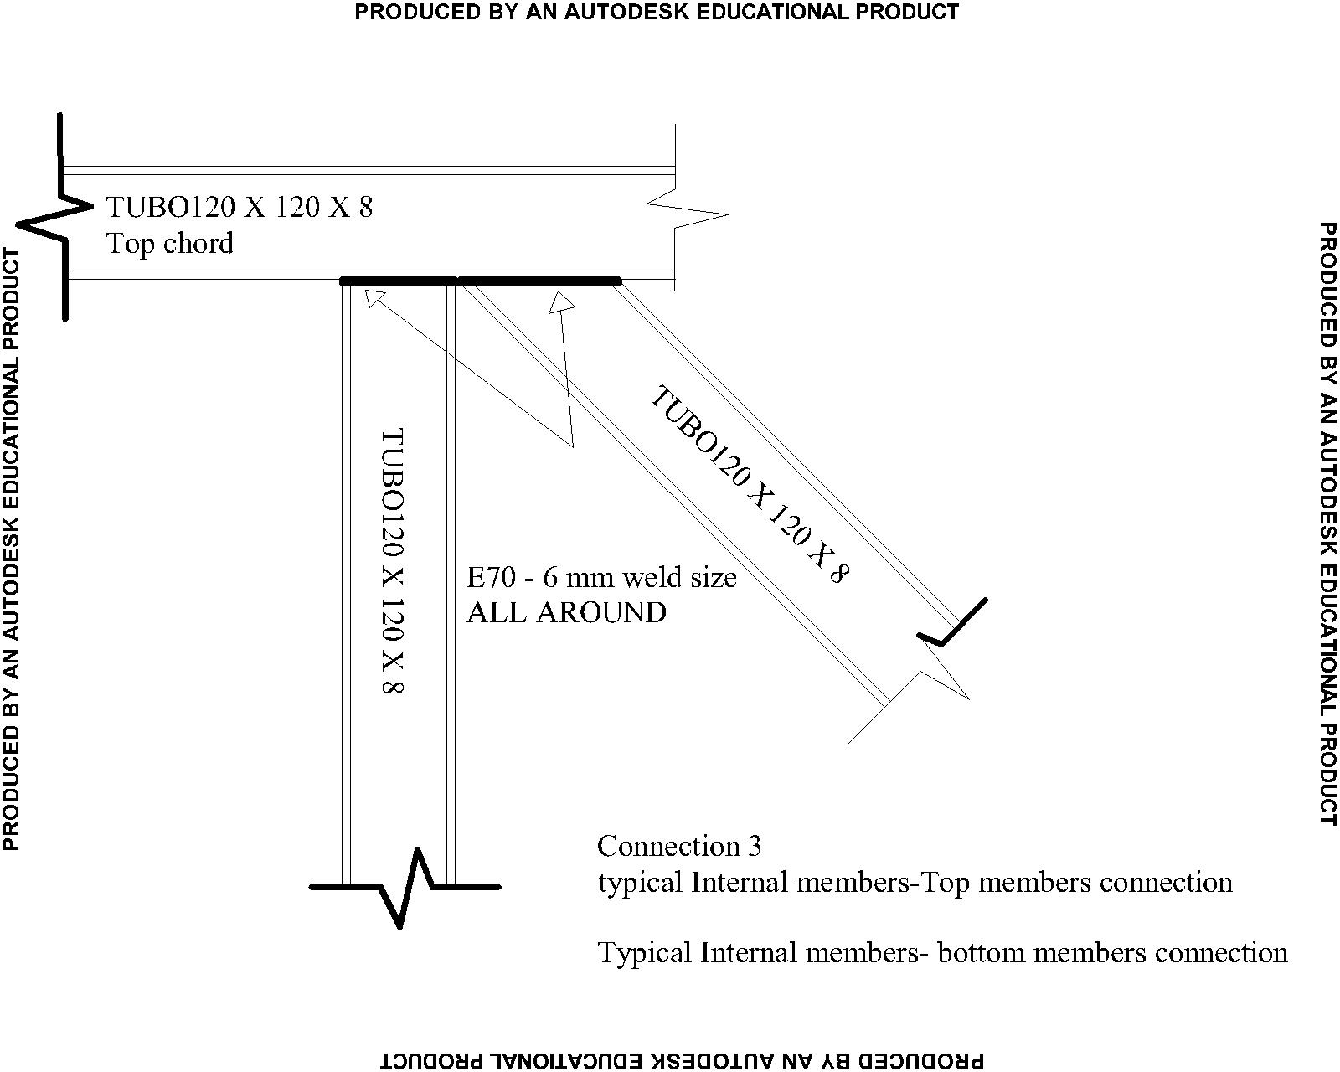

Connection of members

Slide 42


Connection of frame and truss bracing

Slide 43

Footing Detailing

Slide 44


Solar system design
Type of distribution | Dimension | Area of module | # of modules | Total area | Production
Flat | (1.58*0.808) | 1.2766 | 600 | 765.96 | 144Mwh
Landscape | (1.58*0.706) | 1.11548 | 360 | 401.57 | 88.4Mwh
portrait | (1.38*0.808) | 1.11504 | 400 | 446.016 | 103Mwh

Slide 45


Result
20.2kwh /m²
22kwh /m²
4.5

Slide 46




safety system

Slide 47
Electrical Design

Slide 48







Manufacturing area
Surface | Finish marital | Reflection factor
Ceiling | Vinyl coated gypsum panels | 75%
Wall | Epoxy paint CMU | 50%
Floor | Epoxy | 25%
Results
IP=65

Slide 49





Laboratory

Slide 50






Warehouse

Slide 51






Administration

Slide 52
Energy consumption
Space | Energy consumption (kwh/m²/a)
Manufacturing area | 24
Laboratory | 15
Warehouse | 17
Administration | 22
In avg. energy consumption = 20.2 kwh /m2/a

Slide 53
Mechanical Design

Slide 54




Slide 55
3) HVAC system design
The mechanical design in our project is water to air system design ,by using the chilled water system, boiler feed water system,
and Supply Air Handling Systems.

Slide 56
Heating System
.
Heating of primary air is accomplished using hot water .
Incoming ventilation air in colder climates is heated utilizing separate hot water system with a concentration of propylene glycol to prevent water system freezing.

Slide 57
Cooling System
Cooling of facility systems is accomplished utilizing chilled water.
If the process does not require the lower temperatures of chilled water, condenser water can be a cost effective solution, as it does not require the additional energy of the mechanical refrigeration process .
.

Slide 58
Design for pressure
Specific process step | Room classification
Processes including media and buffer prep | D or C
Purification | C
Product filling | B
Actual point of fill | A
.
Product contamination was controlled by the use of:
positive and negative pressurization utilizing airlocks.

Slide 59
Design for cleanliness
.
In order to achieve specific cleanliness classifications, clean, HEPA filtered air is provided to the space.

Slide 60
Quantity survey & cost estimation

Slide 61
Quantity survey & Cost estimation
Beams and tie beams:
Item | Form work (m2) | Concrete (m3) | Steel Ton
T.B | 645.4 | 61.8 | 6.18
B | 1135 | 445.23 | 44.6
Sub total | 1780.4 | 506.63 | 50.78
Cost/ unit Nis | 25 | 300 | 2600
Total cost | 44510 | 151989 | 132028
Total cost of beams and tie beams = NIS 328527

Slide 62
Quantity survey & Cost estimation
Shear walls and columns:
Item | Form work (m²) | Concrete (m³) | Steel Ton
Columns | 652.8 | 140 | 9.14
Shear Walls | 829.3 | 568 | 8.17
Sub total | 1482.1 | 708 | 17.31
cost / unit Nis | 25 | 300 | 2600
Total cost | 37052.5 | 212400 | 4500
Total cost of shear walls and columns= NIS 253952.5

Slide 63
Quantity survey & Cost estimation
Slabs:
Item | Form work (m²) | Concrete (m³) | Steel Ton
Slab | 11680 | 1320 | 620
Sub total | 11680 | 1320 | 620
cost / unit NIS | 25 | 300 | 2600
Total cost | 290000 | 396000 | 1612000
Total cost of slab = NIS 22983000

Slide 64
Quantity survey & Cost estimation
Footings:
Item | Steel Ton | Excavation (m3) | Concrete (m3) | Formwork
Footing | 6.98 | 636 | 634 | 563
cost / unit NIS | 2600 | 25 | 300 | 25
Total cost | 18148 | 1575 | 190200 | 14075
Total cost of footing = NIS 223998

Slide 65
Quantity survey & Cost estimation
Finishing works:
Item | Quantity | Unit | Cost / unit Nis | Total cost
Plastering | 6540 | (M2) | 16 | 104640
Painting | 4180 | (M²) | 17 | 71060
Epoxy painting | 2360 | (M²) | 370 | 873200
Tiling | 5578 | (M²) | 50 | 278900
Stone | 3524 | (M²) | 110 | 387640
mortar | 5623 | (M2) | 20 | 112460
Total cost of slab = NIS 1827900

Slide 66
Quantity survey & cost estimation
Final quantity & cost for the blocks:
Item | Quantity | Unit | Cost/NIS | Total cost
Concrete | 3216.63 | CM | 300 | 964989
Steel | 803.07 | Ton | 2600 | 2087982
Excavation | 636 | CM | 25 | 15900
Formworks | 50622.6 | SM | 25 | 1265565
Finishing work | 27805 | ----- | ------ | 1827900
photovoltaic | ------ | -------- |  | 430740
lighting |  |  |  | 1986685
Mechanic (chiller, air handling unit,duct ) |  | ---- | ----- | 6874363.2

Slide 67
Quantity survey & cost estimation
Final cost for the block:
Total cost of the blocks = NIS 15960924.2

Slide 68


