Slide 1


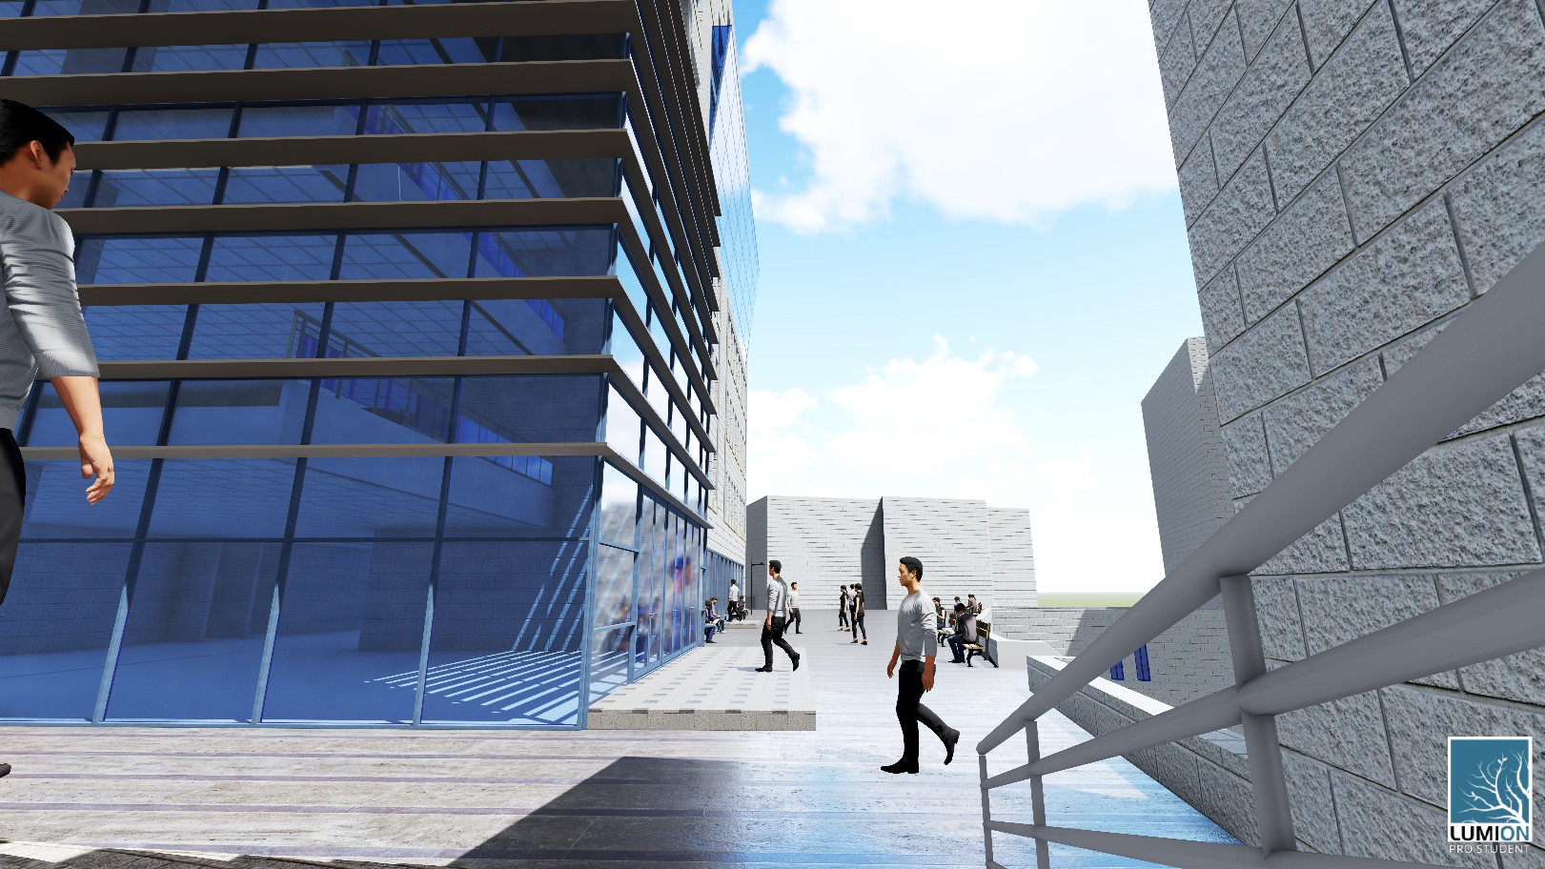
Faculty of Law
Prepared By: Supervisor:
Anan Bobali. Eng. Fadi Fatayer.
Guevara Aqel.
Jamil Odeh.

Slide 2
Contents:
Introduction.
Site Analysis.
Architectural Design.
Environmental Design.
Structural design.
Electrical design.
Mechanical design .
Safety.
Quantity Survey.

Slide 3
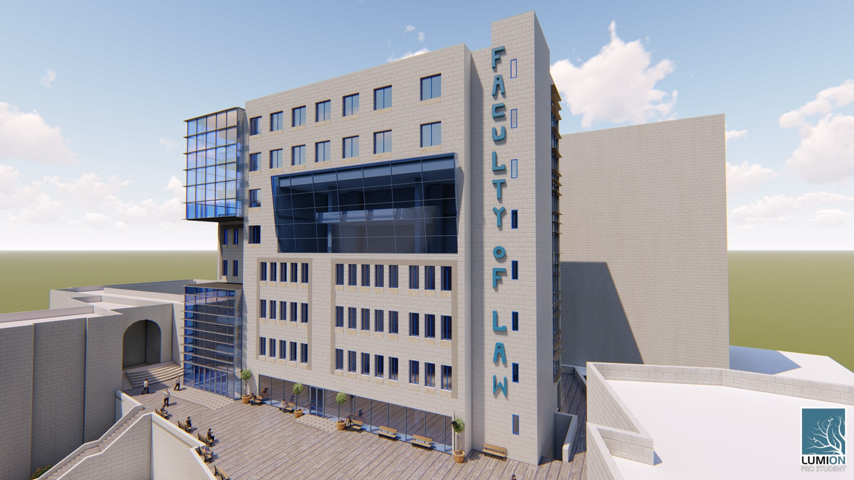
Introduction:

Slide 4
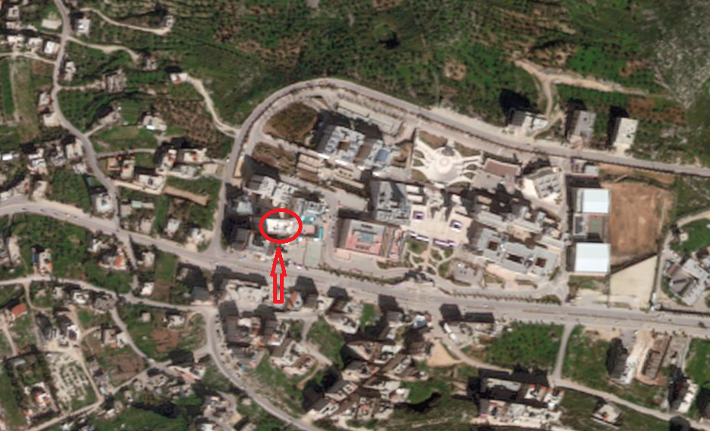
Site Analysis:
The site is located in Nablus city at Al-Jnaid region near Beit Wazan town.

Slide 5
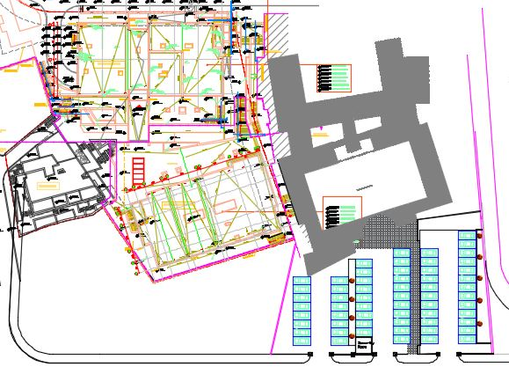
Architectural Design:
Site plan:
N

Slide 6
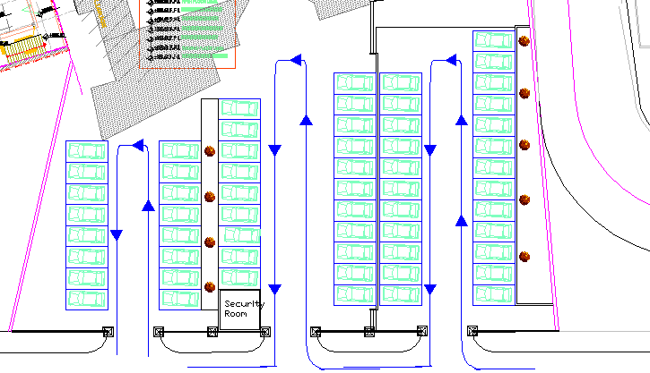
Architectural Design:
A Shared park with the Korean Institute.

Slide 7
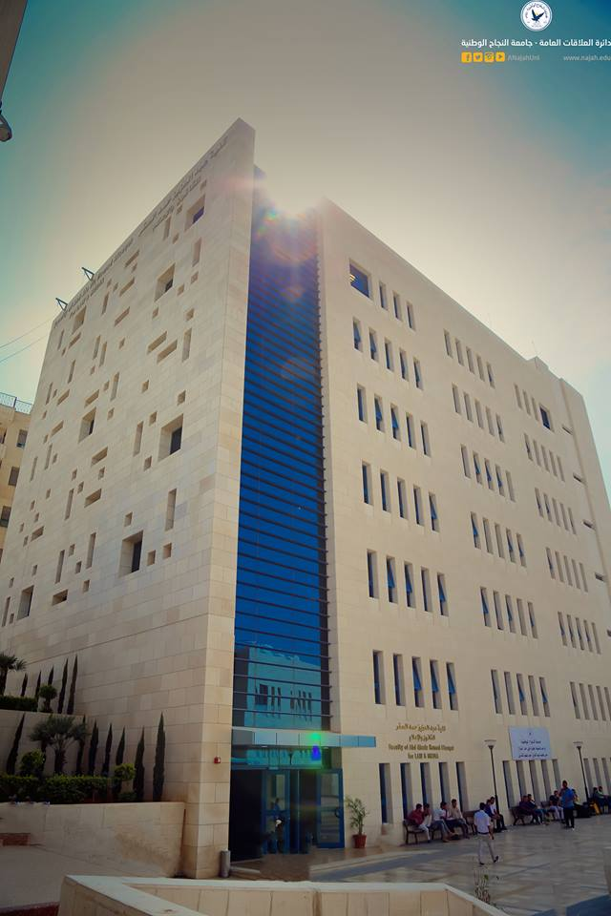
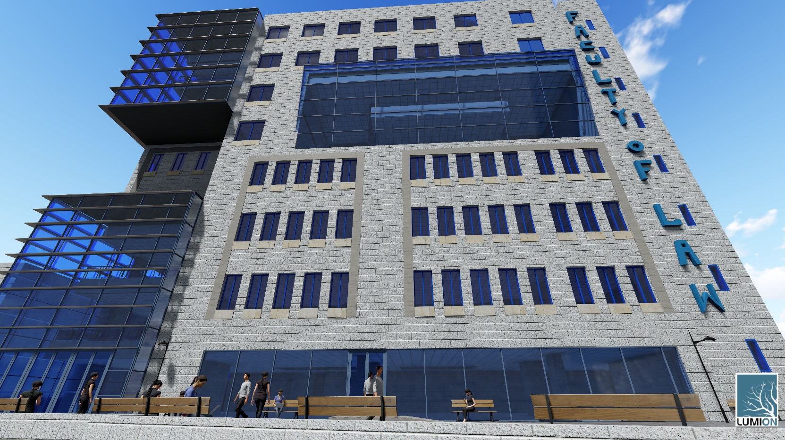
Architectural Design:
Before Redesign After Redesign

Slide 8
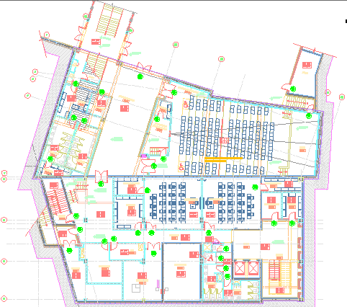
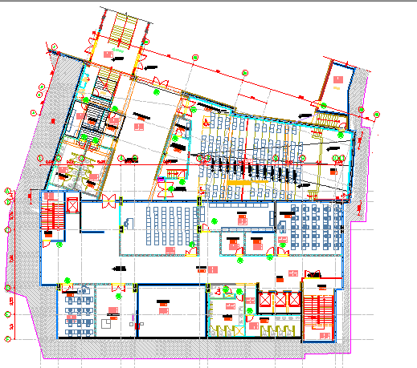
Architectural Design:
Basement Floor:
Total area of this floor it is about 1274 m²
It contains: Auditorium, Electrical room, mechanical room, court room, Storage, water tank and Computer lab.
Before Redesign After Redesign

Slide 9
Architectural Design:
Basement Floor:

Slide 10
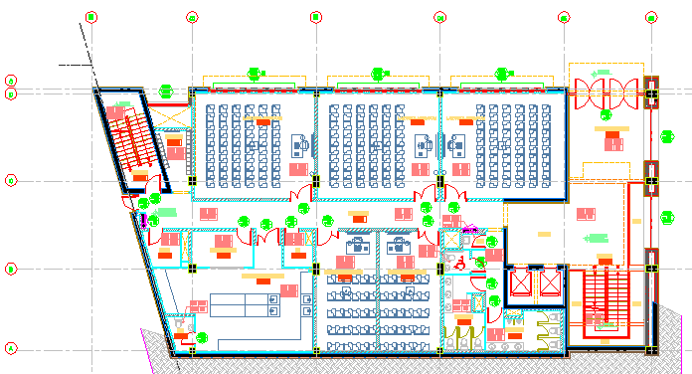
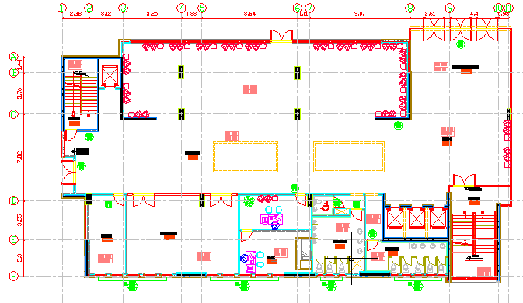
Architectural Design:
Ground Floor:
Total area of this floor it is about 862 m²
It contains: Seats area, mini canteen, secretary and clinic.
Before Redesign After Redesign

Slide 11
Architectural Design:
Ground Floor:

Slide 12
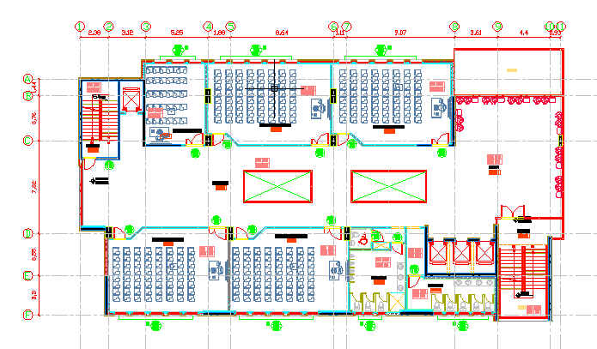
Architectural Design:
First and Second Floor:
Total area of this floor it is about 862 m²
It contains: Classrooms.
Before Redesign After Redesign

Slide 13
Architectural Design:
First and Second Floor:

Slide 14
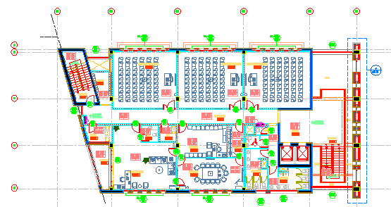
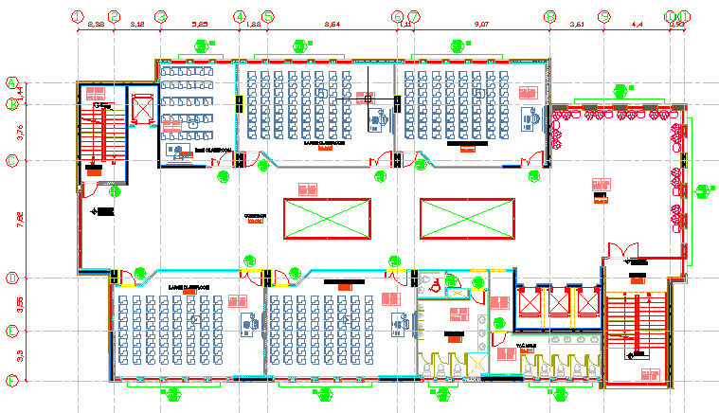
Architectural Design:
Third Floor:
Total area of this floor it is about 862 m²
It contains: Classrooms.
Before Redesign After Redesign

Slide 15
Architectural Design:
Third Floor:

Slide 16
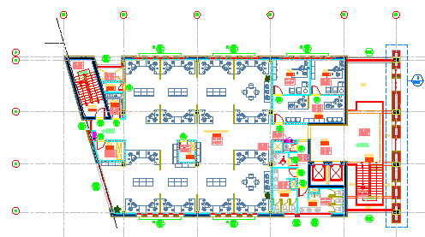
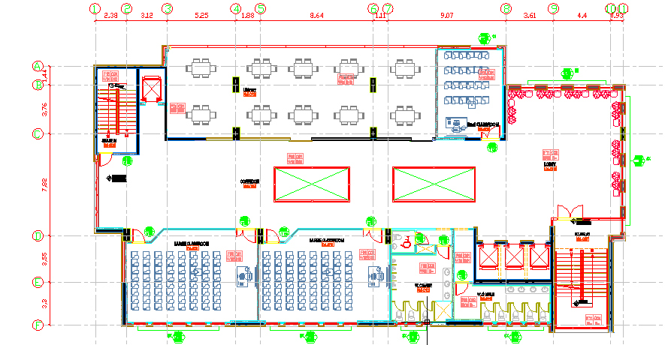
Architectural Design:
Fourth Floor:
Total area of this floor it is about 862 m²
It contains: Classrooms and library.
Before Redesign After Redesign

Slide 17
Architectural Design:
Fourth Floor:

Slide 18
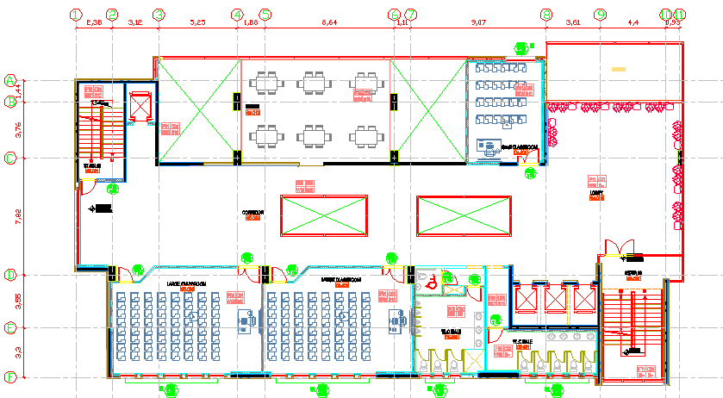
Architectural Design:
Fifth Floor:
Total area of this floor it is about 862 m²
It contains: Classrooms and library.
Before Redesign After Redesign

Slide 19
Architectural Design:
Fifth Floor:

Slide 20
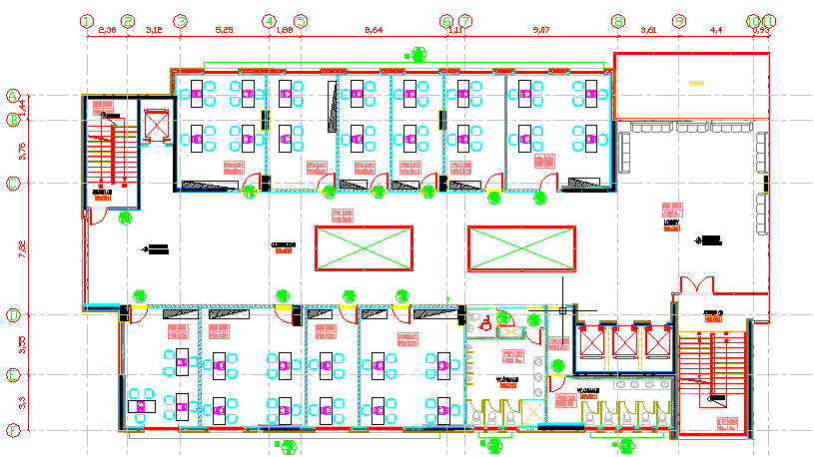
Architectural Design:
Sixth Floor:
Total area of this floor it is about 862 m²
It contains: Offices.
After Redesign

Slide 21
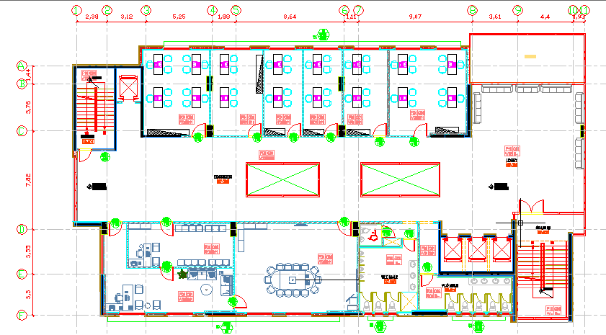
Architectural Design:
Seventh Floor:
Total area of this floor it is about 862 m²
It contains: Offices, Deans office, waiting and meeting room.
After Redesign

Slide 22
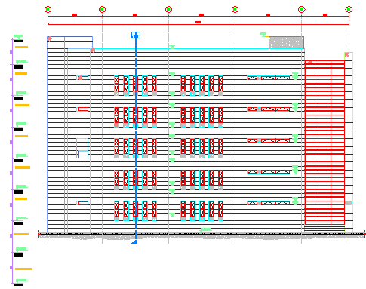
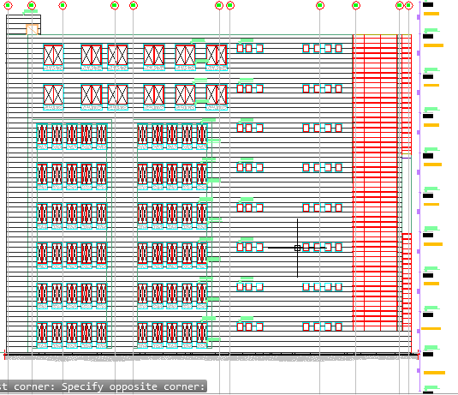
Architectural Design:
Southern elevation:
Elevations:
Before Redesign After Redesign

Slide 23
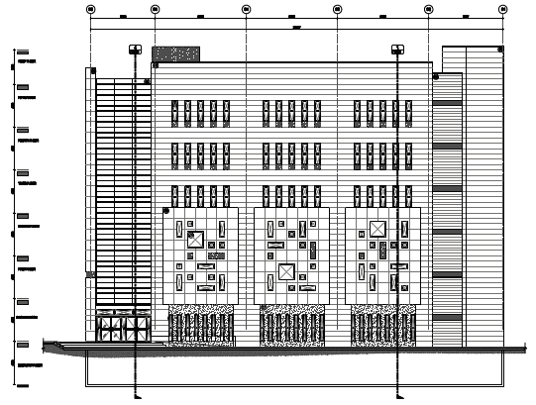
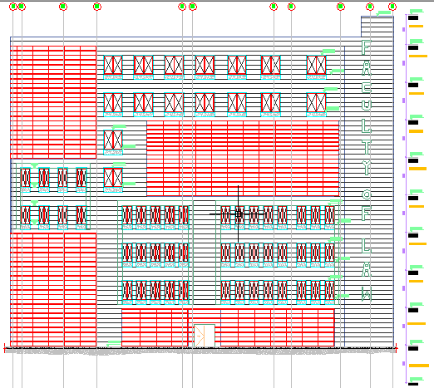
Architectural Design:
Northern elevation:
Elevations:
Before Redesign After Redesign

Slide 24
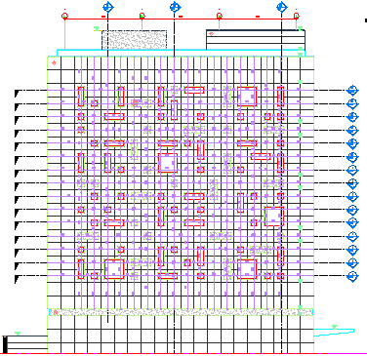
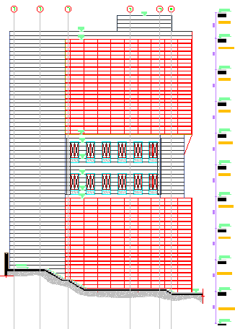
Architectural Design:
Eastern elevation:
Elevations:
Before Redesign After Redesign

Slide 25
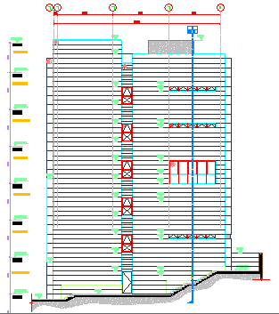
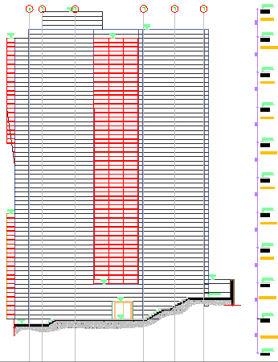
Architectural Design:
Western elevation:
Elevations:
Before Redesign After Redesign

Slide 26
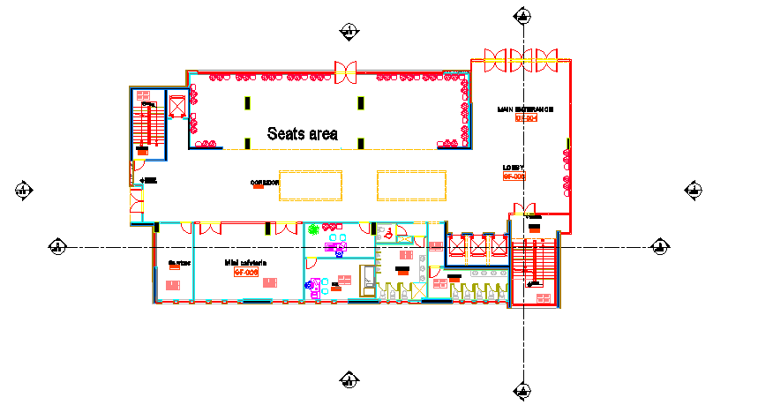
Location of sections on plan

Slide 27
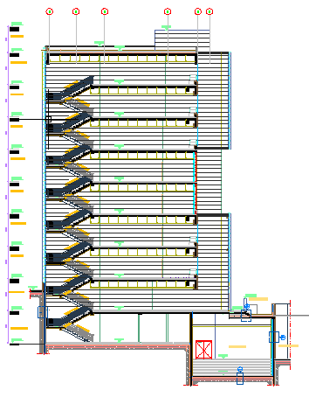
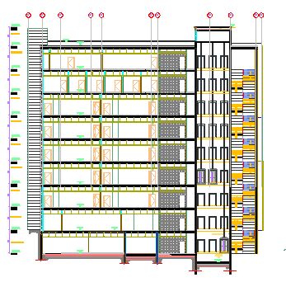
Architectural Design:
Sections:
Section B-B
Section A-A

Slide 28
Architectural Design:
Areas
New and removed Spaces
Space | old design | New design | Recommend
 | area (m2) | area (m2) | area (m2)
Large Classroom | 60.18 | 70 | 70.8
Small Classroom | 34.65 | 34 | 36
Toilet Students | 27.7 | 49 | 30
Micro Teaching Lab | 58.14 | Removed | 60
Psychology Lab | 59.85 | Removed | 60
Educational Technology Lab | 59.16 | Removed | 60
Computer Labs | 62.53 | 60 | 60
HOD offices | 17 | Removed | 36
Dean’s office | 49.5 | 40 | 36
Open-Plan Offices or closed | 22.9 | 22.4 | 15
New spaces | Spaces removed | Notes
Clinic | Micro Teaching Lab | Converting open offices to closed offices
Seats | Psychology Lab
Secretary | Educational Technology Lab
Mini Canteen
Parking
Direction
Space | Old Direction | New Direction | Notes
Classrooms | North or south | North or south | Suitable
Offices | North or south | North or south | Suitable
Meeting room | South | South | Suitable
Space | Old design | New Design
 | # of people | # of people
Classroom | 776 | 1076
Toilet Students | 1260 | 1980
Student
Number

Slide 29
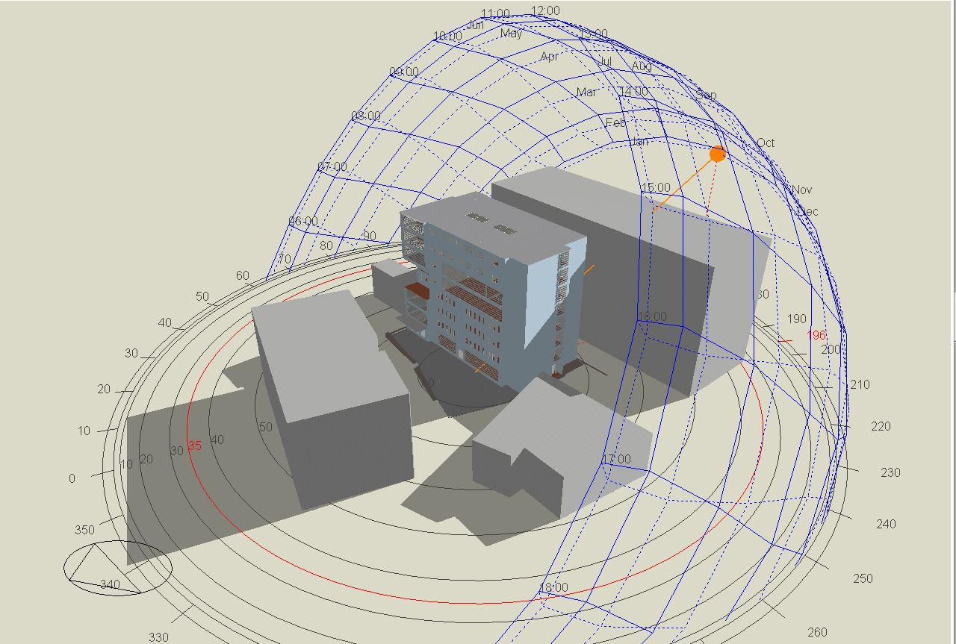
Environmental Design:
Thermal Design.
Acoustical Design.
Lighting Design.

Slide 30
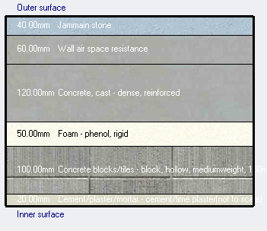
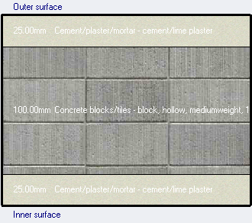

Thermal Design:
Materials:
External walls internal walls
U-value = 0.5 w/$m^{2}$.K U-value = 2.00 w/$m^{2}$.K

Slide 31
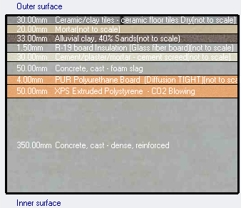
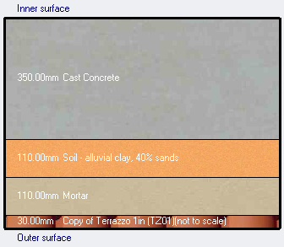

Thermal Design:
Materials:
Roof internal Floor
U-value = 0.435 w/$m^{2}$.K U-value = 1.2 w/$m^{2}$.K

Slide 32
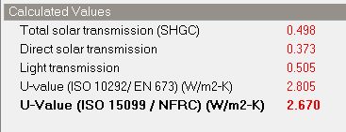
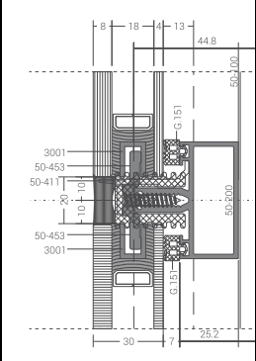

Thermal Design:
Materials:
Widows Curtain Wall
U-value = 2.67 w/$m^{2}$.K U-value = 1.7 w/$m^{2}$.K

Slide 33
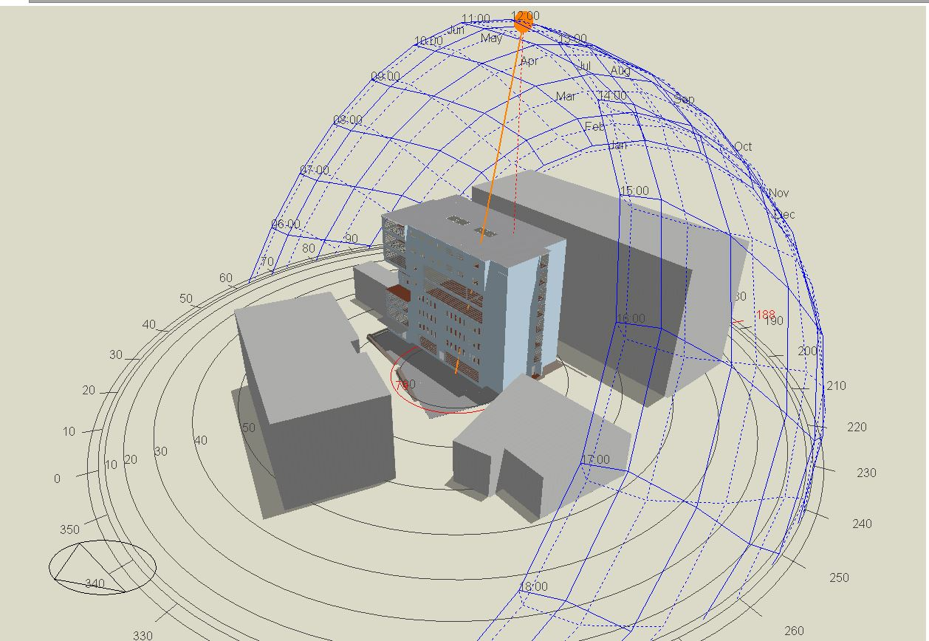
Thermal Design:
Shading:
Shading in summer (21St/July) at 12.00 P.M Shading in winter (21St/January) at 12.00 P.M

Slide 34
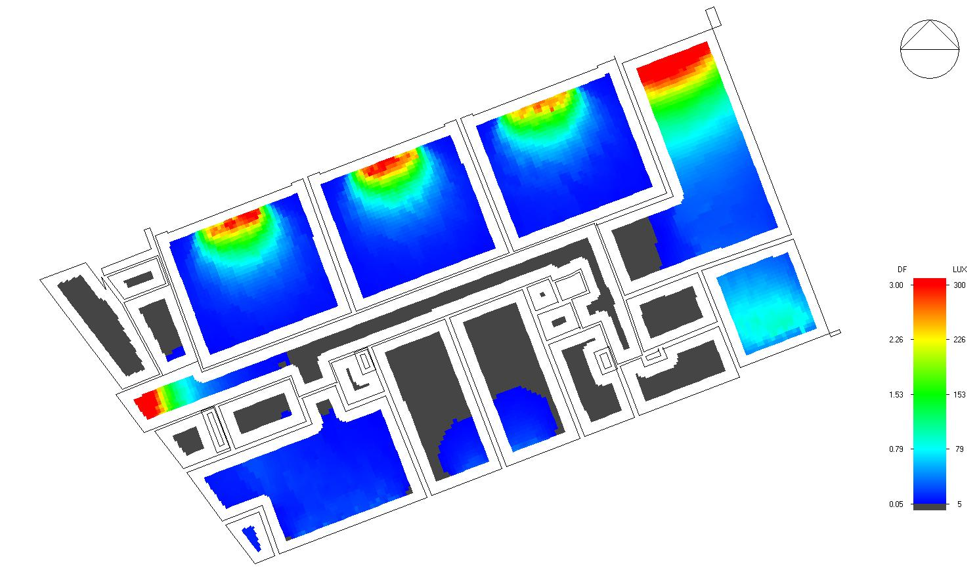
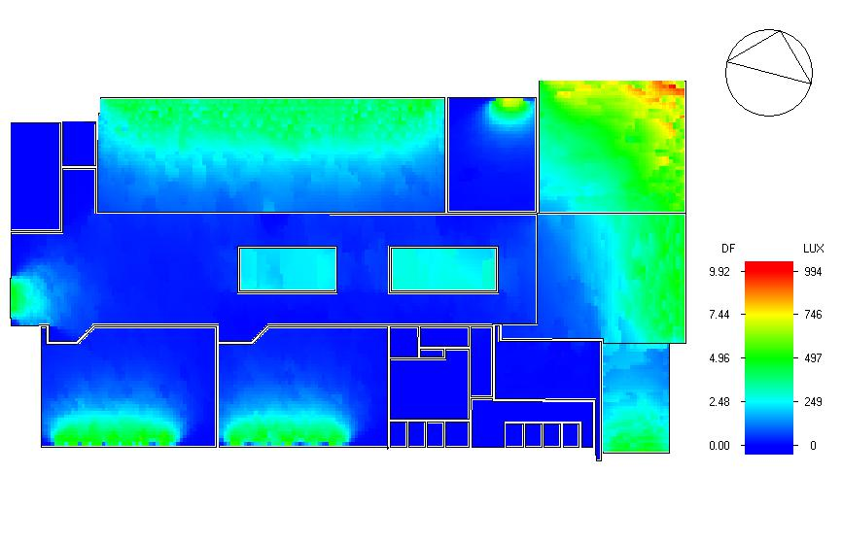
Thermal Design:
Natural daylight analysis.
Ground floor before redesign Fifth floor after redesign

Slide 35
Thermal Design:
Heating and cooling Capacities.
Site energy.

Slide 36
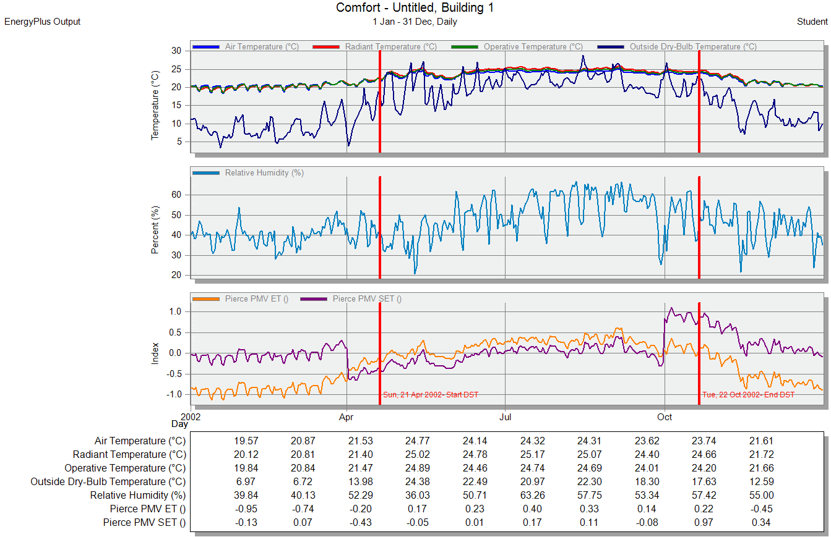
Thermal Design:
simulation:

Slide 37
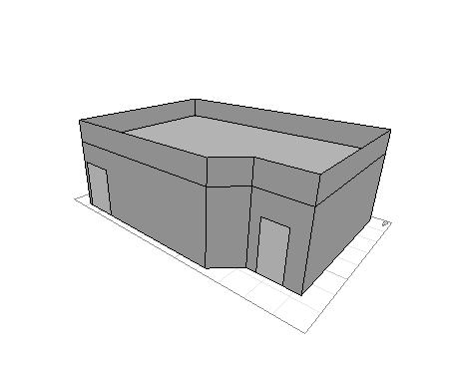
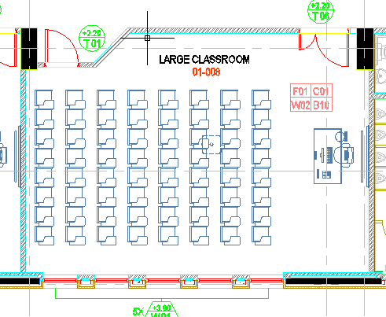
Acoustical Design:
Reverberation Time (RT60):
Ecotect Software was used for calculation of RT60. Three zones were taken into consideration:
Classroom: The required RT60 for this zone is between (0.6 – 0.8), we used normal layers in walls, Tile in the floor and plaster decorative panels in ceiling to meet the requirements value.

Slide 38
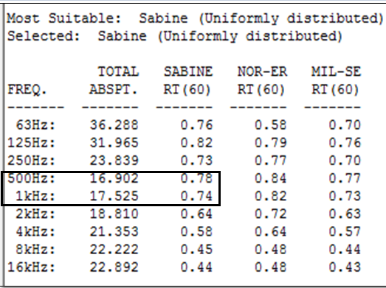
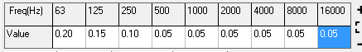
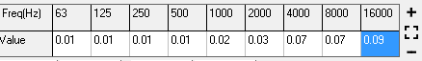
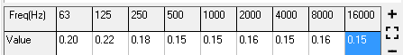
Acoustical Design:
Final Layers:
Element | Final Layer
Walls | Plaster
Floor | Tile
Ceiling | plaster decorative panels
RT 60 values:
Wall absorption factor
Floor absorption factor
Ceiling absorption factor

Slide 39

Acoustical Design:
Reverberation Time Algorithm:

Slide 40
Acoustical Design:
Reverberation Time for other spaces

Slide 41
Acoustical Design:
Sound Transmission Class (STC):
We use Insul Software in order to achieve the required design.

Slide 42




Acoustical Design:
Sound Transmission Class (STC):
We use Insul Software in order to achieve the required design.
1- External Wall: The required STC for the wall is 50, and the designed value by using Insul software is 54 dB.

Slide 43




Acoustical Design:
2- Internal Wall: The required STC for the wall is 45, and the designed value by using Insul software is 45 dB.

Slide 44




Acoustical Design:
Impact Insulation Class (IIC):
1- Ceiling: The minimum IIC ratings for floor-ceiling assemblies above core learning spaces should be IIC-45.

Slide 45
Structural Design:
Old system
Flat plate slab with 250mm thickness.
Spans dimensions ( 5.5 *8.0 )m
New system
One way, two way ribbed and solid slab with 350mm thickness.
Spans dimensions
Type | Dimensions (m*m)
One-way ribbed | 4*10
Two-way ribbed | 7*10
Solid slab | Cantilever

Slide 46
Structural Design:
Codes and Standards:
ACI 318-14 for reinforced concrete design.
UBC-97 for seismic design and its load combinations.
Materials :
Concrete strength for columns, shear wall and footing f′c= 40MPa, and 28MPa for beams and slabs.
Steel yield strength Fy= 420MPa.
Bearing capacity for soil = 350 kN/m²

Slide 47
Structural Design:
Loads :
Dead load.
Super imposed dead load =4 kN/m².
Live load = 4 kN/m².
For external walls load = 24 kN /m.

Slide 48

Structural Design:
Lateral loads:
Nablus City.
Seismic zone is 2B (z=0.2)
Soil profile is S_{B}
Acceleration seismic coefficients, Ca=0.2
Velocity seismic coefficients, Cv= 0.2
Importance factor, I=1.25
Force reduction factor, R=5.5

Slide 49

Structural Design:
3D Model from Etabs.

Slide 50


Structural Design:
Checks:
Compatibility check.

Slide 51
Structural Design:
Checks:
2. Equilibrium check.
 | Hand | ETABS | Error% | Ok?
Live load | 26080 | 26046 | 0.1% | ok
SID | 39215 | 40116 | 2.2% | ok
DL | 70719 | 71780 | 1.5% | ok

Slide 52
Structural Design:
Checks:
3. Internal forces check.
All columns, beams and slab that checked are Ok.
4. Deflection check.
MAX. allowable deflection for cantilever = 25mm (L /120)
From ETABS deflection = 21mm. So, Ok.
5. Modal participation mass ratio.

Slide 53
Structural Design:
Checks:
6. Period check.
period from ETABS = 0.991 sec. , period from hand calc.= 0.717sec
T from ETABS < 140% from hand calc.
0.991 sec.< 1.004 sec.
7. Base shear check.
V manual = 7432
Vx =7443kN > 7432 kN ➔ Ok.
Vy= 7444 kN > 7432 kN ➔ Ok.

Slide 54
Structural Design:
Checks:
Drift check.
➔ Ok.
STORY | Δm | limitation
7th floor | 19.25 mm | 80 mm

Slide 55
Structural Design:
Sections Dimensions:
Member | Width (cm) | Depth (cm)
Slabs | - | 35
Beams | 40 | 70
 | 30 | 35
 | 60 | 70
 | 40 | 90
Columns | 120 | 50
 | 100 | 55
 | 100 | 30
 | 40 | 30
Shear walls | 20 | -

Slide 56

Structural Design:
Basement floor beams distributions :

Slide 57

Structural Design:
Typical floor beams distributions :

Slide 58

Structural Design:
Section of ribbed slab:

Slide 59
Structural Design:
Beams Reinforcements table (sample):

Slide 60




Structural Design:
Beams Reinforcements:

Slide 61
Structural Design:
Columns Reinforcements table for basement floor:
Basement
Column | Size (mm2) | Longitudinal Steel | Stirrups
 |  |  | Zone A | Zone B
C1 | 1000*550 | 18ᴓ20 | ᴓ10 @150mm | ᴓ10 @300mm
C2 | 1200*500 | 20ᴓ32 | ᴓ10 @150mm | ᴓ12 @300mm
C3 | 1200*500 | 20ᴓ20 | ᴓ10 @150mm | ᴓ10 @300mm
C4 | 1000*550 | 18ᴓ20 | ᴓ10 @150mm | ᴓ10 @300mm
C5 | 1000*550 | 18ᴓ20 | ᴓ10 @150mm | ᴓ10 @300mm
C6 | 1000*300 | 16ᴓ16 | ᴓ10 @150mm | ᴓ10 @300mm
C7 | 1200*500 | 20ᴓ20 | ᴓ10 @150mm | ᴓ10 @300mm
C8 | 1200*500 | 20ᴓ32 | ᴓ10 @225mm | ᴓ10 @450mm
C9 | 300*400 | 8ᴓ14 | ᴓ10 @100mm | ᴓ10 @200mm

Slide 62


Structural Design:
Columns Reinforcements:

Slide 63




Structural Design:
Columns Reinforcements:

Slide 64




Structural Design:
Columns Reinforcements:

Slide 65

Structural Design:
Footing layout:

Slide 66


Structural Design:
Footing Reinforcements:

Slide 67


Structural Design:
Shear wall Reinforcements:

Slide 68

Structural Design:
Stairs Reinforcements:

Slide 69




Structural Design:
Water Tank Reinforcements:

Slide 70
Electrical Design:
Lighting Arrangement.
Lighting design.
Sockets Arrangement.

Slide 71

Electrical Design:
Lighting Arrangement:
First floor lighting arrangement.

Slide 72



Lighting Design:
Artificial Design:
We use DIALux EVO Software to achieve the required artificial deign, four zones were taken into consideration.
1- Classroom: the required value of luminance is 300 lux, the design value was 361 lux with uniformity of 62% and UGR is 16 which is less than the allowed 19.

Slide 73
Lighting Design:
  Dialux evo. Results

Slide 74


Electrical Design:
Sockets Arrangement:
First floor sockets arrangement.

Slide 75
Mechanical Design:
Water supply system.
Water consumption.
Drainage system.
HVAC system.
Elevators system.

Slide 76

Water supply distribution:
Old water supply system
Pipe | pipe type | Diameter
Vertical | Steel | 3 inch
Horizontal | Steel | 2 inch
Branch | Steel | 1 inch

Slide 77

Water supply distribution:
New water supply system
Pipe | pipe type | Diameter
Vertical | Steel | 3 inch
Horizontal | Steel | 1 inch
Branch | PVC | 1/2 inch

Slide 78

Water supply distribution:
Water supply and
Firefighting system riser:

Slide 79

Water supply distribution:
Water fountain locations

Slide 80
Water consumption:
Water consumption by people = (12 – 15) liter / person * 5 days (water cycle) * 1500 people = 105 m3 / 5 days.
Water consumption by firefighting system according to NFPA 14 code = 102 m3.
Total water consumption = 105 + 102 = 207 m3
Water tank capacity = 210 m3 ➔ Ok.

Slide 81

Drainage system:
uses | diameter (inch)
Water Closet | 4
Urinal | 3
Lavatory | 2
Horizontal branch in each floor | 4
Riser | 4
Horizontal pipes between manholes | 6

Slide 82

HVAC system:
HVAC Design:
VRF system was used instead of
VAV system.
Main component of VRF
system is:
1- Outdoor unit.
2- Controller.
3- Fan coil (indoor units).
4- Ducts.
5- Diffusers.

Slide 83

HVAC system:
VRF Design:
Cooling load for building = 281 kW
Outdoor unit was selected from Petra Company.
Series of DSP units was selected

Slide 84


HVAC system:
VRF Design:
Fan coil units was selected from Petra company.
RAC from Petra was chosen.
Diffusers was selected from Air Tag company.
4 way blow from Air Tag was chosen .

Slide 85

HVAC system:
VRF Design:
Separated system for fresh air was used.
Revit was used to design the system.
Duct sizing from Revit.

Slide 86

HVAC system:
Distribution of HVAC system at first floor:

Slide 87


HVAC system:
Exhausting system:
Exhausting fan from Petra company was used.
PEXT fan was used.

Slide 88
Elevators design:
Elevators design:
Previous number of elevator = 3.
New number of elevators = 4.
Car capacity = 3500 Lb (1600 Kg).
Car speed = 350 fpm.
PHC (%) = 14.04.
I = 31.25 sec.

Slide 89




Safety Design:
Automatic sprinkler system.
Extinguisher.
Hose station.
Warning signs.
Smoke detectors.
Evacuation.

Slide 90


Distribution of fire suppression system in first floor:
Hose Station

Slide 91


Distribution of fire suppression system in fourth floor:
Hose Station
sprinkler

Slide 92



Evacuation System in Ground Floor:
Emergency sign
Speakers

Slide 93


Fire alarm System in Third Floor:
Smoke Detector

Slide 94

Reflected Ceiling for first floor.
Smoke Detector

Slide 95

Above Reflected Ceiling for first floor.
Smoke Detector

Slide 96
Quantity Survey:
Stage | Cost
Structural work | 4,003,069.69 NIS
Finishing | 5,758,084.00 NIS
Mechanical work | 1,824,387.00 NIS
Electrical work | 161,725.00 NIS
Total project cost | 11,747,265 NIS
Unit cost | 1,518.00 NIS/m²

