Slide 1

Seniors Assistant
& Seniors Assistive Launcher.
Students :Rahaf Qawariq, Ru'a Abadi.

Slide 2
Introduction
Our project Senior Assistant is a mobile application. that eases the life and daily tasks for seniors.

Slide 3

Problem
Senior's smartphone ownership is on the rise, but app developers missing this crucial segment of possible consumers. Most seniors taking some kind of pills and the problem is that they keep forgetting to take their medications. and needs encourage for doing simple exercises at home. Moreover, older adults face unique challenges when using smartphone apps, since physical and cognitive abilities change with age.

Slide 4
Scope
This project concerns with all seniors affairs. from reminding them to take medication to View some simple home exercises, and to go for a walk with a stepper counter. also with life saving features, which are Finding location by caretaker and fall detection, to providing android users with a simple launcher.

Slide 5
Importance
It is an essential thing for every son and daughter to ensure his parents or his grandfathers and grandmothers to be comfortable and to take every pill in time. Also for those have diseases like dementia and Alzheimer to be able to rack their location and for those who are prone to falls because of age to be notified if an accidental fall happened.

Slide 6
Technical choices
React Native :React Native is a framework that builds a hierarchy of UI components to build the JavaScript code.. it is developed by Facebook.
Expo :Expo is a framework and a platform for universal React applications. It is a set of tools and services built around React Native and native platforms
Google Maps :It is a Web-based service that provides detailed information about geographical regions and sites around the world.

Slide 7
Server Side
PHP for server-side scripting.
MySQL Database (our main database.)It is the most popular open source database management system which is developed, distributed, and supported by Oracle Corporation. MySQL database is very fast, reliable, scalable.Firebase is a mobile- and web application development platform, backed by Google.
Firebase manages its own infrastructure with a nice set of tools.

Slide 8
Requirement Analysis
Functional Requirements
The users can register and create an account and log in to their accounts.
The senior user can add and delete pill reminders.
The senior user can watch simple home exercises to do it.
The senior user can go for a walk with the stepper counter feature.
The senior user can view his location on the map.
The caretaker user can view his senior location on the map.
The caretaker user would receive a notification if a fall is detected with his senior.

Slide 9
Non-Functional Requirements
Security.
Privacy.
Availability.
Usability.
User-friendly.
Scalability.

Slide 10
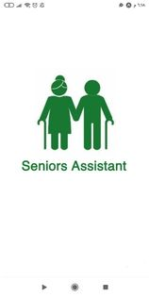
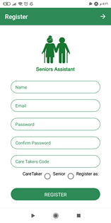
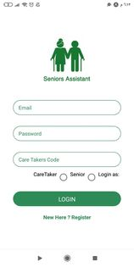
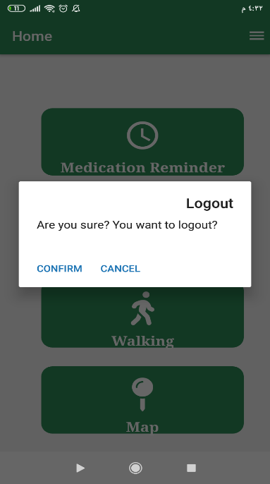
Methods and Techniques
main pages
Splash screen sign up screen log in screen log out screen

Slide 11
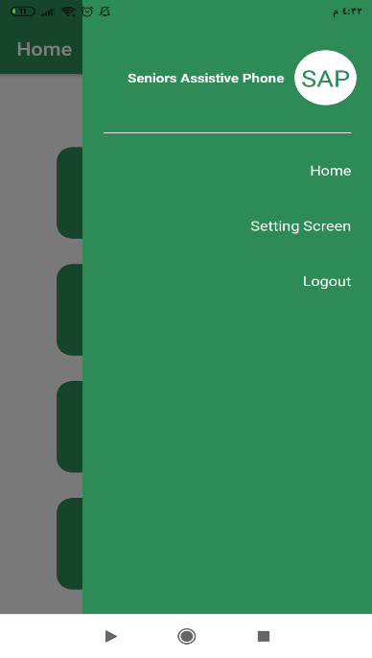
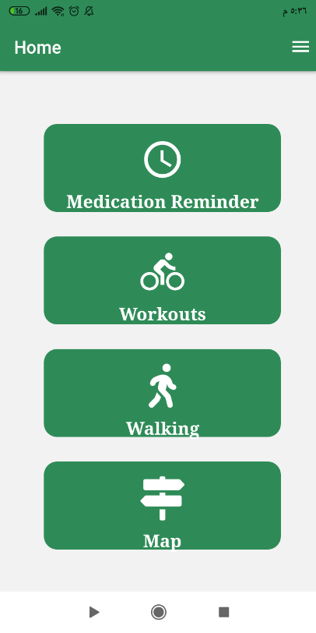
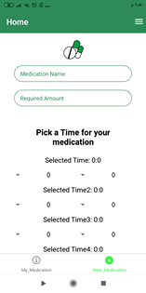
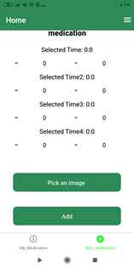
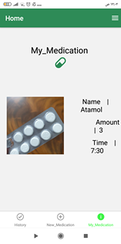
Seniors Pages

Slide 12
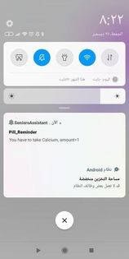
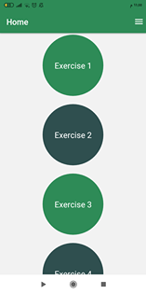
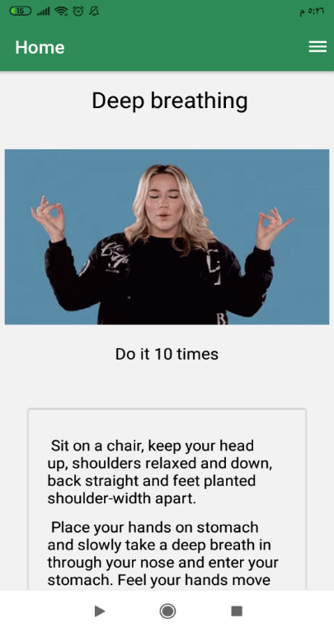
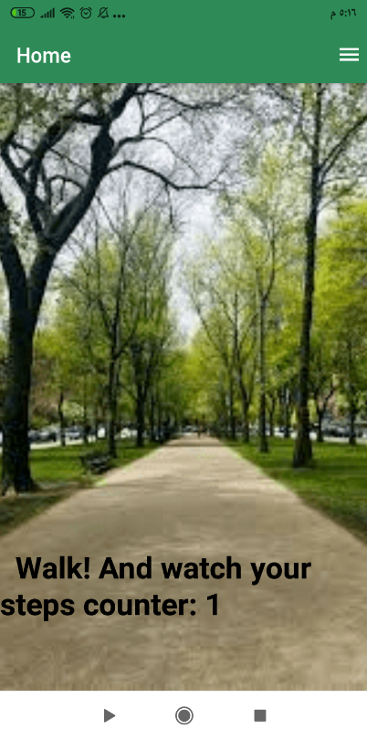
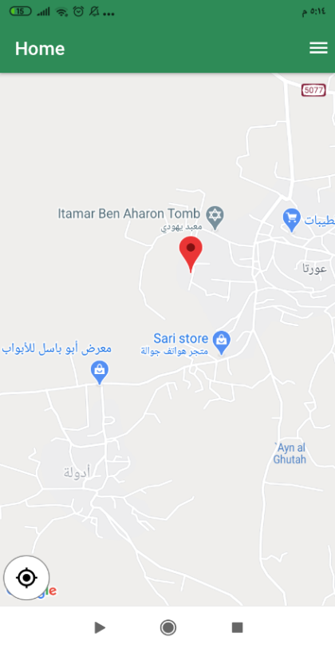

Slide 13
Navigation
Stack Navigator.
Switch Navigator.
Drawer Navigator.
Bottom tab Navigator.

Slide 14
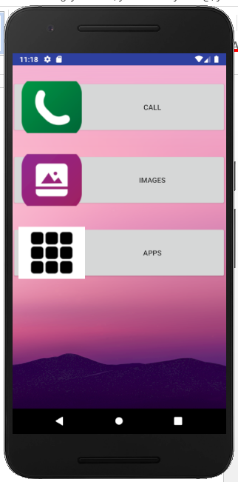
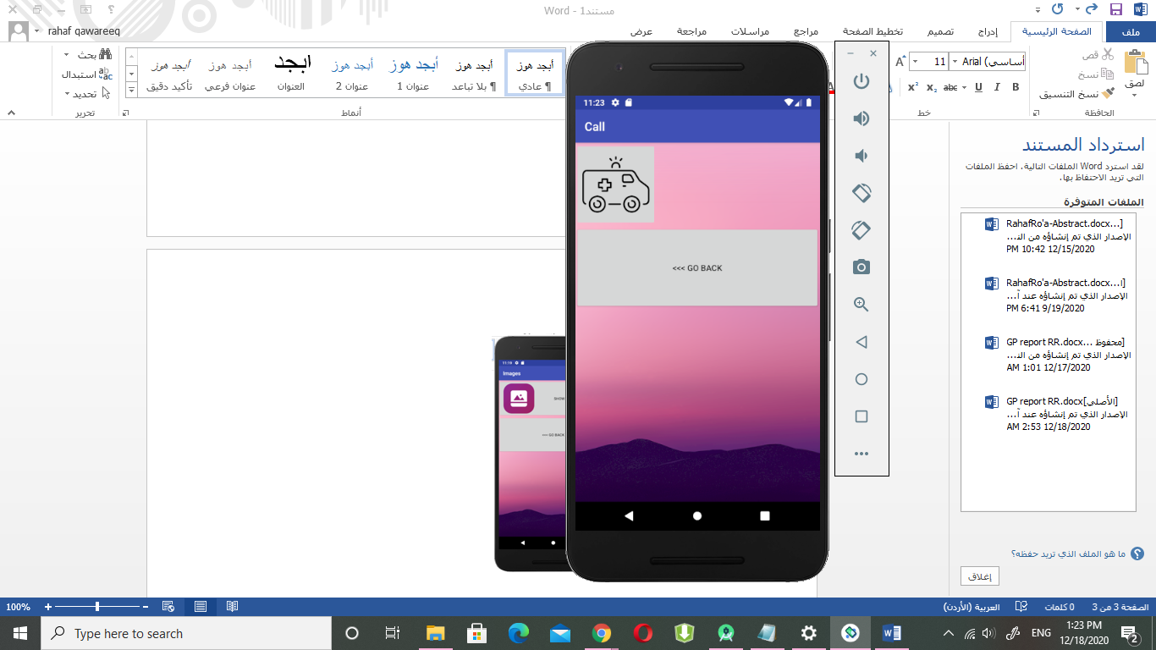
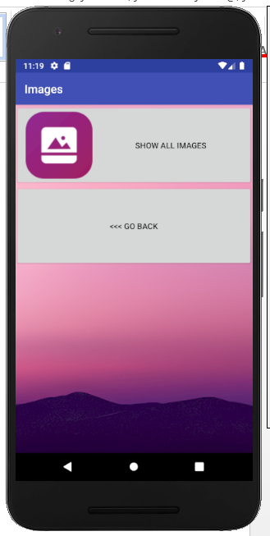
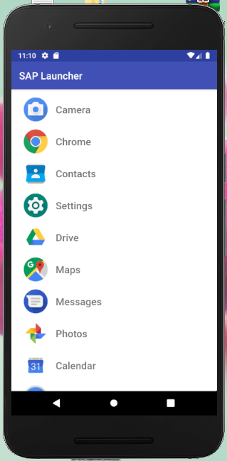
Seniors Assistive Launcher
A Simple launcher app for Seniors android users, It registers as an app launcher.

Slide 15
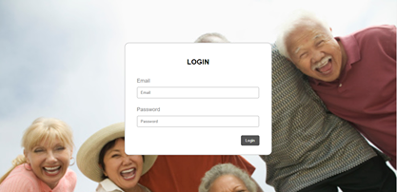

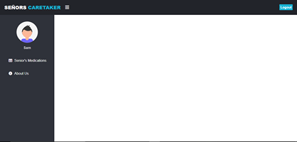
Web Application For the CareTaker

Slide 16
Result
• Cross platform application with previously mentioned services
• Notification system that keeps the user reminded with his medications.
• Location tracking system that enables the caretaker to monitor his senior location. This is very useful for patients of mentality or Alzheimer.
• Fall detection system that enables the caretaker to be notified if accidental fall happens with his senior.
• Simple android launcher simplify the use of a smartphone for seniors who do not use a lot of applications.
• A simple web Application for the caretaker.

Slide 17
Conclusion
Skills gained :
Dealing with several React Native packages.
Implementing back-end by PHP.
Dealing with maps.
Learned how to make an Android launcher.
Learned how to use Firebase and Onesignal.
Making web application.

Slide 18
Future Work
Due to the limited time there is no remaining time to do some features .
We can improve the map services by making a tracking line to the road senior take instead of just showing his location, we can provide the senior with drinking water notifications and we would improve this simple launcher.

Slide 19
Thank You For Listening.
Please Watch Demo To see more ☺

