Slide 1
Alarm Network System
Supervised by:
Dr. Luai Malhis.
Prepared by:
Mahmoud Musa & Mustafa Assaf

Slide 2
Outline
Introduction.
System descriptions.
Methodology.
Recommendations for Future Work

Slide 3
Introduction
This project present a two networks applications.
The first one is an alarm network system application .
The other is a system application is used to configure the routers using a good user interface.

Slide 4
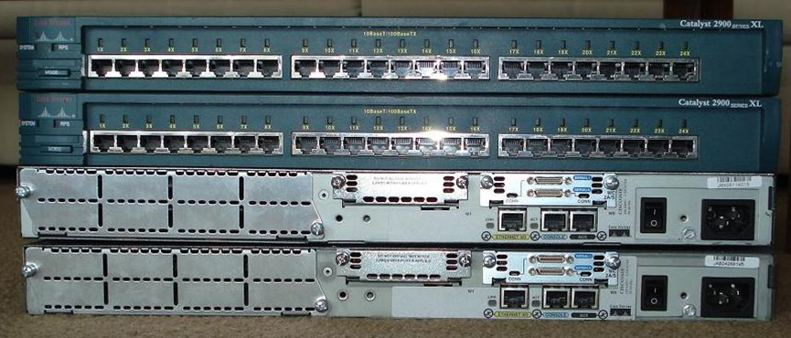
System Environment
Our system will be used to manage a cisco 2600 series router. It can support another version of cisco series, but some service will not be enable since it have to have a hardware to support it.

Slide 5
Software Information
Microsoft Visual Studio C# environment.
Telnet: Our project relies on telnet communication.

Slide 6
System Features
Easy to use our system.
It support configure the router either with regular way throw writing a command or with user friendly interface .
It monitors your network and tell you about any change in it.
It send an alarm messages throw a SMS messages or E-mail messages.
It can work in background.
It have a login window to give the system more security.

Slide 7
System Constraints
Our system work only on Windows operating system.
System must work in machine that support telnet.
Not all feature will be enable on all router series. Because it have to have an internal hardware support this features.

Slide 8
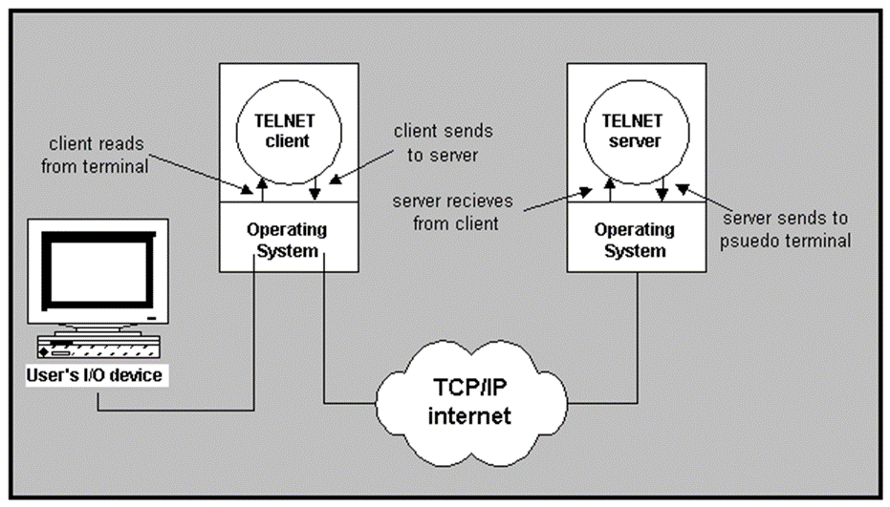
Methodology
Telnet
we built a telnet connection over a TCP connection to make communication channel to the router. And then throw this communication channel, we pass our commands to router and receive a replay from it.

Slide 9
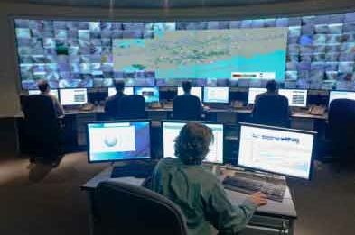
Methodology
Monitors the router
The alarm network system application is used to monitoring the networks and checking it from any changes are happened in the networks like change in temperature of the router.

Slide 10
Monitors the router

Slide 11

Methodology
Sending a messages
And the system is also sent a message using SMS messages and E-mail messages to the network administers to inform them about the changes or errors that are happened in the routers.

Slide 12
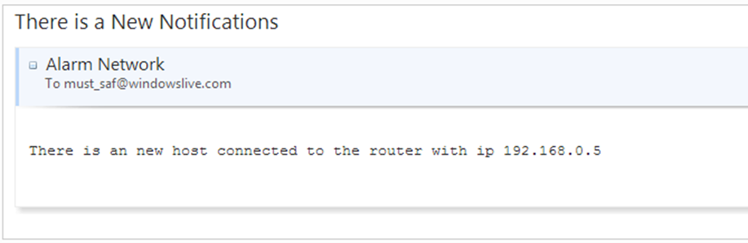
Sending a messages

Slide 13

Methodology
Configure the routers
The CCP is a network system application is used to manage the routers and configure it in simplicity way by using a user interface that will help network administers by generate the command that the network administers want to write using the user interface in the application instead of write a command in regular way. And also the system support configure the routers in traditional way.

Slide 14
Configure the routers

Slide 15
Configure the routers

Slide 16
Recommendations for Future Work
The system can be developed to cover more type of traps like power trap and change in route table … etc.
The system can be developed to cover more command in its user interface.
The system can be developed to be work on another environments, for example, the system can be run in web browsers or in UNIX.
The system support router cisco only, so the system can be developed to support another types of routers.
The system use telnet in their connections to the router, so the system can be developed to be worked in more secure channel like SSH.

Slide 17


