Slide 1

An-Najah National University
Faculty of Engineering and Information Technology
Graduation project report II
Design of Water Distribution Network for Asira ash - Shamalya
Prepared by: “AHMAD SALEH” SADDER
AMEED MAHER
SEBA YASEEN
Supervised by : DR.ANAN JAYOUSSI

Slide 2
Introduction
General introduction about Water Distribution Network(WDN).
The Importance of WDN.
The Component of WDN .
WDN in Palestine specially in Asira ash - Shamalya

Slide 3
Objective:
Analysis the existing WDN of Asira ash-Shamalya.
Find the problems in the existing WDN if there is any, and solve it by redesign the network.
Design a WDN for the town that cover the future demand for 2050.
Cost estimate of the designed WDN.

Slide 4
  Approaches:
Identify the area to be served.
Data collection which include
1-Topography map (contours).
2-Road network.
3-Buildings.
4-Water resources (e.g. supply, demand).
Set design criteria and constraints.

Slide 5
We used in this project WaterCAD, AutoCAD, GIS.
The collected data used to design a WDN for the town that met the design specifications.

Slide 6
  Study Area :
Location:
Asira ash Shamalya is a Palestinian town in Nablus Governorate, located 3.5km north of Nablus City. It is bordered by Talluza, Al Badhan, and Azmut to the east, Nablus city to the south, Zawata, Ijnisinya, & Nisf Jubeil to the west, and Beit Imrin & Yasid to the north
Topography:
Asira ash-Shamalya had an average elevation of 680m above mean sea level.
Population:
According to the Palestinian Central Bureau of Statistics (PCBS), the total population of Asira ash Shamaliya inShamaliya in 2017 was 8813 of whom 4490 were male and 4323 female with growth factor 1.46%

Slide 7
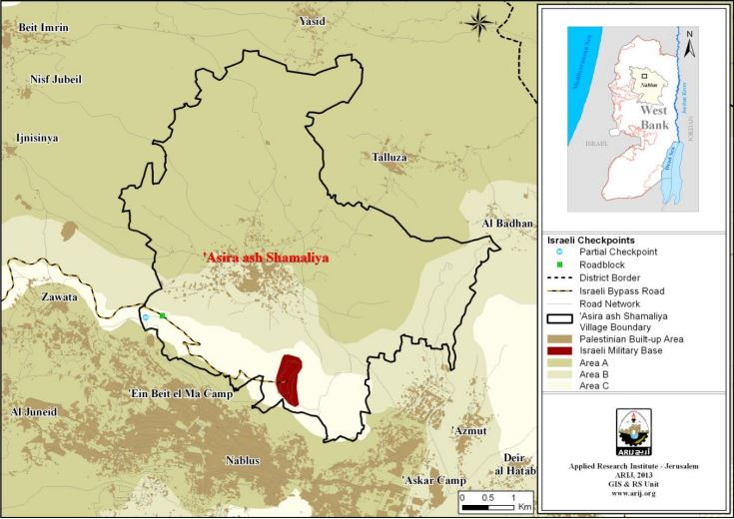
MAP1: Asira ash Shamaliya location and borders.

Slide 8
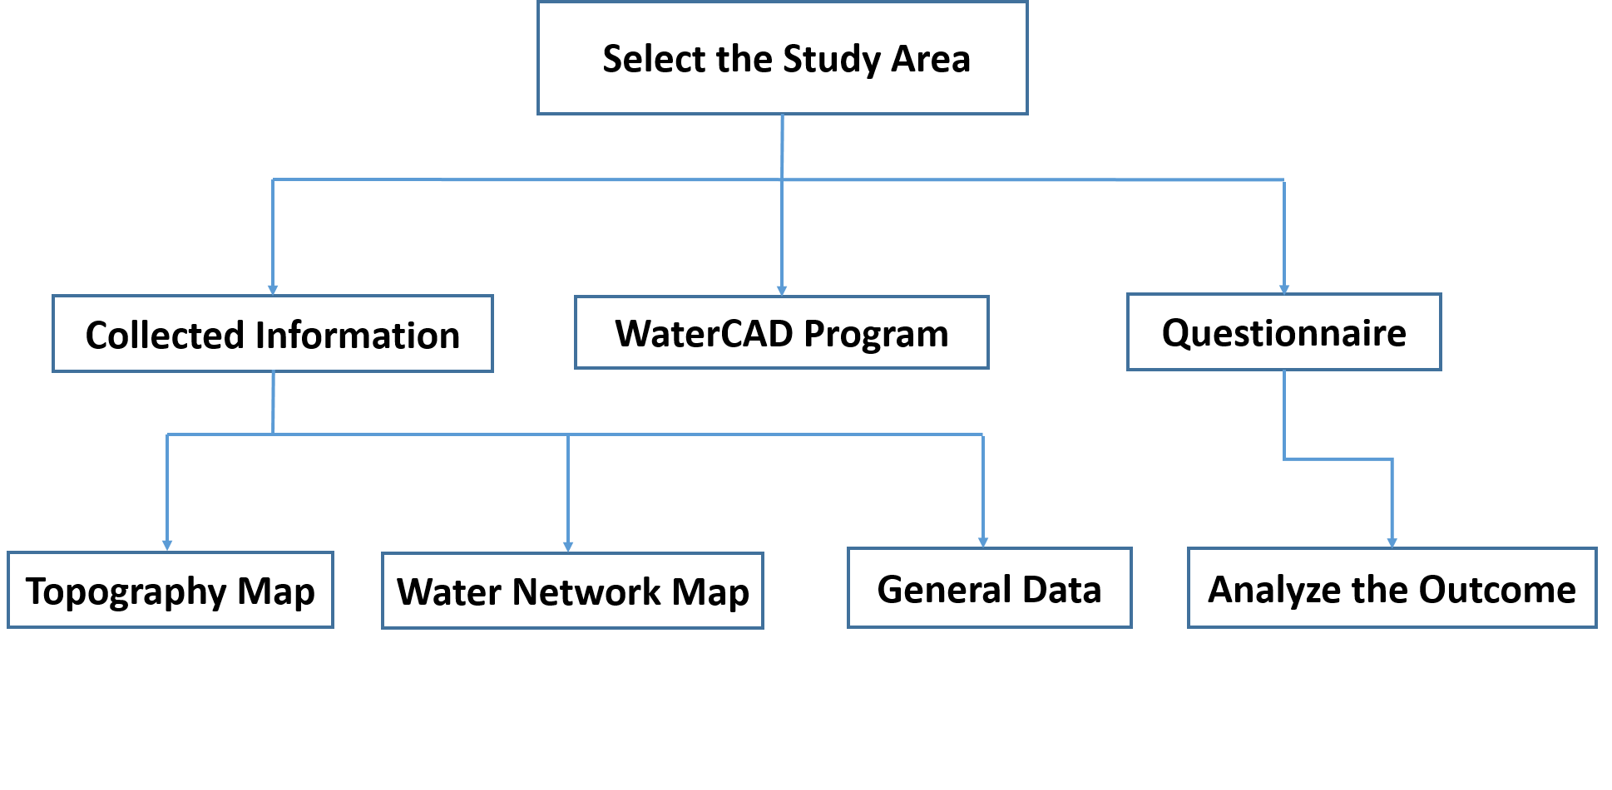
Methodology:

Slide 9
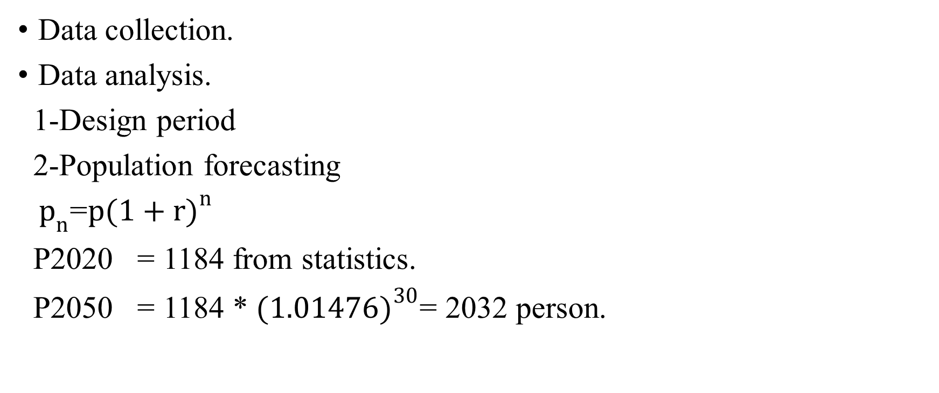
METHODOLOGY
Data collection.
Data analysis.
1-Design period
2-Population forecasting
${ p}_{n}$=$p{(1+r)}^{n}$
P2020 = 1184 from statistics.
P2050 = 1184 * ${(1.01476)}^{30}$= 2032 person.

Slide 10

METHODOLOGY
3-Demand.
Q design = (future population) *L/c-day * hourly factor = 2032 * $\frac{120}{1000}$
=231 $m^{3}$/day.

Slide 11
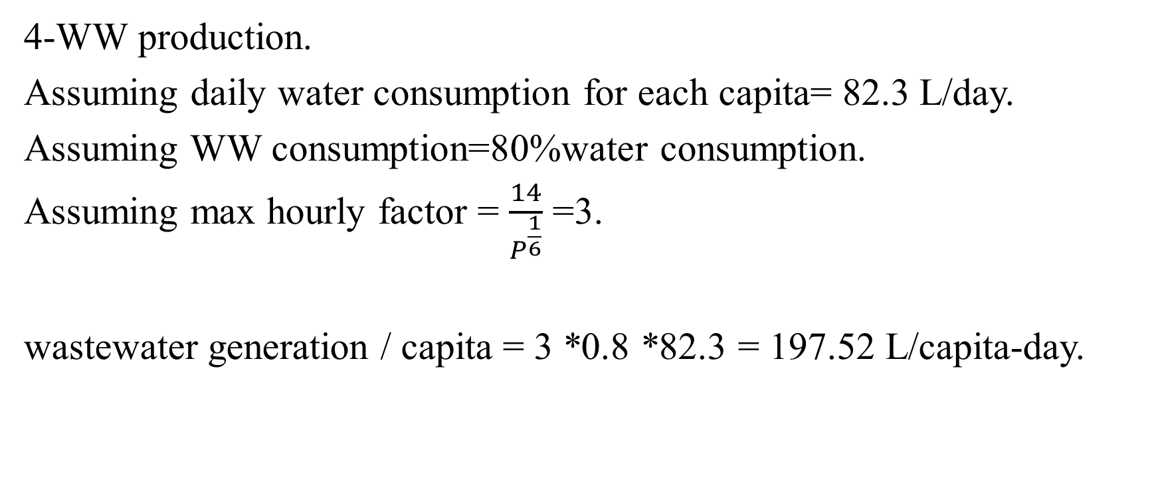
METHODOLOGY
4-WW production.
Assuming daily water consumption for each capita= 82.3 L/day.
Assuming WW consumption=80%water consumption.
Assuming max hourly factor = $\frac{14}{P^{\frac{1}{6}}}$ =3.
wastewater generation / capita = 3 *0.8 *82.3 = 197.52 L/capita-day.

Slide 12
METHODOLOGY
5-Infiltration
Infiltration = 20% of WW production
Infiltration = 0.2*0.8*82.3= 13.168 L/capita-d.
6-Hazen William's coefficient
Hazen William's coefficient for PVC =0.013

Slide 13
METHODOLOGY
Standard and specification
Design criteria:
-Manning coefficient is 0.013.
-Free outfall.
-The material of conduit is PVC with circular shape.
-Steady state condition.
-Flow in conduit is partially with 75% percentage.
-Ground elevation is equal to rim elevation.

Slide 14
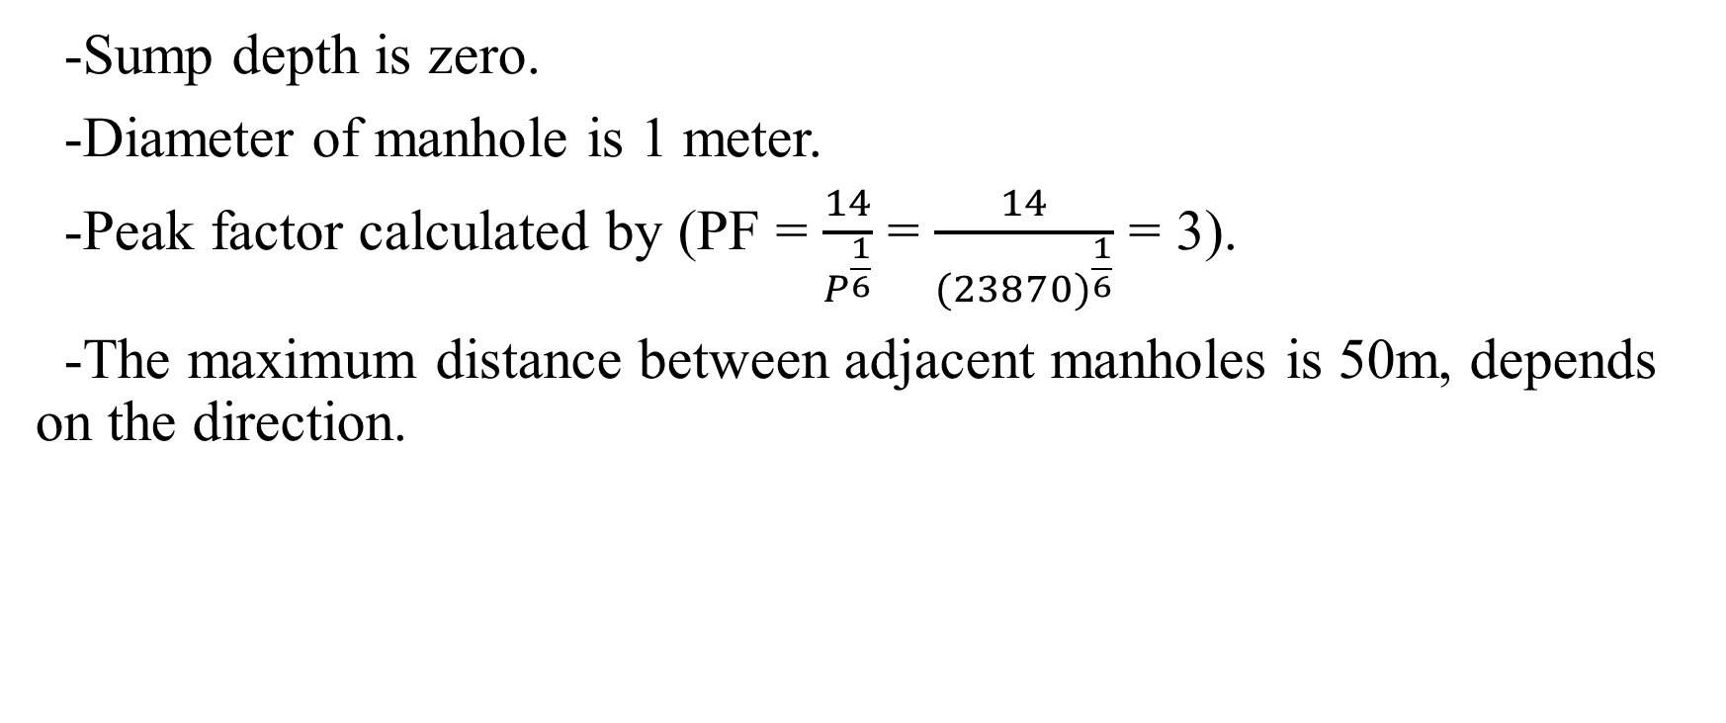
METHODOLOGY
-Sump depth is zero.
-Diameter of manhole is 1 meter.
-Peak factor calculated by (PF = $\frac{14}{P^{\frac{1}{6}}}$ = $\frac{14}{{(23870)}^{\frac{1}{6}}}$ = 3).
-The maximum distance between adjacent manholes is 50m, depends on the direction.

Slide 15
METHODOLOGY
project constrain
-Cover between 1m-5m.
- Slope 1%-15%.
- Velocity 0.6m/s - 3m/s.

Slide 16
MODELING
Put the data and layers on the SewerCAD program
Start defining the location of the manholes and allocate the outfall
.
Define the catalogue for the conduit from the conduits library, that the design will use to design the conduit diameters.
Insert the conduits between the manholes, the length of the conduits will be determined according to the scale of the drawings.

Slide 17
MODELING
Use the TRex wizard tool to enter the manholes elevation.
Use the Thiessen polygon tool divide the area of the ground to help distributing the load over the manholes.
Define the unit sanitary load that we determine previously
Define the extreme flow setup
Define the load over the manholes.

Slide 18
MODELING
Define all the constrains of the model
Import conduit material from the library and select the minimum number to start the design on.
Select design in calculation type.
Run the model.

Slide 19
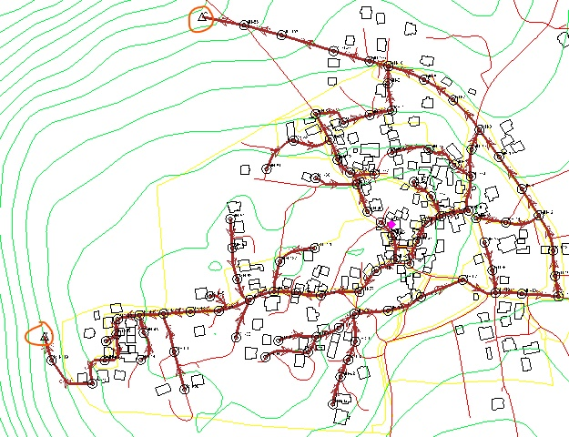
MODELING

Slide 20
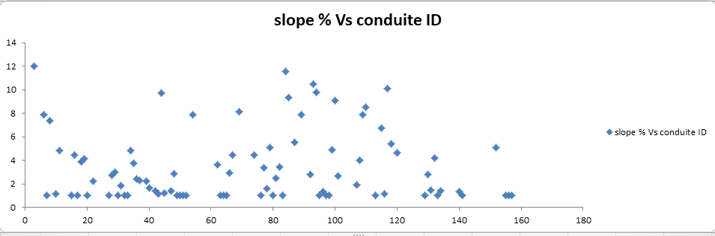
RESULTS

Slide 21
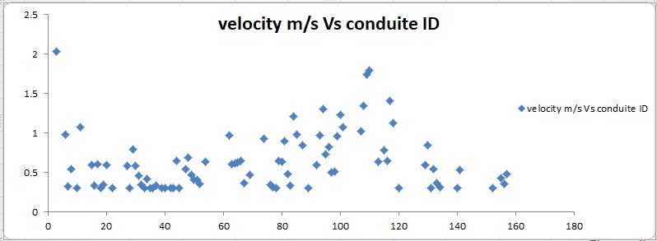
RESULTS

Slide 22
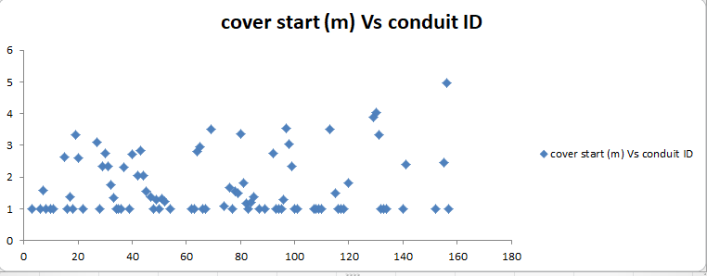
RESULTS

Slide 23
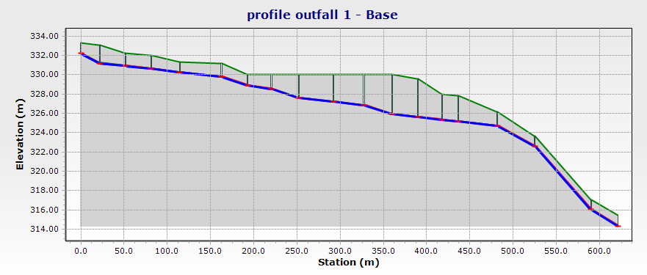
RESULTS

Slide 24
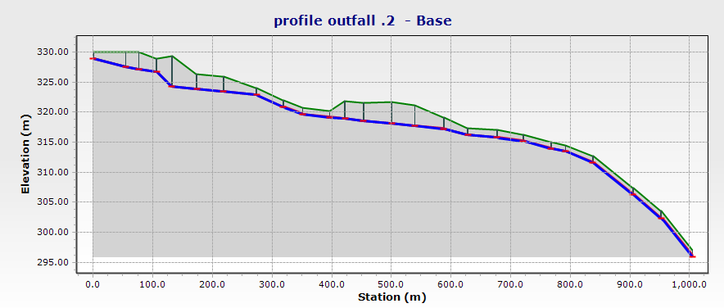
RESULTS

Slide 25
  Conclusion
Compare the result with the specification
- max cover value was 4.96m and min value was 1m, the tow values
are acceptable
- generally; values of velocity were low , max value 2.03m/s which
acceptable , min value 0.27m/s lower than min accepted
value(0.3m/s).

Slide 26
  Recommendations
The villagers must stop using cesspits, and start using WWCS
Flush the system periodically.

