Slide 1
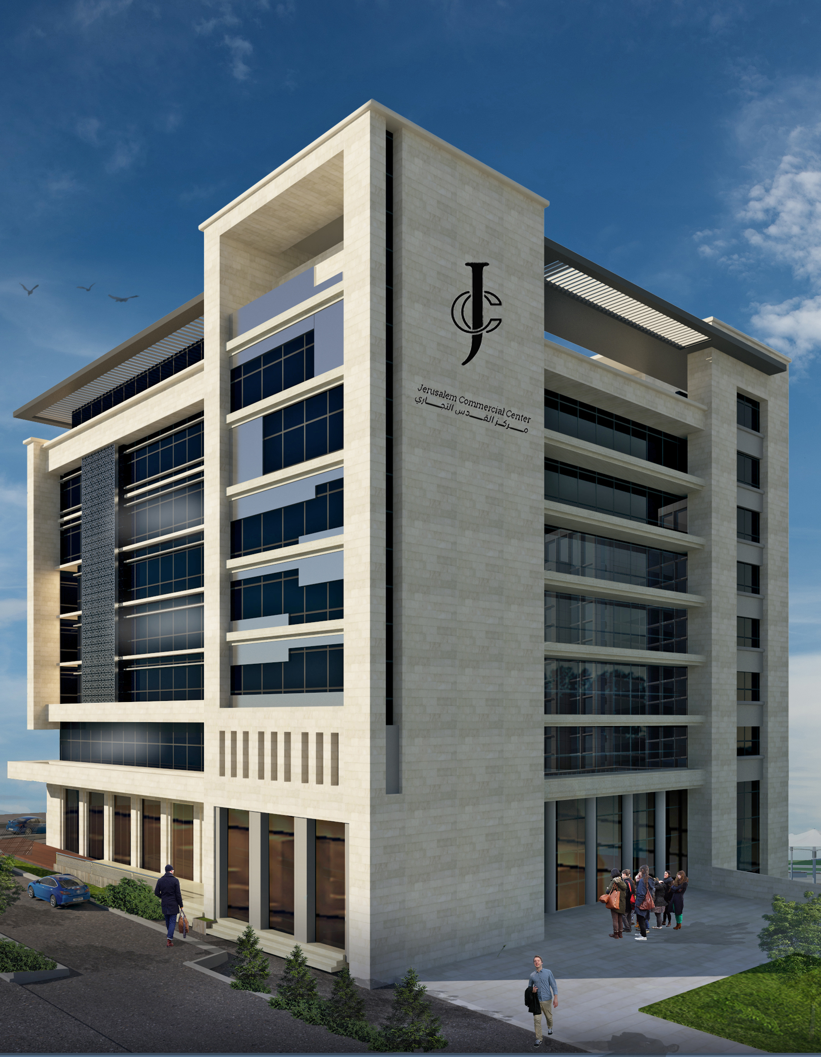
Structural Analysis and Design of Jerusalem commercial center in Jerusalem city -Palestine
By
Diaa' Ahmad Reg. No:11715876
Lana Ali Saleh Reg. No:11716417
Sara Abu Ali Reg. No:11716579
Yousef Arman Reg. No:11716611

Slide 2
Work plan
Introduction
Preliminary dimension
Loads
Checks
Design

Slide 3
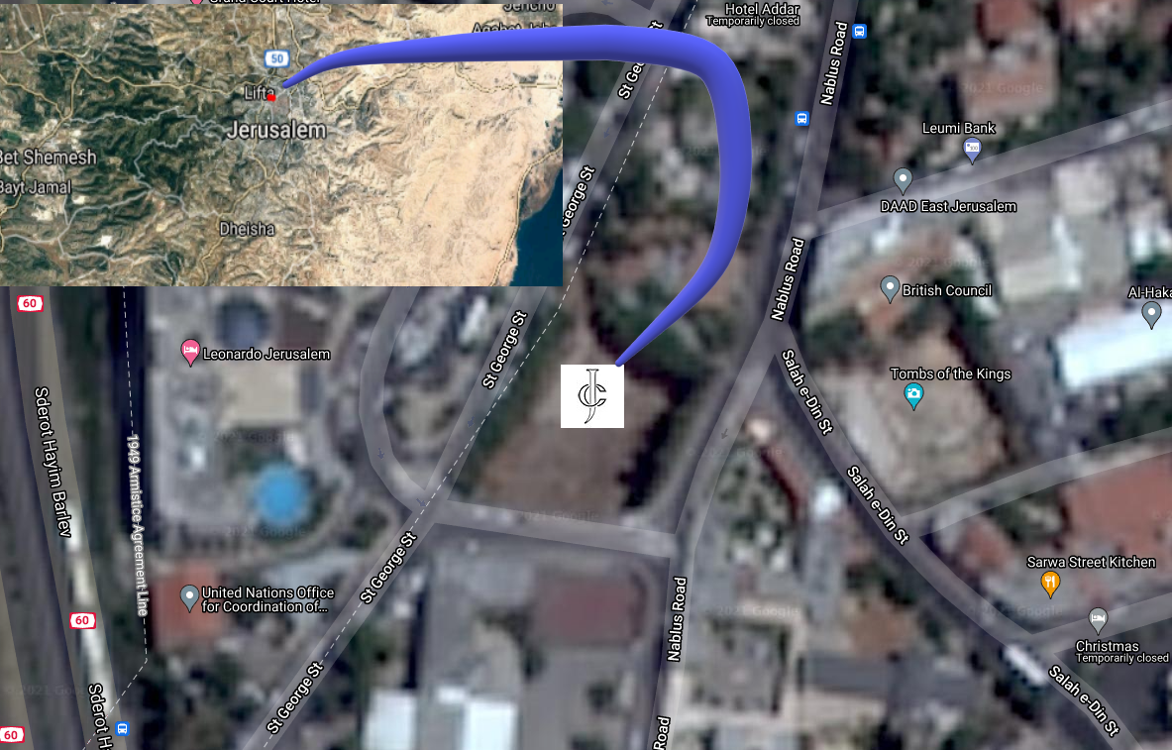
Project description
This project deals with the structural analysis and design of Jerusalem Commercial Center in the city of Jerusalem, which is fourteen floors with a total base area of 19215𝑚2 and total height of 50.9 m.

Slide 4
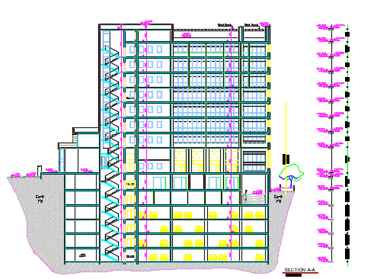
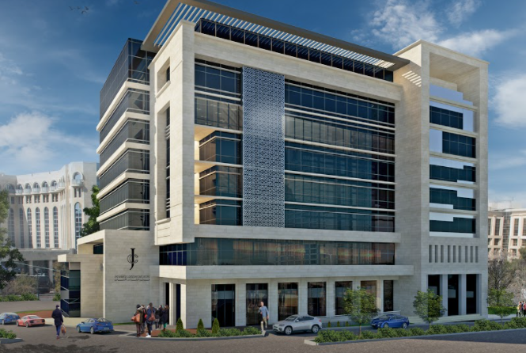

Slide 5
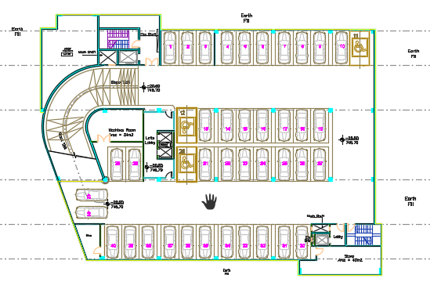
Architectural plan for basement floor

Slide 6
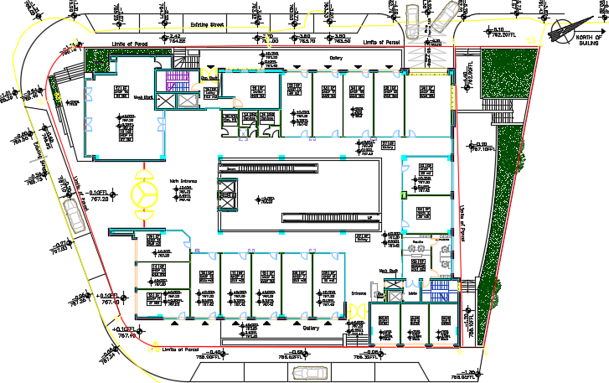
Architectural plans for ground floor

Slide 7
Areas and usage for each floors
Floor | Height (m) | Area(m2) | Use
Basement 6 (B6) | 3.3 | 1556 | Parking
B5 | 3.3 | 1556 | Parking
B4 | 3.3 | 1556 | Parking
B3 | 3.3 | 1556 | Parking
B2 | 3.3 | 1556 | Parking
B1 | 3.9 | 1510 | Parking
G | 6 | 1340 | Commercial
Floor 1(F1) | 3.5 | 1325 | Commercial
F2 | 3.5 | 1210 | Offices
F3 | 3.5 | 1210 | Offices
F4 | 3.5 | 1210 | Offices
F5 | 3.5 | 1210 | Hotel
F6 | 3.5 | 1210 | Hotel
F7 | 3.5 | 1210 | Hotel

Slide 8
Software programs:
ETABS 2019(to analyze and design the model)
AutoCAD 2020 ( to prepare the structural drawings)
Codes and standards:
ACI 318-11 (American Concrete Institute) for member's design.
ASCE 7-10 (American Society of Civil Engineers) for loads computations.
ASTM 2016 (American Society for Testing and Materials) for material specification.
IBC 2012 (International Building Code).
Israeli Code for Seismic Design SI-413.

Slide 9
Materials :
For Structural elements
concrete
Steel uses ASTM A615Gr60 steel with 420 MPa yield strength and 620 MPa tensile strength.
Structural Element | Concrete e Type | fcʹ (MPa) | Ec (MPa) | Poisson ratio | Ɣ (kN/m³)
Slabs and Beams | B350 | 28 | 2.48 * 10^4 | 0.2 | 25
Columns and walls | B450 | 36 | 2.82 * 10^4 | 0.2 | 25

Slide 10
For non-Structural elements
Materials | Ɣ (kN/m³)
Mortar | 23
Tiles (porcelain) | 27
Masonry stone | 27
Bricks | 15
Aggregates (filling materials) | 18
Plastering | 23
Glass clear float | 25
Aluminum | 26.1

Slide 11
Preliminary dimension:
For slabs :
Flat slab
Thickness of slab =35 with drop panel dimension 4*4 and thickness=10 cm
Solid slab
Ribbed slab
Thickness of slab = 40cm and beams dimension =0.4m depth and 1.5m width
Thickness of slab =25 cm
Beam dimension =50*70 cm and 50*85 cm

Slide 12
Preliminary dimension for column:
Tributary area concept mainly can be used for getting preliminary dimensions for columns.
Column that carry highest tributary area has been chosen.
dimensions that satisfy this area are (1000mm × 1000mm).

Slide 13
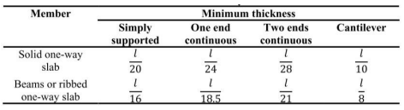
preliminary design for beams:
The preliminary thickness of beams can be calculated based on deflection laws as shown Table2.4.1 extracted from ACI 318-11.
Beams in the basement floors are (500mm X 700mm)
Beams in the typical floors (B1-7th stories) are (500mm X 850mm)

Slide 14
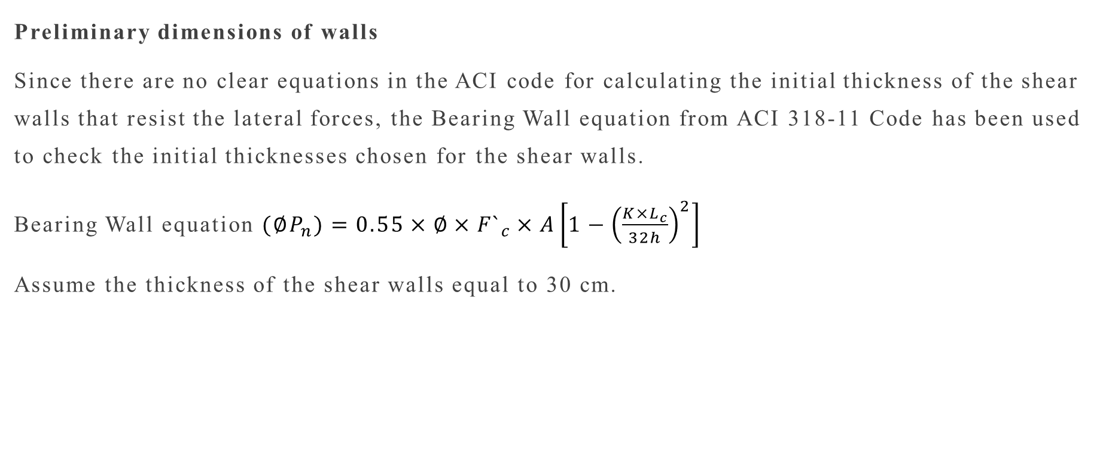
Preliminary dimensions of walls
Since there are no clear equations in the ACI code for calculating the initial thickness of the shear walls that resist the lateral forces, the Bearing Wall equation from ACI 318-11 Code has been used to check the initial thicknesses chosen for the shear walls.
Bearing Wall equation $(∅P_{n})=0.55×∅×{F`}_{c}×A\left[1−{\left(\frac{{K×L}_{c}}{32h}\right)}^{2}\right]$
Assume the thickness of the shear walls equal to 30 cm.

Slide 15
Loads
Lateral load
Earthquake load
Soil load
Gravity load
Live load
Dead load
Superimposed dead load

Slide 16
Equivalent static method
Dynamic analysis
Response spectrum
Time history
Analysis and design method for seismic force

Slide 17
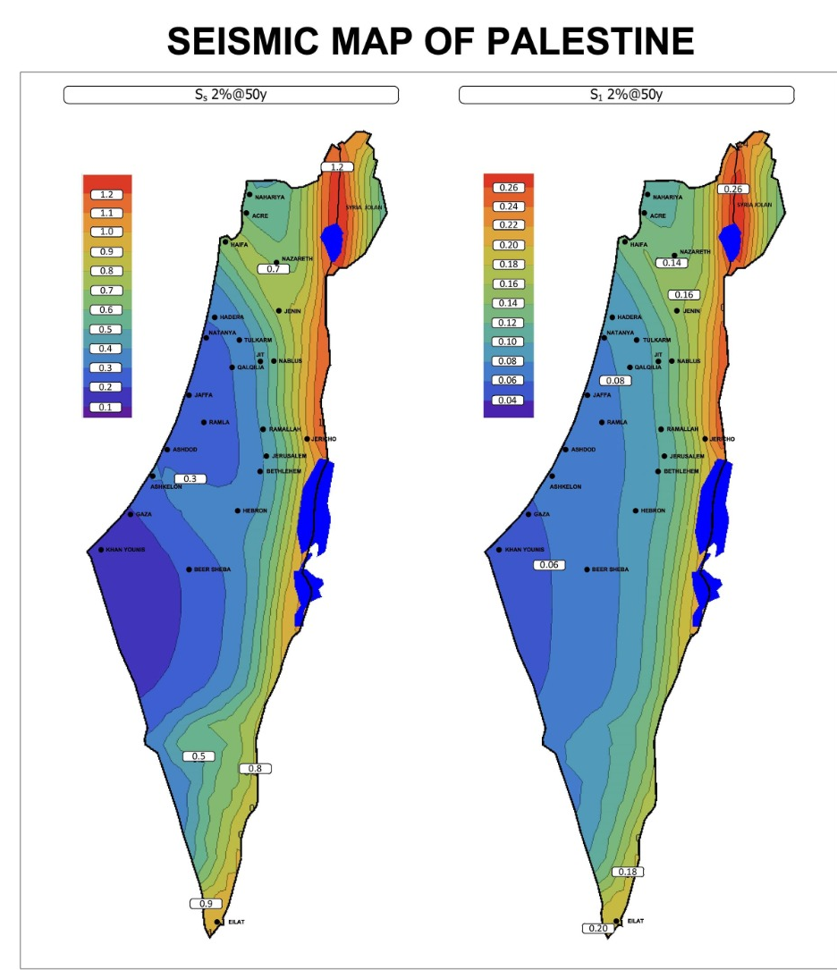

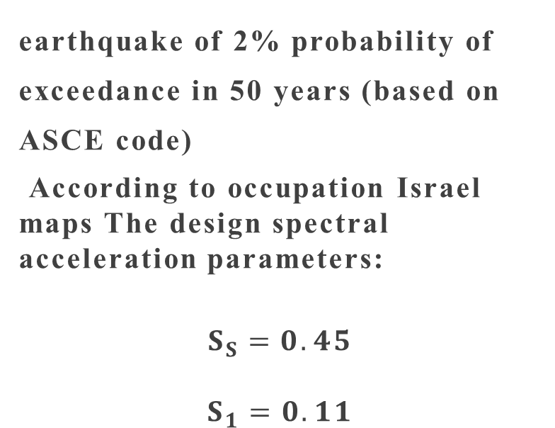
earthquake of 2% probability of exceedance in 50 years (based on ASCE code)
According to occupation Israel maps The design spectral acceleration parameters:
$$S_{S}=0.45$$
$$S_{1}=0.11$$

Slide 18
Symbol | Definition | Value | Code | Table/section
Risk Category | ____________ | III | ASCE-10 | Table 1.5-1
F_{a} | Site coefficient | 1 | ASCE-10 | table 11.4-1
F_{V} | Site coefficient | 1 | ASCE-10 | table 11.4-1
S_{ms} | Spectral acceleration in the short-period range for the design ground motion | 0.45 | ____________ | ____________
S_{m1} | Spectral acceleration at 1 second period range for the design ground motion. | 0.11 | ____________ | ____________
Seismic Design Category | ____________ | C | ASCE-10 | Table 11.6-1 Table 11.6-2
I_{e} = 1.25
R =5.5
C_{d}=4.5
The seismic forces resisting system
Dual system; Ordinary reinforced concrete shear walls

Slide 19
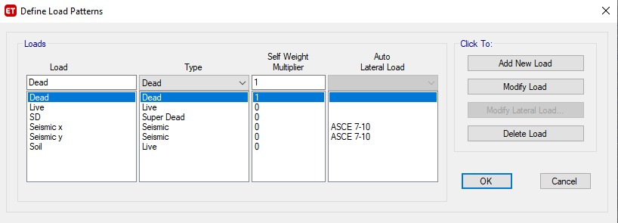
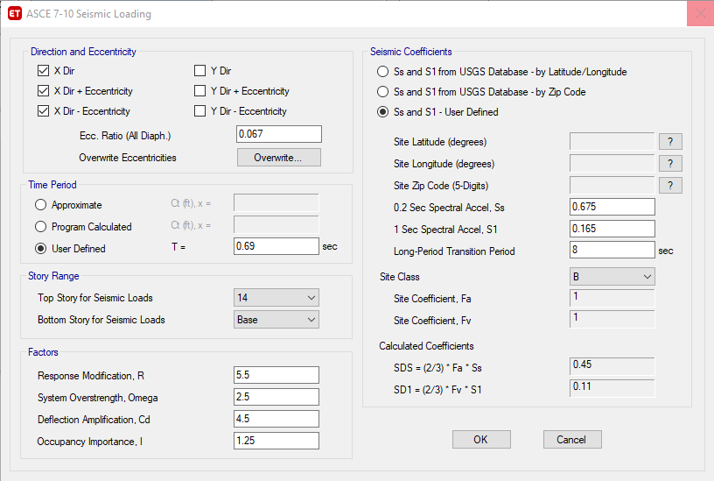
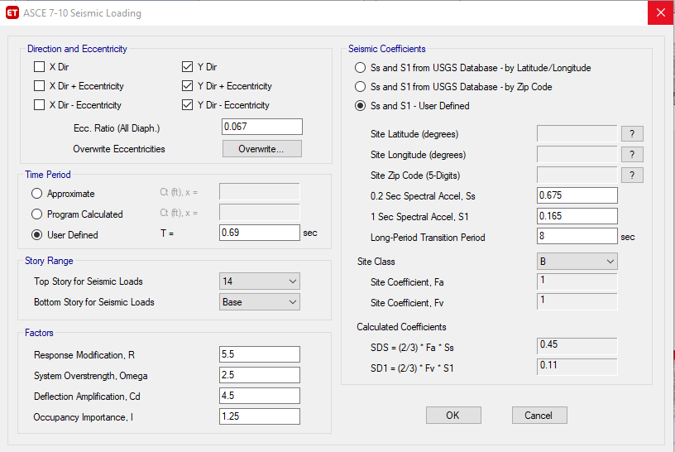
Load definition

Slide 20
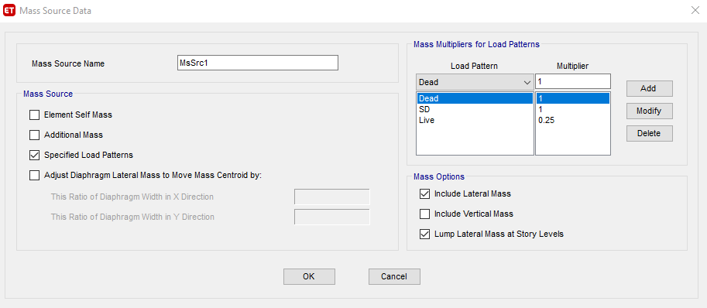
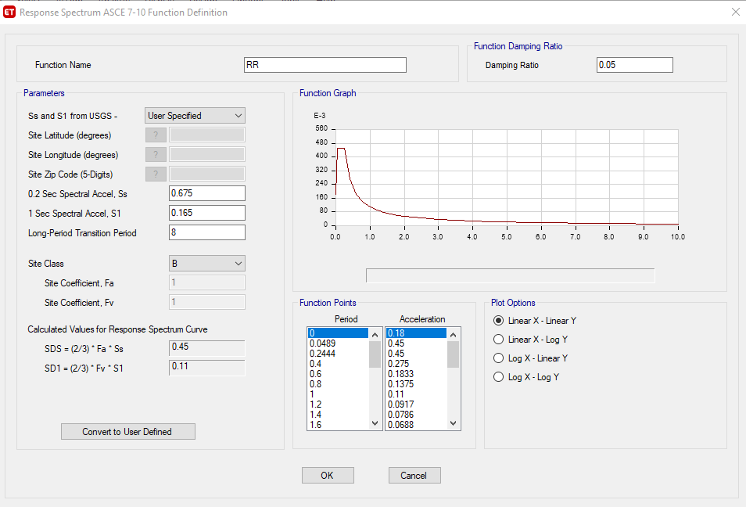
Effective mass
Response spectrum

Slide 21
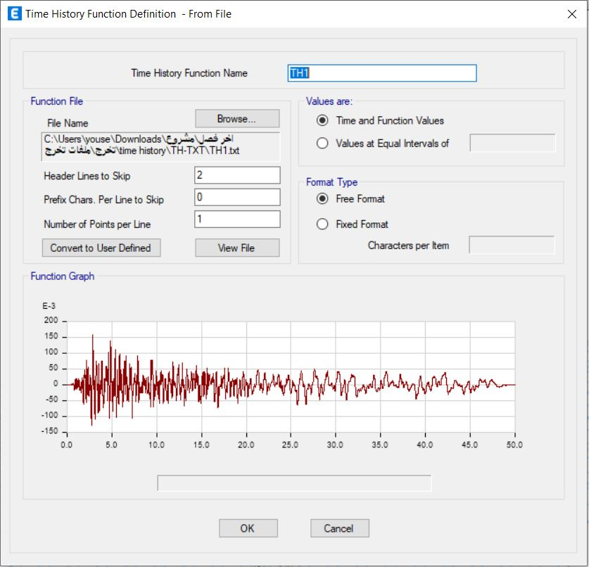
Time history

Slide 22
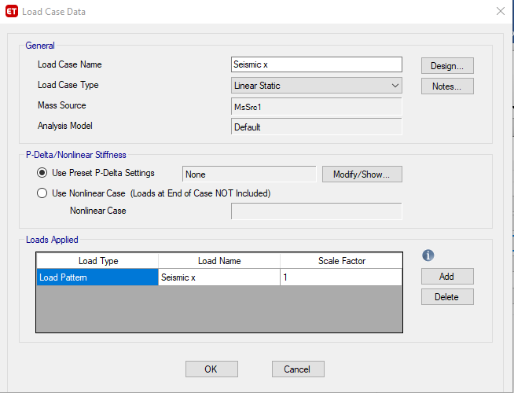

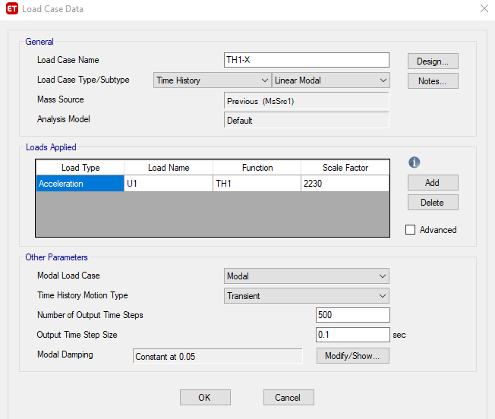
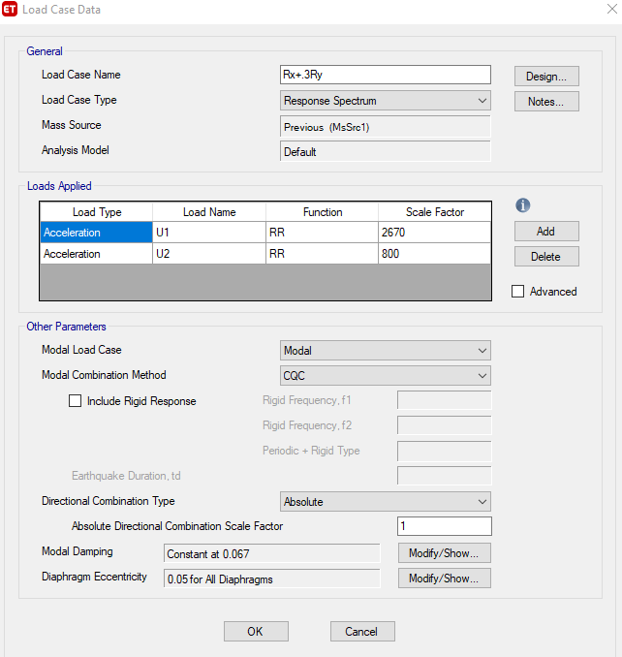
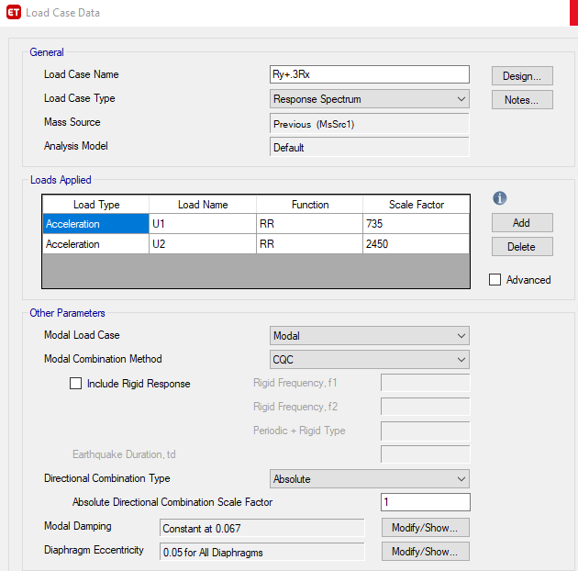
Load cases

Slide 23
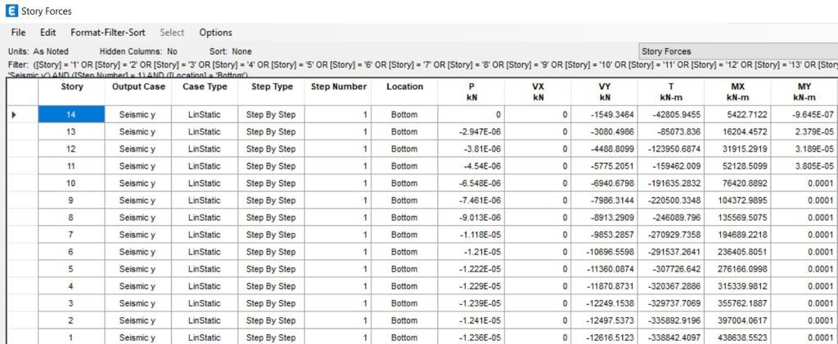
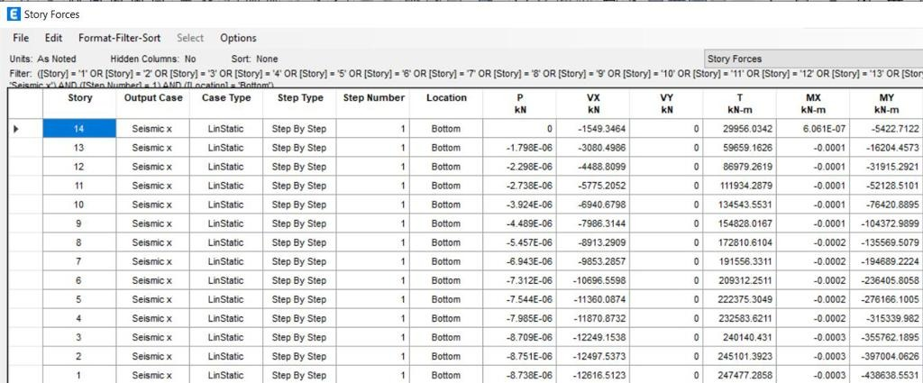
Seismic force
Equivalent static method
In Y –direction
Seismic force =12616 KN
In X –direction
Seismic force=12616 KN

Slide 24
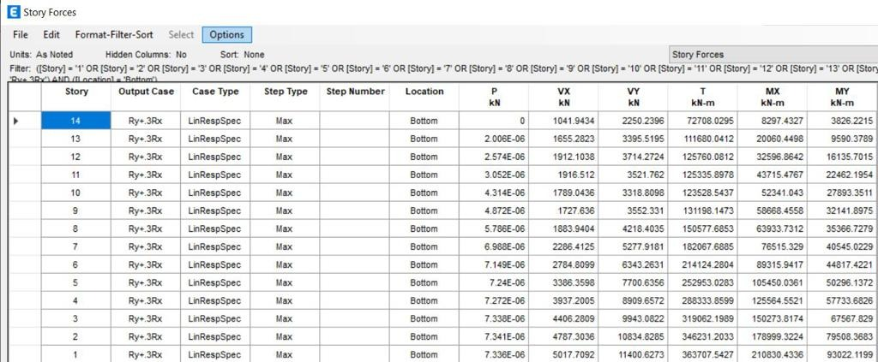
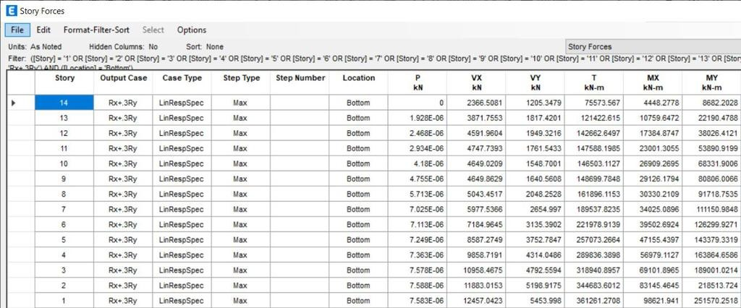
Response spectrum
In Y –direction
Seismic force=11400 KN
In X –direction
Seismic force=12457 KN

Slide 25
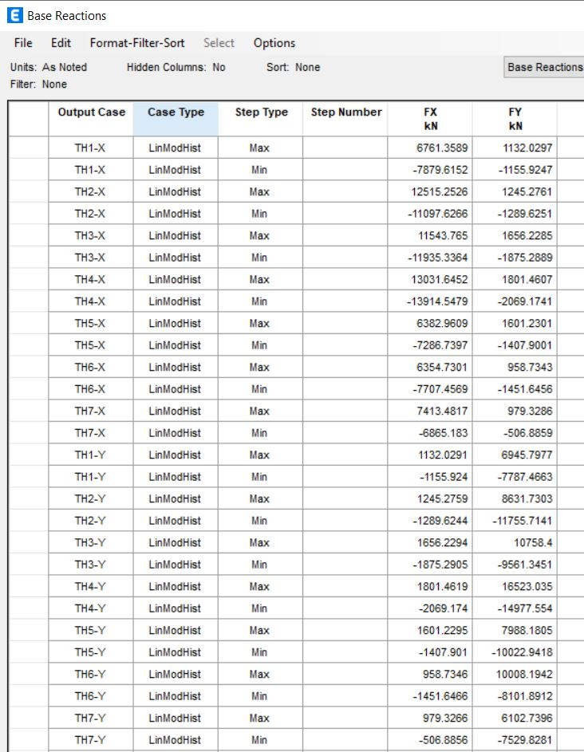
Time history
In X –direction
Seismic force=9142 KN
In Y –direction
Seismic force 9565 KN

Slide 26
Results
 | Forces in x | Forces in Y
Response spectrum | 12457 | 11400
Equivalent static | 12616 | 12616
Time history | 9142 | 9565
Response/equivalent | 98% | 90.3%
For design the equivalent static method used

Slide 27
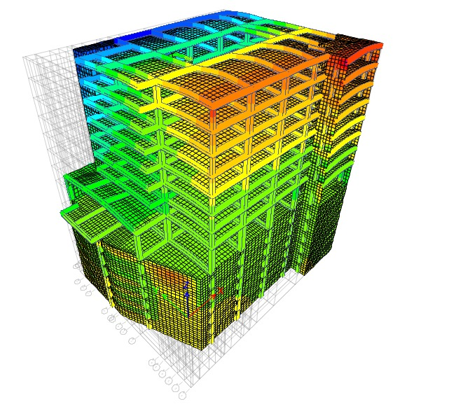
ETABS verification :
1) Compatibility check

Slide 28
2) Equilibrium check
Load type | Hand result | Etabs results | % error
Dead | 265880 | 311520 | 5%
Super imposed | 91550 | 88205 | 3.7%
Live | 54930 | 55021 | 0.25
All differences are less than 10 %

Slide 29
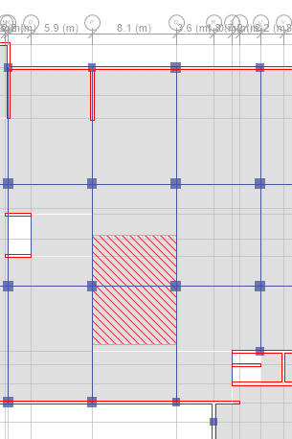
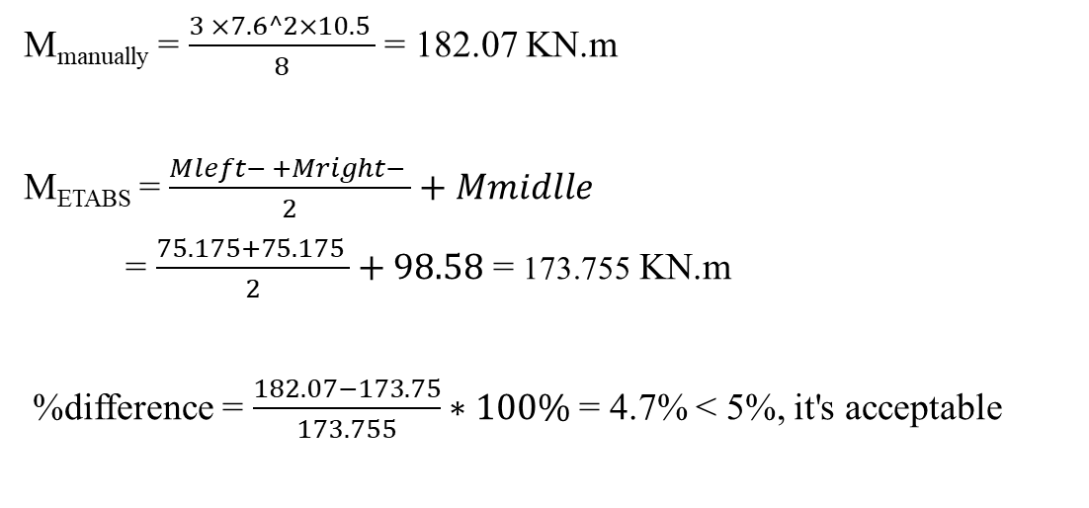
3) Stress-strain check
For frames :
M_{manually} = $\frac{3 ×7.6^2×10.5 }{8}$ = 182.07 KN.m
M_{ETABS} = $\frac{Mleft− +Mright− }{2}+Mmidlle$
= $\frac{75.175+75.175 }{2}+98.58$ = 173.755 KN.m
%difference = $\frac{182.07−173.75}{173.755}∗100\%$ = 4.7% < 5%, it's acceptable

Slide 30
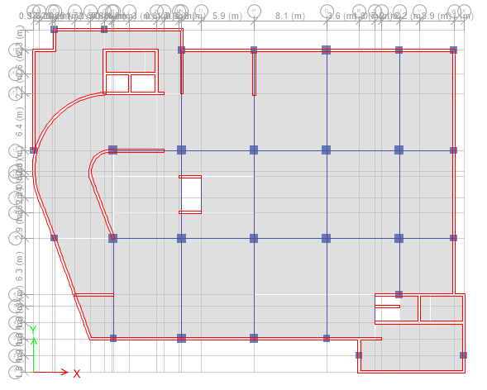
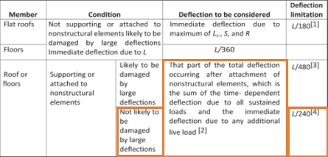
4) deflection check :

Slide 31
4) deflection check :
location | 1ST corner | 2ND corner | 3d corner | 4th corner | At the middle of panel | At the middle of the beam
Deflection(mm) | 38 | 47.95 | 54.97 | 44.3 | 90.46 | 83.5
deflection ∆𝐿𝑇= 2∆𝐷 + 1.5∆_{L}
Allowable deflection =L/240
11.2/240=46.67mm take it 1.15*46.67=53.67mm
panel deflection = displacement at the middle of the panel - average support displacement
= 90.46 -(54.97+44.34+38+47.9)/4=90.46 -46.3 =44.16 <53.67, it's acceptable
Deflection of beam = 83.5-(47.95 +38.1)/2=40.4mm < 53.67, mm it's acceptable

Slide 32
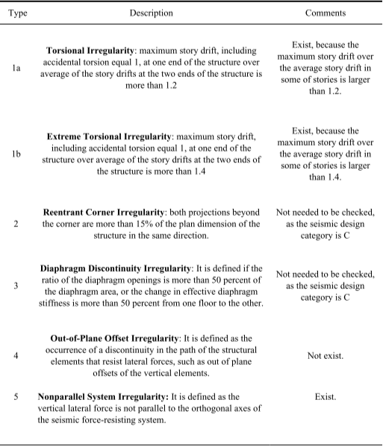
5)Structural irregularity check
Horizontal irregularity

Slide 33
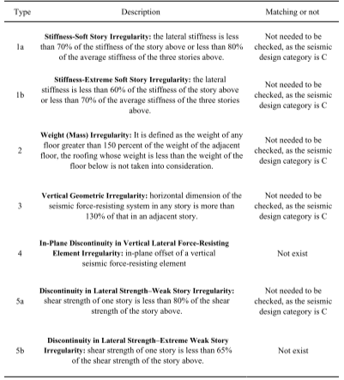
Vertical irregularity

Slide 34
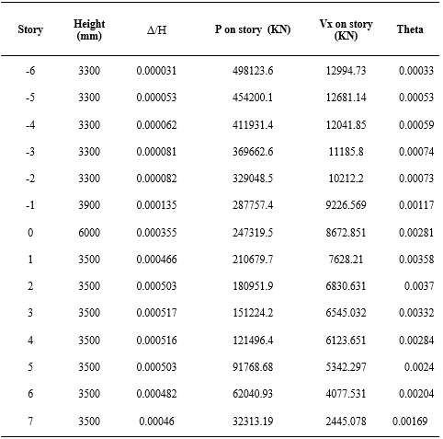

6) Effect of p-delta
θ = $\frac{P∆ Ie }{V∗Cd∗hsx}$< 0.1

Slide 35
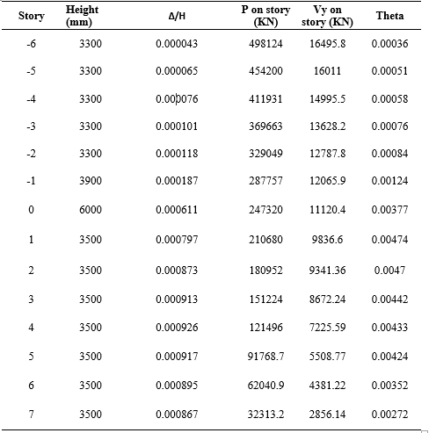
6) Effect of p-delta
θ = $\frac{P∆ Ie }{V∗Cd∗hsx}$< 0.1

Slide 36
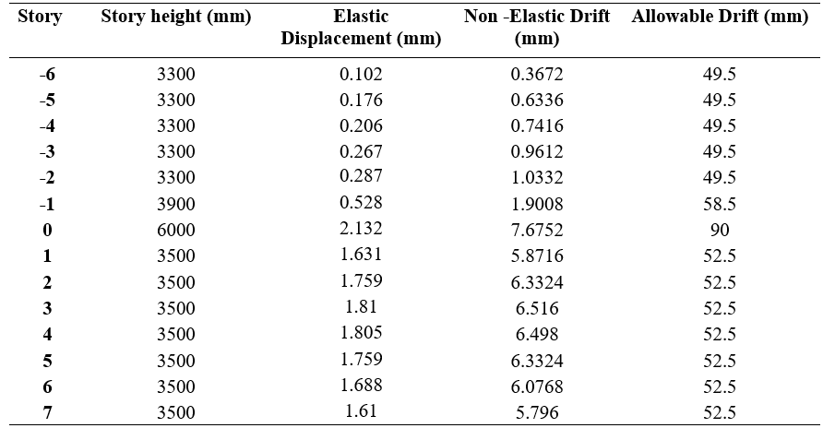
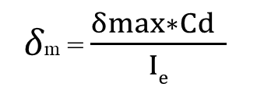
7) Drift check
𝛿m = $\frac{δmax∗Cd }{Ie}$
∆𝑎= 0.015ℎ𝑠𝑥
In X-direction

Slide 37
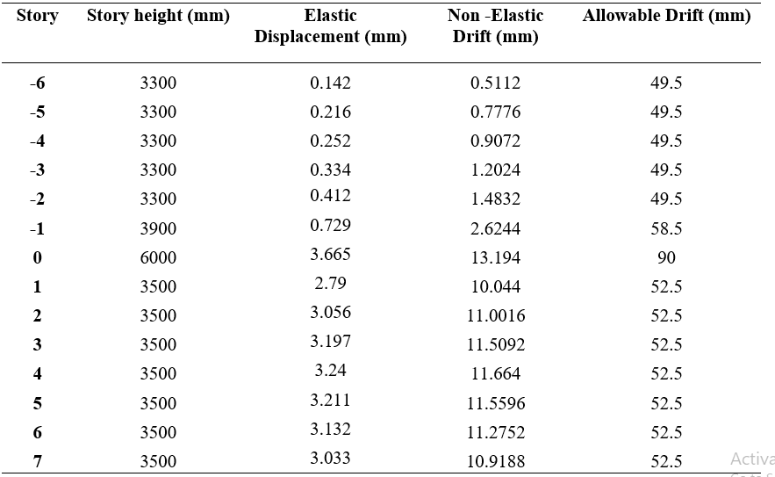
7) Drift check
In Y-direction

Slide 38
8) Period check
T_{a} =C_{t}*h_{n} ^{x}
T_{a} =0.0488*34.2^{0.75} =0.69 sec
Upper limit = T_{a}*C_{u} =0.69*1.7=1.17 sec
-The fundamental period of the structure in X- direction= 0.8 sec < upper period limit
- The fundamental period of the structure in Y- direction= 1.1sec < upper period limit

Slide 39


9) Base shear check
$V=C_{s}×W$
$C_{s}=\frac{S_{DS}}{\frac{R}{I_{e}}}$ = $\frac{0.45}{\frac{5.5}{1.25}}$ =0.102
$C_{s max}=\frac{S_{D1}}{\frac{T∗R}{I_{e}}}$= $\frac{0.11}{\frac{0.69∗5.5}{1.25}}$ = 0.036 use $C_{s max}$
W=D +SD+ 0.25*L=353000 KN
V=0.036*353000=12708 KN
V from etabs=12547 KN
%=1.3%

Slide 40
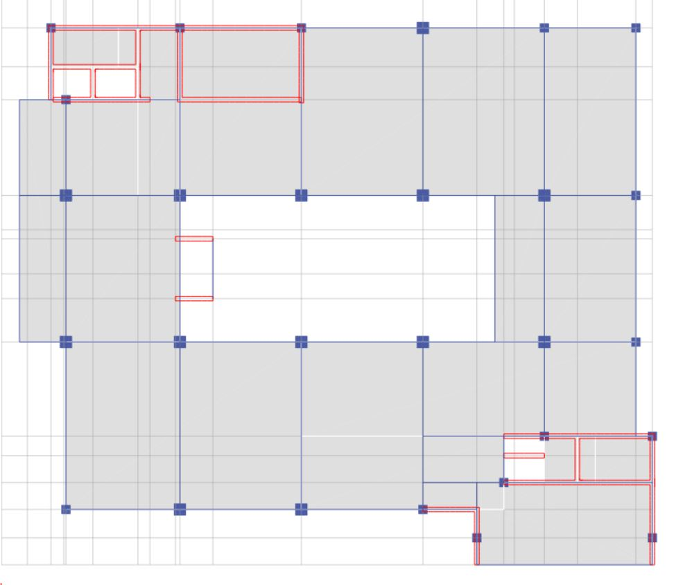
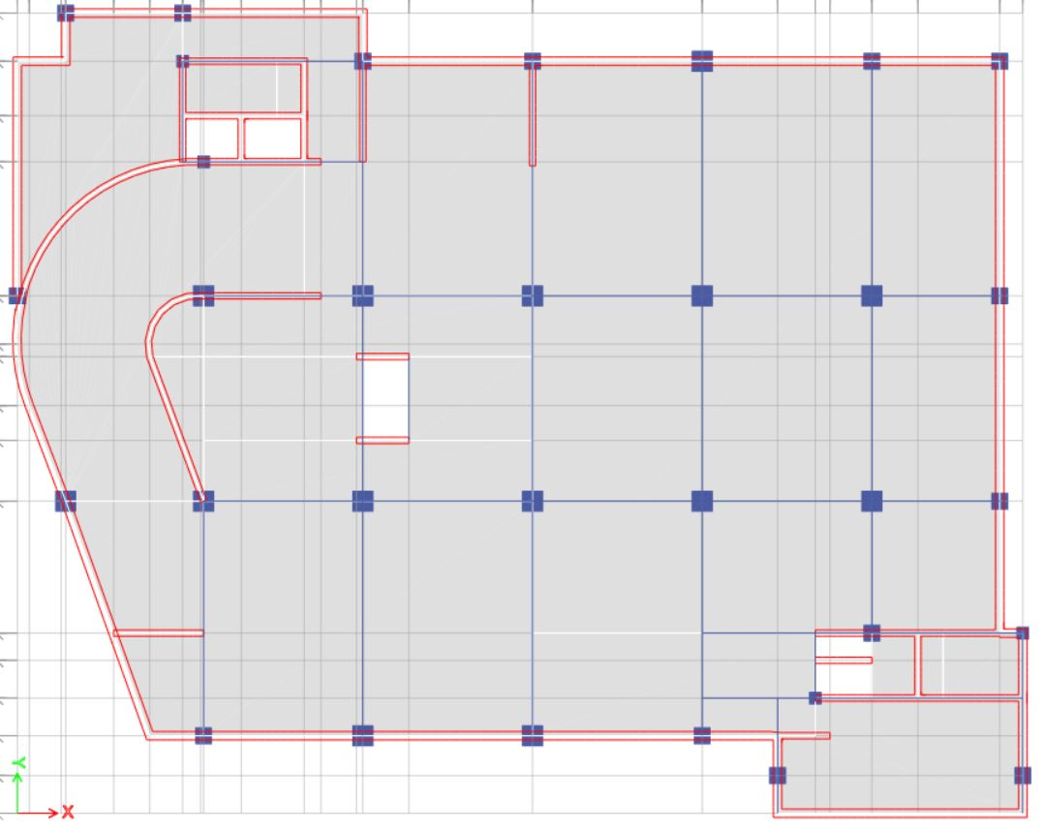
Design :
DESIGN OF SLAB
All slab are solid slab
Thickness = 250mm
cover = 30mm
ETABS model shows that all slabs in first five
stories have nearly the same reinforcement
and the other stories to the thirteen story
have nearly the same.

Slide 41
Steel reinforcement from ETABS .
Direction |  | Basement 2 | Top floor
In x direction | Top | ∅14/120mm | ∅14/150mm
 | Bottom | ∅14/200mm | ∅12/120mm
In y direction | Top | ∅14/120mm | ∅14/150mm
 | Bottom | ∅14/120mm | ∅12/150mm

Slide 42
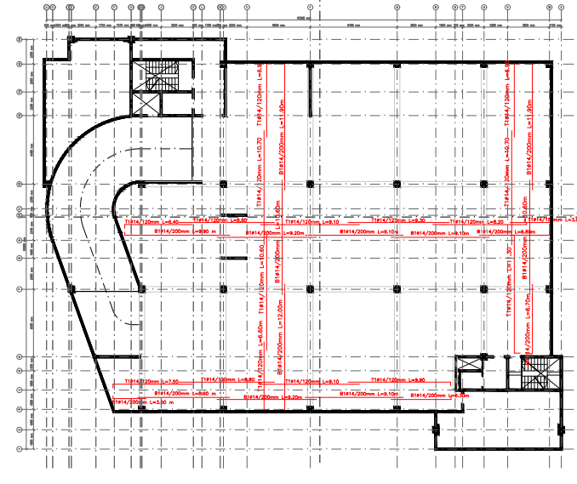
Slab reinforcement - basement 2

Slide 43
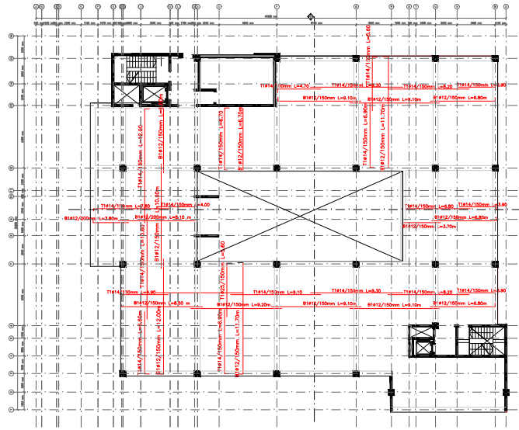
Slab reinforcement - Top floor

Slide 44
2 )Design of beams
All the beams are drop beams
B (mm) | H (mm)
400 | 500
500 | 700
500 | 850

Slide 45
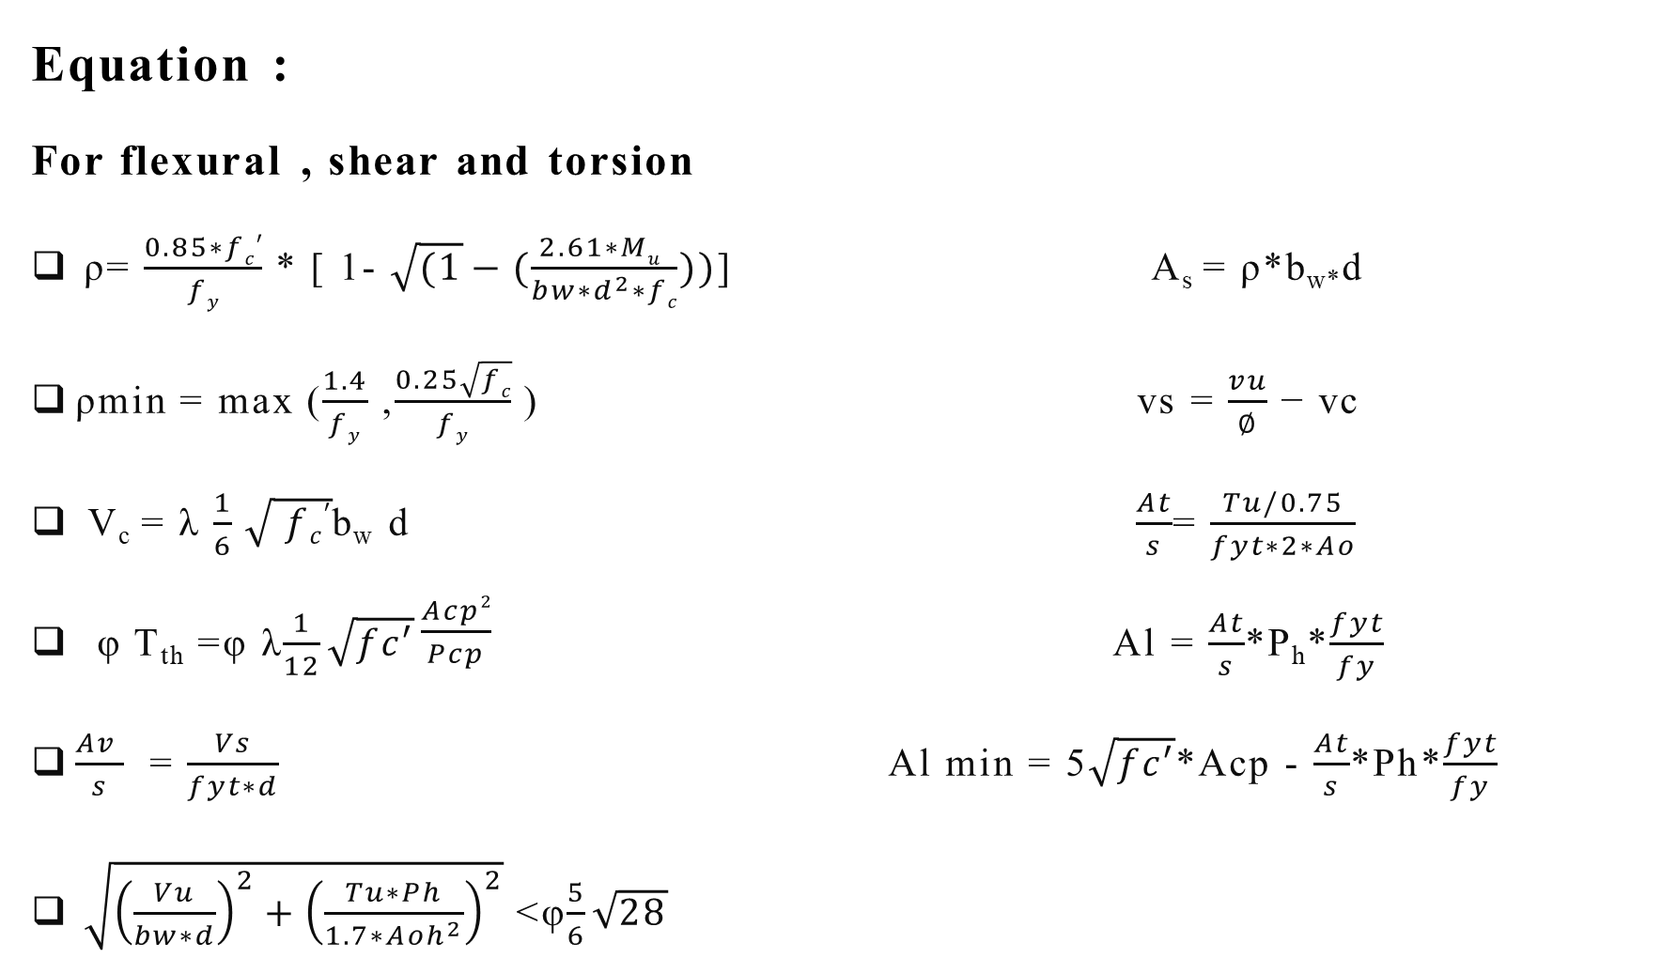
Equation :
For flexural , shear and torsion
ρ= $\frac{0.85∗fc′}{ fy }$ * [ 1- $\sqrt{(1}−(\frac{2.61∗Mu }{bw∗d^{2}∗fc}))$] A_{s} = ρ*b_{w*}d
ρmin = max ($\frac{1.4}{fy}$ ,$\frac{0.25\sqrt{fc}}{fy}$ ) vs = $\frac{vu}{∅}$ − vc
V_{c} = λ $\frac{1}{6}$ $\sqrt{ fc′}$b_{w} d $\frac{At}{s}$= $\frac{Tu/0.75}{fyt∗2∗Ao}$
φ T_{th} =φ λ$\frac{1}{12}\sqrt{fc′}\frac{Acp2}{Pcp}$ Al = $\frac{At}{s}$*P_{h}*$\frac{fyt}{fy}$
$\frac{Av }{s}$ = $\frac{Vs}{fyt∗d}$ Al min = 5$\sqrt{fc′}$*Acp - $\frac{At}{s}$*Ph*$\frac{fyt}{fy}$
$\sqrt{{\left(\frac{Vu}{bw∗d}\right)}^{2}+{\left(\frac{Tu∗Ph}{1.7∗Aoh^{2}}\right)}^{2}}$ <φ$\frac{5}{6}\sqrt{28}$

Slide 46
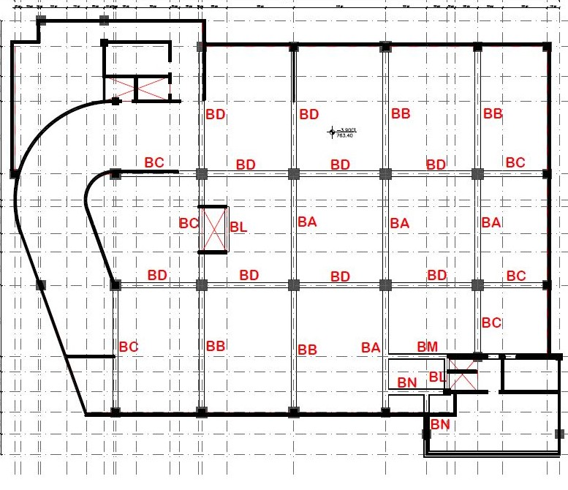
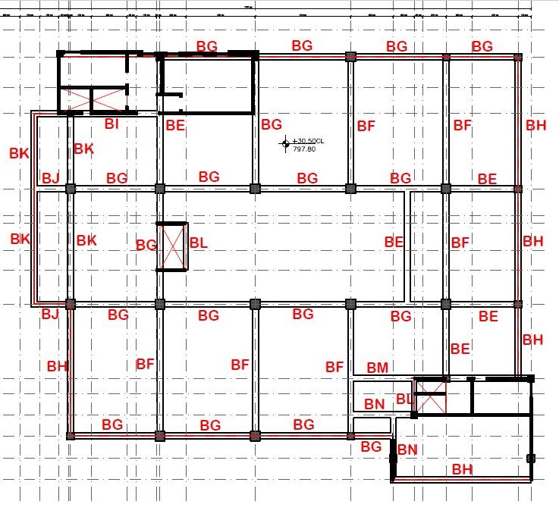
Design of beams

Slide 47
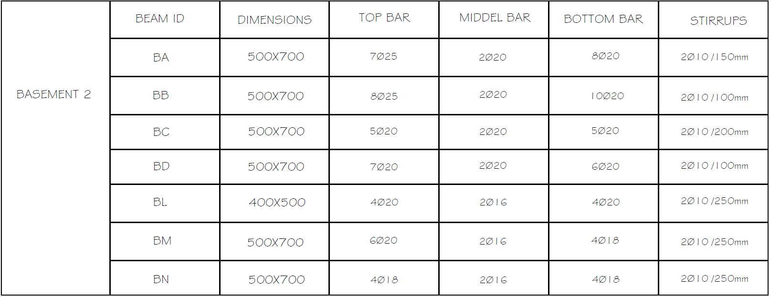
Beams reinforcement - basement 2

Slide 48
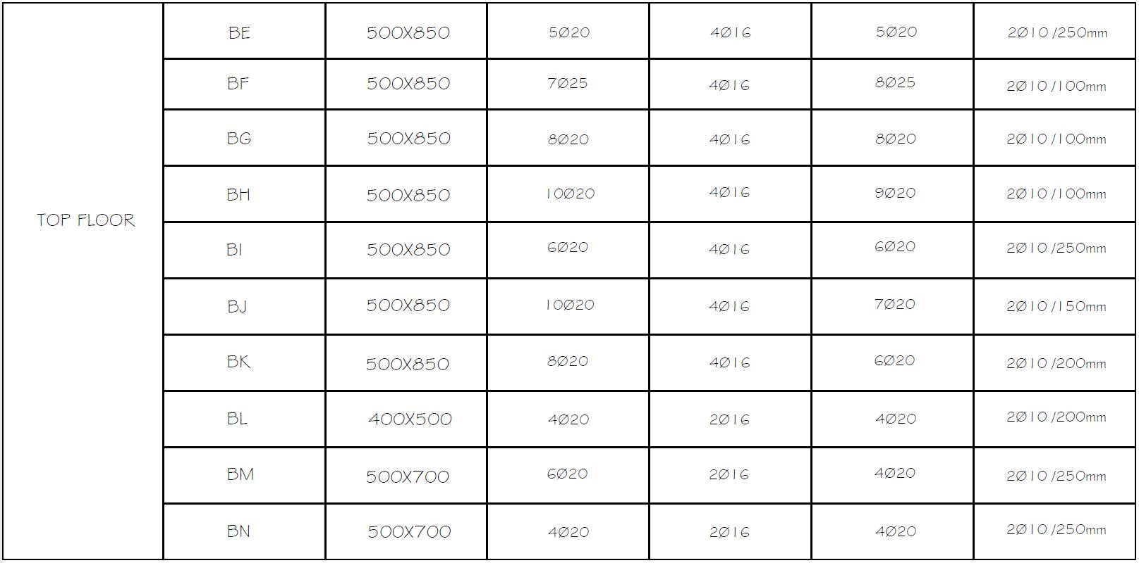
Beams reinforcement - Top floor

Slide 49
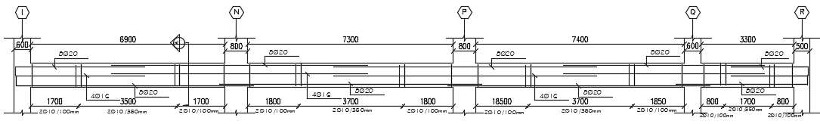
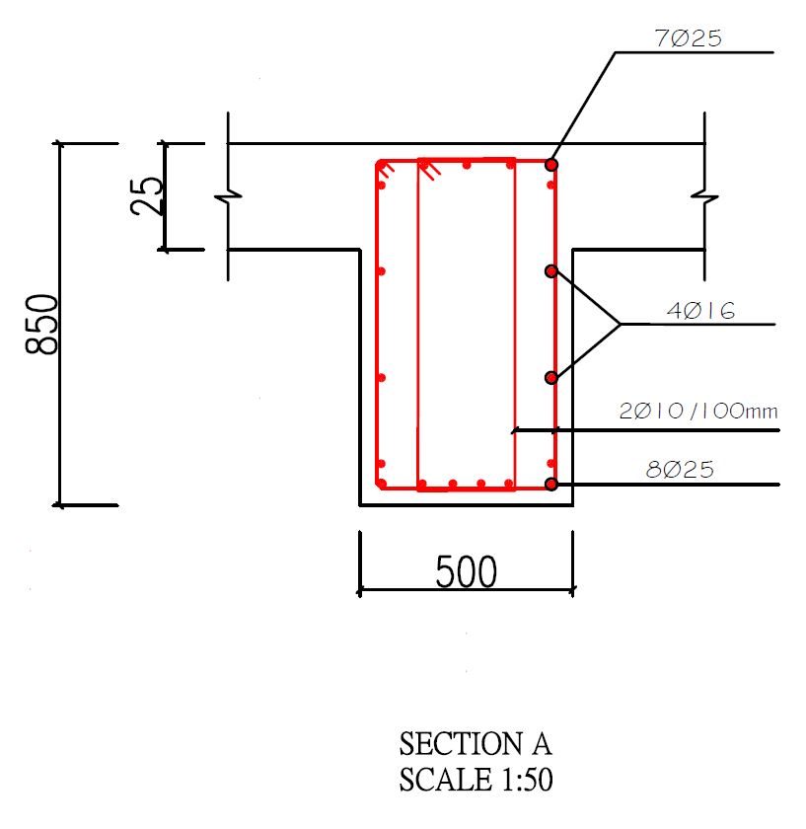
Frame (1) reinforcement
LONGITUDUNAL
CROSS SECTION

Slide 50
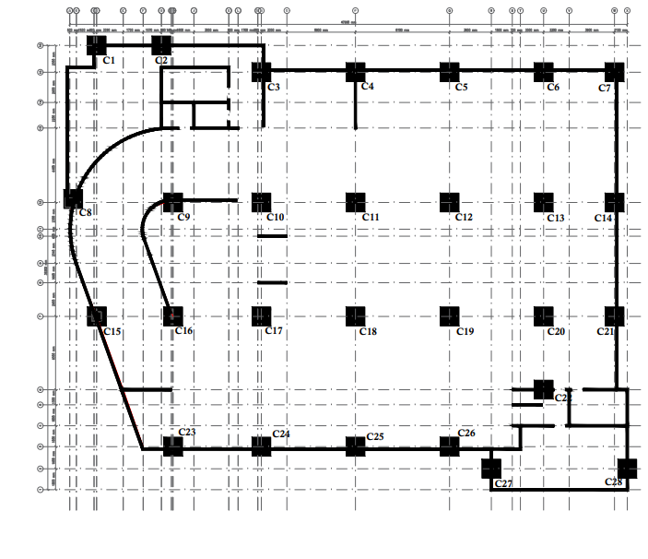
3)column design
Column layout

Slide 51

column reinforcement

Slide 52


column reinforcement

Slide 53
4) Design of Walls
Group of piers and spandrels were defined in ETABS software. Where, the vertical elements in each wall were assigned to a certain pier, while the horizontal elements which are exist above the openings were assigned to a certain spandrel.
Thickness
500 mm
400 mm
300 mm

Slide 54


Reinforcement of Walls
Longitudinal reinforcing per meter length $=\frac{14000}{11.2}=1250{mm}^{2}/m$
Longitudinal reinforcing in each layer $=\frac{1250}{2}=625{mm}^{2}/m$
$No. of bars = \frac{625}{\frac{π}{4}{×14}^{2}}=4.06$ Use 1$∅$14/200mm.

Slide 55


Reinforcement of Walls
Shear reinforcing per meter length $1250$mm²/m
Shear reinforcing in each layer $=\frac{1250}{2}=625{mm}^{2}/m$
$No. of bars = \frac{625}{\frac{π}{4}{×14}^{2}}=4 bar$ Use 1$∅$14/200mm.

Slide 56

5) Design of footing :
Assume B.C =400 Mpa
Total footing area = $\frac{load soil }{bearing capacity}$ =$\frac{498254}{400}$= 1245 m²
Basement area =1556 m^2
As 1245/1556 =0.80 , this gives an indication that mat foundation should be used.
Area of mat = 1887 m² extend out the area of building by 2 m
H =1.7 m, d=1.64m (cover 6 cm)

Slide 57

498254/1887 = 264 MPa < 400 Mpa
ok, area of mat sufficient
From ETABS Max Soil pressure =390 KN/m2
<400 Mpa ok

Slide 58


Punching shear Check:
𝑉𝑐 = min 0.33× √𝐹`𝑐 × 𝑏_{O} × d
0.083 ($\frac{ αsd}{bO}$+ 2) × √𝐹`𝑐 × 𝑏_{O} × d
0.17 (1 +$\frac{ 2}{βc}$ ) × √𝐹`𝑐 × 𝑏_{O} × d
From ETABS all D/C ratio <1
Max D/C =0.746

Slide 59

Reinforcement for mat
For top bars used minimum area of steel 1φ25/150 mm in both direction
For bottoms used 1φ25/150 mm in both direction
Except blue circle additional bottom reinforcement 1φ32/150mm in both direction
And yellow circle additional bottom reinforcement 1φ18/150mm in both direction

Slide 60


Reinforcement for mat

Slide 61


