Slide 1

An-Najah National University Facility of Engineering and Information Technology Department of Building Engineering Graduation Project 2
An integrated Redesign for a samer center
Supervisor:
Dr. Monther Dwaikat
Prepared by:
Deena Hanani
Shahd Hmouda
Sujood Qadomi
May Samaeneh
Academic year : 2021-2022

Slide 2
Site and location

Slide 3
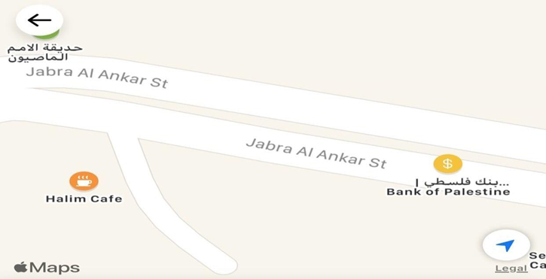
Site location
This project is located in the city of Ramallah, AL Masyon, Jabra AL Ankar St next to the Bank of Palestine, which is in the Al-Safad Building. It is surrounded by a residential house from behind, and next to it is a commercial building

Slide 4
Architectural Plans

Slide 5
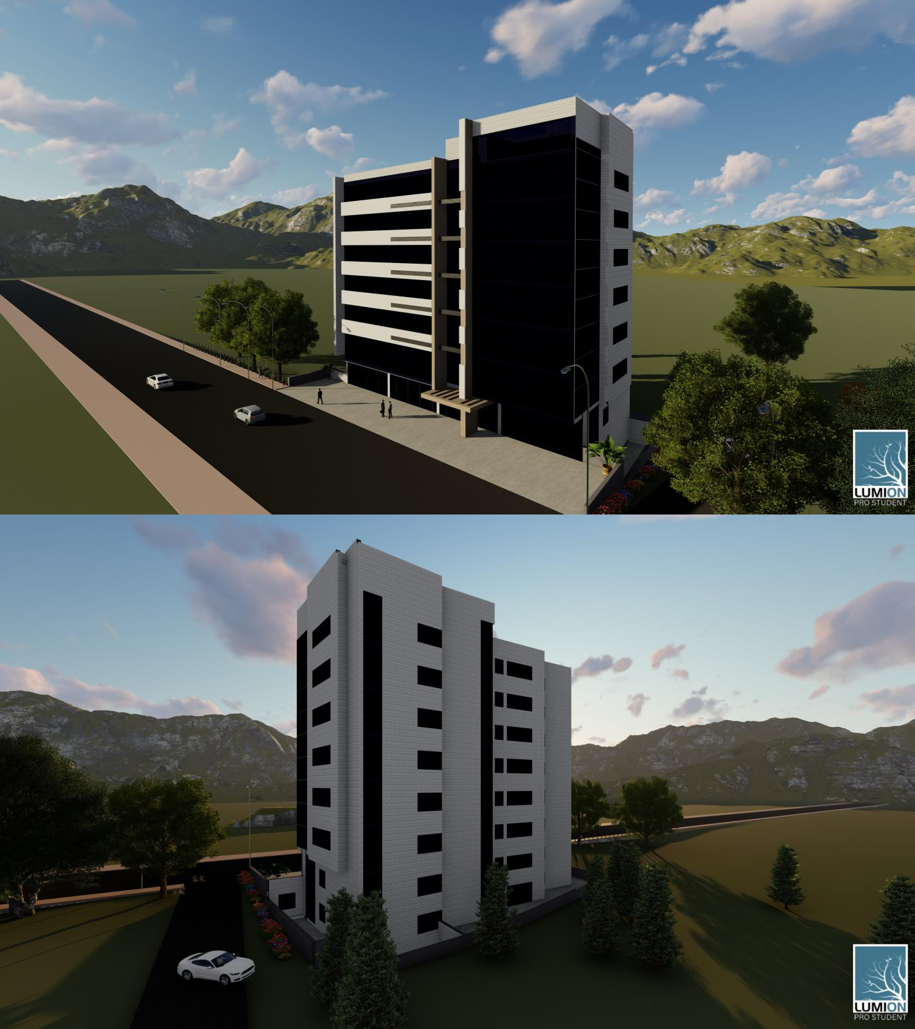
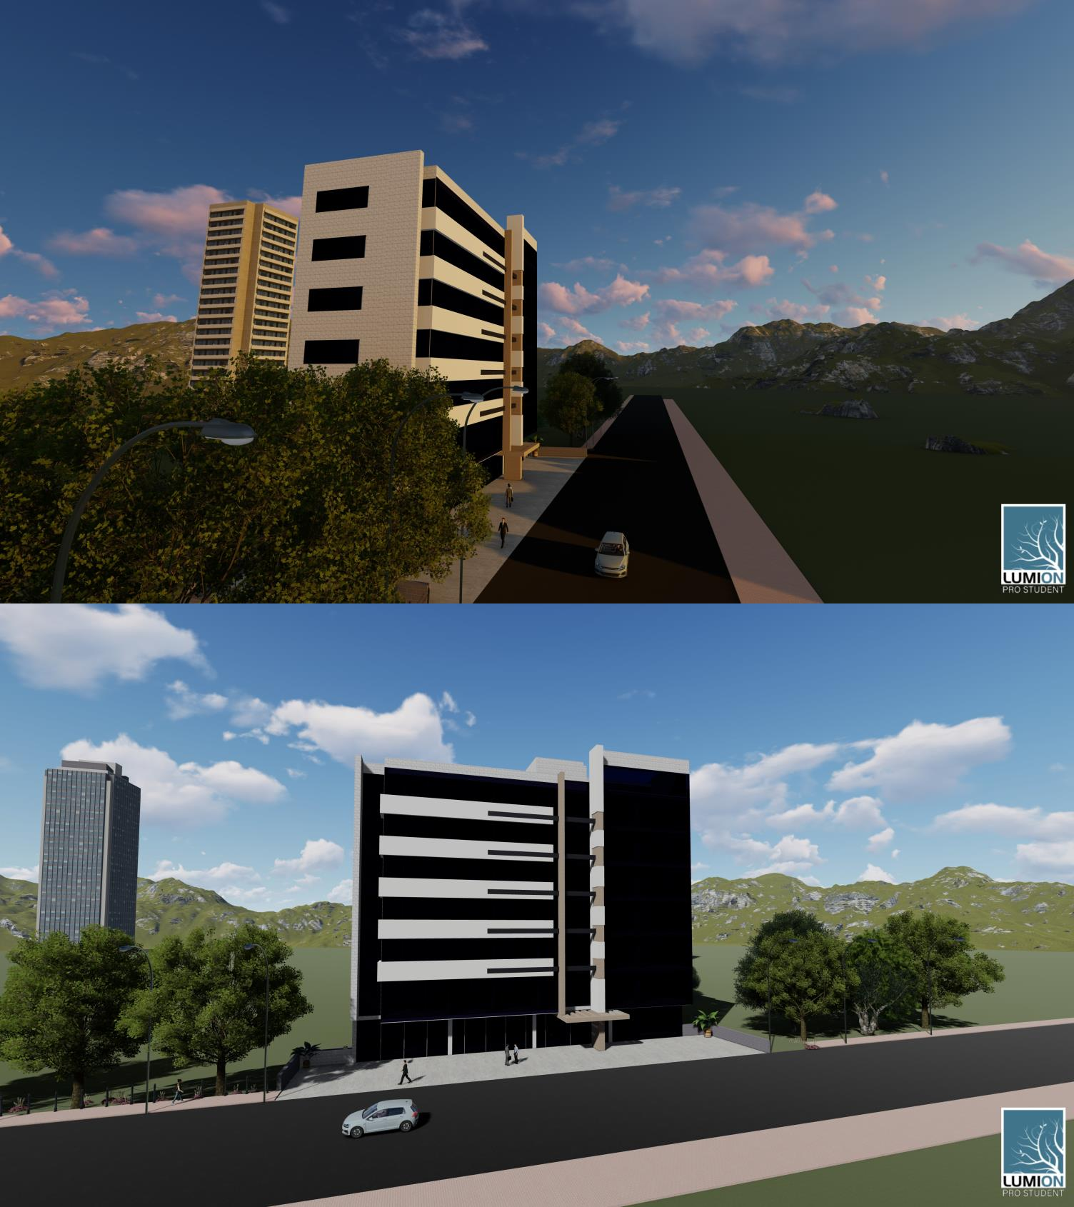
3D Model

Slide 6
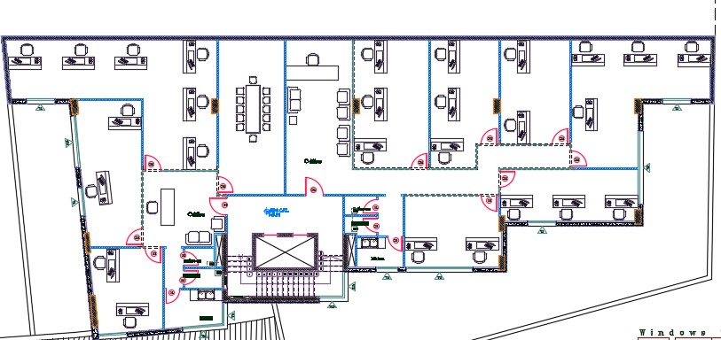
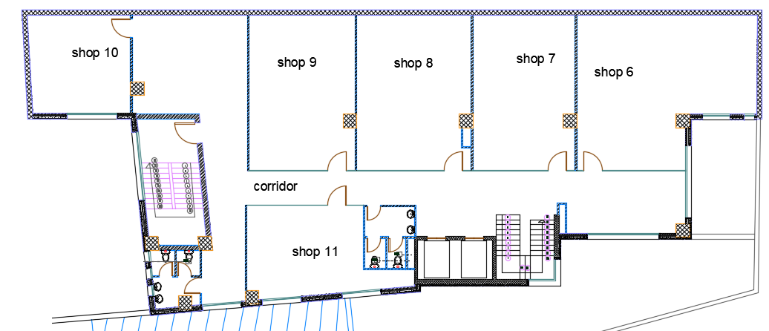
First basement
Before
After

Slide 7
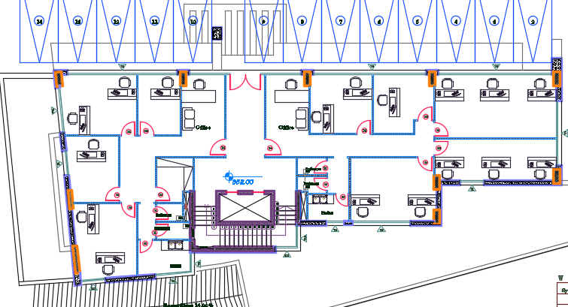
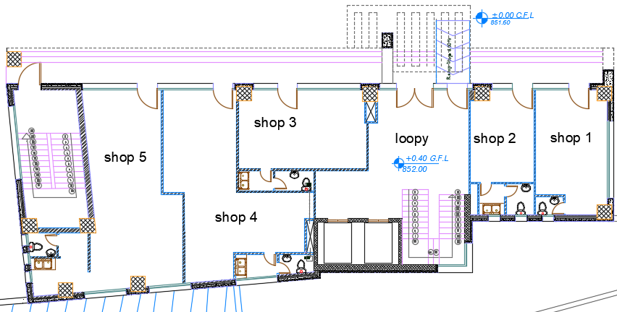
Ground floor
Before
After

Slide 8
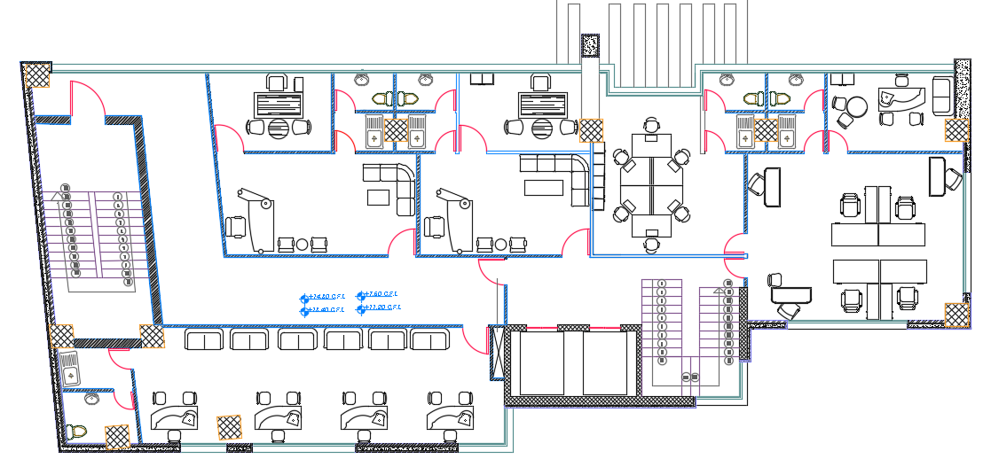
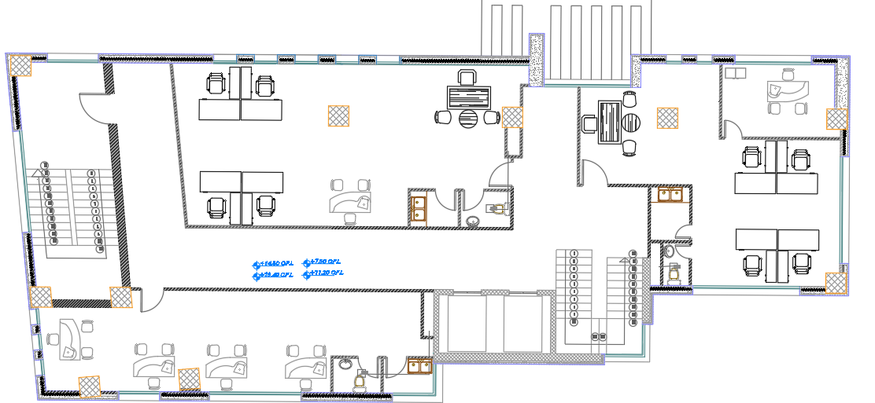
Typical floor (Offices)
Befor
After

Slide 9
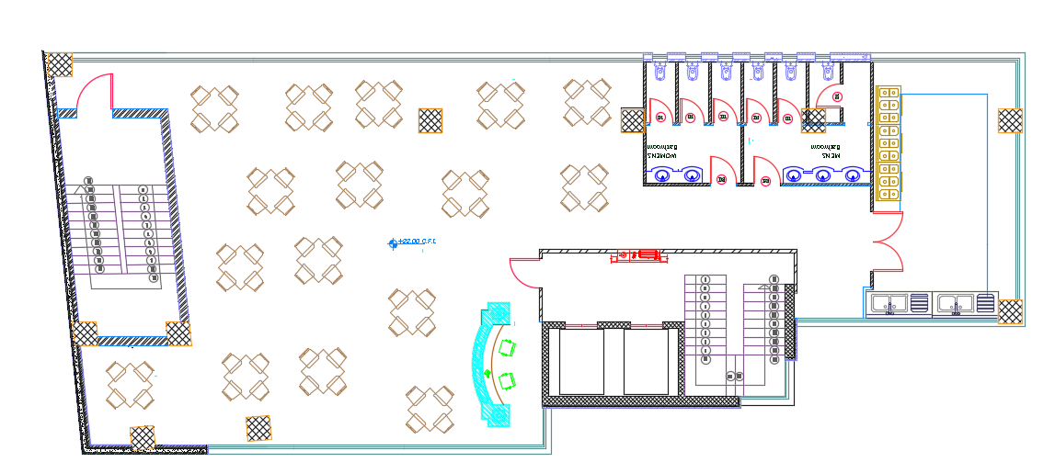
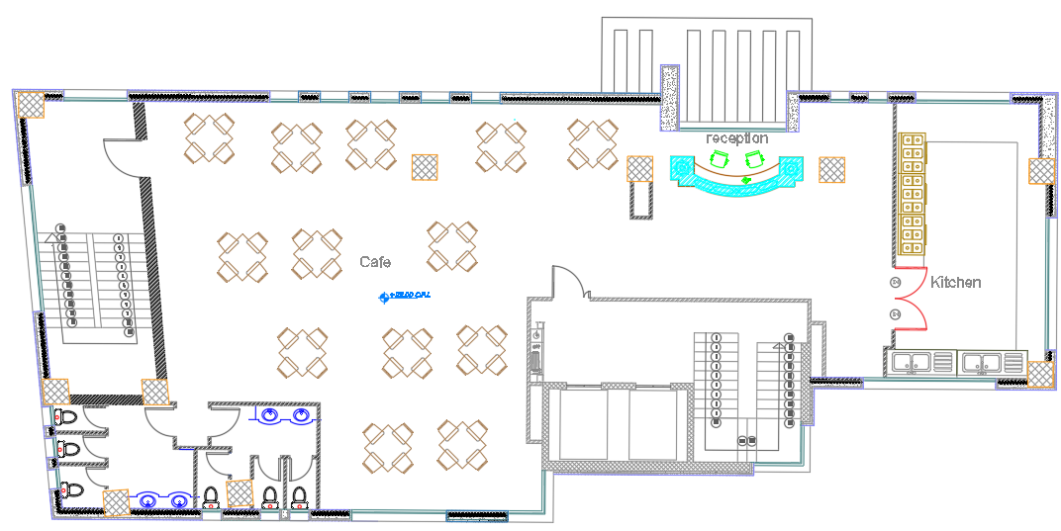
Roof floor
Befor
After

Slide 10
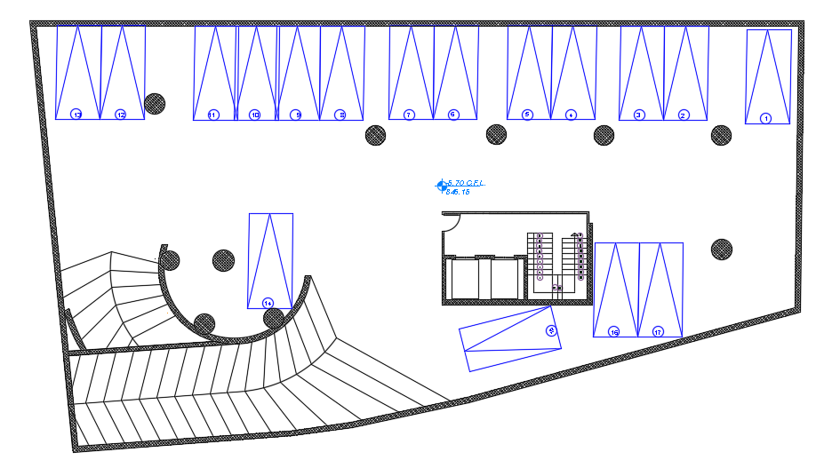
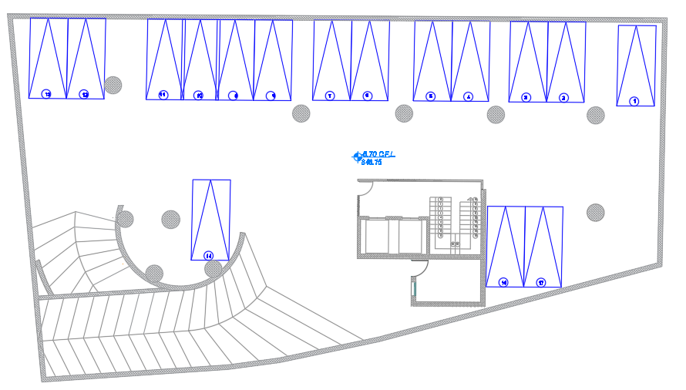
Second basement
Befor
After

Slide 11
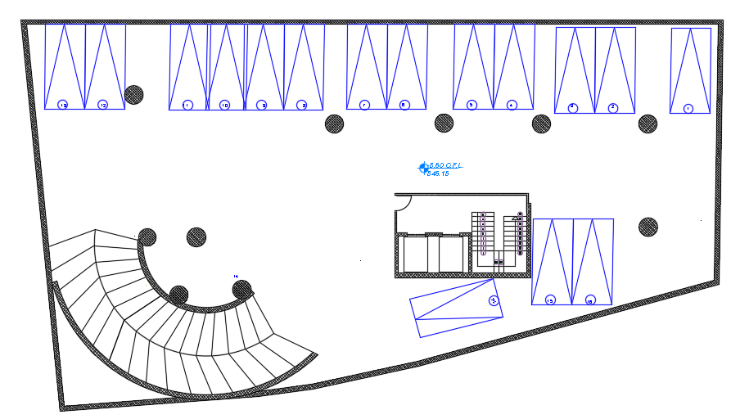
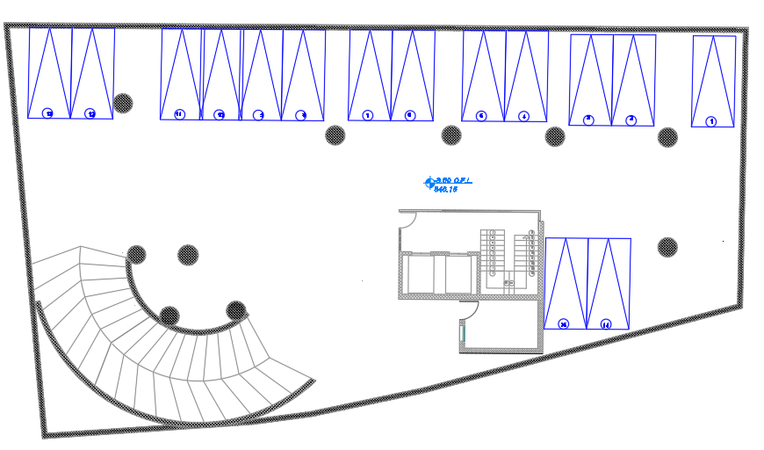
Third basement
Befor
After

Slide 12
Environmental Design

Slide 13
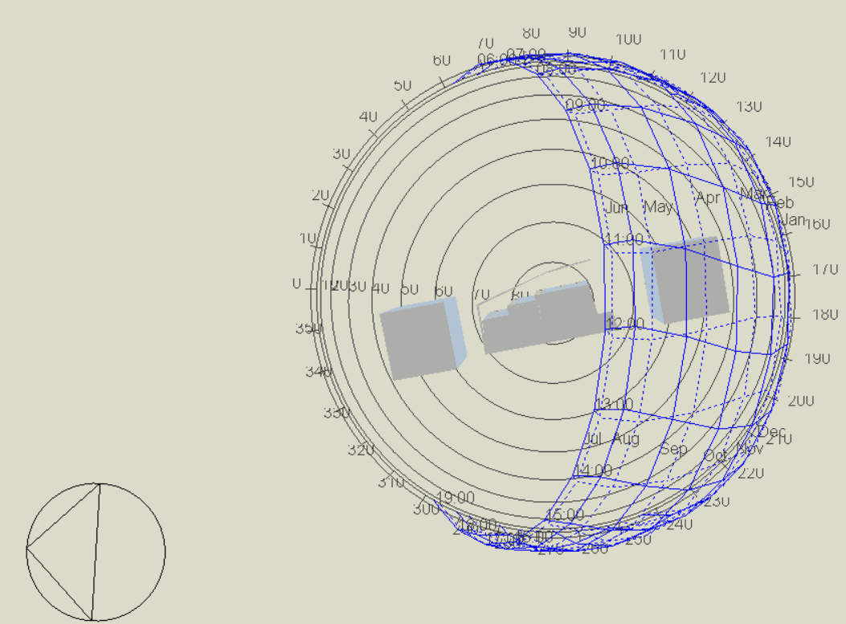
Sun path

Slide 14
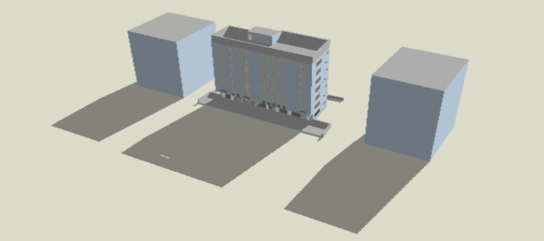
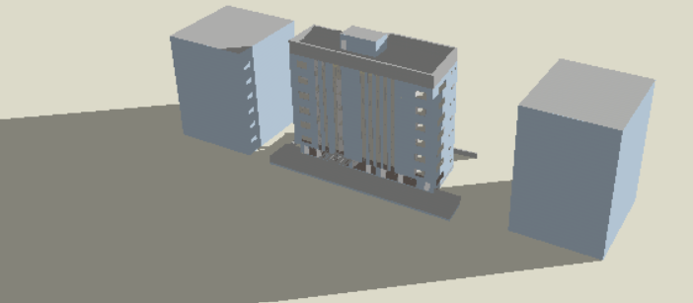
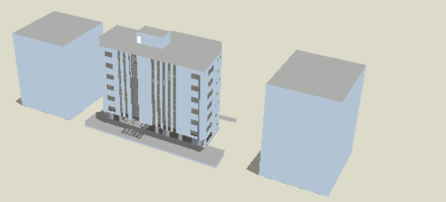
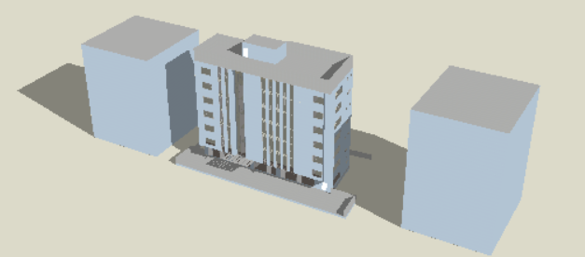
Shading
In summer
In winter
At 8:00 AM
At 12:00 PM

Slide 15
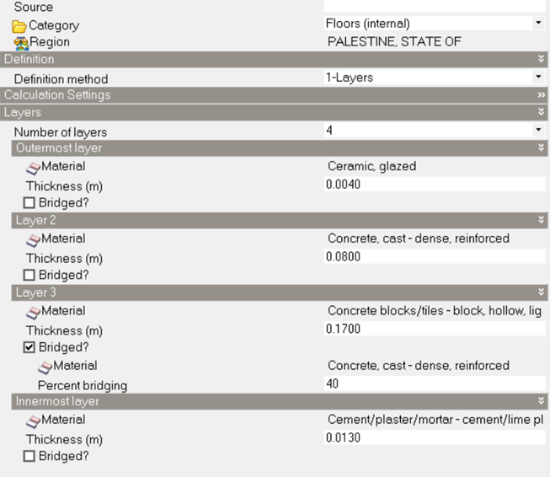
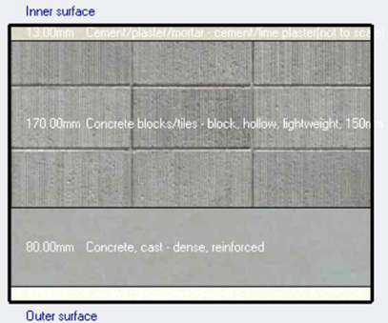
Material used
Internal slab:
According to the table above, the value of (u-value) was calculated, the result is u=1.6(w/m^2.k)

Slide 16
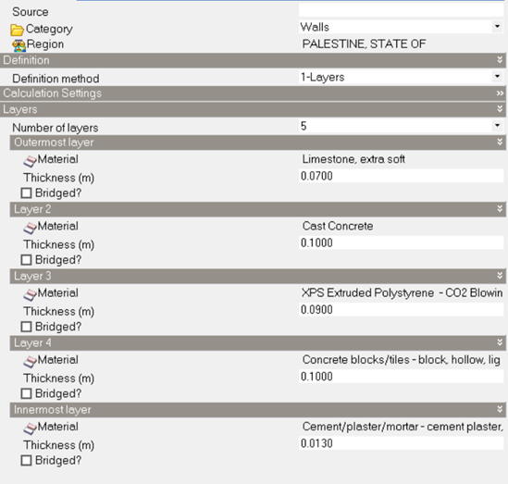
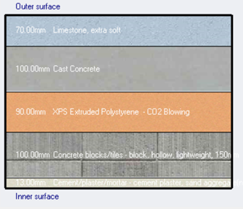
Wall material :
According to the table above, the value of (u-value) was calculated, the result is u=0.3(w/m^2.k)

Slide 17
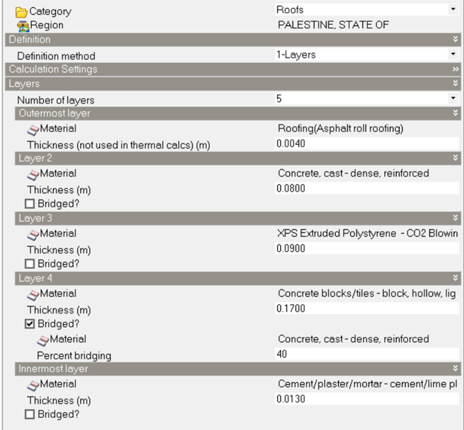
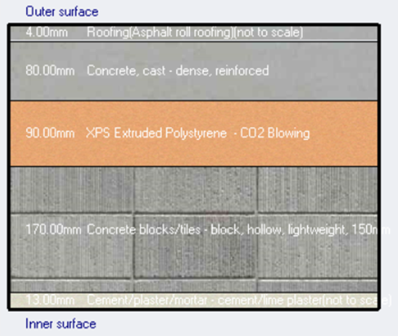
Roof material :
According to the table above, the value of (u-value) was calculated, the result is u=0.325(w/m^2.k)

Slide 18
Modification scenario on building :
Scenario
1. Isolate the building
2. Using double type of glass (U-value =1.33 W/m2-K)
3. Using another type of double glass (U-value =1.26 W/m2-K)
4. Placing louvers on the eastern and western facades
5. Minimizing the size of the west windows
6. Minimizing the size of the east windows
7. Reducing the size of the northern windows and placing windows on the southern elevation
8. Edit HVAC system to VRF

Slide 19
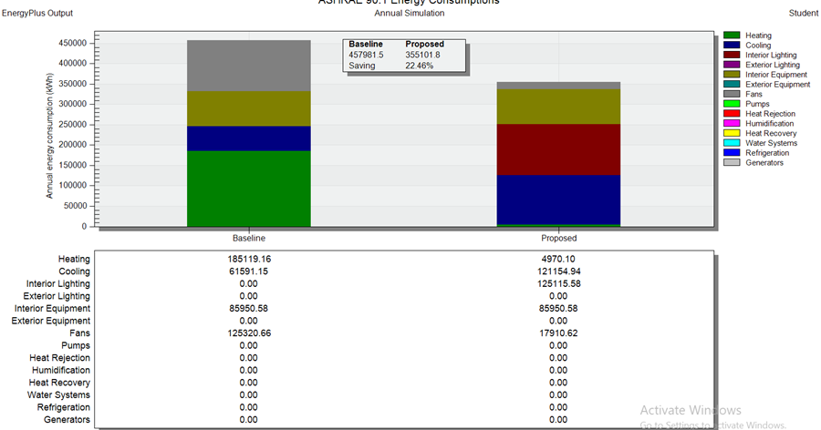
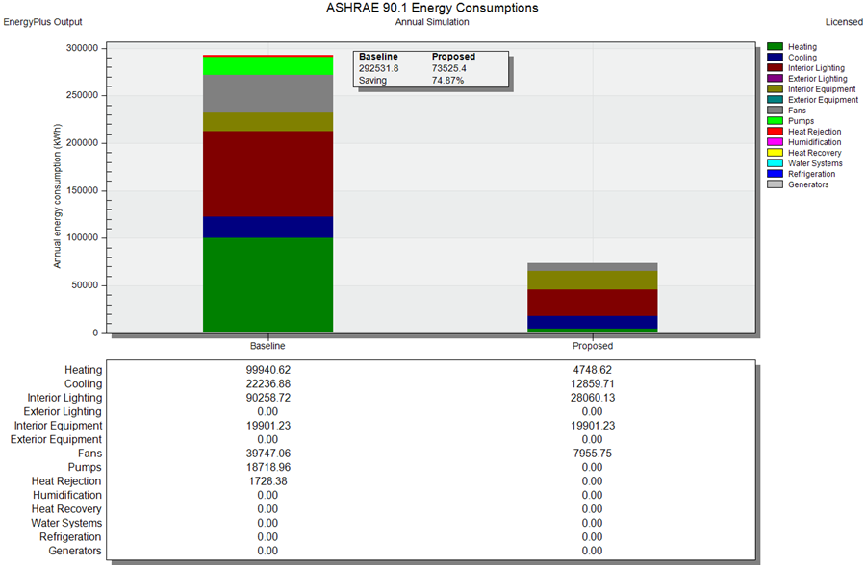
This type of building's baseline total consumption is (292531.8 KWh)
We have made several modifications to improve the building where the energy conservation rate has reached from 20% to 75%, which indicates that the building has become more energy efficient
لل
Befor
After

Slide 20
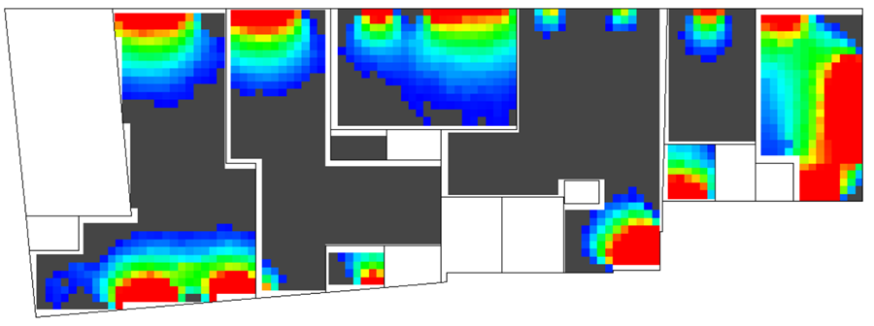
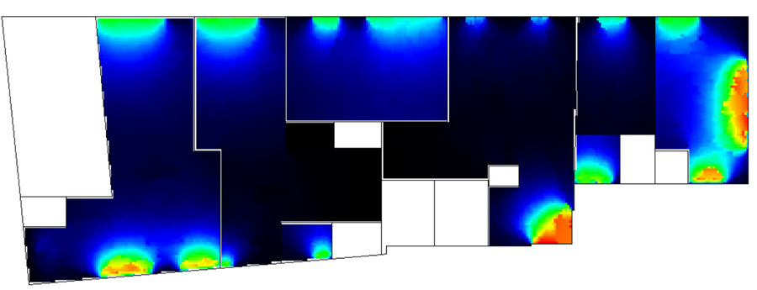
Daylight analysis Ground floor
Befor
After

Slide 21
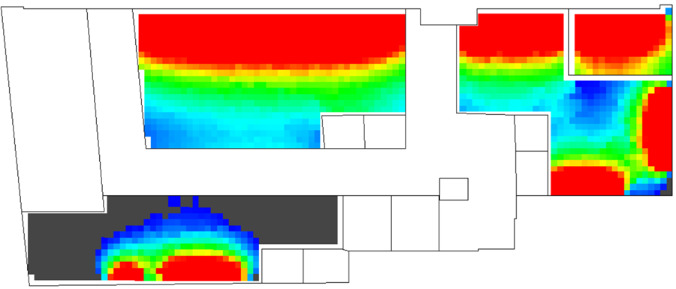
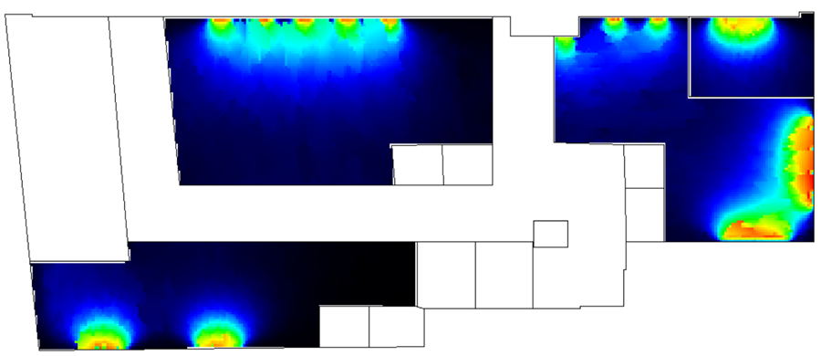
Typical floor ( Offices )
Befor
After

Slide 22
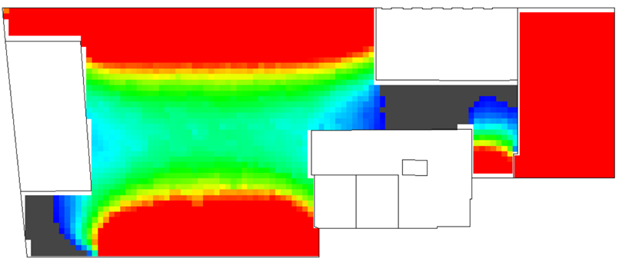
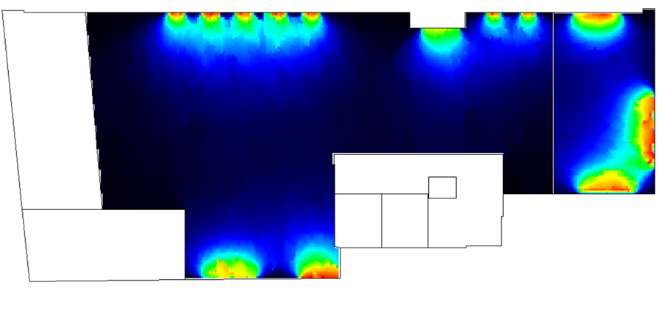
Roof floor
Befor
After

Slide 23
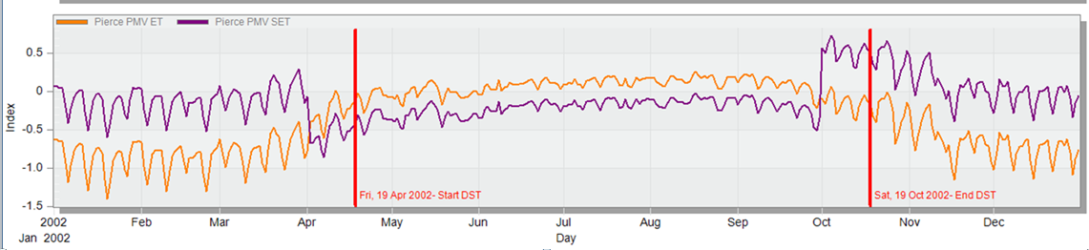
Thermal comfort
The comfort graph for the faculty from Design Builder
According to Pierce PMV SET (the Predicted Mean Vote), if the range between – 0.5 and + 0.5, the occupant will be comfortable during the year. In this Figure, shows that the Pierce PMV SET lies approximately between - 0.5 and + 0.5, so the occupant will be comfortable during the year.

Slide 24
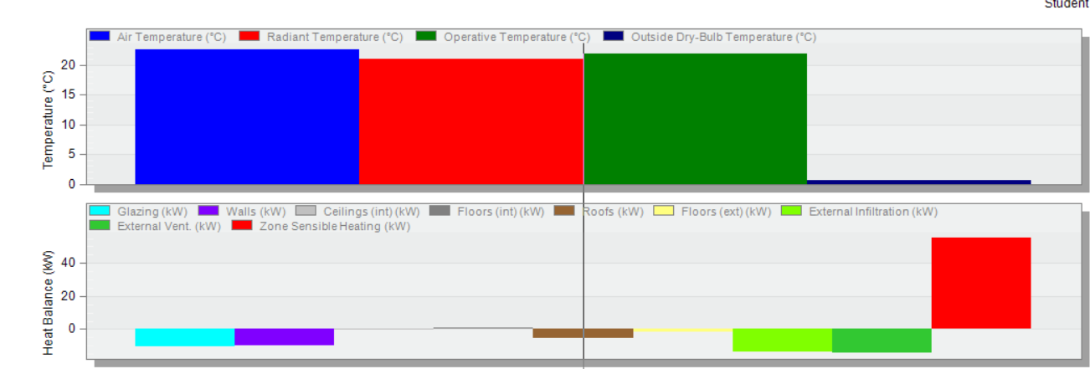
Cooling load
Heating load

Slide 25
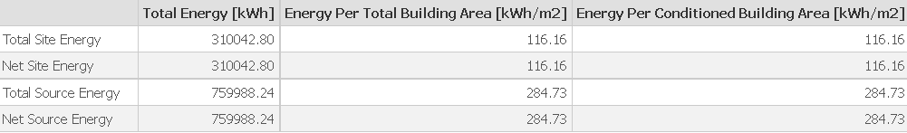
Simulation output

Slide 26
Structural design

Slide 27
Structural design
Rainforced Concrete Structure
(28 MPA)

Slide 28
Structural design
applied area Loads | Load type
4KN/m2 | Superimposed load
5KN/m2 3KN/m2 6KN/m2 | Live load for: retail offices Parking
-0.4KN/m2 -0.2KN/m2 | Soil lateral pressure : 5.6m 8.8m
applied wall loads | Load type
20KN/m | Masonry wall
0.7KN/m | Curtain wall

Slide 29
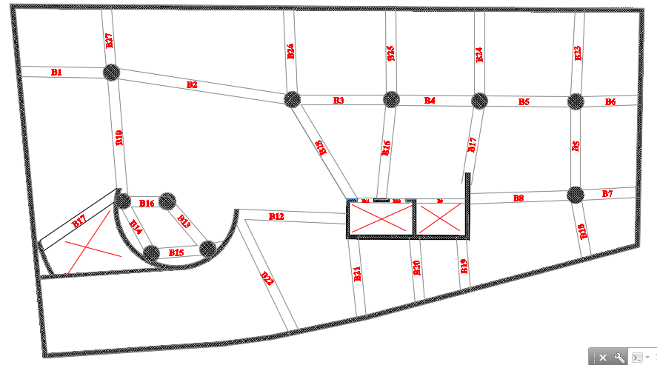
Structural design

Slide 30
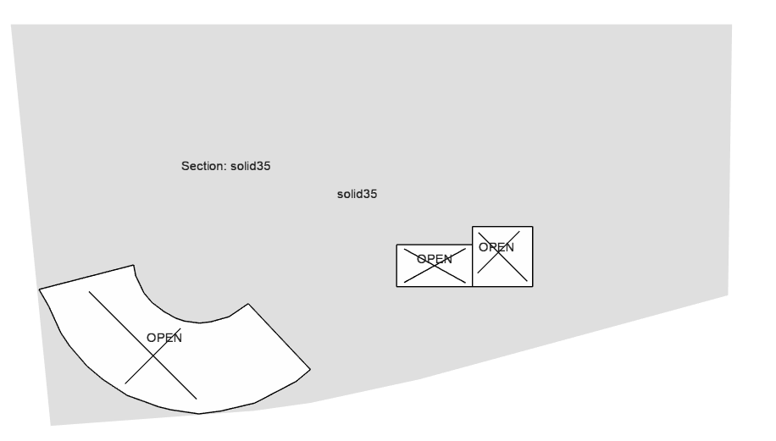
Structural design

Slide 31
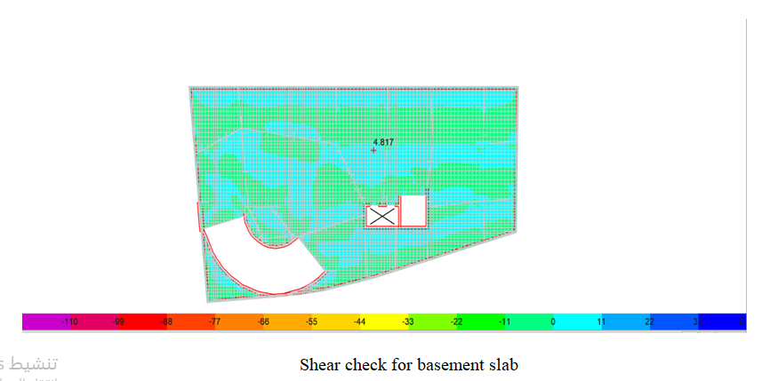
Structural design
∅Vc=158.79KN

Slide 32
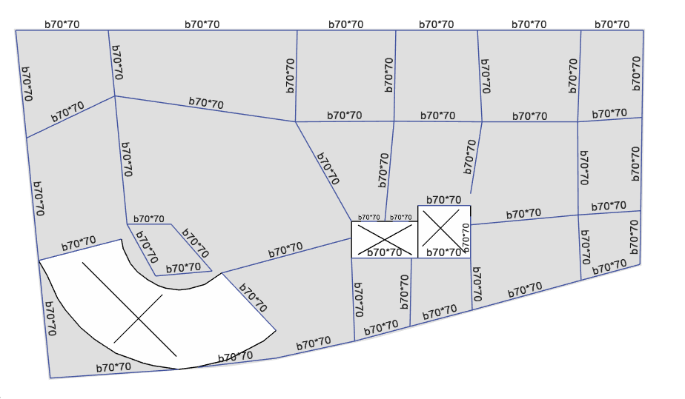
Structural design

Slide 33
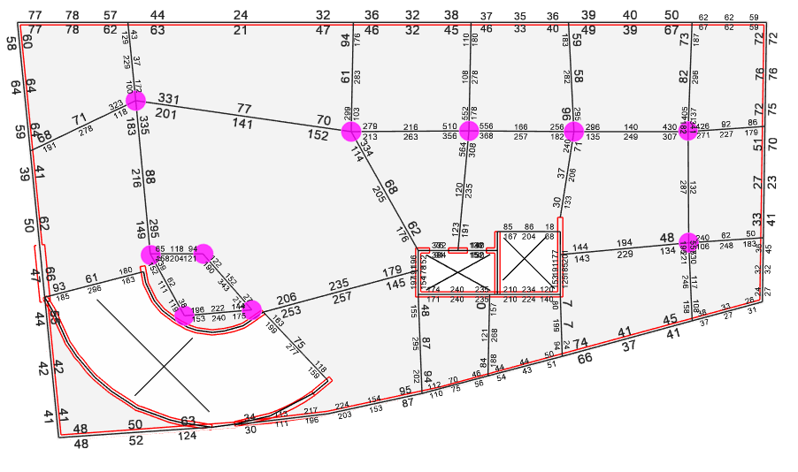
Structural design
Dimensions of Beams

Slide 34
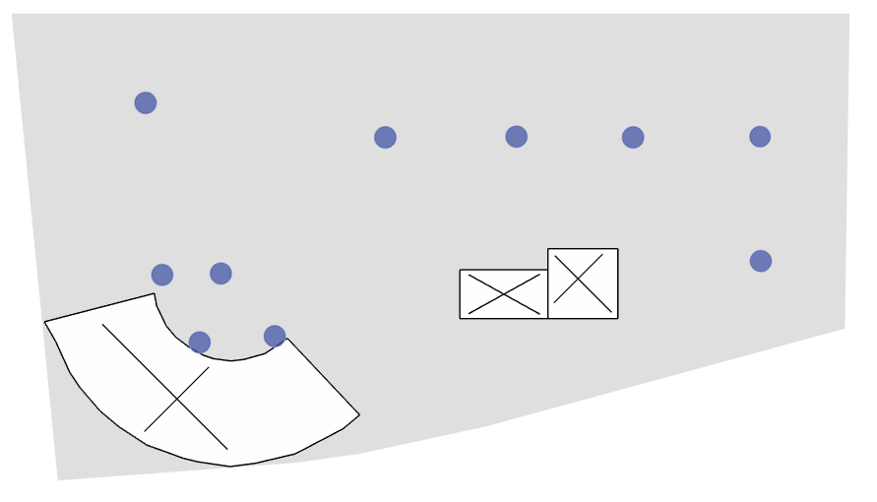
Structural design

Slide 35
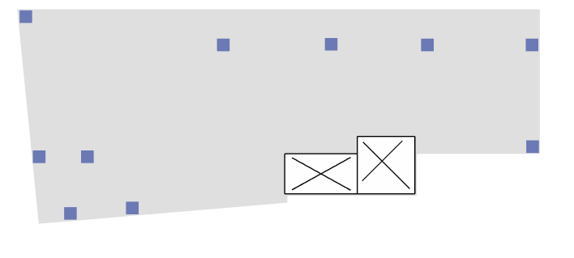
Structural design

Slide 36
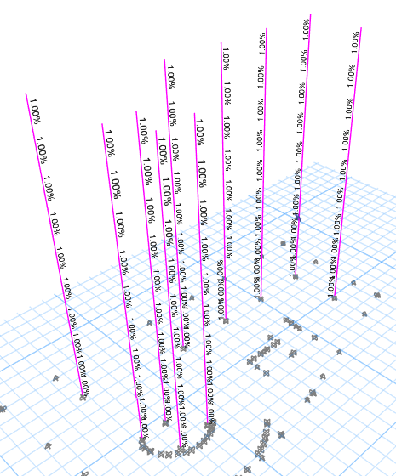
Structural design
Dimensions of Columns:

Slide 37
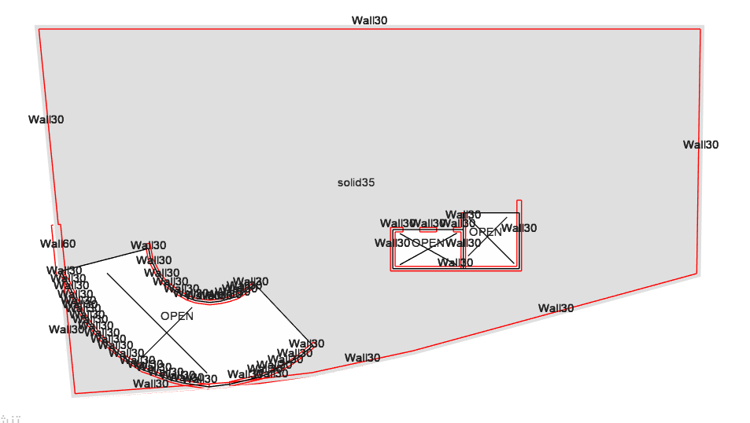
Structural design

Slide 38
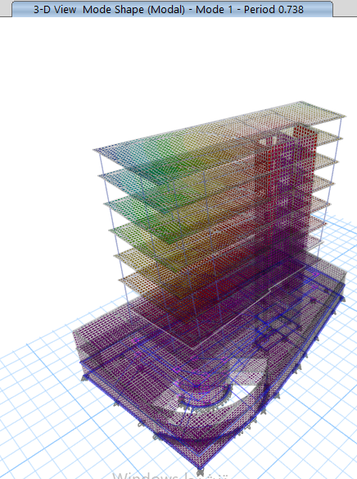
Structural design
(ACI 318 -14)
ASCE7

Slide 39
Structural design
UBC
Response Spectrum
Model Participating Mass Ratios
Mode | SumRx | SumRy
100 | 0.8 | 0.8293
101 | 0.923 | 1.02

Slide 40
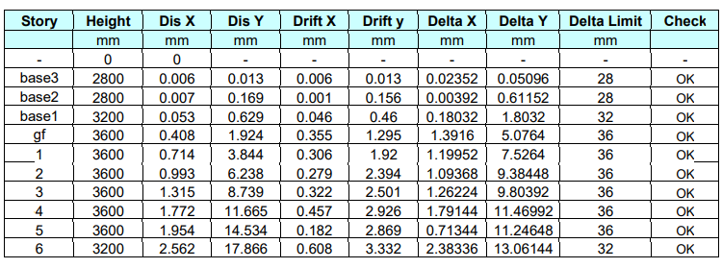
Structural design
Base shear
Drift check:

Slide 41
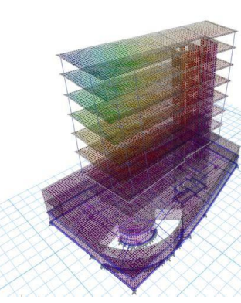
Structural design
%error | Manual | ETABS | Load
3.22% | 39873.0 | 38625.6 | SID
0.26 | 20656.7 | 20710.5 | Live
0.55 | 77534.8 | 77967.0 | Dead
Equilibrium check
Diffrence | Manual | ETABS
7.3% | 6377.8 | 6887.5 | Column
4.6% | 278.40 | 291.95 | beam
9.6% | 196.7656 | 179.5 | slab
Compatibility check
Stress strain (Internal Force check)

Slide 42
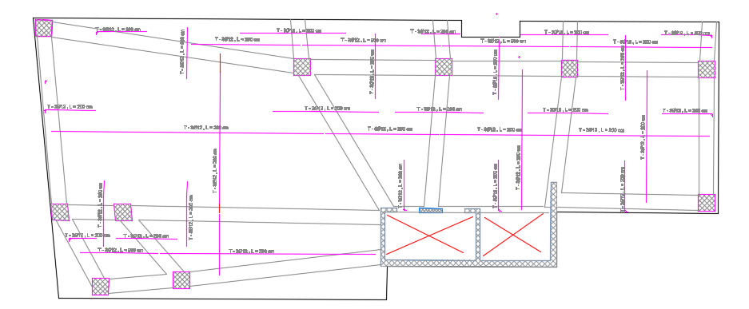
Structural design
Design of Slabs:

Slide 43



Structural design
Design of columns:

Slide 44


Structural design
Design of beams

Slide 45

Structural design
Design of Footing

Slide 46

Structural design
Design of Footing

Slide 47
Electro-Mechanical design

Slide 48



HVAC Design
System used is VRF
Out door unit
Indoor unit
Fan coil celling diffuser 4 way(60*60)

Slide 49
The cooling capacity was designed because the cooling capacity is greater than the heating capacity.
Total heating load capacity= 69.42 kW
Total cooling load capacity=92.3 Kw

Slide 50
Café shop Design
Zone | number of supply diffusers | number of fan coil | number of return diffusers | number of the cassette unit
Roof:Cafe | 4 | 3 | 3 | 7
Roof:Kitchen | 2 | 2 | 1 | 3

Slide 51

AutoCAD Drawing

Slide 52
Acoustical System
1-Insull software
2- EASE software

Slide 53


Insul out put:

Slide 54


Ease out put: Café Shop
RT 60

Slide 55

Articulation loss

Slide 56


SPL

Slide 57

STI (Sound Transmission Index)

Slide 58
Artificial lighting design
DialuxEvo 10 program is used to design artificial lighting according to lighting design standards in terms of glare, illuminance and uniformity
Surface | Reflection factor%
Ceiling | 70
Wall | 50
Floor | 20

Slide 59



Slide 60



Slide 61




Coffee shop :
Coffee Shop for visual Task according to European code needs 300 Lux
UGR check:

Slide 62




Slide 63

Luminaires distribution for roof floor :

Slide 64

Socket and distribution board distribution for roof floor

Slide 65
Power design
The total power load =29732 watt
Total current = 87 Amp
Total current for the circuit breaker =99.68 Amp = 100 Amp
The total current in the cable = 114.63 Amp
The cross-section area that be used for the cable = 50 mm2 with 117 Amp

Slide 66
Water supply system
Water consumption
The volume of water tank = 6 m3

Slide 67
Water supply system
Types of pipes:
Steel for Vertical pipes
PVC for horizontal and branch pipes

Slide 68
Pipes Diameters:
Feeder 1 :
Feeder 1
No. of floor | First basement floor | Ground floor | Typical floor
Vertical pipe | 2" | 2" | 2"
Horizontal pipe | 1" | 1" | 1 1/4"
Branch pipe | 3/4" | 3/4" | 1"

Slide 69


Feeder 1 plans :
First basement floor
Ground floor

Slide 70


Typical floor:

Slide 71
Pipes Diameters:
Feeder 2 :
Feeder 2
No. of floor | First basement floor | Ground floor | Roof floor
Vertical pipe | 1 1/2" | 1 1/2" | 1 1/2"
Horizontal pipe | 3/4" | 3/4" | 1 "
Branch pipe | 1/2" | 1/2" | 3/4"

Slide 72


Feeder 2 plans :
First basement floor
Ground floor

Slide 73

Roof floor

Slide 74
Pipes Diameters:
Feeder 3 :
Feeder 3
No. of floor | Ground floor | Typical floor | Roof floor
Vertical pipe | 2" | 2" | 2"
Horizontal pipe | 1" | 1" | 1 "
Branch pipe | 3/4" | 3/4" | 3/4"

Slide 75



Feeder 3 plans :
Ground floor
Typical floor:
Roof floor

Slide 76

Drainage System
Total Fixture unit in floors for stack No. 1:

Slide 77
Diameters used in sewage pipes
2" diameter: The branch diameter connects the lavatory to the floor drain.
4" diameter: the main stacks line's.
4" diameter: water closet (WC) to the main stack.
6" diameter: between manholes.

Slide 78

The diameters that would be used in the building for vent, stack, drainage, and sewer are seen in the table below.

Slide 79



stack No. 1
First basement floor
Ground floor
Typical floor

Slide 80

Manholes schedule:

Slide 81

Manholes plan:

Slide 82



Fire protection system
The most common systems used in commercial building is:
Fire house
extinguisher
sprinkler

Slide 83

Fire Protection System in 2nd &3rd Basement:
sprinkler system , fire hose with extinguisher:

Slide 84

fire alarm system :

Slide 85

Fire Protection System in first Basement:
sprinkler system , fire hose with extinguisher:

Slide 86

fire alarm system :

Slide 87

Fire Protection System ground floor :
sprinkler system , fire hose with extinguisher:

Slide 88

fire alarm system :

Slide 89

Fire Protection System roof floor :
sprinkler system , fire hose with extinguisher:

Slide 90

fire alarm system :

Slide 91
The cost of project
Total cost for earth work andsub-structural work | 1,664,279 NIS
Total cost for mechanical work | 1,151,000 NIS
Total cost for electrical and environmental work | 115,873 NIS
Total cost for finishing work | 1,168,848 NIS
Total cost for the project | 4,100,000NIS

Slide 92
Thank you

