Slide 1

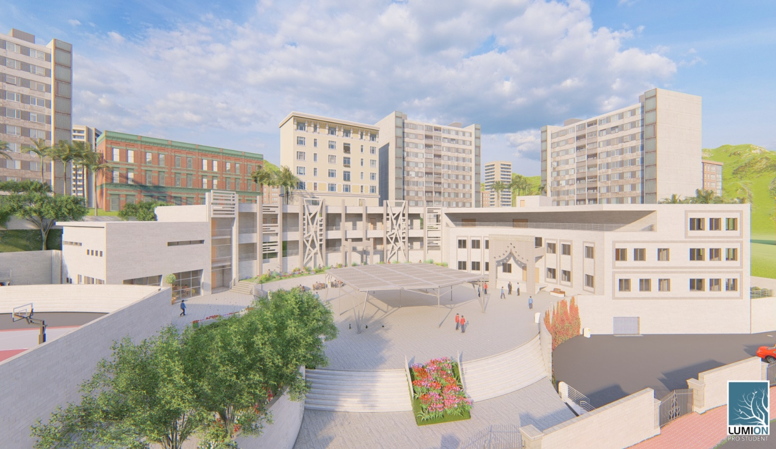
High School design
Prepared by: Supervised by:
Aya Al-Taher. Eng. Fadi Fatayer.
Haneen Nassar.
Yara Abu-Baker.

Slide 2
Quantity surveying
Site analysis
Architectural design
Structural design
Environmental design
Electrical design
Mechanical design
Outline

Slide 3
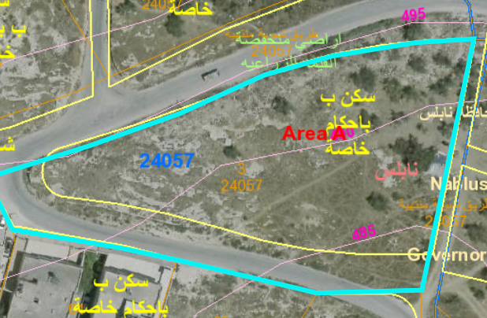
Site analysis
Located in the east of Nablus city at Al-Ma’ajeen
Land area = is 5237.3 m²
Building area = 3911 m²
Noise Level
Noise Level (dB) | Direction
68 | East
63 | South
67 | West
64 | North

Slide 4
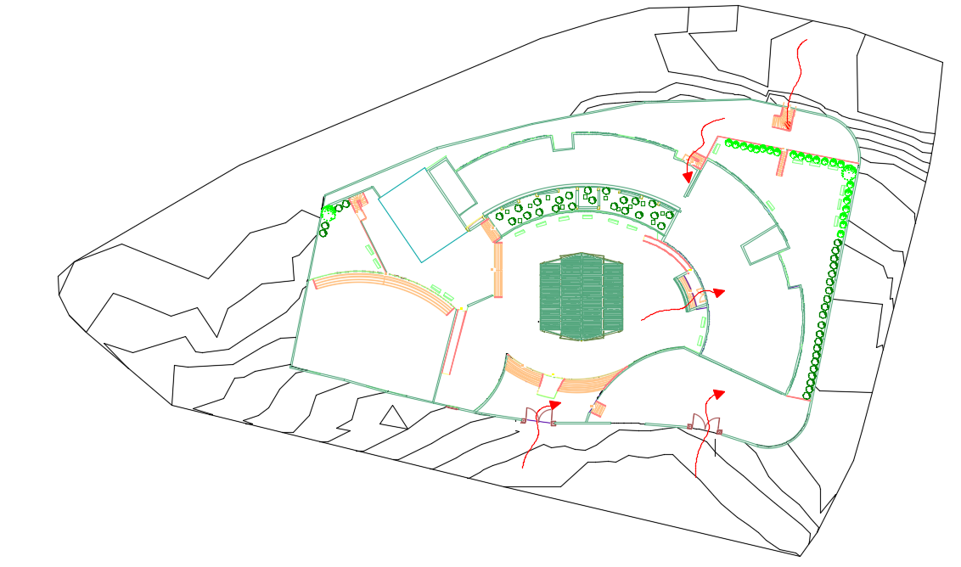
Architectural design
School site

Slide 5
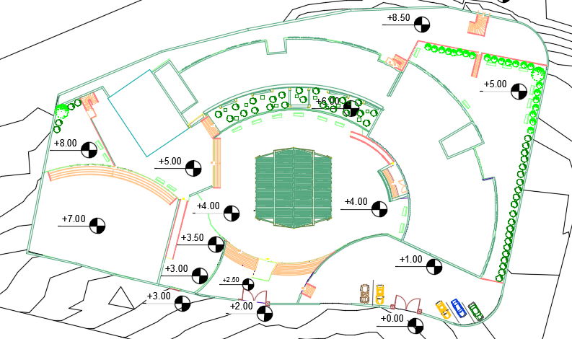
Architectural design
Site plan

Slide 6
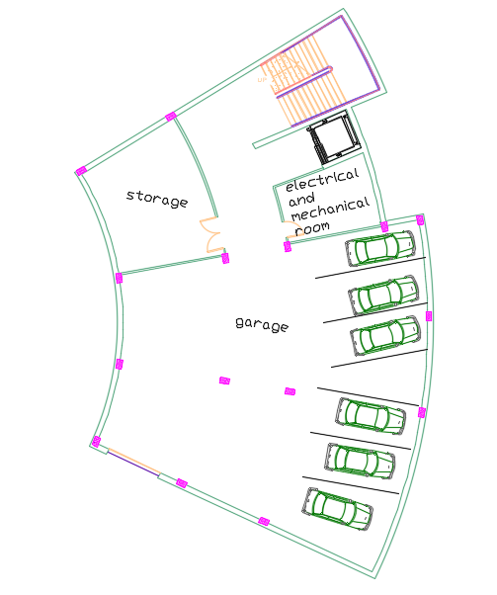
Architectural design
Basement floor plan
Space | Required area | Actual area | Check
General storage | 40 | 42 | Ok
Mechanical room and Electrical room | 15 | 19.60 | Ok

Slide 7
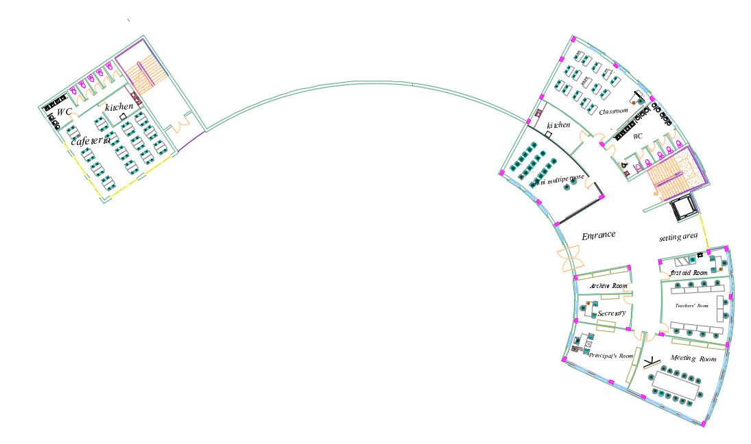
Architectural design
Ground floor plan
Space | Required area | Actual area | Check
Classroom (40 student) | 48 | 75 | Ok
Head office | 30 | 42 | Ok
First aid | 15 | 20 | Ok
Kitchen | 10 | 20 | Ok
Teachers room | 50 | 50 | Ok
Secretary | 20 | 20 | Ok
Canteen | 16 | 73 | Ok
Archive, Printing | 15 | 18.8 | Ok
Music room | 70 | 75 | Ok

Slide 8
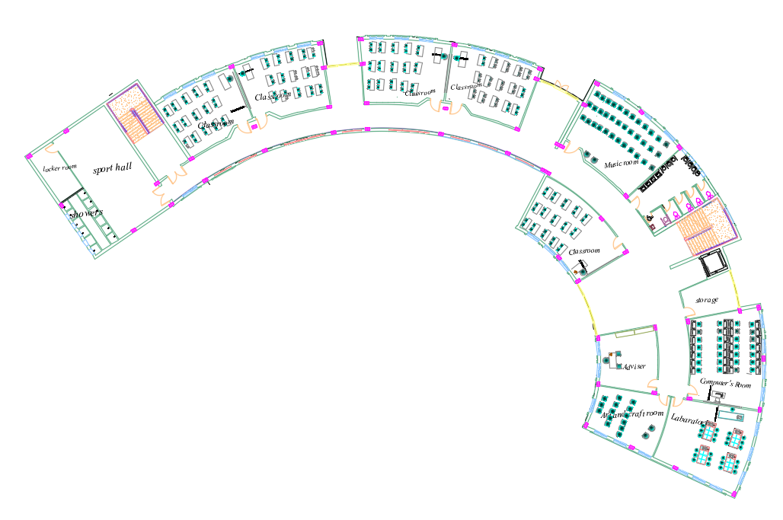
Architectural design
First floor plan
Space | Required area | Actual area | Check
Classroom (40 student) | 48 | 75 | Ok
Consultant (adviser) | 15 | 37 | Ok
Storage | 15 | 20 | Ok
Chemistry lab | 70 | 71 | Ok
computer lab | 65 | 71 | Ok
Music room | 70 | 75 | Ok

Slide 9
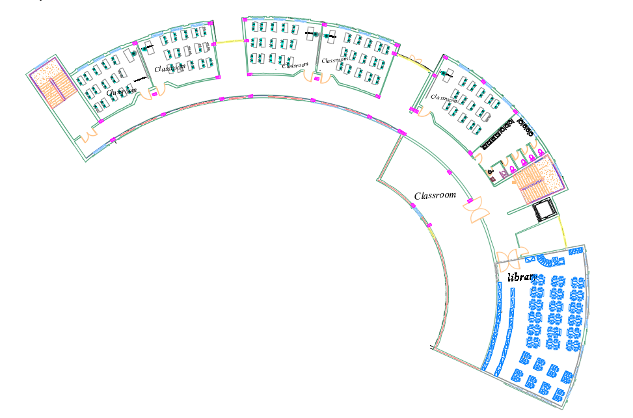
Architectural design
Second floor plan
Space | Required area | Actual area | Check
Classroom (40 student) | 48 | 75 | Ok
Library | 80 | 180 | Ok
Storage | 15 | 20 | Ok
Chemistry lab | 70 | 71 | Ok

Slide 10
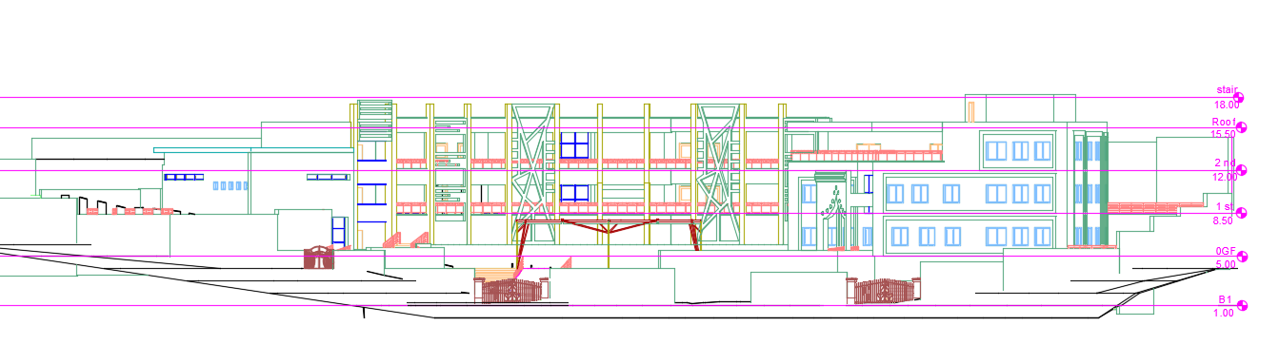
Architectural design
South Elevation

Slide 11
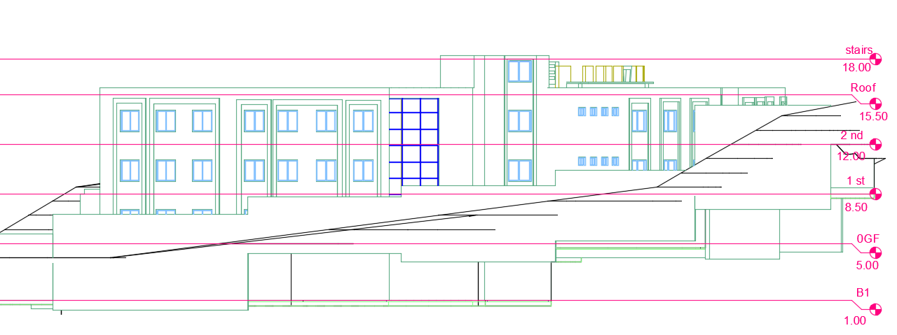
Architectural design
East Elevation

Slide 12
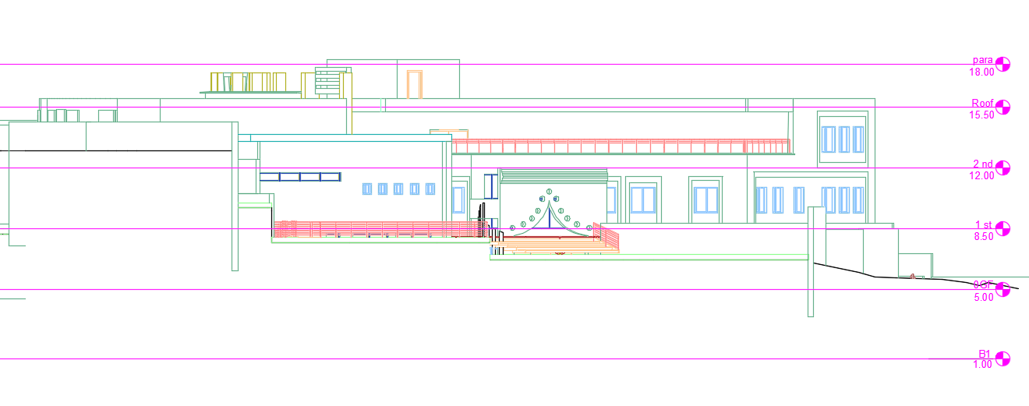
Architectural design
West elevation

Slide 13
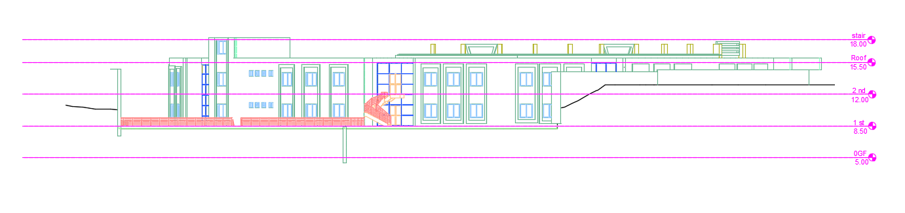
Architectural design
North Elevation

Slide 14
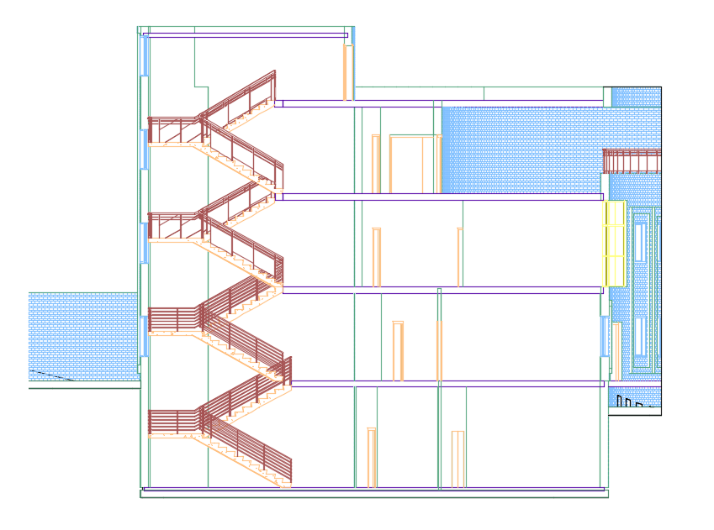
Architectural design
Section A-A

Slide 15
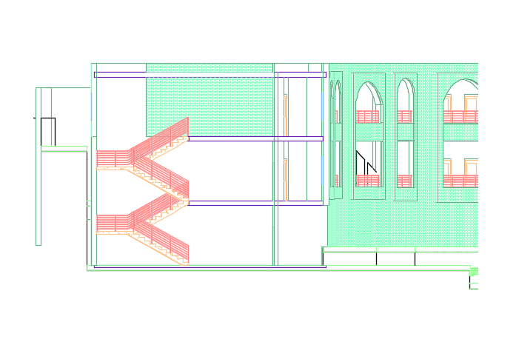
Architectural design
Section B-B

Slide 16
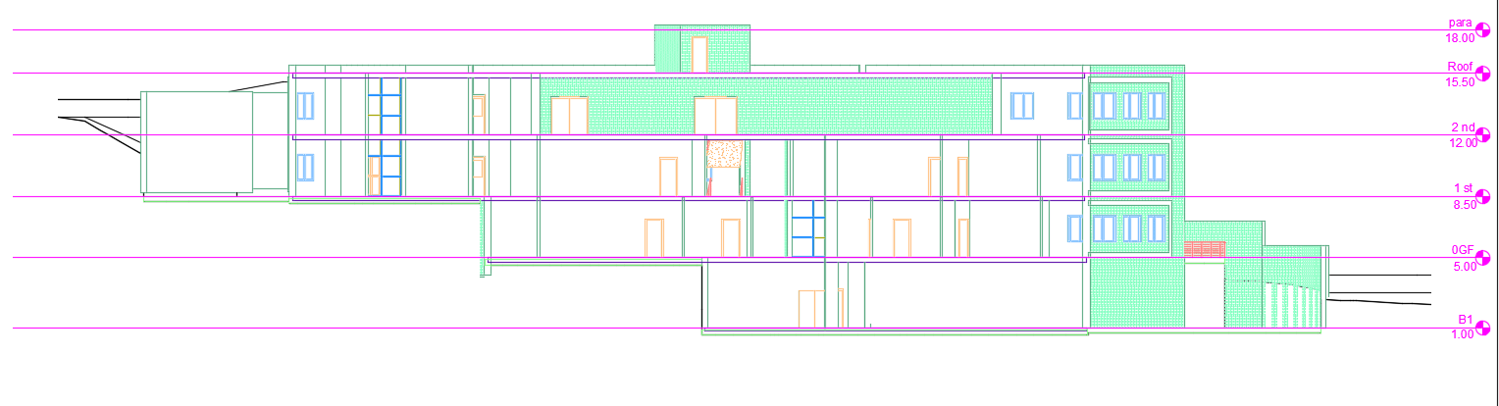
Architectural design
Section C-C

Slide 17
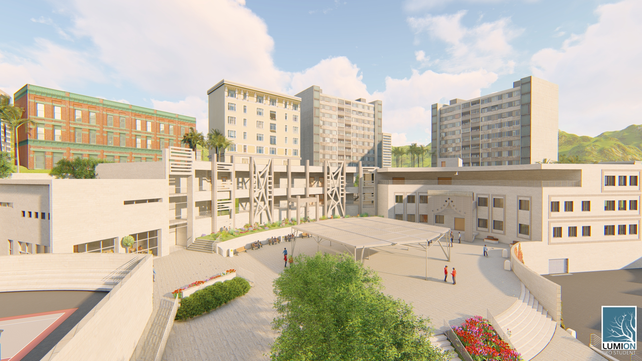
Architectural design
3D View

Slide 18
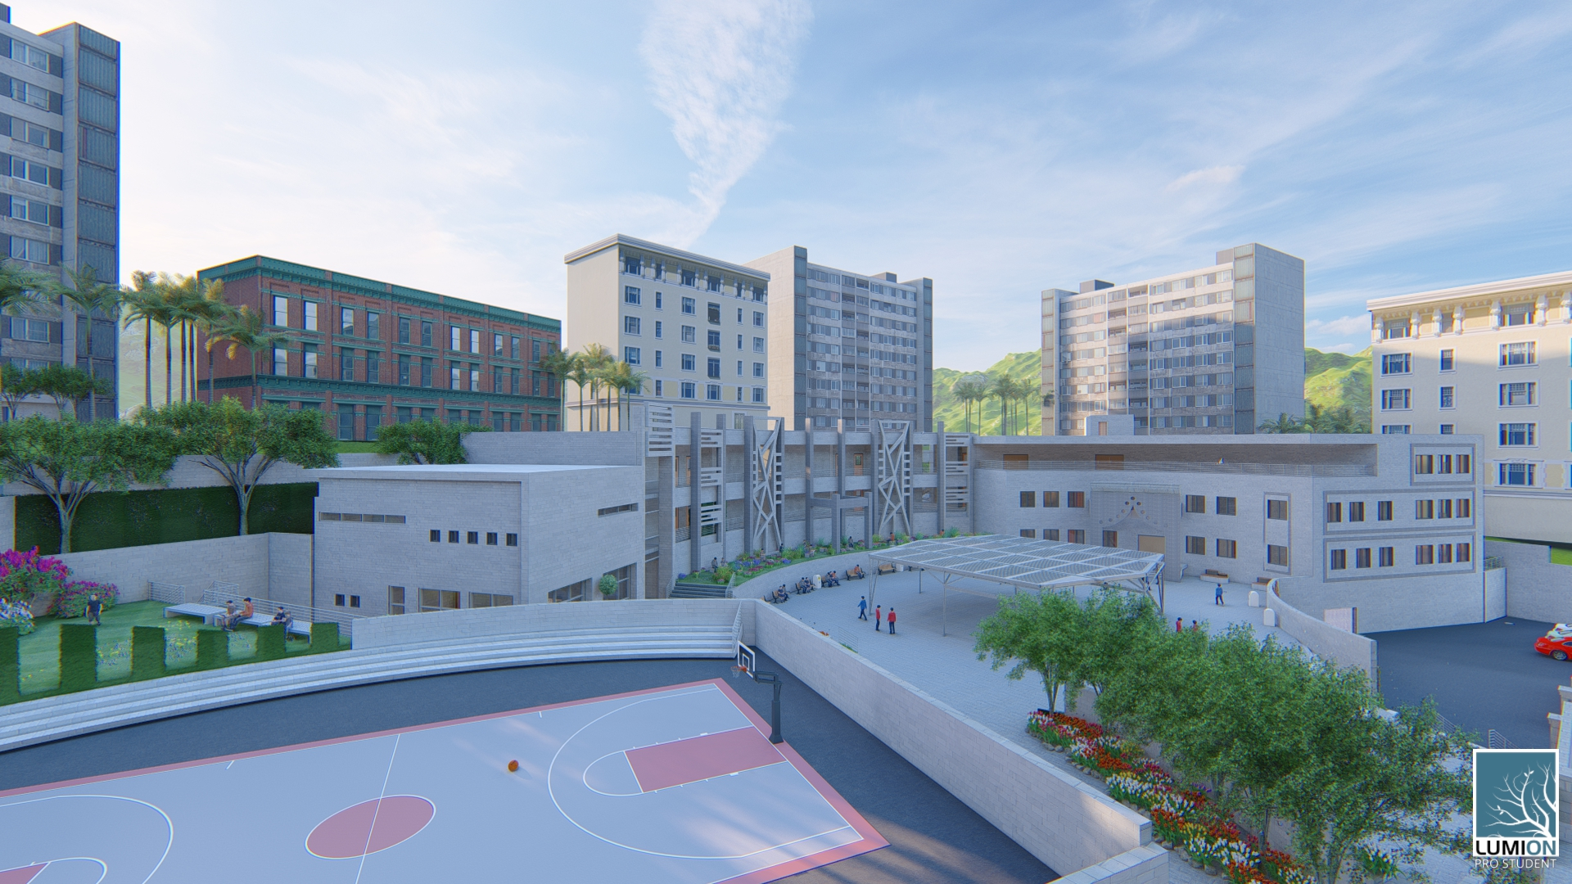
Architectural design
3D View

Slide 19
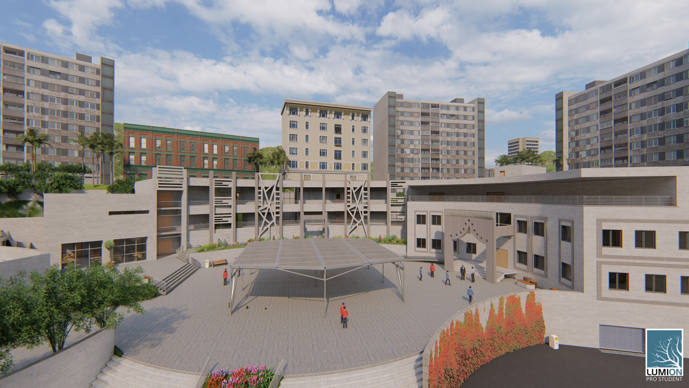
Architectural design
3D View

Slide 20
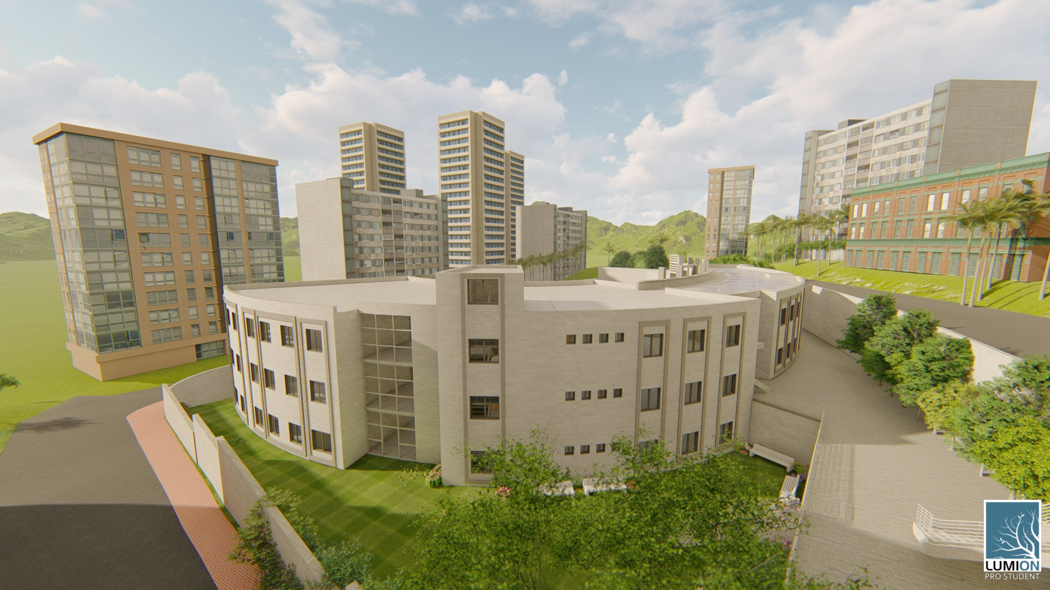
Architectural design
3D View

Slide 21
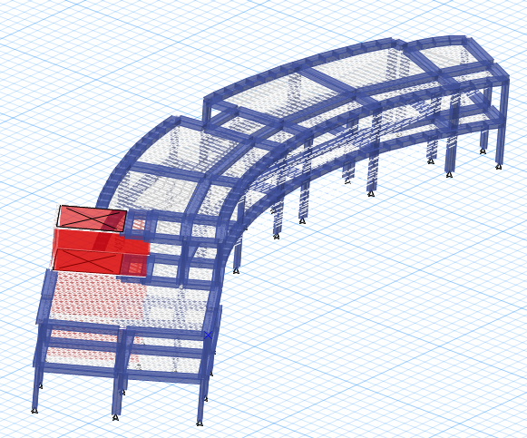
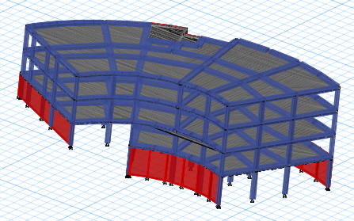
Structural design
Reinforced concrete structure

Slide 22
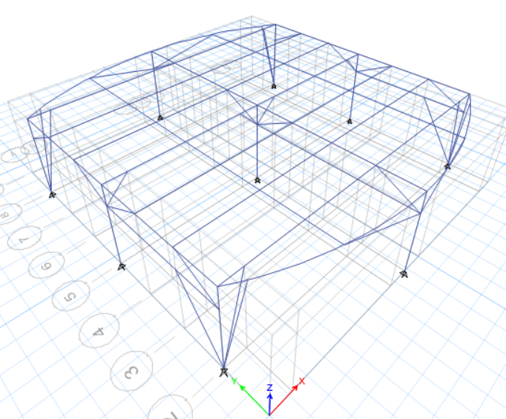
Structural design
Steel structure

Slide 23
Structural design
Codes:
ACI 318-14
UBC – 97 for earthquake design.
ASCE for loads computations.

Slide 24
Structural design
Designing data and loads:
f’c = 24 Mpa for beams and slabs.
f’c = 28 Mpa for columns.
Fy = 420 Mpa
Bearing capacity of soil at street level = 250 KN/m².
Live loads = 5 KN/m².
Super imposed dead load = 4KN/m².

Slide 25
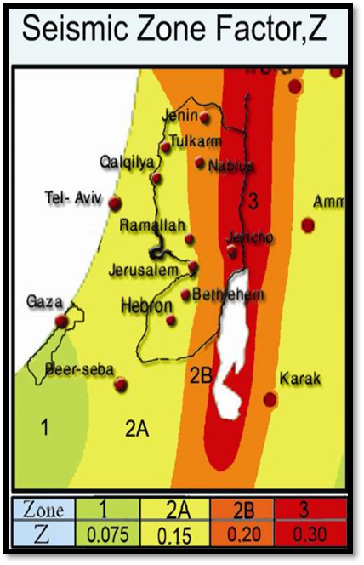
Structural design
Lateral loads:
The seismic zone of Nablus is 2B (Z = 0.20)
The soil profile is type Sc.
The acceleration seismic coefficient Ca=0.24
The velocity seismic coefficient Cv=0.32
The Seismic importance factor is 1
The structural design type is building frame R=5.5
(for sway intermediate concrete frame structure).
Response spectrum scale factor= (g×I)/R=1783.63

Slide 26
Structural design
Manual checks
Compatibility check → ok
Equilibrium check → ok
Internal force check → ok
Deflection check → ok
Period check → ok
Base shear check → ok
Drift check → ok

Slide 27
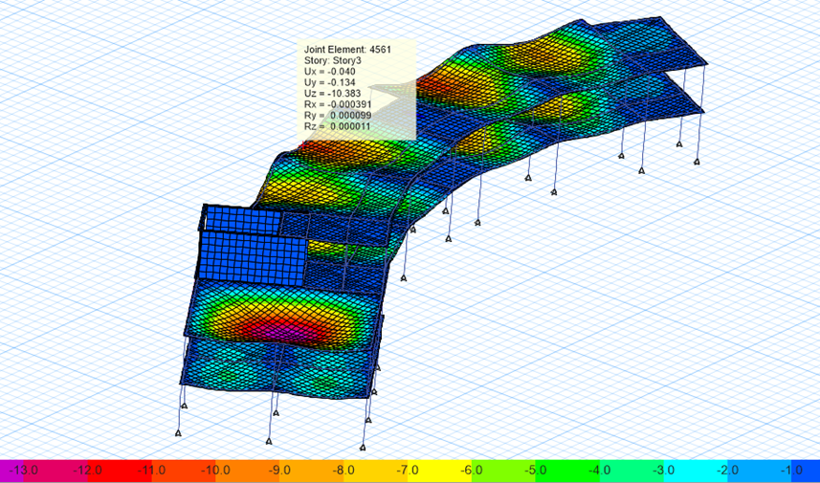
Structural design
Compatibility check:
The building Is compatible.

Slide 28
Structural design
Equilibrium check:
%of error <5% →ok
Percentage of difference | From manual (KN) | From ETAB(KN) | Load Case
1.9% | 12980 | 13236.3 | Dead
%0.04 | 5740 | 5742.6 | Live
%0.6 | 12650.4 | 12574.6 | SID

Slide 29
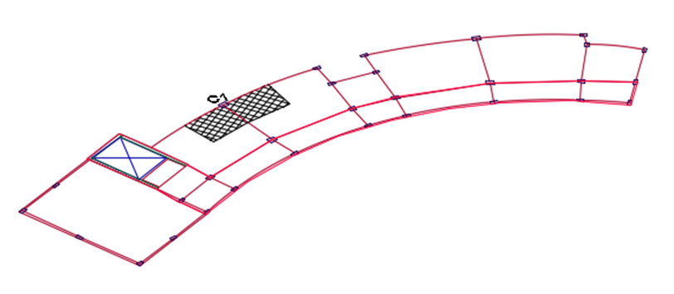
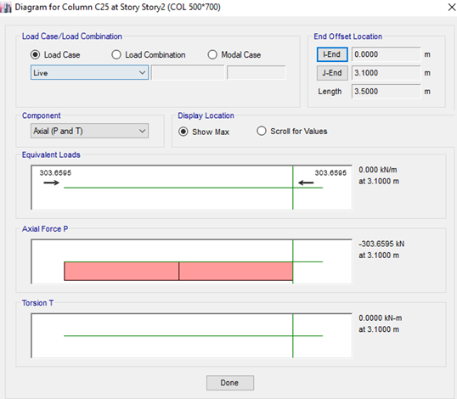
Structural design
Internal force check:
For columns:
Manual axial load =300KN
Axial load from ETAB =303KN
The percentage of difference= 1% < 5%
→the check is OK
20 May 2019

Slide 30
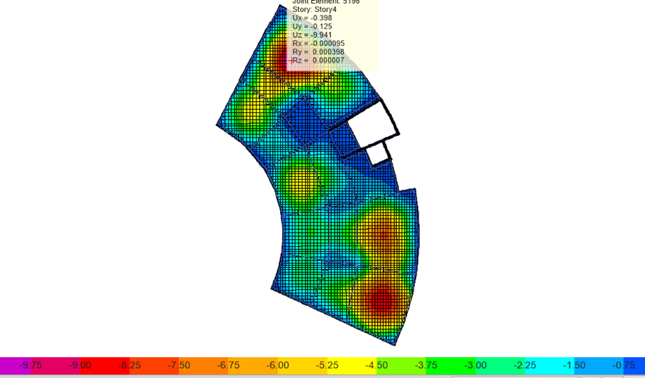
Structural design
Deflection check:
Immediate deflection.
This check from live load for critical slab
Max allowable deflection =25 mm
Max deflection from ETAB = 9.9mm
→the check is ok.

Slide 31
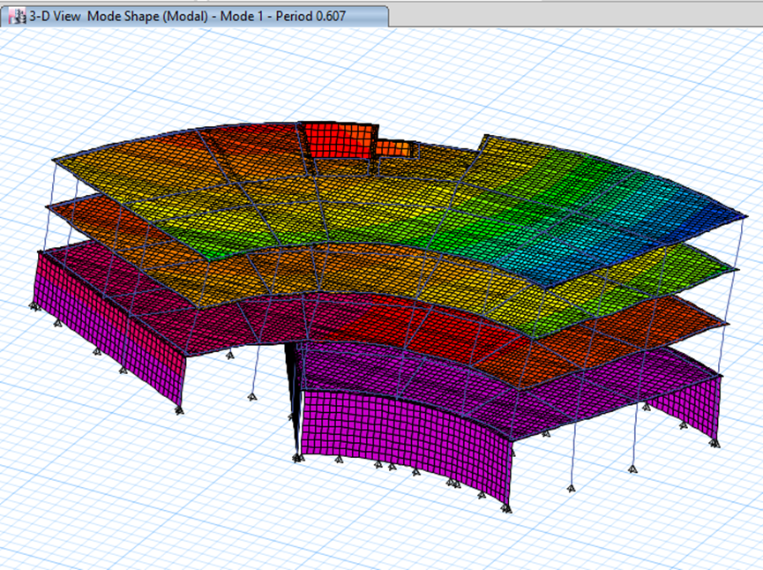
Structural design
Period check (model1)
T manual=0.676 sec
T Etab=0.607 sec
T etabs < T manual→ So the check is ok.

Slide 32
Structural design
Base shear check (model1):
Vx = 7672 KN.
Vy = 8731.6 KN.
FZ (KN) | FY (KN) | FX (KN) | Load Case/Combo
28884.0982 | -0.0048 | 0.0317 | Dead
11000.3638 | -0.0014 | 0.0255 | Live
48406.0013 | -0.0059 | 0.05 | SID
7.113E-06 | 3541.5574 | 7672.0103 | EQx Max
2.329E-05 | 8731.7853 | 4608.3174 | EQy Max

Slide 33
Structural design
Drift check (model1):
story | Height (mm) | Displacment X( mm) | Displacment Y mm | Drift Xmm | Drift Y mm | Delta X | Delta Y | Delta -limit(mm)
1 | 4500 | 1.23 | 0.24 | 1.23 | 0.24 | 4.74 | 0.93 | 90
2 | 3500 | 3.52 | 3.37 | 2.29 | 3.13 | 8.82 | 12.06 | 70
3 | 3500 | 7.13 | 6.8 | 3.61 | 3.43 | 13.9 | 13.21 | 70
4 | 3500 | 11.25 | 9.75 | 4.12 | 2.95 | 15.87 | 11.3575 | 70

Slide 34
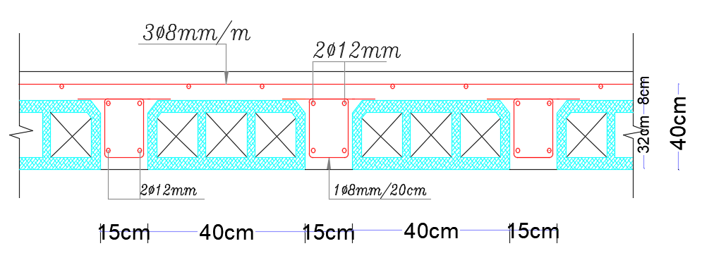
Structural design
Two way ribbed slab
Thickness = 40cm
As shrinkage = 3Ø8/m
As = 2Ø12

Slide 35
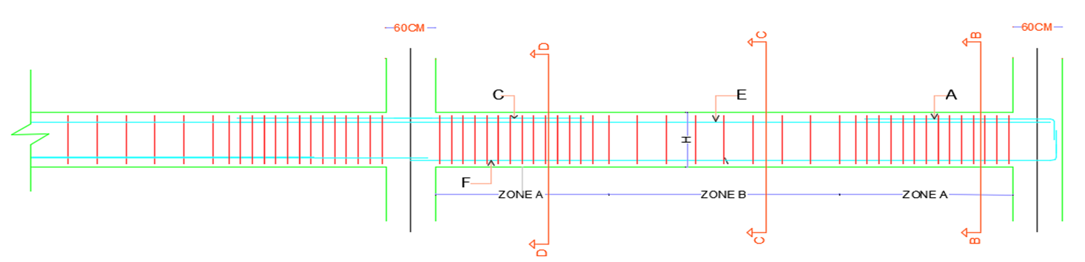
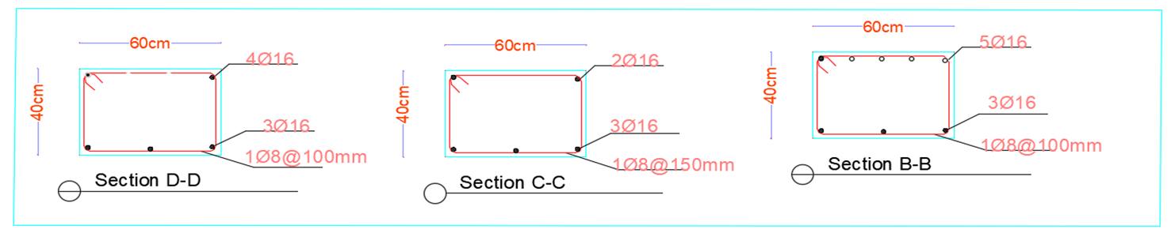
Structural design
Beams reinforcement and details:

Slide 36

Zone B length 1-8mm/150mm | Zone A length 1-8mm/100mm | F- length(m) 3-16mm | E- length(m) 2-16mm | c-length(m) 2-16mm | A-length(m) 3-16mm | Beam dimension (cm) | beam length(m) | Beam Number
3.4 | 0.8 | 6.6 | 3.7 | 3.9 | 2.3 | 60*40 | 5 | 1
0.6 | 0.8 | 3.8 | 2.5 | 2 | 1.6 | 60*40 | 2.2 | 2
0.4 | 0.8 | 3.6 | 2.4 | 1.9 | 1.5 | 60*40 | 2 | 3
5.9 | 0.8 | 9.1 | 4.7 | 5.6 | 2.9 | 60*40 | 7.5 | 4
0.3 | 0.8 | 3.5 | 2.4 | 1.8 | 1.5 | 60*40 | 1.9 | 5
2.4 | 0.8 | 5.6 | 3.2 | 3.2 | 2 | 60*40 | 4 | 6

Slide 37
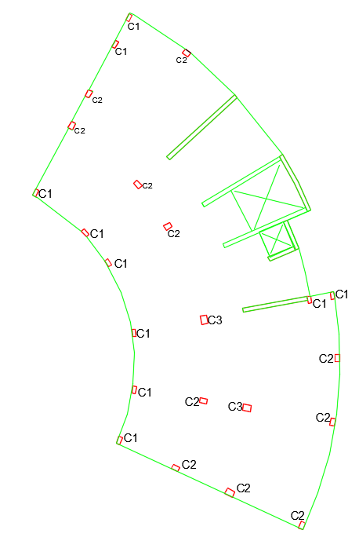
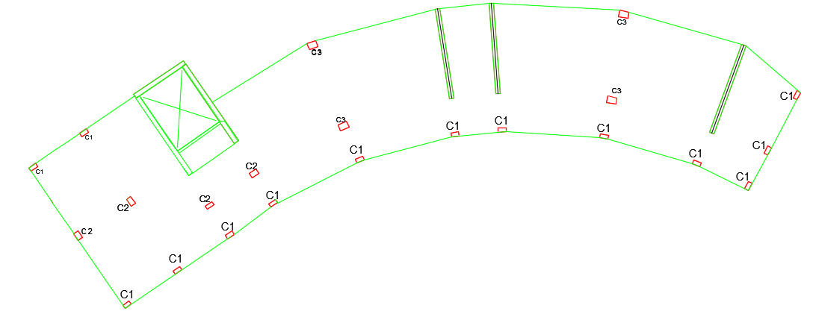
Structural design
Columns reinforcement and details:
20 May 2019

Slide 38
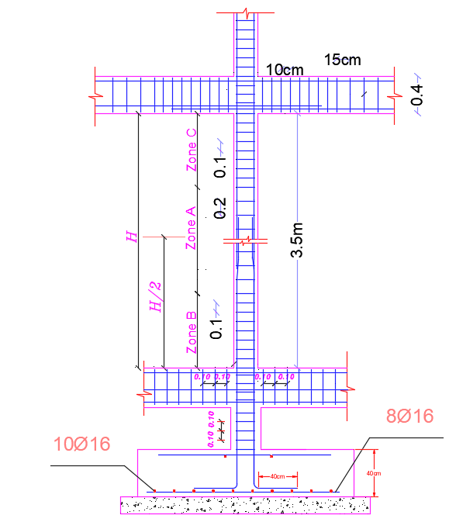
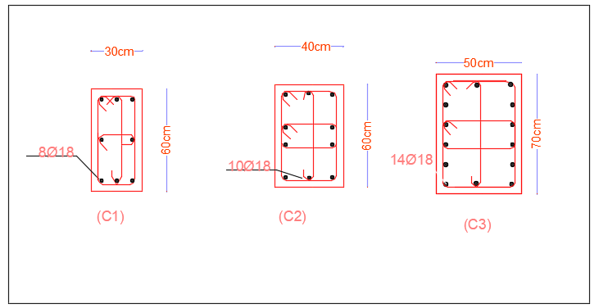
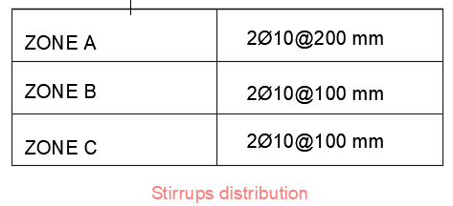
Structural design

Slide 39
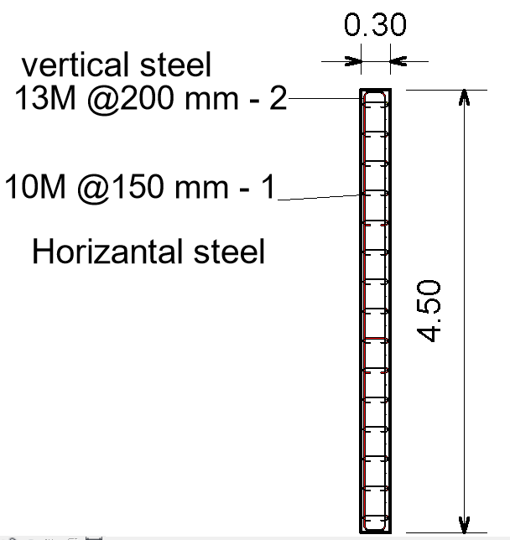
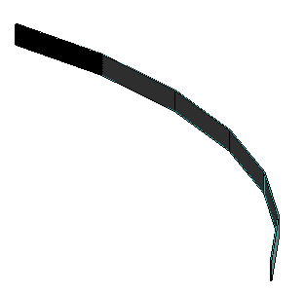
Structural design
Shear walls reinforcement and Details:

Slide 40
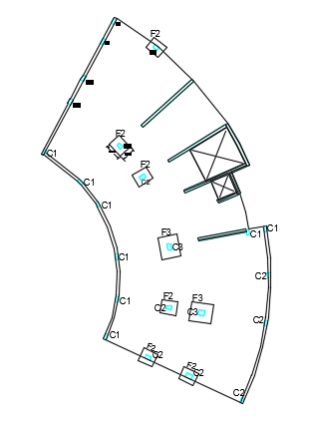
Structural design
Foundations(model1):

Slide 41
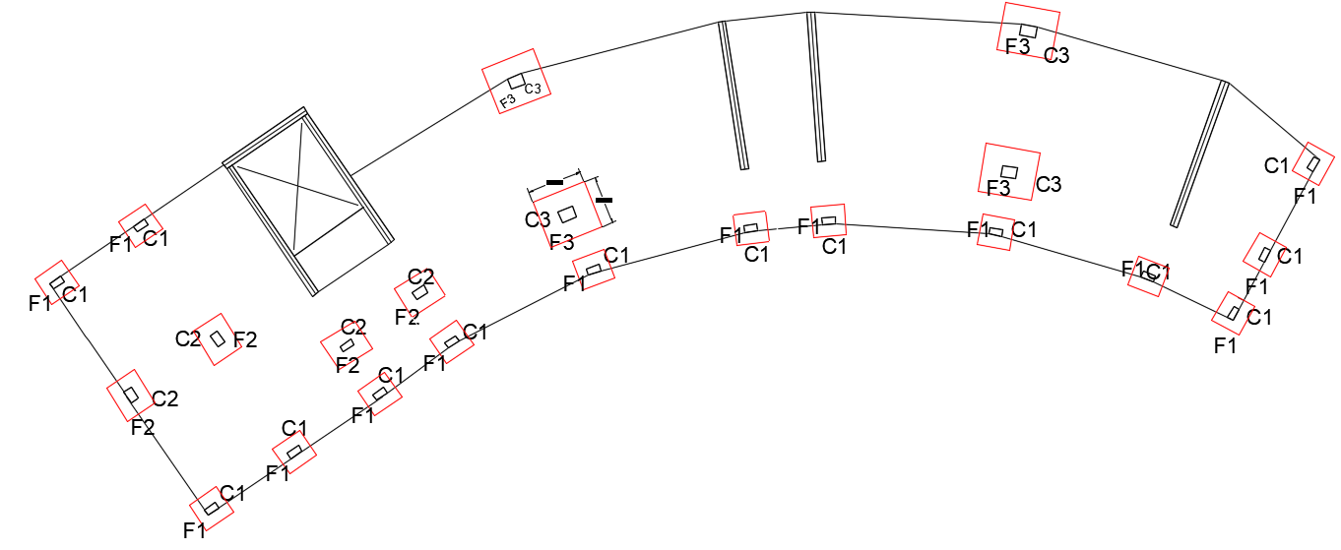
Structural design
Foundations(model2):

Slide 42
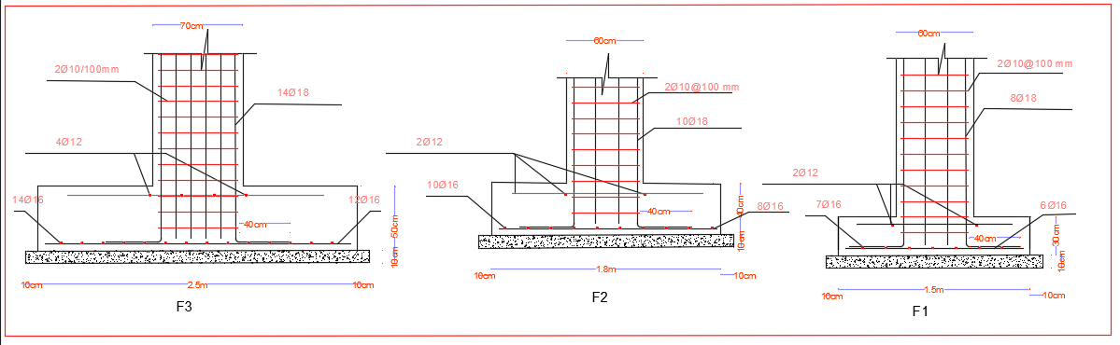
Structural design
Footing design
Isolated footings are used:

Slide 43
Structural design
Steel umbrella:
Design assumptions:
The truss section is selected to be tube section (TUBO)
The cover system Louvres
The type of welded connection is E60xx

Slide 44
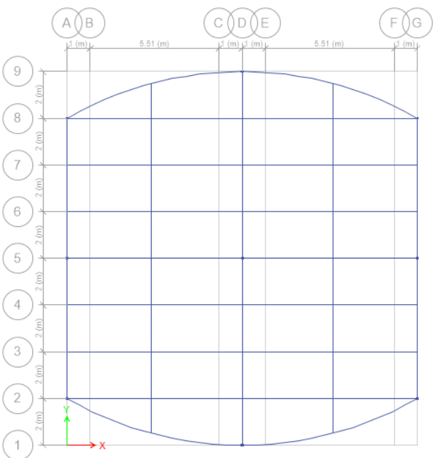
Structural design

Slide 45
Structural design
Loads:
Load type | value
L.L (kN) | 3.75
W.L (kN) | 1.92
SID (kN) | 3.75

Slide 46
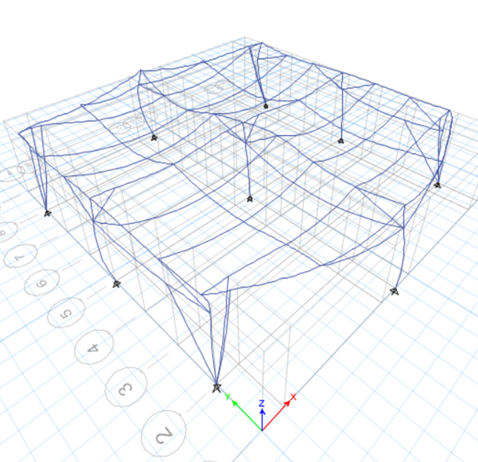
Structural design
Checks:
Compatibility check:

Slide 47
Structural design
Equilibrium check:
Total truss length was 135.64m
Manual check:
For Live load 1KN/m*135.64m=135.64KN
For SID = 135.64KN
For wind load 0.51*227.3=69.17KN.
From ETABS:
ETAB result | Load type
136.5699 | Live
136.5699 | Sid
69.6506 | Wind

Slide 48
Environmental DESIGN:
Shading
Acoustics
Thermal
Daylight factor

Slide 49
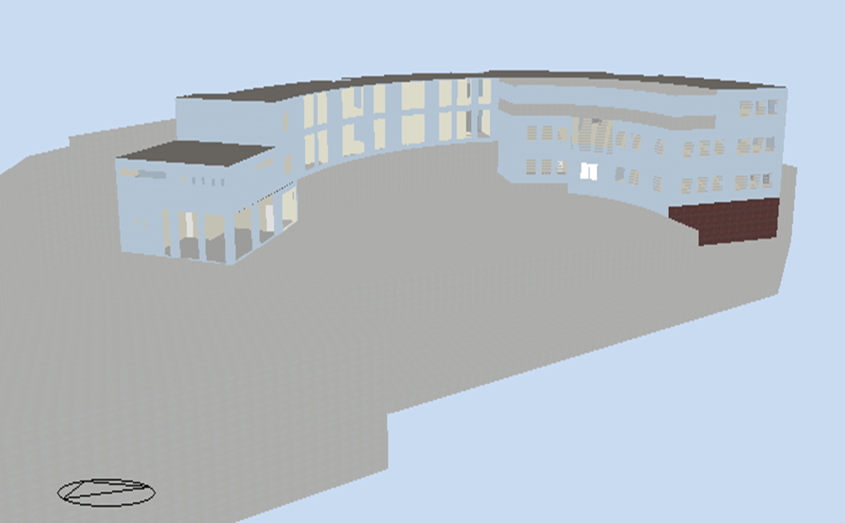
Environmental DESIGN:
Used design builder program

Slide 50
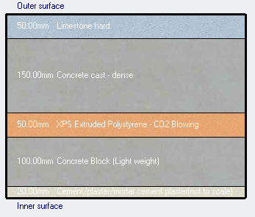
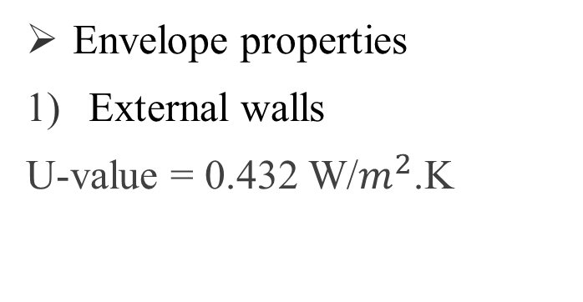
Environmental DESIGN:
Envelope properties
External walls
U-value = 0.432 W/$m^{2}$.K

Slide 51
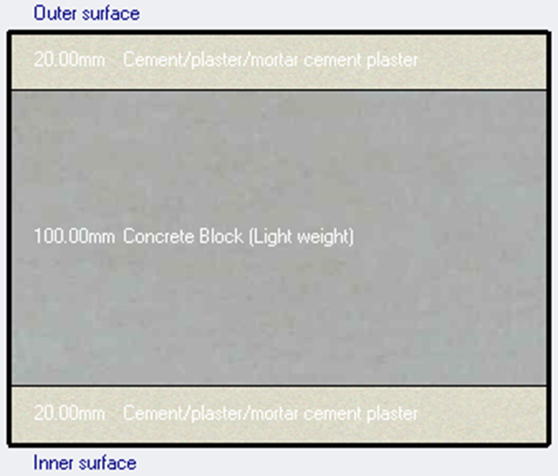
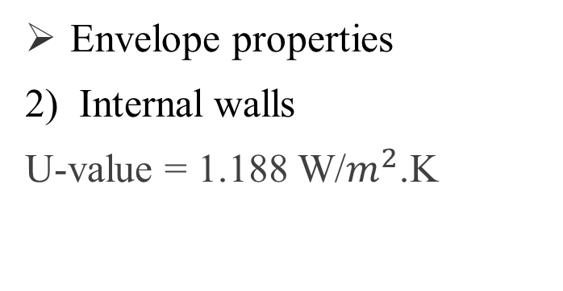
Environmental DESIGN:
Envelope properties
2) Internal walls
U-value = 1.188 W/$m^{2}$.K

Slide 52
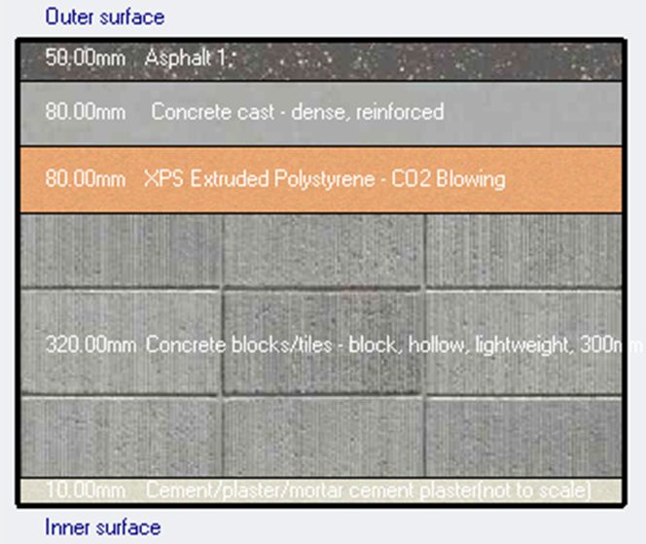
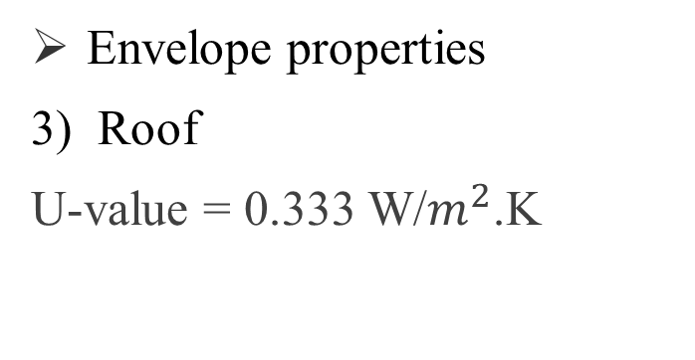
Environmental DESIGN:
Envelope properties
3) Roof
U-value = 0.333 W/$m^{2}$.K

Slide 53


Environmental DESIGN:
Envelope properties
4) Floors
U-value = 0.321 W/$m^{2}$.K

Slide 54

Environmental DESIGN:
Envelope properties
4) Windows material is double glass generic clear 3mm glass
U-value = 1.092 W/$m^{2}$.K

Slide 55

Environmental DESIGN:
Heating load design.
Air temperature = 23 °C
Radiant temperature = 20 °C
Operative temperature =22 °C
Total heating load = 77.75 kW

Slide 56

Environmental DESIGN:
Comfort curves
RH less 60%
PMV between (-0.5 - 0.5)

Slide 57

Environmental DESIGN:
Comfort curves
The number of uncomfortable hours equals 1688 hr/year.
Energy consumption = 33.71 kWh/$m^{2}$

Slide 58
Environmental DESIGN:
Daylight factor
Ground floor
Average DF% in first floor equal 0.5% not within the standard (2-5)%

Slide 59


Environmental DESIGN:
Daylight factor
First floor and second floor
Average DF% in first floor equal 3.9% within the standard (2-5)%

Slide 60

Environmental DESIGN:
Louver system was used on southern façade 2mm thickness, 30 cm depth and 0.5 m vertical spacing

Slide 61

Environmental DESIGN:
Acoustics (${RT0}_{60})$
Used Ecotect program
${RT0}_{60}$ and $∝$ for Classroom
FREQUNECY | ∝ (Walls: Painted Plaster) | ∝ (Floor: Tile) | ∝ (Ceiling: Plaster) | ∝ (Glass) | ∝ (Door) | RT60
63Hz | 0.31 | 0.01 | 0.01 | 0.10 | 0.05 | 0.69
125Hz | 0.31 | 0.01 | 0.01 | 0.10 | 0.05 | 0.69
250Hz | 0.33 | 0.02 | 0.02 | 0.07 | 0.25 | 0.56
500Hz | 0.14 | 0.02 | 0.02 | 0.05 | 0.60 | 0.81
1kHz | 0.10 | 0.02 | 0.02 | 0.03 | 0.15 | 0.80
2kHz | 0.10 | 0.02 | 0.02 | 0.02 | 0.05 | 0.59
4kHz | 0.12 | 0.02 | 0.02 | 0.02 | 0.10 | 0.58
8kHz | 0.12 | 0.02 | 0.02 | 0.02 | 0.10 | 0.42
16kHz | 0.12 | 0.02 | 0.02 | 0.02 | 0.10 | 0.42

Slide 62


Environmental DESIGN:
Acoustics (${RT0}_{60})$
Millington-Sette is selected
${RT0}_{60}$ for Classroom is in the range (0.5 – 0.9sec.)
the result from different frequencies is within the range

Slide 63

Environmental DESIGN:
Acoustics (${RT0}_{60})$ for other spaces
FREQUNECY | RT60 (art room) | RT60 (computer lab) | RT60 (meeting room) | RT60 (music room) | RT60 (library)
63Hz | 0.63 | 0.73 | 0.85 | 0.68 | 0.66
125Hz | 0.62 | 0.73 | 0.85 | 0.68 | 0.69
250Hz | 0.51 | 0.58 | 0.72 | 0.57 | 0.63
500Hz | 0.74 | 0.77 | 1.15 | 0.90 | 0.88
1kHz | 0.73 | 0.70 | 1.13 | 0.95 | 0.90
2kHz | 0.62 | 0.46 | 0.82 | 0.76 | 0.67
4kHz | 0.59 | 0.53 | 0.72 | 0.66 | 0.76
8kHz | 0.39 | 0.43 | 0.47 | 0.45 | 0.65
16kHz | 0.38 | 0.42 | 0.46 | 0.45 | 0.64
RT60 (standard) | (0.5 – 0.8sec.) | (0.4 – 0.8sec.) | (0.6 – 1.3sec.) | (0.6 – 1.3sec.) | (0.4 – 0.8sec.)

Slide 64





Environmental DESIGN:
Acoustics (${RT0}_{60})$
Millington-Sette is selected
the result from
different frequencies is within the range

Slide 65


Environmental DESIGN:
STC and IIC:
IIC for floor = 59 > 52 ok
IIC for ceiling = 54 >52 ok
Space | Adjected area | STC required | STC deign | Check
Classroom | Classroom | 42-40 | 43 | Ok
 | Corridor | 40-38 | 43 | Ok
Headteacher room | Corridor | 40-38 | 43 | Ok
Teachers room | Science lab | 45-41 | 43 | Ok
 | Corridor | 40-38 | 43 | Ok
 | Classroom | 40-38 | 43 | Ok
Music room | Corridor | 45-42 | 43 | OK
Library | Corridor | 45-42 | 43 | OK
Internal wall
External wall

Slide 66
Environmental DESIGN:
Noise reduction:
The background noise for class rooms is from 30-35 dB.
space | Noise | NR | BN | Standard | OK/not ok
classroom | 67 | 39.67 | 27.32 | < 30 | Ok

Slide 67


PV system design
PV system distribution
Horizontal landscape | PV panel
130 | No. of modules
39.65 | Electricity produced (KW)
82.45% | Performance ratio
88.63 | (MKW/Year)

Slide 68
Electrical design
Sockets distribution
Artificial lighting design
Sound reinforcement system design
Electrical boards distribution

Slide 69




Electrical design
Sockets distribution

Slide 70

Electrical design
Artificial lighting
classroom

Slide 71
Electrical design
Classroom lighting design
Used luminaires
LED panels → (2550) Lm
LED panels → (4700) Lm
plan | Required | Value
classroom | 300 lux | 365
board | 500 | 516
lux
Glare
Maximum required | Minimum required | Value
19 | <10 | 15.2
Surface reflection
Ceiling | walls | Floor
45% | 44% | 50%

Slide 72

Electrical design
Lighting distribution

Slide 73

Electrical design
Artificial lighting
Computer lab

Slide 74
Electrical design
Computer lab lighting design
Used luminaires
LED panels → (2550) Lm
LED panels → (4700) Lm
plan | Required | Value
Lab | 300 lux | 324
board | 500 | 517
lux
Glare
Maximum required | Minimum required | Value
19 | <10 | 16.4
Surface reflection
Ceiling | walls | Floor
45% | 45% | 50%

Slide 75

Electrical design
Luminaires distribution

Slide 76


Electrical design
Sound reinforcement system design
Ceiling mounted
is (H-2/WP) type from TOA Corp company
θ = ${100}^{°}$
Coverage : $\left\{\begin{aligned}Cafiteria=22.90 m^{2} \\ sport hall and caridorres=14.40 m^{2}\end{aligned}\right.$

Slide 77


Electrical design
Sound reinforcement system design
Cafeteria
Sport hall

Slide 78



Electrical design
Sound reinforcement system design
corridors

Slide 79

Electrical design
Electrical boards distribution
GF
1st
2nd

Slide 80
Mechanical design
Storm water
HVAC
System
Fire Fighting
Drainage
System
Water Supply
System
Emergency Exits

Slide 81


Mechanical design
HVAC system
Radial System radiators
Radiator from VIADRUS company.
KALOR :

Slide 82
Mechanical design
HVAC system
Total heating load in the school = 77.75 kW
Radial System radiators
Steel pipe sizing
PVC-pipe sizing
Selection of Pump
Number of Section
The volume of boiler

Slide 83

Mechanical design
HVAC system
Ground floor design
Steel pipe sizing – D =25 mm
PVC-pipe sizing – D =15 mm
Selection of Pump - Using Barmesa Pump model 24S 051

Slide 84
Mechanical design
HVAC system
Ground floor design
Number of Section
Space | Q Heating Load From Design Builder | Qrad | Number of Section | Section Use
Teacher Room | 1.27 | 1.4605 | 12.1 | 13
Meeting Room | 2.15 | 2.4725 | 20.6 | 21
Corridor | 1.4 | 1.61 | 13.4 | 14
Head Office | 1.32 | 1.518 | 12.6 | 13
Secretary | 0.5 | 0.575 | 4.7 | 5
First Aid | 0.58 | 0.667 | 5.5 | 6
Reception 1 | 0.82 | 0.943 | 7.8 | 8
W.C's | 2.31 | 2.6565 | 22.1 | 23
Classroom | 2.44 | 2.806 | 23.3 | 24
Reception 2 | 1.17 | 1.3455 | 11.2 | 12
Multipurpose Room | 1.76 | 2.024 | 16.8 | 17

Slide 85

Mechanical design
HVAC system
Ground floor design
Distribution of radiators
in ground floor

Slide 86


Mechanical design
HVAC system
Distribution of radiators
in first floor and
second floor

Slide 87

Mechanical design
HVAC system
The volume of boiler
for the building equal 2 m³

Slide 88

Mechanical design
Water supply system
Diameters of water pipes:
Pipe Diameter (in) | Branch | Horizontal | Vertical
Ground Floor | ¾ | 1.25 | 2
First Floor | ¾ | 1.25 | 2
Second Floor | ¾ | 1.25 | 2

Slide 89


Mechanical design
Water supply system
The total fresh water volume = 97.80 m³/3day.
Distribution of water supply in ground floor

Slide 90


Mechanical design
Water supply system
Distribution of water supply in first floor and second floor

Slide 91
Mechanical design
Drainage system
Vertical stack had a 4-inch diameter.
Vertical vent had a 4-inch diameter.
Sewer line for the W.C's had 4-inch diameter. (1% slope)
Sewer line for the lavatories and sink had 2-inch diameter (2% slope)
The pipes between manholes is 6-inch.

Slide 92


Mechanical design
Drainage system
Distribution of drainage system
in ground floor

Slide 93



Mechanical design
Drainage system
Distribution of drainage system
in first floor and second floor

Slide 94

Mechanical design
Storm water
Minimum slope on roofs 0.05%.
The capacity of the underground water tank equal 730 m³

Slide 95




Mechanical design
Fire fighting system
Fire suppression using:
  Extinguishers
  Hose stations
  Sprinklers
Fire detecting :
  Smoke detectors

Slide 96


Mechanical design
Distribution of Fire suppression system

Slide 97


Mechanical design
Distribution of Fire suppression system

Slide 98



Mechanical design
Distribution of detecting system

Slide 99


Mechanical design
Safety
Emergency signs
Emergency routes

Slide 100


Mechanical design
Safety
Emergency signs
Emergency routes

Slide 101
Quantity surveying
Total school cost
= 6,326,602 NIS
Total unit cost = 1617.6 NIS/ m2

Slide 102
Conclusion
New Design.
Site analysis
Architectural design
Structural design
Environmental design
Electrical design
Mechanical design

Slide 103


