Slide 1
SMART EQUALIZER
Water temperature regulation system
Prepared by:
Ibrahim Yasin
Ibrahim Abdulhaq
Supervisors:
Dr. Raed Al-Qadi
Dr. Laui Malhes
Dr. Haya Samaneh
23/12/2014

Slide 2
Introduction
Aim:
  Utilize the available sources of hot and cold water to get a new source with a specific temperature.
Project Summary:
  A smart faucet that provides water with a pre-specified temperature.
  Mixes specific ratios of the available water sources.
Targets:
  Scientific labs.
  Industrial fields.
  Daily usage of water at home.

Slide 3
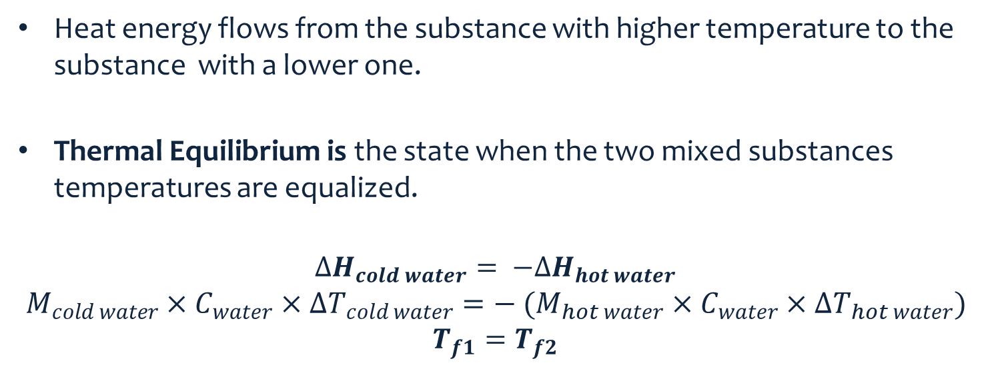
Thermal Equilibrium
Heat energy flows from the substance with higher temperature to the substance with a lower one.
Thermal Equilibrium is the state when the two mixed substances temperatures are equalized.
  $$∆H_{cold water}= −∆H_{hot water}$$
  $$M_{cold water}×C_{water}×∆T_{cold water}=− (M_{hot water}×C_{water}×∆T_{hot water})$$
  $$T_{f1}=T_{f2}$$

Slide 4
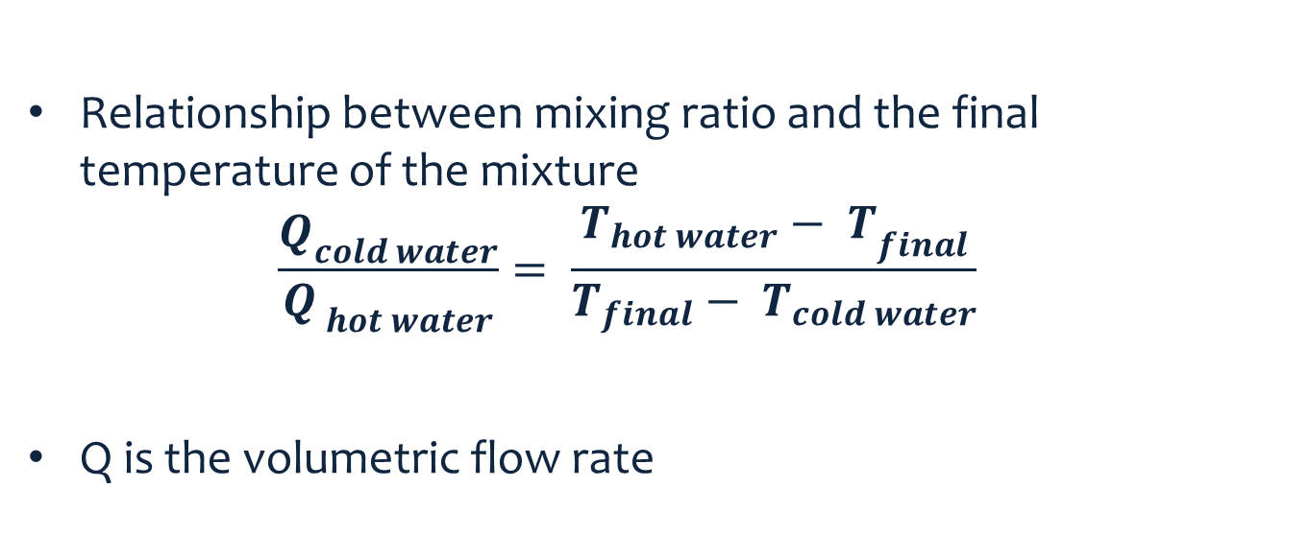
Thermal Equilibrium Cont.
Relationship between mixing ratio and the final temperature of the mixture
  $$\frac{Q_{cold water}}{Q_{ hot water}}= \frac{{T_{hot water}− T}_{final}}{T_{final}− T_{cold water}}$$
Q is the volumetric flow rate

Slide 5
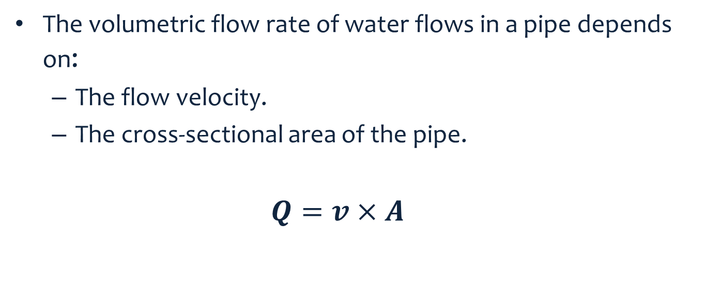
Flow Rate Controlling
The volumetric flow rate of water flows in a pipe depends on:
  The flow velocity.
  The cross-sectional area of the pipe.
  $$Q=v×A$$

Slide 6
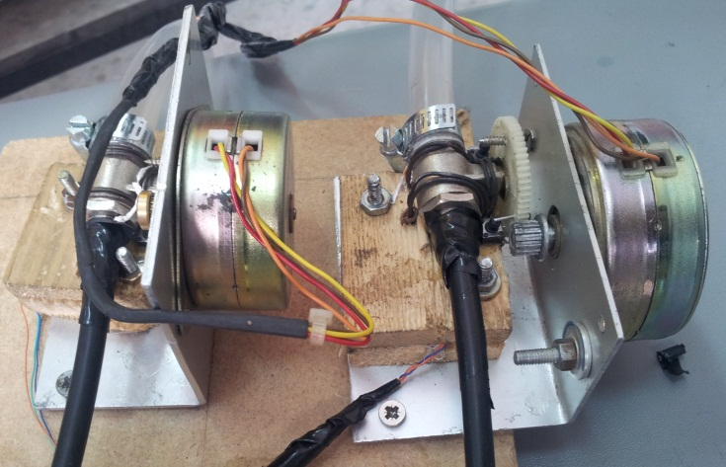
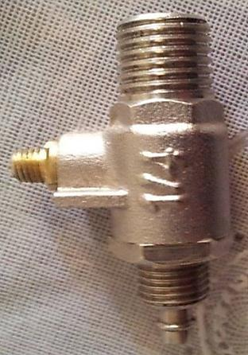
Controlling the cross-sectional Area
A small ¼” valve tied to a stepper motor:
  Open , Close
  MAX , MIN

Slide 7
Stepper driving circuit
0.25 A
Interfacing circuit:
  the L297 Stepper Motor Controller IC.
  the L298 H-Bridge IC.

Slide 8
Stepper Software Interface
Functions:
void initialize_stepper_driver()
void close_stepper(int1 STEPPER_ID)
void open_stepper(int1 STEPPER_ID)
void rotate_stepper(int1 Stepper_ID,int1 Direction ,int steps)
int1 isMax(int1 Stepper_ID)
int1 isMin(int1 Stepper_ID)

Slide 9
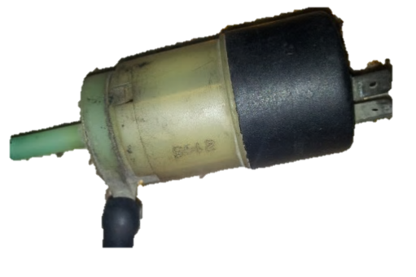
Controlling the flow velocity
Use DC pumps.
consumes up to 3.5A DC current
  TIP122, an NPN Darlington driver Transistor, up to 5 A.
1 KHz square wave with PWM techniques to change the speed of the DC motor.

Slide 10
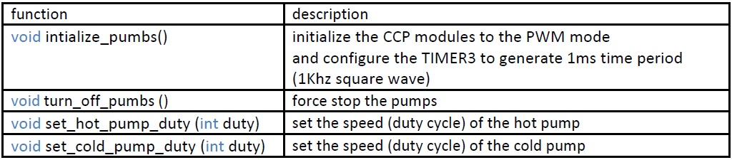
DC pump Software Interface

Slide 11
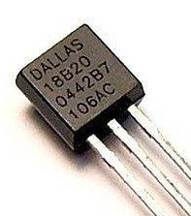
Measuring the temperature
one wire Digital Temperature Sensor - DS18B20 from Dallas.
  One Pin for Communication.
  Unique 64-Bit Address.
  3.0V to 5.5V Power Supply
  Working Range -55°C to +125°C
  9 to 12 Bits Resolution
  (-)±0.5°C Accuracy from -10°C to +85°C
  (-)Converts Temperature to 12-Bit Digital Word in 750ms
Notes:
from -10°C to +85°C

Slide 12
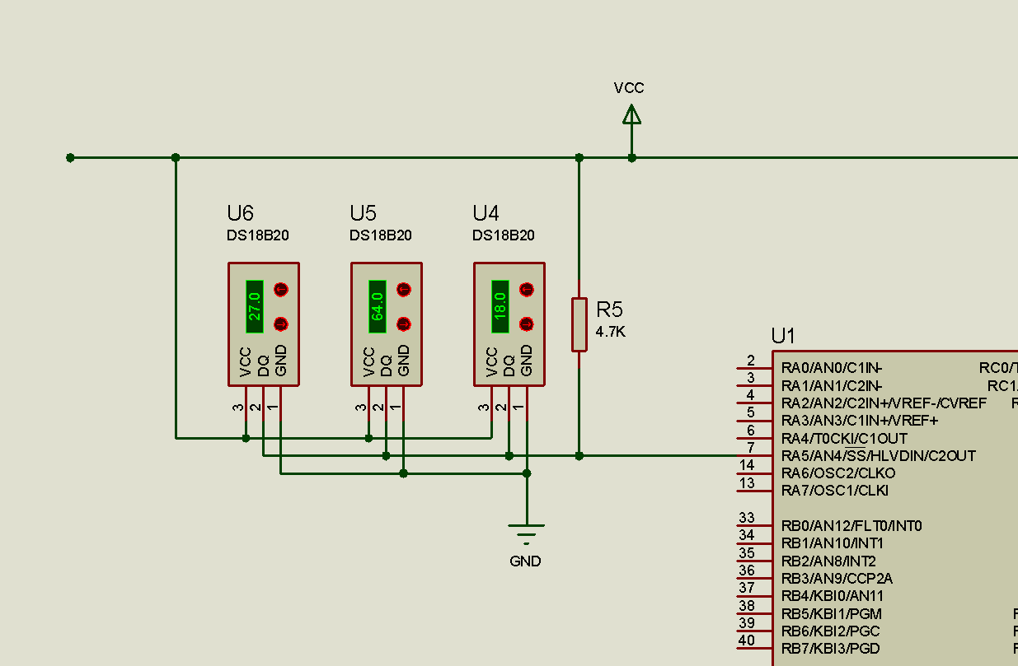
DS18B20 interfacing Circuit

Slide 13
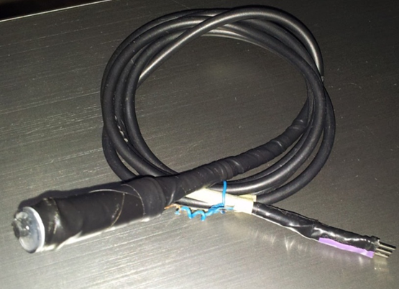
Waterproof Temperature Sensor

Slide 14
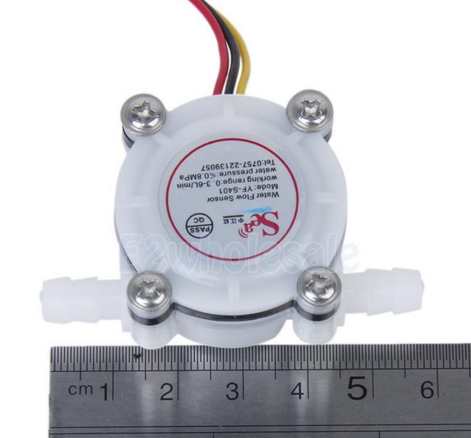
Flow Meter
The YF-S401 flow meter
has three terminals:
  VCC
  GND
  OUTPUT: pulse signal each time the rotor rolls.

Slide 15
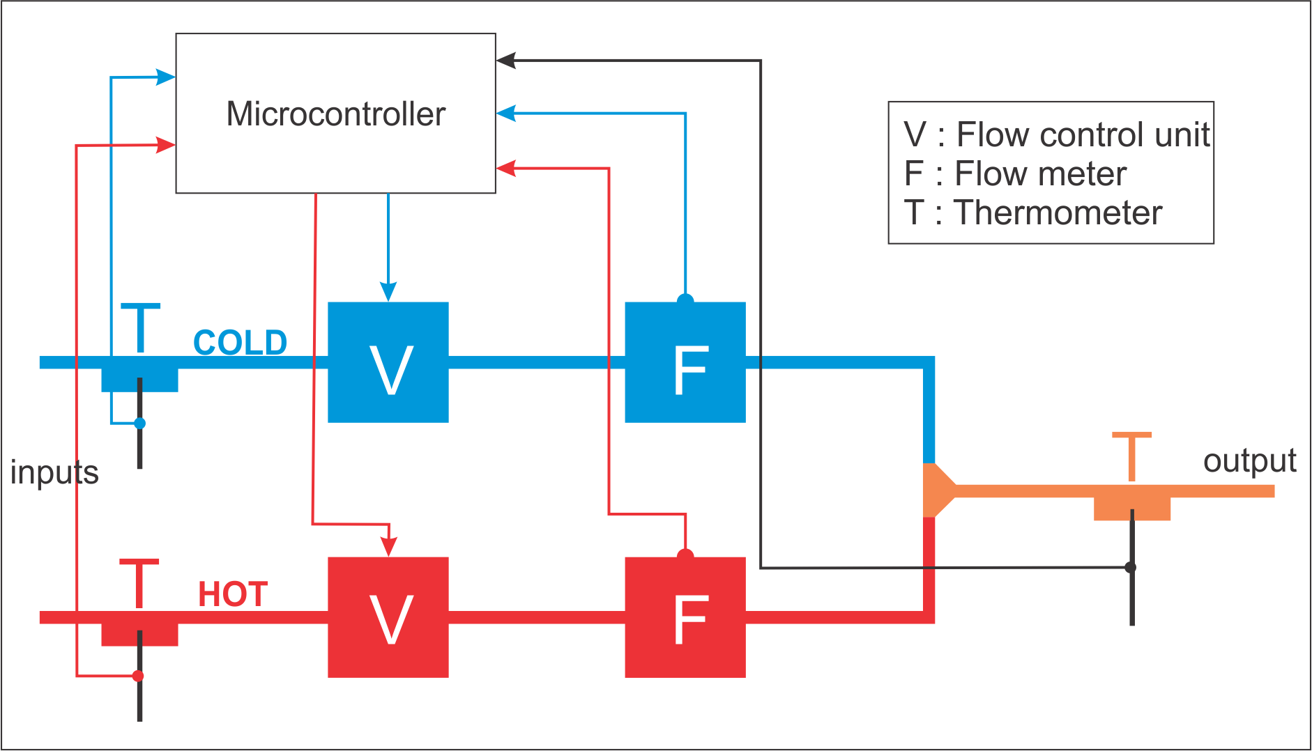
Ad-hoc controller
The main components

Slide 16
Ad-hoc controller
Three Main Stages :
  The initialization stage
  Outputting the suitable ratio stage
  The correction stage

Slide 17
  Ad-hoc - The initialization Process
Calculate all hot and cold ratios that the system can provide.
  Read flow meters ( hot and cold water flow)
  Calculate ratio
    If Cold ratio ➔ hot flow / cold flow
    If Hot ratio ➔ cold flow / hot flow
  Rotate the valve, then repeat step 1

Slide 18
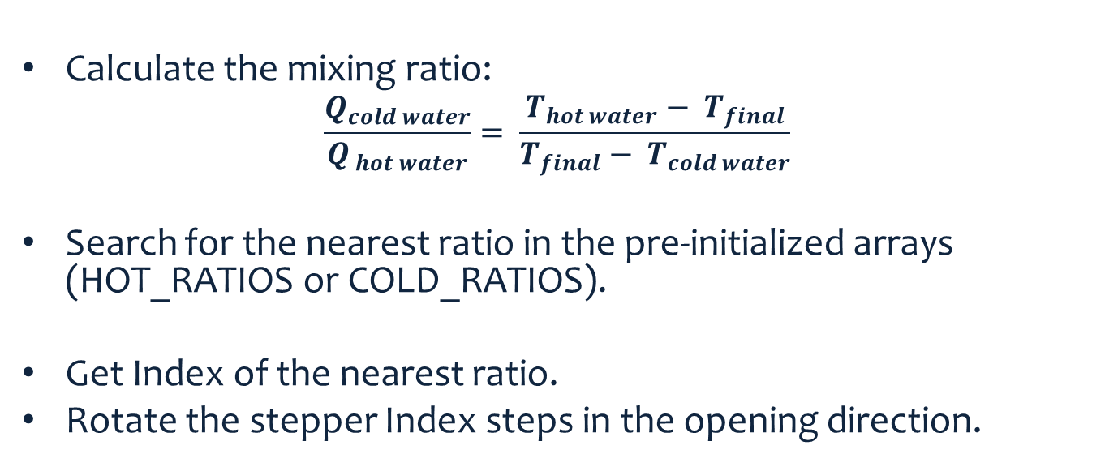
Outputting the suitable ratio
Calculate the mixing ratio:
  $$\frac{Q_{cold water}}{Q_{ hot water}}= \frac{{T_{hot water}− T}_{final}}{T_{final}− T_{cold water}}$$
Search for the nearest ratio in the pre-initialized arrays (HOT_RATIOS or COLD_RATIOS).
Get Index of the nearest ratio.
Rotate the stepper Index steps in the opening direction.

Slide 19
The correction process
Reads the T_output and calculates (∆T_OD).
  ∆T_OD = T_Output – Tdesired
Uses the ∆T_OD and the following array to determine the number of the steps the stepper motor that should rotate:
  int deltas_array[7]={1,1,2,2,3,3,4};
  And it indexes it using the ∆T_OD value:
    deltas_index=(int)∆T_OD
Example, if ∆T_OD = 5.5 C then deltas_array[5] = 3.

Slide 20
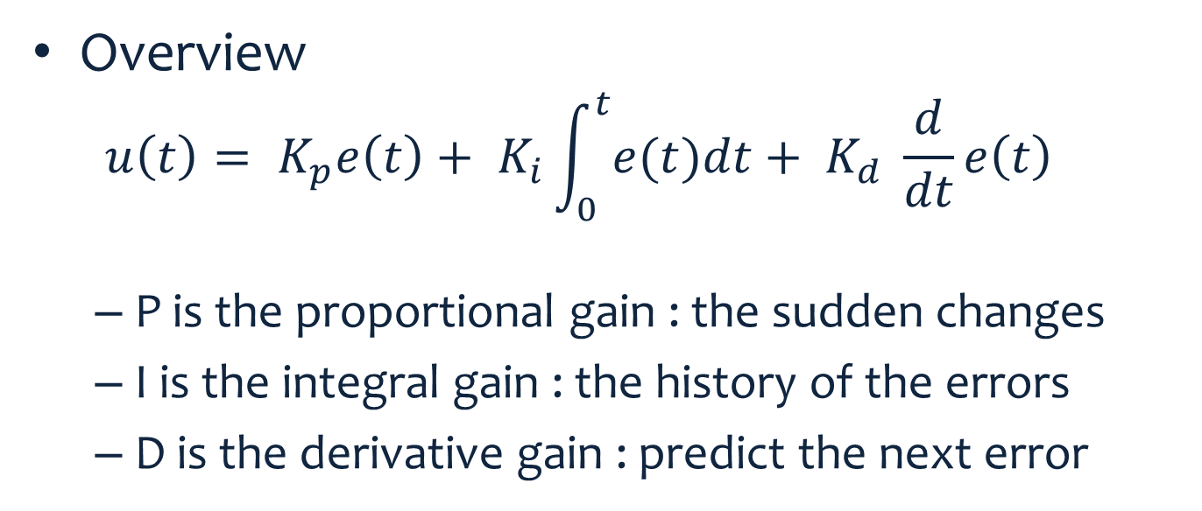
PID Controller
Overview
  $$u\left(t\right)= K_{p}e\left(t\right)+ K_{i}\int_{0}^{t}{e(t)dt}+ K_{d} \frac{d}{dt}e\left(t\right)$$
  P is the proportional gain : the sudden changes
  I is the integral gain : the history of the errors
  D is the derivative gain : predict the next error

Slide 21
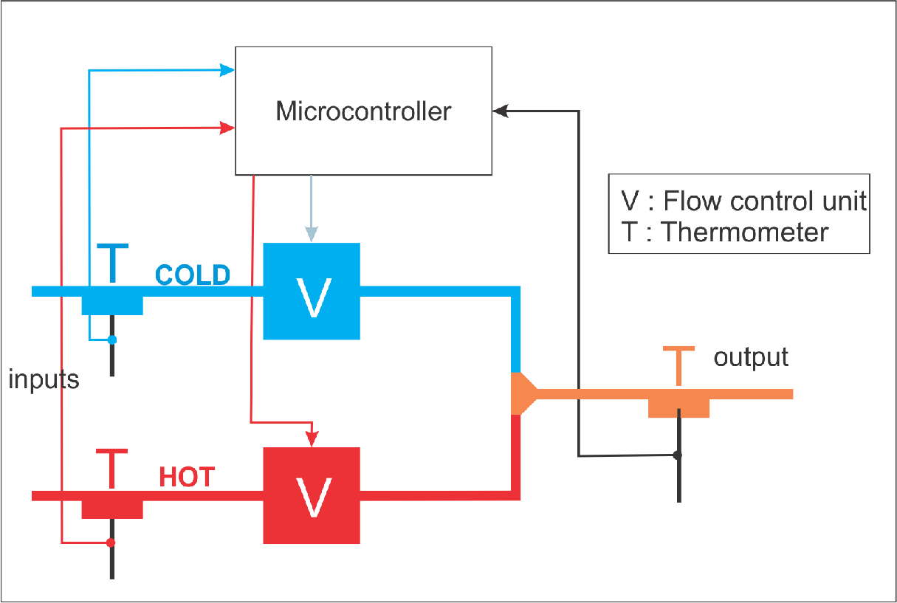
PID Controller Cont.
  main components

Slide 22
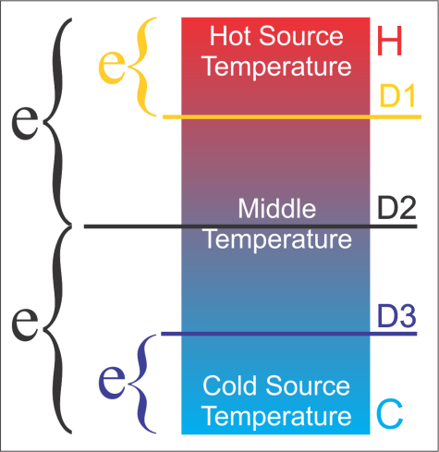
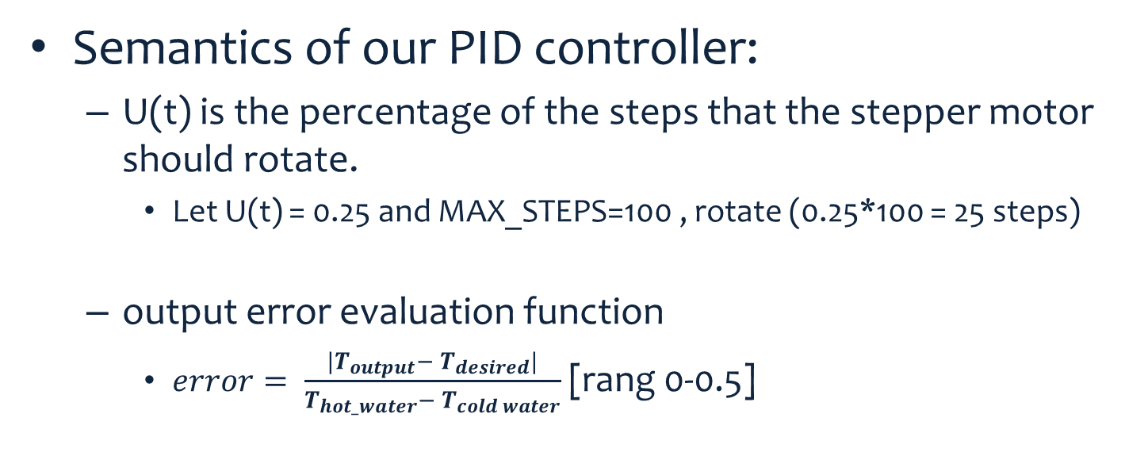
PID Controller Cont.
Semantics of our PID controller:
  U(t) is the percentage of the steps that the stepper motor should rotate.
    Let U(t) = 0.25 and MAX_STEPS=100 , rotate (0.25*100 = 25 steps)
  output error evaluation function
    $error= \frac{|{T_{output}− T}_{desired}|}{T_{hot_water}− T_{cold water}}$ [rang 0-0.5]

Slide 23
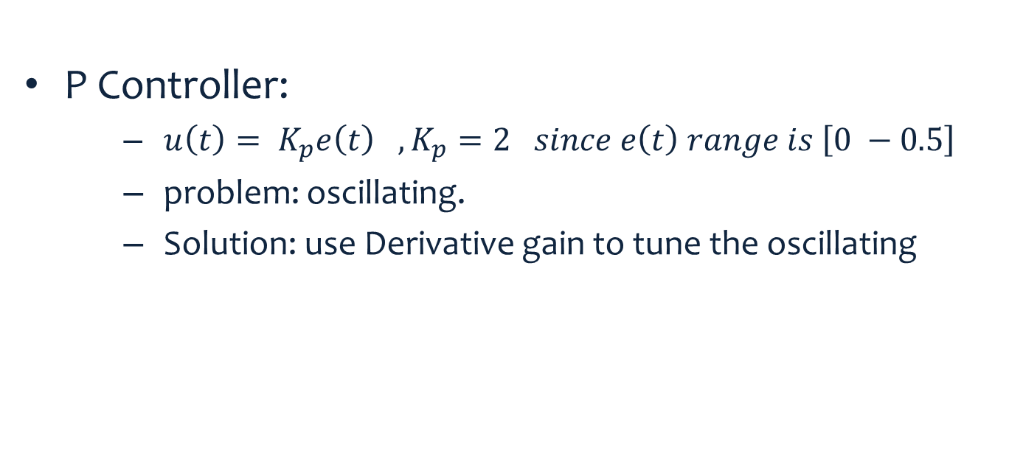
PID Controller Cont.
P Controller:
      $u\left(t\right)= K_{p}e\left(t\right) ,K_{p}=2 since e\left(t\right) range is \left[0 −0.5\right]$
      problem: oscillating.
      Solution: use Derivative gain to tune the oscillating

Slide 24
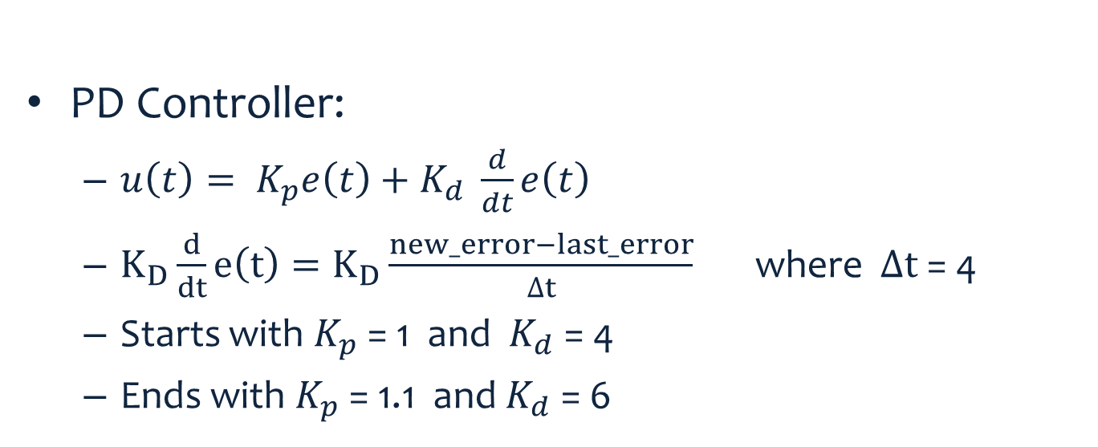
PID Controller Cont.
PD Controller:
  $u\left(t\right)= K_{p}e\left(t\right)+K_{d} \frac{d}{dt}e\left(t\right)$
  $K_{D}\frac{d}{dt}e\left(t\right)=K_{D}\frac{new_error−last_error}{∆t}$ where $∆t$ = 4
  Starts with $K_{p}$ = 1 and $K_{d}$ = 4
  Ends with $K_{p}$ = 1.1 and $K_{d}$ = 6

Slide 25
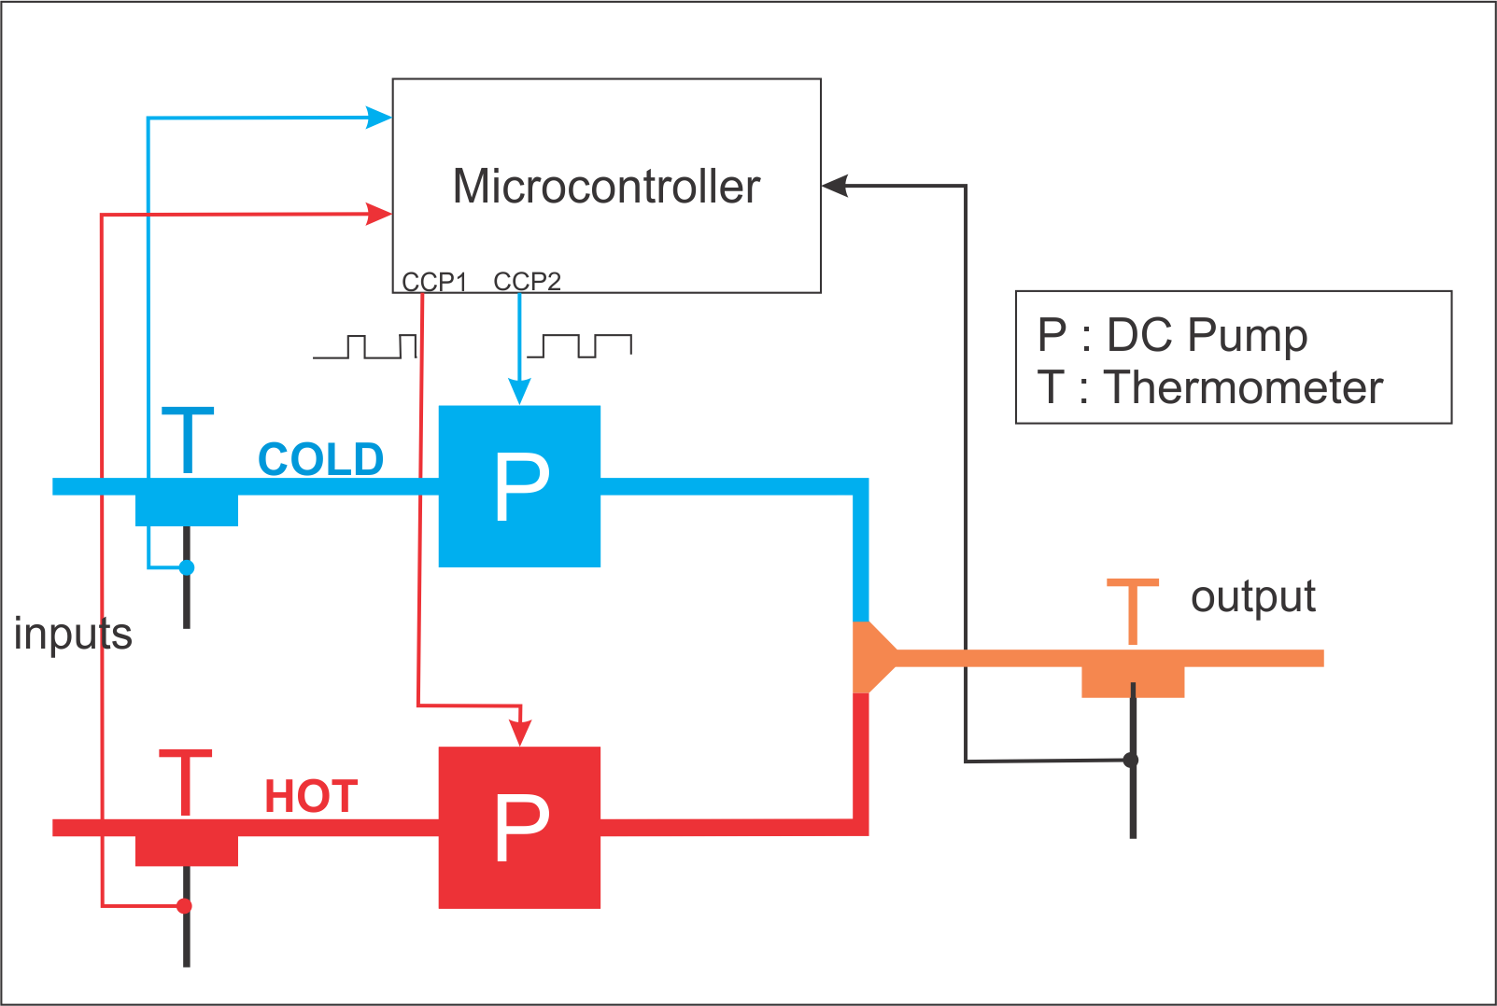
DC pumps Controller
The main components:

Slide 26
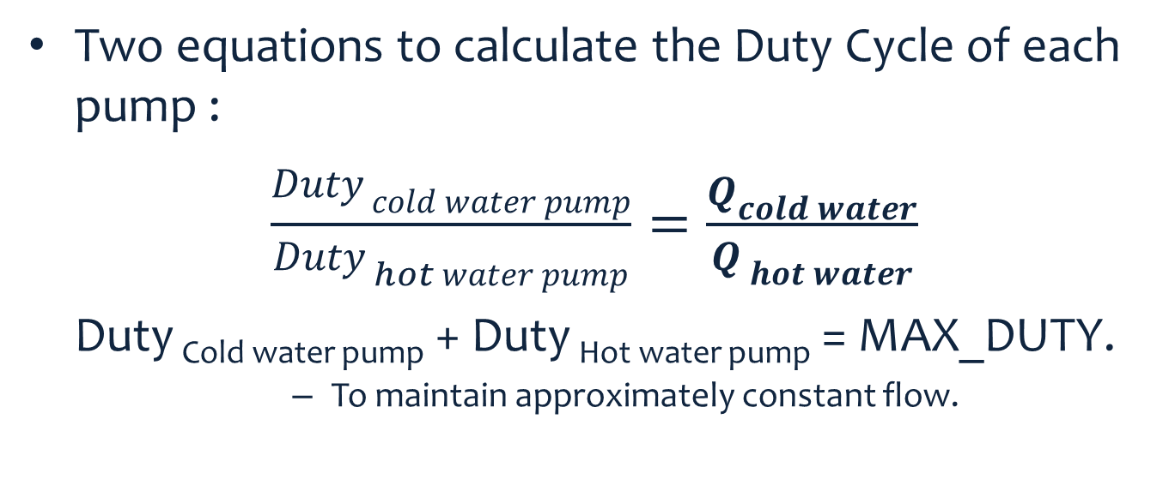
DC pumps Controller Cont.
Two equations to calculate the Duty Cycle of each pump :
$\frac{{Duty}_{ cold water pump}}{{Duty}_{ hot water pump}}=\frac{Q_{cold water}}{Q_{ hot water}}$
Duty _{Cold water pump} + Duty _{Hot water pump} = MAX_DUTY.
  To maintain approximately constant flow.

Slide 27
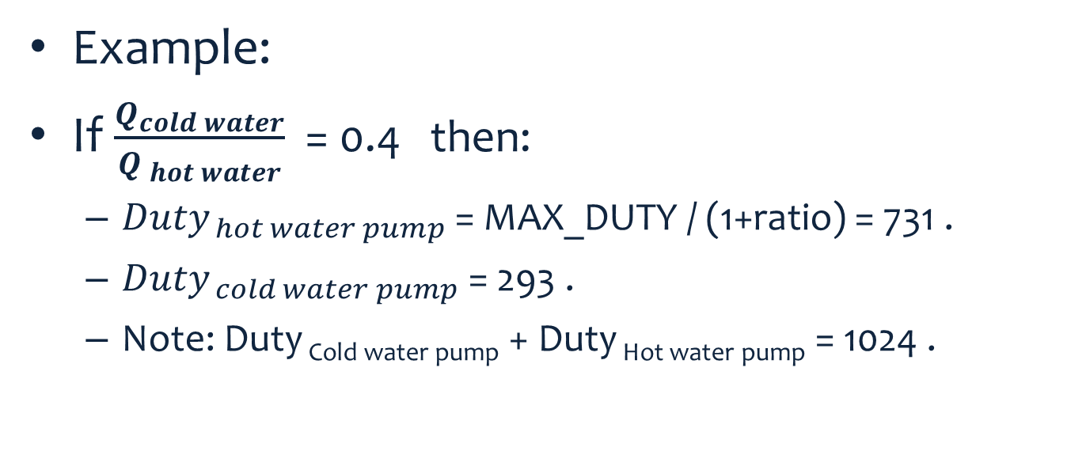
DC pumps Controller Cont.
Example:
If $\frac{Q_{cold water}}{Q_{ hot water}}$ = 0.4 then:
  ${Duty}_{ hot water pump}$ = MAX_DUTY / (1+ratio) = 731 .
  ${Duty}_{ cold water pump}$ = 293 .
  Note: Duty _{Cold water pump} + Duty _{Hot water pump} = 1024 .

Slide 28
DC pumps Controller Cont.
The correction process:
  accumulates the error in a correction factor.
  output the new ratio (old ratio + correction factor).
This Controller FAILS – more details in the next slides

Slide 29
Results – Ad-hoc Controller
Advantages:
Disadvantages:
very fast.
The initial error rate is small, which limits the correction factor boundaries.
System initialization.
System need to be reinitialized when water pressure changes.
Sudden Large changes in the water source temperatures will cause high error rate and the system will take long time to readapt.

Slide 30
Results – PID Controller
Advantages
Disadvantages:
No system initialization state.
very adaptable
  that means sudden changes in water pressure or water temperatures can be tolerated quickly.
a little slower than the first controller
  it needs up to 40 seconds to reach the desired temp.

Slide 31
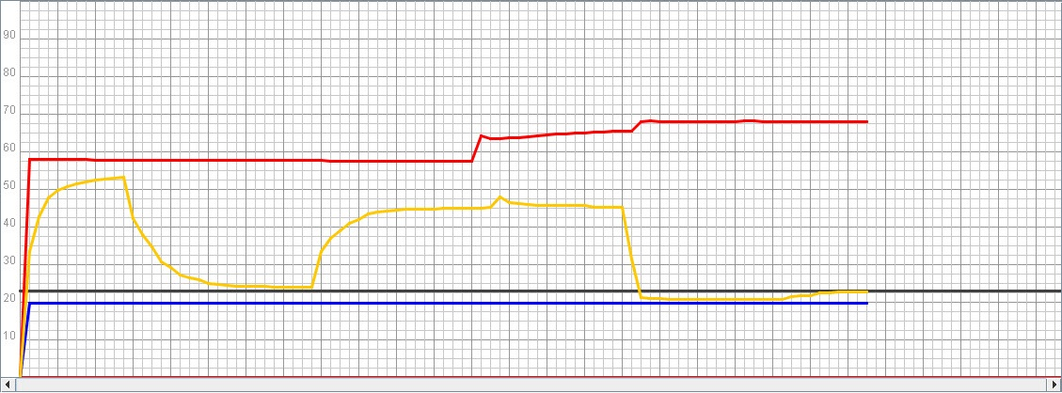
PID Responses

Slide 32
Results DC-Pump
poor results from this controller.
reasons :
  hen the pump is off, the water flow is not zero.
  two different dc pumps which have different speed response at the same duty cycle.
A Disadvantage of using DC pumps:
  Needs high current supply

Slide 33
Results
We were able to achieve a 2% error rate of the range between the two sources temperature
  ( 60 - 20 ) ➔ ±0.8 degree
We could not minimize the error rate because of:
  The manually isolated thermometer.
  The stepper motors have small range of steps between fully open and fully closed.
Can’t obtain Max hot temperature edge.

Slide 34
Thank you
Any Question ?

