Slide 1
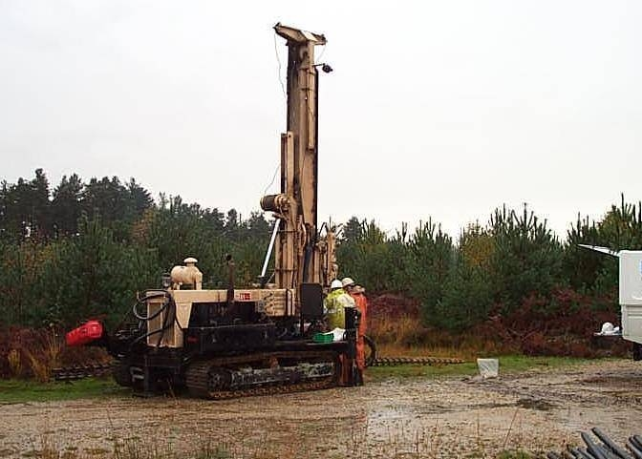

`
An-Najah National University
Faculty of Engineering
Civil Engineering Department
Reality and Importance of Site Investigation in Nablus City
Prepared by:
Mohammad Zaqqa
Mohammad Ardah
Bahya Sa’d AL-Deen
Haya Zaid
Supervised by:
Dr. Isam Jardaneh

Slide 2
Description of The Project
This project highlighting on the importance of conducting site investigation in construction activities.
identify the problems that might be occur in constructions when the site investigation didn’t taken into considerations.
Propose a suitable solutions for that problems.
Identify the codes that will be used in site investigation.
Getting the opinions from professionals regarding the benefits of site investigation.

Slide 3
Introduction
The design of foundations of any structures such as buildings, bridges, and dams requires a knowledge about the type of soil deposits that will support these structures. The technique of identifying that layers which underlie a proposed structure referred to subsurface exploration.
However many of engineers didn’t take this concept into considerations as a result the structural problems will be high due to un expected geotechnical problems.

Slide 4
Methodology
A questionnaire was distributed to many owners, engineers and contractors of building to shed lights on site investigation.
The sites were visited and inspected several times to identify the problem and to find out possible causes of these problems.
Problems that have been observed at the region have been studied and photographed.
Proposed suitable economic solutions for that problems.

Slide 5
Importance of site investigation
Determine the type and the depth of foundation substitute for a given structure.
Estimate of the probable settlement of structure.
Determination of potential foundation problems.
Evaluation of the load-bearing capacity of the foundation.
Establishment of ground water table location.

Slide 6
Subsurface exploration steps
Collection of preliminary information
Site investigation
Reconnaissance

Slide 7

Preliminary information:
collection of some information about the proposed structure like ( type of building and its use, location of the building, the design area of the building, approximate column loads and their spacing, the code that will be used and its requirements.
Reconnaissance :
(walk over the site) in this step engineers should go to the site and make a visual inspection to get a basic information about the hydrology, slope instability, mining, and access of the site.

Slide 8
Site Investigation steps
Making several test borings at the site
Collecting disturbed and un disturbed samples
Conducting field and lab tests
Writing the main report

Slide 9
Codes Used for Site Investigation
There are specific site investigation codes for each country, the code is standards and specifications written by experienced engineers whom they have experiences and knowledge. These codes summarize the main requirements for site investigation.
Three different codes are discussed, there requirements and where they will be used.
Locally we follow the Jordanian code since the nature of our soil and our engineering work are similar to those in Jordan.

Slide 10
Building on Difficult Soils
The construction of foundation depends on the nature of the soil, when the soil characteristics are in good conditions the capability of construction become more easy and more economical.
According to our survey in Nablus city the most difficult soil are :
  Collapsible soil.
  Expansive soil.
  Landsliding.

Slide 11
Collapsible soil:
Collapsible soils consist of loose, dry, low-density materials that collapse and compact under the addition of water or excessive loading, debris flow sediments, and loess (wind-blown sediment) deposits.
Human activities that facilitate soil collapse include:
Irrigation.
Water impoundment.
Watering the lawn.
Changing the natural drainage.
Disposal of wastewater.

Slide 12
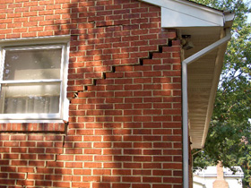
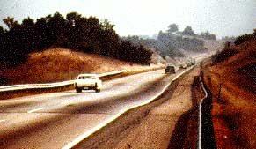
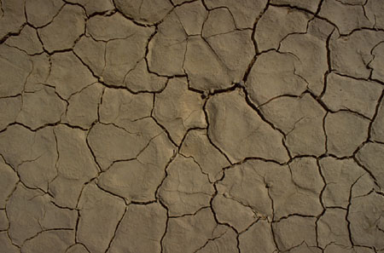
Expansive Soil:
There are many plastic types of clay that swell considerably when water is added to them and then shrink with the loss of water. Foundations constructed on these clays are subjected to large uplifting forces caused by the swelling. This force will induce heaving, cracking, and breakup both of building foundations and slab-on-grade members.

Slide 13
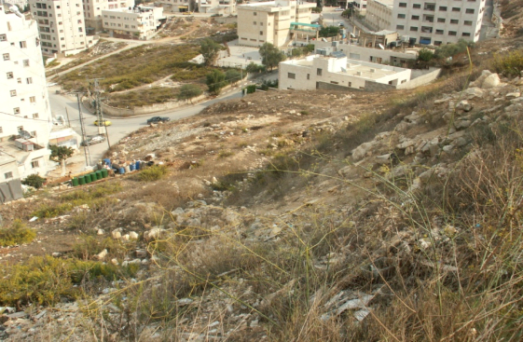
Landsliding:
The first sign of an imminent landslide is the appearance of surface cracks in the upper part of the slope, perpendicular to the direction of the movement. These cracks may gradually fill with water, which weakens the soil and increase the horizontal force which initiates the slide.

Slide 14
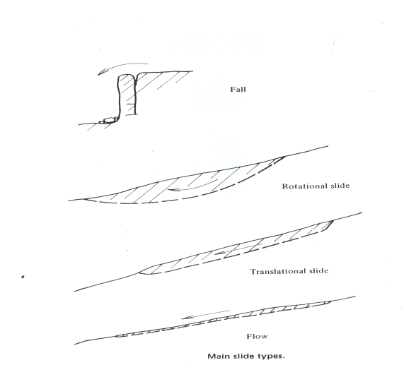
Types of Landsliding:
There are different types of Landsliding:
  Fall
  Rotational landslide
  Translational slides
  Flows
Causes of land sliding:
A large number of factors such as geological and hydrological conditions, topography, climate, and weathering affect the stability of a slope and can initiate a landslide

Slide 15
Survey Results
A survey was conducted in different zones of Nablus city for different types of structures and different types of soils, to get information from owner, contractors, and subcontractor who conduct site investigation in their projects.
The survey shows that projects that carried site investigation prior to design and construction had no geotechnical problems and thus no structural problems.

Slide 16
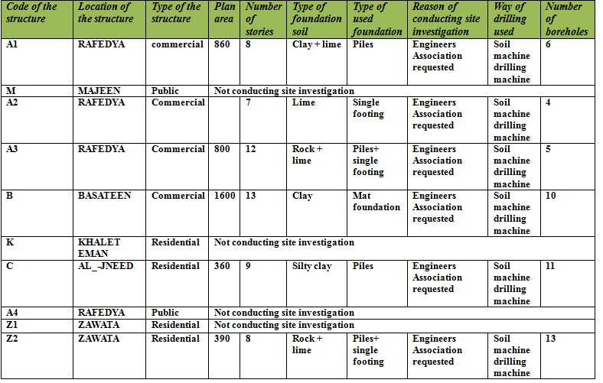

Slide 17
Consequences of Not Conducting Site Investigation
During the investigation, three sites were found that had structural problems due to geotechnical problems. It was found that these sites did not conduct site investigation requirements. The sites are :
  mosque at Al-MAJEEN
  Omar IIBN Al-KHATAB street (mosque and school Ali bin ABI TALEB)
  North Mountain (KHALAT Al-EMAN).

Slide 18
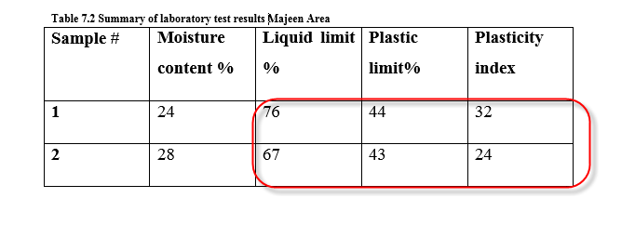
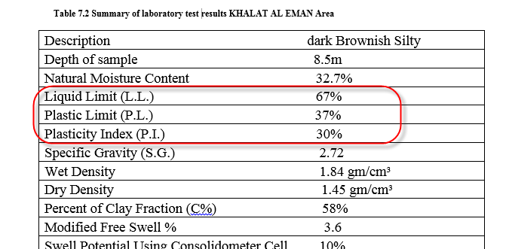
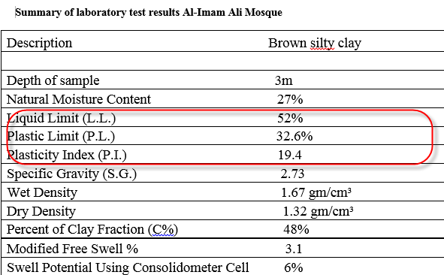
Laboratory Tests:
Laboratory test that was carried out are natural moisture content, liquid limit, plastic limit, specified gravity, hydrometer analysis, modified free swell and consolidation swelling potential and pressure.

Slide 19
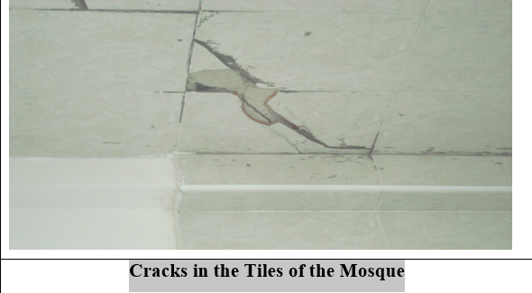
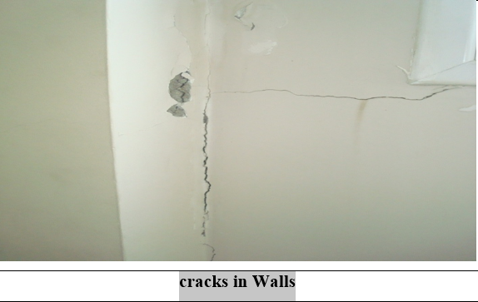
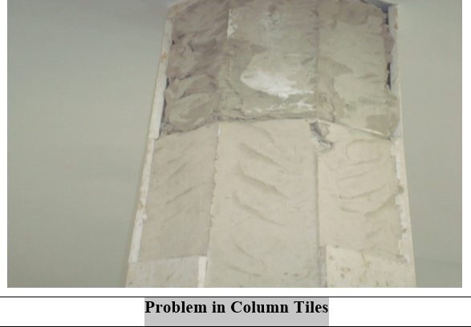
Eye Inspections
Majeen Mosque

Slide 20
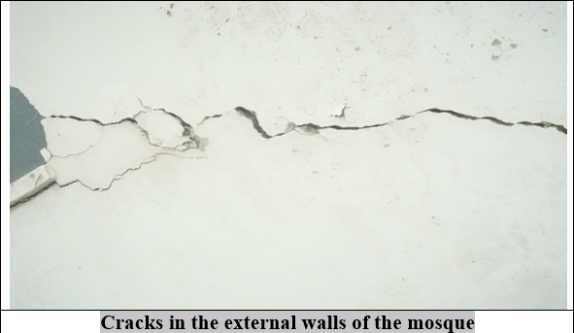
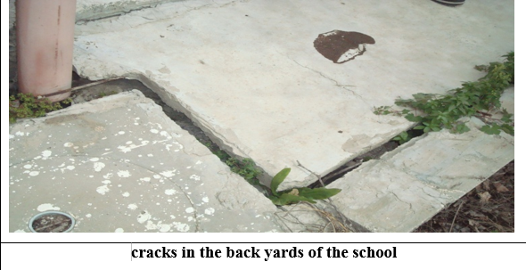
Omar IBN Al-KHATAB Street (mosque and school Ali bin ABI TALEB).

Slide 21
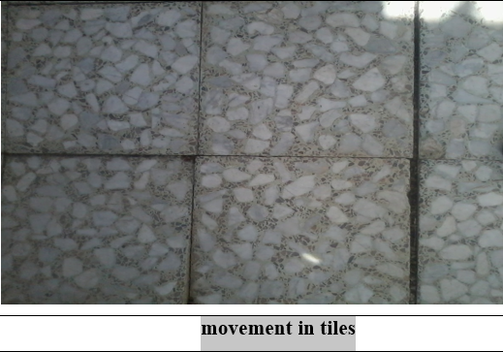
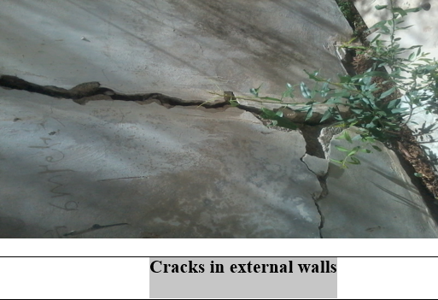
House in KHALAT AL-EMAN

Slide 22
Causes of the Problems
Swelling and shrinkage: this may happen if an expansive soil exists at the site. This may be checked by testing samples of soils in the soil mechanics laboratory.
L.L and P.L limits are above the normal range this indicates that the soil has very high swelling.
Land sliding: this may happen if a slope stability problem exist at the site or near by
The building weight exceeds the strength of the soil.
Type of foundation used.
Foundations lies on the some cavities .
Undrainage of rainfall: this may happen of water from rainfall accumulated.
Springs and streams

Slide 23
Solutions for that problems
For Expansive soil:
Remove the expansive soil.
Mix the soil with non –expansive materials.
Mix in chemical to change the way the clay reacts with water.
Keep the soil moisture constant.
Used reinforced foundations that are designed to withstand soil volume change.
Ensure proper drainage away from the foundation.
Management of vegetation.

Slide 24
The depth of foundation must be at least to the level of active depth.
The distance between the trees and the structure must be at least equal to height of the building.
Don’t construct a well under the building.
Landsliding:
The commonly used correction methods can be divided into the following three main groups:
Geometrical methods, which involve the change of the geometrical conditions of a slope.
2) Hydrological methods, such as a lowering of the groundwater table or a reduction of the water content of the soil or rock.
3) Chemical and mechanical methods, including grouting which cause an increase of the average shear strength the soil.

Slide 25
Recommendations
This study verifies the importance of conducting site investigation in construction activities through the problems that might be appear when the site investigation didn’t taken into considerations. So site investigation should be a must if the owner and contractors do so the geotechnical problems will be at the minimum level thus the structural problem so no need for additional cost for maintenance.
Usually site investigation cost very little comparing to total construction cost.

Slide 26


