Slide 1

Domestic Olive oil extruder
Supervisor: Dr.Salamah Abdel-Fattah
Students:
Moath Dweekat
Wisam Mlitat
Khalid Al-Ataywi

Slide 2
Contents
Introduction
Process
Control
Conclusion

Slide 3
introduction
Palestine is a famous country of olive trees from ancient times. That famous fruit is picked at harvest seasons, and farmers need to extrude the oil from the olives with modern ,automated extruders. However, these extruders are expensive and demanding of long waiting times to have a turn. So we aspired to create a domestic olive oil extruder that is cheaply priced , easy to use and provides higher production quality. It will be a fast way to extrude oil while the olives still fruity. In this project it was attempted to manufacture the machine using common and heavily used parts .

Slide 4
Process
In producing olive oil four steps must be done one after another, the general production process have the following steps :
cleaning and washing olives.
crushing to produce olive paste
mixing the paste
phases separation

Slide 5
Cleaning and washing
What is meant by cleaning?
What is meant by washing?
How it is done?

Slide 6
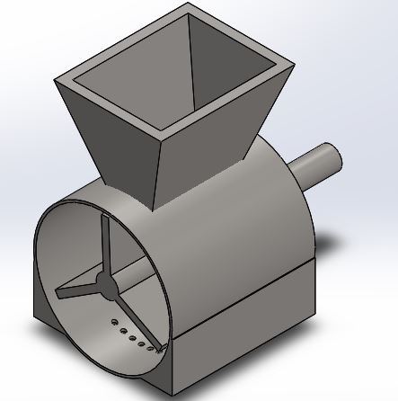
Crushing process:
Hammermills:
What is a hammermill?
Advantages of a hammermill?
Disadvantages hammermill?
Effects on quality?
hammer mill

Slide 7
Hammermills Effects on quality
Machine | Positive effect | Negative effect
Hammermill | + Fruity + Green | - Sweetness + Pungent + Bitter

Slide 8
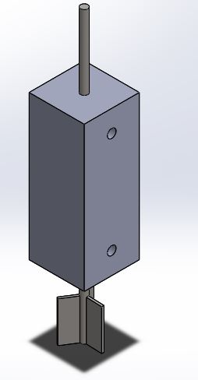
malaxing the paste:
The purpose of malaxing
Restrictions during malaxing
Duration of malaxing
mixer

Slide 9
Phases separation
What is meant by phases?
The methods of separation:
Press system
Centrifugation systems *decanter centrifuge
in this project a press system was used.

Slide 10
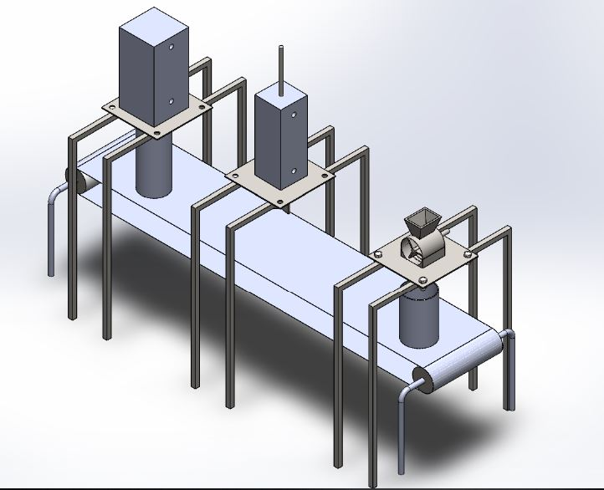
Crushing

Slide 11
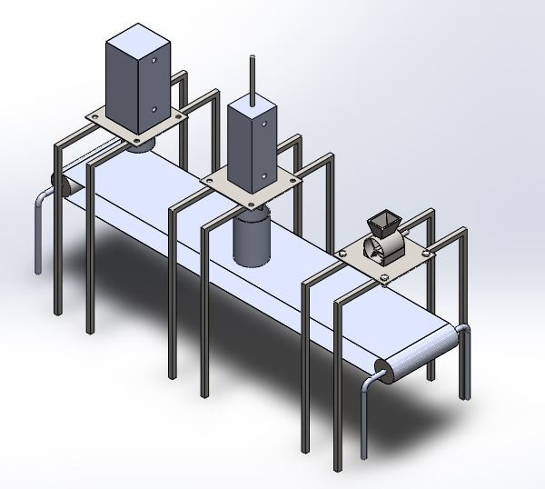
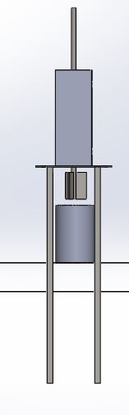
mixing

Slide 12
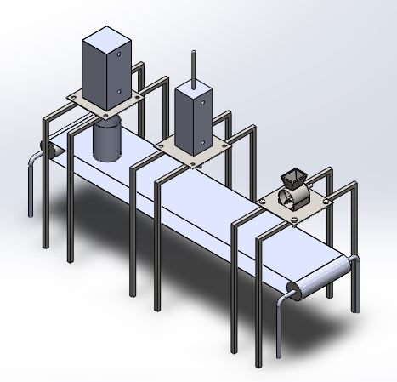
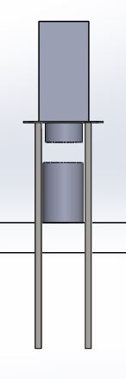
Pressing

Slide 13
Control
a plc will be used to control the line within the machine
1- the timing for the container
2- starting and stopping the hammer mill
3 – mixing and its duration
4- starting the press and opening the valves .
5- controlling the final separation
A pneumatic system will be used to actuate the process
1- moving the container
2- lowering the needed part to complete tasks

Slide 14
Pneumatic system
A pneumatic system was used in this project and it consists of the following
Components :
1- compressed air source
2- control valves
3- acting cylinders
4- tubes and hoses
5- filter

Slide 15
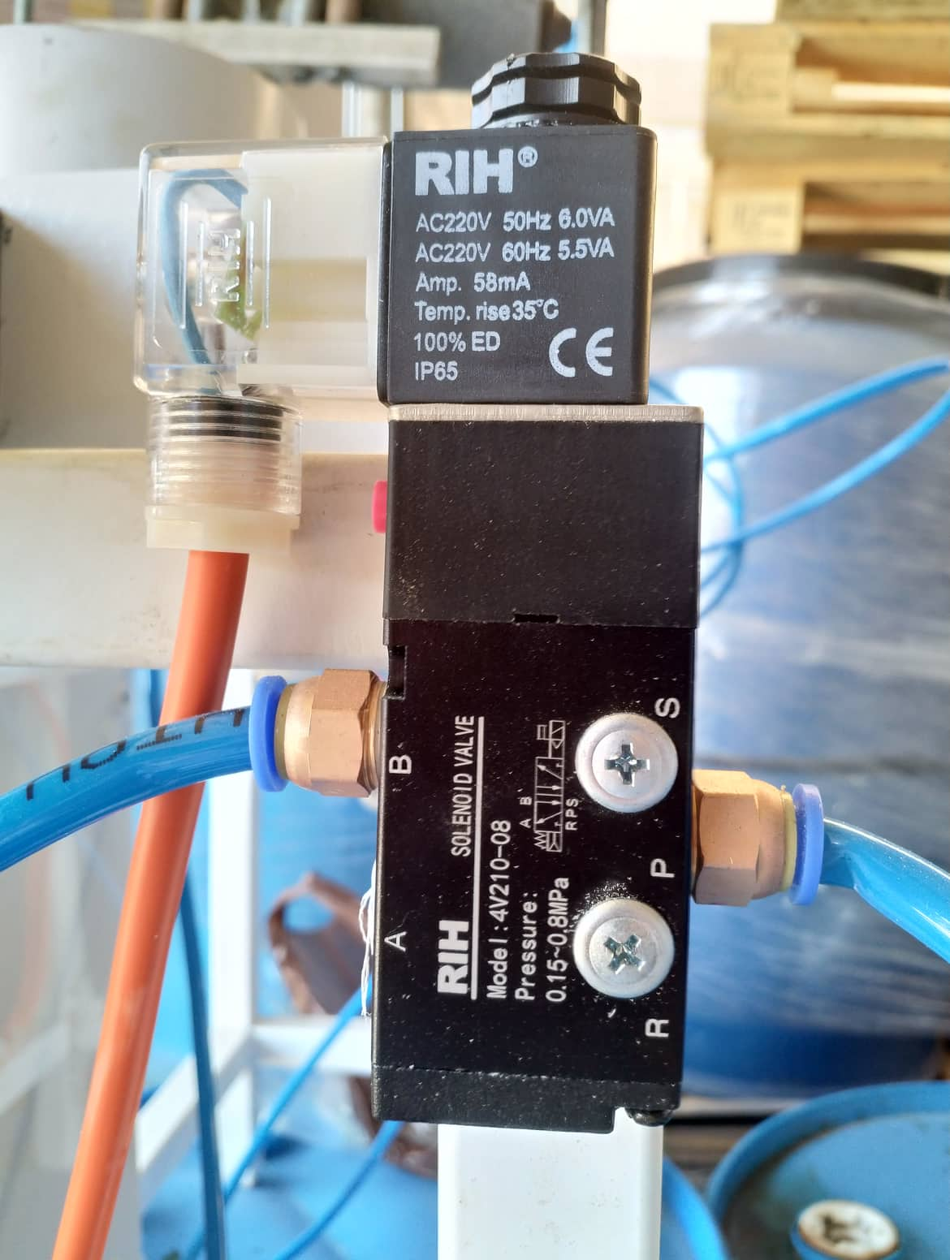
Control valve:
4V210-08 Solenoid Valve was used in this project to control the acting cylinders.
Valve type: Double solenoid 5/2 way
Port size: In=out=1/4″ Exhaust=1/8″
Standard Voltage: AC220V
Connection and initial status: Threaded
Sub-plated mounted (for 5/2way)
Coil and type: 10 Single coil
Valve Working Medium: 40 Micron Filtered Air
Working Pressure: 0.15~0.8Mpa
Max.Pressure Resistance: 1.2 Mpa

Slide 16
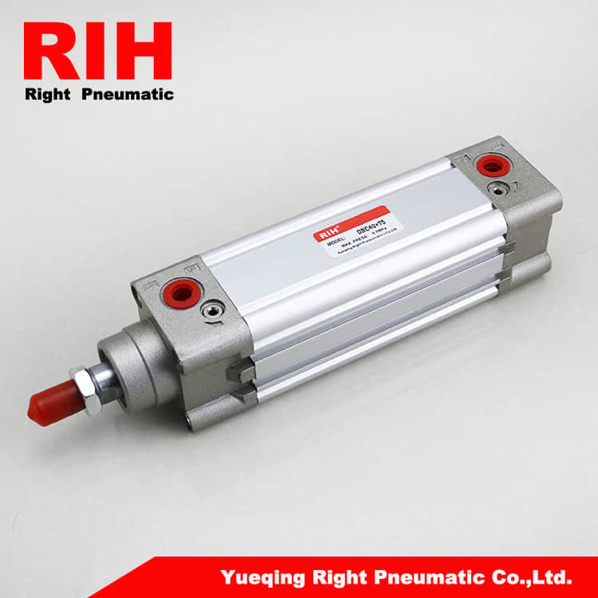
Double acting cylinders :
RIH Band Square Cover Type Double Acting DNC Standard Pneumatic Cylinder
Are in use in this project.
Two of them had a maximum stroke of 100mm for the mixing and pressing operations
the third 600mm to move the container between the 3 stages.

Slide 17
Programmable logic controller
To operate the whole project and to synchronies all the process’s a plc have been added to the system.
The plc used in this project is the Delta dvp es2 4
16 inputs & 8 outputs Standard PLC / Analog I/O PLC
it offers these specifications :
1- 32-bit CPU for high-speed processing
2- Program capacity: 16k steps ( program lines )
3- Max. execution speed of basic instructions: 0.35 μs
4- Highly efficient processing ability: 1 k steps of programs can be completed within 1ms

Slide 18
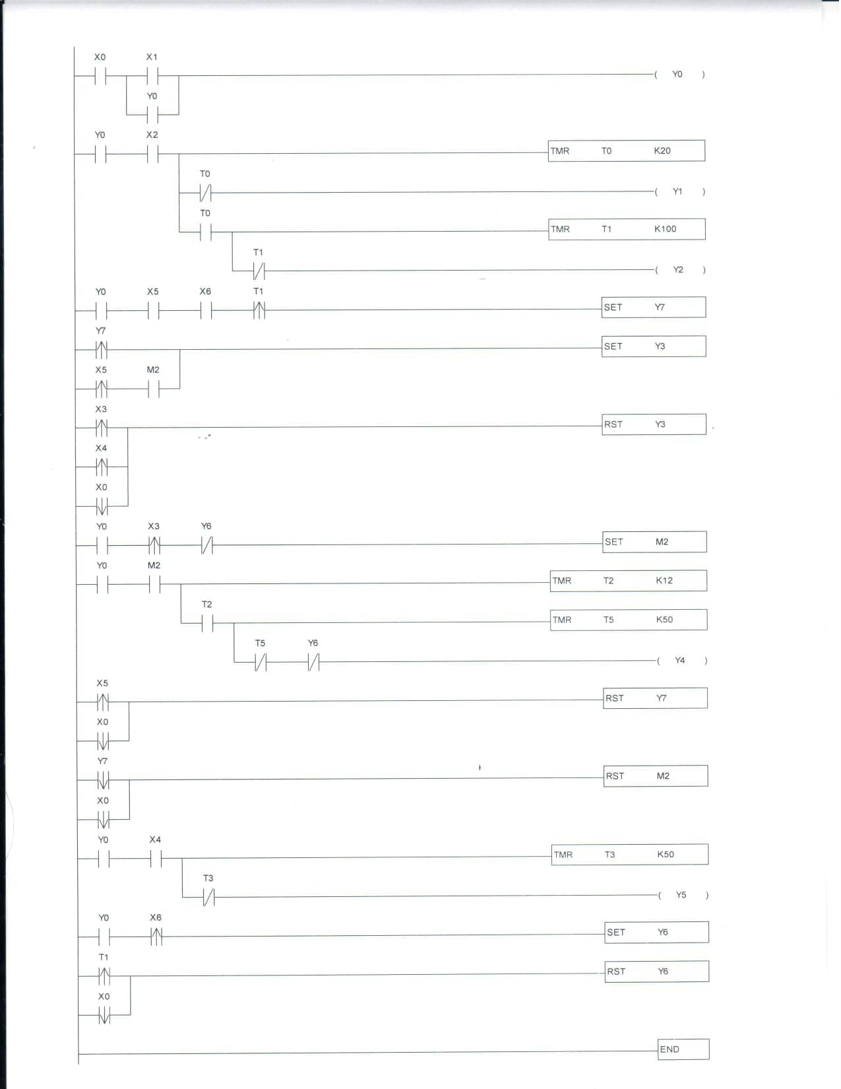
Program ladder

Slide 19
Advantages
The machinery is compact
They are semi-continuous and automated.
There is no need for an oil/water separation step
Disadvantages
expensive
energy consumption is high

Slide 20
Olive Press
Advantages
It is simple and reliable machinery.
The energy consumption is low.
The resulting pomace has a low moisture content.
No water has to be added
Disadvantages
Decomposition of materials left on mates,
It is a discontinuous process.
An additional step is needed to separate the oil from the vegetable water.
more oxidation and a higher level of peroxides.
The shelf life of the oil is shorter.

Slide 21
Conclusion
centrifuge , expensive , not affordable, high speed motor up to 4500 rpm
a lot of complex machining operations to make the centrifuge parts
lack of funding and resources led to not finishing the prototype
machining cost is out of our expense limit
team is determent to continue working on machine after submitting the project
in the case of mass production the expenses will be reduced efficiently and a business can be started if investors were to be found

Slide 22
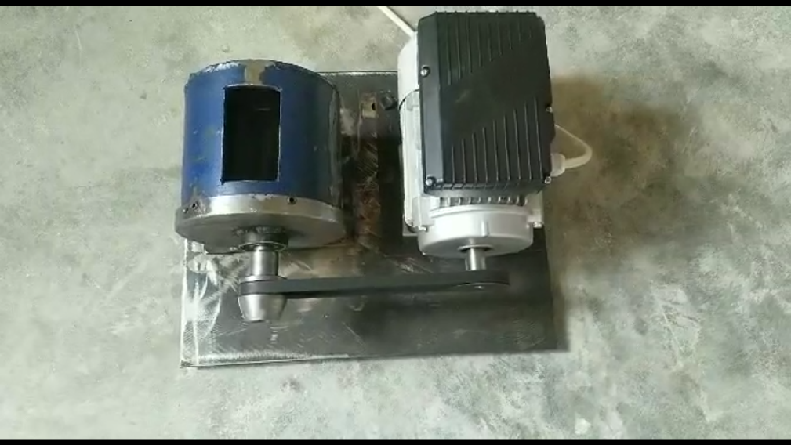
The prototype hammer mill

Slide 23
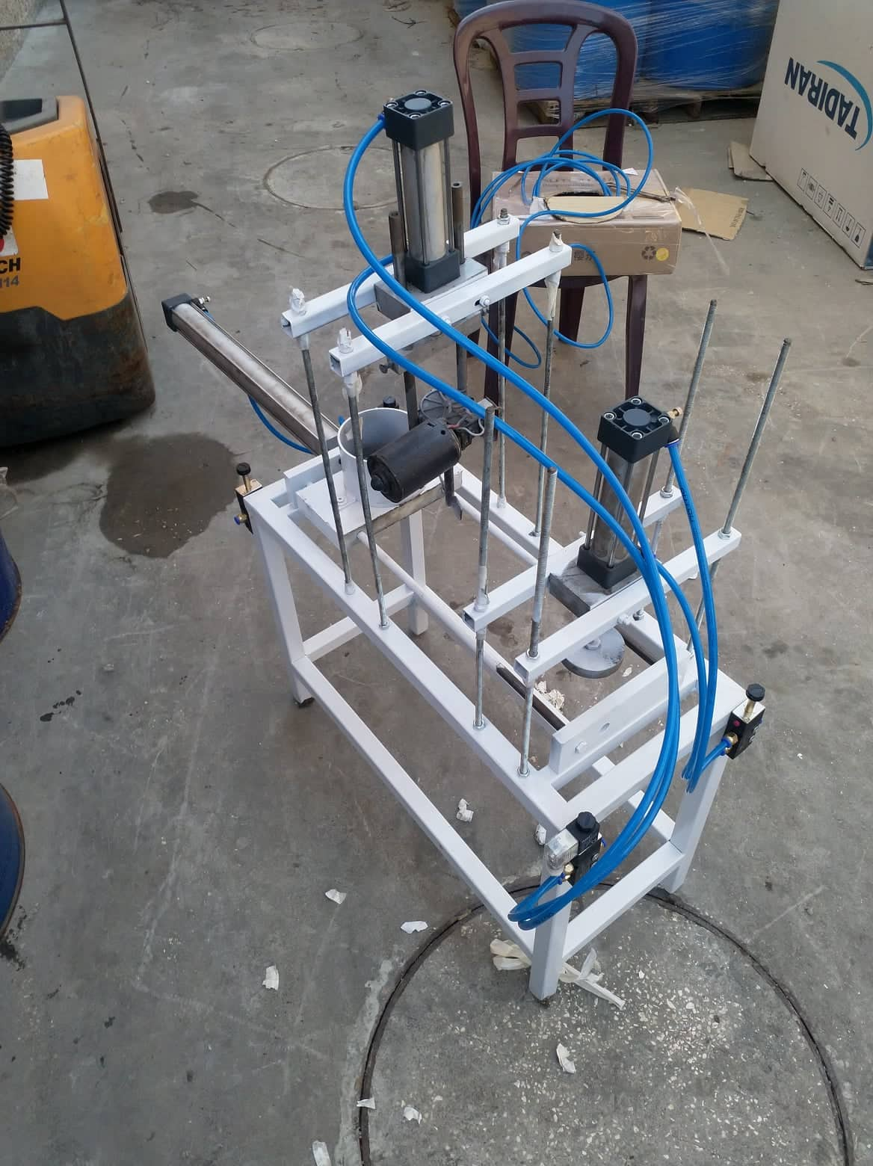
The mixer and the press assembly with the pneumatic system

Slide 24
Thank you for listening

