Slide 1

An-Najah National University
Faculty of Engineering & Information Technology
Department of Building Engineering
A comprehensive design of a Municipality building in Nablus
Prepared by:
                Ahmad Nazeeh Nasrallah
                Shadi Zarour
                Ibrahim Hassan
Supervisor: Eng. Amer Al-Shareef

Slide 2
Outline:
Definition of the Municipality.
Architectural Design.
Environmental Design.
Structural Design.
Electrical design.
Mechanical And Safety Design.
Quantity Survey And Cost Estimation.
1

Slide 3
What is the Municipality
Municipality : is one of the state departments, And the Municipal building, is the chief administrative building of a city.
Main goal: The city of Nablus was chosen because the existing building of the municipality of Nablus is now an old building, and is no longer adequate.

Slide 4
Architectural Aspects

Slide 5
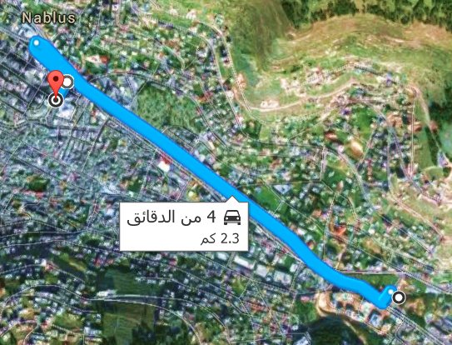
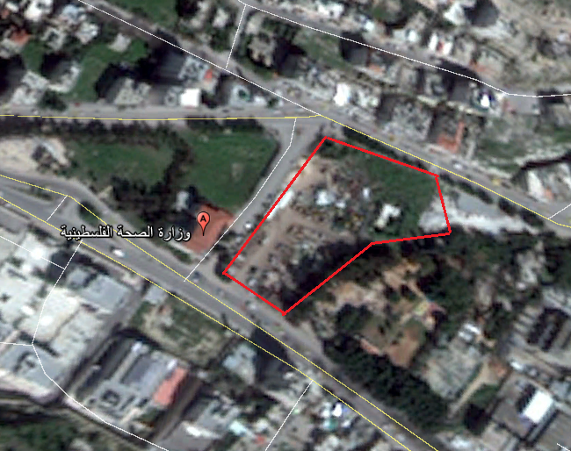
Site description :
2.3 km from the city center( 4 minutes by car)

Slide 6
Site Analysis
Total Land Area ( 6552 m2 )
Annual average of humidity (61%).
Maximum temperature in August = 38 ºC.
Wind speed 5 Km/hr.
Noise level in the site. 38dB

Slide 7
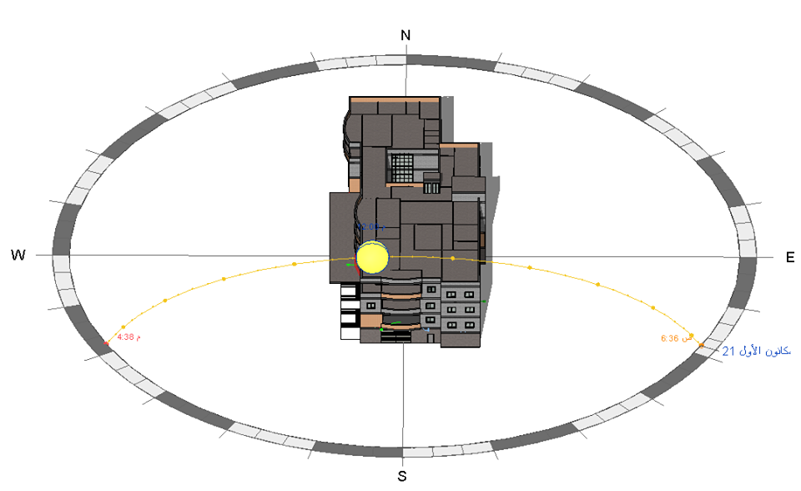
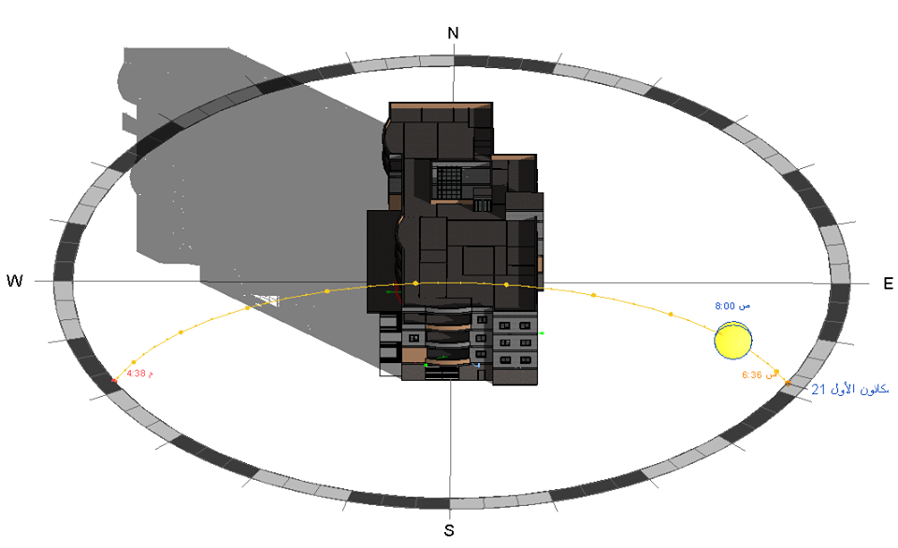
Sun path
Winter:

Slide 8
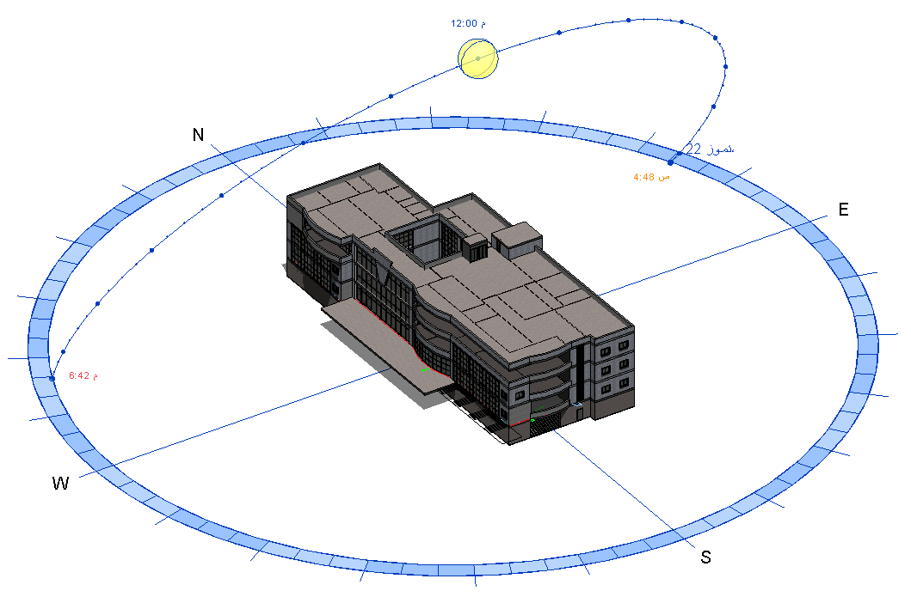
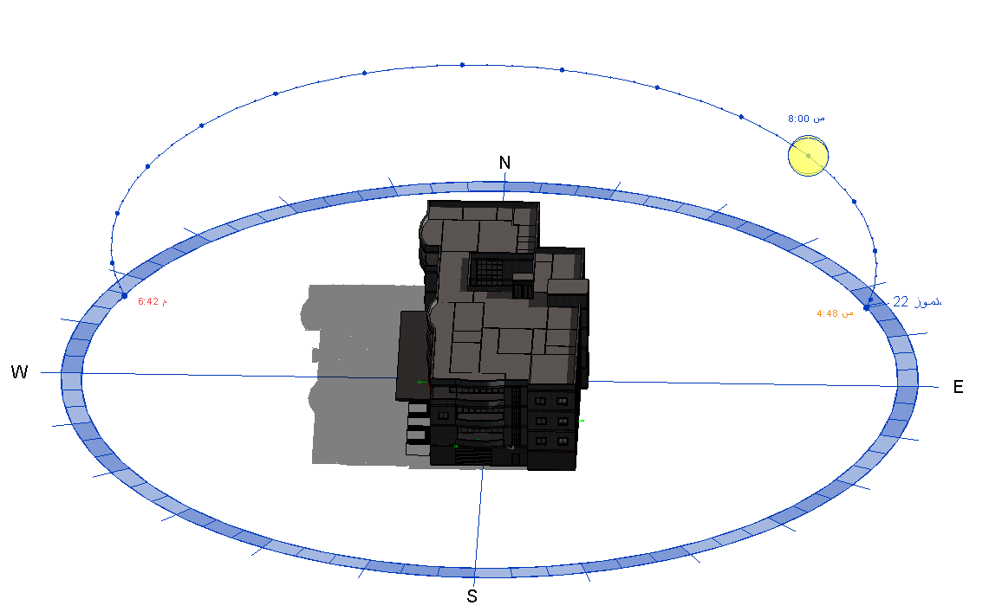
Summer:

Slide 9
Municipality departments
Administration department
Parking
Investment
Technical Section
Finance Department
Department of Land Control and Infringement
Department of Environmental Health

Slide 10

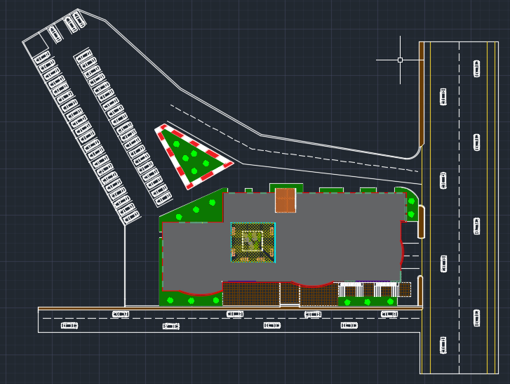

Slide 11
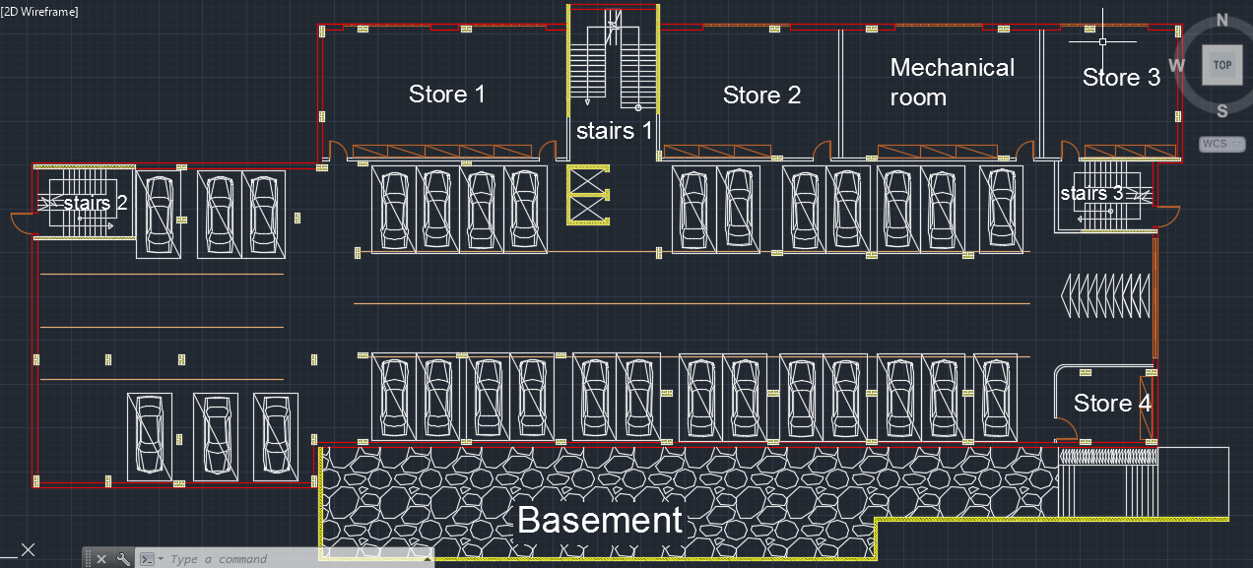
Basement Floor plan

Slide 12
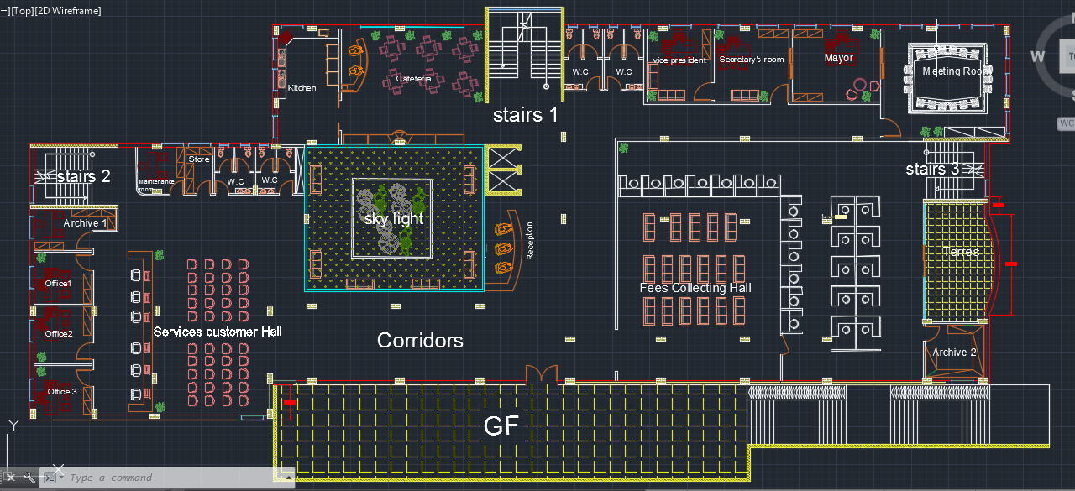
ground floor plan

Slide 13
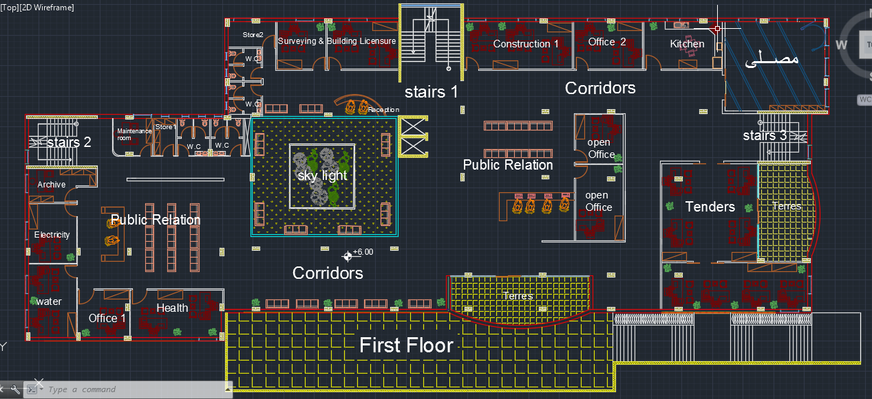
First Floor plan

Slide 14
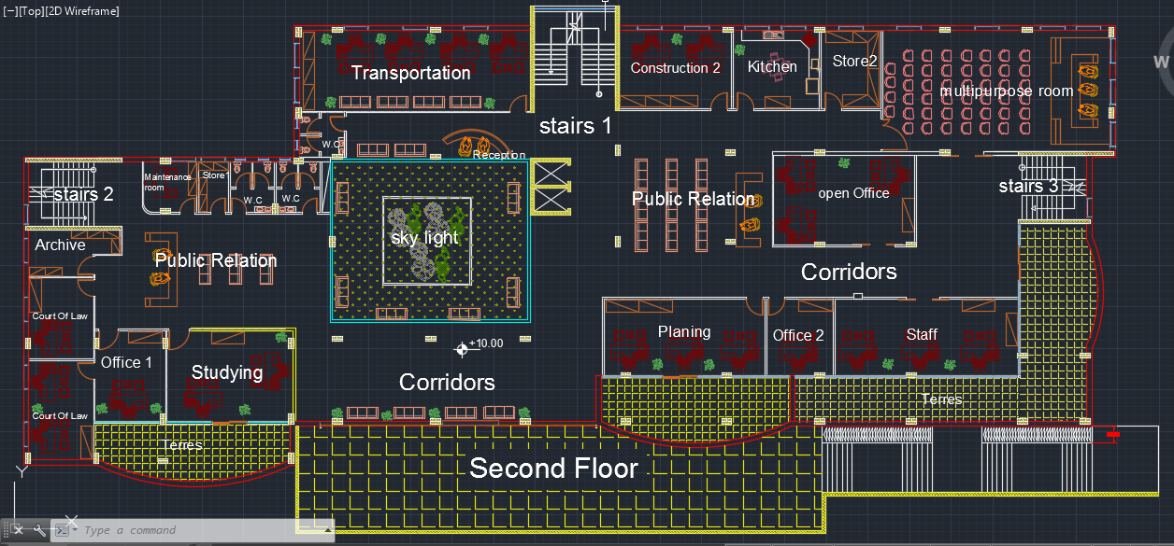
Second Floor plan

Slide 15
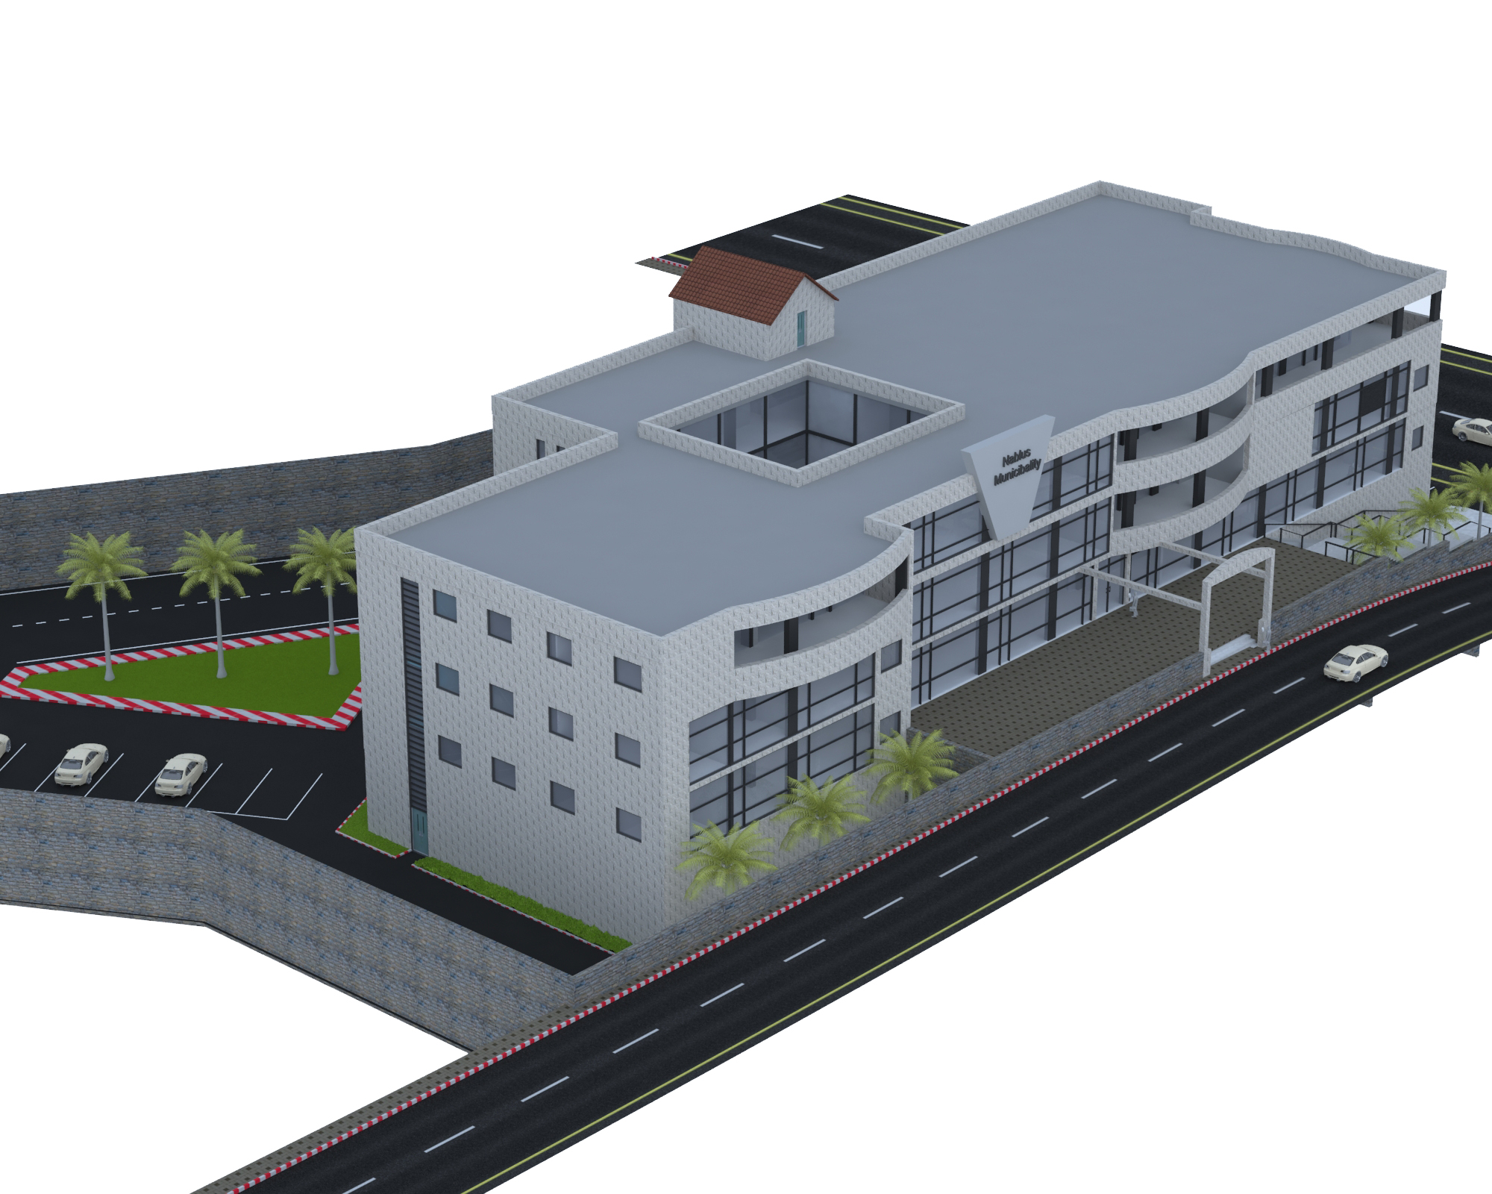
General view of the Municipality
:

Slide 16
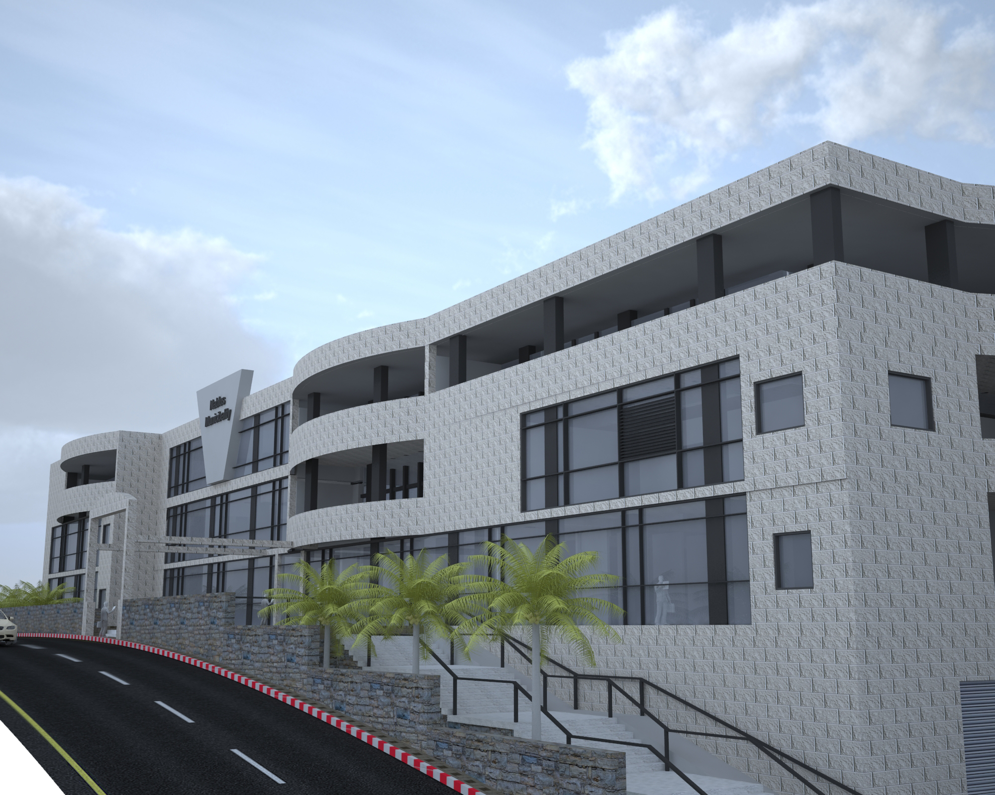
Some views from the Municipality

Slide 17
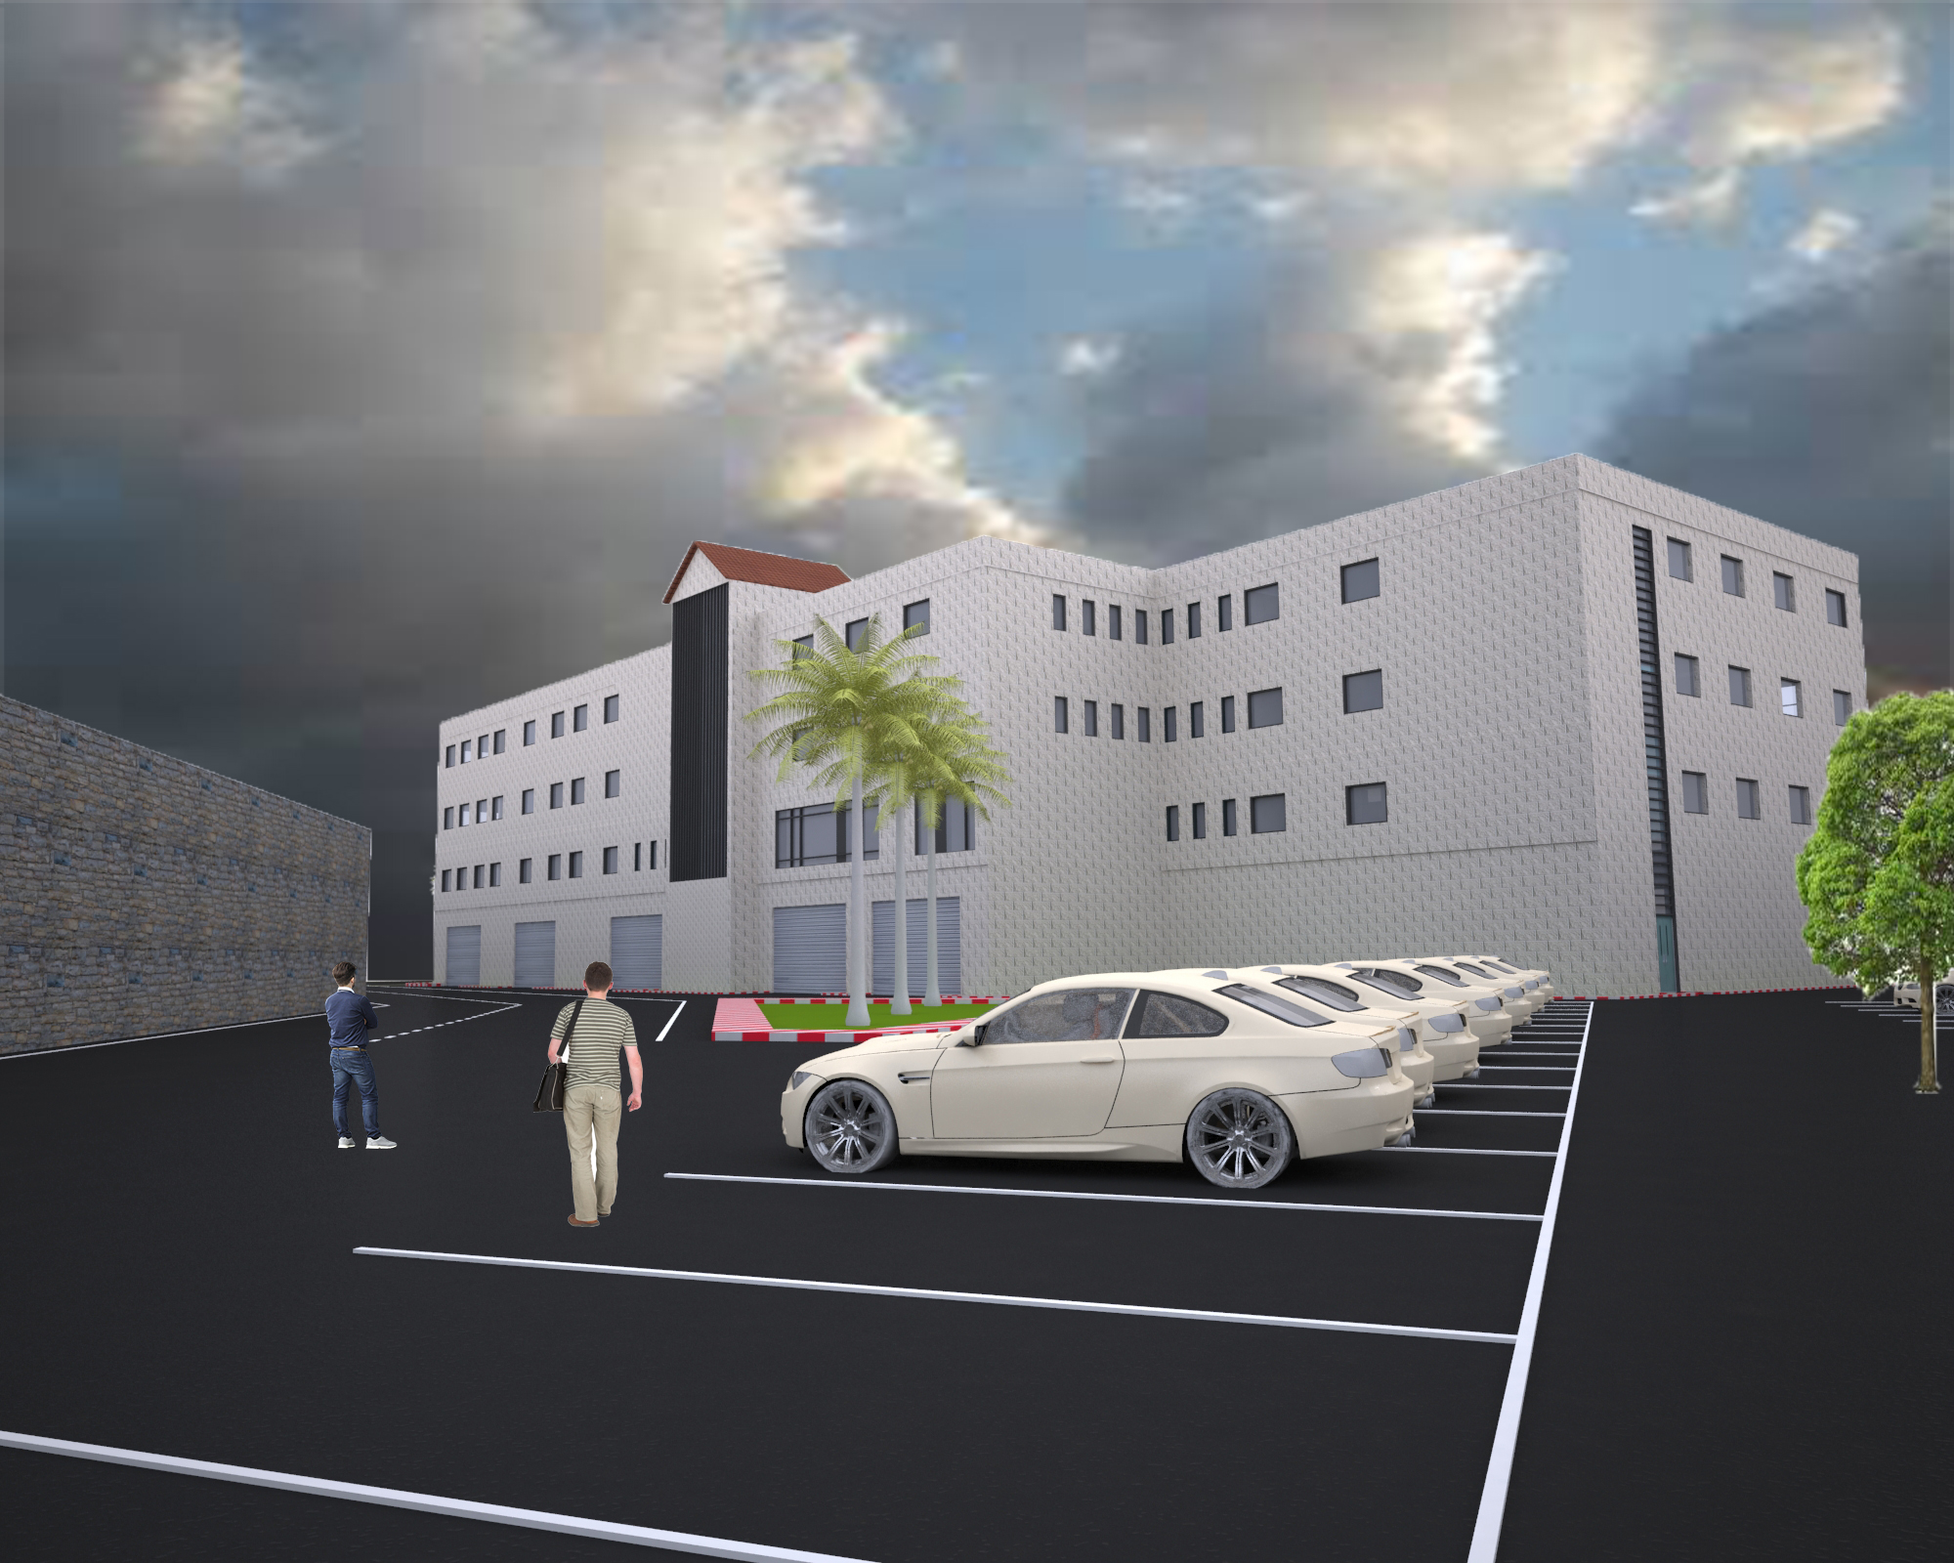
Some views from the Municipality

Slide 18
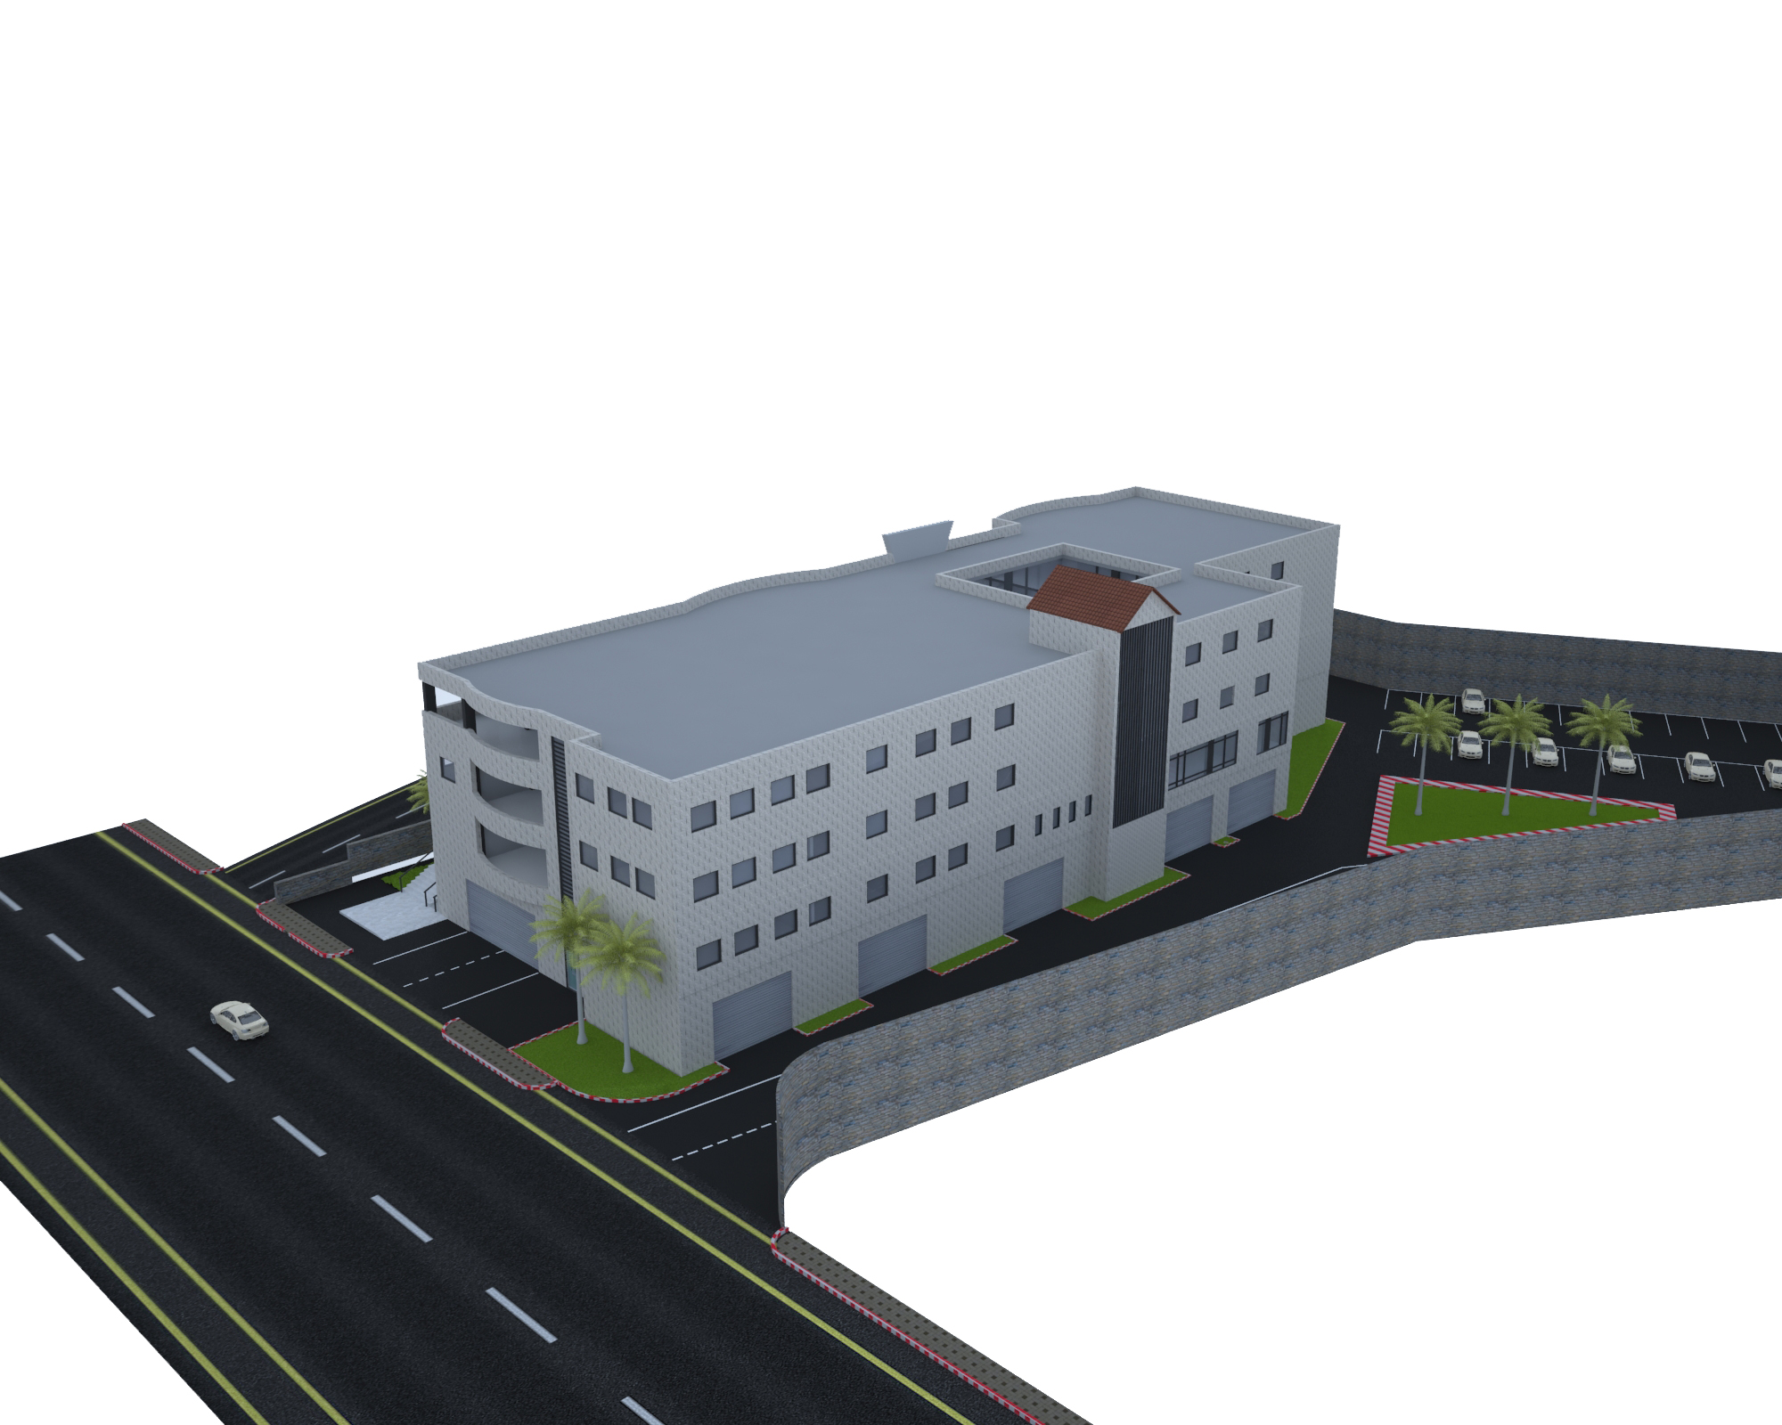
Some views from the Municipality

Slide 19
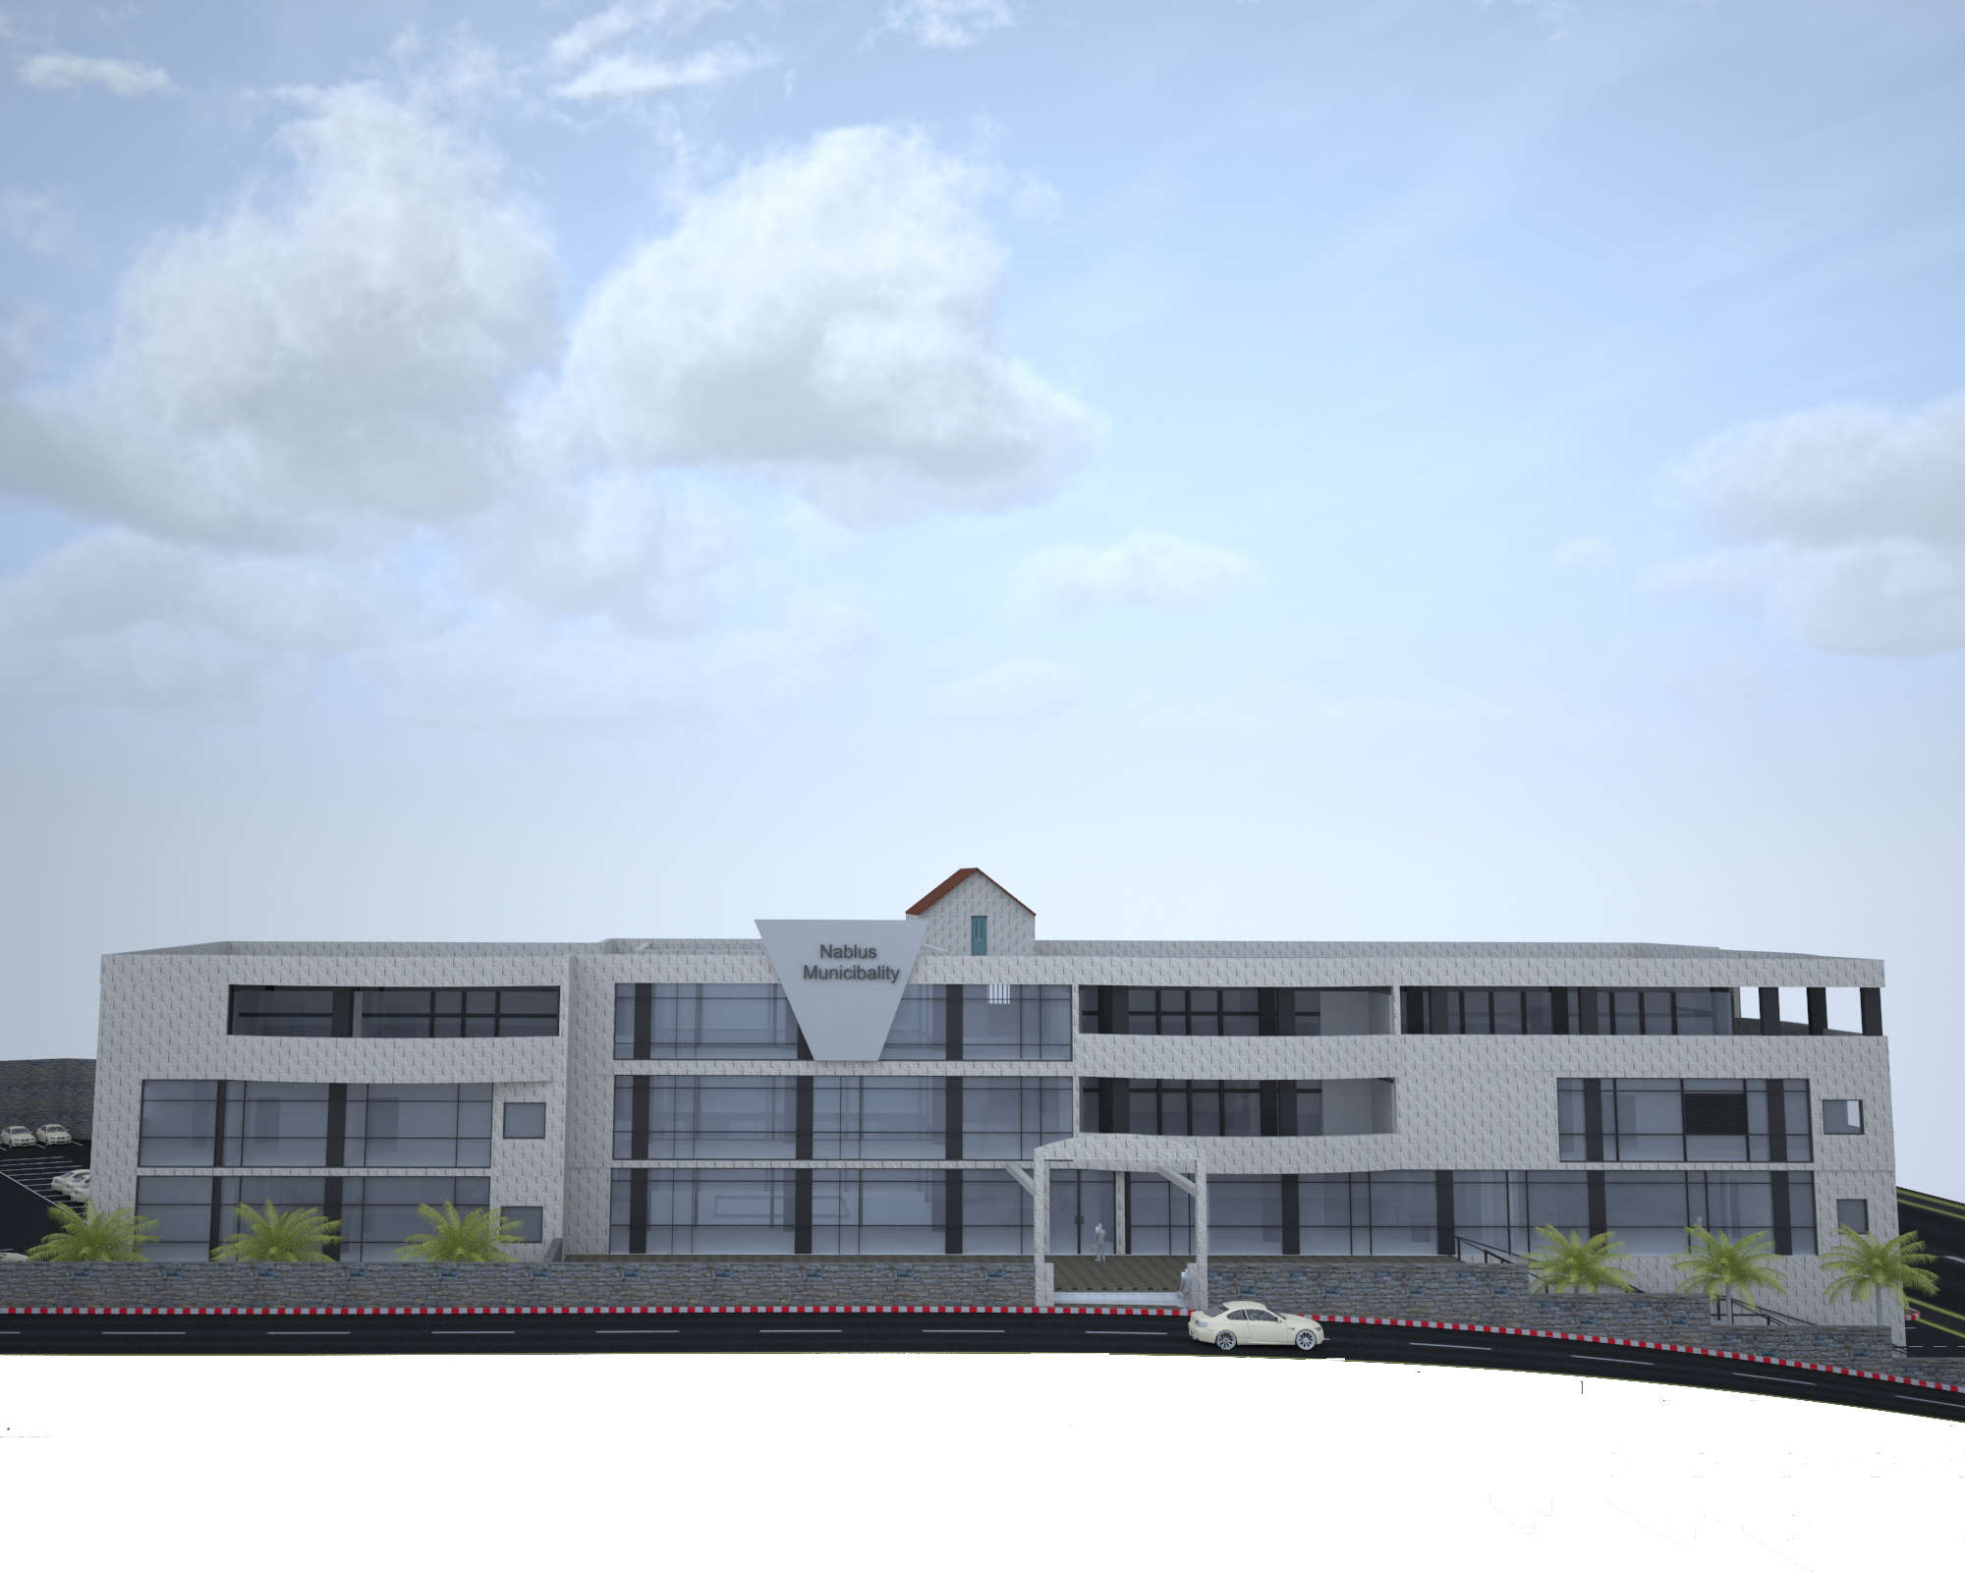
Some views from the Municipality

Slide 20
Environmental Aspects

Slide 21
Environmental Aspects
Environmental Aspects
Thermal and energy simulation.
Acoustical Analysis.
Natural lighting analysis.

Slide 22
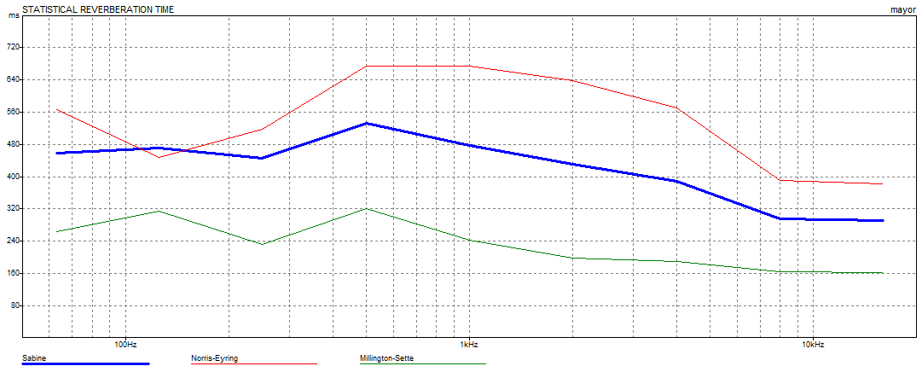
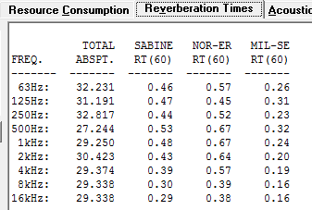
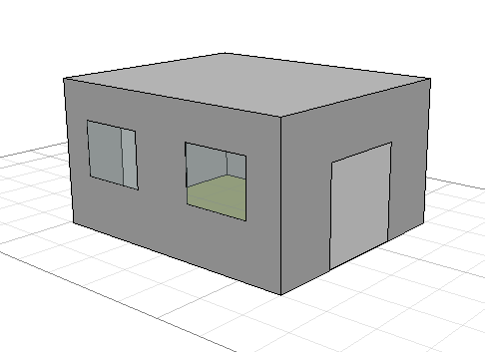
Acoustical analysis
Reverberation time (RT60):
Mayor room
RT60 range ( 0.4 - 0.6 )

Slide 23
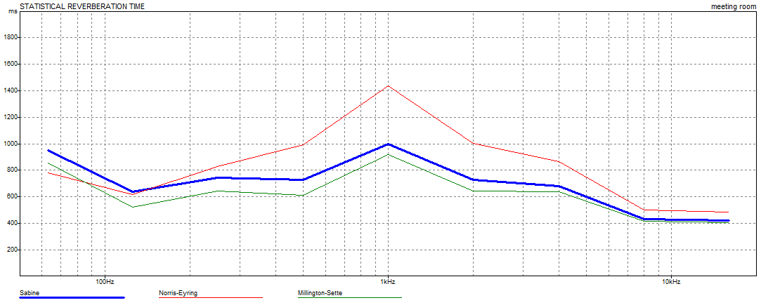
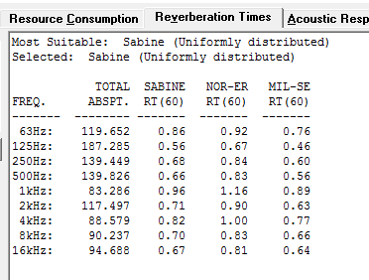
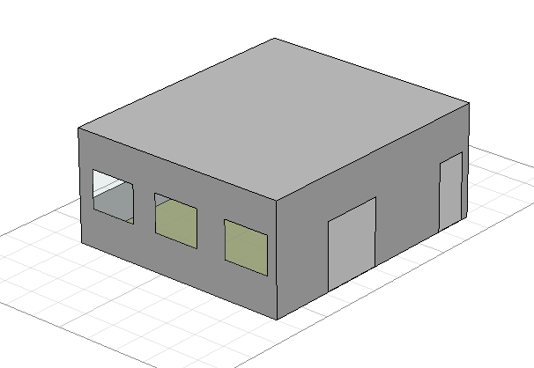
Acoustical analysis
Meeting room :
RT60 range (0.65 - 1.25)

Slide 24
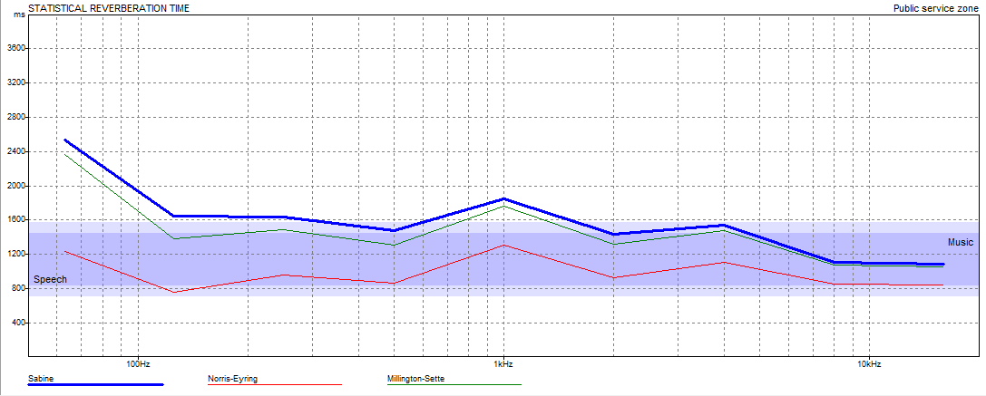
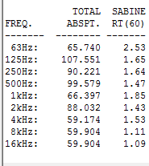
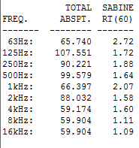
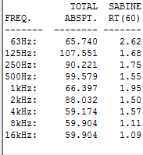
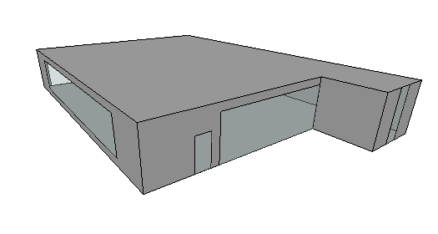
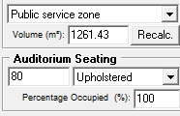
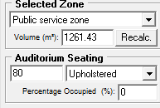
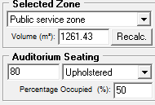
Acoustical analysis
Public service zone:
RT60 range (1.4 - 2)

Slide 25
Thermal Analysis
External wall (30cm)
Roof:
Floor:
Limestone (50 mm)
Concrete (100 mm)
Polystyrene (50 mm)
Block (100 mm)
Plaster (13 mm)
Asphalt (10 mm)
Concrete foam (50 mm)
Polyurethane (50 mm)
Concrete and block (250 mm)
Plaster (10 mm)
Tiles (10 mm)
Mortar (30 mm)
Sand (150 mm)
Polystyrene (50 mm)
Concrete and block (250 mm)
U-Value = 0.5 W/m2.k
U-Value = 0.45 W/m2.k
U-Value = 0.9 W/m2.k

Slide 26
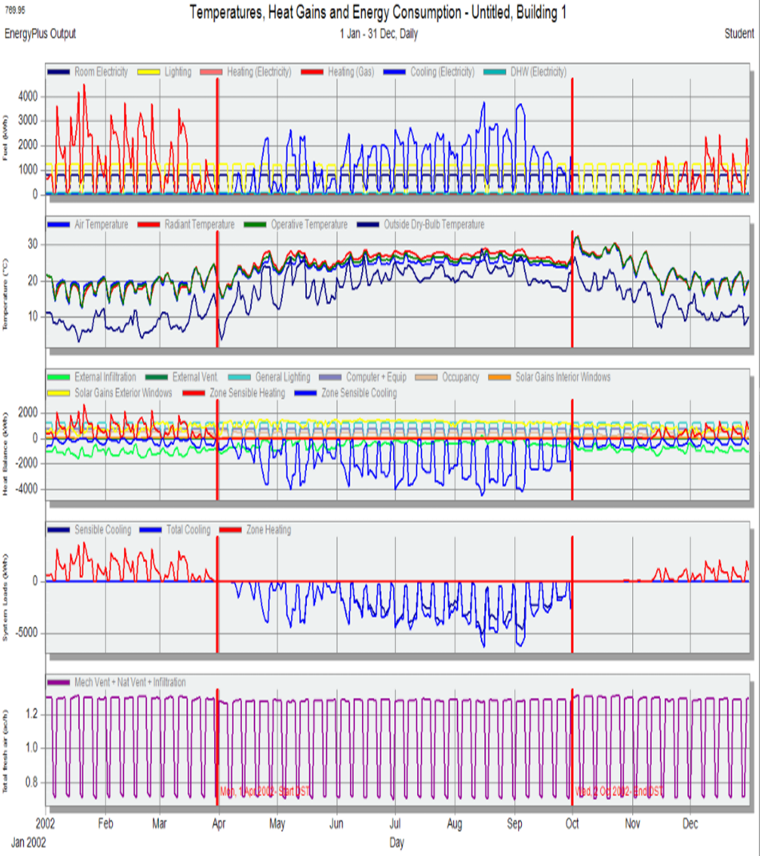
Energy simulation
Maximum Cooling = 578 kW
Maximum Heating = 479 kW

Slide 27
Room | DF %
F.F Electrical Room | 3.9
G.F Archive Room | 5.2
F.F Licenses Room | 2.8
F.F Bath Room | 0.4
F.F Surviving Room | 2.1
F.F Tenders Room | 15.3
Court of Law Room 2nd.F | 3.5
cafeteria G.F | 5.7
Multi-purpose room 2nd.F | 3
Natural Lighting
  Natural Lighting:
  Avg. DF for the building
  Daylight factor for some of the main spaces: 4.6

Slide 28
Structural Design

Slide 29
Design Data:
Concrete Fʹc = 24 MPa for slabs, and beams.
Concrete Fʹc = 28 MPa for columns, and footings.
Allowable Bearing Capacity of Soil = 300 kN/m²
Loads:
Super imposed load = 4.5 kN/m²
Live load = 4.5 kN/m²

Slide 30
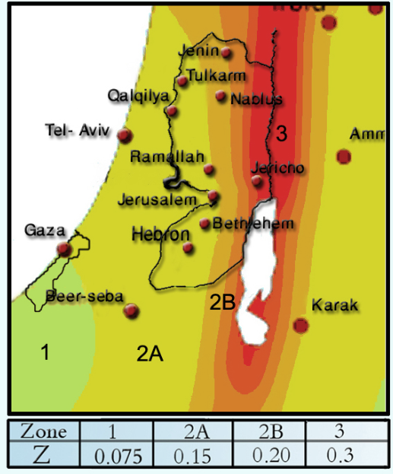
Seismic Design Data
Standard Occupancy, I = 1.0
Soil Profile Type is Sc
R = 5.5
Ca = 0.24
Cv= 0.32
Location → Nablus
Zone =2B → Z=0.20

Slide 31
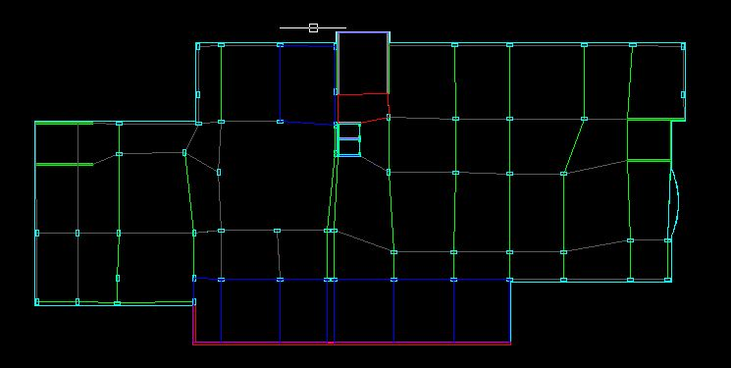
Structural plan

Slide 32
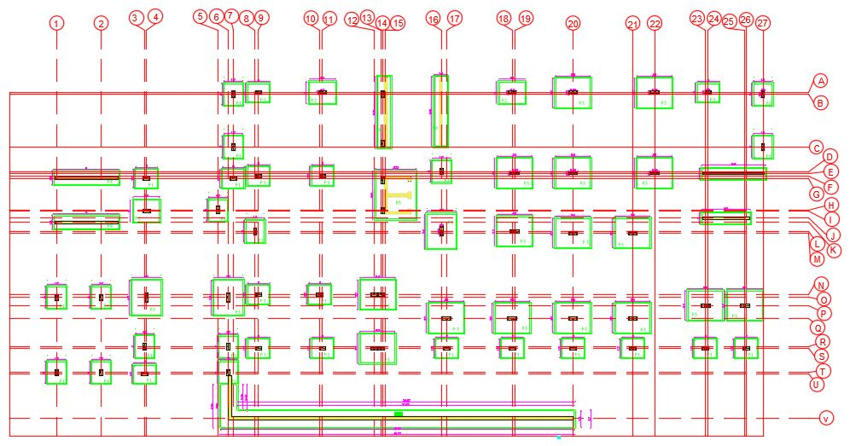
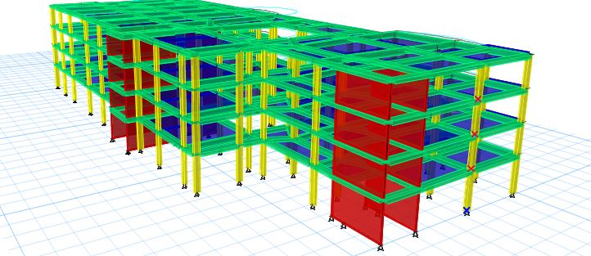
Plan of structural designed block
Model from ETABS
1400m2@4floors

Slide 33
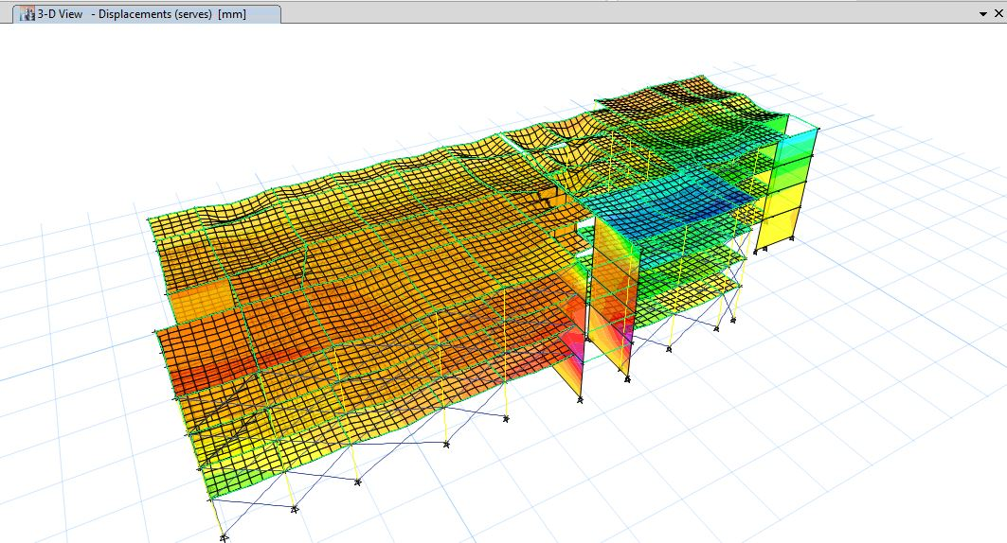
Deformed shape of the building:
The model is valid for:
1- Compatibility.
2- Equilibrium.
3- Stress & Strain relationship.

Slide 34
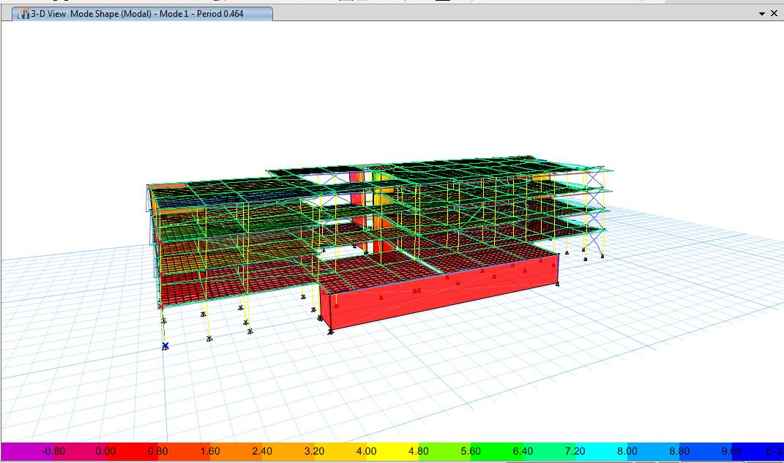
Dynamic checks:
Period check:
→ T standard =0.47sec
→ From ETAB 0.464 sec

Slide 35
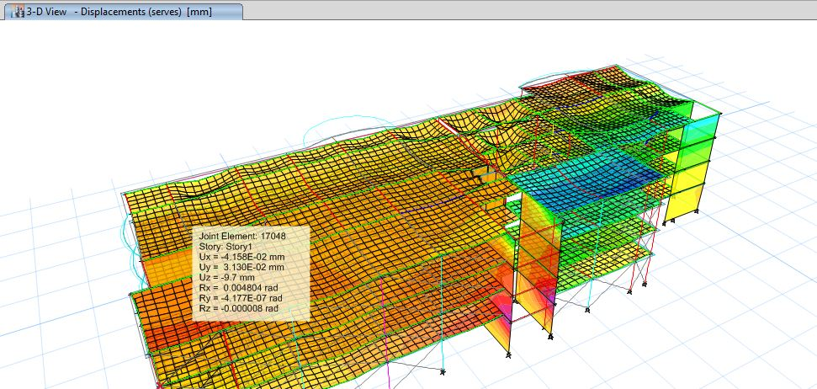
Drift check:
Maximum drift available = 29 mm
∆ limit of the story = 0.02 * height of story = 0.02 *1450 = 29 cm (manual check).
∆ inelastic =0.7*R*∆elastic (ETABS check).
→∆inelastic for moment in x- direction =0.7*5.5* -4.158 = 16.0083 mm
→∆inelastic for moment in y- direction =0.7*5.5* 3.13 = 12.0505 mm
Since ∆inelastic (for delta Mx and delta My) < ∆ limit story then check drift is ok.

Slide 36
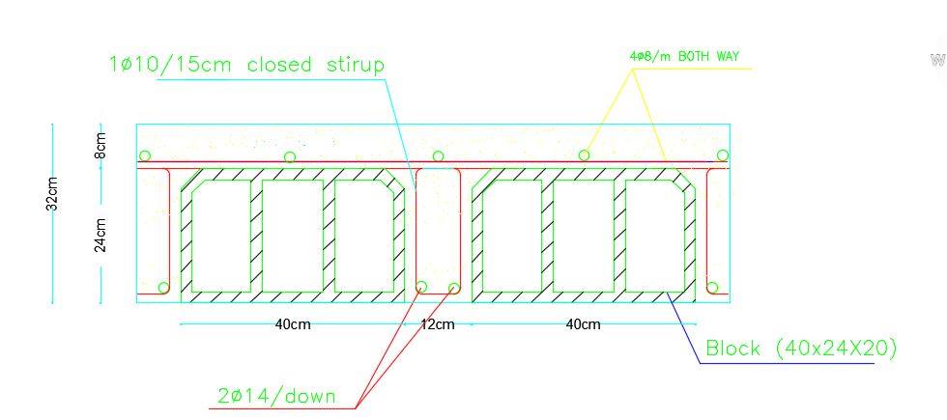
Results:
1) Slab design:
Reinforcement:
Thickness= 320mm
2∅14 mm/rib
As shrinkage 4∅8 mm/m

Slide 37
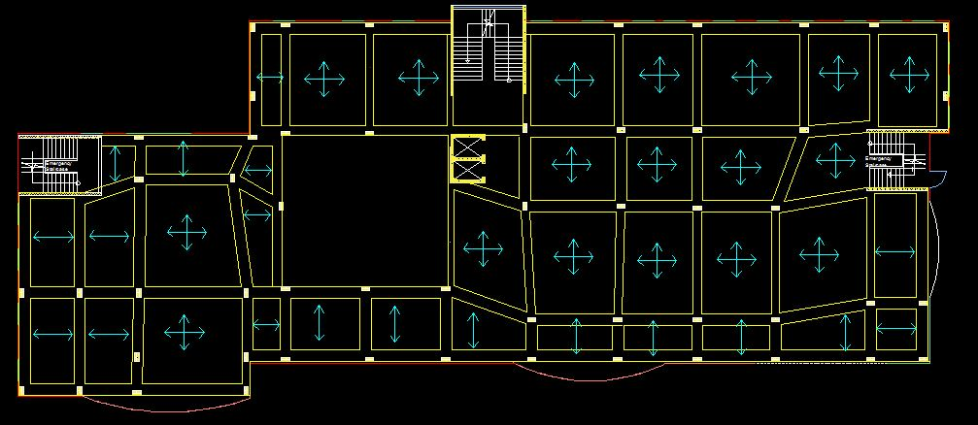
layout

Slide 38
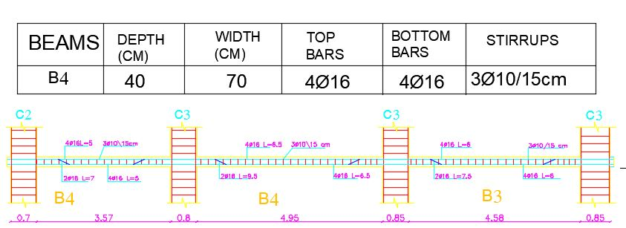
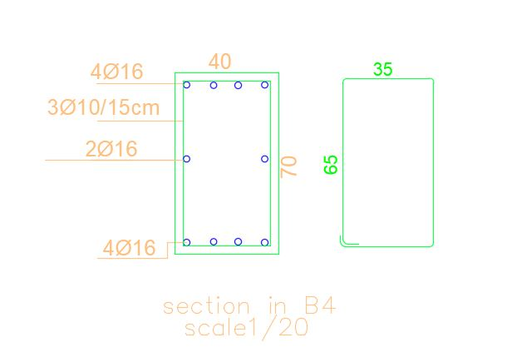
2)Beam design details:

Slide 39
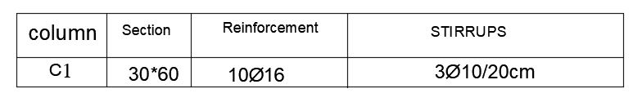
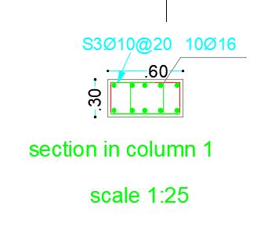
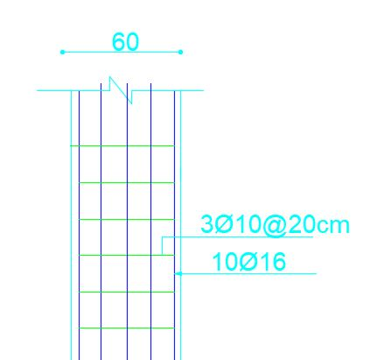
3) Column 1 design details:

Slide 40
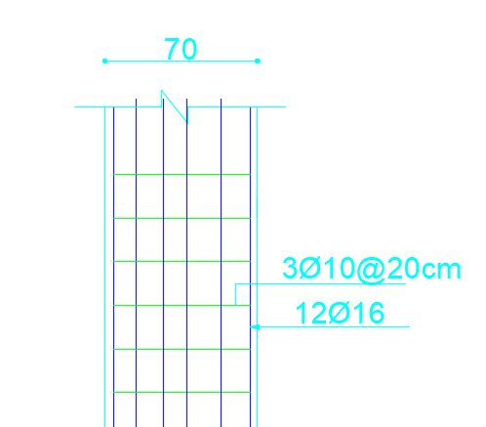
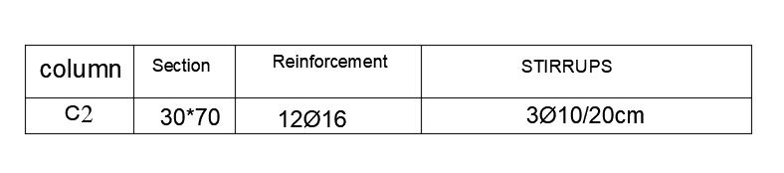
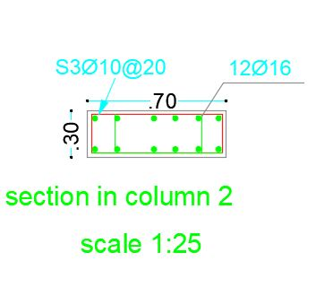
Column 2 design details:

Slide 41
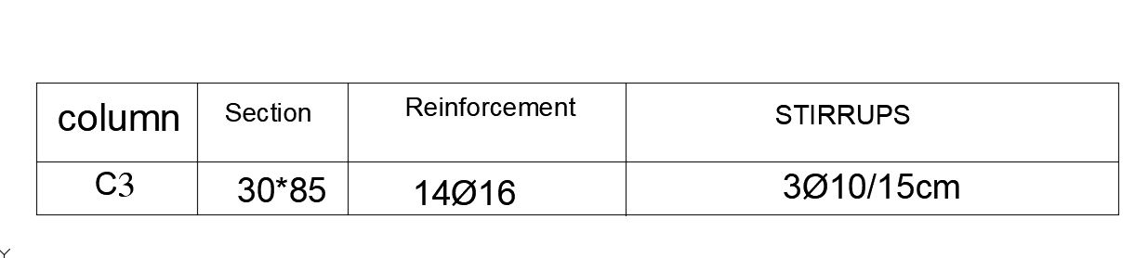
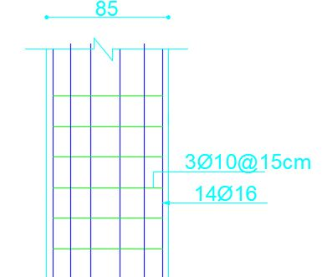

Column 3 design details:

Slide 42
4) Footings
Distribution layout

Slide 43



Footing 3 design details:

Slide 44

Stairs design details
→ Take A_{s,min} = 450mm² → 4Φ12/m

Slide 45
Artificial Lighting

Slide 46


1) offices
Walls’ reflection factor = 50 %.
Ceiling’s reflection factor = 70.5 %.
Floor reflection factor = 44.2 %.
E(avg) = 418 Lux
U = 0.57 UGR = 15.7

Slide 47

Offices luminaire

Slide 48


2) multi-purpose
Walls’ reflection factor = 50 %.
Ceiling’s reflection factor = 70.5 %.
Floor reflection factor = 44.2 %.
E avg = 586 Lux
U = 0.52 UGR = 16.2

Slide 49

multi-purpose room luminaire

Slide 50

Connect the bulbs :

Slide 51

Connect the Sockets :

Slide 52
Mechanical Aspects

Slide 53
Mechanical Aspects
Mechanical Aspects
HVAC system.
Water supply.
Drainage system.

Slide 54

1) Water supply system

Slide 55

1) Types of water supply system
Cold water
Hot water
Filtered water
Is used only in WC

Slide 56
Dimensions of pipes in water supply system
Ground floor:
Floor/Pipe | Vertical | Horizontal | Branch
Ground floor | 2.5in | 2 in | 1.5in
Floor/Pipe | Vertical | Horizontal | Branch
First floor | 2.5 in | 2 in | 1.5 in
First floor:

Slide 57
2) Drainage system
Each W.C represents 6Dfu…………. pipe 4".
Each Lavatory represent 1Dfu…………… pipe 2".
Each kitchen sinks Represent 2Dfu………… pipe 2".
Main stack 4". Use ventilation stack 4''.

Slide 58

Types of drainage system
Black water
Gray water

Slide 59

Drainage system on the site plane

Slide 60

Rain water drainage

Slide 61

3) HVAC system design
The method of the HVAC system is VRF system, which allow for cooling and heating at the same time.
The internal unit that is used is suspended on false ceiling .

Slide 62

HVAC Units distribution for the ground floor.

Slide 63




Safety Design
Automatic fire Sprinkler
Standpipes and hose station

Slide 64

Safety Design
Fire alarm system used heat detectors in office building.

Slide 65

Escape route

Slide 66
Quantity survey & cost estimation

Slide 67
Quantity survey & Cost estimation
Excavation :
Cost (Nis)
50,000 | excavation
Total cost of excavation= NIS 50,000

Slide 68
Quantity survey & Cost estimation
Cost of concrete and steel:
total cost | cost steel | cost concrete | steel (ton) | Concrete (CM)
124070 | 35100 | 88970 | 13 | 287 | footing
64340 | 30240 | 34100 | 11.2 | 110 | tie beam
92770 | 24570 | 68200 | 9.1 | 220 | ground slab
94710 | 57510 | 37200 | 21.3 | 120 | column
695300 | 307800 | 387500 | 114 | 1250 | slabs
87680 | 44280 | 43400 | 16.4 | 140 | shear wall
74400 | 0 | 74400 | 0 | 240 | plain concrete
1233270 |  |  |  |  | total
Total cost of
concrete
And steel =
NIS 1,233,270

Slide 69
Quantity survey & Cost estimation
cost | meter square
840000 | 5600 | Porcelain tiles
390000 | 2600 | stone
66000 | 3520 | blocks 10 cm
78750 | 2100 | blocks ribbed
6875 | 220 | blocks 20 cm
120000 | 600 | Satires marble
16500 | 30 | granite
716400 | 11940 | plaster
597000 | 11940 | painting
300000 | 500 | glass wall + window
100000 | 200 | door
500000 | 1000 | Marble tile
3731525 |  | total
Total cost of stone, tiles, plaster and ..its
= NIS 3,731,525

Slide 70
Quantity survey & Cost estimation
cost
200000 | electricity
280000 | elevators
80000 | plumping
1237600 | laborer construction
42500 | cement
30000 | sand & gravel
165000 | Engineering and Licensing
656550 | PR requirements
500000 | HVAC
325000 | fall ceiling
10000 | Clay tile
200000 | furniture
3726650 | total
Finishes of
cost
Total cost
of finishes = NIS 3,726,650

Slide 71
Quantity survey & cost estimation
Final cost for the building:
Total cost of the building = NIS 8,741,445
Total cost of site plane = NIS 725,000
total cost = NIS 9,466,445
Unit cost of the building = NIS 1853.2/m2
Unit cost of the building and site = NIS 2007/m2

Slide 72


