Slide 1

Assessment and Development of Water and Wastewater Service Providers Performance in Tulkarm Governorate
Supervision by:
Dr. Anan Jayyousi
Prepared by:
Jawa Raid Hamdallah
Dina Jameel Jallad

Slide 2
Outline
Introduction
Objectives
Study Area
Service providers list
Performance Indicators
Data Collection and Analysis
Comments on data availability
Monitoring Progress of Service Providers Performance Indicators
Main challenges and priority actions and projects
Proposed Investment Plan
Conclusion

Slide 3


Introduction
Water and Wastewater service sector is of a great influence on region development, and so monitoring and assessment is needed.

Slide 4
Objectives
Study the current situation of water service providers in Tulkarm Governorate.
Measure indicators and compare the measured values with specifications.
Make a set of priority actions.

Slide 5
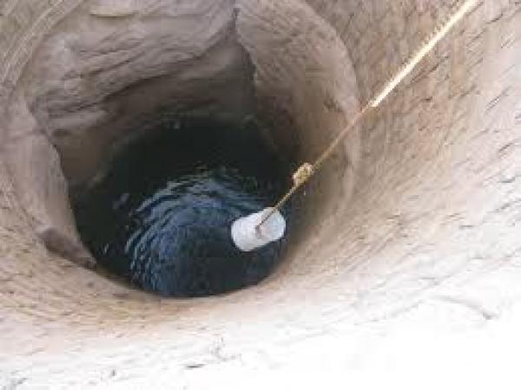

Study Area
Tulkarm district is located in the north western part of the West Bank. It has a Mediterranean climate.
The Governorate contains several water sources and so it has a high Population density.

Slide 6
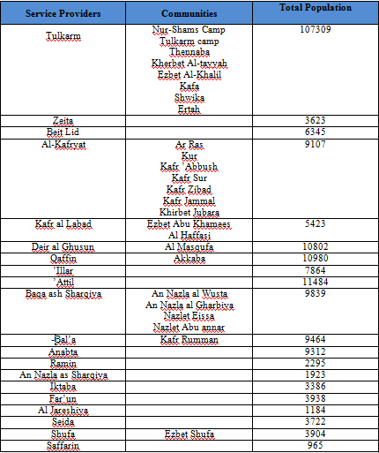
Service Providers list

Slide 7
Performance Indicators
Performance Indicators are classified into :
Technical Indicators
Financial Indicators
Quality Indicators
Quality of Service Indicators

Slide 8
Data Collection and Analysis
A questionnaire was prepared in order to gather information needed for indicators evaluation.
It includes questions related to general information about network, quantities, expenses, quality and quality of service.

Slide 9
A set of indicators were measured based on collected information from the 20 service provider in Tulkarm Governorate.
The following slide shows the final results we obtained for the different indicators.

Slide 10
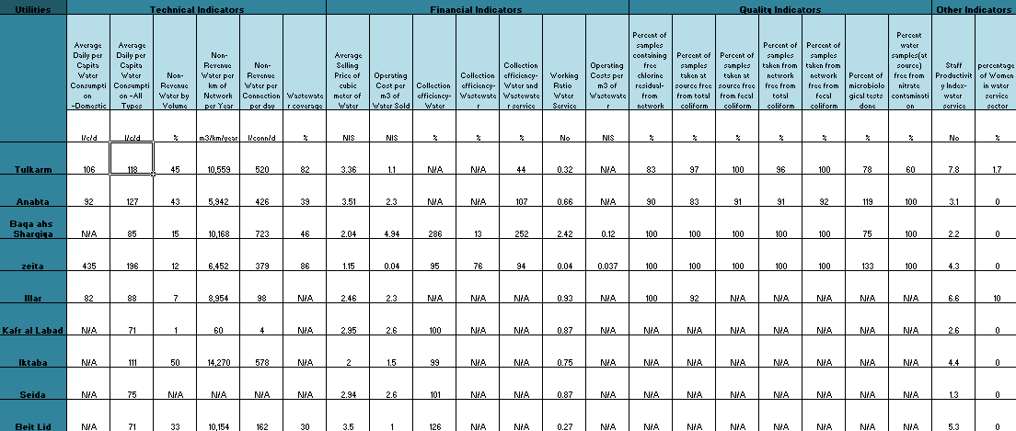

Slide 11
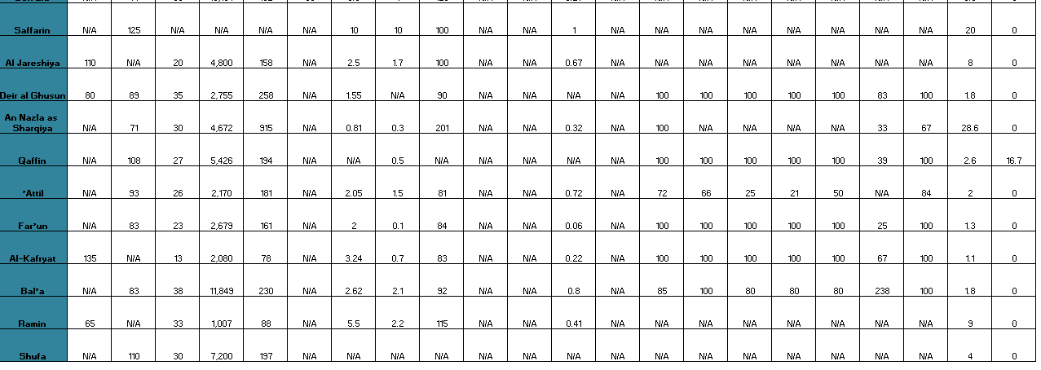

Slide 12
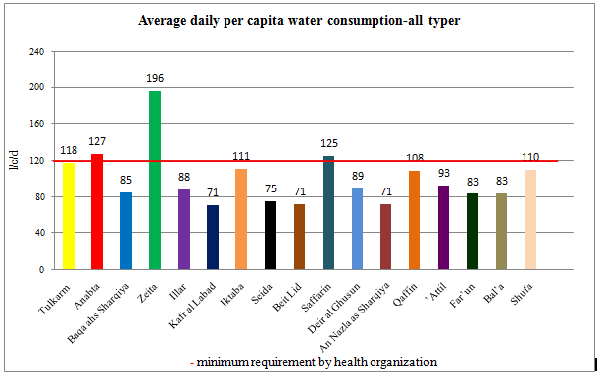
Technical Indicators

Slide 13
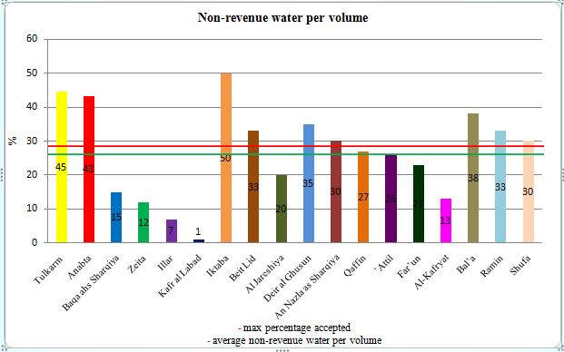

Slide 15
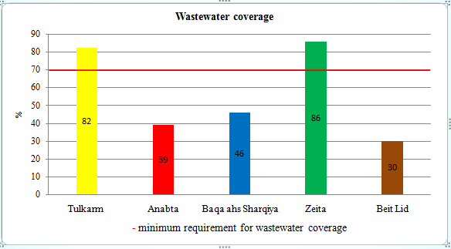

Slide 16
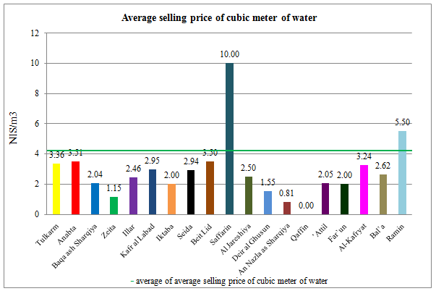
Financial Indicators

Slide 17
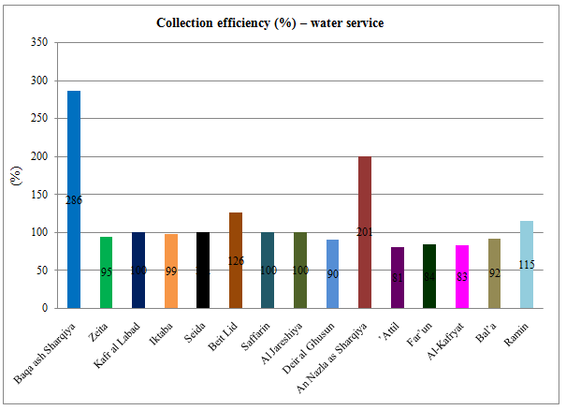

Slide 18
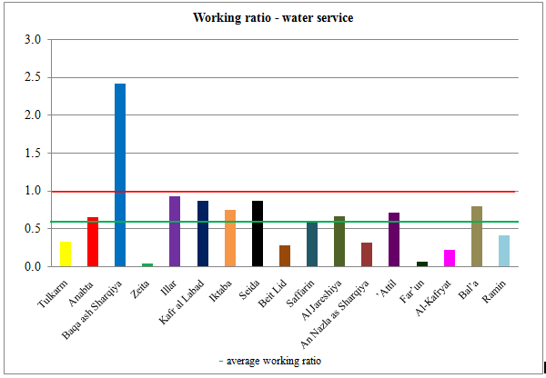

Slide 19
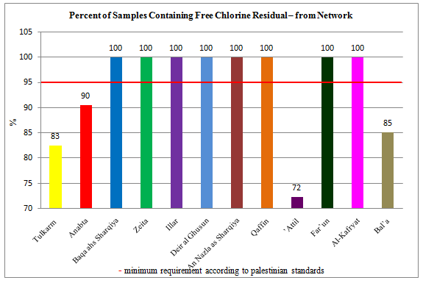
Quality Indicators

Slide 20
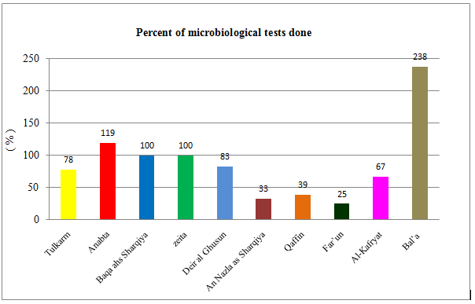

Slide 21
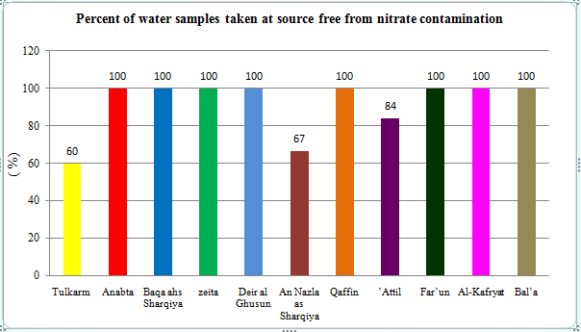

Slide 22
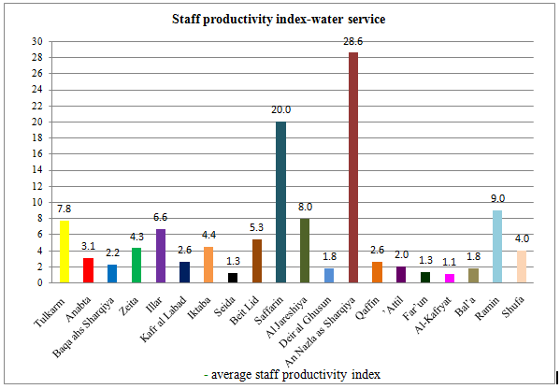
Other Indicators

Slide 23
Comments on Data Availability
There were two main challenges regarding
the collected information :
Missing data
Quality of data

Slide 24
Monitoring Progress of Service Providers Performance Indicators
Based on the Performance Monitoring of Water Service Providers in Palestine For the Year of 2015 Report, and the result obtained from this project for the year of 2016, a comparison sheet is provided for Tulkarm, Anabta, Dier al Ghuson, Illar and Attil.

Slide 25
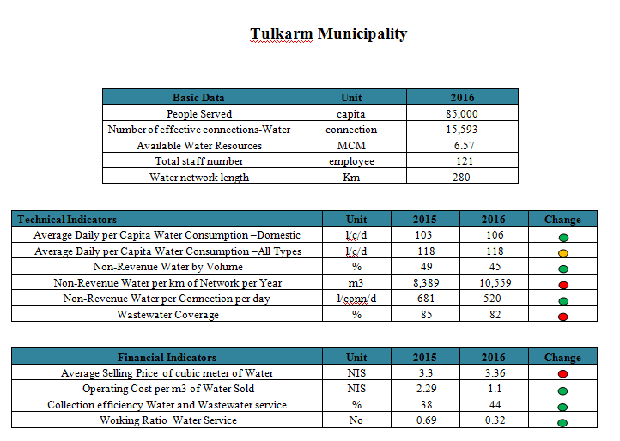

Slide 26
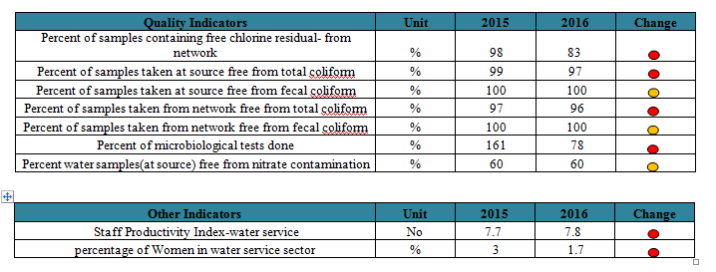

Slide 27
Main challenges and priority actions and projects
Several problems appeared for each service provider. Here the main problems were selected based on the most influence on the quality of services provided.
Then, These different challenges were gathered into eight main challenges that include the most urgent problems that faces each community.

Slide 28
After allocating the main challenges that faces water and wastewater sector .Some proposed actions were suggested to resolve these main challenges.

Slide 29
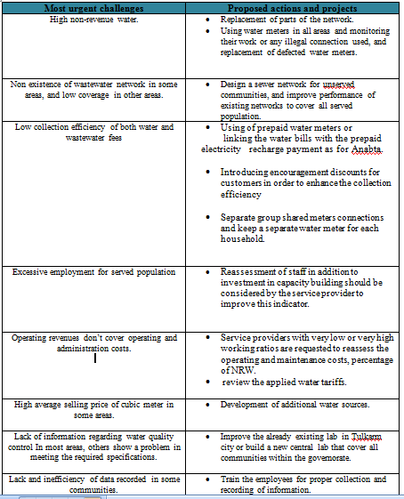

Slide 30
After proposing a set of actions and projects , ten main actions and projects have been arranged based on :
impact of these projects and actions on each other.
un-serviced communities.
the provision of services that benefit the citizens
the provision of services that benefit the municipalities.

Slide 31
The ten main projects and actions are:
Extension and Rehabilitation of water networks.
Construction of Wastewater networks for un-served localities.
Replacement of defected meteres.
Installation of prepaid meters.
Development of Additional water sources.
Reassessment of staff.
Review the water tariff according to tariff regulations.
Build a new central water and wastewater laboratory.
Introducing encouraging discounts for customers.
Development of staff capabilities.

Slide 32
Proposed Investment Plan
The purpose of the Investment Plan is to agree with national and international specifications on the way to improve water and wastewater sector in the next fifteen years, i.e. 2018-2033.
For each project and actions the estimated total cost and the time period needed are shown next.

Slide 33
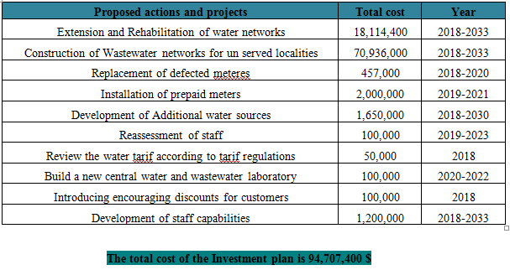

Slide 34
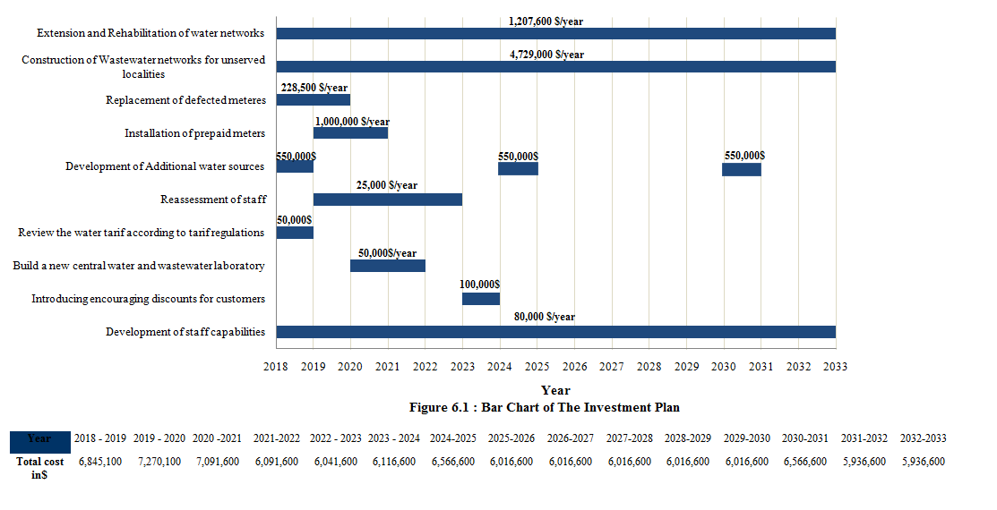

Slide 35
Conclusion
Improving the performance of the service providers will achieve benefits for both consumers and service providers themselves, Leading to the improvement of services level in Palestine.

Slide 36
Thank You

