Slide 1

Feasibility Study for Establishing Polypropylene Random Copolymer (PPR) Pipes and Fittings Plant
An-Najah National University
Faculty of Engineering
Industrial Engineering Department
Graduation Project (II)

Slide 2
Supervised by
Dr. Ahmad Alramahi
Dr. Ahmad Alramahi
Prepared by
Hamdy Abu Esha
Ibraheem Dwikat
Dr. Sulaiman Dauifi
Deema Khalele
Presented to

Slide 3
Outlines
Introduction
Methodology
Market Study
Technical Study
Financial Study
Recommendations

Slide 4
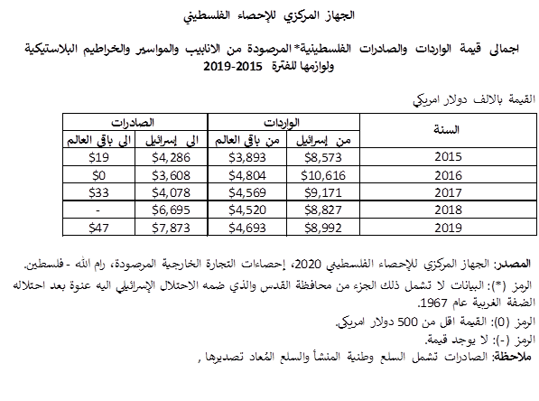
Introduction
Problem Statement
The (PPR) pipes and fittings are imported from outside Palestine.
And this statistics are obtained from (PCBS).

Slide 5
Introduction cont’d
because there are no local producers, a large proportion of the import value shown in the statistics refers to PPR products and the best idea to solve this problem is to establish a plant to produce these products.
Objectives:
  Conducting a comprehensive market study.
  Perform an appropriate technical study related to the machines used.
  Conducting a financial study in which the feasibility of the project can be the judge.

Slide 6
Methodology
The following points explain the methodology of work which the team uses to conduct the feasibility study:
Product Identification
Production Processes
Market Study
Technical Study
Financial Study

Slide 7
Market Study Analysis
Questionnaire Components:
Categories
Importers
Local Authorities
Retail Stores

Slide 8
Market Study Analysis

Slide 9
Market Study Analysis

Slide 10
Market Study Analysis

Slide 11
Market Study Analysis

Slide 12
Market Study Analysis
Production Quantities for identified products
 | Ø20 mm | Ø25 mm | Ø32 mm | Ø40 mm | Ø50 mm | Ø63 mm
Annually Demand (meter) | 20,500 | 19,000 | 34,150 | 60,000 | 58,000 | 63,100
Plant Market Share | 24% | 26% | 30% | 43% | 44% | 44%
Quantity per year(meter) | 5,000 | 5,000 | 10,500 | 26,000 | 25,500 | 28,000

Slide 13
Market Study Analysis
Fittings quantity needed for production quantity of pipes
Batches of pipe dimension | Fittings need (unit) |  |  |  |  |  |  | Total
 | Coupling | Reducer | Equal tee | Reducer tee | Elbow 90° | Elbow 45° | End Cap
Ø20 mm | 1000 | 100 | 150 | 200 | 400 | 200 | 50 | 2,100
Ø25 mm | 1000 | 100 | 150 | 200 | 400 | 200 | 50 | 2,100
Ø32 mm | 2200 | 210 | 315 | 420 | 840 | 420 | 105 | 4,510
Ø40 mm | 5500 | 520 | 780 | 1040 | 2080 | 1050 | 260 | 11,230
Ø50 mm | 6000 | 510 | 765 | 1020 | 2040 | 1020 | 255 | 11,610
Ø63 mm | 6000 | 600 | 900 | 1200 | 2400 | 1200 | 300 | 12,600
Total |  |  |  |  |  |  |  | 44,150

Slide 14
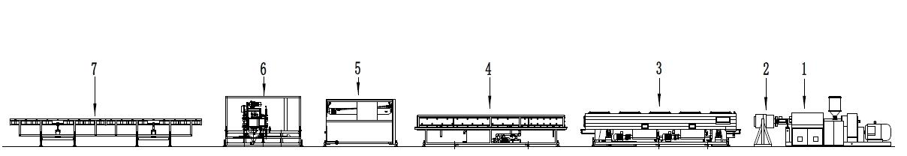
Technical Study Analysis
  Main Equipment’s and Machines needed for the plant
Pipe Extrusion production line
Injection Molding Machine
Fittings Molds

Slide 15
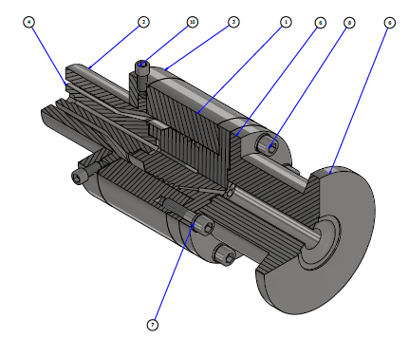
Technical Study Analysis
Extrusion Die Head Design

Slide 16
Technical Study Analysis
Human Resources Needed in the plant
Job Title | No.
Manager | 1
Quality control supervisor | 1
Production line supervisor | 1
Technician for maintenance | 1
Accountant | 1
Store Supervisor | 1
Sales and Purchasing supervisor | 1
Marketing supervisor | 1
Workers | 4
Total | 12

Slide 17
Technical Study Analysis
Organization Structure of the PPR Pipes and Fittings Plant
CEO
Quality Control Supervisor
Transportation & Material Handling
Sales & Marketing
Finance & Accounting
Sales
Bids & Projects
Marketing & Promotion
Purchaising
Accounting
Production & Manufacturing
Inventory Management
Production Management
Maintenance
Company Car
Forklift Driver

Slide 18
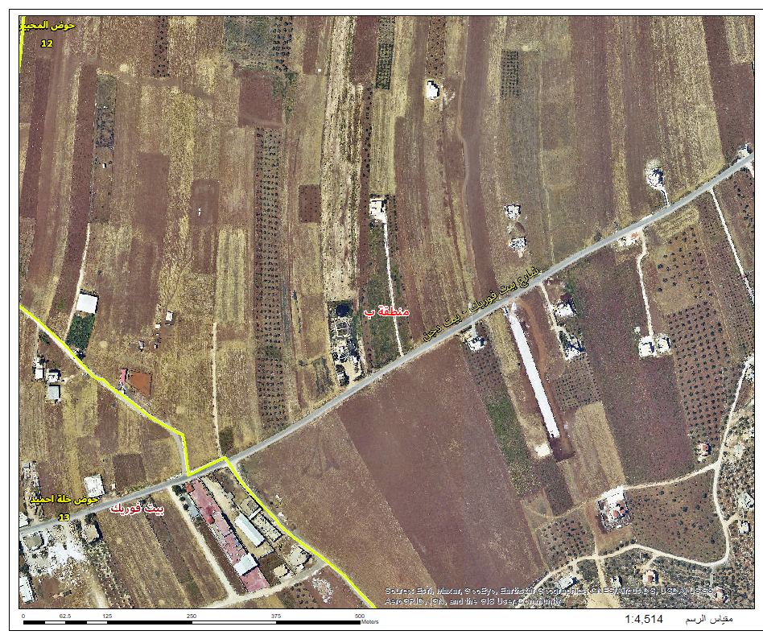
Technical Study Analysis
Plant Facility Location
The location selected for establishing the plant of manufacturing pipes is Nablus/Beit Dajan.

Slide 19
Technical Study Analysis
Plant Layout

Slide 20
Financial Study Analysis
Start-up Capital Cost
Startup Capital Elements | Elements Cost in NIS
Land price | ₪220,200
Construction Cost | ₪912,200
Electricity Cost | ₪140,345
Water System cost | ₪10,000
Other Supportive Equipment to production | ₪16,650
Production Equipment | ₪850,259
Fittings Mold cost | ₪1,107,112
Total | ₪3,254,766

Slide 21
Financial Study Analysis
Total Operational Cost
Types of Cost | Cost (NIS)/year
Salaries | ₪360,000
Depreciation | ₪97,219.18
Insurance | ₪27,638.95
Other cost | ₪6,000
Lighting and fuel consumption | ₪85,536
Office Expenses | ₪600
Machinery & Equipment Maintenance | ₪42,512.9
Inflation Growth Rate | ₪130,190.69
Salaries Growth Rate | ₪36,000
Total | ₪785,697.7

Slide 22
Financial Study Analysis
The total cost for each product depending on the annually production quantities
Product Dimension | Pipe | Coupling | End cap | Equal tee | Elbow 45° | Elbow 90° | Reduced tee | Reducer
Ø20 mm (20 x 25 mm) | ₪2.2342 | ₪15.071 | ₪78.914 | ₪30.85833 | ₪26.094 | ₪19.29 | ₪26.265 | ₪34.22
Ø25 mm (32 x 25 mm) | ₪3.1704 | ₪15.242 | ₪78.914 | ₪30.94433 | ₪26.235 | ₪19.375 | ₪26.607 | ₪34.22
Ø32 mm (40 x 25 mm) | ₪4.554 | ₪13.82509 | ₪50.21452 | ₪21.66057 | ₪19.21886 | ₪16.0229 | ₪19.90185714 | ₪19.8669
Ø40 mm (50 x 25 mm) | ₪6.755077 | ₪13.14355 | ₪34.73754 | ₪16.8731 | ₪15.51419 | ₪14.49425 | ₪16.52734615 | ₪12.38738
Ø50 mm (50 x 40 mm) | ₪10.51325 | ₪13.62883 | ₪35.28663 | ₪17.96766 | ₪16.21333 | ₪15.20435 | ₪16.72633333 | ₪12.66114
Ø63 mm (63 x 50 mm) | ₪16.51336 | ₪14.35283 | ₪34.17667 | ₪19.22133 | ₪17.0885 | ₪16.53858 | ₪17.8565 | ₪12.53433

Slide 23
Financial Study Analysis
Project Evaluation
Break-Even Point for each product
Product Dimension | Break-Even Point for Each Product (#Unit)
 | Pipe | Coupling | End Cap | Equal Tee | Elbow 45° | Elbow 90° | Reduced Tee | Reducer
Ø20 mm (20 x 25 mm) | 354 | 3,281 | 900 | 593 | 839 | 1,236 | 463 | 437
Ø25 mm (32 x 25 mm) | 358 | 2,423 | 649 | 489 | 856 | 1,251 | 410 | 358
Ø32 mm (40 x 25 mm) | 561 | 3,744 | 684 | 559 | 1,022 | 1,689 | 427 | 277
Ø40 mm (50 x 25 mm) | 1,176 | 7,238 | 960 | 769 | 1,402 | 1,944 | 744 | 410
Ø50 mm (50 x 40 mm) | 1,645 | 6,407 | 760 | 621 | 750 | 1,377 | 651 | 288
Ø63 mm (63 x 50 mm) | 2,396 | 3,776 | 410 | 441 | 621 | 1,161 | 658 | 266

Slide 24
Financial Study Analysis
Project Evaluation
Payback Period
  Payback Period = Cost of Investment / Annual Cash Flow
  Payback Period = 3,254,766 / 2,335,631
  = 1.393 year
Rate of Return (ROR)
  Rate of Return = Annual Cash Flow / Cost of Investment
  = 2,335,631 / 3,254,766
  = 71.7%
Net Present Value
  NPV = ∑ {Net Period Cash Flow / (1+r) t}-initial investment
  NPV = (2,335,631*2 / (1+0.19)2) – 3,254,766 = ₪43,915

Slide 25
Conclusions
The idea of establishing a factory for PPR pipe products and their fittings is a great idea, as it is the first manufacturer of such products in the West Bank, and the factory’s profits are excellent when compared to its costs, and the proposed product is considered a competing product in terms of advantages, price, and specifications compared to the products that are currently used, each These indicators provide a great and strong opportunity to adopt the project and start in-vesting in it.

Slide 26
Recommendations
To construct the plant on the lands of the village of Beit Dajan - Nablus. This is since the great demand is concentrated in the northern regions, so the cost of transportation is low, and the price of land in those areas is also lower than in other areas.
Focusing on the sector that has not been studied, which is the building construction sec-tor, because the demand from it increases by one and a half of the annual demand.
To improve the plant market shares from each product after one year of construction.
Producing quantities less than the break-even point for some types of accessories lead to a loss situation in these products, therefor we recommend producing a quantity that exceeds the break-even point and placing it in the inventory to avoid a loss.
Increasing the marketing of PPR products, their features, and qualities, which leads to increasing people's awareness of these products and increasing the demand for them.
Assign qualified personnel to increase and improve factory productivity.

Slide 27


