Slide 1

AL - Najah National University
“Passive Villa“
Supervisor : Dr. Muhannad Haj Hussein
By: Ibtehal Alawnih
Elanah Abu Neameh
Fannan Ghozzi

Slide 2
Contents:
1- site analysis.
2-design stage → Architectural
→Environmental
→Structural design
→Electro-mechanical design
3- quantity survey and cost estimate.

Slide 3
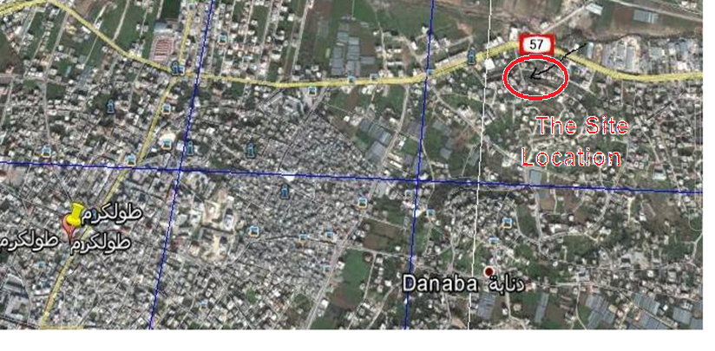
Site analysis :
Our project located in north – east of Tulkarem city
In the Zone C
Max Number of floor=5floors +roof
Area of site=958 m²

Slide 4
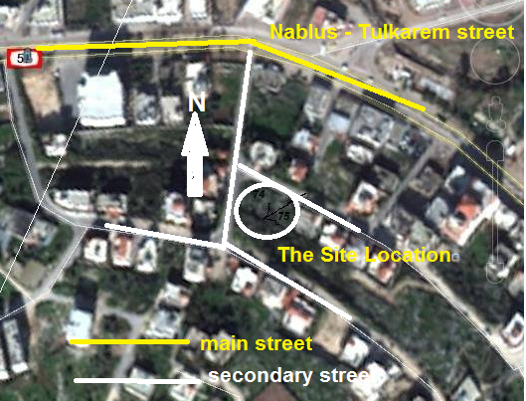
Accessibility of the site :

Slide 5
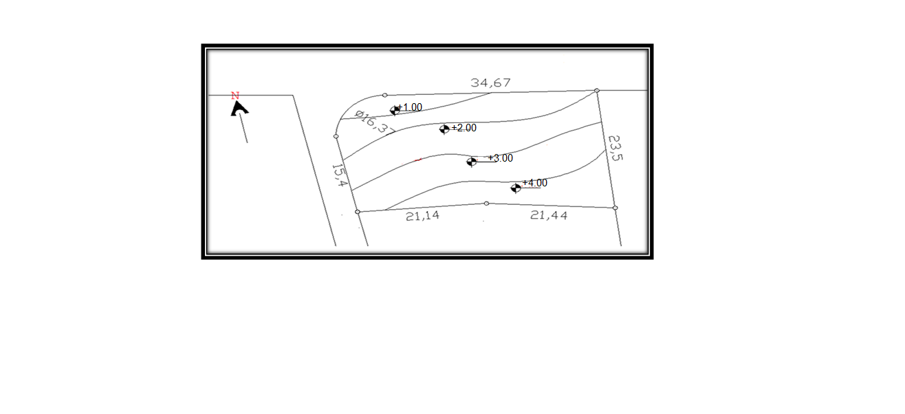
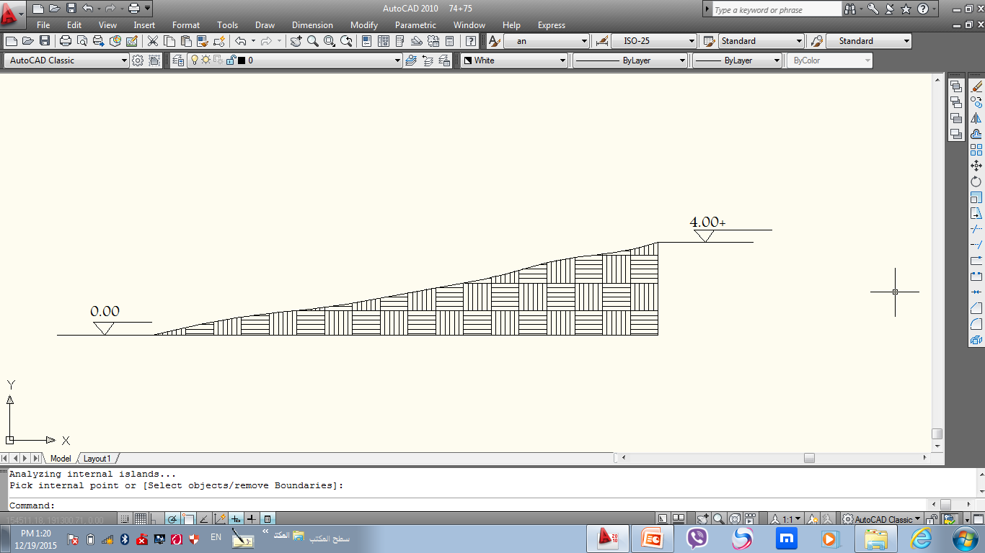
The countering of the site

Slide 6
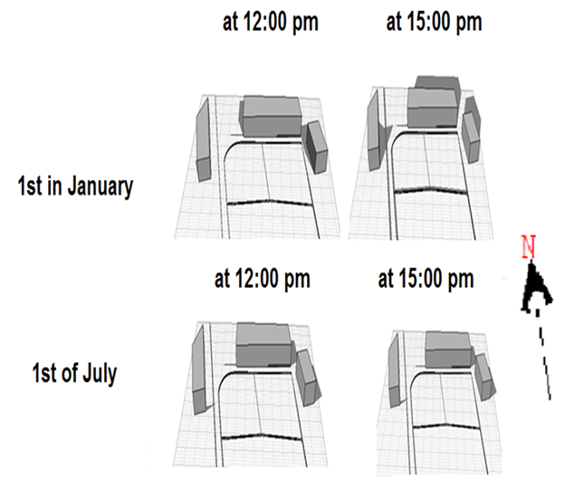
Shadow of the surrounding building to the site

Slide 7
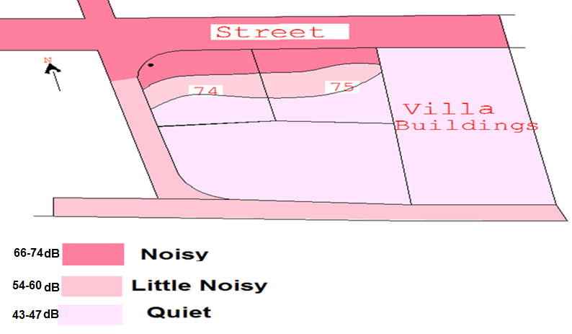
Noise Analysis to the site at 4.00 PM

Slide 8
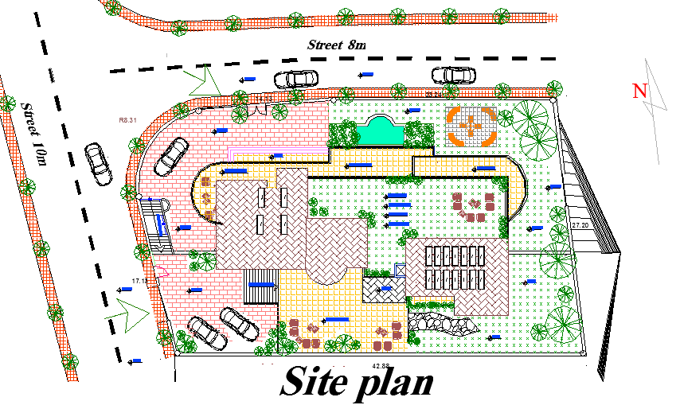

Design Villa Concept
Total area =1370 $m^{2}$,with 2floor ,2basment and roof
Notes:
The Villa site consists of an outdoor Garden , with small pool two main entrances the first one located in the west direction and second one on the north direction , and the two entrances are related directly to the main street . Parking for cars,, stairs to connected between the different level of the landscape. These all are shown in the figure below.
This villa consists of five floors, with an shape near to rectangular shape as shown in figures below.
The ideal orientation for buildings is an elongated, narrow plan allowing the north and south facades of the building maximum exposure to more easily controllable daylight. From a day lighting point of view, this is Favorite because direct south facade solar radiation is easier to control to prevent excess solar gain, it is relatively uniform, and is necessary for passive solar heating strategies
.
figure 3. 14:Ground floor plan
In order to respect and ensure privacy consideration between different spaces in the villa, we separate the resting spaces , bed room and study room from living spaces and activities space. So, we divided the building into different floor , according to the different types of functions in the villa .
The use of the green yards between the building parts will be important in :
Use the cantilever in the slab itself to satisfy shading concept by the building itself and use type of window doesn’t need shad that lead to reduce the cost of the shading.
Use the stair up to do as chimney to get more effective natural ventilation and cool fresh air in summer.

Slide 9
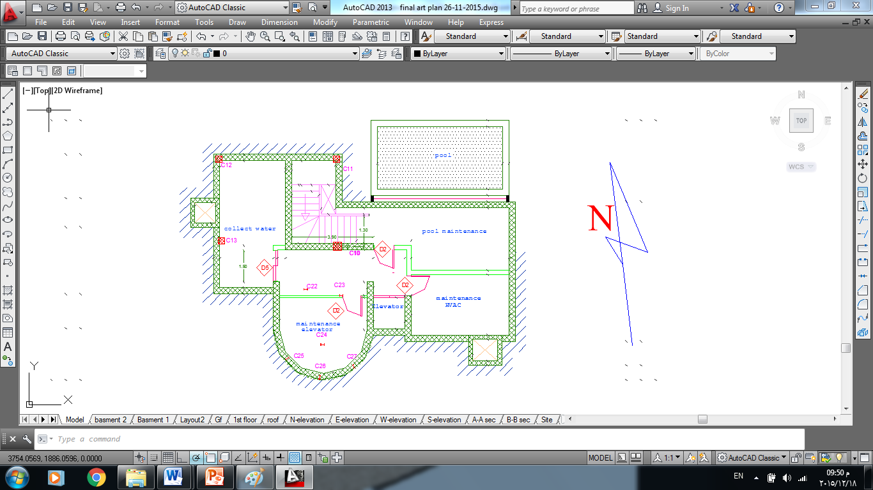
Basement 2

Slide 10
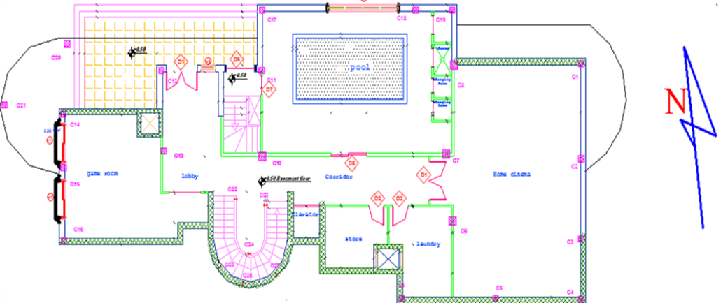
Basement 1

Slide 11
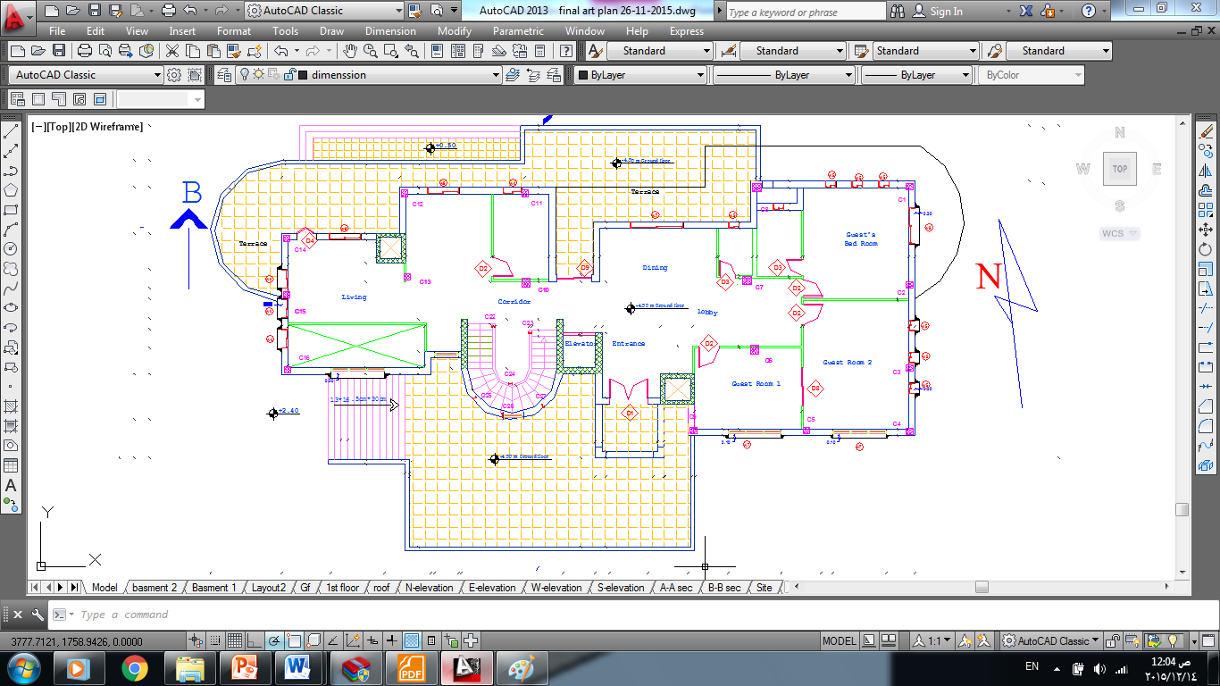
Ground floor

Slide 12
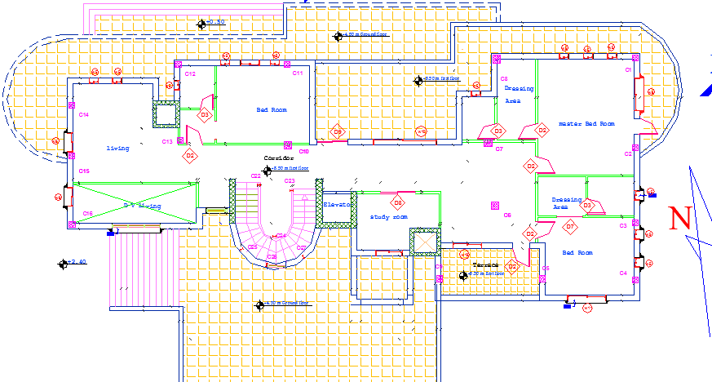
First floor

Slide 13
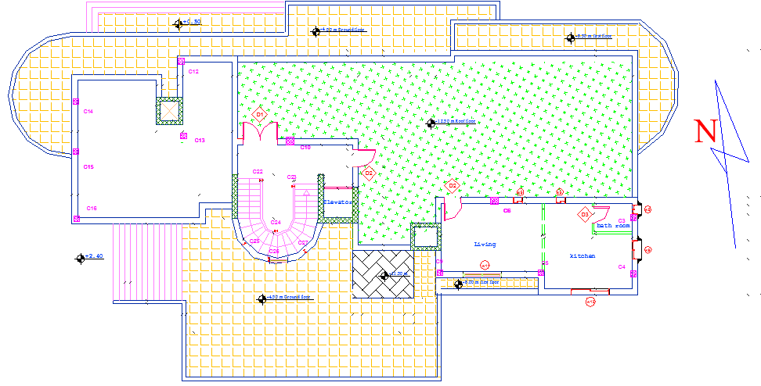
Roof floor

Slide 14
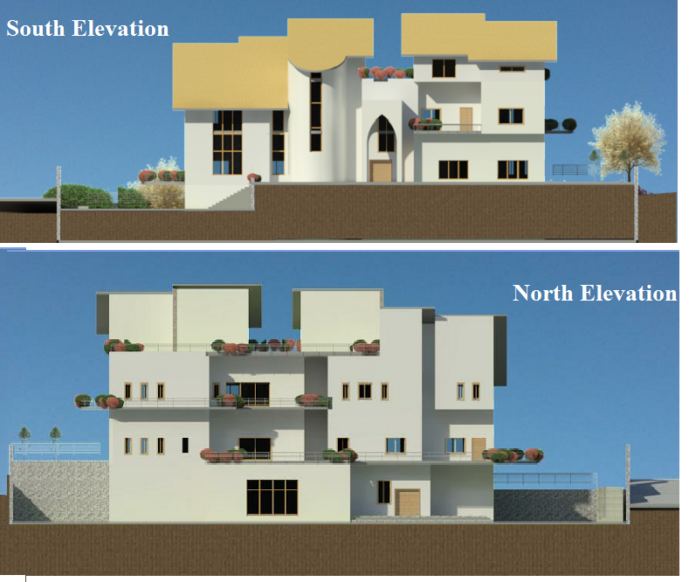

Slide 15
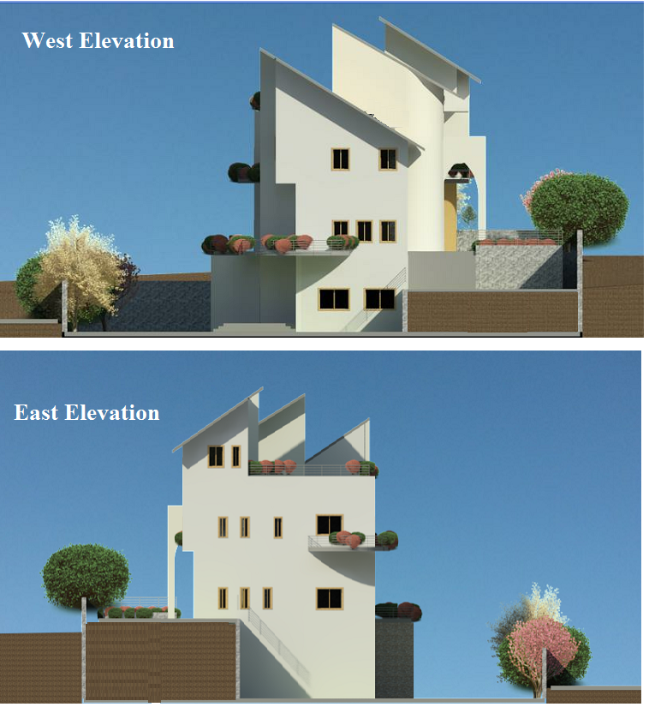

Slide 16
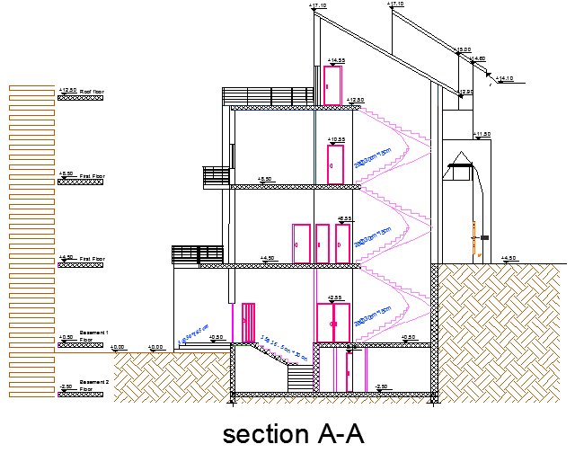

Slide 17
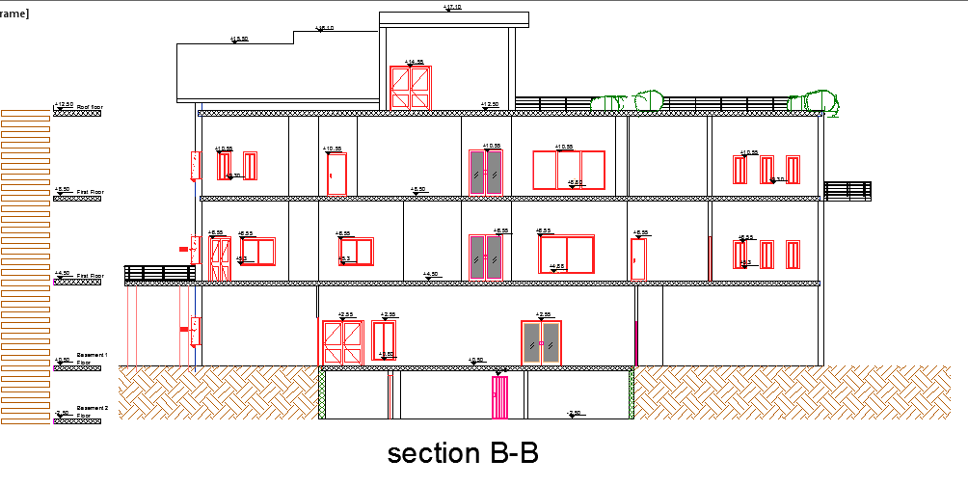

Slide 18
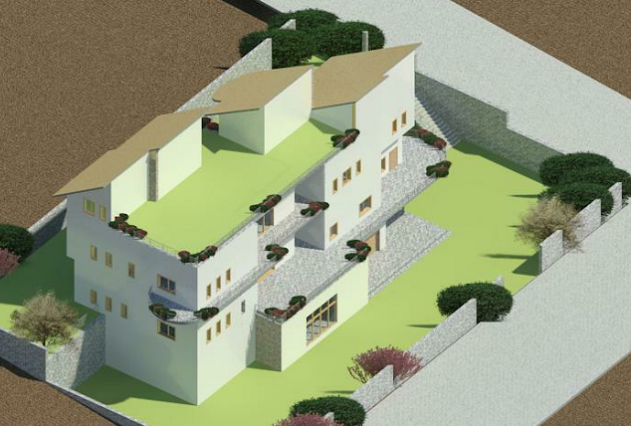
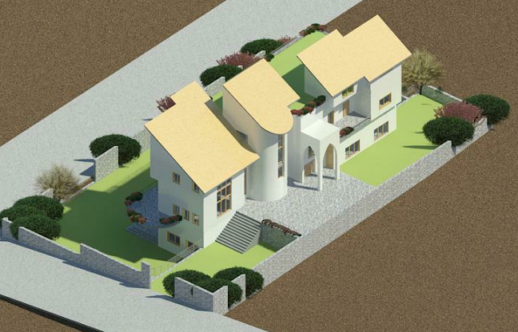
South view
North view

Slide 19
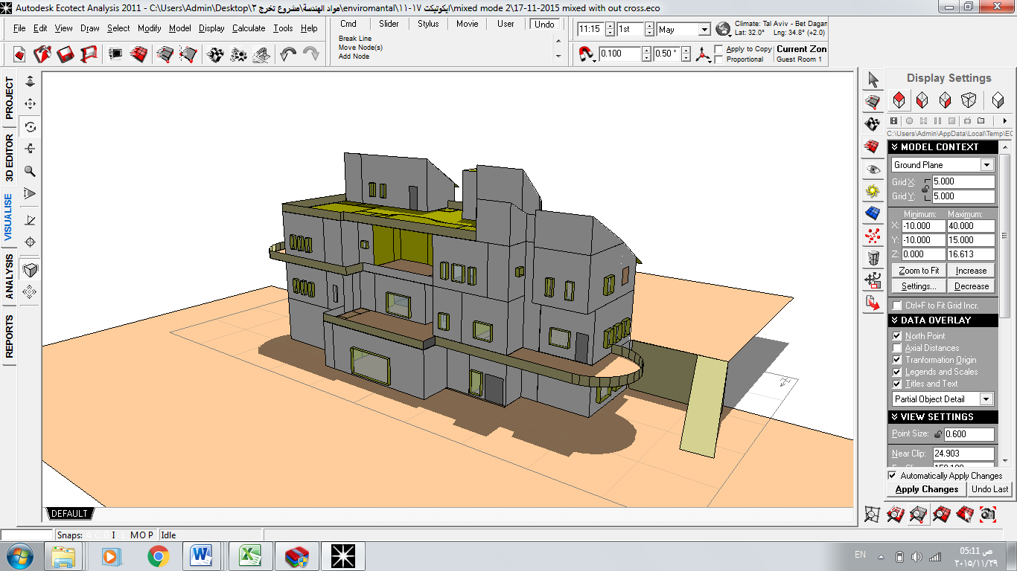
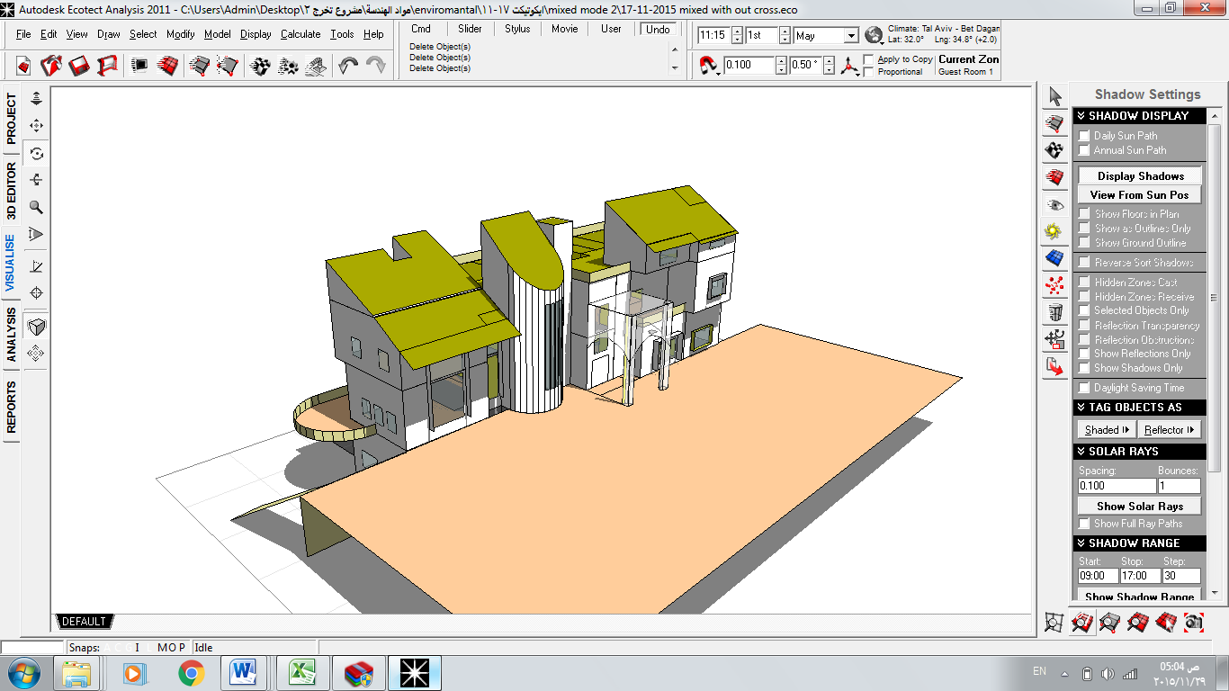
Environmental analysis

Slide 20
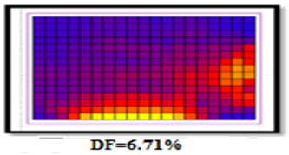
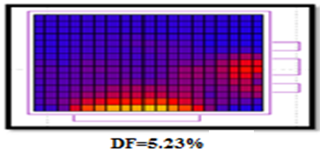
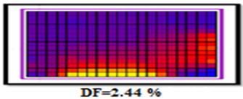
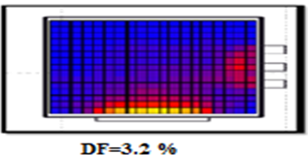
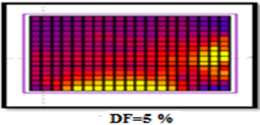
Natural Day light analysis
Recommended DF% for residential building = 1.7-3.5 %
DF% analysis for Guest room
scenario 2 | scenario 1
similar to sc1 +shading | original Ag with windows has SHGC =0.41 and τ=0.64
scenario 4 | scenario 3
original Ag with windows has SHGC =0.28 and τ=0.41 | change Ag windows has SHGC =0.41 and τ=0.64 and shading
scenario 5
Chang Ag with windows has SHGC =0.28 and τ=0.41

Slide 21
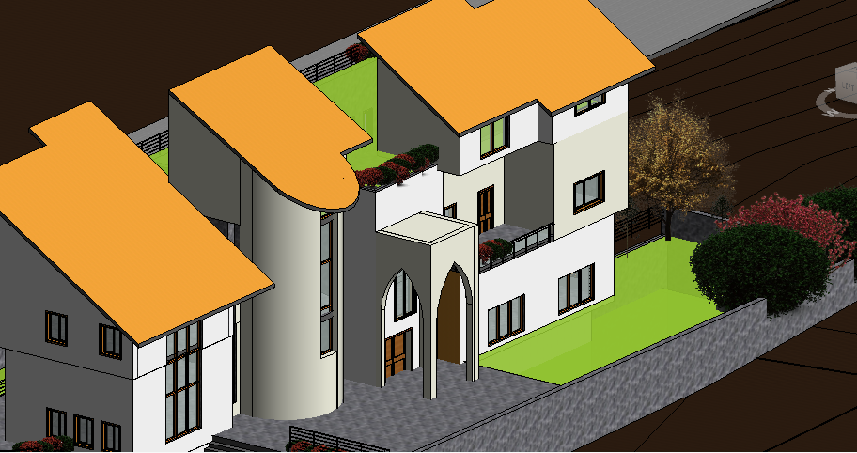
Shading Techniques
Windows with SHGC=0.41 &τ=0.64
Cantilever in the slab it self for the south direction
Vertical shading for east and west direction

Slide 22
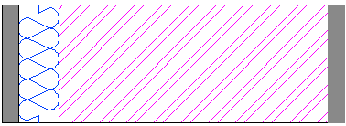
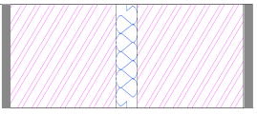
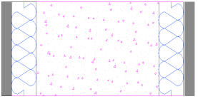
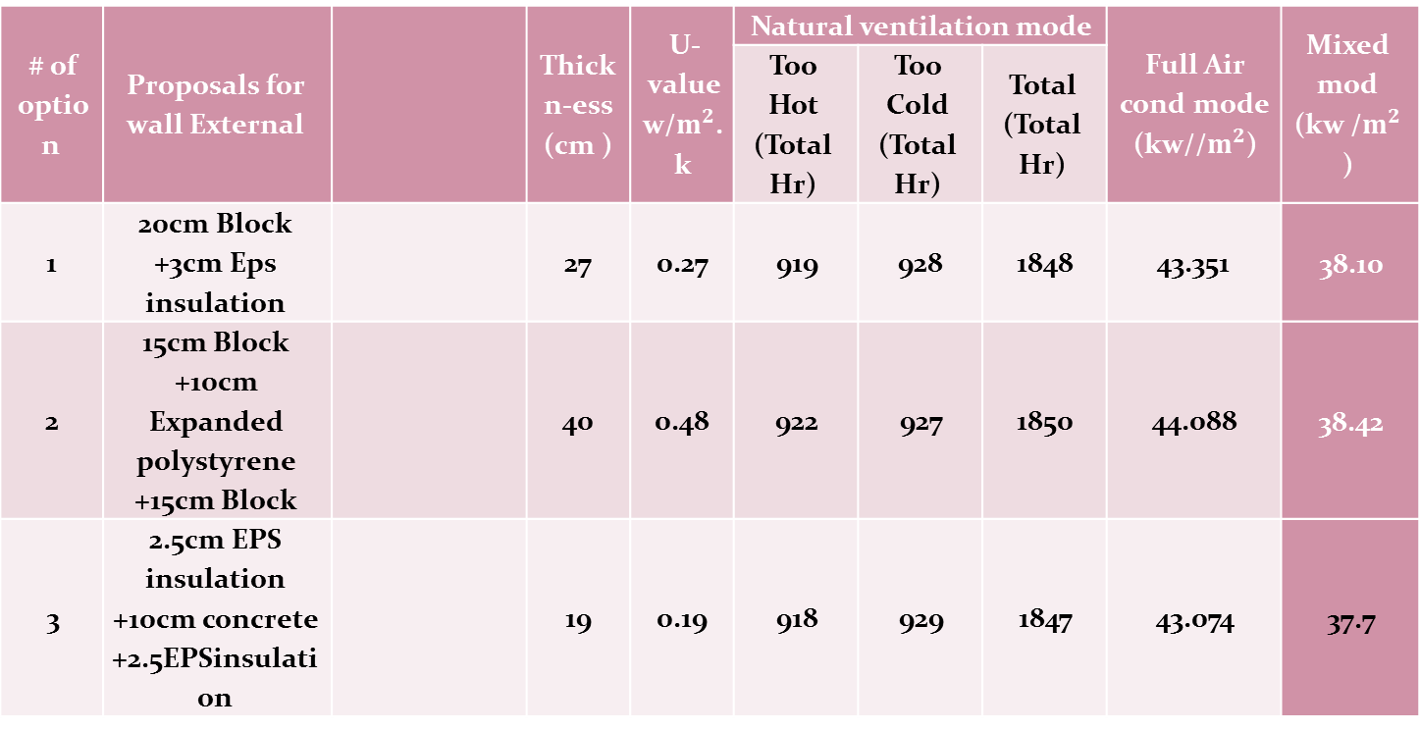
Thermal analysis
Mixed mod (kw /$m^{2}$ ) | Full Air cond mode (kw//$m^{2}$) | Natural ventilation mode |  |  | U-value w/$m^{2}$.k | Thickn-ess (cm ) |  | Proposals for wall External | # of option
 |  | Total (Total Hr) | Too Cold (Total Hr) | Too Hot (Total Hr)
38.10 | 43.351 | 1848 | 928 | 919 | 0.27 | 27 |  | 20cm Block +3cm Eps insulation | 1
38.42 | 44.088 | 1850 | 927 | 922 | 0.48 | 40 |  | 15cm Block +10cm Expanded polystyrene +15cm Block | 2
37.7 | 43.074 | 1847 | 929 | 918 | 0.19 | 19 |  | 2.5cm EPS insulation +10cm concrete +2.5EPSinsulation | 3

Slide 23
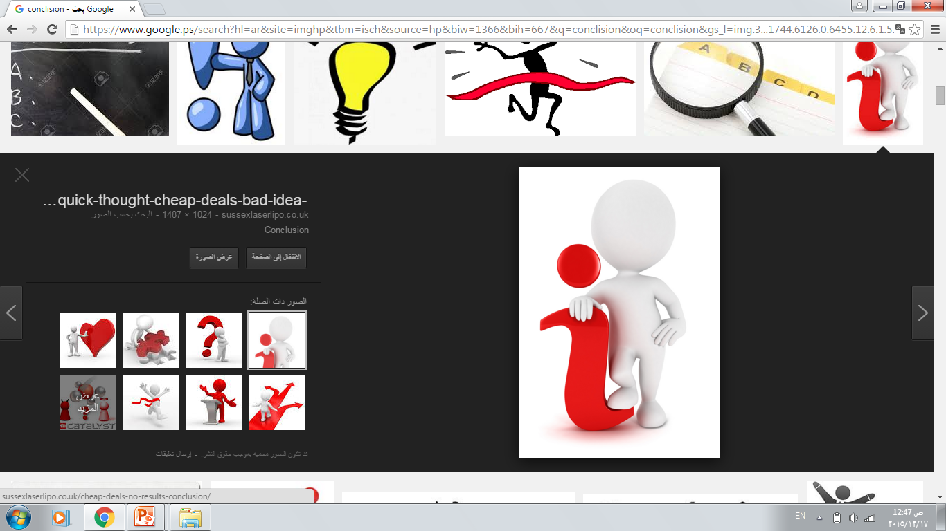
Compression The Results With Passive Bench March
element | Benchmark/requirement | Palestinian Guide line Green building | Achieved/concept
Total energy demand | ≤30 kWh/m2.yr | 30-80 kWh/m2.yr | 38.1
Specific heating demand or | ≤15kWh/m2.yr | - | 18.1
Specific cooling demand | ≤15kWh/m2.yr | - | 20
Window U value | ≤0.80 W/m2K | 1.9 W/m2.°K | 1.5
U-value walls | <0.15 [W/m²K] | 0.5 W/m2.°K | 0.27
U-value roof | <013 [W/m²K] | 0.39 W/m2.°K | 0.26
U-value to ground and to open space | <0.15 [W/m²K] | 0.6 W/m2.°K | 0.27

Slide 24
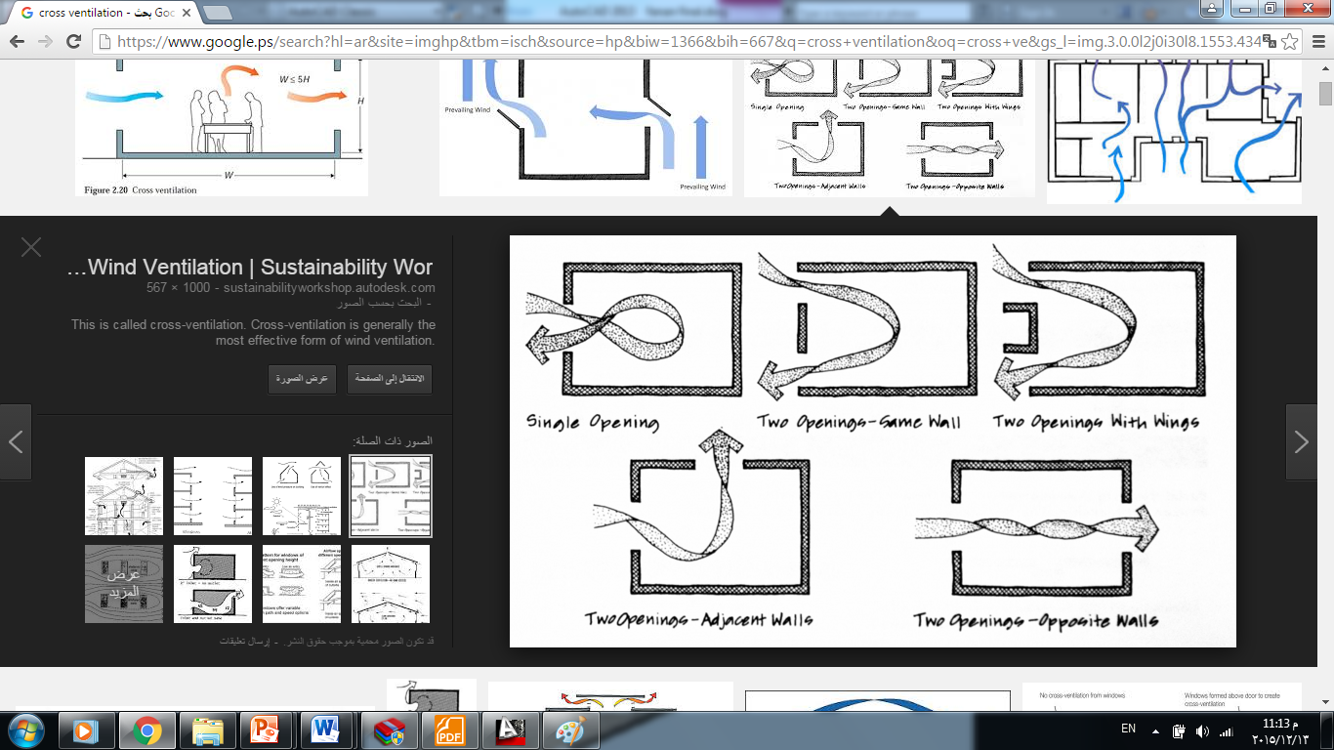
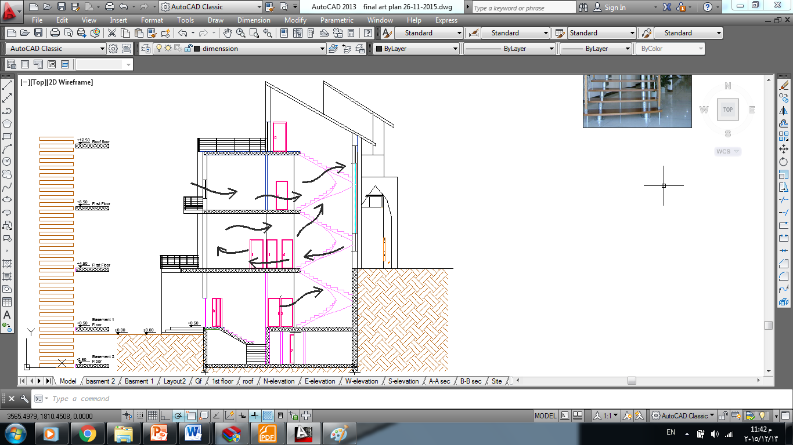
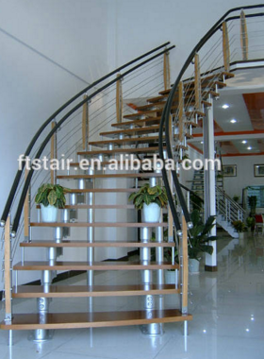
ventilation.
Chimney give 3nach/hr
And light wind .

Slide 25
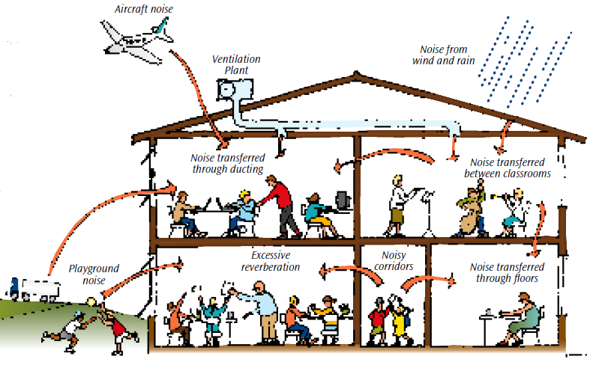
Acoustical analysis:

Slide 26
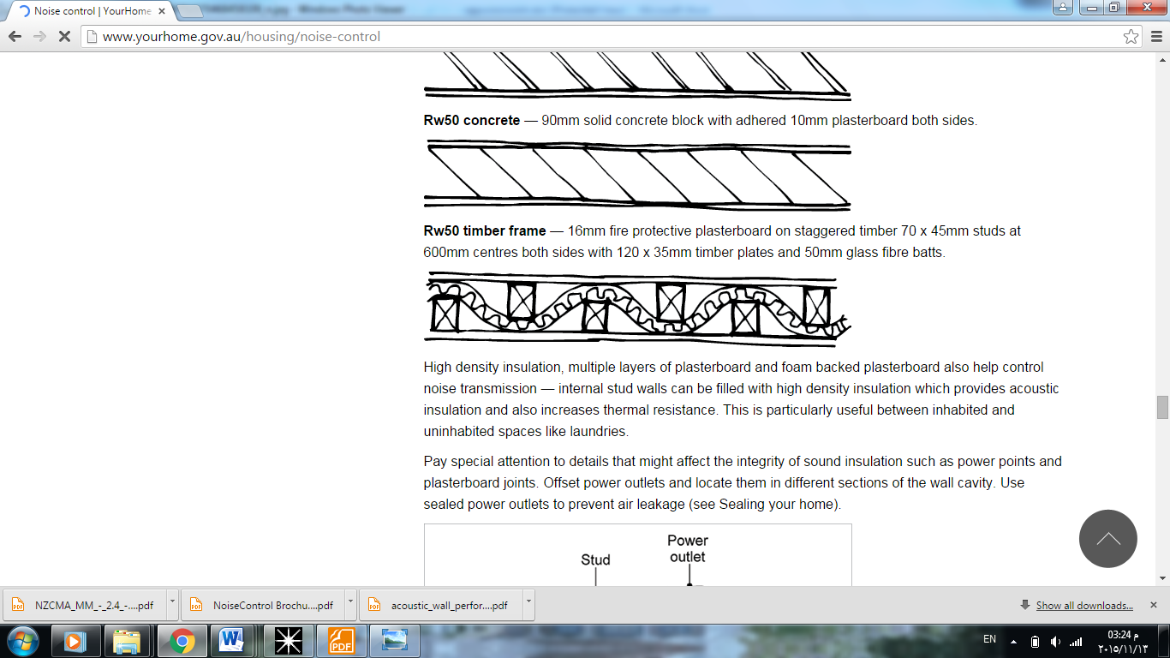
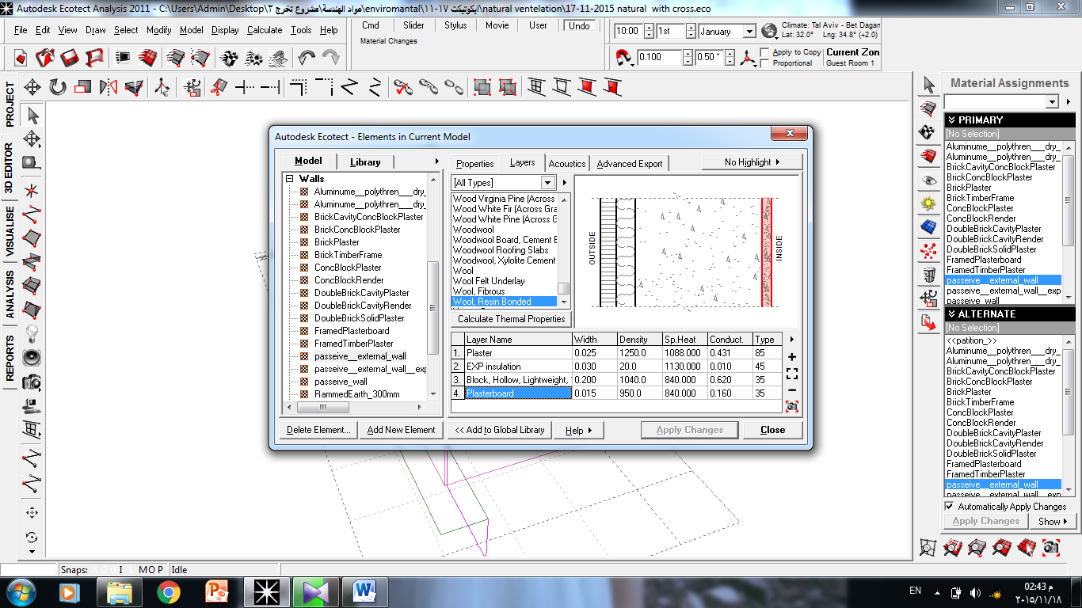
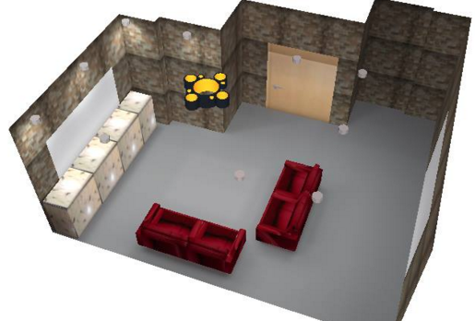
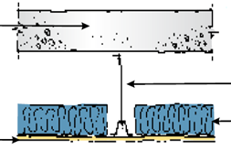
IIC & STC for rooms .
STC=51db
STC=50db
IIc = 50dB.

Slide 27
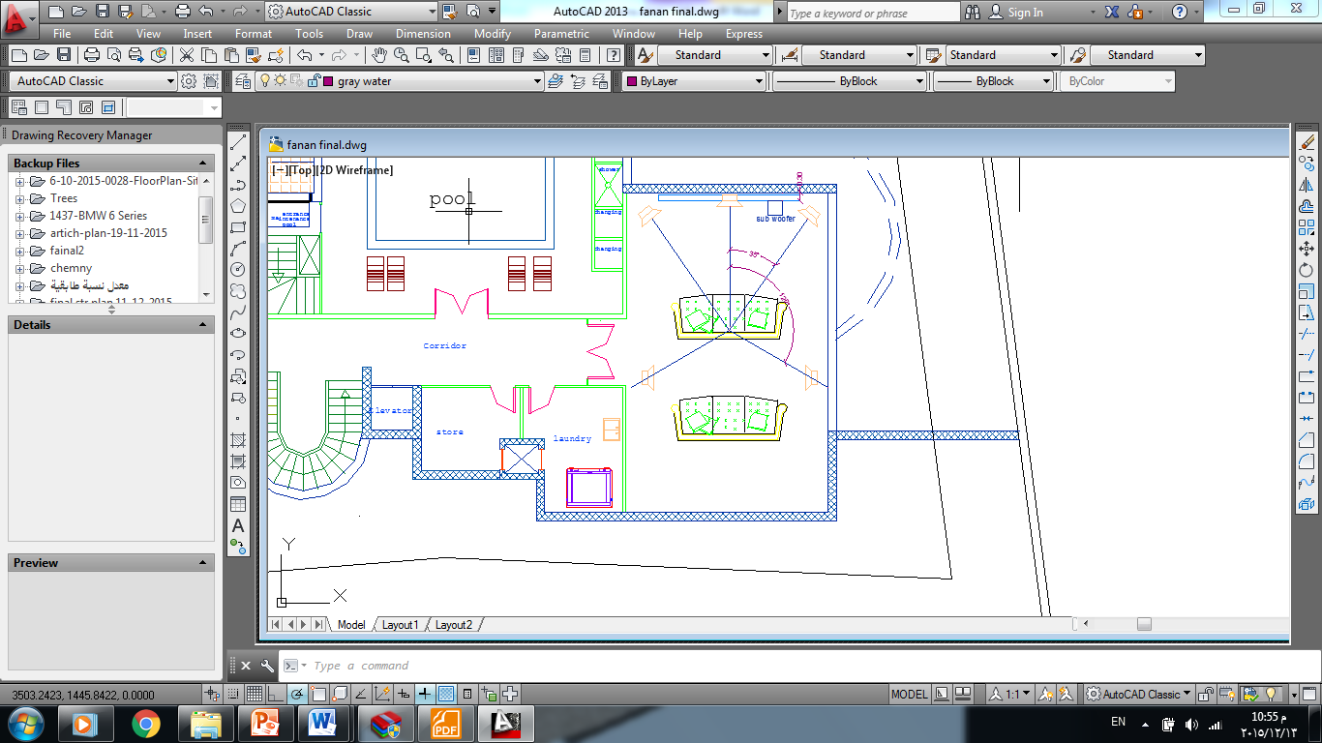
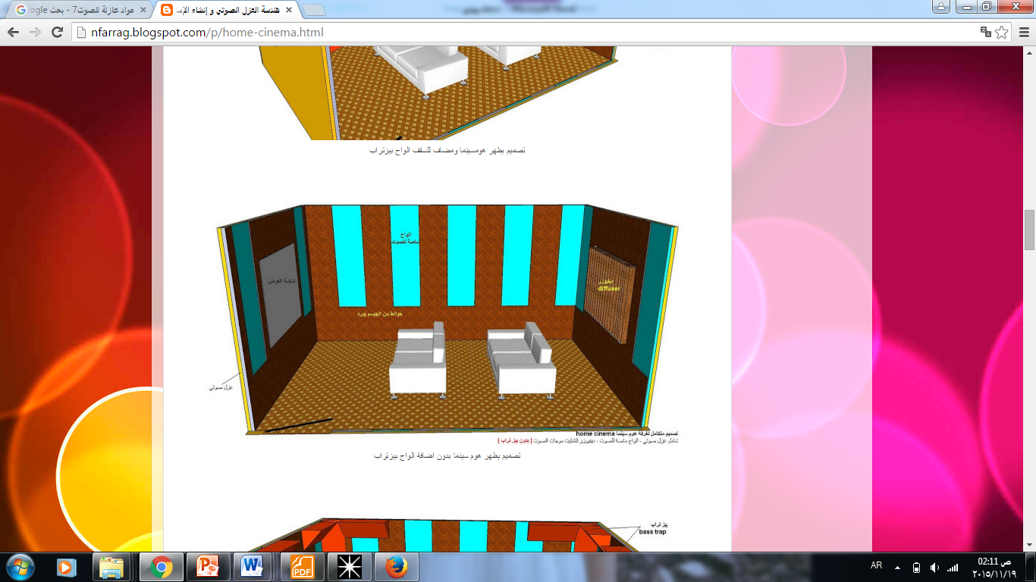
Home Cinema Design
A 5.1 speaker system consists of five speakers positioned as shown in figure
Material | Surface treatments
carpet | Floor
Page board over 50mm(2") fiber glass board | For wall
Plasterboard (12mm(1/2") in suspended ceiling grid) | For ceiling

Slide 28
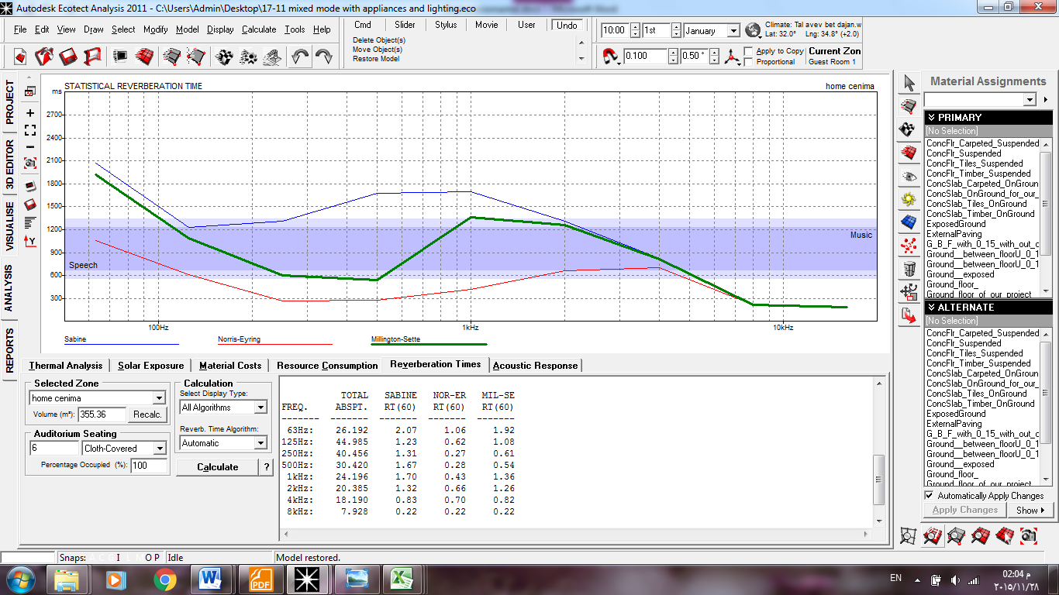
RT60 for Home Cinema
full | Empty | TOTAL
RT(60) | RT(60) | ABSPT. | FREQ.
1.08 | 1.09 | 44.985 | 125Hz:
0.61 | 0.61 | 40.456 | 250Hz:
0.54 | 0.55 | 30.42 | 500Hz:
1.36 | 1.38 | 24.196 | 1kHz:
1.26 | 1.26 | 20.385 | 2kHz:
0.82 | 0.81 | 18.19 | 4kHz:
0.49 | 0.51 | 7.928 | 8kHz:
From previous figures and tables for RT60 we conclude that home cinema are within range(0.5-1.6) .
Most suitable is milling tone .

Slide 29
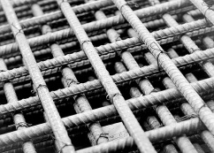
Structural Design

Slide 30
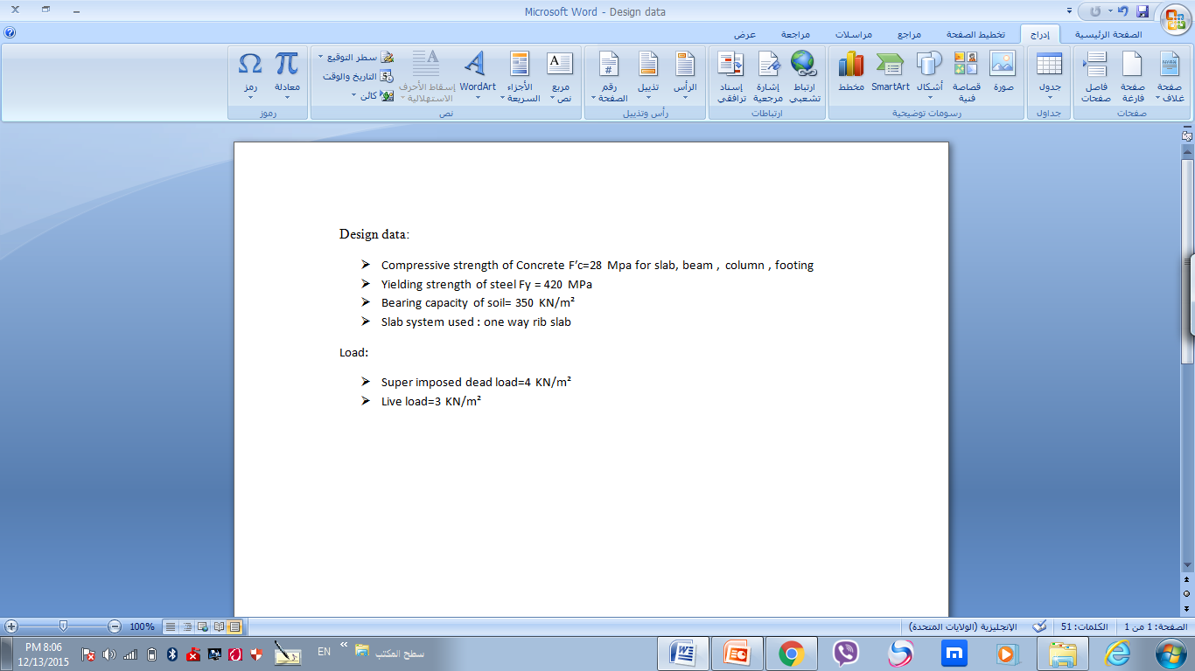
Structural Design

Slide 31
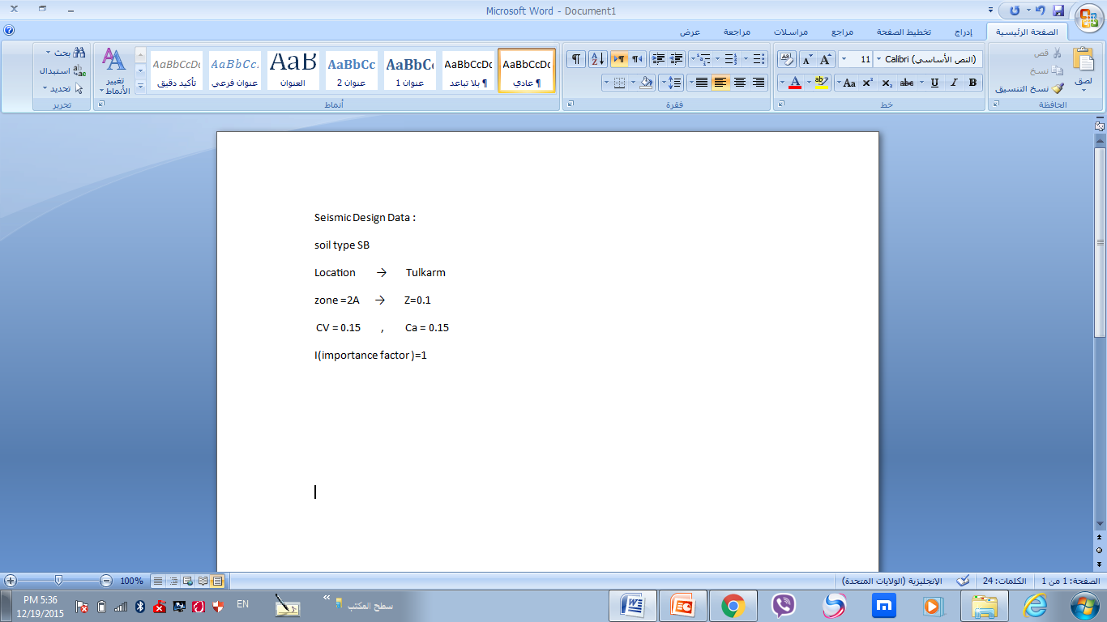
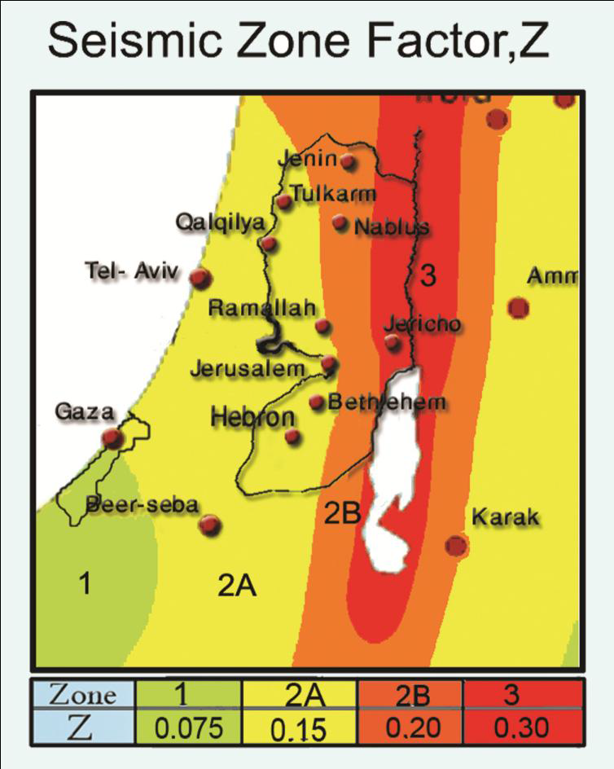

Slide 32
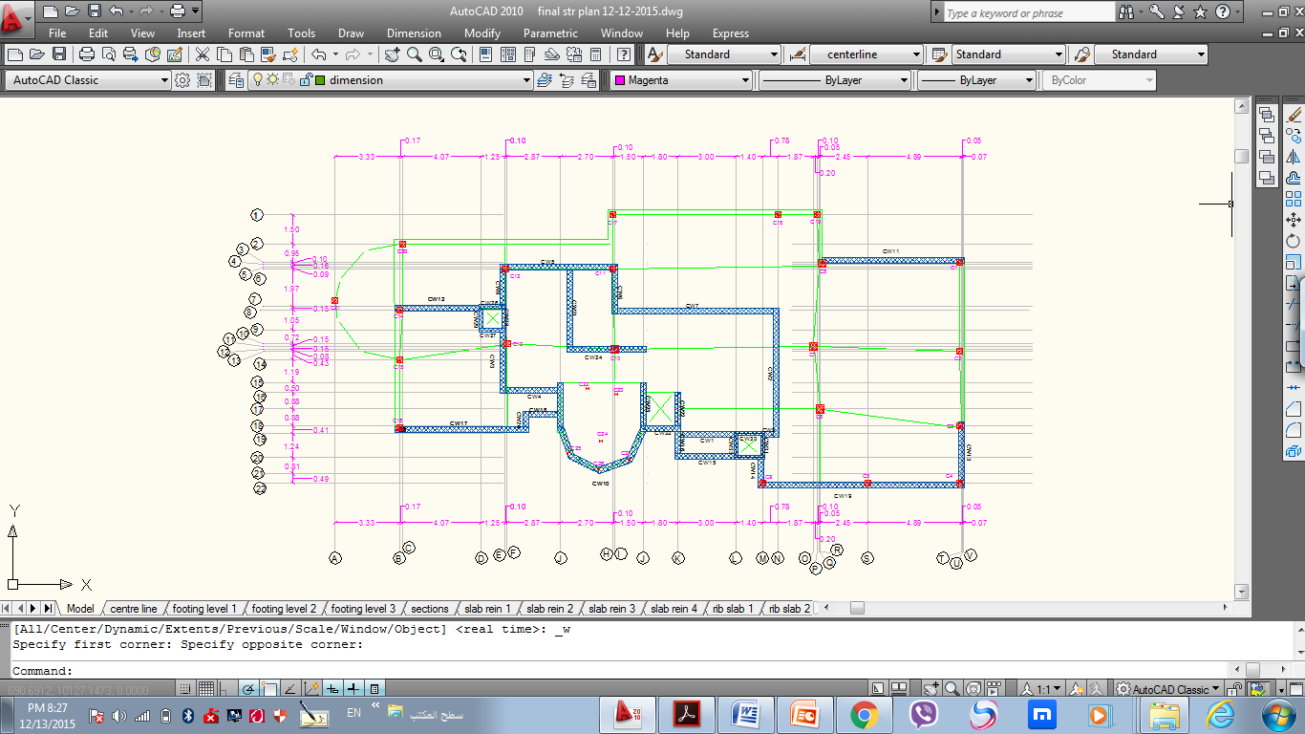
Column Center Lines Grid

Slide 33
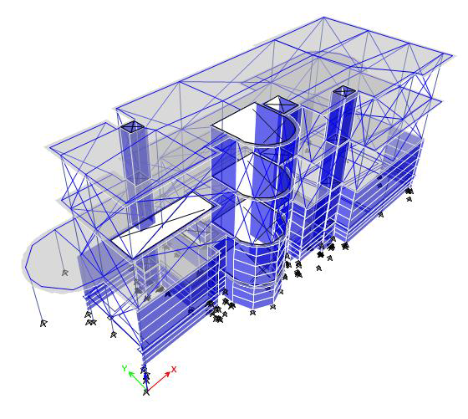

Slide 34
Case | Manual Result | ETAB Result | Error %
dead | 13488.54 | 13644 | 1.15%
Live Load | 3062.51 | 3059.652 | 0.093%
Super Imposed | 4075.919 | 4073.43 | 0.06 %
Error<5%... ok

Slide 35
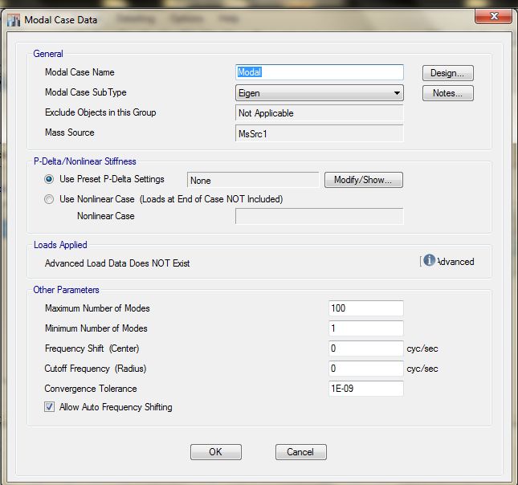
T ETAB | T manual | 1.3*T manual | check
0.35 | 0.428 | 0.556 | T ETAB<1.3 T manual

Slide 36
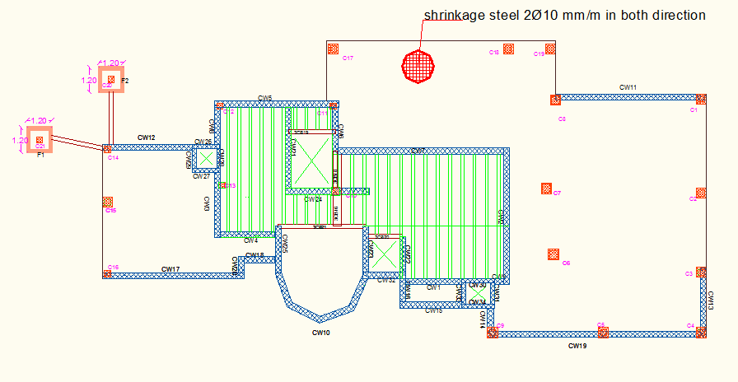
Footing Plan
Footing Level 1

Slide 37

Footing Plan
Footing Level 2

Slide 38

Footing Plan
Footing Level 3

Slide 39

Three Types of footing :
Single Footing

Slide 40

wall Footing

Slide 41


Mat foundation

Slide 42

Column Design

Slide 43


Longitudinal Column Sections :

Slide 44

Slabs Reinforcement:
Slab reinforcement for first floor
44

Slide 45

Slabs Reinforcement:
Slab reinforcement for ground floor
45

Slide 46

Slabs Reinforcement:
Slab reinforcement for basement1 floor
46

Slide 47

Slabs Reinforcement:
Slab reinforcement for baseent2 floor
47

Slide 48

Beam Reinforcement :

Slide 49


Shear Wall Reinforcement

Slide 50


Pool Reinforcement

Slide 51


Electro-Mechanical Design

Slide 52

Water Supply System

Slide 53

Recycled water | Fresh water
21 | 35 | Total FUs
1.5" | 2" | Vertical pipe diameter
1" | 1.25" | Horizontal pipe diameter
3/4" | 3/4" | branch pipe diameter

Slide 54


Water drainage

Slide 55

Fire system:

Slide 56

VRF system
pipe | Unit power | Supply diameter(inch) | Return diameter(inch)
1 | 8 | 3/8 | 5/8
2 | 8 | 3/8 | 5/8
3 | 8 | 3/8 | 5/8
4 | 6 | 3/8 | 5/8
5 | 3 | 1/4 | 1/2
6 | 3 | 1/4 | 1/2
7 | 3 | 1/4 | 1/2
8 | 3 | 1/4 | 1/2
9 | 3 | 1/4 | 1/2
10 | 3 | 1/4 | 1/2
11 | 3 | 1/4 | 1/2
12 | 3 | 1/4 | 1/2
13 | 3 | 1/4 | 1/2
14 | 3 | 1/4 | 1/2

Slide 57

Sockets
Space | Number of sockets
Bedroom | 4
Living room | 4
Guest room | 4
Study room | 4
Dining room | 2
Kitchen | 6
Laundry | 2
Home cenima | 4
Home gym | 4
Bathroom | 1
Pool | 4
Store | 1

Slide 58

Lighting arrangement

Slide 59


Item | result | Acceptable limit
Eavg | 207 | 150
Uo | 0.627 | >= 0.6
UGR | 10-17 | < 19

Slide 60



Photovoltaic

Slide 61

Quantity survey and cost estimate

Slide 62
Item | unit | quantity | cost (NIS)
Concrete | m³ | 1102.26 | 330678
Steel | Ton | 50.49 | 157422
Excavation | m³ | 1604.25 | 320850
Mechanics | _ | _ | 103200
Electrical | _ | _ | 76770
Finishing | _ | _ | 3080
Total cost of the villa = 1311879 NIS
239 $/m² = Cost/m² = 957 NIS

Slide 63


