Slide 1
family wallet
Isra Mousa Reham Helo
Supervisor:
Dr.Haya Samaneh

Slide 2
Outline:
Problem
Introduction
Technologies and tools
Features
Future work
Demo

Slide 3



Why Family wallet?

Slide 4


Technologies and tools:
Web based:

Slide 5


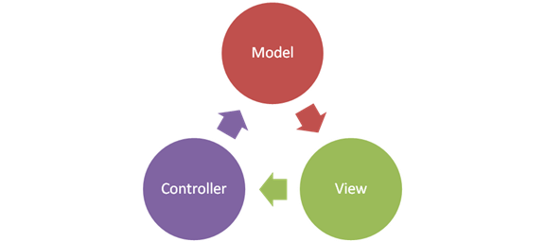

Android:

Slide 6
Features:
Charts.
Notification.
Alert messages.
Locations (GPS).
Currency converter.
Scan bills.
Receives SMS messages.
Searches.

Slide 7
Future work:
Connect our application with the near markets to get the cheaper price.
Add a payment system to our application.
Add feature of online shopping.

Slide 8
Demo :D

