Slide 1


An-Najah National University
Faculty of Engineering
Chemical Engineering Program
Graduation Project II
Supervisor: Dr. Majd Eshtaya
Whey as a resource: Transforming Dairy Waste into Lactic Acid.
Jul 2nd, 2025

Slide 2

Meet Our Team
Ameer Abu Hayat
Deema Tammam
Nadeen Hawash
Omar Alabed

Slide 3
Outline
01
Introduction and overview
02
Methodology
03
Results and discussions
Scale Up, Conclusion and Recommendation.
04

Slide 4

1
Introduction and Overview

Slide 5
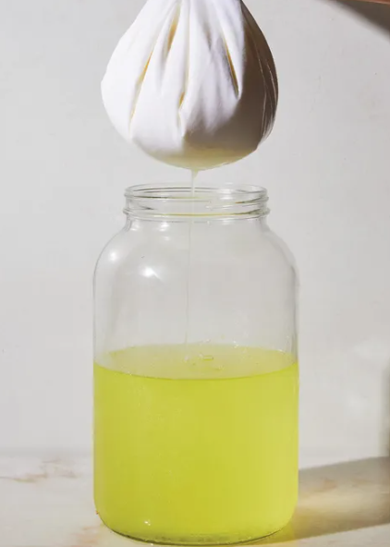
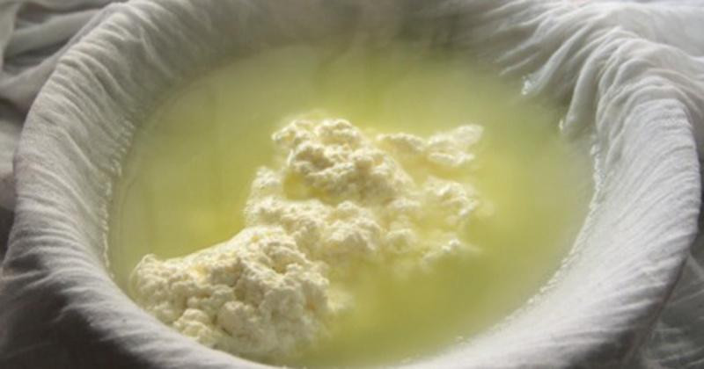
Introduction and overview
Main Objective
The project's main objective is to develop a bioprocess that efficiently converts diary waste into lactic acid by fermentation

Slide 6
Introduction and overview
Study Key
1- Isolation and Identification of lactic acid bacteria. 2- Generate A Growth rate Curve of LAB.
3- Lactic Acid production by using Mixed Culture.
4- Lactic Acid production by using Isolated LAB Strain.

Slide 7
Introduction and overview
Significance of the Work
This project aims to reduce environmental impact by converting whey into lactic acid, a by-product of the dairy industry. This not only repurposes the by-product but also reduces disposal costs. The project also supports industrial profitability by producing base chemicals and biodegradable poly-lactic acid.

Slide 8
Whey
Definition & Types
Whey is the liquid remaining after milk curdles, produced through acid or enzyme coagulation.
Two main types:
Sweet Whey (pH 5.2–6.7) from rennet-based cheese (Cheddar, Mozzarella).
Acid Whey (pH 3.8–4.6) from fermented dairy (Ricotta).
Main components: Lactose (63–75% of total solids), Protein (9–11%), Minerals (Calcium, Phosphate, Chloride), and Fat.
Physio-chemical properties include low viscosity, unstable heat stability

Slide 9
Whey
Whey Utilization:
Environmental Challenge: 85% of milk in cheese production turns into whey waste, causing pollution.
Industrial Uses:
Food Industry: Whey powder in protein supplements, baked goods, dairy products.
Agriculture: Used as fertilizer, soil pH balancer, and animal feed supplement.
Beverages
Bioplastics: Whey-derived polylactic acid (PLA) for packaging & electronics.

Slide 10
Whey
Treatment Methods of Whey
Physic-Chemical Treatment
Electrocoagulation
Membrane Treatment
Biological Treatment Methods
Aerobic Treatment
Anaerobic Treatment

Slide 11
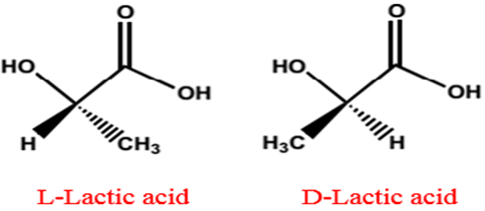
Lactic Acid
Lactic acid is a key component in biochemical processes, produced by muscles, found in dairy products, and its colorless or yellow in liquid state.
There are two optical isomers of lactic acid: L (+)- and D (–)-lactic acid. While L (+)-lactic acid is classified as GRAS for food additive, D (–)-lactic acid can be harmful to human metabolism and cause acidosis and decalcification.

Slide 12
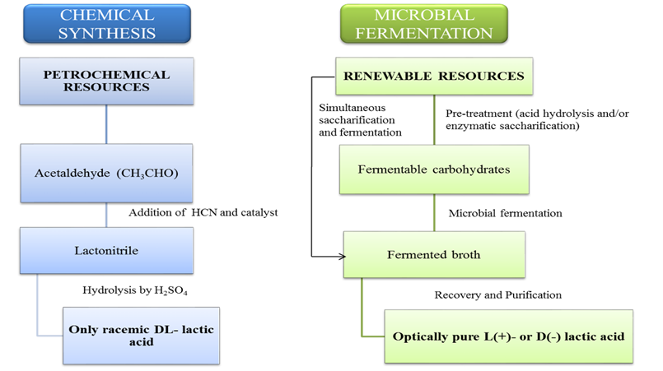
Lactic Acid
Production Processes

Slide 13
Lactic Acid
Applications and Market
Lactic acid is essential in food, pharmaceuticals, cosmetics, and industry. The food sector uses 35% of it as a preservative and pH regulator, while cosmetics and pharmaceuticals benefit from its moisturizing and antimicrobial properties.
A major innovation is polylactic acid (PLA), a biodegradable plastic used in packaging and medical devices, though high production costs remain a challenge. Despite this, demand for sustainable materials continues to drive market growth.

Slide 14
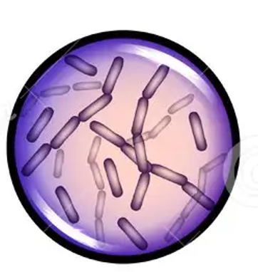

Lactic Acid Bacteria
Rod
(Like Lactobacillus)
Classification (shape)
Cocci (spherical)
Gram Positive
Non-Spore Forming
Characteristic
Facultative Anaerobic
Low pH Tolerance

Slide 15
Lactic Acid Bacteria Isolation
Gram Staining
Identification of LAB
Growth Rate Curve
Lactic Acid Production
Pure Strain
Mixed Culture
2
Methodology

Slide 16
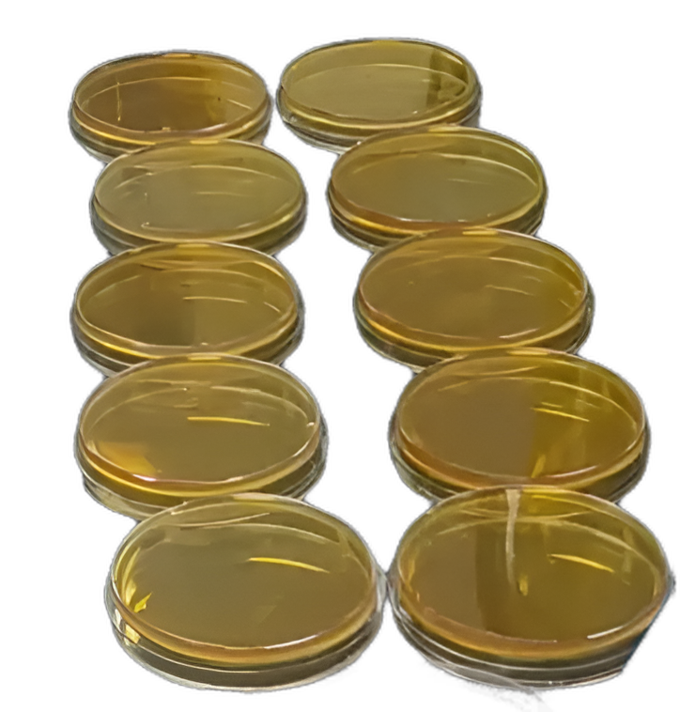
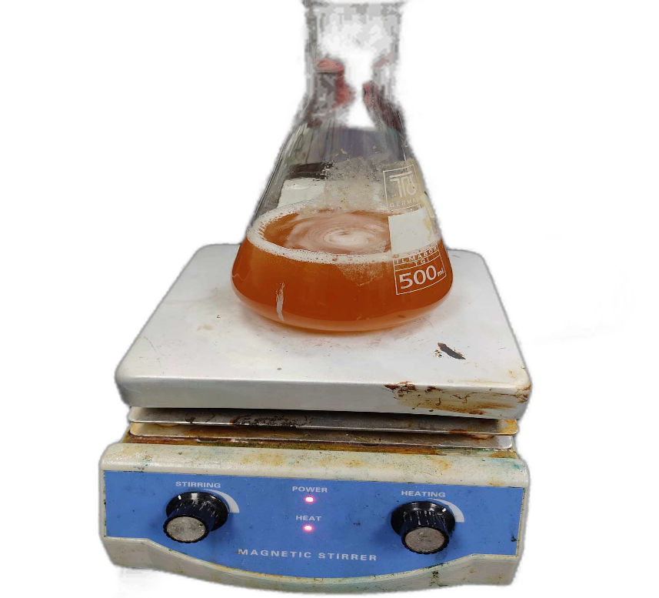
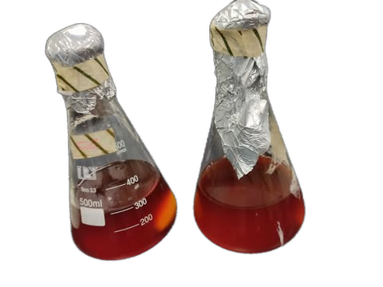
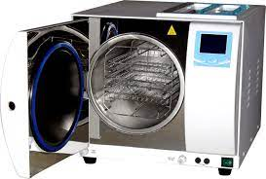
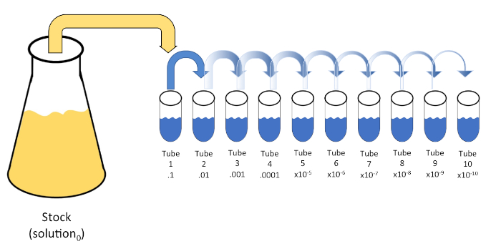
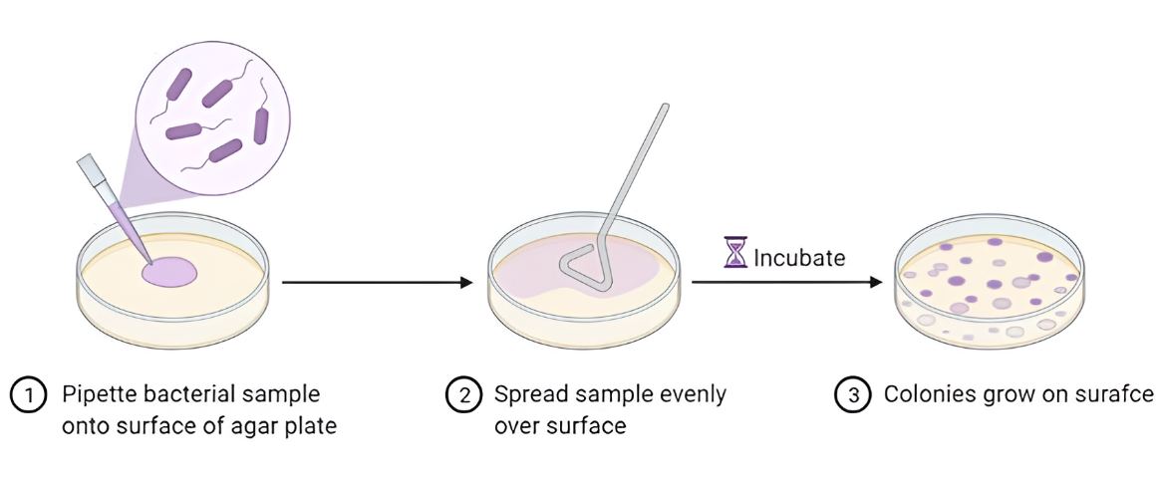
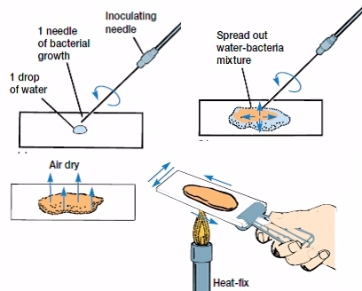
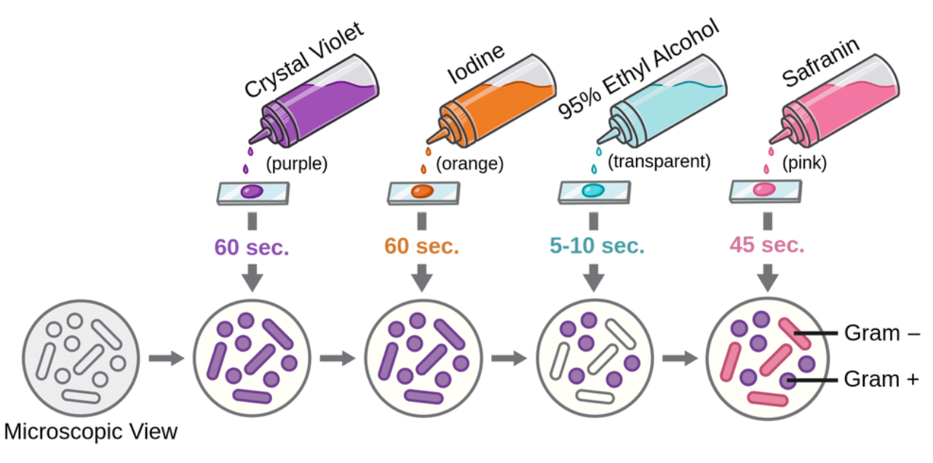
Isolation of LAB

Slide 17
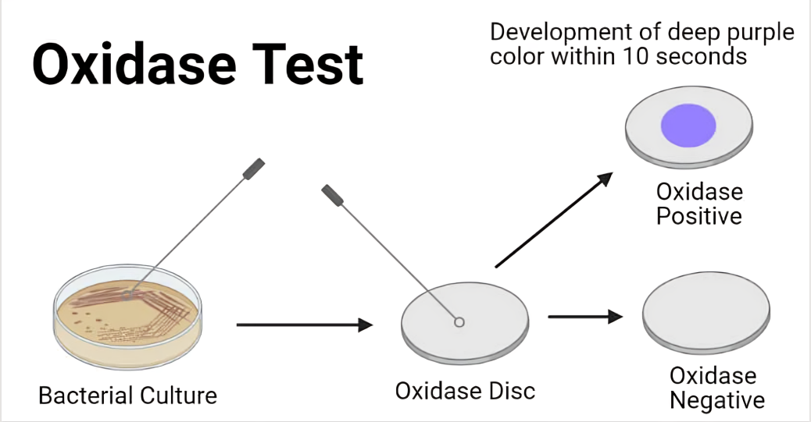
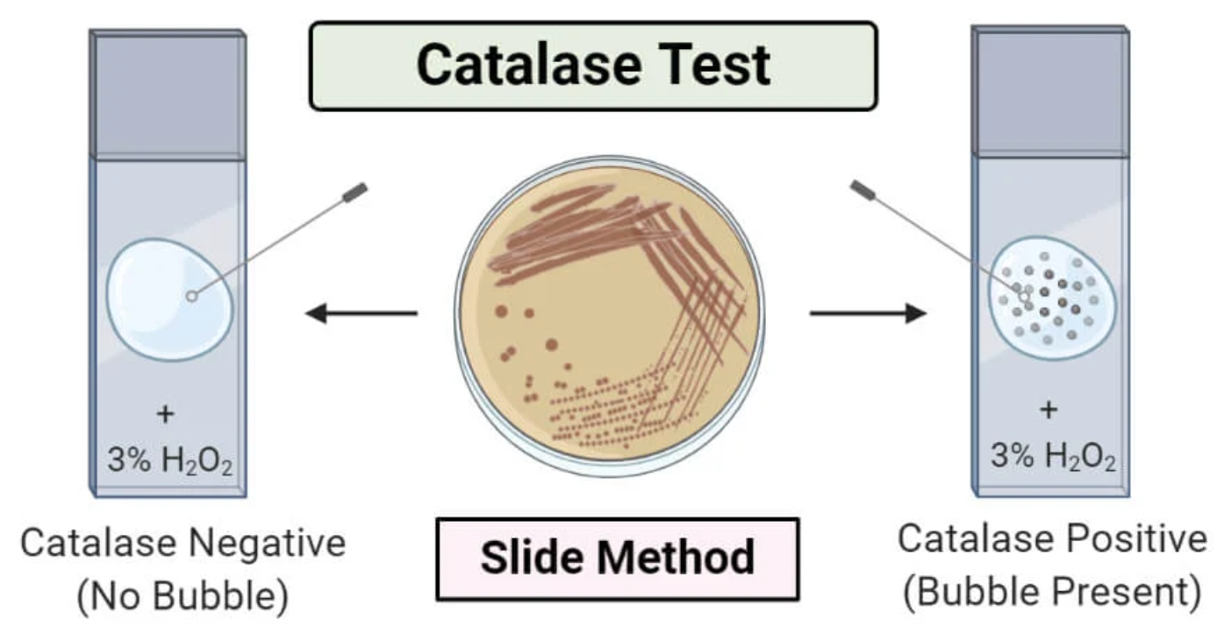
Identification of LAB

Slide 18
Bacterial Growth Measurement
2
Turbidity Measurement at 600 nm

Slide 19
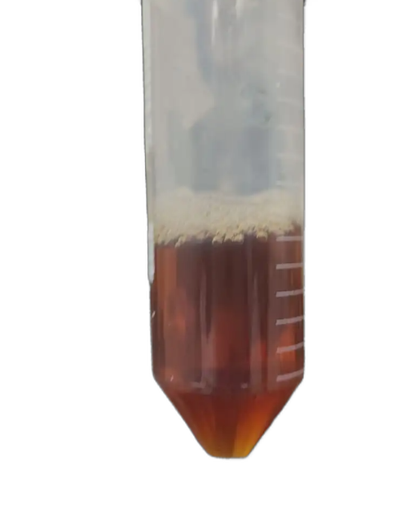
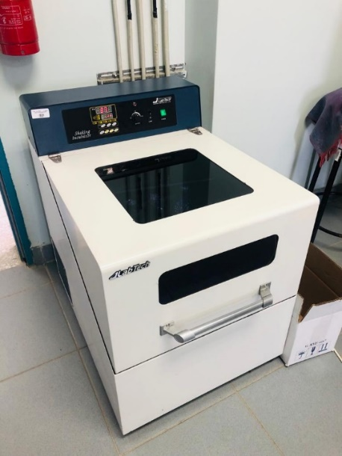

Activated Bacteria
Bacteria and Broth.
MRS broth
Autoclave
Cultured broth placed in the shaker incubator.
Every 1 hour samples taken and absorbance at 600 nm measured .

Slide 20
Lactic Acid Production
2
1
Mixed Culture
2
Isolated Pure Strain

Slide 21
LA Production by Mixed Culture
Mixed Culture Media
pH
Un-Adjusted
Lactose
Cheese Whey
Nutrients
Yeast Extract
Nitrogen Sorces
Peptone
With Protein
(Un-Treated )
Without Protein (Treated)
Effect of Protein
Without Nutrients
With Nutrients
Labneh Whey
Without Nutrients
Nutrients
pH
pH Adjusted
With Nutrients
2

Slide 22
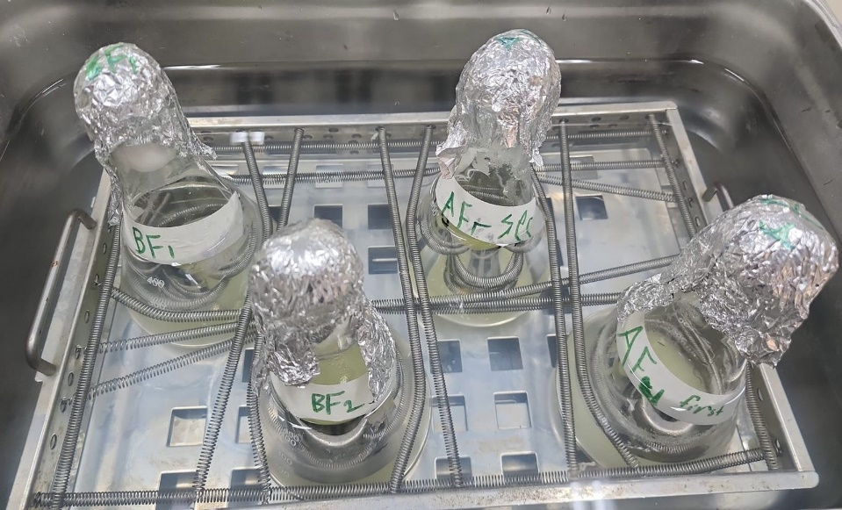
LA Production by Mixed Culture
Solution name | Minerals | Nitrogen Source | Carbone Source | Pre -Treatment
Labneh whey | Magnesium sulphate MgSO₄.7H₂O Potassium dihydrogen phosphate KH₂PO₄ Manganese (II) Sulfate Tetrahydrate MnSO₄.4H₂O | Yeast Extract | Lactose in whey | ✔
Lactose |  | Yeast Extract | Lactose | ✕
Cheese whey |  | Yeast Extract | Lactose in whey | ✕
Cheese whey |  | Peptone | Lactose in whey | ✕
Cheese whey |  | - | Lactose in whey | ✔
Cheese whey | - | - | Lactose in whey | ✕
Cheese whey | - | - | Lactose in whey | ✔
Labneh Whey | - | - | Lactose in whey | ✕
Labneh Whey | - | - | Lactose in whey | ✔
Lactic acid production experiments by Mixed Culture
Fermentation process in a water bath at 37°C

Slide 23
1
LA Production by Isolated LAB Strain
Exp. # | Substrate | Nitrogen Source | Minerals | LAB | Duplicate
1 | Cheese Whey | Peptone | Magnesium sulphate MgSO₄.7H₂O Potassium dihydrogen phosphate KH₂PO₄ Manganese (II) Sulfate Tetrahydrate MnSO₄.4H₂O | ✔ | ✔
2 | Cheese Whey | Peptone |  | ✕ | ✔
3 | Lactose | Peptone |  | ✔ | ✔
4 | Labneh Whey | Peptone |  | ✔ | ✔
5 | Cheese Whey | - | - | ✔ | ✕
6 | Glucose | - | - | ✔ | ✕
7 | MRS | Peptone, Yeast extract, Beef extract | A lot of minerals in its ingredients. | ✔ | ✕
2

Slide 24
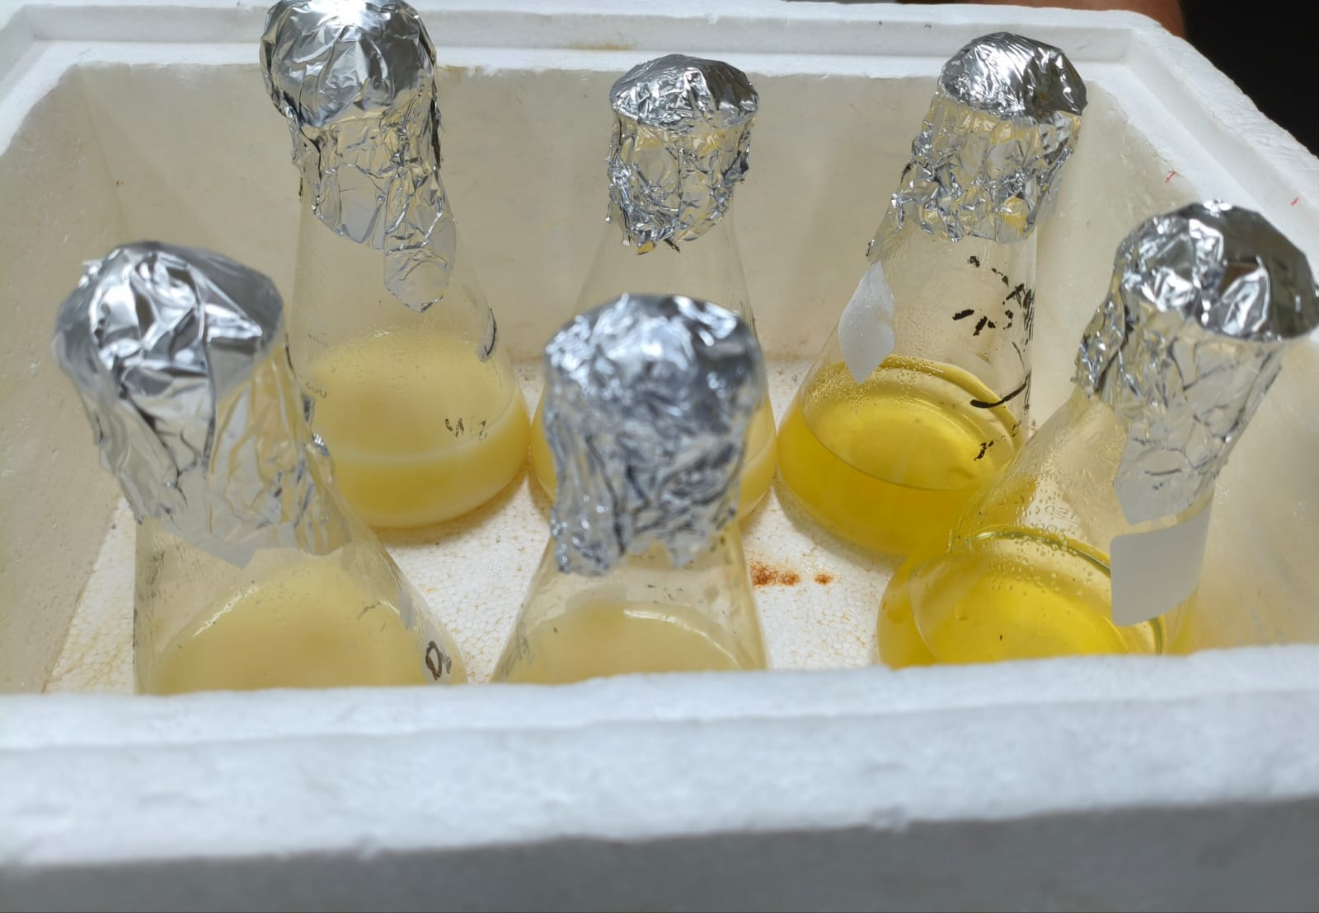
1
LA Production by Isolated LAB Strain
2
Covered media
Autoclave
Shaking Incubator

Slide 25
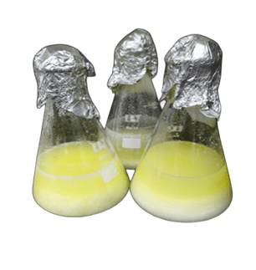
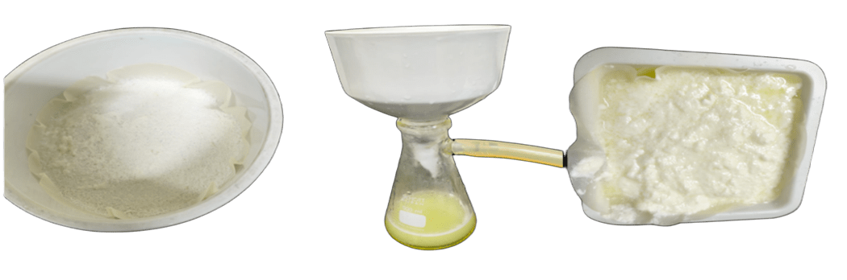
Cheese Whey Pre-Treatment
Heated cheese whey
Precipetated Protein removed by vacuum filtration.

Slide 26
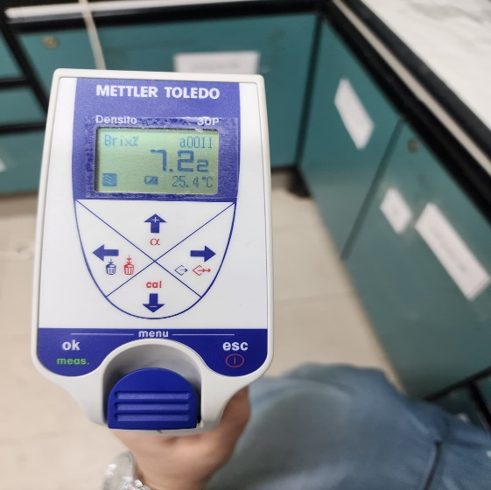

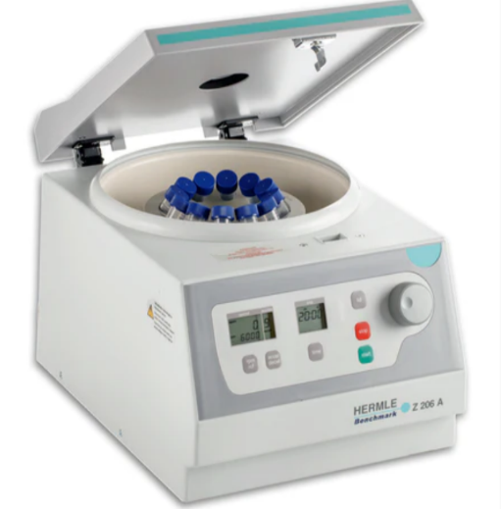
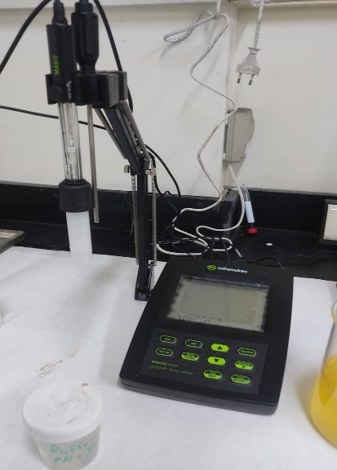
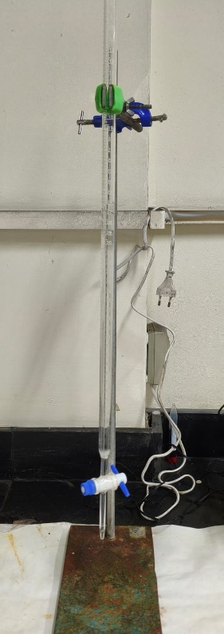
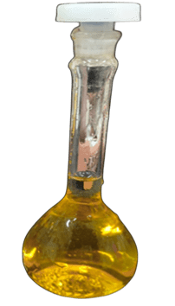
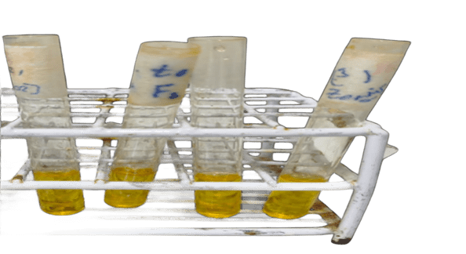
1
Sample Analysis
1
2
Centrifuged and pH
3
Sugar Content
Optical density
UV-Spectrophotometry
Centrifuge
Densometer
pH meter
A
B
UV-Spectrophotometry (390 nm)
Total Titratable Acidity (TTA)
4
Lactic Acid Determination
Iron (III) chloride solution

Slide 27
3
Result and Discussion

Slide 28
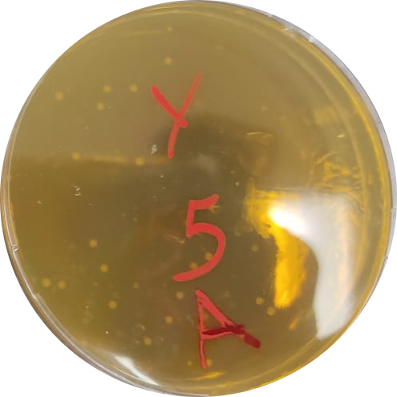
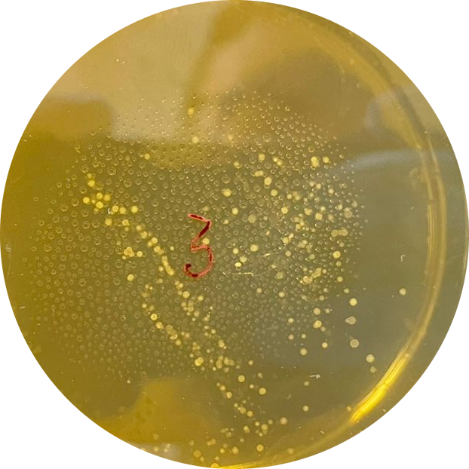
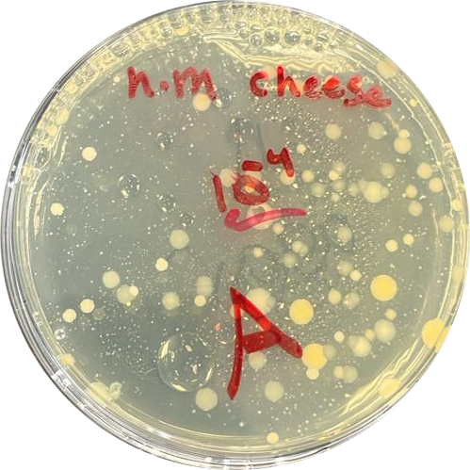
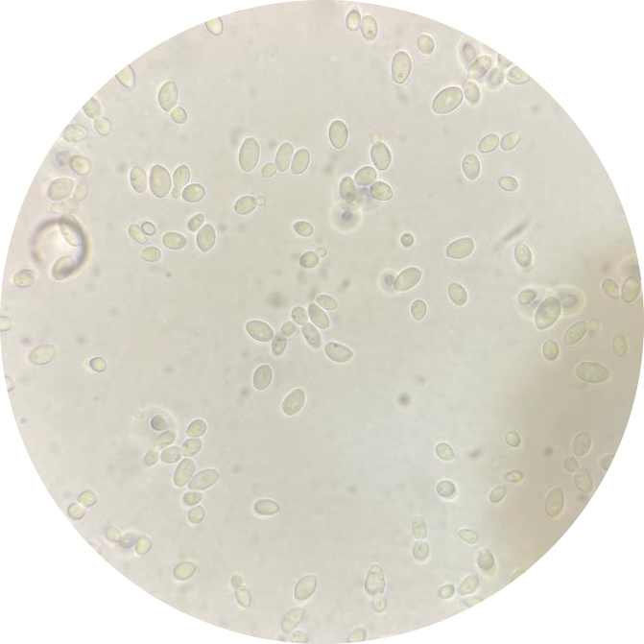

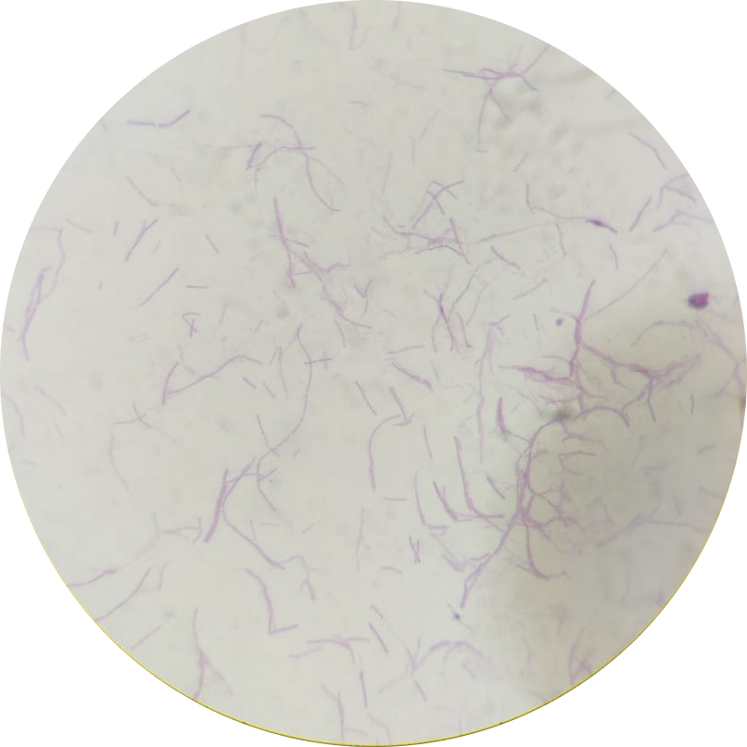
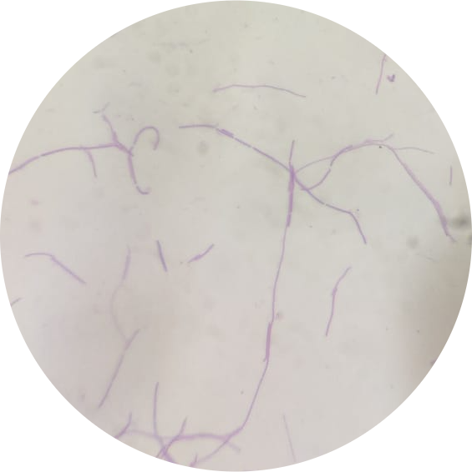
LAB Isolation Results
Yogurt
Cheese Whey
Labneh Whey

Slide 29
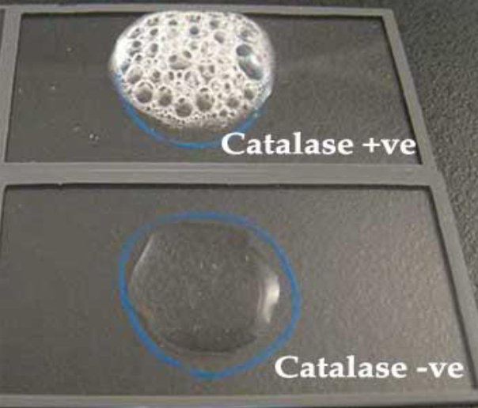
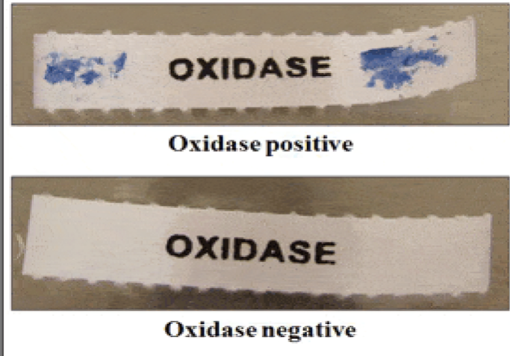
Biochemical Test Results
Catalase negative (no bubble )
Oxidase negative (no color change).
Its confirmed as lactobacillus.

Slide 30
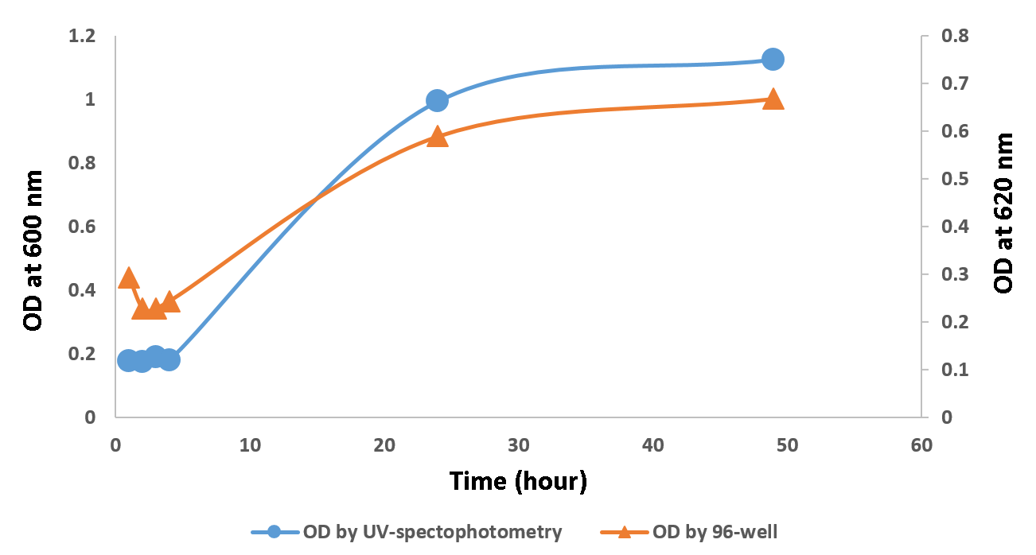
Growth Rate Results
Growth rate curve for LAB in MRS broth at 37°C.
This process presents a significant challenge because it is performed frequently due to contamination, which leads us to repeat the isolation process from the beginning.

Slide 31
LA Production by Mixed Culture Results
1
Effect of pH Adjustment on LA Production
Effect of Nutrient on LA Production
2
Effect of Nitrogen Source (Yeast & Peptone)
3
Effect of Protein on LA Production
4
5
Effect of Different Carbon Source

Slide 32
LA Production by Mixed Culture - Effect of pH Adjustment
To evaluate the influence of initial pH on LA production, labneh whey only was fermented at 37 °C for four days.
Two conditions were investigated: one with unadjusted pH (initially 3.17) and another with adjusted initial pH of 6.57.
labneh whey without adjusted the initial pH.
labneh whey with initial pH adjusted.

Slide 33
LA Production by Mixed Culture - Effect of pH Adjustment
The following Figure shows that lactic acid concentration with pH-adjusted labneh whey is more than LA concentration without pH adjustment. These findings are in agreement with prior research.

Slide 34
LA Production by Mixed Culture - Effect of Nutrients
Labneh Whey
Two experiments were conducted to evaluate the impact of nutrients on LA production, one with labneh whey adjusted to pH 6.7 and the other without pre-treatment, both at 37°C and observed for four days.
LA production using labneh whey without nutrients
labneh whey with nutrients.

Slide 35
LA Production by Mixed Culture - Effect of Nutrients
The following figure reveals that nutrient addition does not significantly improve lactic acid production in labneh whey, consistent with a previous study suggesting that the effectiveness of nutrient addition depends on the strain present in different types of whey.

Slide 36
LA Production by Mixed Culture - Effect of Nutrients
Cheese Whey
Cheese whey with nutrient.
Cheese whey without nutrients.

Slide 37
LA Production by Mixed Culture - Effect of Nutrients
As shown in the following Figure, Lactic acid production in cheese whey improved with nutrient addition and reached 35 g/L.

Slide 38
LA Production by Mixed Culture - Effect of Nitrogen Source (Yeast & Peptone)
To assess the effects of different nitrogen sources on lactic acid fermentation, Two experiments were conducted using cheese whey using yeast extract and peptone.
Cheese whey with yeast extract.
Cheese whey with peptone

Slide 39
LA Production by Mixed Culture - Effect of Nitrogen Source (Yeast & Peptone)
As shown in the following Figure, Lactic acid production by using cheese whey supplemented with yeast (35 g/L) was notably higher than with peptone (25 g/L).

Slide 40
LA Production by Mixed Culture - Effect of Protein
The effects of protein content on LA fermentation were assessed by comparing two experimental conditions: untreated cheese whey and treated cheese whey.
Untreated cheese whey
Treated cheese whey

Slide 41
LA Production by Mixed Culture - Effect of Protein
Enhanced performance of untreated cheese whey (25 g/L), as shown in the following Figure, which shows that whey protein improve LAB viability and Lactic acid production.

Slide 42
LA Production by Mixed Culture - Effect of Carbon Source
Three substrates, lactose, Labneh whey with pH adjustment to 6.7, and untreated cheese whey in order to assess the impact of carbon source on lactic acid production. Every fermentation was carried out at 37°C.
The following showed that lactose is fermentable, its limited nutrient profile restricts yield (9 g/L). In contrast, labneh whey (28 g/L) and cheese whey (22 g/L).

Slide 43
LA Production by Isolated LAB Strian Results
In order to assess the impact of carbon source on lactic acid production by isolated LAB strain. Three substrates, lactose, labneh whey, and treated cheese whey were fermentation at 37°C.
The following figure showed that labneh and cheese whey give the highest lactic acid production with concentrations of 30 and 29.6 g/L, respectively, which seems to support LAB fermentation more effectively than lactose (11 g/L).
5

Slide 44

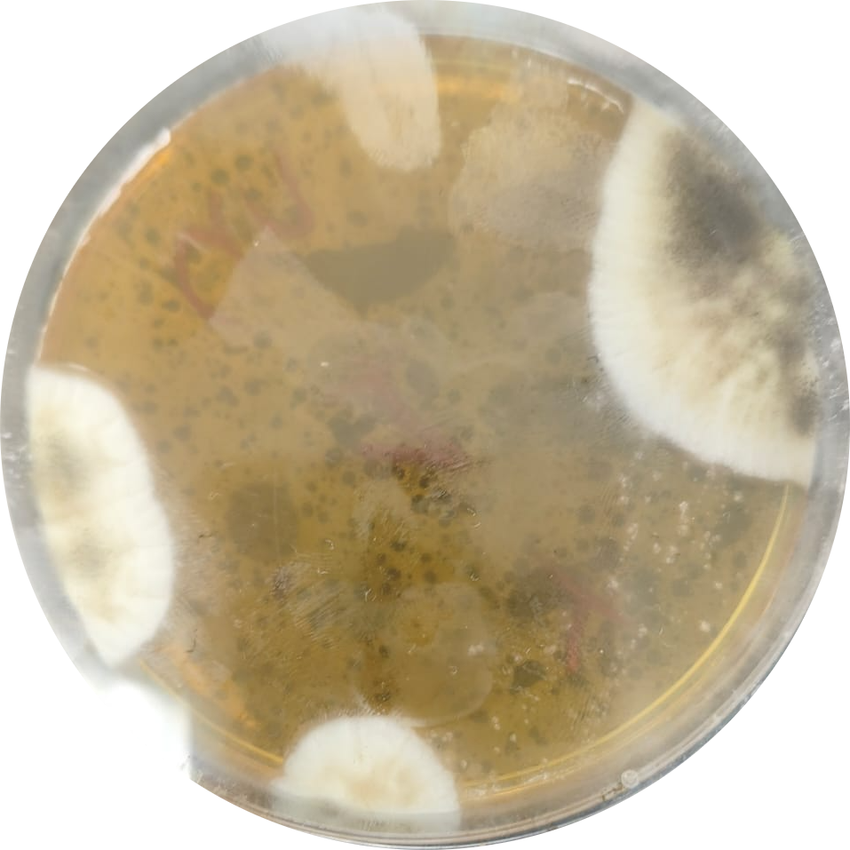

Limitations of LA Production by Isolated LAB Strain
Time Restrictions
The lack of techniques to identify the bacterial species isolated.
Contamination through Isolation and Production.

Slide 45
Glucose and Lactose Calibration Curve
To establish the relationship between Brix readings and glucose/lactose concentrations (g/L) using a calibration curve.

Slide 46
Lactic acid Calibration Curves via UV-Spectrophotometry and Titrimetric Analysis

Slide 47




Constraints
Economy
Operational
Sustainability
Policy

Slide 48
4
Scale Up and Economic Study

Slide 49
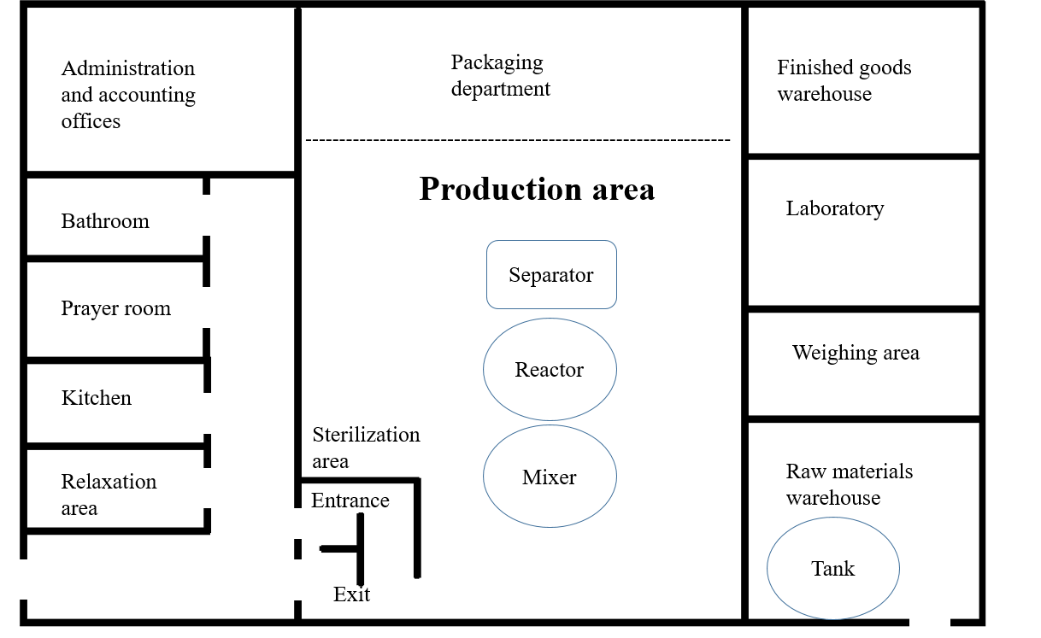
Lactic acid production plant layout

Slide 50
Production Assumptions :
Parameter | Value
Daily whey processed | 1 ton
Lactic acid yield per ton | 10 liters
Daily lactic acid production | 10 liters
Bottle size | 100 mL
Bottles per day | 100
Working days per year | 300 days (assumed)

Slide 51
Summary of Economic Calculation:
Fixed Costs | 58,140 ILS
Annual Variable Costs | 192,710 ILS
Total Annual Costs (Year 1) | 250,850 ILS
Annual Revenue | 450,000 ILS
Net Profit (Year 1) | 199,150 ILS
ROI (Year 1) | 342.5%

Slide 52
Conclusion
In this project, lactic acid production from dairy waste was evaluated and this study yielded the following:
Isolation
Identification
MRS agar & yogurt showed best LAB growth
Confirmed LAB via microscopic & biochemical tests.
Gram Staining
LAB were gram-positive.
Growth Rate
OD600 effectively tracked bacterial biomass.
Production
PH adj.
Calibration
Economic Study
Native whey Without Treatment worked well
Accurate acid/sugar quantification via validated curves.
ROI: 342.5%
Nutrients improved acid production differently.
Yeast Extract is the best nitrogen source
Labneh Whey is the best Carbon source
52

Slide 53
Recommendation
Its recommend pre-treating cheese whey to enhance fermentation, trying co-fermentation with alternative carbon sources, and using waste-derived nitrogen.
Applying biochemical assays, using analytical tools such as HPLC and exploring efficient methods for lactic acid separation and purification.

Slide 54

Any Question?.

Slide 55
Thank You!

