Slide 1

3-D Static Structural Design of Ajyad Building
An-Najah National University
Faculty of Engineering
Civil Engineering Department
Graduation Project II
Prepared By:
Mohammed wafiq omer
Mahmoud hammad
Abd Algani Sami
Malath omair

Slide 2
Presentation Outline
  Project Description.
  Design Determinants.
  3D- Modeling & Checks.
  Preliminary Design.
  Static Design.
  Slabs.
  Beams.
  Columns.
  Shear walls.
  Footings.
  Seismic design

Slide 3
Project Description
This project is a structural analysis and design of “Ajyad” building which lies in “Nablus city – Beit Wazan”. The building consists of seven floors and will be used as residential building. with a total area of 2940 m² and an area for each floor of 420 m²

Slide 4
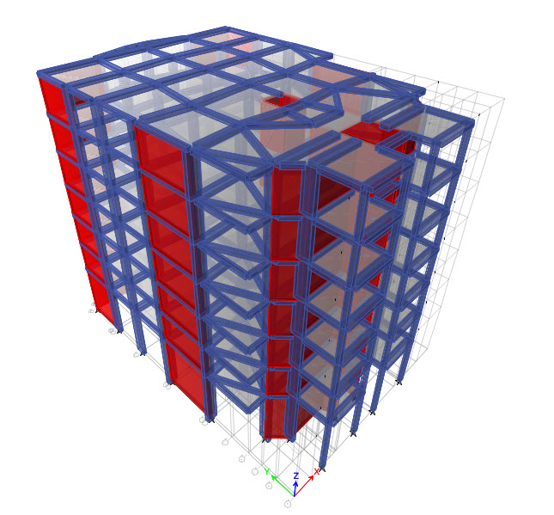

Slide 5
Design Determinants
Materials
  Concrete:
  the compressive strength f_{c} = 28 Mpa.
  The unit weight of the concrete is 25kN/m3.
  Steel:
  Steel yielding strength f_{y} = 420 Mpa.
  modulus of elasticity (E) of 200Gpa.
  Soil:
  Soil bearing capacity is 250 kN/m2 .

Slide 6
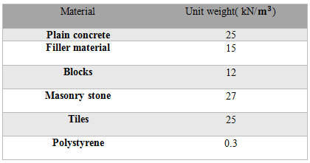
Design Determinants
Materials
Non – structural material
Elements with the following unit weights:

Slide 7
Design Determinants
Loads
Loads are divided into two categories, gravity and lateral.
A- For gravity loads:
1. Dead loads:
Own weight of structural elements.
Superimposed dead load (S.I.).
Which is the own weight of non-structural elements such as the weight of partitions, mortar, tiles, filler under the tile sand plaster.
Partitions Weight = weight of all partition wall / area of floor = 1 kN/
S.I. = partitions weight +mortar +tiles +filler +plaster.
=1kN/ + 0.03*25+0.02*23+0.1*18+0.015*23 = 4.355 KN/m²

Slide 8
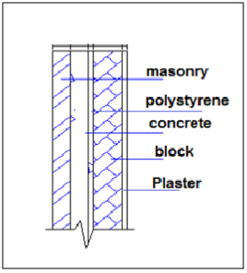
Design Determinants
Loads
Wall weight.
Wall weight = weight of masonry stone + weight of plain concrete +
weight of polystyrene+ weight of block +weight of plaster.
Wall weight = 3.0*(0.015(23)+0.1(12)+0.02(0.3)+0.13(23)+0.05(27))
=17.7KN/m

Slide 9
Design Determinants
Loads
Live load:
This type of load results from the use and occupancy weights.
Our structural model is residential, so we have a uniform live load for the structure .
According to IBC-2009/sec.1607/table 1607.1, we will take a live load for the residential buildings as:
Residential : 2.5 kN/

Slide 10
Design Determinants
Codes
In order to determine the required loads and structural elements dimensions, the structure is designed using practicecodes and specifications that control the design process.
These codes are:
ACI 318-08 : American Concrete Institute provisions for reinforced
concrete structural design.
IBC-2009: International Building Code.
UBC-1997: Uniform Building Code.

Slide 11
Design Determinants
  Load combination:
The ultimate design method is used in this project. In this method, different load factors are used for different types of loads.
According to "ACI 318-08 9.2.1" The load factors (combinations) are:
Wu=1.4 D
Wu=1.2 D +1.6 L
Wu=1.2D.L +1.0L.L ±1.0E
Wu=0.9 D ±1.0 E
Where:
D: Dead load.
L: Live load.
E: Earthquake load.

Slide 12
Design Determinants
Computer Programs:
ETABS (13.1.5) : this program is used to analyze and design the structural elements.
AutoCAD: this program is used to draw structural details.

Slide 13
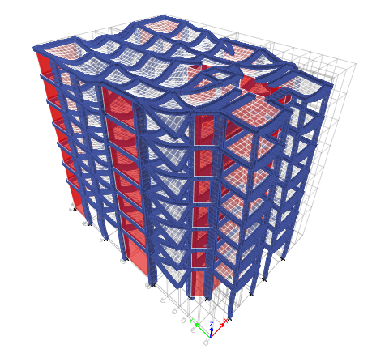
3D-Modeling & Checks
Compatibility:
The structure works as one unit is verified.

Slide 14
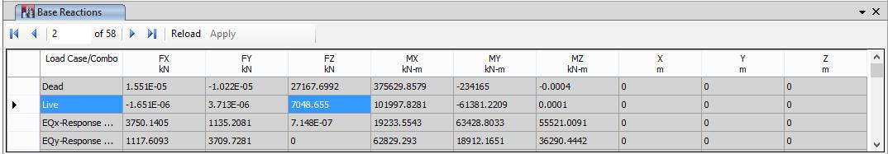

3D-Modeling & Checks
Check for Equilibrium:

Slide 15
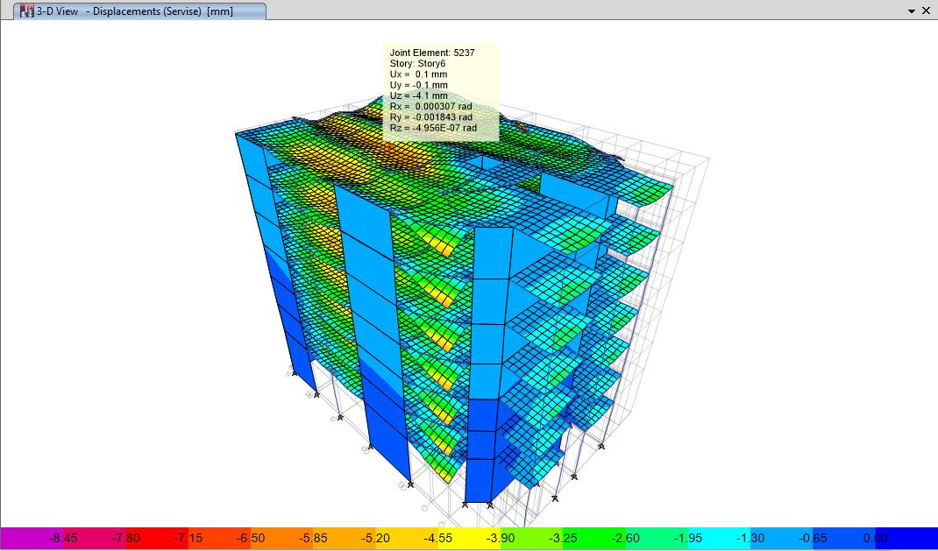
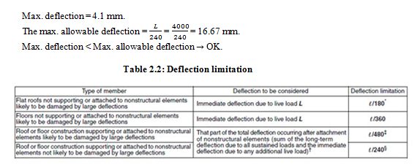
3D-Modeling & Checks
Check for Deflection:

Slide 16
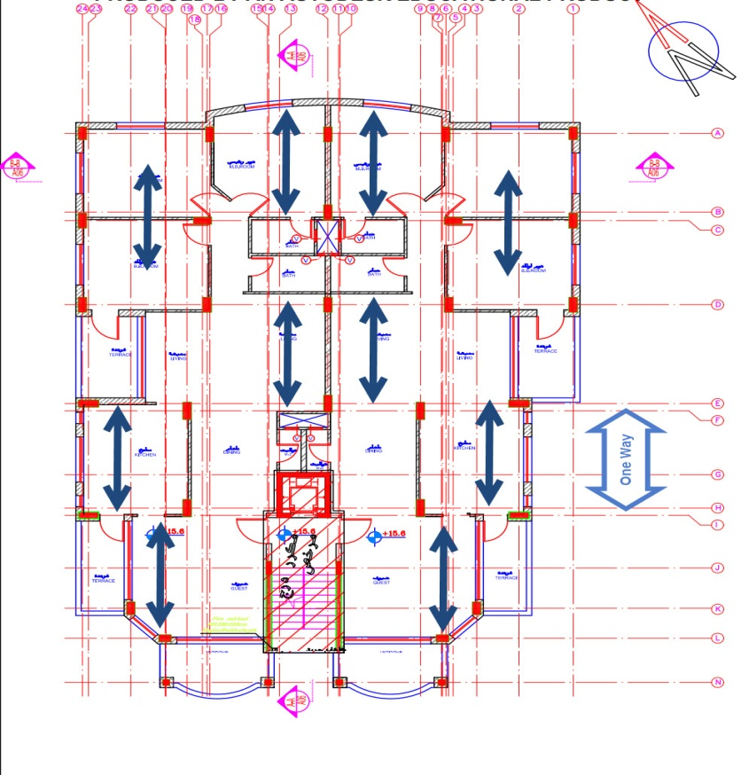
Preliminary Design of Slabs
  The structural system used is one way ribbed slab with main beams in X-direction and secondary beams in Y-direction.

Slide 17
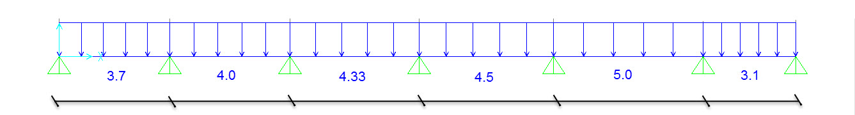
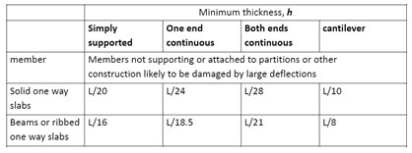
Preliminary Design of Slabs
2.3.1 Slab Analysis and Design:

Slide 18
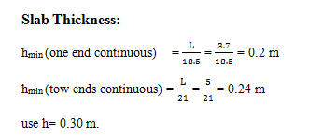
Preliminary Design of Slabs

Slide 19
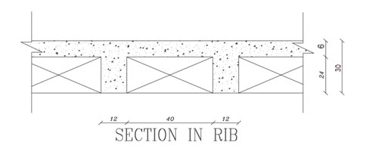
Preliminary Design of Slabs
The section dimensions for the ribbed slab are shown in figure 2.3.
According to ACI code:
b_{w}= 120 mm ≥ 100mm
h = 300 mm ≤ 3.5 b_{w}=3.5X120=420 mm.
S = 400 mm ≤ 750mm.
h_{f} = 60 mm ≥ 50mm.
≥S/12=400/12=33.33 mm.
➔ Rib dimensions are OK

Slide 20
Preliminary Design of Slabs
W_{u} for one way slab:
_{block} = 12 kN/m³
Own weight/rib = [(0.52*0.06)+(0.12*0.24)]*25 +(0.4*0.24*12)= 2.65 kN/rib
Own weight/m² = 2.65/0.52 = 5.1 kN/m².
W_{u} = 1.2 DL + 1.6 LL
= 1.2 (5.1+3.36) + 1.6 (2.5)
= 14.32 kN/m².
W_{u}/rib = 14.32X0.52 = 7.446 kN/m/rib.

Slide 21
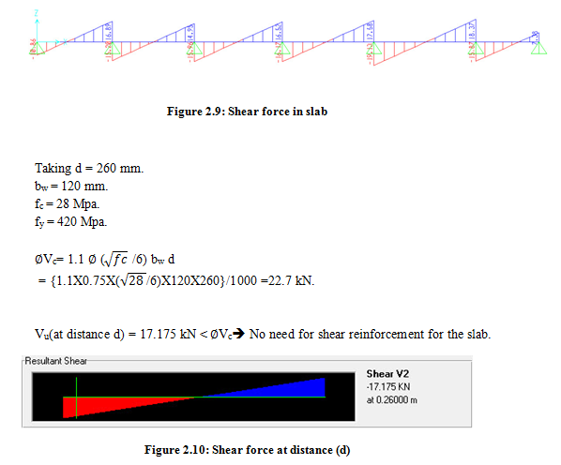
Preliminary Design of slab
Shear Analysis and Design:

Slide 22
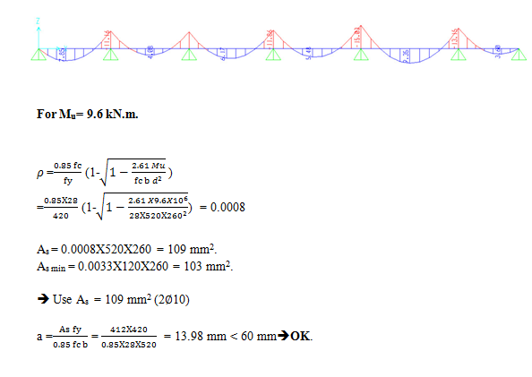
Preliminary Design of slab
Flexure Analysis and Design:

Slide 23
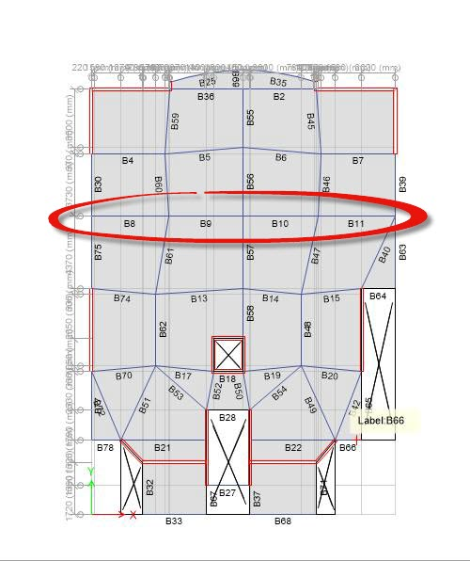
Preliminary Design of Beams
Beam Analysis and Design:

Slide 24
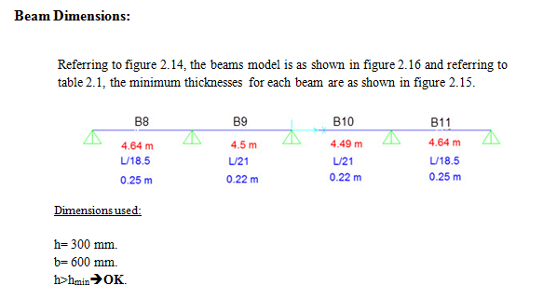
Preliminary Design of Beams

Slide 25
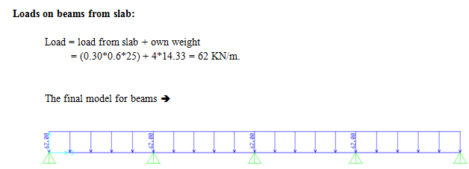
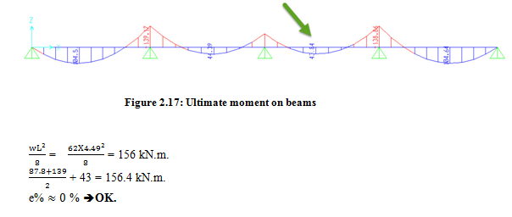
Preliminary Design of Beams

Slide 26
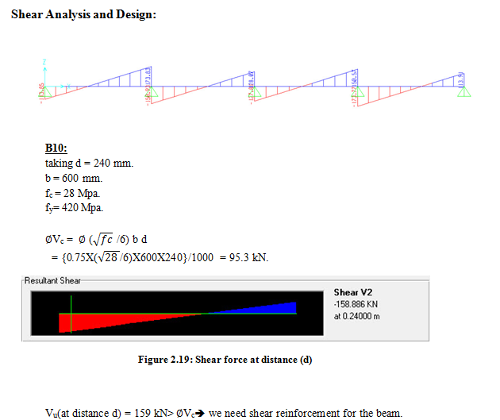
Preliminary Design of Beams

Slide 27
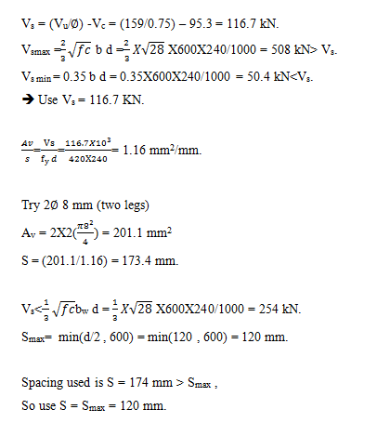
Preliminary Design of Beams

Slide 28
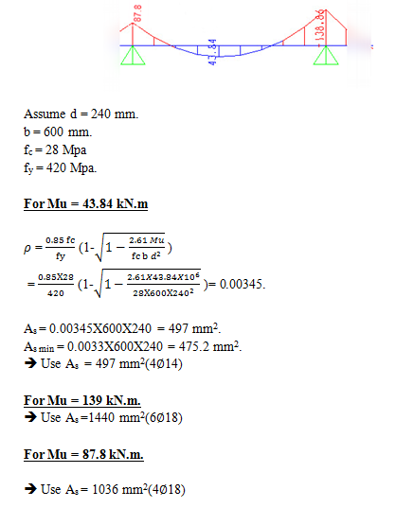
Preliminary Design of Beams

Slide 29
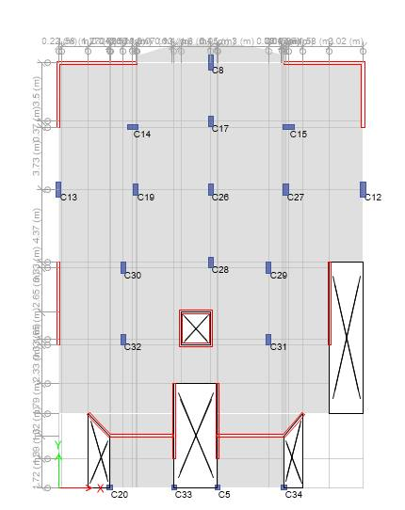
Static Design/Columns
Design is made for the bottom floor columns according to the subjected loads on them which are:
Axial force.
Bending moment.

Slide 30
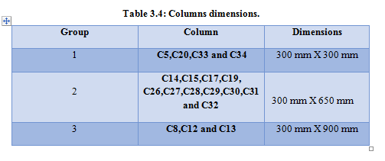
Static Design/Columns

Slide 31

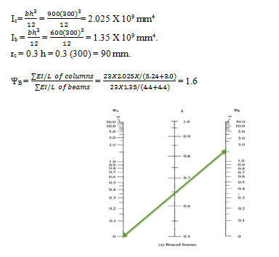
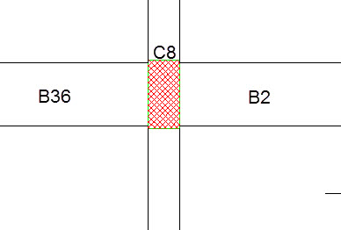
Static Design/Columns
Check Slenderness

Slide 32
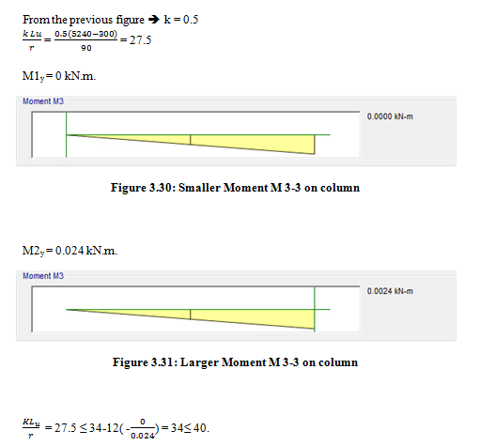
Static Design/Columns

Slide 33
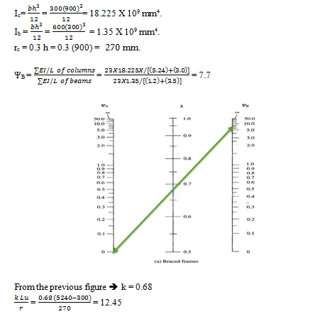
Static Design/Columns

Slide 34
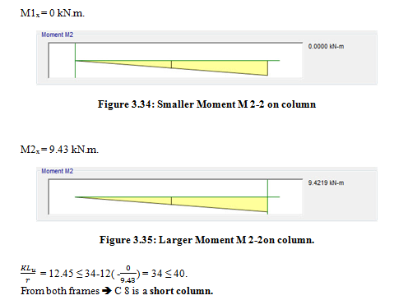
Static Design/Columns

Slide 35
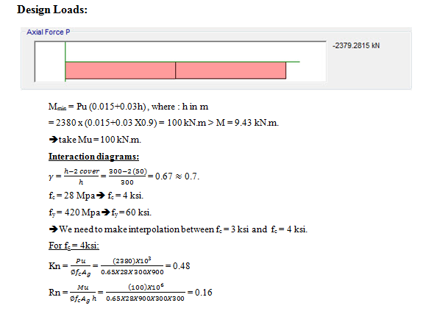
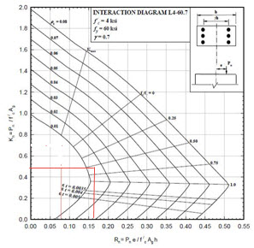
Static Design/Columns

Slide 36
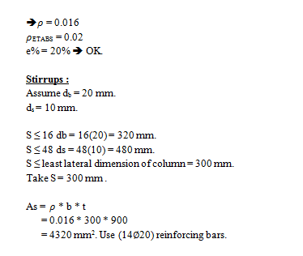
Static Design/Columns

Slide 37
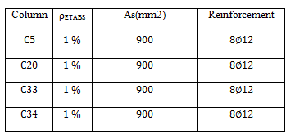
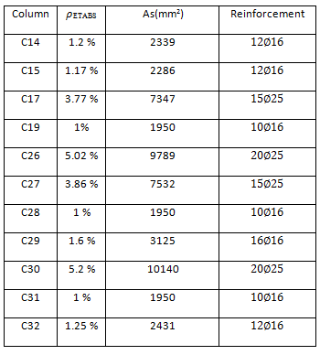
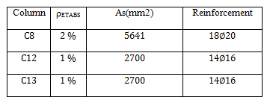
Static Design/Columns

Slide 38
Static Design/Footings
The main function for footing is to carry the whole loads from columns and distribute it over a larger area on the ground.
In this Project we decided to use a Single footing Type due to main reasons:
Firstly, The Bearing Capacity (qall) of the soil is 250 kN/m2.
secondly, The Ultimate Moments on the footing is negligible as we compare it with the axial loads.

Slide 39
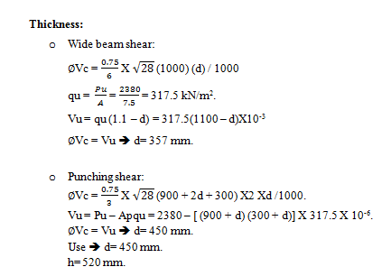
Static Design/Footings
Taking footing F6 Column #8 to be calculated:
column dimensions(30*90)cm.
to get the area of the footing, assume (M=0).
q_{all} = 250 kN/m².
Pu = 2380 kN.

Slide 40
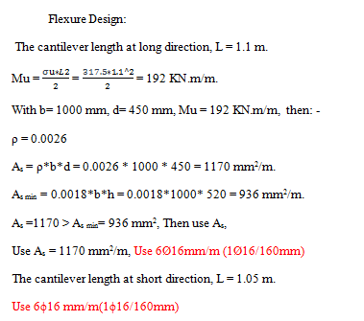
Static Design/Footings

Slide 41
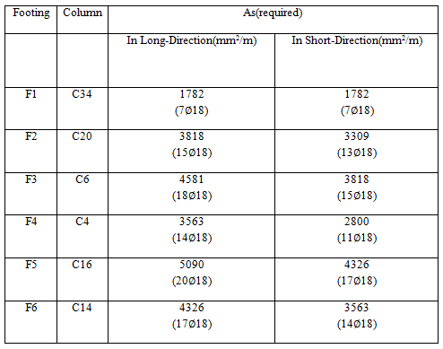
Static Design/Footings

Slide 42
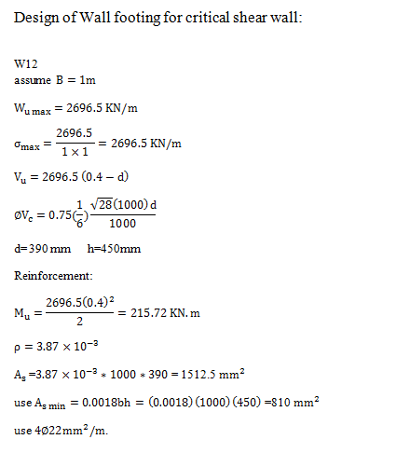
Static Design/Footings

Slide 43
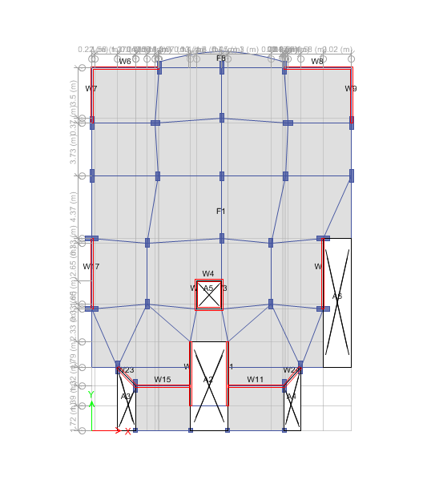
Static Design/Footings

Slide 44
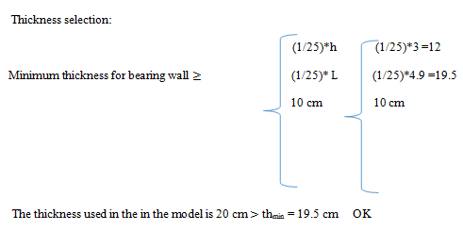
Static Design/Footings

Slide 45
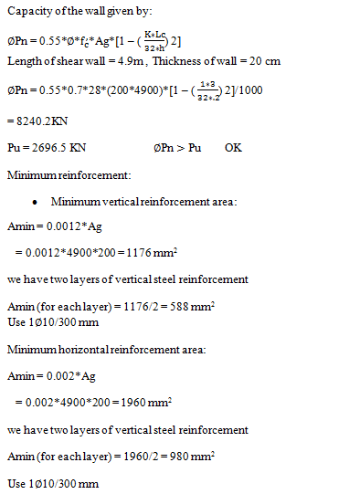
Static Design/Footings

Slide 46
Seismic Analysis
A. Equivalent static method
B. Dynamic analysis
a) Response spectrum analysis
b) Time history analysis

Slide 47
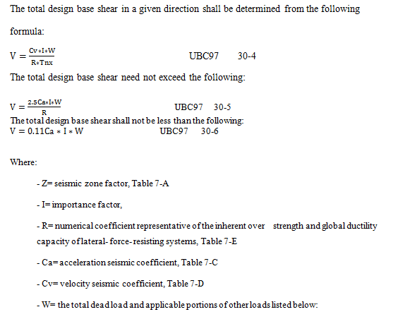
Seismic Analysis

Slide 48
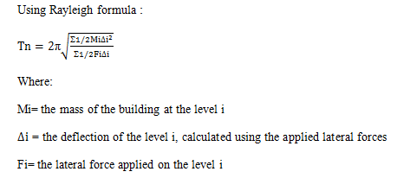
Seismic Analysis
Structural period
Using Rayleigh formula , structural properties and deformational characteristics

Slide 49
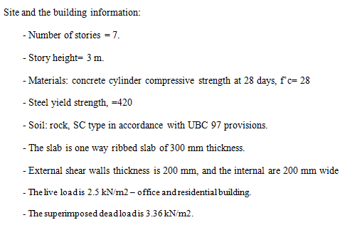
Seismic Analysis

Slide 50
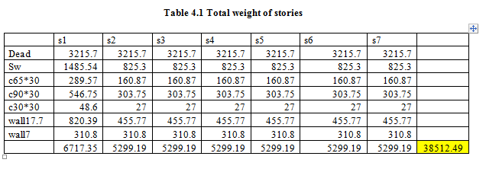
Seismic Analysis
Dynamic analysis:

Slide 51
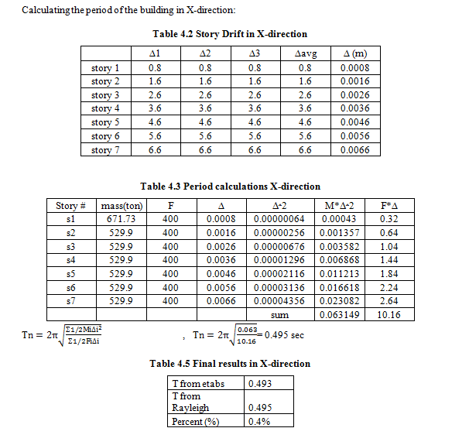
Seismic Analysis

Slide 52
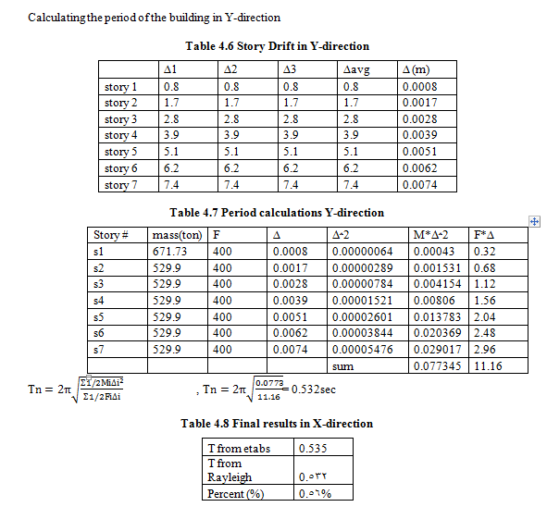
Seismic Analysis

Slide 53
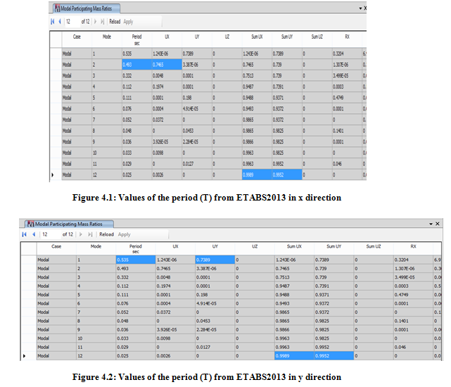
Seismic Analysis

Slide 54
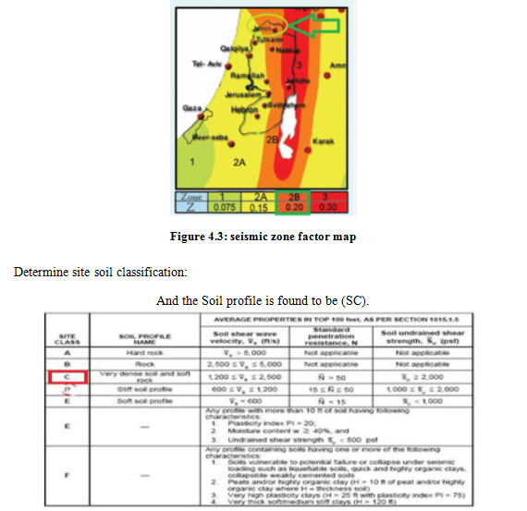
Seismic Analysis

Slide 55
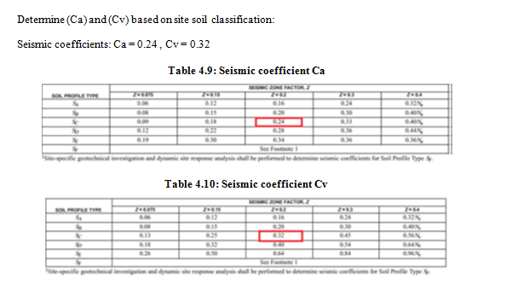
Seismic Analysis

Slide 56
Seismic Analysis

Slide 57

Seismic Analysis

Slide 58

Seismic Analysis

Slide 59

Seismic Analysis
Initial base shear from etabs

Slide 60

Seismic Analysis
Final base shear from etabs

Slide 61

Seismic Analysis

Slide 62
Seismic Analysis
Determine the distribution of base shear and calculation the internal forces:
Distribution of base shear
STORY | Hx | Wi(KN) | Wi*hx | Cvx | Fx manual | sum | Fx etabs | percent%
0 | 0 | 0 | 0 | 0 | 0 |  | 0 | 0
1 | 5.4 | 671.73 | 3627.342 | 0.06695 | 281.04706 | 4197.86 | 4282.85 | -1.98443
2 | 8.4 | 529.9 | 4451.16 | 0.082155 | 344.87661 | 3916.8129 | 4032.343 | -2.86509
3 | 11.4 | 529.9 | 6040.86 | 0.111497 | 468.04683 | 3571.9363 | 3670.08 | -2.67415
4 | 14.4 | 529.9 | 7630.56 | 0.140838 | 591.21705 | 3103.8895 | 3175.925 | -2.26818
5 | 17.4 | 529.9 | 9220.26 | 0.170179 | 714.38727 | 2512.6725 | 2549.878 | -1.45911
6 | 20.4 | 529.9 | 10809.96 | 0.19952 | 837.55748 | 1798.2852 | 1791.94 | 0.354102
7 | 23.4 | 529.9 | 12399.66 | 0.228861 | 960.7277 | 960.7277 | 902.109 | 6.497962
 |  |  | 54179.8

Slide 63

Seismic Analysis
Check drift, P– Δ effect, diaphragm design:

Slide 64

Seismic Analysis

Slide 65

Seismic Analysis

Slide 66
Thank You All
for your attention
☺

