Slide 1
Graduation Project
Mechanical system for Building of_ al Kuwait Surgery Specialized Hospital

Slide 2
Supervised By: Dr. Ahmad Alramahi
prepared by:
Mohammad khaliliah
Abedelrahman sabha
Mohammad quzmar
Adnan neis
Fadi mana'a

Slide 3
Project-abstract
Al-Kuwaiti specialized hospital which sits in Ramallah Palestine consists of six floors. contain two basement floors, ground floor first floor and second floor. There are different room types inside this hospital such as, operation rooms, patient's room, I.C.U. area, recovery room, store rooms, emergency rooms, delivery rooms, laboratory, X-ray and laser sessions, staff lounge waiting rooms, offices, locker rooms, nurse stations, wards, secretary rooms, halls, cafeteria, and kitchens, pharmacy. The main aims of our project is to design proper heating , ventilation and air conditioning system (HVAC) include F.C.unit, A.H.unit, in addition firefighting system, plumping system , drainage system and elevators system.
Mechanical system provides comfortable and clean healthy environments free of germs and diseases that could harm the patient and the people inside the hospital; to do so many requirements must be taken in the building structure.

Slide 4
The HVAC system provides appropriate adjustment of temperatures and moisture in absent of adores, it is able to purify the air inside the building so that the inside atmosphere is suitable and healthy for patient. In addition suitable inside atmosphere protects the hospital devises and make then give accurate results.
In this project fire alarm system and firefighting system is to be designed to keep the hospital safe from fire, this system is very essential to provide early detection of the fire and to extinguish it in its initial stages. Water services and plumbing system design is also required, the availably of water service system inside the building with hot and cold water together with a proper drainage system prevent the hazard of leakage and pollution. Furthermore, proper system if medical gasses and elevators are to be designed.

Slide 5
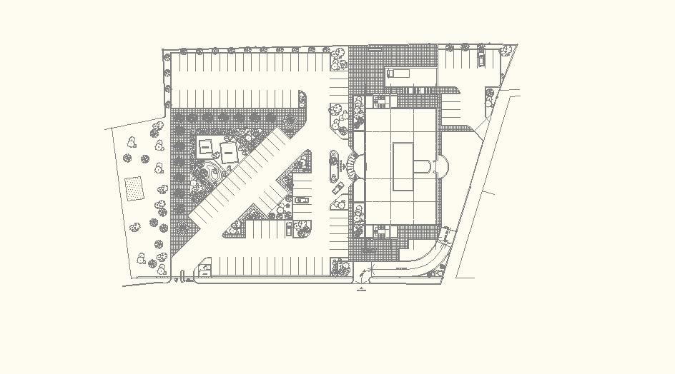
N
Top view of the Hospital

Slide 6
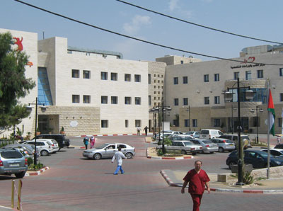

Slide 7
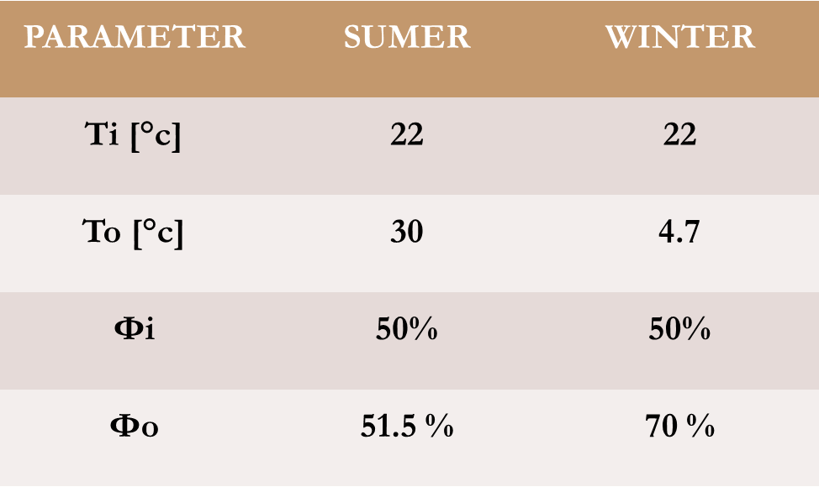
Description of the building
As we mentioned earlier the project consists of six floors
              1. Location :
              Country: Palestine / west bank.
              City: Ramallah.
              Street: moveimbic hotel street
              Elevation: 940 m above sea level.
              Latitude: 32 N.
              Longitude: 35 E.
              Wind’s speed in Ramallah
              is about 5 m/s above,(Northwest).
2. Inside and outside design condition

Slide 8
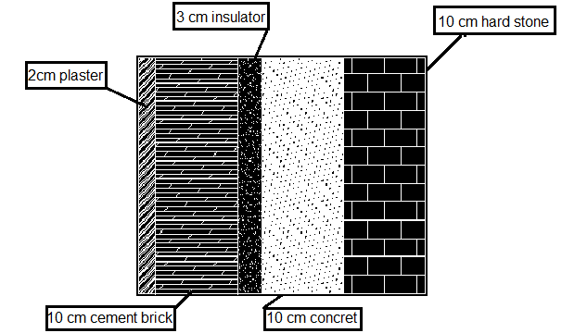
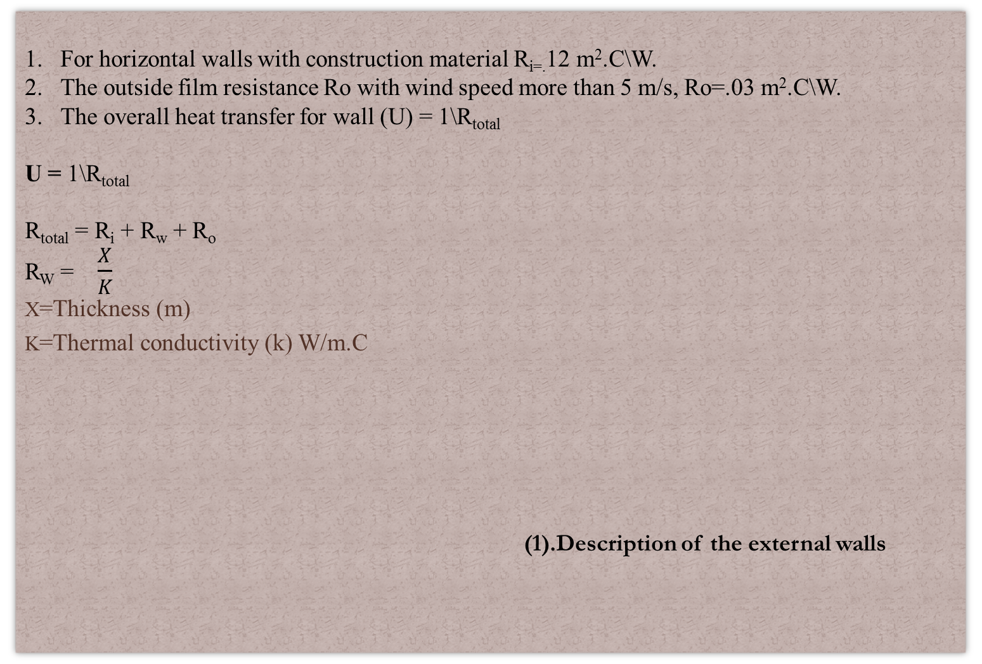
Details of the construction
For horizontal walls with construction material R_{i=.}12 m².C\W.
The outside film resistance Ro with wind speed more than 5 m/s, Ro=.03 m².C\W.
The overall heat transfer for wall (U) = 1\R_{total}
U = 1\R_{total}
R_{total}= R_{i} + R_{w}+ R_{o}
R_{W} = $\frac{X}{K}$
X=Thickness (m)
K=Thermal conductivity (k) W/m.C
(1).Description of the external walls

Slide 9
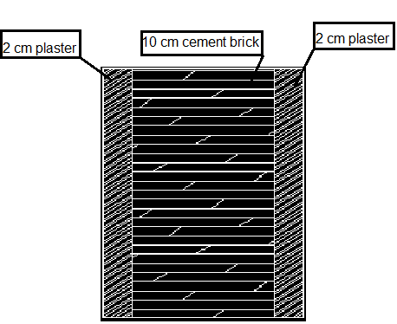
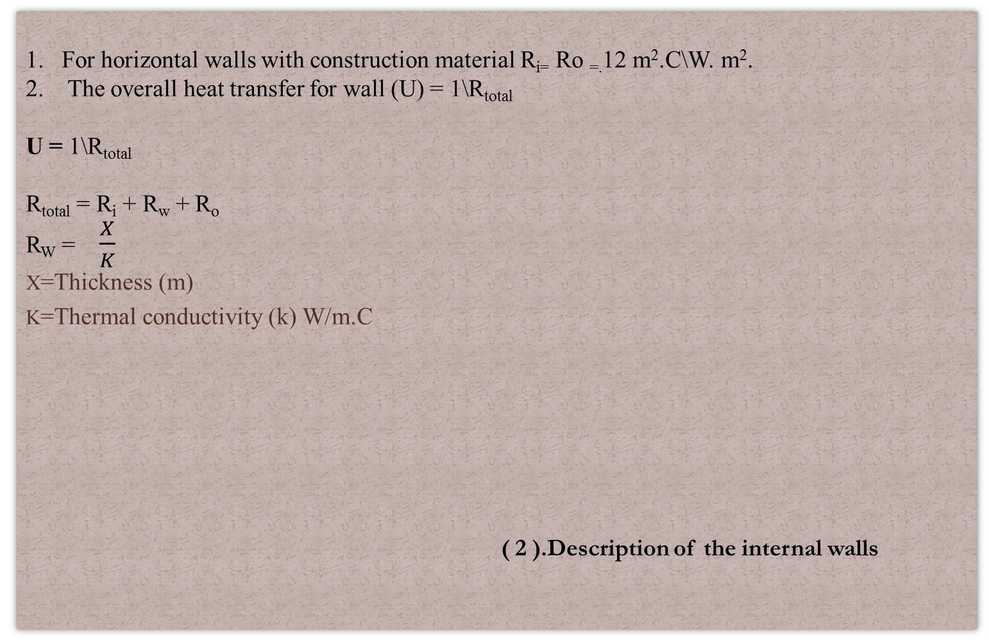
Details of the construction
For horizontal walls with construction material R_{i=} Ro _{=.}12 m².C\W. m².
The overall heat transfer for wall (U) = 1\R_{total}
U = 1\R_{total}
R_{total} = R_{i} + R_{w} + R_{o}
R_{W} = $\frac{X}{K}$
X=Thickness (m)
K=Thermal conductivity (k) W/m.C
( 2 ).Description of the internal walls

Slide 10
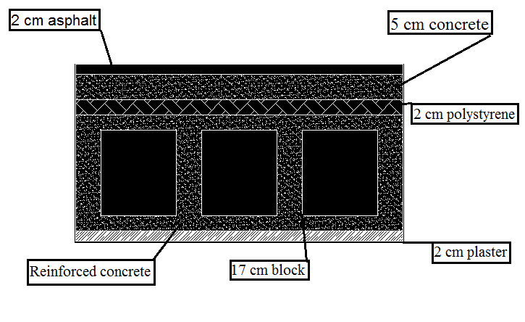
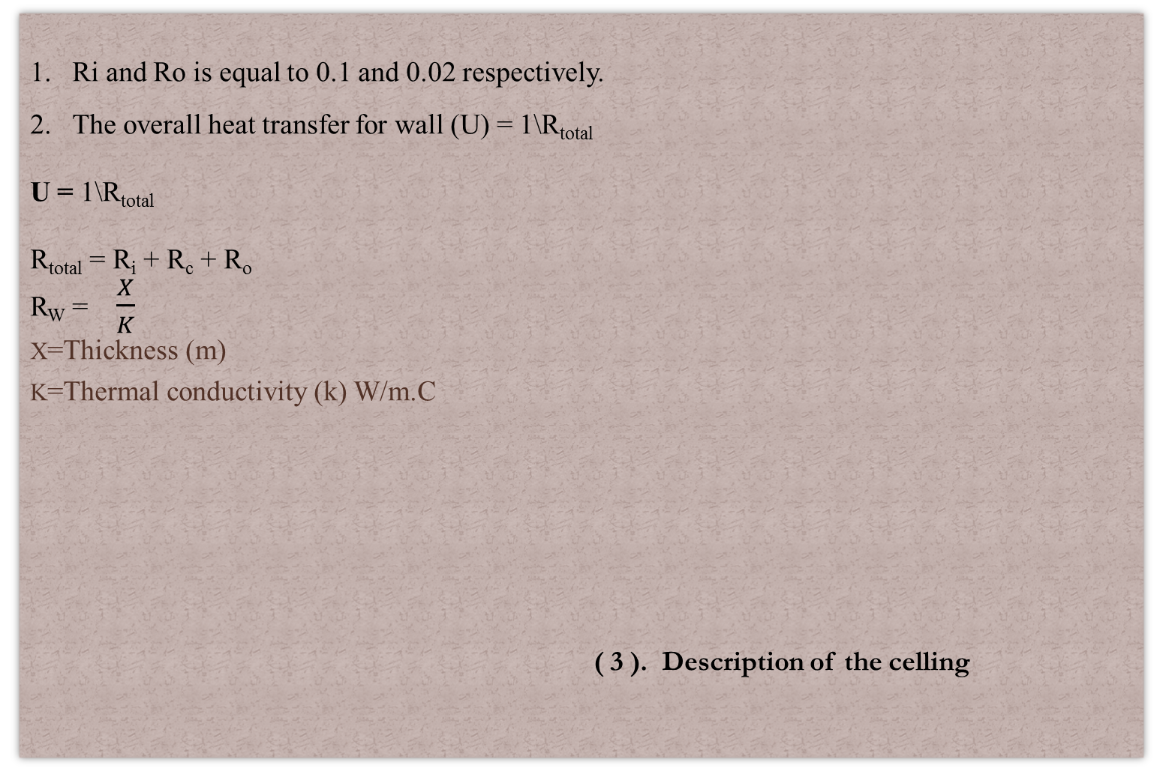
Description for cellin
Ri and Ro is equal to 0.1 and 0.02 respectively.
The overall heat transfer for wall (U) = 1\R_{total}
U = 1\R_{total}
R_{total} = R_{i} + R_{c}+ R_{o}
R_{W} = $\frac{X}{K}$
X=Thickness (m)
K=Thermal conductivity (k) W/m.C
( 3 ). Description of the celling

Slide 11
HVAC System
Heat loss from the building
Floor | Heating load (kw)
Second floor | 48.80645281
First floor | 28.85421003
Ground floor | 51.60051081
Basement one | 59.4621061
Basement tow | 32.32649056
Total | 221.0487

Slide 12
Heat equation
Sample Calculation Of Heat Loss From The First Room
                Total loss (KW) =Qscond+Qsvent
Q _{total.} _{s.cond} = Q _{outside wall} + Q _{ceiling} +Q _{inside wall}
Q v_{sensible} = 1.2 X V_{entilation} X ∆T
Over All Coefficient
block wall | 2.4259
Outer wall | 0.8634
Window | 3.5
Door Steel | 5.8
Door Wood | 3.5
Celling | 0.8379
Floor | 1.0525

Slide 13
HVAC System
Cooling heat gain from the building
Floor | Heating load (kw)
Second floor | 95.8082
First floor | 138.366
Ground floor | 94.912601
Basement one | 166.122
Basement tow | 76.8526
Total | 572.052

Slide 14
HVAC System
`
over all heat coefficient(u)
inerr wall | 2.4259
outer wall | 0.8634
celling | 0.8379
window glass | 3.5
floor | 1.0525
wood door | 3.5
steel door | 5.8
with false ceiling | 0.699
 |  | الرطوبة
Tin | 22 | 50%
Tout | 30 | 52%
Tuc | 27.333
`
CLTD correct for wall and ceiling
wall direction | CLTD | LM | K | CLTD corect
north | 6 | 0.5 | 0.83 | 9.495
east | 14 | 0 | 0.83 | 15.72
south | 9 | -2.2 | 0.83 | 9.744
west | 8 | 0 | 0.83 | 10.74
from | table 9-4 | table 9-2 | medium
ceiling | 17 | 1.1 | 0.5 | 13.15
Wi | `
Wo | 20.8
(SHG)*(SC)*(CLF)
wall direction | SHG | SC | CLF | Result
North | 139 | 0.9 | 0.7 | 87.57
East | 675 | 0.9 | 0.24 | 145.80
South | 189 | 0.9 | 0.43 | 73.14
west | 675 | 0.9 | 0.49 | 297.68
CLTD correct for window
wall direction | CLTD | LM | K | CLTD corect
North | 8 | 0 | 1 | 12.1
East | 8 | 0 | 1 | 12.1
South | 8 | 0 | 1 | 12.1
west | 8 | 0 | 1 | 12.1

Slide 15
HVAC System
Cooling equation
  (CLTD)corr (conv)=CLTD + (25.5 – Ti) + (To – 29.4)
  Qs _{Ceiling+wall} = (CLTD) _{corr}X U X A
  Qs _{transmit window}= A X SHG X SC X CLF
  Qs _{convection window}= A XCLTD correct X U
  Q_{SPeople} = q_{s}X CLF X n
  Q_{SVent} = 1.2 X V X ∆T
  Q_{Lvent} = 3 X V X∆w
  Q_{S Equipment} = qs *CLF

Slide 16
HVAC System
Cooling equation
QS Equipment = qs *CLF
QS Light = area X qs X CLF
Qtotal =
Qwall,window+Qpeople(s+l)+Qventlation(s+l)+Qequipment+Qligh

Slide 17
Duct Design
Design procedures
1. The total sensible heat of room is calculated.
2. The Vcirculation of floor is calculated.
3. The flow rate (CFM) is calculated.
4. Number of diffusers are calculated and distributed uniformly.
5. The initial velocity for the main duct must ≤ 5 m/s.
6. The pressure drop is depend on the initial velocity for the main
duct and flow rate (CFM).
7. The main diameter is calculated.
8.The height and width of the rectangular ducts are determined from the duct program

Slide 18
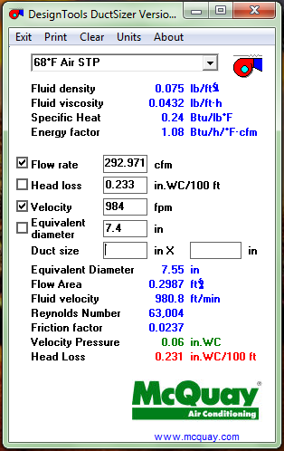
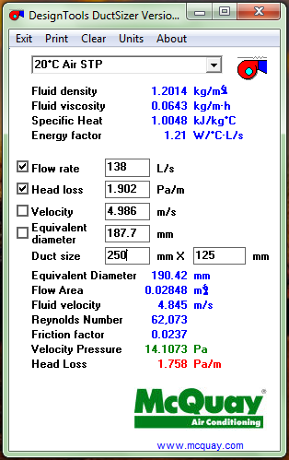
Duct Design

Slide 19
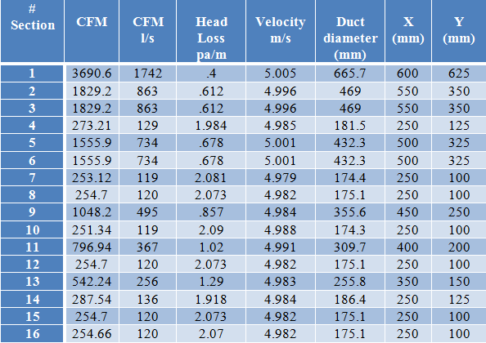
Duct Design
CFM = V_{circulation} X 2.2 X1000
Speed = 5 m/s

Slide 20
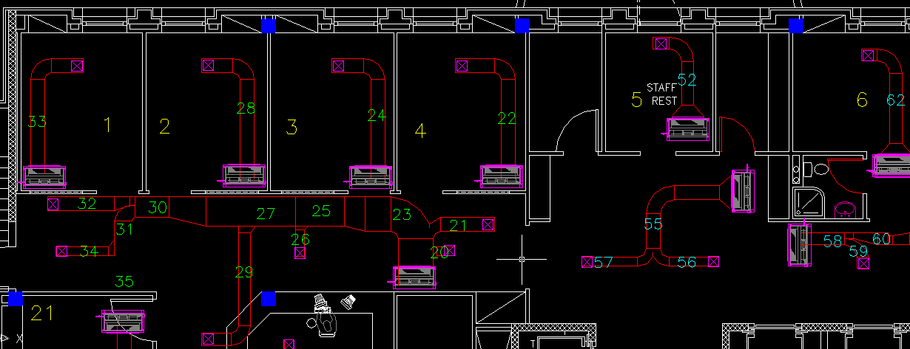
Duct Design

Slide 21
Plumping System hot&cold water
Total demand water :
For second floor
Pipe sizing for one bathroom
Demand Water L/s | Totally Fixture Unit | Type Of Supply Water
5.71 | 202 | Cold
3.7 | 72 | Hot
 | #Fixture Unit | Pipe size | Flow rate l/s
One collector | 14.5 | 1 (1/4)" | 1.14
Main pipe | 202 | 2(1/2)’’ | 5.71

Slide 22
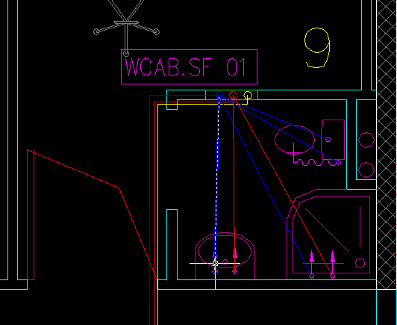
Plumping System hot&cold water

Slide 23
Plumping System
Drainage Water
Type of fixture and diameter for second floor
number of fixture unit
Type of Fixture | Diameter
W.C | 4"
Lavatory | 2"
Sink Service | 2"
Shower | 2"
Floor drain | 4"
Type of Fixture | No. F.U
W.C | 4
Lavatory | 1
Sink Service | 2
Shower | 2
Floor drain | 6

Slide 24
Plumping System
Drainage Water
Diameters and Total F.U For stack for all units second Floor
Riser | Total F.U For stack | Vertical pipe diameter Stack))
A | 120 | 4"
B | 73 | 4"
C | 25 | 2 "
D | 37 | 2 "

Slide 25
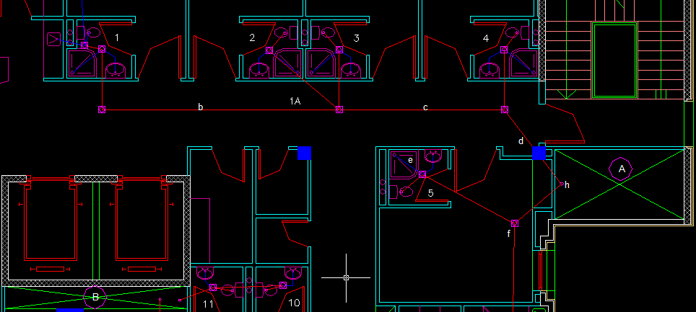
Plumping System
Drainage Water

Slide 26
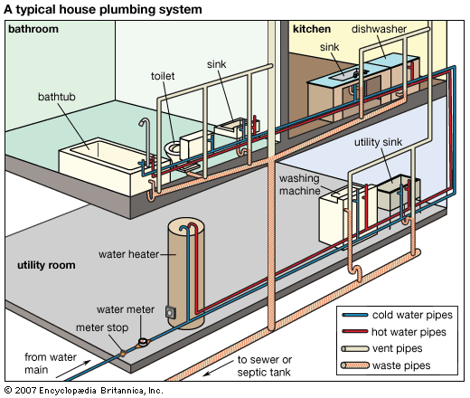
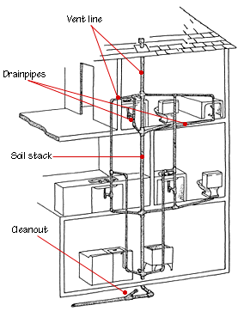
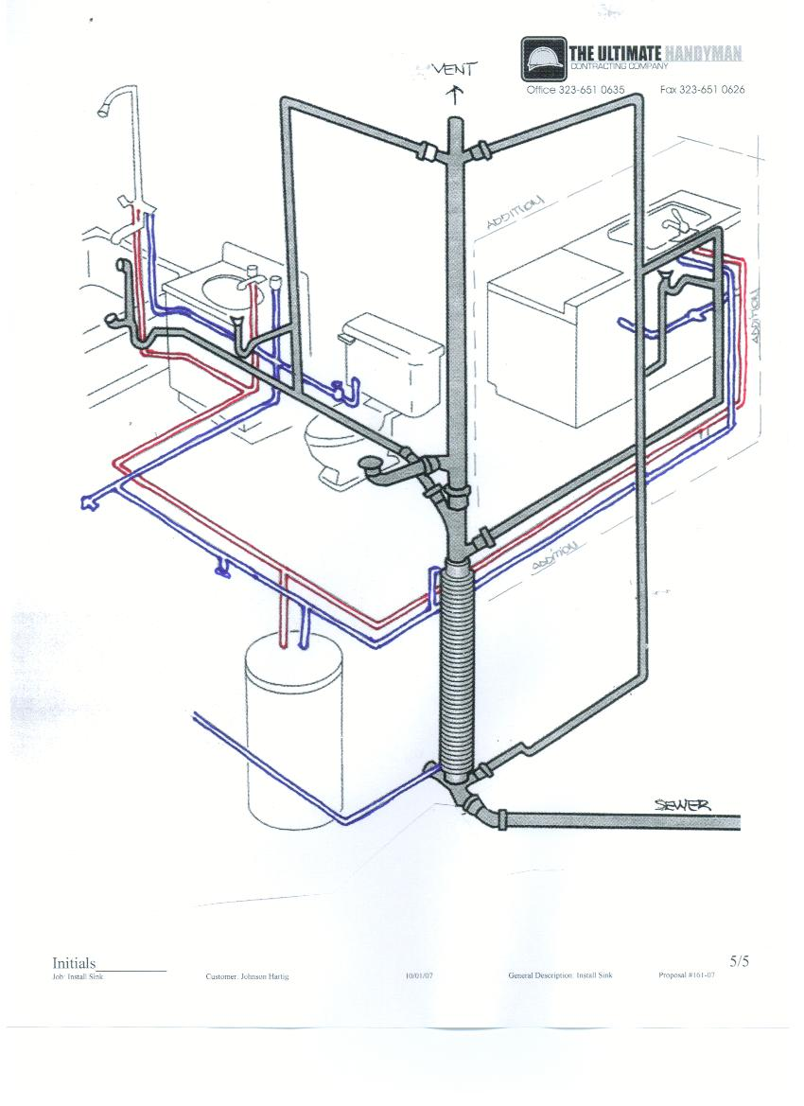
Plumping System
Drainage Water

Slide 27
Fire System
The Class III is used for design the fire system
Pipe size
Pipe size (inch) | Demand (GPM) | Name of pipe
4’’ | 500 | Main pipe
4’’ | 500 | Riser
4’’ | 250 | Pipe enter the floor
2 1/2’’ | 250 | Pipe for landing valve
1 1/2’’ | 100 | Pipe for Cabinet

Slide 28
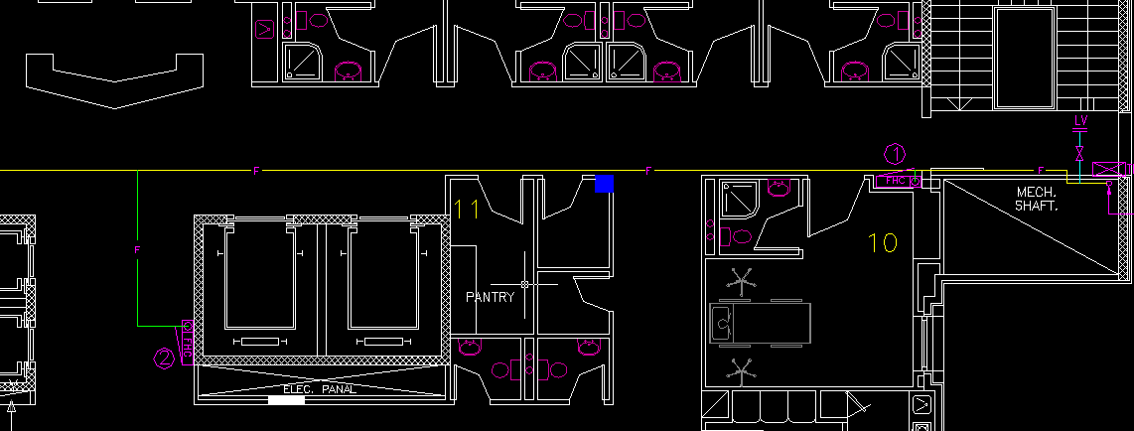
Fire System

Slide 29
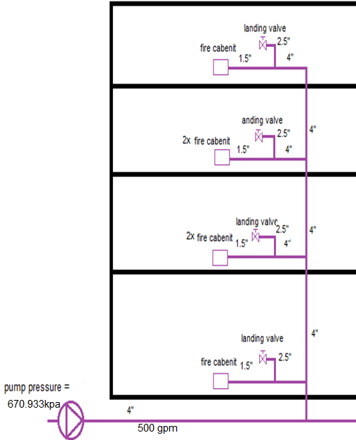
Fire System

Slide 30
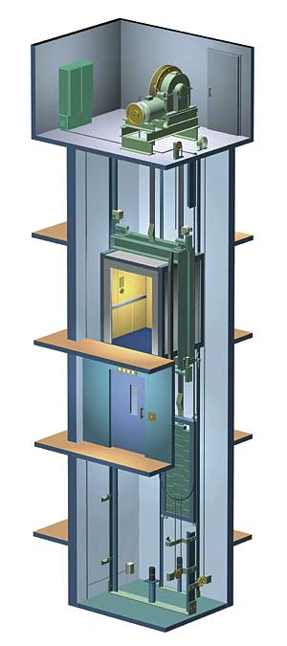
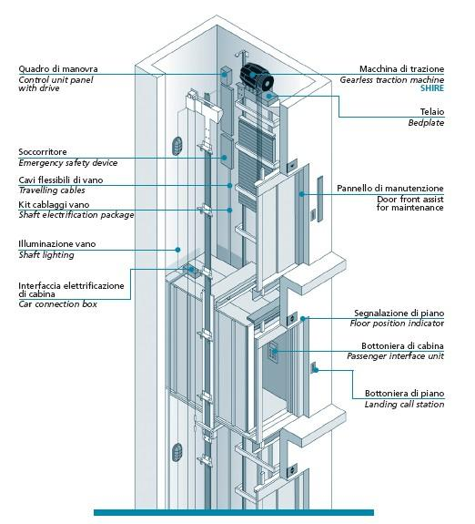
ELEVATORS

Slide 31
ELEVATORS
Sizing For Patients (bed)Elevator
load | Entrance layout | Internal Shaft Diminution |  | Door Type | Doors Opining (at a height 2000mm) | PIT | Headroom
_{Kg}/_{person} |  | Width (mm) | Depth (mm) |  | Width (mm) | Depth (mm) | Height (mm)
_{1600/21} | Through (180) | 2400 | 2850 | 2PSO automatic | 1100 | 1300 | 3600

Slide 32
Equipment Selection
Boiler :
From Obrien boilers Company catalogs of steam boiler is
250 kw. REX K25 which has capacity is
 | Qdomestic | M l/s | QTotal W | #Floor
 | 1346.8 | 1.432138 | 48.80645281 | Second Floor
 | 1346.8 | 1.628975 | 28.85421003 | First Floor
 | 1346.8 | 2.736 | 54.90051081 | Ground Floor
 | 1346.8 | 2.5938 | 59.46210613 | First Basement
 | 1346.8 | 1.365957 | 32.32649056 | Second Basment
 | 6734 | 9.75 | 224.34 | Total

Slide 33
Equipment Selection
Where:
  Mw: daily consumption of domestic hot water.=280leter
  (Th-To) = (50 – 60) = 10 .
  t: time = 4 hour .
  Cp: specific heat = 4180 J/kg. K.
  Daily consumption of domestic hot water (L/S).

Slide 34
Equipment Selection
Chiller :
From Petra catalog we select a model
Which has capacity is 153 ton. APSa 145-2S
Model total load and flow rate from the building
floor # | kw |  | L/S | GPM
Second Floor | 95.8089 |  | 1.432 | 22.7688
First Floor | 138.266 |  | 1.624 | 25.821
Ground floor | 103.741 |  | 2.736 | 43.5024
Basement one | 166.12 |  | 2.593 | 41.228
Basement tow | 94.984 |  | 1.366 | 21.7194
TOTAL |  |  | 9.751 | 155.038
MODEL | CAP[T.R] | GPM | PI | WPD
APSa 145-2S | 153 | 155.038 | 138 | 3.7
LWT | 45
AMPEANT .T | 85
FREQUANCY | 50 HZ

Slide 35
Equipment Selection
Fan coil :
100 cfm F.C.U we will select: RAC 2 GCC H/C 4Rows
200 cfm F.C.U we will select: RAC 2 GCC H/C 4Rows
300 cfm F.C.U we will select: RAC 3 GCC H/C 4Rows
400 cfm F.C.U we will select: RAC 4 GCC H/C 4Rows
450 cfm F.C.U we will select: RAC 5 GCC H/C 4Rows
500 cfm F.C.U we will select: RAC 5 GCC H/C 4Rows
600 cfm F.C.U we will select: DCC 6 H/C 4Rows
700 cfm F.C.U we will select: DCC 8 H/C 4Rows
2000cfm F.C.U we will select: DCC 20 H/C 4Rows

Slide 36
Equipment Saelection
Air Handling Unit:
From Petra catalog we select
The suitable A.H.U for the operation room in the Ground floor is
AH40C4H2X2
The air handler unit in our project has the total load
AHU# | Qs kw | Qs (BTU) | V cir[l/s] | CFM
AHU 1 | 34.408 | 117970.28 | 3.546 | 4480.38
AHU 2 | 27.902 | 92571.42 | 1.519 | 3349.09
AHU 3 | 14.497 | 49704 | .641 | 1836.71

Slide 37
Equipment Selection
The details for AHU was selected in two basement floor shown in table below:
 | DB | WB | CFM | T.CAP mph | S.CAP mph | WFR gpm | WPD ft
PAH40 | 80 | 67 | 4000 | 133.13 | 82.14 | 26.63 | 3.77
PAH32 | 80 | 67 | 3200 | 108 | 66.53 | 21.6 | 3.68
PAH16 | 80 | 67 | 1600 | 51.75 | 32.14 | 10.35 | 3.7

Slide 38
Equipment Selection
The details for AHU was selected in first basement floor shown in table below:
AHU# | Qs kw | Qs (BTU) | V cir[l/s] | CFM
AHU 1 | 34.673 | 118878.85 | 1.33 | 2941.33
AHU 2 | 34.673 | 118878.85 | 1.33 | 2941.33
 | DB | WB | CFM | T.CAP mph | S.CAP mph | WFR gpm | WPD ft
PAH40 | 80 | 67 | 4000 | 133.13 | 82.14 | 26.63 | 3.77
PAH40 | 80 | 67 | 4000 | 133.13 | 82.14 | 26.63 | 3.77

Slide 39
Equipment Selection
Pumps:
Pump Model | Head (m) | Flow Rate (gpm) | Pump
NM 100\200 | 65 | 500 | Firefighting pump
12B63602 | 22.2 | 22.73 | Chiller and boiler pump
 | 120psi | 100 | jokey pump
SMC 240-3 | 33.8 | 22 | Potable water (cold water) pump
SMC 240-2 | 30 | 20.5 | Potable water (Hot water) pump

Slide 40
SUMMARY
1. All steps of design and plans of HVAC system are done.
2. All steps of design and plans of plumping system are done
.
3. we select a suitable equipment for the system which satisfied the required conditions
.

Slide 41
THANK YOU
Thank you for your listening!!!

