Slide 1
Graduation Project (2)
Cookie Quality Optimization for piece of cake
An-Najah National University
Faculty of Engineering and Information Technology
Industrial engineering department
Supervisor Name:
Eng. Ramiz assaf
Group Members:
Ahmad kayed
Yara sayeh

Slide 2
Outline
Introduction.
Project Description.
Methodology.
Current Situation.
Trials and results.
Conclusion.
Recommendation.

Slide 3
Introduction
Piece of Cake is a small family-owned pastry factory established in 2019.
With a staff of 13 employees, Piece of Cake operates without automation, emphasizing manual labor to maintain product quality and consistency.
The factory supplies its products to over 30 coffee shops and restaurants across Palestine

Slide 4
Project Description
Freshness Issue: Piece of Cake's cookies lose their freshness over time, becoming dry and less appealing due to exposure to air.
Goal: The project aims to find solutions to prolong the shelf life of Piece of Cake's cookies while maintaining their initial taste and texture, improving customer satisfaction and market position.

Slide 5
Methodology
Data Collection and Analysis by using questionnaire.
Literature Review.
Develop Systems.
Supervise the implementation of the developed systems and tools.
Reporting.

Slide 6
Current Situation
Flowchart
Raw material
Preparing Recipe
Mixing the dough
Piping
Freezing
(30 min)
Freezing to store
Baking
No
Forming
Baking
yes
Final product
Figure 21: Process Flowchart

Slide 7
Current Situation
After observing the cookies for 3 days, it was found that the results of the questionnaire regarding the ability of the cookies to maintain their quality and freshness were possible to develop.
Fresh out of the oven the cookie always had a good rating and feedbacks from customers, its fresh, soft inside, and crunchy outside.

Slide 8
Current Situation
we used an alternative recipe for professional reasons. And it is as follow:
Material | W. flour | B. sugar | W. sugar | Butter | Chocolate chips | Eggs | Soda | Baking powder | Salt | Vanilla
Measurement | 180g | 100g | 100g | 115g | 175g | 60g | 5g | 5g | 3g | 4.5g
Table 1:The experimental recipe

Slide 9
Our Work
Our project aims to improve that taste somewhat close to that fresh cookie by adjust the recipe slightly.
We did some experience and trials using minitap to get the best recipe that maintains the best quality overtime as a main purpose.

Slide 10
Trials and results:
After consulting with the specialist chef, 3 basic factors were identified that mainly affect the recipe. These factors are flour, sugar, and soda. Therefore, these factors were taken into consideration when modifying the recipe.
NOTE: scores are subjective and they might vary depending on the day and the mentality of the judge so it’s not 100% accurate, but it’s the way we chose to continue our project. Plus, these judges were picked by the chef and the owners of piece of cake.

Slide 11
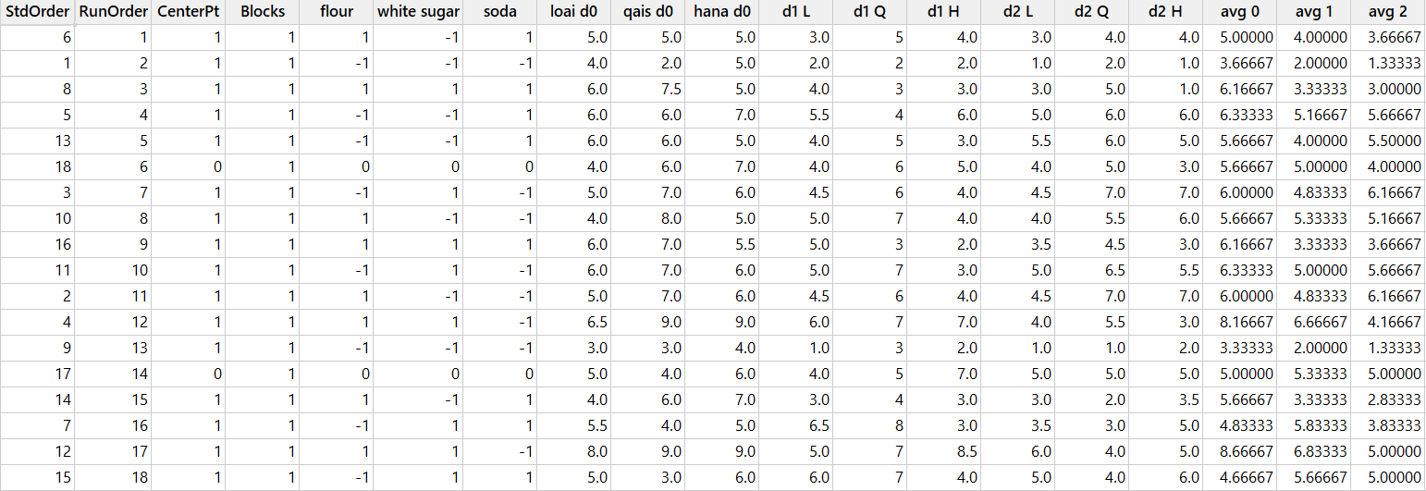
Trials and results:
Table 2:Trials and results

Slide 12
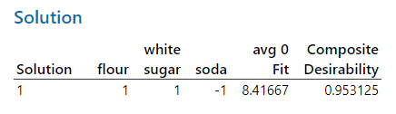
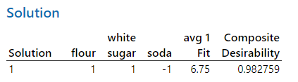
Trials and results:
Day 0 analysts
Day 1 analysts
Figure 27:Day 0 analysts
Figure 28:Day 1 analysts

Slide 13
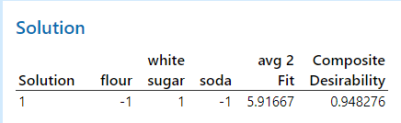
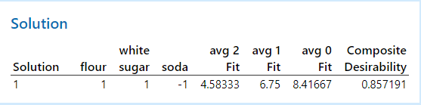
Trials and results:
Day 2 analysts
All the averages together
Figure 29:Day 2 analysts
Figure 30: All the averages together

Slide 14
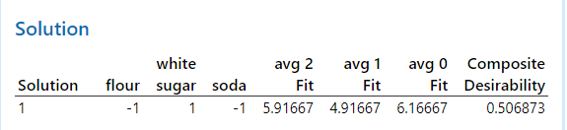
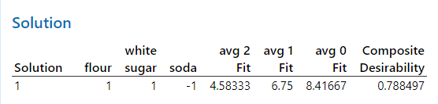
Trials and results:
Figure 31: More importance for average 2
Figure 32:Average 2 as a target

Slide 15
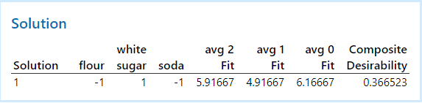
Trials and results:
Figure 33:Average 2 as a target & more importance

Slide 16
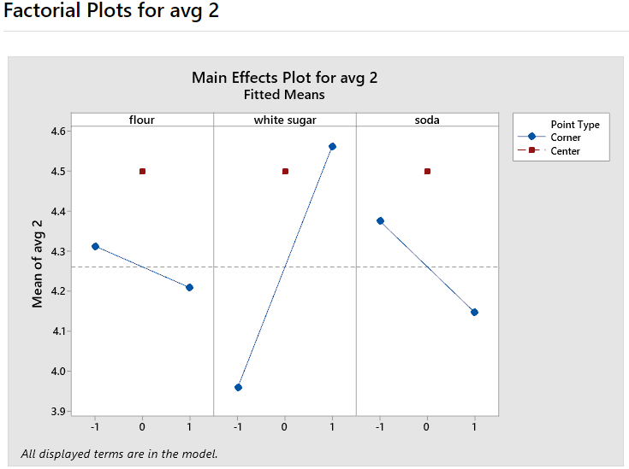
Trials and results:
Figure 34:The factorial plot

Slide 17
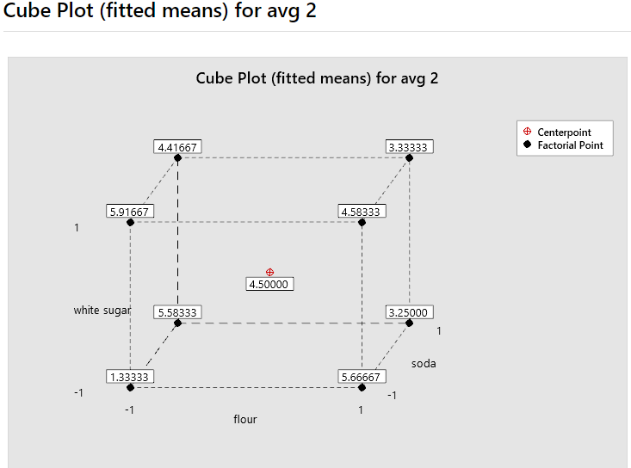
Trials and results:
Figure 35:The cube plot

Slide 18
Conclusion:
After upgrading and analysing two experimental recipes, we presented them to the Piece of Cake chef, who applied the changes to his original recipe. Feedback from the head chef and judges was positive, showing improved quality and extended freshness

Slide 19
Conclusion:
If the recipe is applied and approved after a period of time has passed, this will affect many factors, including:
Volume Increase
Storage Conditions
Packaging Efficiency
Customer Satisfaction
Price Adjustments

Slide 20
Recommendation:
Implement one of the recipes and continue improving upon it
Improve the packaging which also can affect the quality for longer time
Produce the cookies on higher volume since it keeps the freshness for longer time since we upgraded the recipe and the ability to maintain the quality for longer period of time
Educate staff who bakes the cookies to store the cookies when they cool off a bit

Slide 21


