Slide 1
Toys Arranging Robot
TAR
By: Ala’a Haj Ali & Rania Atta.
Supervisors: Dr. Ashraf Armoush & Eng. Asma’a Afifi.

Slide 2
Outline
Introduction
Contribution
Tools and Components
Methodology
Constraints
Summary

Slide 3
Introduction
TAR is a car robot that’s designed to collect lego pieces from kids’ playrooms and place them in a desired box that’s put on top of it.

Slide 4
Current projects vs Contribution
Most robotic cars that aims to collect objects are based on manual controlling via bluetooth connection with a mobile app.
Some other robots aim to collect general objects based on color and size and separate them according to that base.
Our robot is used to detect a specific object via camera module and it does not need manual controlling.

Slide 5
Tools and Components
DC motors : four DC motors were used connected to four wheels for the purpose of car movement .
Servo motors: to build robotic arm using two servo motors after giving the appropriate degrees to initialize the movement.
Dual H-Bridge driver: to control the speed and the direction of the DC motors, two drivers were used.

Slide 6
Tools and Components
Ultrasonic sensor: to measure the distance from the object in addition to avoiding obstacles.
Arduino: used as a microcontroller to control DC, servo motors and ultrasonic.
Raspberry pi 4 with pi camera module: for image processing to detect objects(Lego) using openCV with python.

Slide 7
Tools and Components
Boost voltage converter: to convert input voltage(5V) to the appropriate voltage needed by drivers and the base servo motor.
Power supply (5V/5A): provide a sufficient power for all components.
White board and wires.

Slide 8
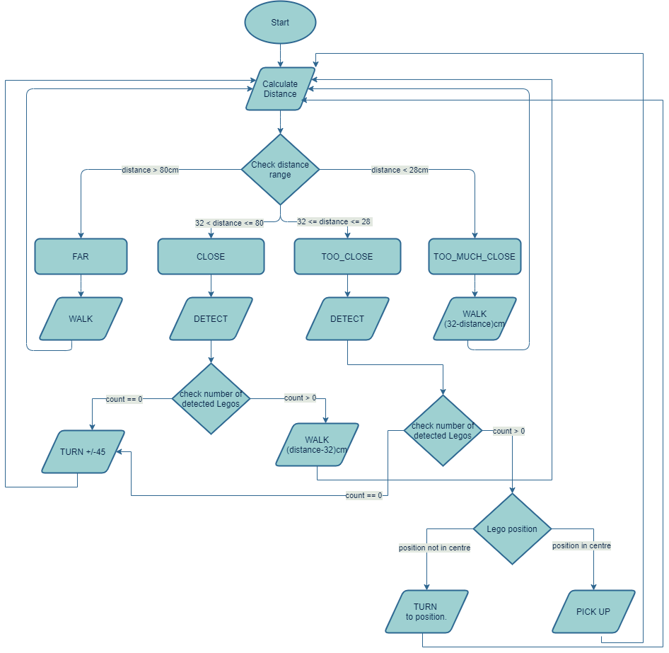
Methodology

Slide 9
Constraints
Robot weight.
Performance.

Slide 10
Summary
TAR serves mothers and kindergartners in collecting Lego pieces from kids’ playrooms saving the time and effort taken to do this task.

