Slide 1

Creating HEALTHCARE for the WORLD

Slide 2
An- Najah National University
Faculty of Engineering
Industrial Engineering Department
Developing Maintenance Management System in Al-Arabi Specialized Hospital
Supervisor
Eng . Tamer Haddad
Reem Asmr Nazmia Mana’a Ahmad Zaher
Shayma Smaaneh Sawsan Deek Rasha Abu-shanab
Students

Slide 3
Sections :
Introduction
5.Apply the 5S system to arrange the workshop and reduce the time taken in maintenance.
Maintenance management
Current Status for Maintenance System
Suggested Maintenance Management System
Conclusion and Recommendations.

Slide 4

Al-Arabi Specialized Hospital
  History of Al-Arabi Specialized Hospital
  Established in 2000 by a group of creative doctors
  Located in Nablus
  ISO in 2001

Slide 5

Objectives
The main objectives of this project are :
1- Investigate implementing maintenance management systems in Healthcare Facilities.
2- Developing a new suggest maintenance system and compare it with the current used one.
3- Developing a new implementation framework for Healthcare Facilities.
4- Discussing the difficulties in the adoption of maintenance systems with proper solutions.

Slide 6
Maintenance
  Definition : to keep the equipment in operational condition or repair it back into its‟ operational mode
  Objective: increase availability of production systems, increase safety and optimized cost.
Preventive maintenance
Types of maintenance
Corrective maintenance

Slide 7

Maintenance in Healthcare Facilities
  The Hospital maintenance department is a crucial element to a high quality healthcare facility.
  The excellent functioning or, by other words, the maximum reliability of facilities and equipment is a main rule for this department.
  The policy that permits such performance must always be based on planned maintenance including preventive maintenance.
  To be in advance to failures The other goal persuaded, it is to maintain costs as lower as possible.

Slide 8

CURRENT SYSTEM

Slide 9
Current system include
The Organizational Structure
Flow charts
The used reports templates
Performance indicator
Analysis of available data
Problems related to the current system

Slide 10
The Organizational Structure
Medical maintenance Engineer
Head if Maintenance Department
Maintenance technician (1)
Maintenance technician (2)
Organizational structure
Flow charts
Reports templates
Performance indicator
Analysis of data
Problems

Slide 11
The Maintenance Activities Process
Flow chart :
Start
Organizational structure
Flow charts
Reports templates
Performance indicator
Analysis of data
Problems
Failure
Inform the maintenance department for the failure orally
Filling the request of general maintenance report
Inform the service technician internally or externally for the failure orally
Sending request for maintenance department
No
Is it possible to maintain the fault internally?
Filling the request of the external maintenance report
Sending the request to the competent authorities
Yes
Sending the service technician to the site of failure
Repairing the failure
The end

Slide 12
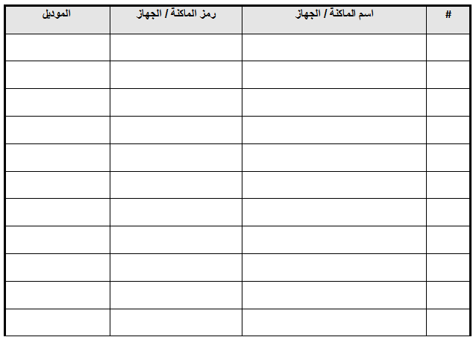
Report templates
1- Devices and Machines List.
Organizational structure
Flow charts
Reports templates
Performance indicator
Analysis of data
Problems
رئيس قسم الصيانة (التوقيع والتاريخ):

Slide 13
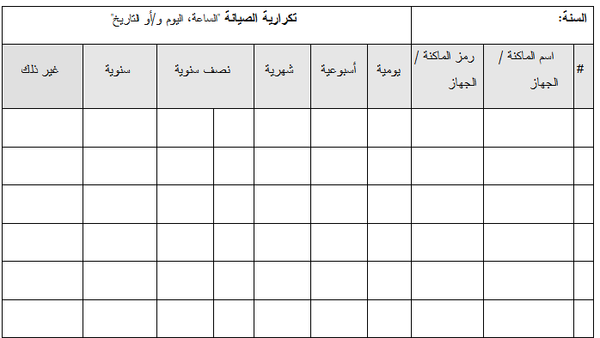
Report templates
2- Annual Preventive Maintenance Plan.
Organizational structure
Flow charts
Reports templates
Performance indicator
Analysis of data
Problems
تاريخ الإعداد: / /
رئيس قسم الصيانة (التوقيع والتاريخ):

Slide 14
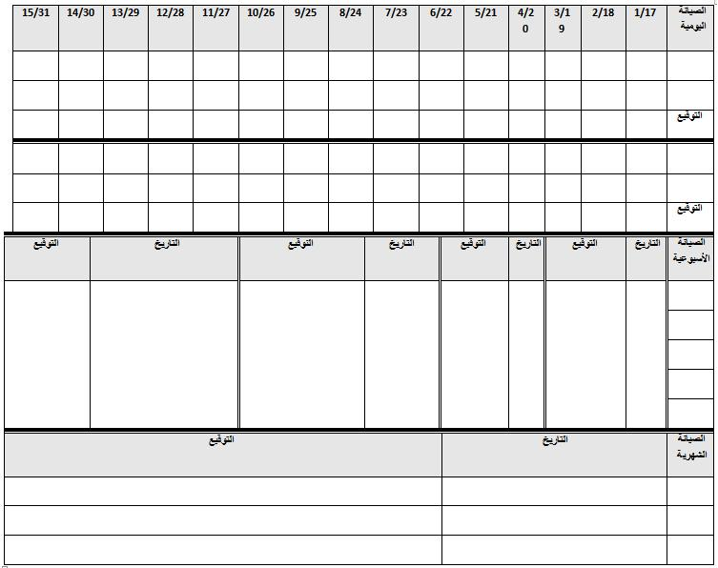
Report templates
3- Summary of Preventive Maintenance Works.
________: رقم الماكنة / الجهاز_______________ الشهر: _________________ السنة ______ اسم الماكنة/الجهاز:
Organizational structure
Flow charts
Reports templates
Performance indicator
Analysis of data
Problems

Slide 15
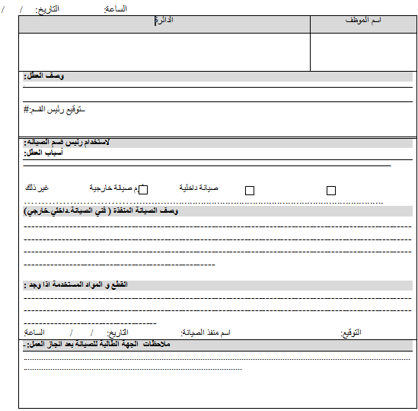
Report templates
. 4- Request for General Maintenance report.
Organizational structure
Flow charts
Reports templates
Performance indicator
Analysis of data
Problems

Slide 16
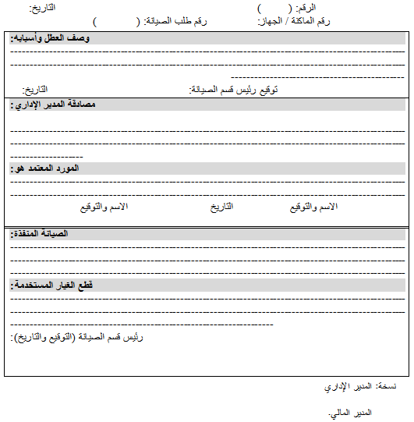
Report templates
5- Request for External Maintenance report..
Organizational structure
Flow charts
Reports templates
Performance indicator
Analysis of data
Problems

Slide 17
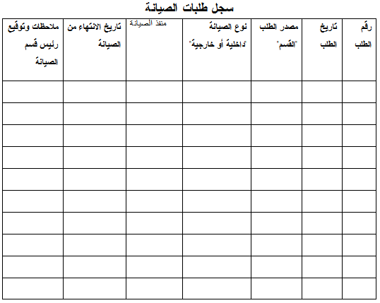
Report templates
6- Record of Maintenance Requests.
Organizational structure
Flow charts
Reports templates
Performance indicator
Analysis of data
Problems

Slide 18
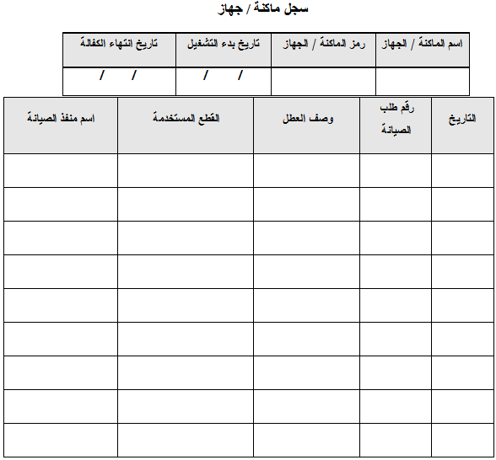
Report templates
7- Machine/Device Record.
Organizational structure
Flow charts
Reports templates
Performance indicator
Analysis of data
Problems

Slide 19
Report templates
8- The “Under Maintenance” Card
Organizational structure
Flow charts
Reports templates
Performance indicator
Analysis of data
Problems
قسم الصيانة
"تحت الصيانة"
UNDER MAINTENANCE
لا تستخدم هذه الماكنة / الجهاز
Do Not Use This Equipment / Device

Slide 20
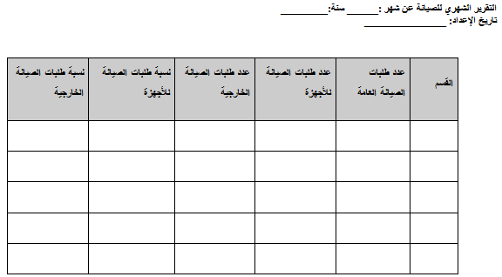
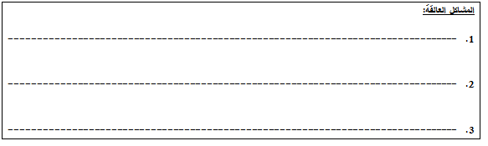
Measurement of Maintenance Activities Performance
The Performance Indicator/ Maintenance Monthly report
Organizational structure
Flow charts
Reports templates
Performance indicator
Analysis of data
Problems

Slide 21
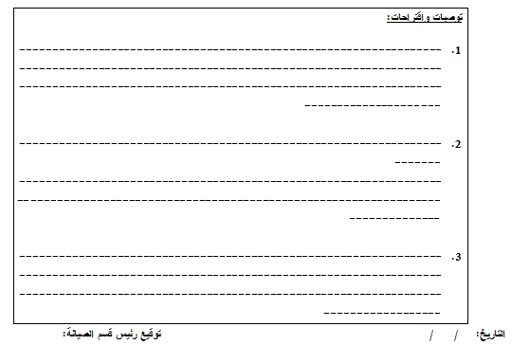
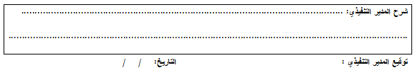
Measurement of Maintenance Activities Performance
The Performance Indicator/ Maintenance Monthly report
Organizational structure
Flow charts
Reports templates
Performance indicator
Analysis of data
Problems

Slide 22
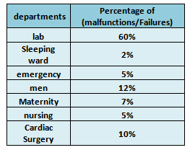
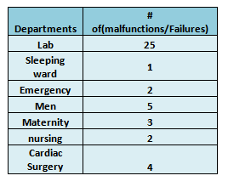
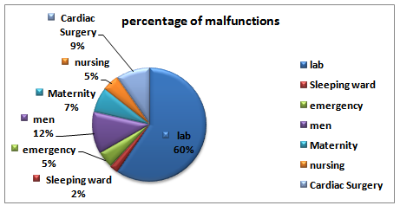
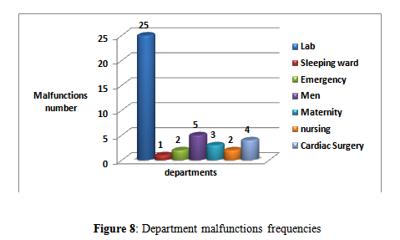
Analysis of Malfunctions Data
Department malfunctions frequencies.
Organizational structure
Flow charts
Reports templates
Performance indicator
Analysis of data
Problems

Slide 23
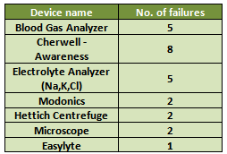
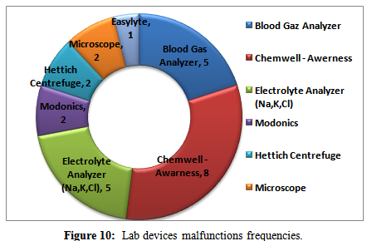
Analysis of Malfunctions Data
Lab devices malfunctions frequencies.
Organizational structure
Flow charts
Reports templates
Performance indicator
Analysis of data
Problems

Slide 24
Malfunctions’ Causes Analysis
A. Chemwell-Awarness
Chemwell-Awarness device has the highest number of failures
Organizational structure
Flow charts
Reports templates
Performance indicator
Analysis of data
Problems
Cause-Effect diagram for Chemwell-Awarness device.

Slide 25
Malfunctions’ Causes Analysis
B. Blood Gas Analyzer
It’s the second highest device in number of failures
Organizational structure
Flow charts
Reports templates
Performance indicator
Analysis of data
Problems
Cause-Effect diagram for Blood Gas Analyzer device

Slide 26
Malfunctions’ Causes Analysis
C. Electrolyte
It has the same number of failures as the Blood Gas Analyzer device
Organizational structure
Flow charts
Reports templates
Performance indicator
Analysis of data
Problems
Cause-Effect diagram for Electrolyte device

Slide 27
Problems related to the existent system
These problems can be summarized as:
Organizational structure
Flow charts
Reports templates
Performance indicator
Analysis of data
Problems
1.The general and external reports are written by hand
2.The reports are stored in a non-professional and unsafe way
3.All maintenance reports related to all hospital departments are stored together in one record.
4.Many simple malfunctions could be fixed at the instant of occurrence instead of taking a long time in performing the maintenance operation.

Slide 28
Problems related to the existent system
These problems can be summarized as:
Organizational structure
Flow charts
Reports templates
Performance indicator
Analysis of data
Problems
5.When there is a need for external maintenance, then the request for external maintenance report must be documented and attached with the request for general maintenance report.
6.Record of Maintenance Request reports are not filled out.
7.The used performance indicator is not efficient and is not accurate.

Slide 29
Problems related to the existent system
The following items are not documented in most request for general maintenance reports:
Organizational structure
Flow charts
Reports templates
Performance indicator
Analysis of data
Problems
1.The name of the department that submitted the request for maintenance report.
2.The name of the person who informed of the malfunction.
3.The date and time of malfunction occurrence.

Slide 30
Problems related to the existent system
The following items are not documented in most request for general maintenance reports:
Organizational structure
Flow charts
Reports templates
Performance indicator
Analysis of data
Problems
4.The name of the technician who performed the maintenance.
5.Description of the malfunction and the reasons of its occurrence
6.Clarifying the need for local or external maintenance

Slide 31

SUGGESTED MAINTENANCE MANAGEMENT SYSTEM

Slide 32
Suggested Maintenance Management System
Include :
Job description
Suggested Organizational Structure
Suggested Flow charts
Suggested Tracking Serial Number
Suggested Report Templates
Suggested Measurement of Maintenance Activities Performance
5S Implementation
Computerized Maintenance Management System (CMMS)

Slide 33
Job Description
a) The Head of the Maintenance Department
Job description
Organizational Structure
Flow charts
Serial Number
Report Templates
Activities Performance
5S
Job Title:
Head of the Maintenance Department:
The academic qualifications and experiences required:
1. Bachelor degree in Medical, Mechanical, Electrical or Electronic engineering.
2. Six years of experience in maintenance work of which two years in experience as head of a department in a hospital.
Main tasks:
1. Planning, organizing, directing and monitoring all maintenance activities in the hospital.
2.Determining the departments annual needs of devices, equipment and spare parts.
3.Supervision of preventive maintenance programs and Documentation and archiving the maintenance reports.
(CMMS)
4. Assess the level of performance of the department

Slide 34
Job Description
b) Medical Maintenance Engineer
Job description
Organizational Structure
Flow charts
Serial Number
Report Templates
Activities Performance
5S
Job Title:
Medical Maintenance Engineer.
The academic qualifications and experiences required:
1. Bachelor degree in Medical or Electronic devices engineering.
2. Five years of experience in maintenance of medical devices.
Main tasks:
1. Developing a work program and distributing duties on medical devices technicians.
2. Following-up on medical devices that are sent to outer repair shops.
3. Provide the tools, inspection equipment and spare parts required for maintenance.
4. Submitting the periodic reports to the head of maintenance department.
5.Developing preventive maintenance programs associated with the medical maintenance department.
(CMMS)

Slide 35
Job Description
c) Medical Devices Technician
Job description
Organizational Structure
Flow charts
Serial Number
Report Templates
Activities Performance
5S
Job Title:
Medical Devices Technician
The academic qualifications and experiences required:
1. A two years diploma in medical devices.
2. Five years of experience in maintenance medical devices.
Main tasks:
1. Preparing tools and inspection equipment that are necessary to inspect and maintain the medical devices.
2. Dismantling and cleaning of medical devices for testing, calibration or maintenance and their re-installment according to the established maintenance procedures and manufacturer’s instructions.
3. Making sure that the backup parts of a device are available before starting to repair it.
(CMMS)

Slide 36
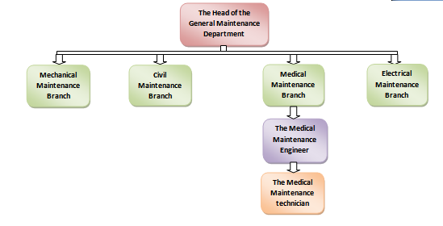
Organizational Structure
Job description
Organizational Structure
Flow charts
Serial Number
Report Templates
Activities Performance
5S
(CMMS)

Slide 37
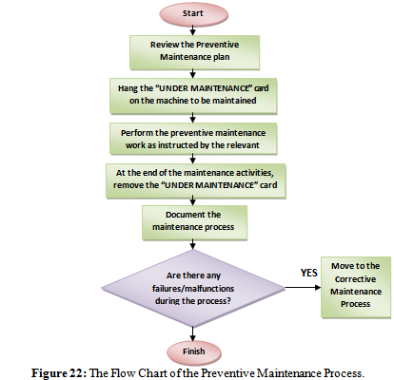
Flow Charts
    Preventive Maintenance process
Job description
Organizational Structure
Flow charts
Serial Number
Report Templates
Activities Performance
5S
(CMMS)

Slide 38
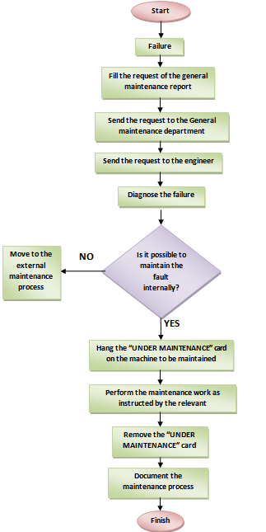
Flow Charts
    2.Corrective Maintenance Process
Job description
Organizational Structure
Flow charts
Serial Number
Report Templates
Activities Performance
5S
Internal Maintenance Process
(CMMS)

Slide 39
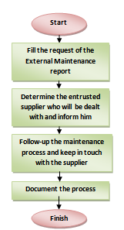
Flow Charts
    2.Corrective Maintenance Process
Job description
Organizational Structure
Flow charts
Serial Number
Report Templates
Activities Performance
5S
External Maintenance Process
(CMMS)

Slide 40
Suggested Tracking Serial Number
serial number is a unique number assigned to facilitate identification the devices locations.
Job description
Organizational Structure
Flow charts
Serial Number
Report Templates
Activities Performance
5S
( EM 04 11 1011)
emergency department,
Machine code #
room number
fourth floor
(CMMS)

Slide 41
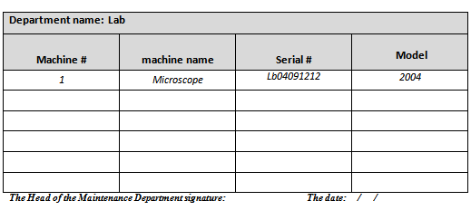
Suggested Report Templates
Job description
Organizational Structure
Flow charts
Serial Number
Report Templates
Activities Performance
5S
1. Device list.
(CMMS)

Slide 42
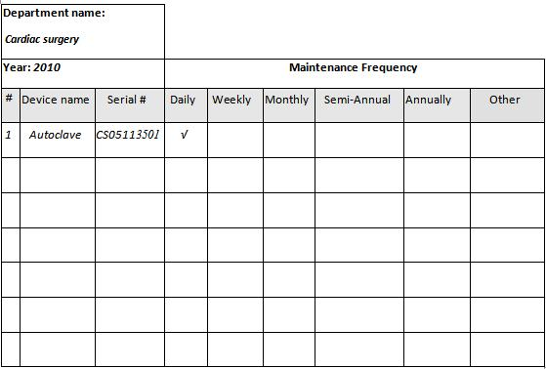
Suggested Report Templates
Job description
Organizational Structure
Flow charts
Serial Number
Report Templates
Activities Performance
5S
2. Annual Preventive Maintenance Plan.
(CMMS)

Slide 43
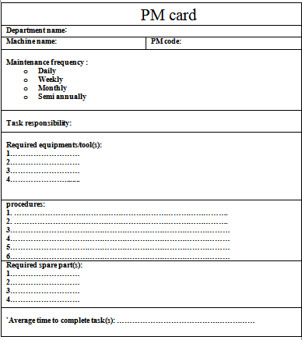
Suggested Report Templates
Job description
Organizational Structure
Flow charts
Serial Number
Report Templates
Activities Performance
5S
3. Preventive Maintenance card “PMC”.
(CMMS)

Slide 44
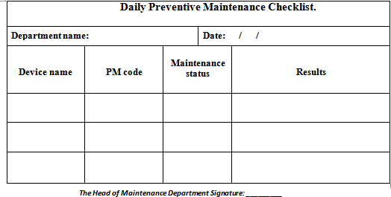
Suggested Report Templates
Job description
Organizational Structure
Flow charts
Serial Number
Report Templates
Activities Performance
5S
4. Preventive Maintenance Checklist.
Daily preventive maintenance checklist.
(CMMS)

Slide 45
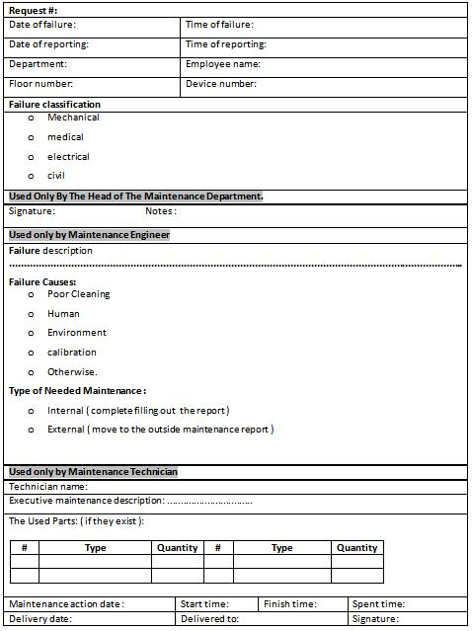
Suggested Report Templates
5. Request for General Maintenance report.
Job description
Organizational Structure
Flow charts
Serial Number
Report Templates
Activities Performance
5S
(CMMS)

Slide 46
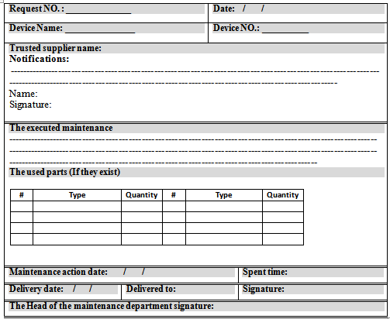
Suggested Report Templates
Job description
Organizational Structure
Flow charts
Serial Number
Report Templates
Activities Performance
5S
6. Request for Outside Maintenance report..
(CMMS)

Slide 47
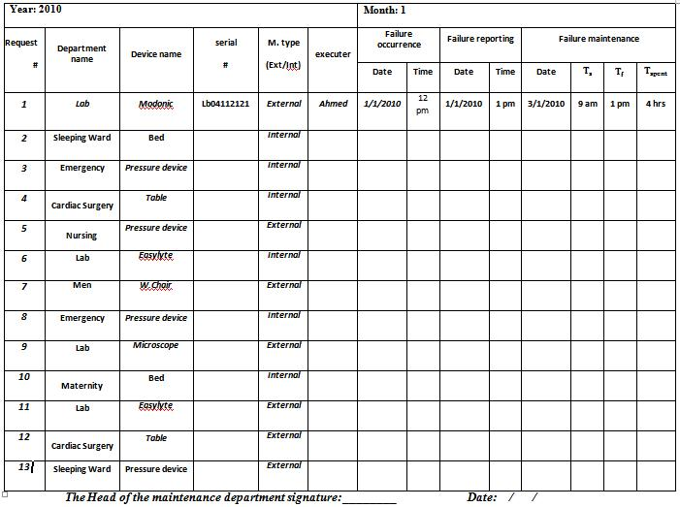
Suggested Report Templates
7. Records of Maintenance Requests
Job description
Organizational Structure
Flow charts
Serial Number
Report Templates
Activities Performance
5S
(CMMS)

Slide 48
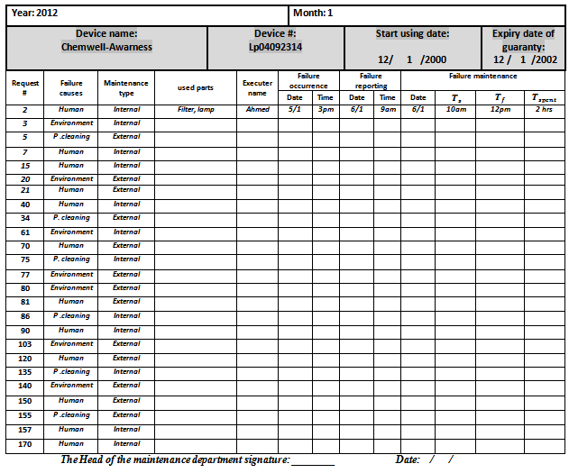
Suggested Report Templates
Job description
Organizational Structure
Flow charts
Serial Number
Report Templates
Activities Performance
5S
8- Device Record
(CMMS)

Slide 49
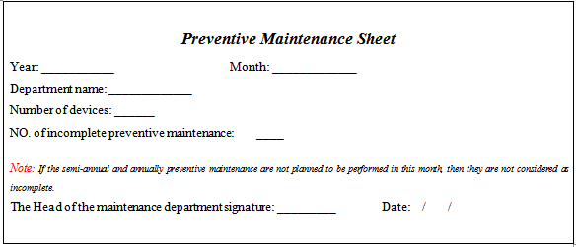
Suggested Measurement of
Maintenance Activities Performance
Job description
Organizational Structure
Flow charts
Serial Number
Report Templates
Activities Performance
5S
Data Sheets
1- Preventive maintenance data sheet.
(CMMS)

Slide 50
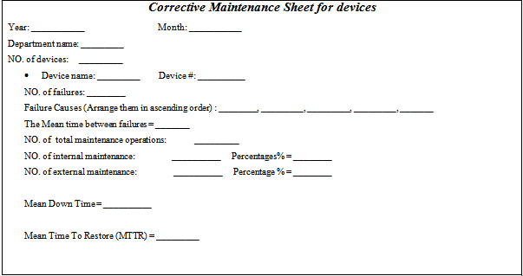
Suggested Measurement of
Maintenance Activities Performance
Job description
Organizational Structure
Flow charts
Serial Number
Report Templates
Activities Performance
5S
Data Sheets
2- Corrective maintenance data sheet for devices..
(CMMS)

Slide 51
Suggested Measurement of
Maintenance Activities Performance
Job description
Organizational Structure
Flow charts
Serial Number
Report Templates
Activities Performance
5S
Data Sheets
2- Corrective maintenance data sheet for devices..
This chart helps in recognizing the most causes of failures and their frequencies. As shown it is obvious that the human causes have the highest frequency.
(CMMS)

Slide 52
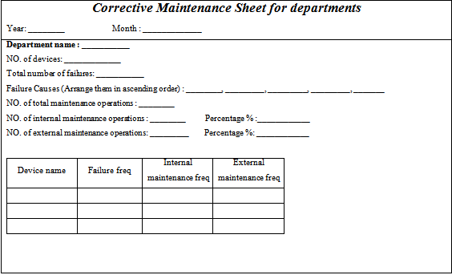
Suggested Measurement of
Maintenance Activities Performance
Job description
Organizational Structure
Flow charts
Serial Number
Report Templates
Activities Performance
5S
Data Sheets
3- Corrective maintenance data sheet for departments.
(CMMS)

Slide 53
Suggested Measurement of
Maintenance Activities Performance
Job description
Organizational Structure
Flow charts
Serial Number
Report Templates
Activities Performance
5S
Data Sheets
3- Corrective maintenance data sheet for departments.
The following chart represents the frequency of failures of the labs’
devices as an example.
(CMMS)

Slide 54
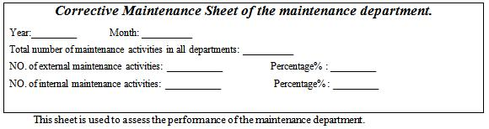
Suggested Measurement of
Maintenance Activities Performance
Job description
Organizational Structure
Flow charts
Serial Number
Report Templates
Activities Performance
5S
Data Sheets
4-Corrective maintenance data sheet for the maintenance department
(CMMS)

Slide 55
Suggested Measurement of
Maintenance Activities Performance
Job description
Organizational Structure
Flow charts
Serial Number
Report Templates
Activities Performance
5S
Data Sheets
4-Corrective maintenance data sheet for the maintenance department
The following chart is used to facilitate identifying and the number of failures in each department in addition to notifying the maintenance type performed for each failure whether if it is internal or external.
(CMMS)

Slide 56
5S Implementation
  Definition : It is an approach to keep the work place in the different departments and in the maintenance workshop in a suitable condition to perform the required work efficiently.
  There are five primary phases of 5S: sorting, straightening, systematic cleaning, standardizing and sustaining.
Job description
Organizational Structure
Flow charts
Serial Number
Report Templates
Activities Performance
5S
(CMMS)

Slide 57
5S Implementation
Sorting
Eliminate all unnecessary tools, parts, and instructions. Go through all tools, materials, and so forth in the plant and work area.
Job description
Organizational Structure
Flow charts
Serial Number
Report Templates
Activities Performance
5S
2. Straightening or Setting in order
There should be a place for everything and everything should be in its place
3. Systematic cleaning or shining
Clean the workspace and all equipment, and keep it clean, tidy and organized.
(CMMS)

Slide 58
5S Implementation
Job description
Organizational Structure
Flow charts
Serial Number
Report Templates
Activities Performance
5S
4. Standardizing (Seiketsu)
Work practices should be consistent and standardized. All work stations for a particular job should be identical.
5. Sustaining the discipline or self-discipline
Maintain and review standards. Once the previous 4 S's have been established, they become the new way to operate.
(CMMS)

Slide 59
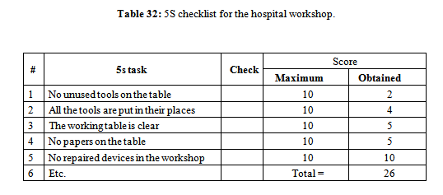
5S Implementation
Job description
Organizational Structure
Flow charts
Serial Number
Report Templates
Activities Performance
5S
To assess the level of the maintenance workshop in the hospital based on the 5S modeling, the following checklist form should be followed.
(CMMS)

Slide 60
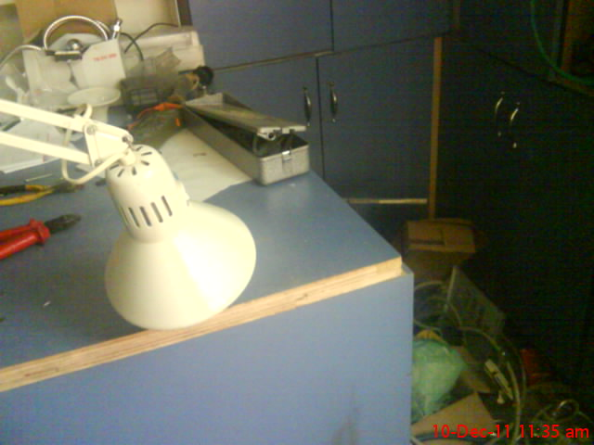
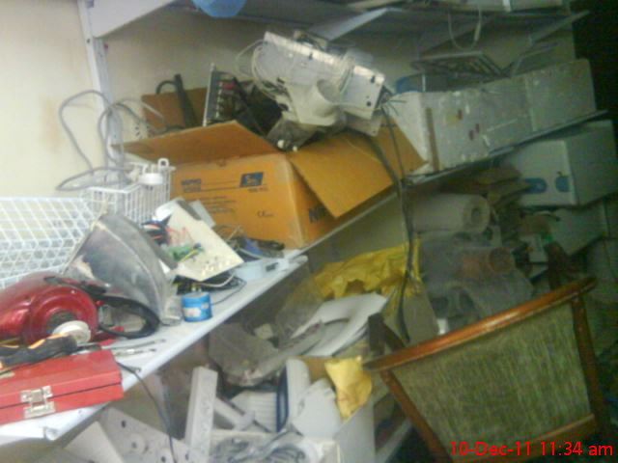
5S Implementation
Job description
Organizational Structure
Flow charts
Serial Number
Report Templates
Activities Performance
5S
The workshop table.
The workshop shelves
As shown, the table is dirty and untidy.
As shown the shelves are in a very bad
(CMMS)

Slide 61

CMMS

Slide 62
Computerized Maintenance
Management System (CMMS)
Job description
Organizational Structure
Flow charts
Serial Number
Report Templates
Activities Performance
5S
Definition
(CMMS) is a type of management software that performs functions in support of management and tracking of maintenance activities.
A suggested CMMS interfaces has been developed for the maintenance department in the hospital to facilitate managing and documenting the operation since there are huge amounts of information should be extracted and documented.
Example:
(CMMS)

Slide 63




Slide 67


Slide 69


Slide 71


Slide 74


Slide 77



Slide 78


Slide 80

RECOMMENDATIONS

Slide 81
Recommendation
1.Creating a computerized system to deal with the data and to ensure the documentation of information to save time.
2.Review the approved coding system and replace it with a new system to facilitate dealing with the hardware.
3.Hold training sessions for the maintenance crew every now and then.
4.Change the (organizational structure) used previously and apply the new organizational structure which regulates and determines the crews’ responsibilities
5.Apply the 5S system to arrange the workshop and reduce the time taken in maintenance.

Slide 82


