Slide 1
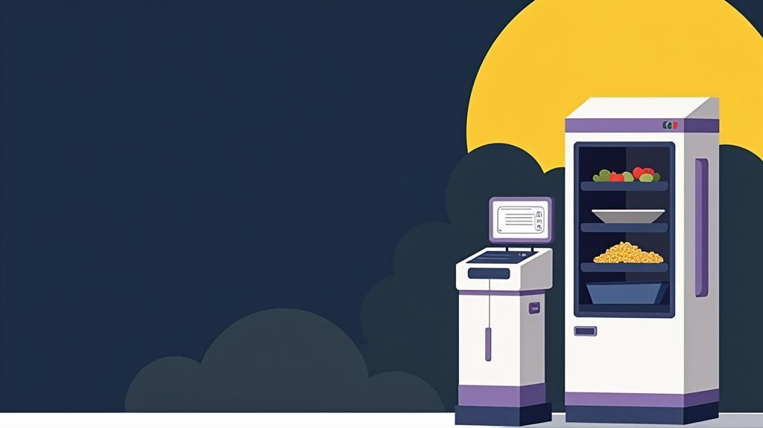
Noodly
Hardware Graduation Project
PRESENTED BY
Talah Qamhieh
Shahd Hennawi

Slide 2

Noodly Overview
01
02
03
Introduction
Features
Overall Design
04
05
06
Mobile App
Constraints
Future Work

Slide 3
Introduction
1
Our project develops an automated system to simplify and speed up instant noodle preparation.
5
Ensures consistent quality and high efficiency in every meal.
2
The machine completes the entire cooking process – from order placement to serving – with minimal human intervention.
6
Combines devices, sensors, and control systems in one integrated machine.
3
Ensures consistent quality and high efficiency in every meal.
4
Combines devices, sensors, and control systems in one integrated machine.

Slide 4
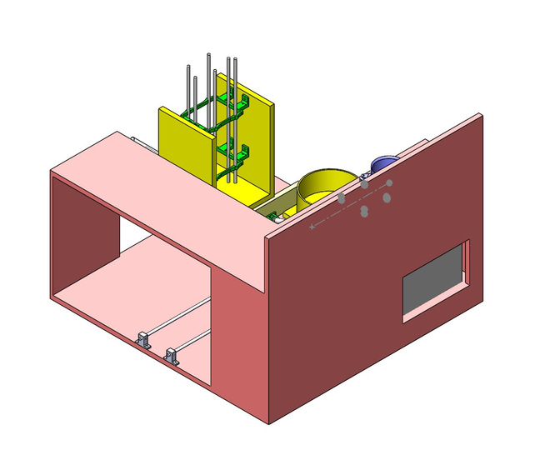
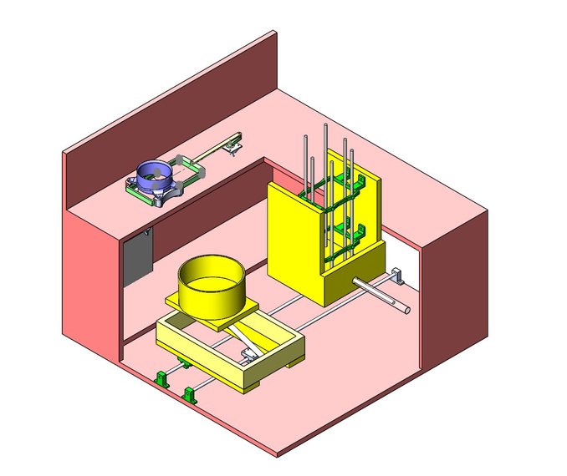
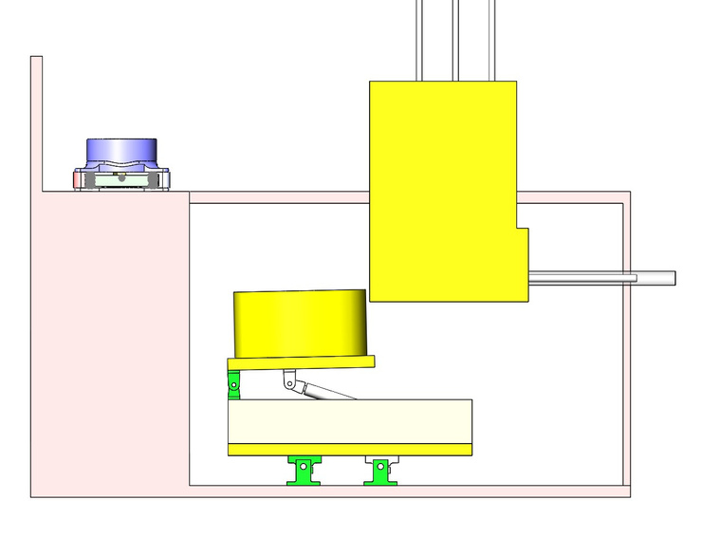
Overall Design

Slide 5
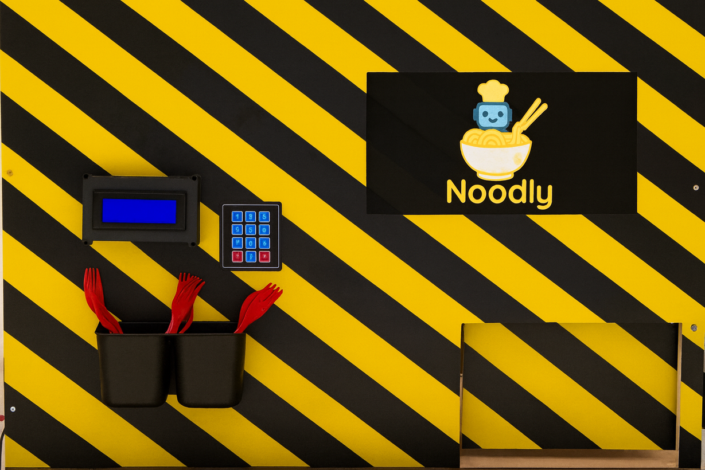
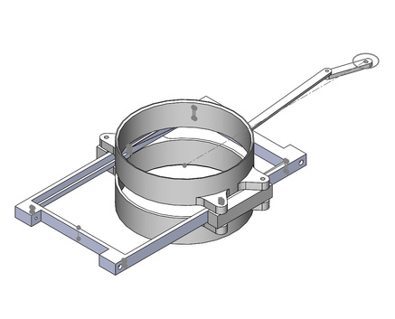
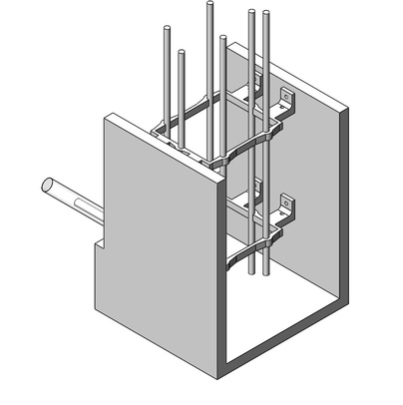
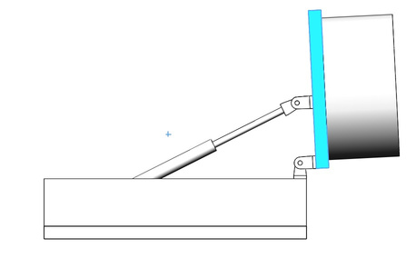
Features

Slide 6
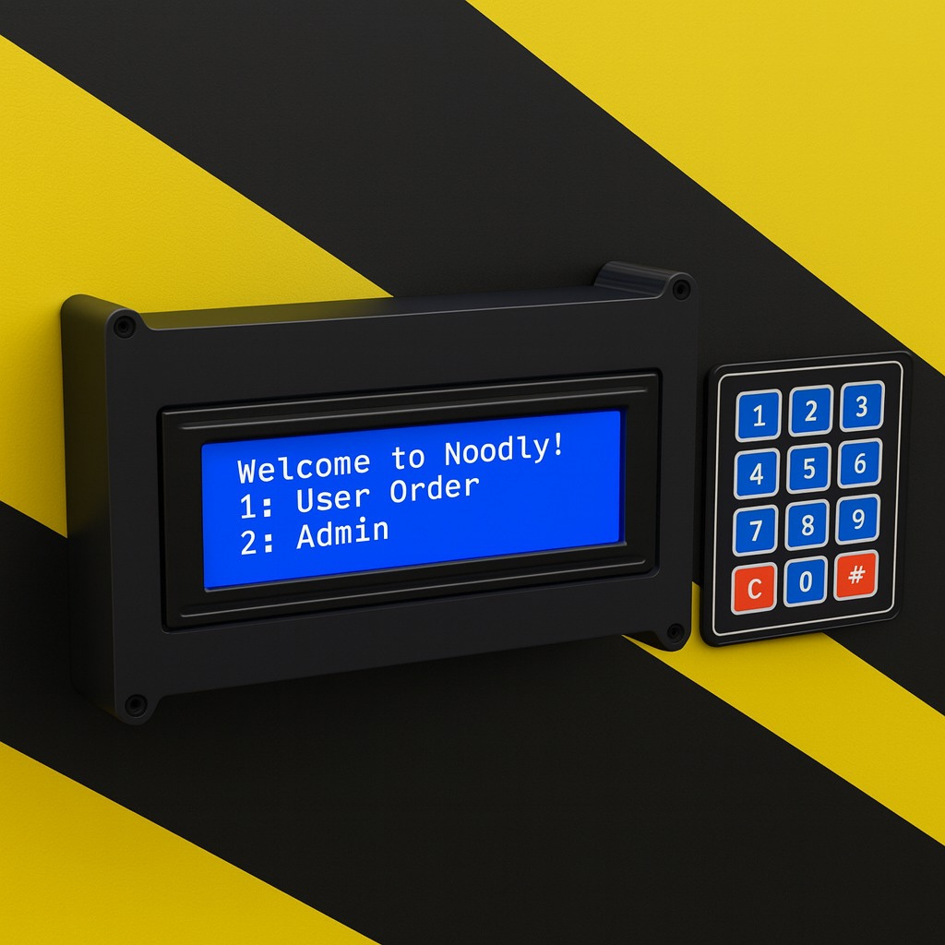
LCD Screens

Slide 7
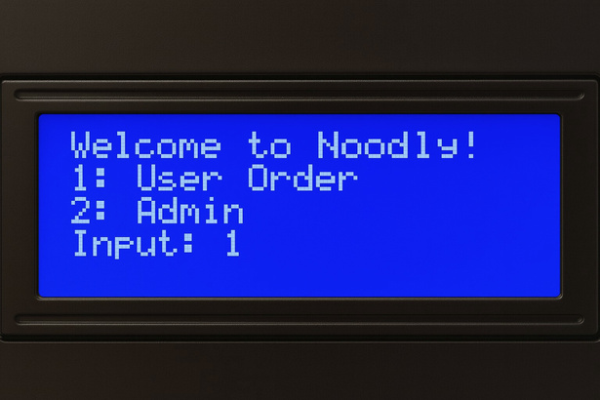
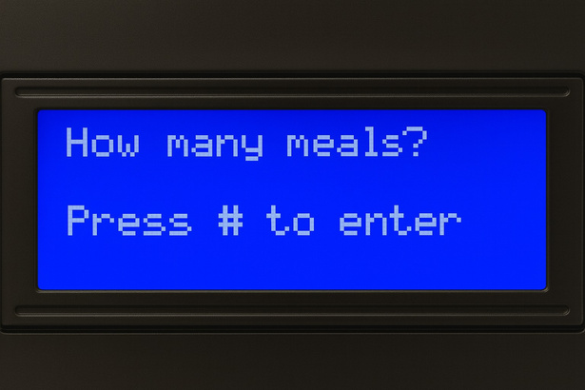
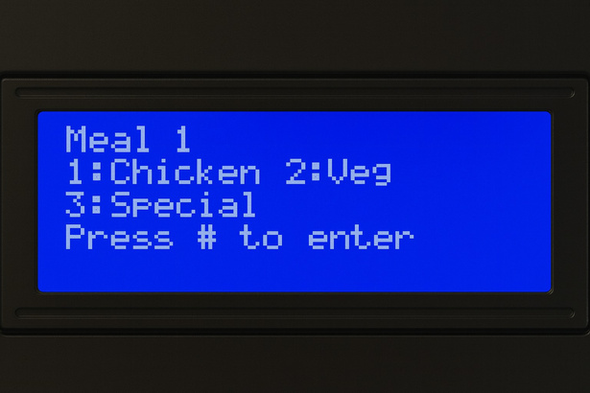
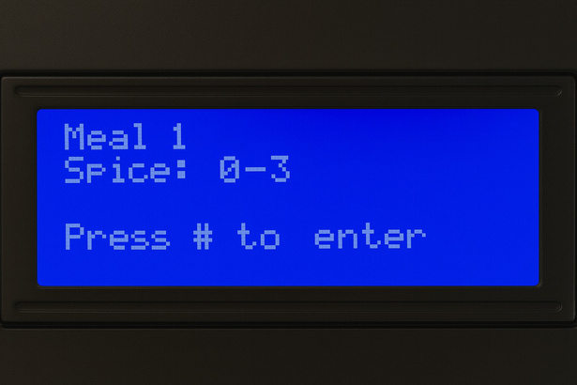
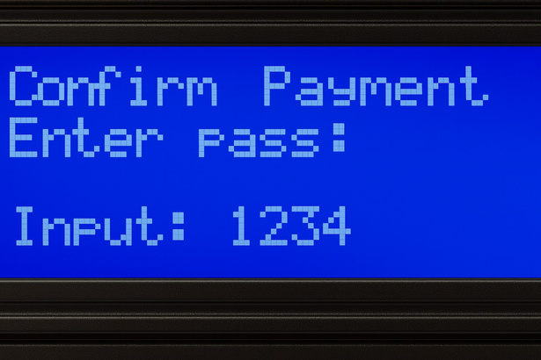
User Order Screen
1
2
3
4
5

Slide 8
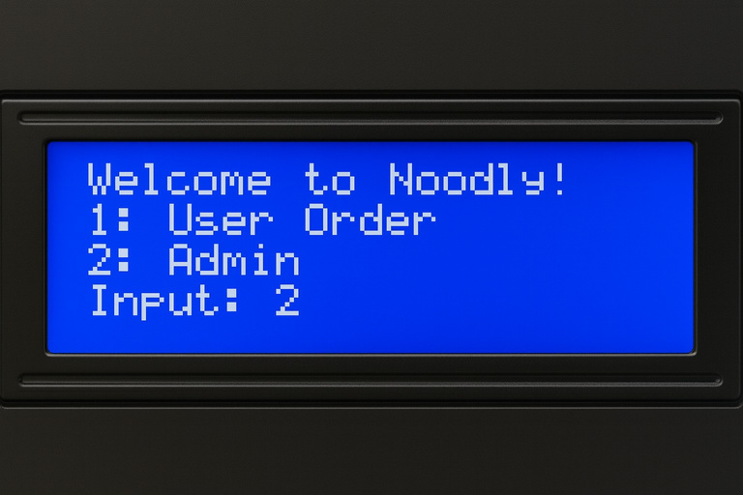
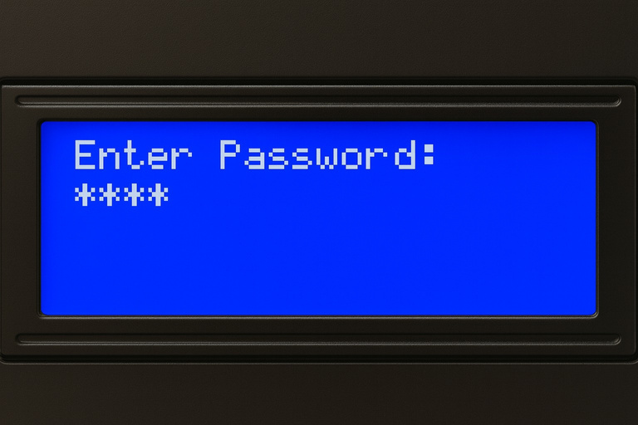
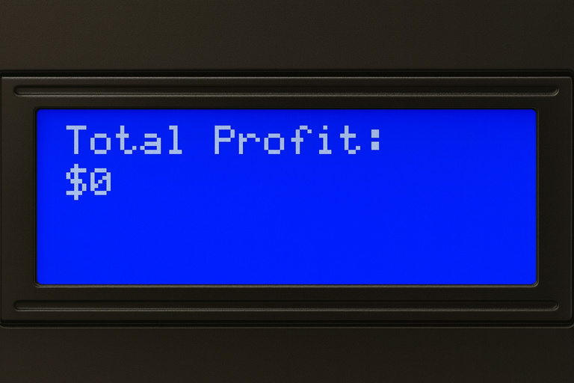
Admin’s Screen

Slide 9
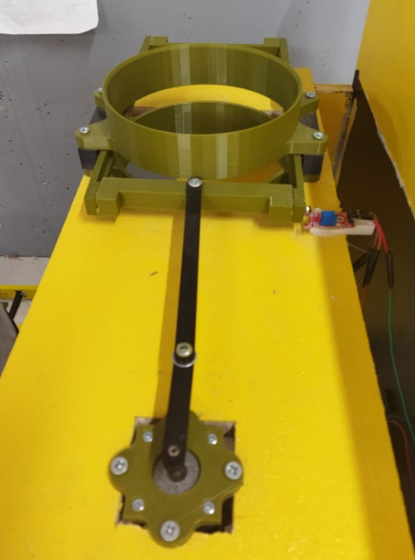
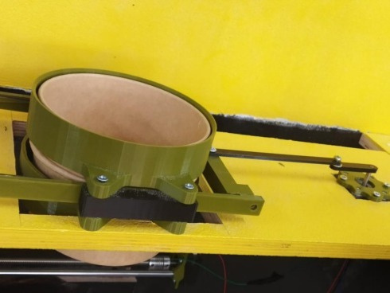
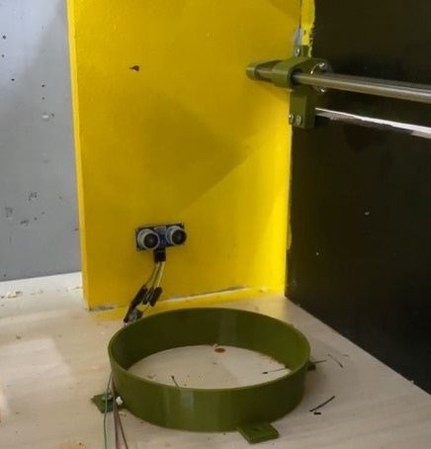
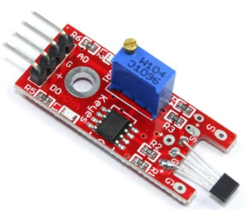
Cup Dispenser
Hall Effect Sensor

Slide 10
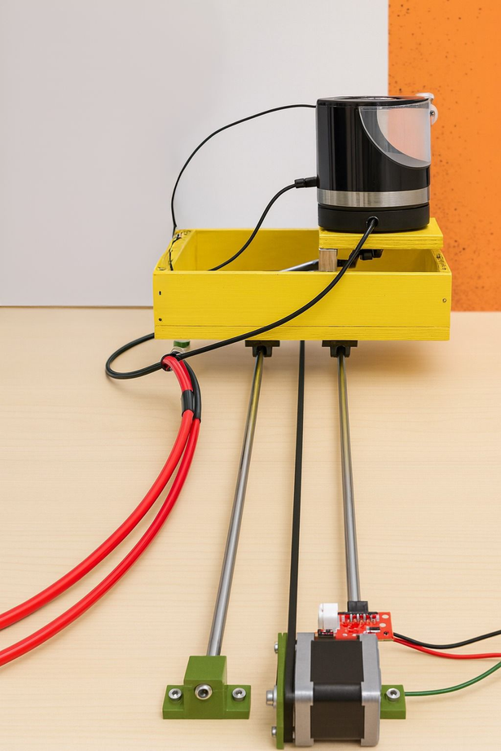
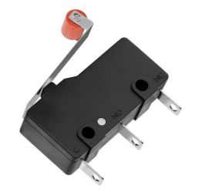
Rail & Kettle Movement
Hall Effect Sensor
Limit Switch Sensor

Slide 11
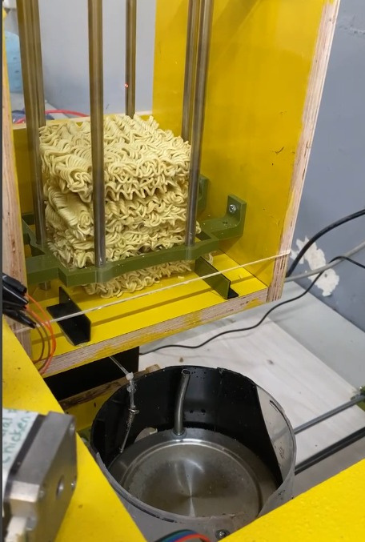
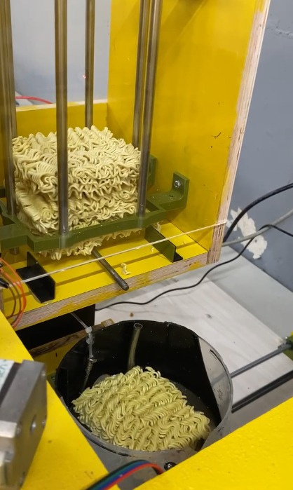
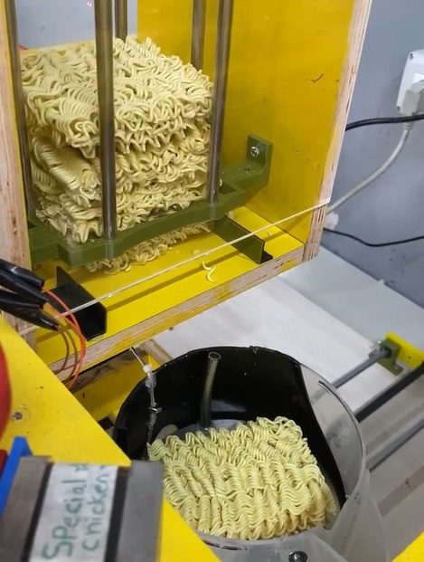
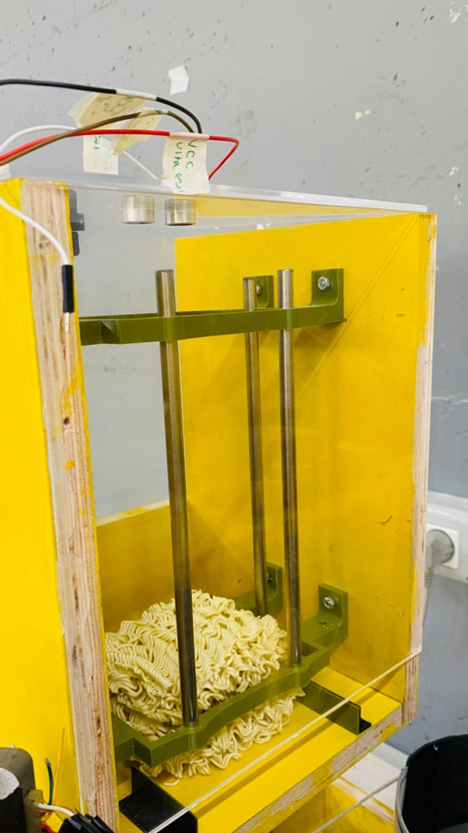
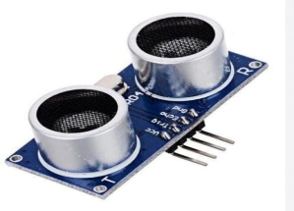
Eject Noodle

Slide 12
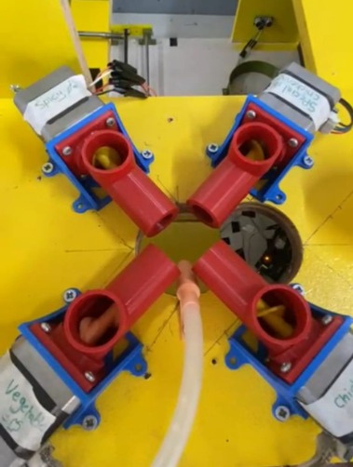
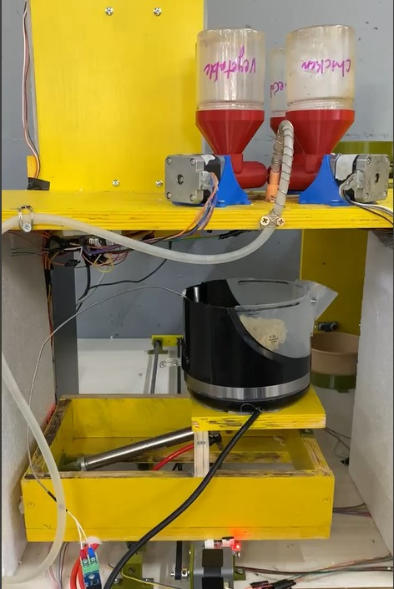
Salt Despise Sensor

Slide 13
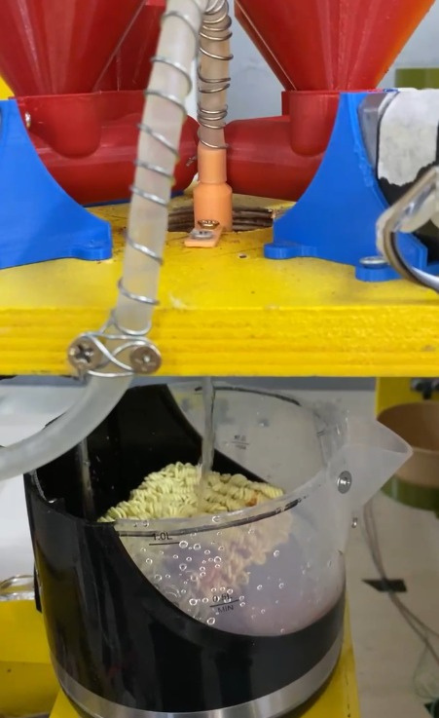
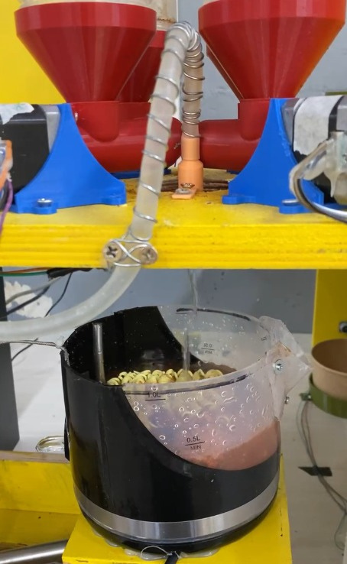
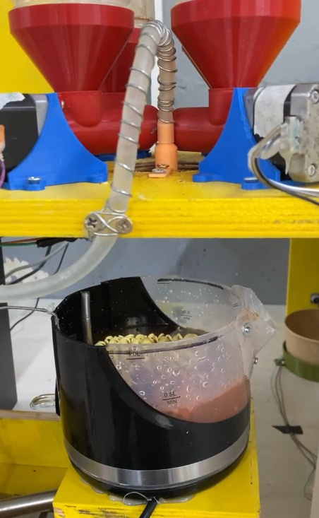
Water Pump

Slide 14
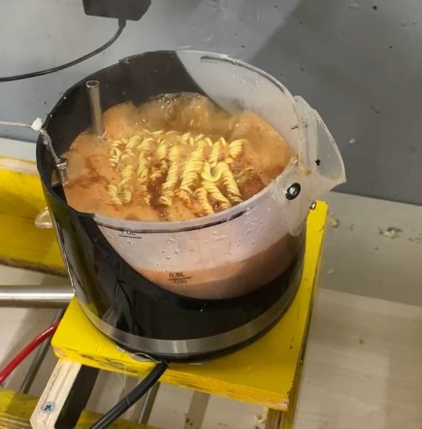
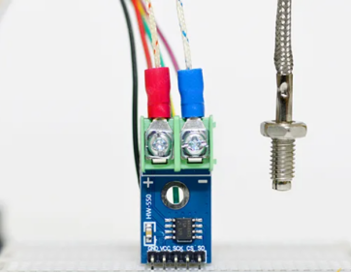
Boiling the kettle
MAX6675 Temperature Sensor

Slide 15
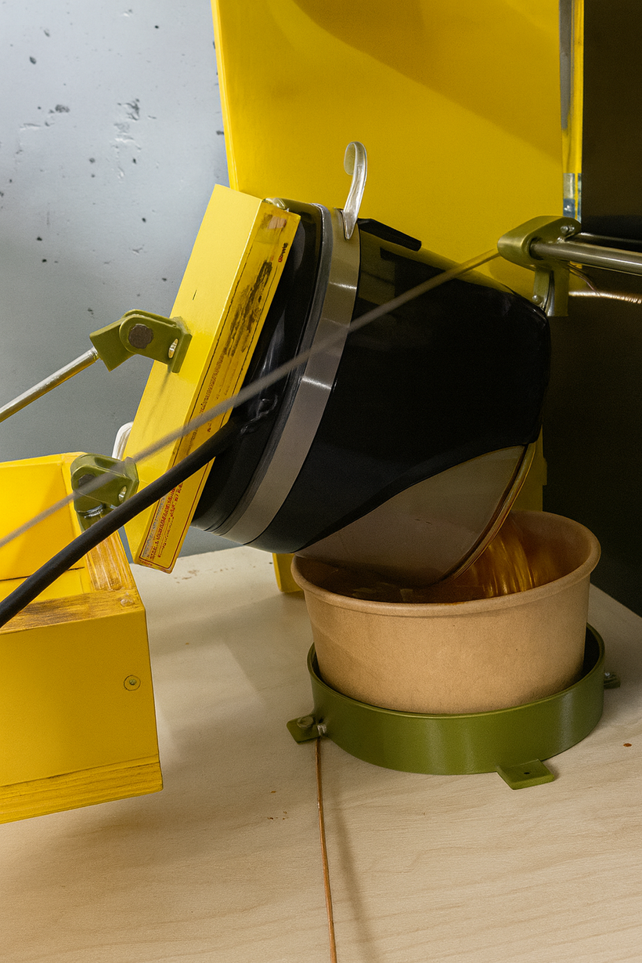
Pouring into the Cup

Slide 16
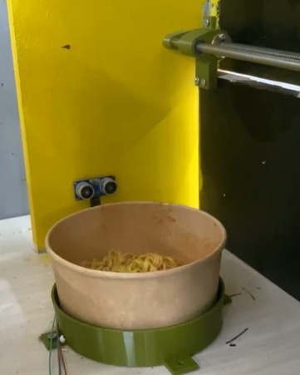
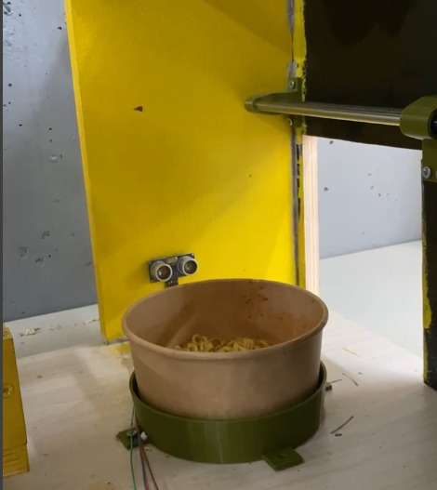
Opening the door

Slide 17
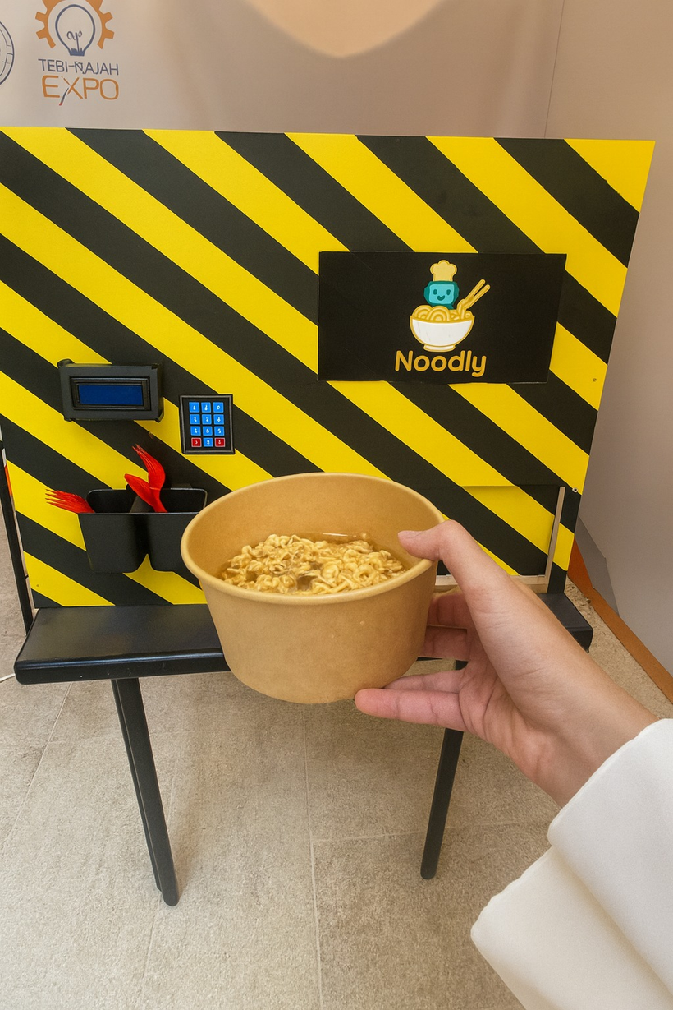
Final Result

Slide 18
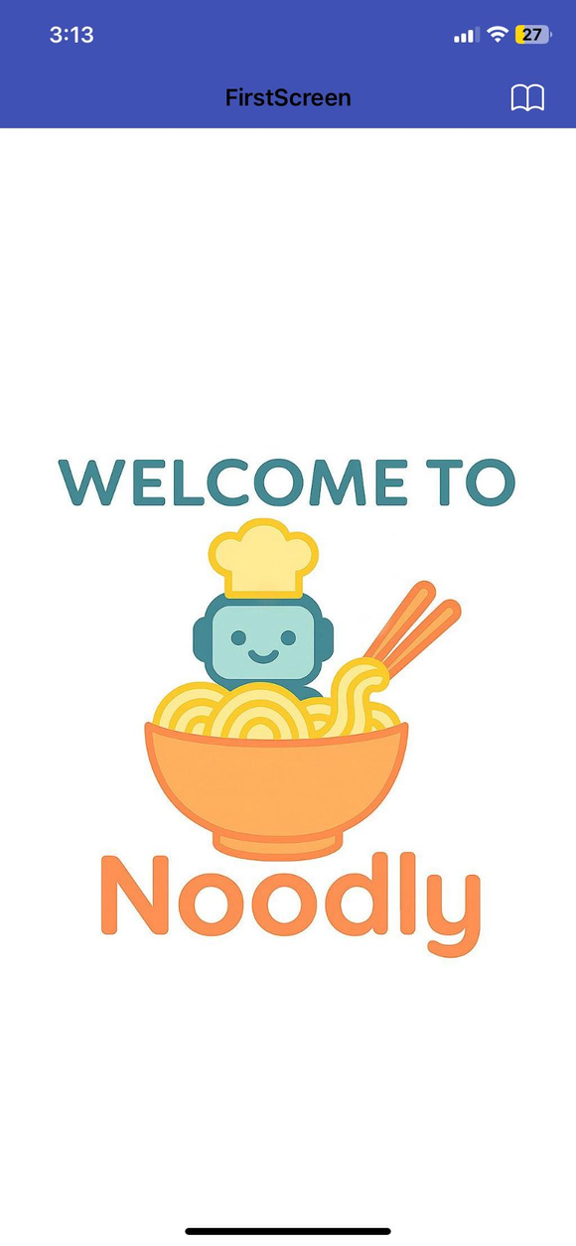
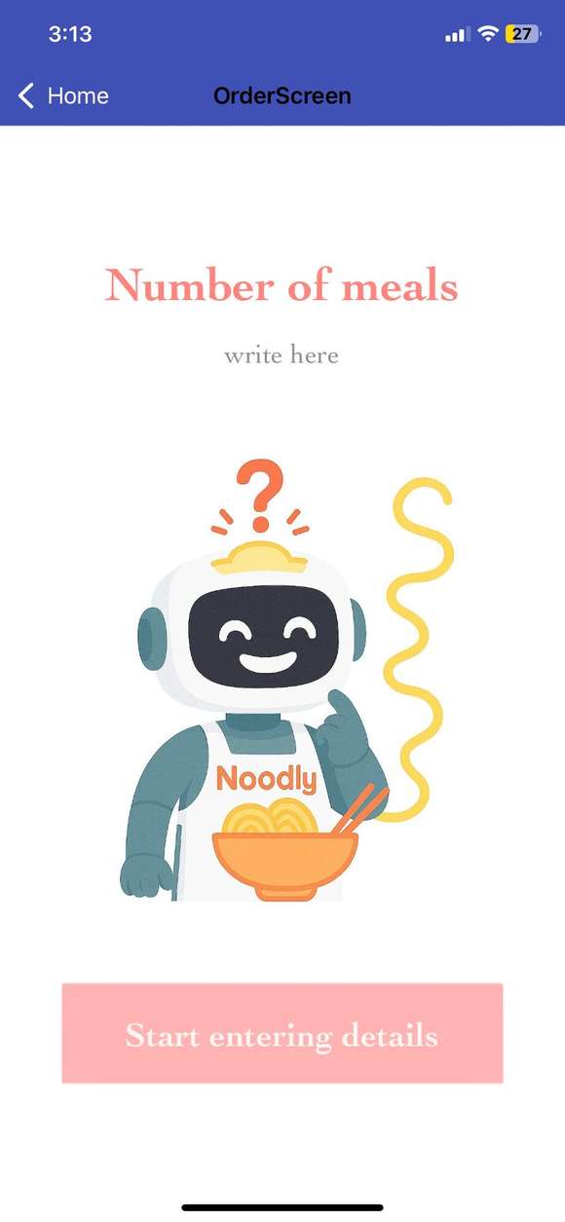
Mobile App
Landing Page

Slide 19
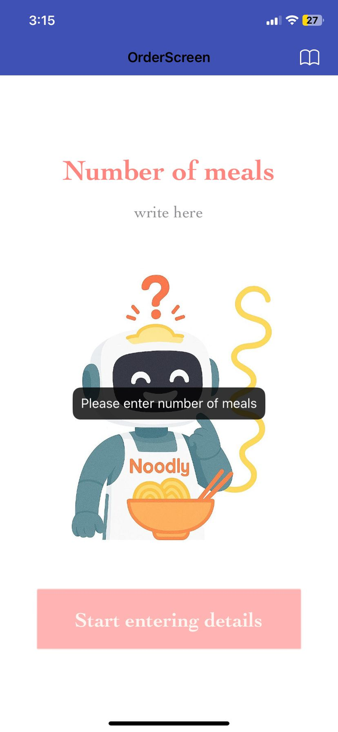
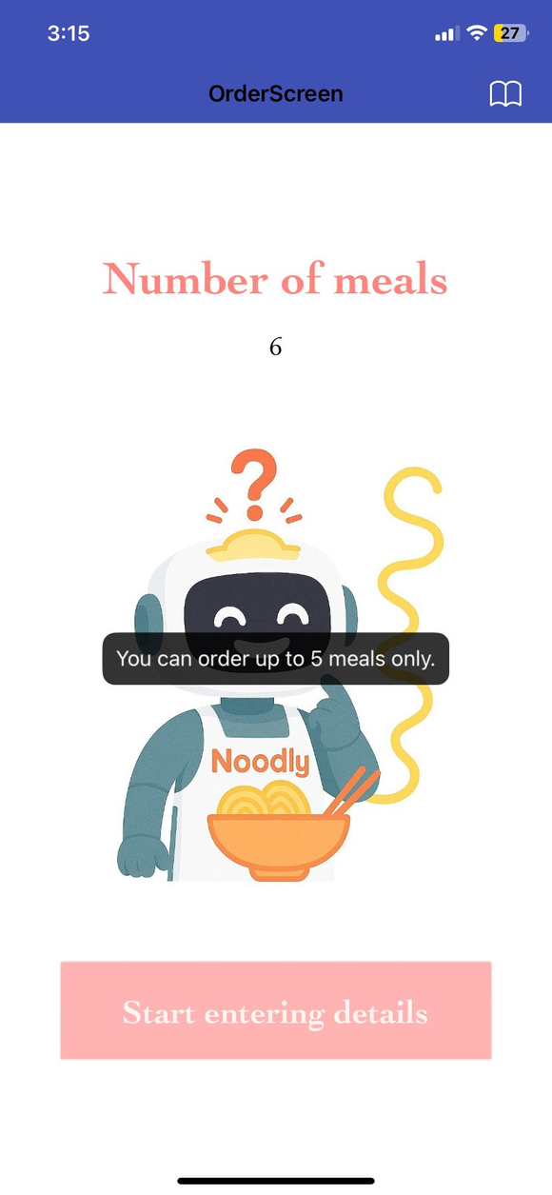
Mobile App
Authentication Part

Slide 20

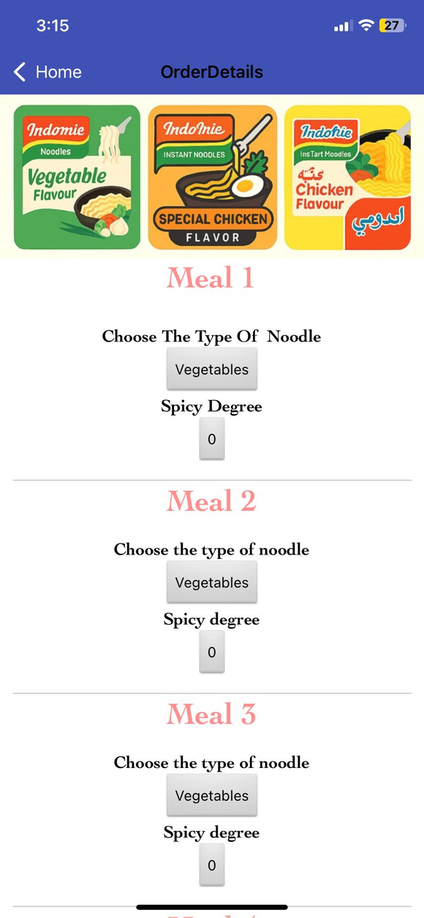
Mobile App
Order Details Page

Slide 21
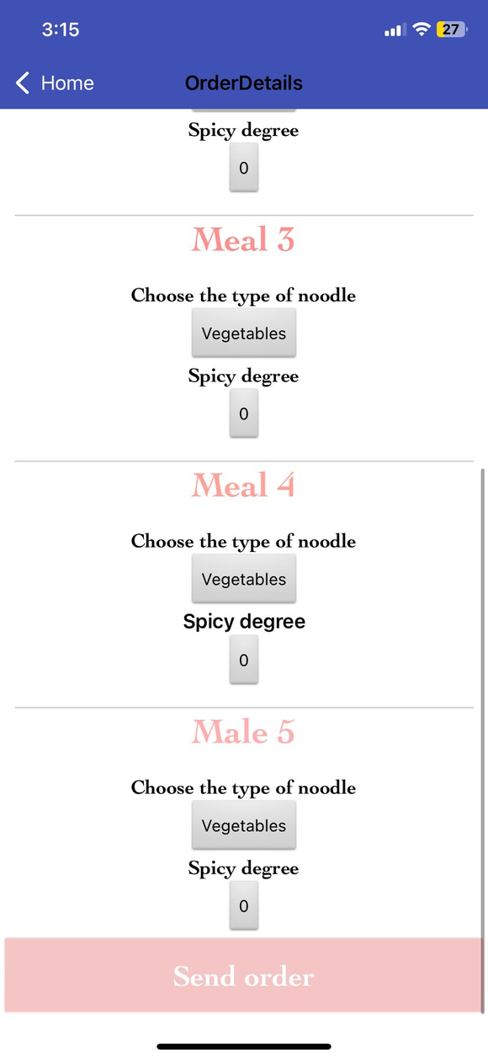
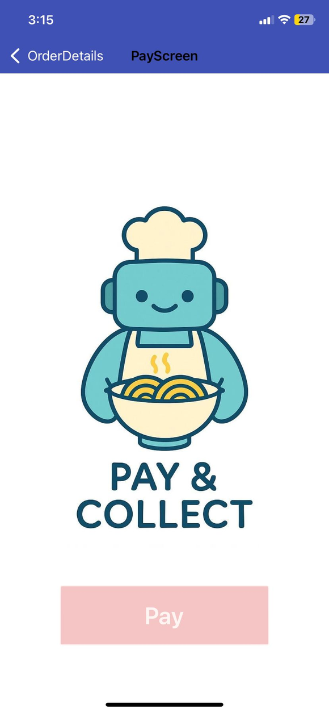
Mobile App
Sending The Order

Slide 22
Constraints
Mechanical
1
Rails and motors must move the kettle accurately and push cups/noodles without slipping.
Sensors
2
All sensors must read correctly to detect cups, noodles, and keep the right cooking temperature.
Operation
3
Only a set number of meals can be made at once, with fixed cooking time, water, and spices. Safety stops the machine if a cup is missing.
Software
4
Timing and motor steps must stay in sync and handle errors safely.

Slide 23
Future Work
We want to
Allow users to customize the amount of water used during cooking.
Provide different portion sizes to suit varying appetites.
Add an option for vegetable toppings to enhance nutrition and taste.
Include an additional container for other types of pasta to increase meal variety.
Integrate a payment system that accepts both cash (shekels) and credit cards for easier operation.

Slide 24

Thank You for Your Attention

