Slide 1
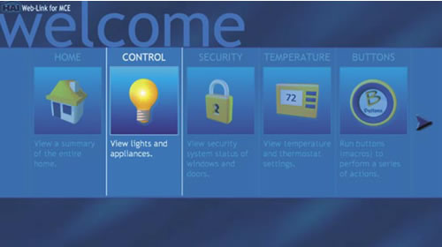

Slide 2


Tariq Ziad Yameen
Oday Jihad Ibrahim
Dr. Ashraf Armoush Supervisor
Notes:
15 , 27, 29

Slide 3
Outline
Introduction
Existing Problem
Technology used
Control the lights
Warning system
  Stolen accidents
  Fire accidents
How is it work?

Slide 4
Introduction
Our project is about “Home automation”.
Control most of your devices at home using your phone.
Get feedback about the status of your home.
Provide an easily and comfortable way to control their home devices from any place.

Slide 5
Existing problem
People usually are outside the home for many reasons like travelling and they want to control some devices from a far distance. Examples:
    Want to fill the water tank.
    Want to turn off the light at rooms.
    Get feedback about the temperature.
    If somebody at your home.

Slide 6
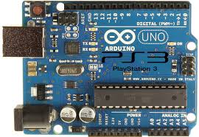
Technology used
  Arduino Uno
  The main piece in our project is an arduino ATmega328 kit attached by GPRS/GSM Shield

Slide 7
Microcontroller | ATmega328
Operating Voltage | 5V
Input Voltage (recommended) | 7-12V
Input Voltage (limits) | 6-20V
Digital I/O Pins | 14 (of which 6 provide PWM output)
Analog Input Pins | 6
DC Current per I/O Pin | 40 mA
DC Current for 3.3V Pin | 50 mA
Flash Memory | 32 KB (ATmega328) of which 0.5 KB used by bootloader
SRAM | 2 KB (ATmega328)
EEPROM | 1 KB (ATmega328)
Clock Speed | 16 MHz

Slide 8
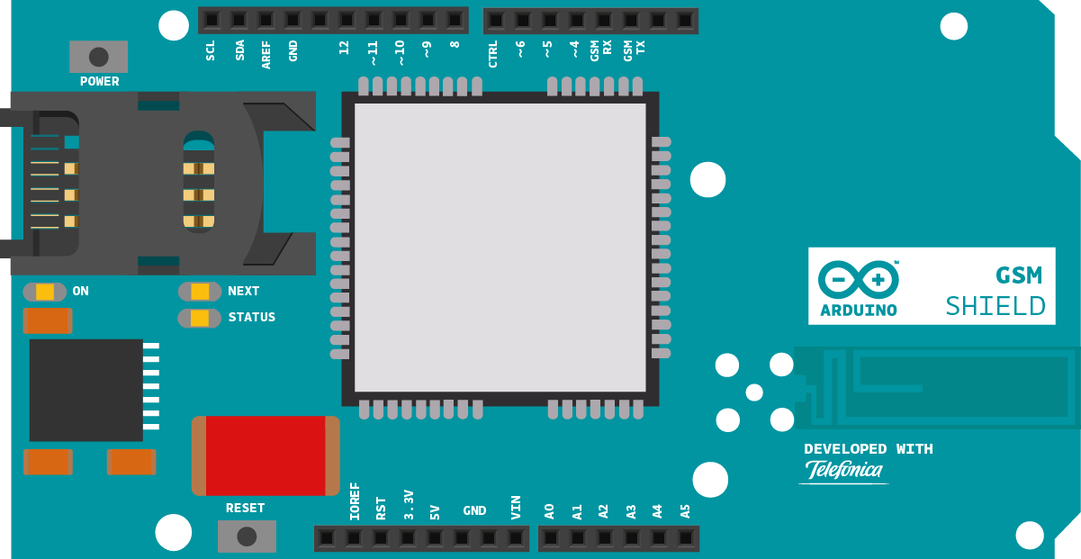
GPRS/GSM Shield

Slide 9
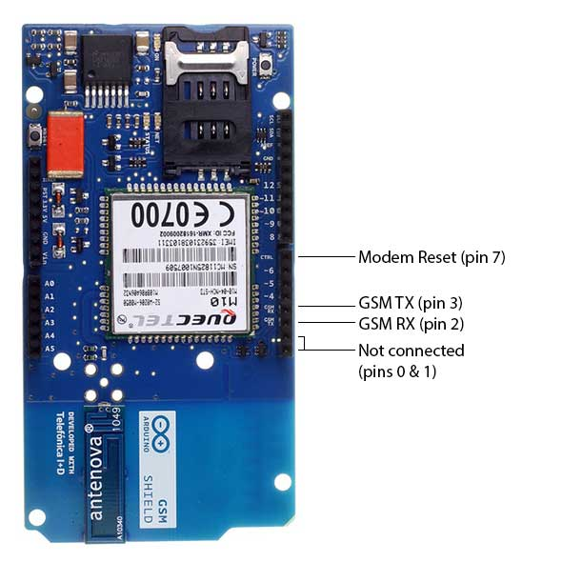
The Arduino GSM Shield connects our Arduino to the network. Plug in a SIM card from an operator offering GPRS coverage and also you can also make/receive voice calls and send/receive SMS messages.
Quad-band GSM/GPRS modem that works at frequencies GSM850MHz, GSM900MHz, DCS1800MHz andPCS1900MHz

Slide 10
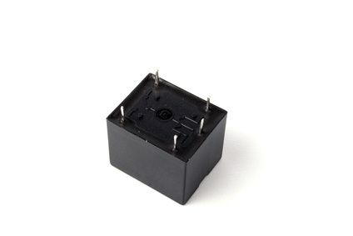
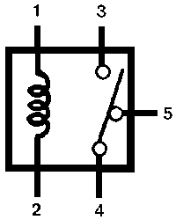
Relay
There are 5 Pins in a relay. Two pins 1 and 2 are two ends of a coil that are kept inside the relay. The coil is wound on a small rod that gets magnetized whenever current passes through it.

Slide 11
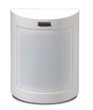
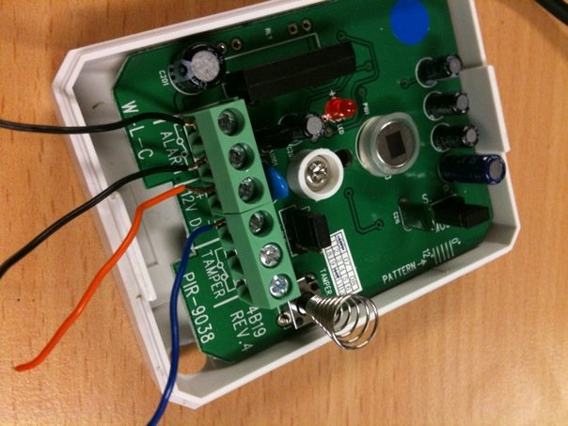
Motion sensor
pet immunity linear image PIR sensor
Two pins for VCC, GND.
Wire one side of contact to Arduino digital pin(input), the other side of contact to a 5 VCC.

Slide 12
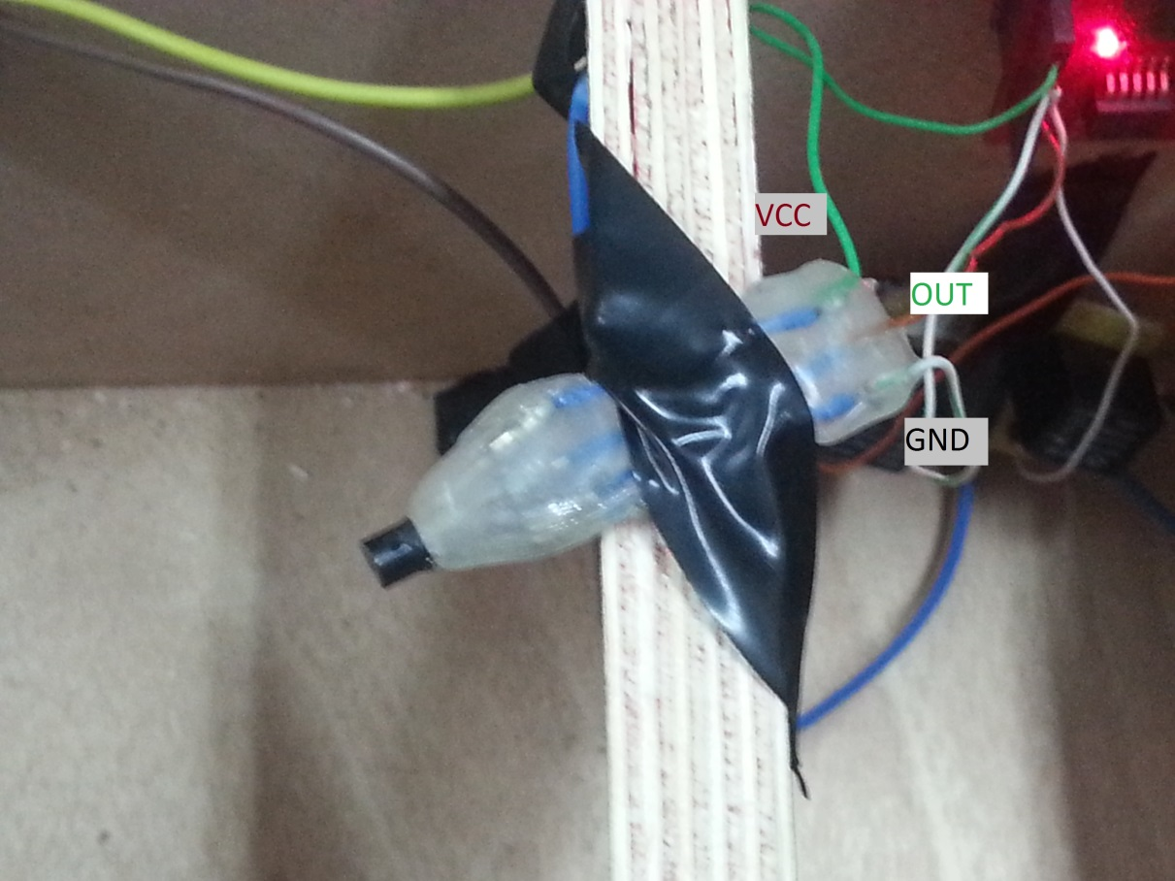
Temperature sensor
tempC = (5.0 * analogRead(tempPin) * 100.0)/1024.0

Slide 13
Smart phone
Mobile application work on android platform to make it easier for people to control their home devices.
Two methods to send the messages from the application on their smart phone to arduino microcontroller which contains GPRS/GSM Shield:
  1- Using direct message form his/her mobile to the GSM Shield.
  Using social sites, in this project we used the twitter web site.

Slide 14
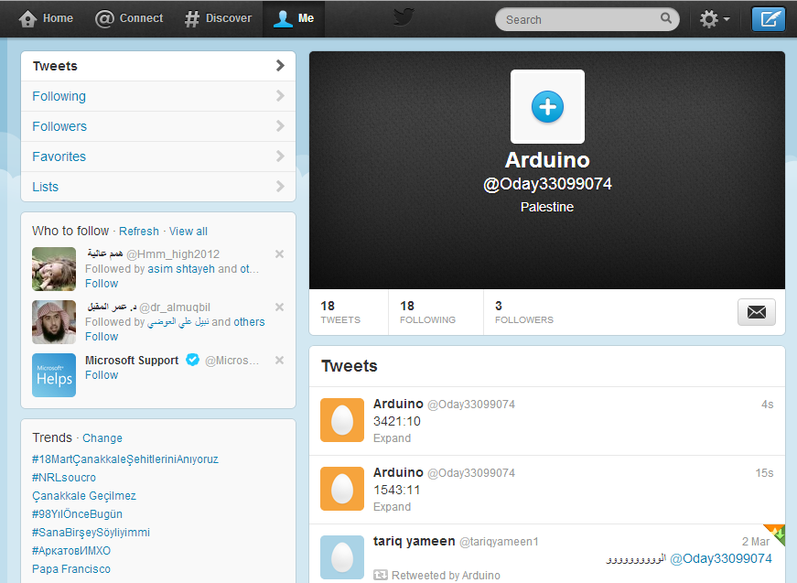
Twitter account for our application
Follow the application account
Activate twitter text messaging
When user make a tweet using the application on Arduino account, the message will send to the GSM shield connected with arduino microcontroller .

Slide 15
Message format
The message format is simple and consists of:
  The simple code generated depending on a particular math equation:
  newValue = ((oldValue + (oldValue *2)/5)%10000)
  Also it contains the number of device we want to control and the status of the device which could be on or off.

Slide 16
3214:41
Serial code
Turn on
Device number 4

Slide 17
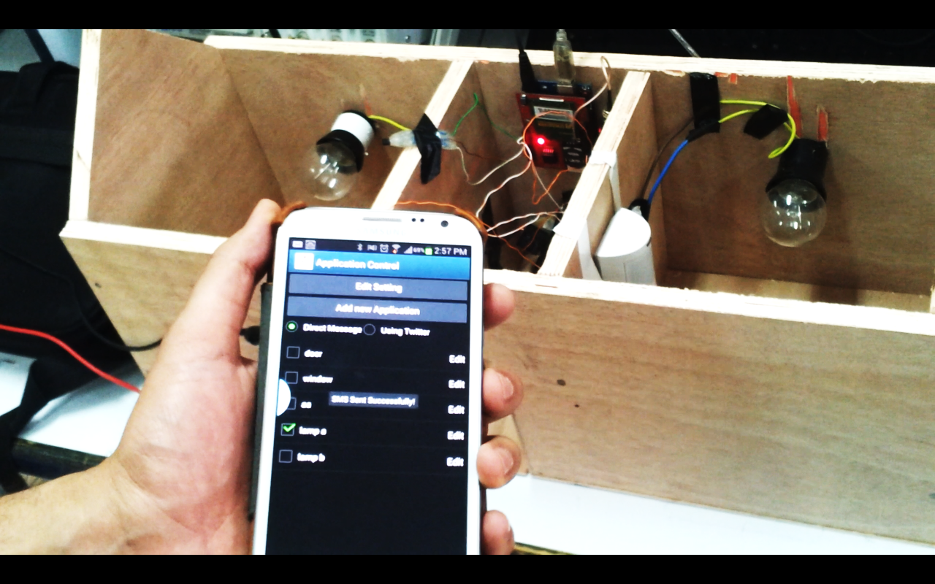
Gathering
Arduino + GSM
Two Lamps
Temperature
Sensor
Motion Sensor
Mobile application

Slide 18
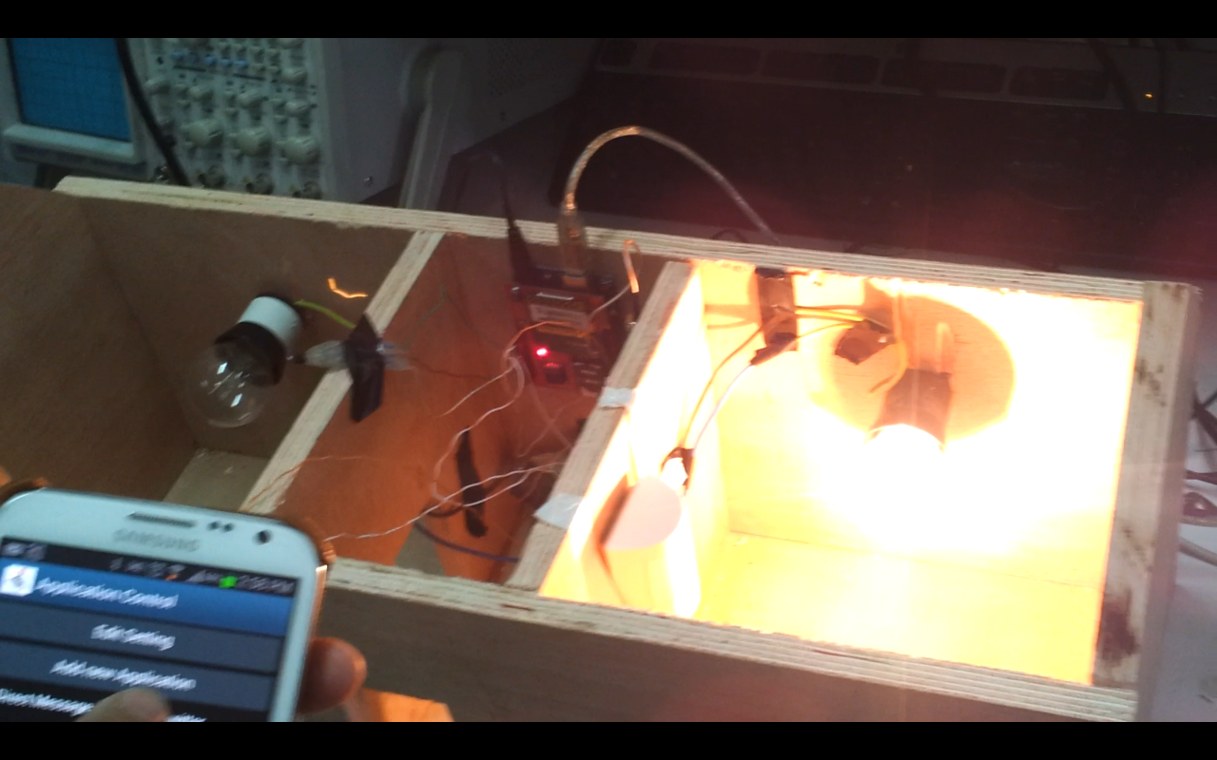
Control the lights
Using relays to take the voltage from home voltage source to operate the two lamps that worked on 220 volt.
The user can control the two lights on or off using the mobile application.
when the message arrive to microcontroller that contains GPRS/GSM Shield it control lamps that connect to it .

Slide 19
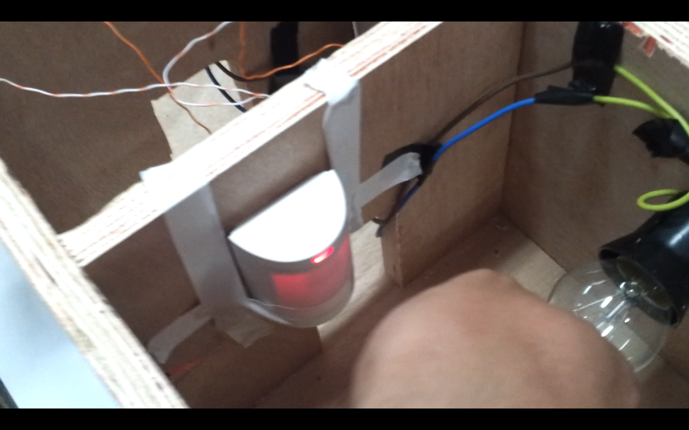
Warning system
Stolen accidents
  Using motion sensor which called pet immunity linear image PIR sensor to detect the motion at home and send a warning message to a particular mobile number.

Slide 20

  Fire accidents
  We used the heat sensor which called (LM35 DZ) sensor to detect the abnormal increase in temperatures at home and send a warning message to a particular mobile number.

Slide 21
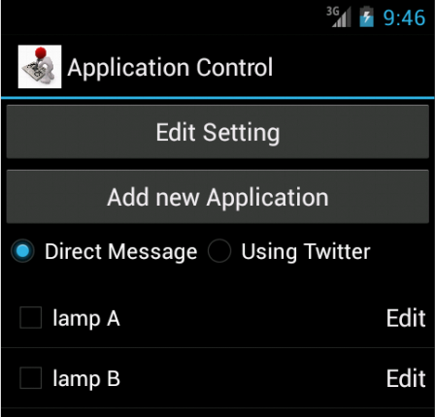
How is it work?
Install the application on smart phone (Android platform).
Set the password and the initial secret code.

Slide 22
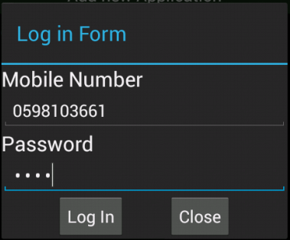
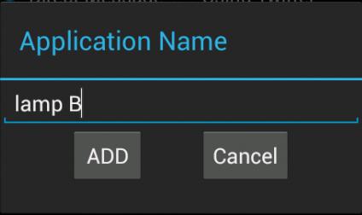
Enter his /her mobile number and his/her password.
Add the devices that you want to control.
Select the device to turn on or off.
The message will send to Directly to the arduino or to the twitter account then send to the arduino.

Slide 23
Arduino receive a message using GSM Shield.
Parsing the message to get the secret code and verify it with one store in EEPROM.
If the verification failed, arduino will not do anything.
After verification of secret code, arduino will generate the next predicate secret (using the equation as described above) code and store on EEPROM to use it in future.

Slide 24

Demo
Time

