Slide 1

Faculty of Engineering & Information Technology
Department of Civil Engineering
“Analysis and Design of two types of Foundations of a Residual Building”
Prepared by:
Mo’men Haj Mohammad
Abduallah Amer
Ahmad Hajeer
Khaleel Faqeeh
Supervisor: Dr. Mahmoud Dwekat

Slide 2
Agenda
Methodology.
Project description.
Load types.
Load combination .
Design of single footings.
Design of combined footings.
Design of the retaining wall.
Design of the mat foundation.

Slide 3
Methodology
We used two type of soil reports.
Specifying the applied loads on columns.
Design of single footings(based on strong soil).
Design of combined footings(based on strong soil).
Design of the retaining wall.
Design of mat foundation(based on weak soil).

Slide 4
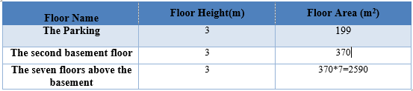
Project description
This project is talking about a Residential building It consists of nine floors, one parking floor, a basement floor and seven floors above it. The area of each floor is shown below:
The toltal area of the building = 3159 m²

Slide 5
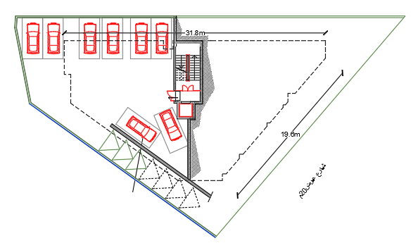
Project description
The parking floor

Slide 6
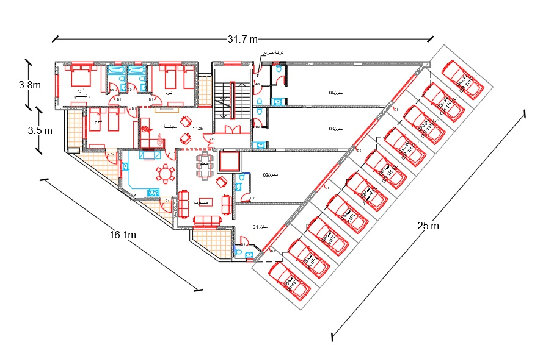
Project description
The basement floor

Slide 7
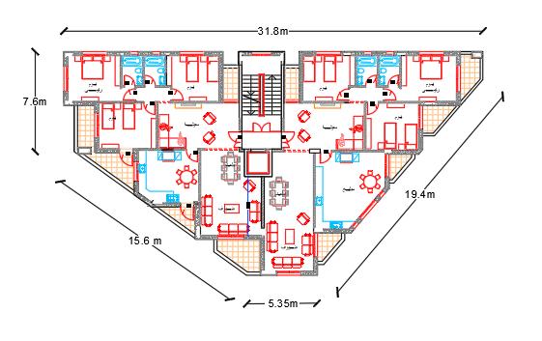
Project description
The rest floors is a residential floor

Slide 8
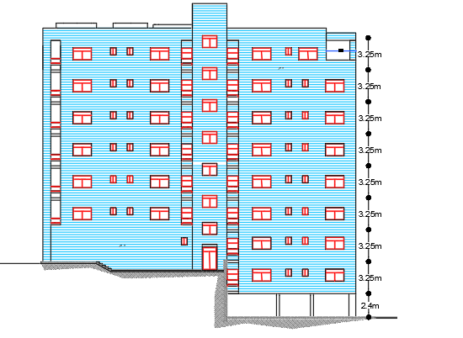
Project description
The front elevation

Slide 9
Project description
Codes: ACI 318-14 and ASTM.
Materials:
  concrete (28MPa) & concrete (21MPa)
  Reinforcing steel (A615Gr60).
  Other materials: block, filling materials, tiles, plaster, aggregate, concrete mortar, masonry stone.

Slide 10
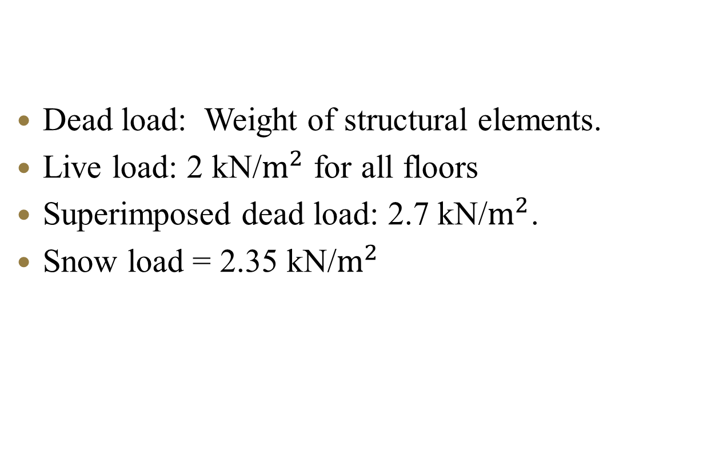
Load types
Dead load: Weight of structural elements.
Live load: 2 kN/$m^{2}$ for all floors
Superimposed dead load: 2.7 kN/$m^{2}$.
Snow load = 2.35 kN/$m^{2}$

Slide 11
Load combination
1.2D +1.6L
1.4 D

Slide 12
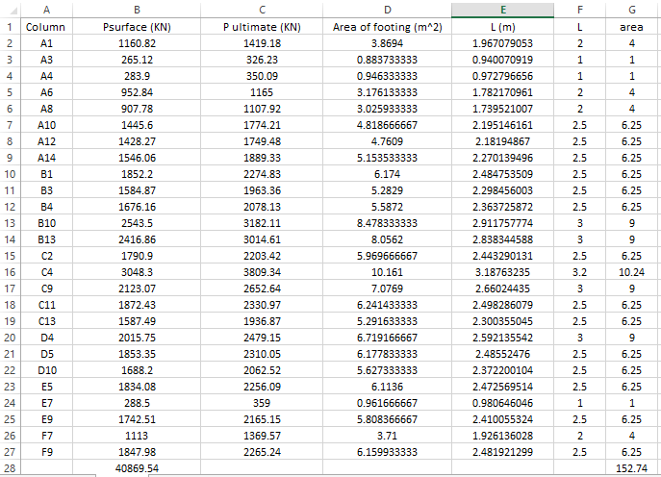
Loads on columns

Slide 13
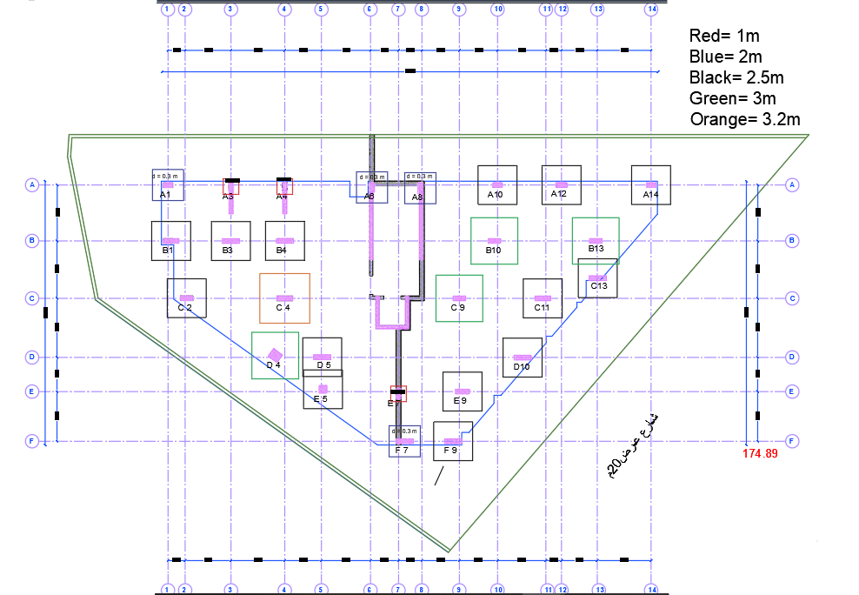
Distribution of footings

Slide 14
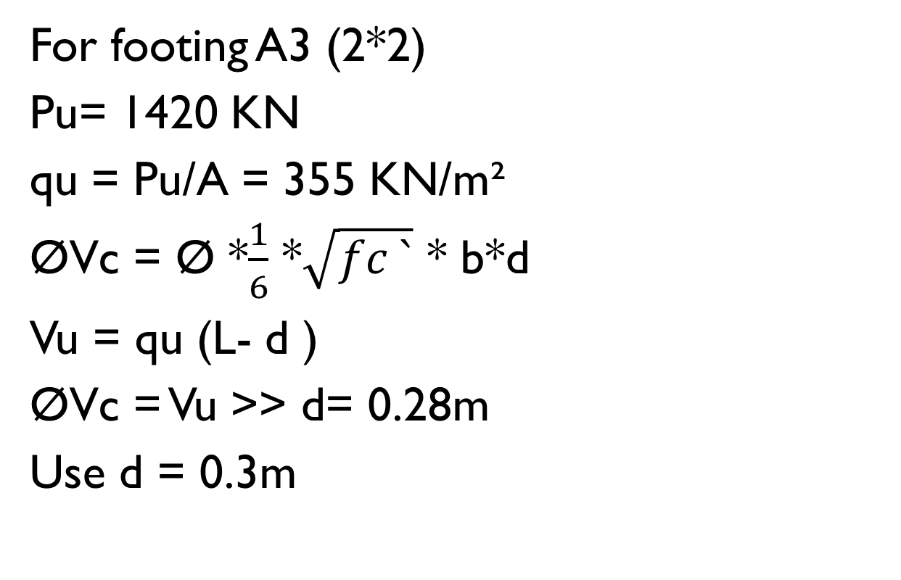
Analysis and design of single footings
For footing A3 (2*2)
Pu= 1420 KN
qu = Pu/A = 355 KN/m²
ØVc = Ø *$\frac{1}{6}$ *$\sqrt{fc `}$ * b*d
Vu = qu (L- d )
ØVc = Vu << d= 0.28m
Use d = 0.3m

Slide 15
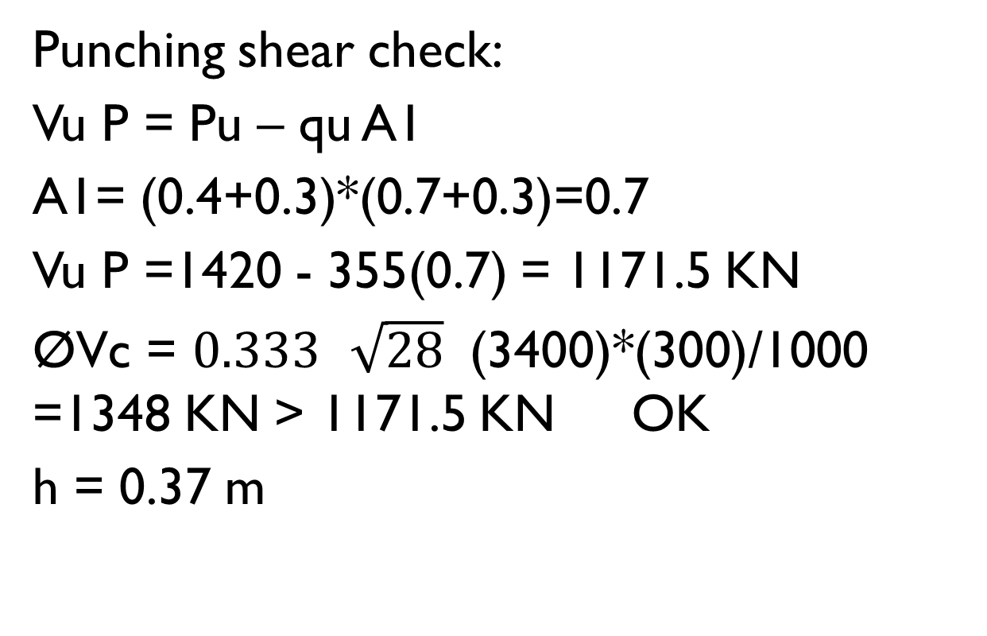
Analysis and design of single footings
Punching shear check:
Vu P = Pu – qu A1
A1= (0.4+0.3)*(0.7+0.3)=0.7
Vu P =1420 - 355(0.7) = 1171.5 KN
ØVc = $0.333$ $\sqrt{28}$ (3400)*(300)/1000 =1348 KN < 1171.5 KN OK
h = 0.37 m

Slide 16
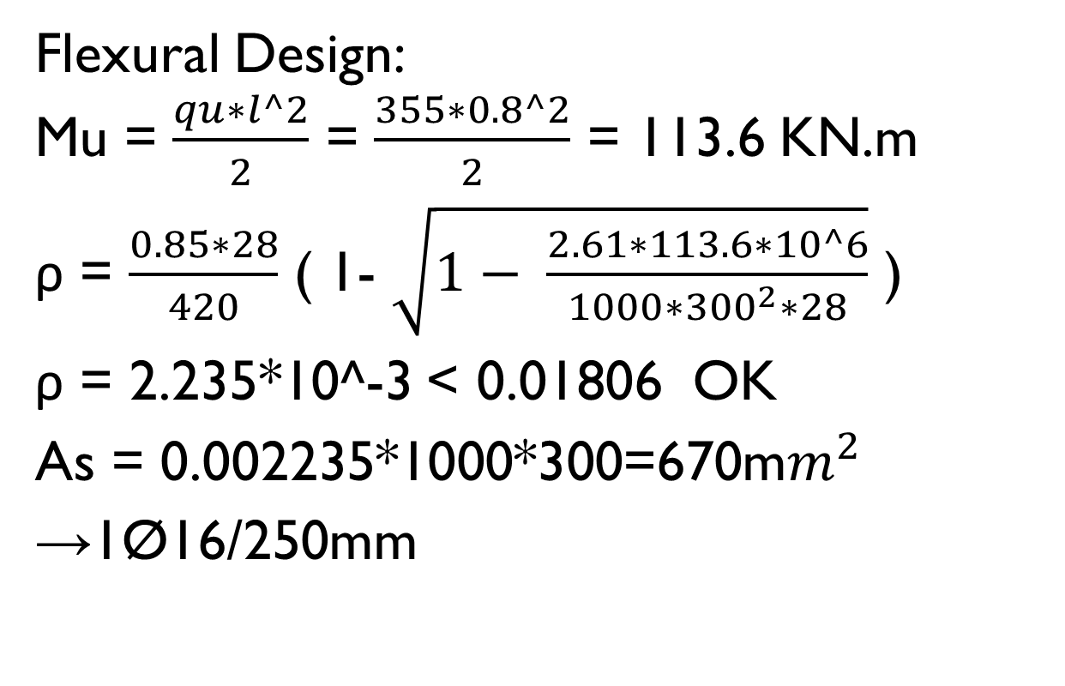
Analysis and design of single footings
Flexural Design:
Mu = $\frac{qu∗l^2}{2}$ = $\frac{355∗0.8^2}{2}$ = 113.6 KN.m
ρ = $\frac{0.85∗28}{420}$ ( 1- $\sqrt{1− \frac{2.61∗113.6∗10^6}{1000∗{300}^{2}∗28}}$ )
ρ = 2.235*10^-3> 0.01806 OK
As = 0.002235*1000*300=670m$m^{2}$
→1Ø16/250mm

Slide 17
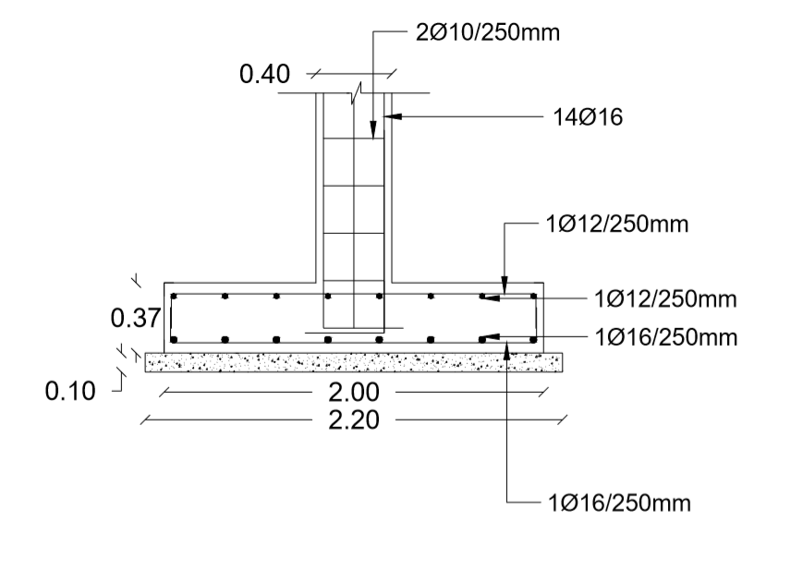
Analysis and design of single footings
Reinforcement of single footing A3(2*2):

Slide 18
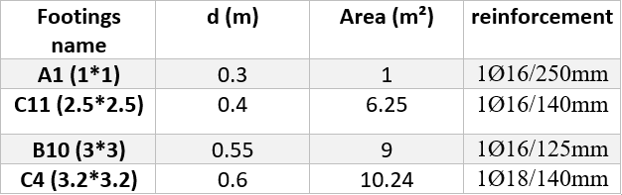
Analysis and design of single footings

Slide 19
Distribution of combined footings

Slide 20
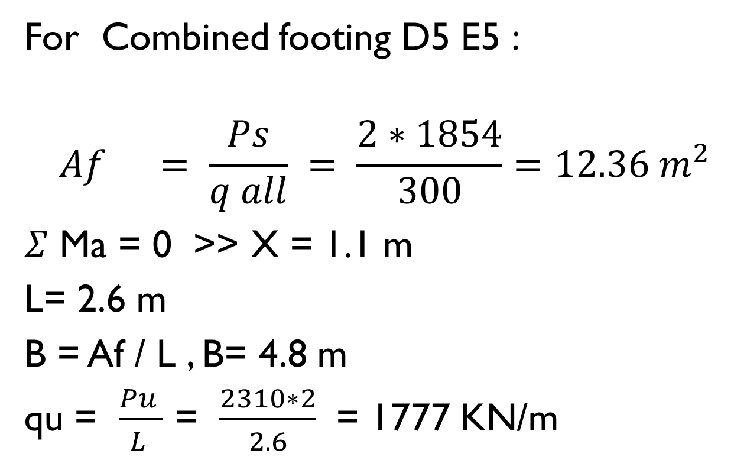
Analysis and design of combined footings
For Combined footing D5 E5 :
$$Af = \frac{Ps}{q all} = \frac{2∗1854}{300}=12.36 m^{2}$$
$Σ$ Ma = 0 << X = 1.1 m
L= 2.6 m
B = Af / L , B= 4.8 m
qu = $\frac{Pu }{L }$ = $\frac{2310∗2}{2.6}$ = 1777 KN/m

Slide 21
Analysis and design of combined footings
Vu =ØVc << d = 0.33 m
Punching shear check:
0.33m not ok for punching so use d = 0.4m
Vu = 1723.6 KN
ØVc = 1797.3 KN < 1723 KN OK
Use h = 0.45m

Slide 22
Analysis and design of combined footings
Flexural design longitudinal direction:
For positive moment 1039.5 KN.m
ρ = 0.0369 << As = 7084.8 mm²
use 23Ø20
For negative moment 35.54 KN.m
Use 20Ø16

Slide 23
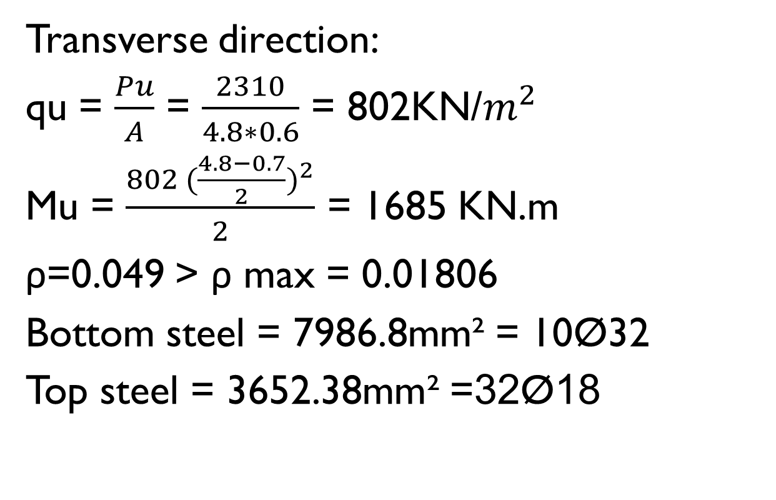
Analysis and design of combined footings
Transverse direction:
qu = $\frac{Pu}{A}$ = $\frac{2310}{4.8∗0.6}$ = 802KN/$m^{2}$
Mu = $\frac{802 {(\frac{4.8−0.7}{2})}^{2}}{2}$ = 1685 KN.m
ρ=0.049 > ρ max = 0.01806
Bottom steel = 7986.8mm² = 10Ø32
Top steel = 3652.38mm² =32Ø18

Slide 24
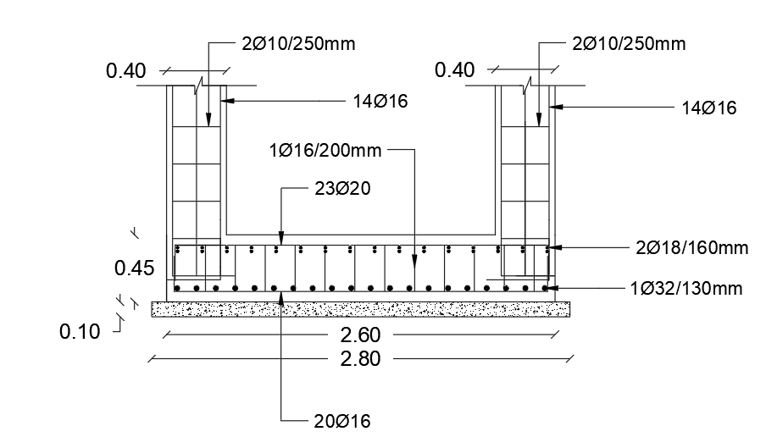
Analysis and design of combined footings
Reinforcement of combined footing D5E5:

Slide 25
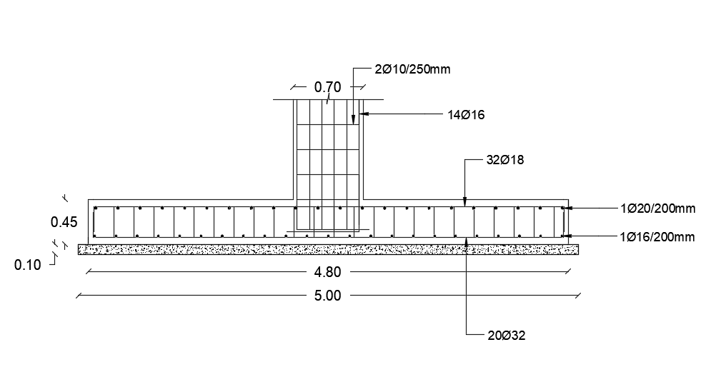
Analysis and design of combined footings
Reinforcement of combined footing D5E5 in long direction:

Slide 26
Analysis and design of combined footings
For combined footing B13C13:
L= 2.8m , B= 5.8m , d= 0.5m , h = 0.55m
Longitudinal direction: M+ = 1507.5 KN.m
As = 8166.4 mm² = 26 Ø20
M- =43.1 KN.m
As =5742 mm² = 29 Ø 16
Transverse direction:
Top → 38Ø18
Bottom → 12Ø32

Slide 27
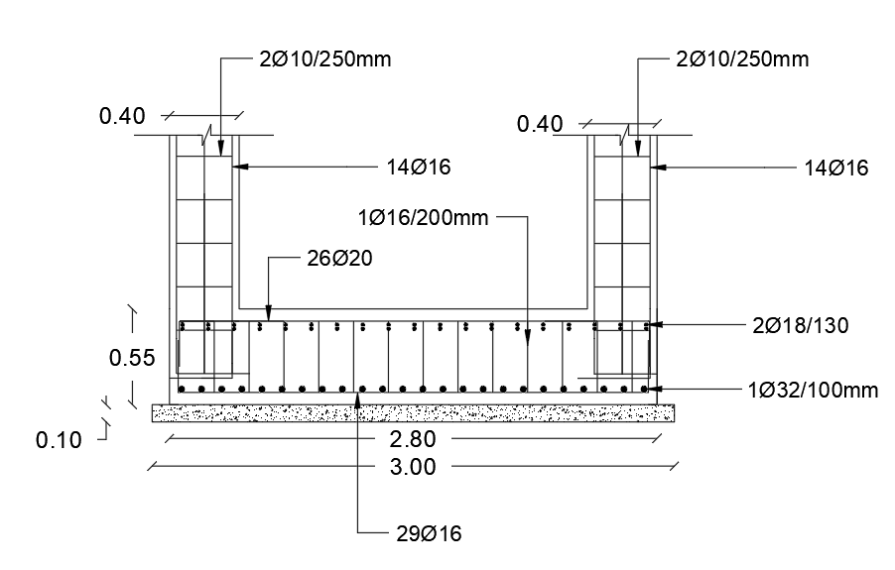
Analysis and design of combined footings
Reinforcement of combined footing B13C13:

Slide 28
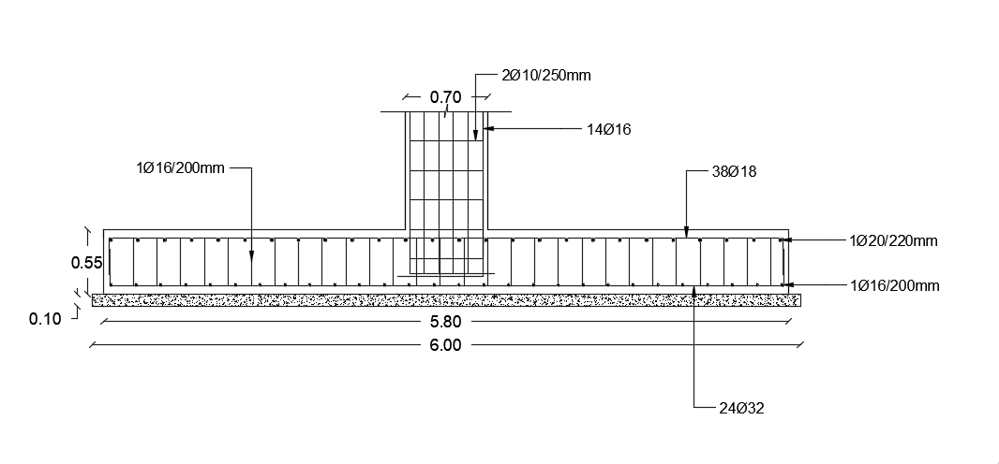
Analysis and design of combined footings
Reinforcement of combined footing B13C13 in long direction:

Slide 29
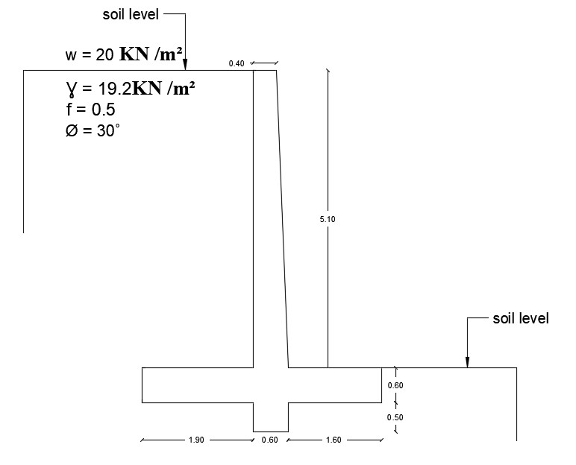
Analysis and design of the retaining wall

Slide 30
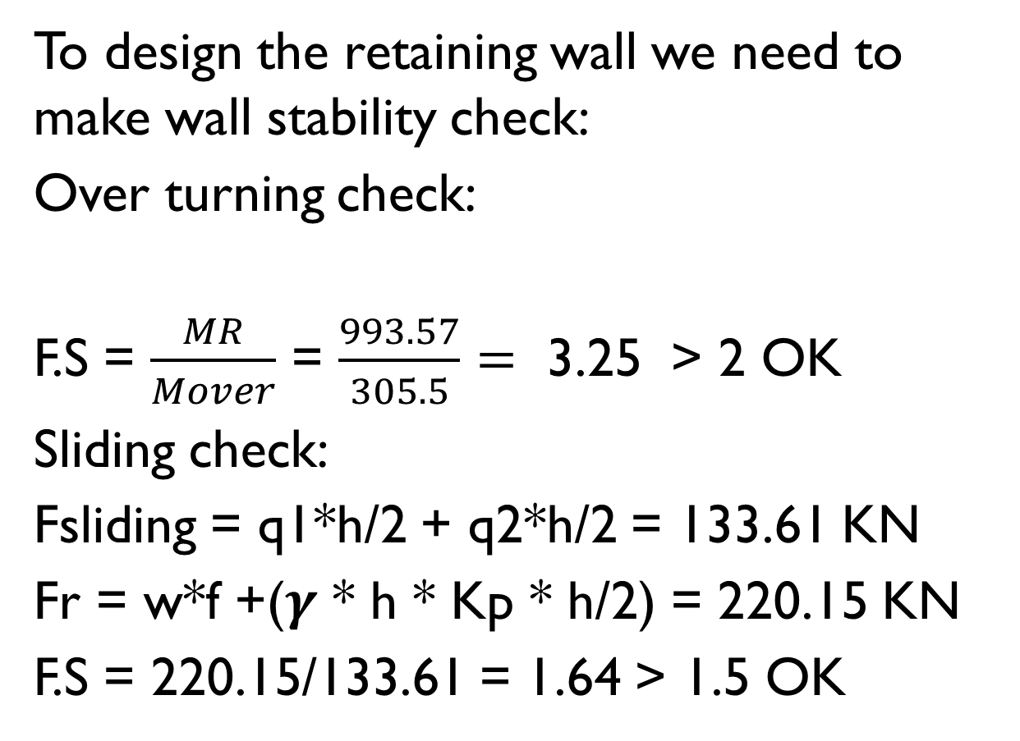
Analysis and design of the retaining wall
To design the retaining wall we need to make wall stability check:
Over turning check:
F.S = $\frac{MR}{Mover}$ = $\frac{993.57}{305.5}=$ 3.25 < 2 OK
Sliding check:
Fsliding = q1*h/2 + q2*h/2 = 133.61 KN
Fr = w*f +($γ$ * h * Kp * h/2) = 220.15 KN
F.S = 220.15/133.61 = 1.64 < 1.5 OK

Slide 31
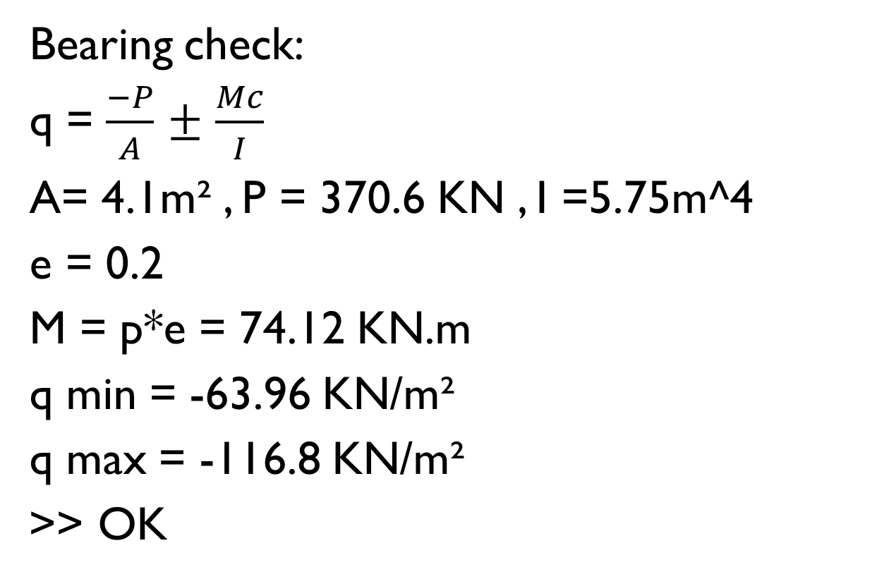
Analysis and design of the retaining wall
Bearing check:
q = $\frac{−P}{A}$ $±$ $\frac{Mc}{I}$
A= 4.1m² , P = 370.6 KN , I =5.75m^4
e = 0.2
M = p*e = 74.12 KN.m
q min = -63.96 KN/m²
q max = -116.8 KN/m²
<< OK

Slide 32
Analysis and design of the retaining wall
Flexural reinforcement:
Vertical according ACI318
Use 1Ø20 / 200mm
Horizontal according ACI350
Use 1Ø16 / 200mm

Slide 33
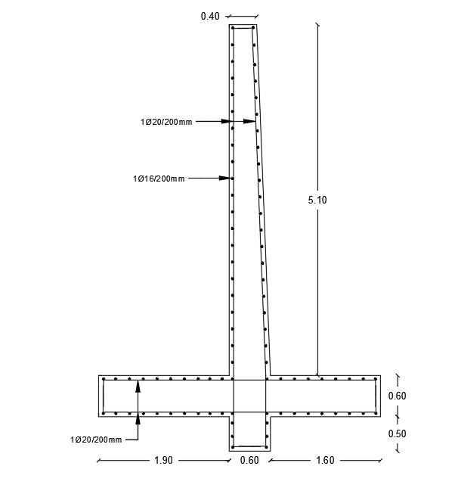
Analysis and design of the retaining wall
Reinforcement of the retaining wall:

Slide 34
Analysis and design of mat foundation
Pu = 3810 KN
Assume d = 0.65m
Punching check:
ØVu = 0.75*0.333√28*4800*650*10⁻³ =4123.24 KN < 3810 KN OK

Slide 35
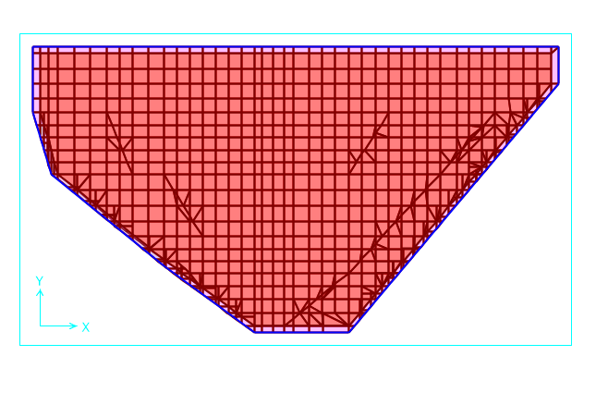
Analysis and design of mat foundation
We used sap in the reinforcement of mat:
Spring stiffness factor = 0.5*0.5*100*180 = 4500 KN / m /m²

Slide 36
Analysis and design of mat foundation
We reinforced the mat with minimum steel
As min = 0.0018*1000*700 = 1260mm^2
→ 7Ø16
ØMn = 0.9 As Fy ( d - a/2 ) = 304.3 KN.m
Any value from M11 or M22 greater than 304.3 KN.m we need additional steel
All values of M22 is less than 304.3 KN.m so we used 7Ø16 in this direction

Slide 37
Analysis and design of mat foundation
For M11 some values were greater than 304.3 KN.m so we need additional steel
Example:
M = 1480KN.m
M = 1480 – 304 = 1176 KN.m
ρ= 0.0079
As = 0.0079*1000*650 = 5135 mm²
We need additional 26Ø16

Slide 38
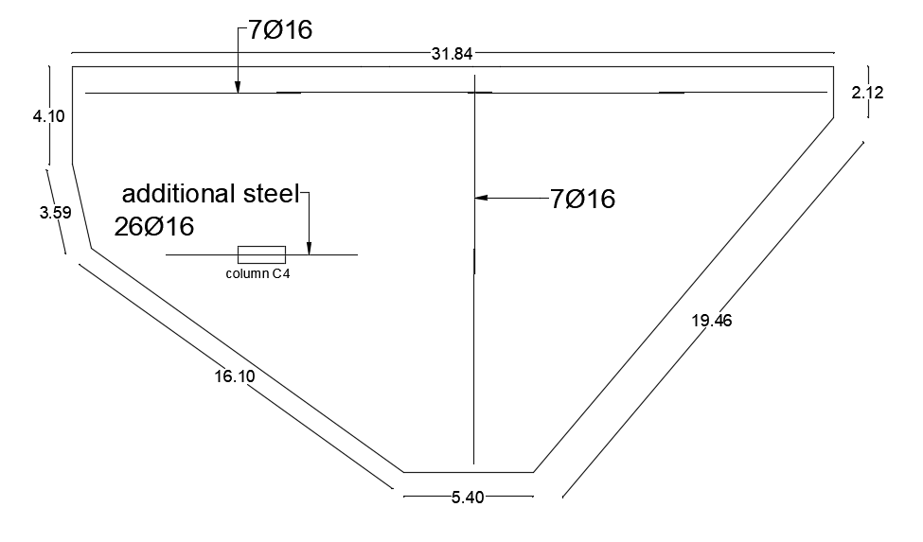
Analysis and design of mat foundation
Reinforcement of mat foundation:

Slide 39


